Slide 1
Case analysis of Economics, Business Studies and Enterprise Education in South Africa
“Could the real Green Economy please stand up?”
Eureta Rosenberg
Environmental Learning Research Centre

Slide 2
Background
Green Skills Programme (South Africa)
Skills for a green economy
To be developed in workplaces, VET spaces, universities and schools:
Foundation Building with teachers
Fundisa for Change course 2021:
Subjects Economics & Business Studies
Dasguphta Report – key leverage points

Slide 3
Acknowledgements
F4C Educators
F4C Course:
Ulisha van der Merwe
Presha Ramsarup
Emmanuel Ojo
Danel Kruger
Heila Lotz-Sisitka
Research:
Garry Rosenberg

Slide 4
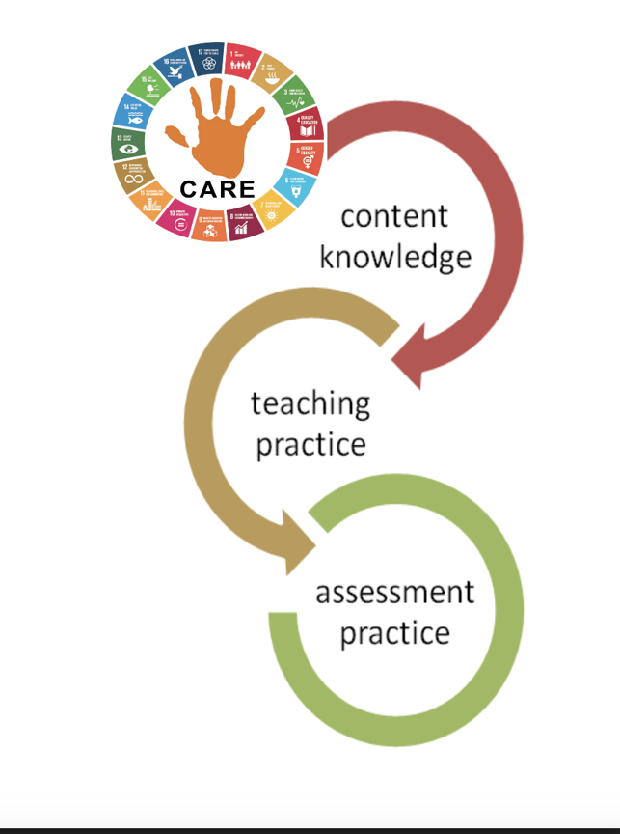
Fundisa for Change Course Curriculum
CONTENT KNOWLEDGE
CAPS++ = Curriculum and Assessment Policy States (South African curriculum)
Green Economy = Sustainable, low-carbon, inclusive, job-intensive (EDD, 2011)
Economy = Market + Home + Commons + State (Raworth, 2017)
Sustainable = SDGs; circular & regenerative; within planet boundaries

Slide 5
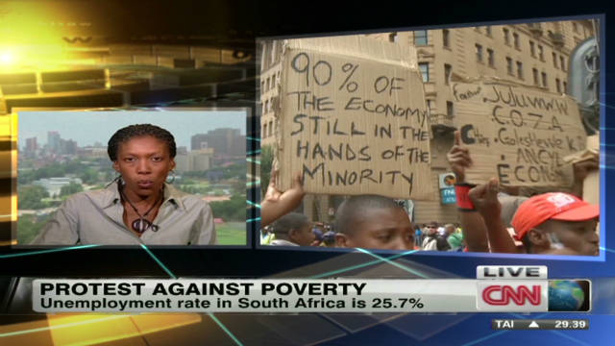
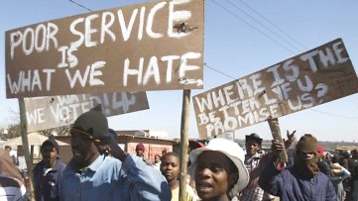
Current Economic Failures

Slide 6
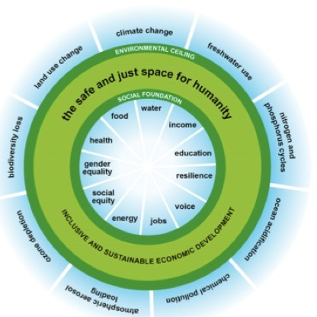
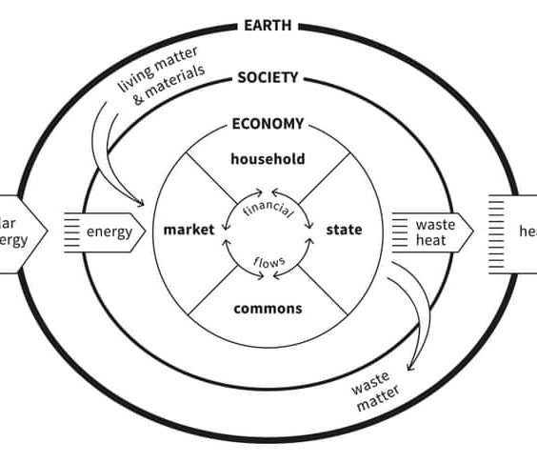
Sustainability – meeting needs within boundaries – a safe operating space:
Raworth, K. 2017. Doughnut Economics: Thinking like a 21st century economist. Random House Business Books, New York

Slide 7
Key Practices in Green Economies – with associated Jobs and Enterprises
Reduce, Refuse
Re-use, Recycle, Repurpose
Repair, Restore
Regenerate, Redesign Redistribute
Designers in the motor industry or packaging industry, system engineers
Run a repair café, work as a sorter in a recycling business

Slide 8
Findings: Primary School - Economics
Reduce, Refuse
Re-use, Recycle, Repurpose
Repair, Restore
Regenerate, Redesign Redistribute

Slide 9
Findings: Primary School - Economics

Slide 10
Findings: High School Business Studies

Slide 11
Findings: High School Business Studies

Slide 12
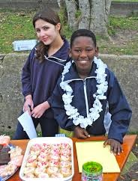
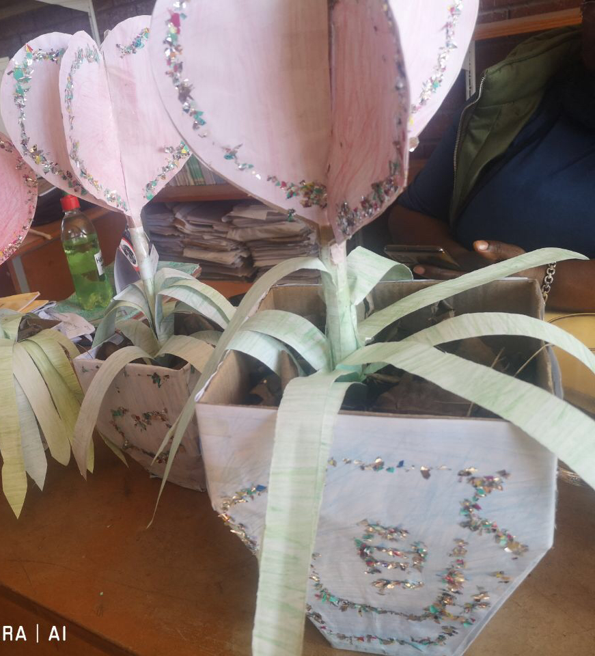
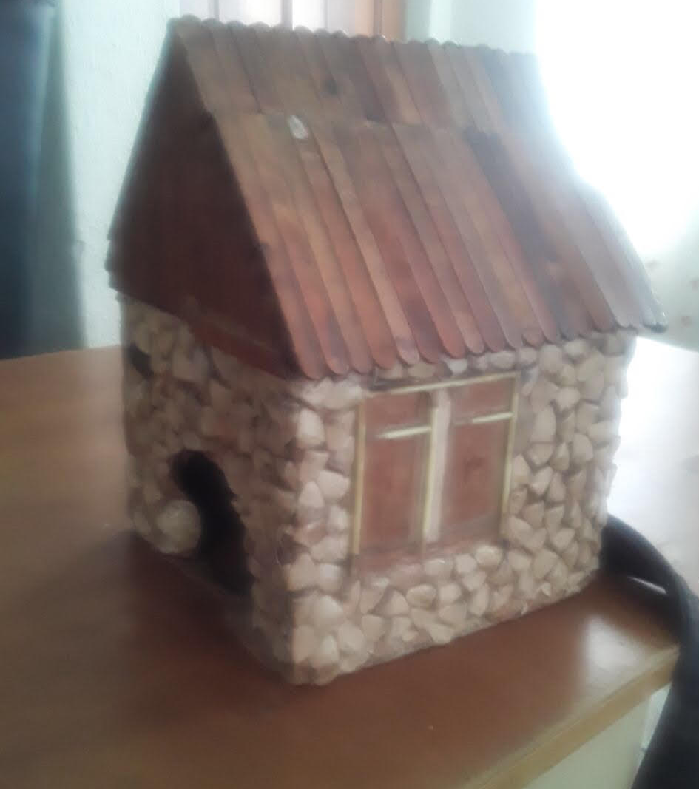
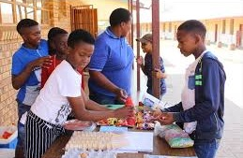
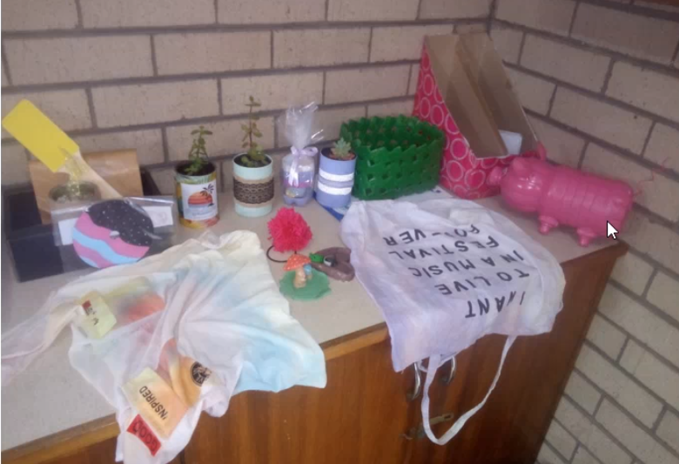
Findings: Teaching Practice - What Happens at the Grade 7 Market Day?

Slide 13
Grade 7 EMS Teacher (Fundisa for Change Course):
Analysis – Green Economy and CAPS
Whole school development
Creativity & energy
Green: Re-use of materials, cleaning up
Skills: Communications
Skills: Problem-solving
Skills: Planning, budgeting, pricing, profit/loss calculation
Skills: Team work
Community-oriented

Slide 14
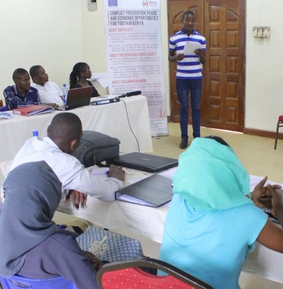
Findings – Business Studies
Project work – develop a business plan and present it
Yet ‘green’ does not feature much (according to participating teachers)

Slide 15
Analysis – Business Studies & Enterprise Development Programmes
Commonly the focus is on ...
Unique niche (USP)
Outcompeting the competition
Maximizing profits
Continuous growth of the business
Singularity (business above other values)
Yet ...
In Africa’s townships and rural areas, livelihoods survive and thrive through collaboration, modestly staying within one’s means, working in harmony with community (relationality)

Slide 16
Conclusions
Lessons from Market Day and how South Africa teachers approach it
The ‘real green economy’ for South Africa is ...
Relational, rather than carving out a unique niche
Embedded in community, rather than built on competition
Sustainable in terms of local resources and capacity – long term planetary boundaries rather than short term BOOM
Sustaining and supportive of the most marginalised (inclusive)
Can we take these principles to scale?
F4C partners and EEASA2021– how do we take these principles into high school, secondary and tertiary education?

Slide 17
Partnership programme for environmental learning and teacher education

