Slide 1
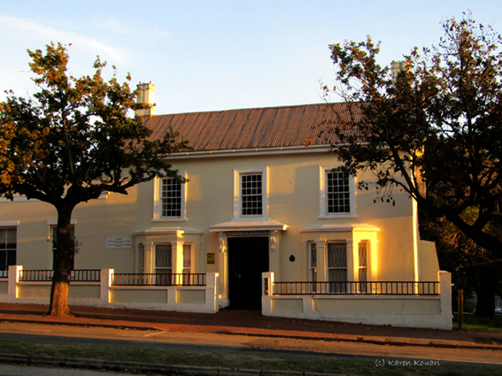
Welcome to the Faculty of Humanities, Rhodes University
Faculty of Humanities, Randell House,
1 Prince Alfred Street

Slide 2
The Role of the Dean
Leadership and strategy development at the Faculty level
Guide students in their studies
Approve courses and degrees
Award degrees
Congratulate students on good performance
Warn students of bad performance
Exclude students from the Faculty and University for continual bad performance

Slide 3
The Deanery
The Dean:
Professor Enocent Msindo
Assisted by:
2 Deputy Deans:
Professor Patrice Mwepu (Research)
Professor Maureen De Jager (Teaching & Learning)
A Faculty Officer:
Ms Karen Kouari

Slide 4
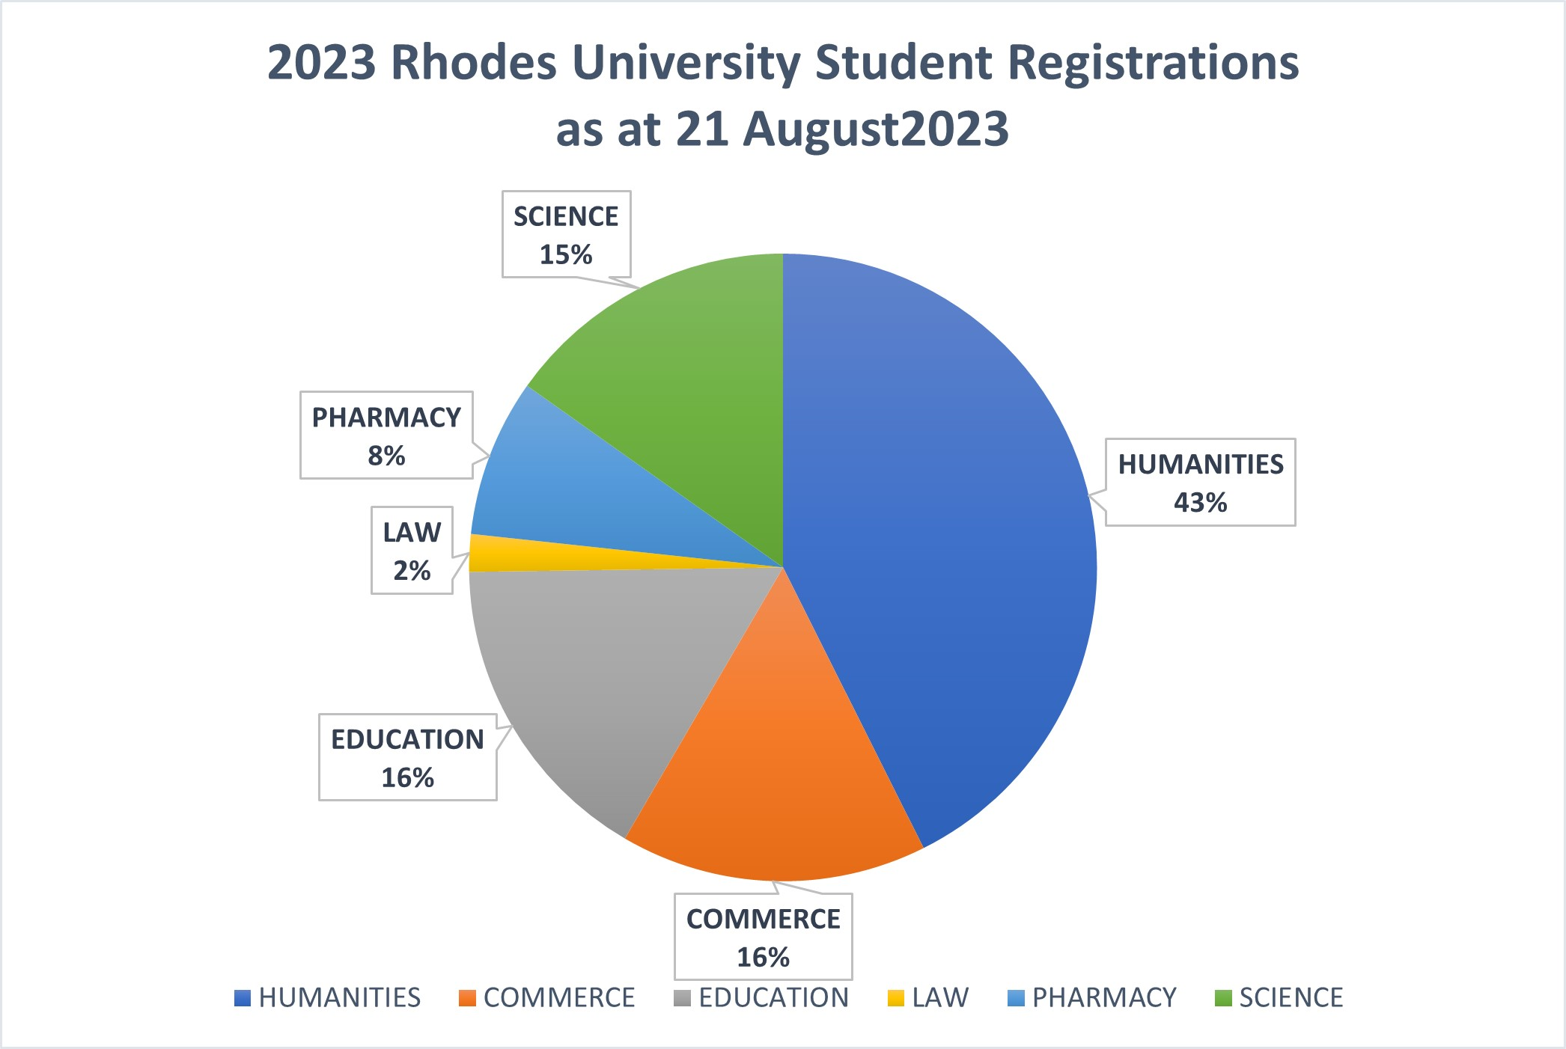
Current Size and Shape: Faculties

Slide 5
What are “the Humanities”?
Studies to do with humans and:
How they think and what they think about
How they behave and live together
How they communicate (language, literature, art, drama, dance, music, etc.)
Their past and their future

Slide 6
Degrees and Subjects
To qualify for a Humanities degree, 50% of
the subjects chosen, including a minimum of
ONE major subject obtained at NQF Level 7
MUST be from Humanities departments/
schools (Legal Theory can count as a
Humanities subject).

Slide 7
Undergraduate Degrees
Degree | Minimum Duration | Subjects
BA | 3 or 4 Year Degree | Must major in a minimum of ONE Humanities subject and have 50% of the degree made up of Humanities subjects
BSocSci | 3 or 4 Year Degree | Must major in at least one of: Anthropology, Economics, Journalism and Media Studies, Politics, Psychology or Sociology, taking into account the 50% Humanities subjects rule In addition, must have at least 2 other subjects from this subject group
BFA | 4 Year Degree | Compulsory Art Subjects with Humanities subjects
BMus | 4 Year Degree | Compulsory Music Subjects with Humanities subjects
BJourn | 4 Year Degree | Compulsory Journalism and Media Studies + isiXhosa for Journalism with other subjects

Slide 8
Subject Departments and Schools
11 DEPARTMENTS:
ANTHROPOLOGY
DRAMA
LITERARY STUDIES IN ENGLISH
FINE ART
HISTORY
LINGUISTICS AND APPLIED LANGUAGE STUDIES
MUSIC
PHILOSOPHY
POLITICAL AND INTERNATIONAL STUDIE
PSYCHOLOGY
SOCIOLOGY
2 SCHOOLS:
SCHOOL OF JOURNALISM & MEDIA STUDIES
SCHOOL OF LANGUAGES AND LITERATURES offers:
African Language Studies
Afrikaans
Chinese
Classical Studies
French
German
Greek
Latin

Slide 9
3-year BA / BSocSci NQF Level 7 = NQF 360 credits
Year
1
A1 + B1 + C1 + D1
Year
2
A2 + B2 + D2 + E1
Year
3
B3 + D3

Slide 10
4-year BA / BSocSci Degree NQF Level 7 = NQF 360 Credits
Year
1
A1 + B1 + C1
Year
2
A2 + B2 + D1
Year
3
A3 + D2
Year
4
B3 + D3

Slide 11
4-year BJourn Degree NQF Level 8 = NQF 480 Credits
Year 1
JMS1 + A1 + B1 + C1
Year 2
JMS2 + A2 + B2 + XHS JRN
Year 3
JMS3 + B3
Year 4
JMS4

Slide 12
4-year BFA Degree NQF Level 8 = NQF 480 Credits
Year 1
FAP1A + FAP1B + AHV1 + X1
Year 2
FAP2A + FAP2B + AHV2 + X2 or Y1
Year 3
FAP3 + AHV3
Year 4
FAP4 + AHV4

Slide 13
4-year BMus Degree NQF Level 8 = NQF 480 Credits
Year 1
IMS1 + MTA1 + MCH1 + ST1 or X1
Year 2
IMS2 + MTA2 + MCH2 + ST2 or X2/Y1
Year 3
IMS3 + MUS3 or MCH3
Year 4
MUS4

Slide 14
Degrees can take longer than 3 or 4 years due to:
Changes in subject choices (particularly majors)
Through failing credits. A degree WILL take an extra year if a student fails to pass:
At least 3 credits in their first year of study
At least 7 credits by the end of their 2nd year of study
2 (or 3) credits in their 3rd year of study

Slide 15
Education is not a Commodity
It is not a matter of paying fees one end and picking up a degree at the other
Rich partnership between student and academic departments that sustains learning and leads to the well-earned award of a degree
Much work to be done by both the student and the lecturer to create the degree

Slide 16
Our Aim
We aim to develop graduates with an emphasis on education, rather than vocation
Our graduates are people who are:
creative
critical thinkers
compassionate clear communicators
have a capacity for life-long learning

Slide 17
Assumptions we make about our students
Want to be at Rhodes University
Want to learn
Want to cooperate with peers and staff
Want to perform at their best
Want to take responsibility for their studies
Want to ask questions
Want to be proactive
Want to work independently

Slide 18
Words of advice to Students
Structure your time:
academic (lectures, assignments, projects, assessments)
Sport, exercise, hobbies
social and entertainment
Develop patterns of behaviour:
get up, eat, attend ALL lectures and tutorials, study, exercise/socialise, sleep
listen/look/experience, question, clarify, argue, understand, write down, file, review

Slide 19
When Things Go Wrong?
Don’t panic, and certainly don’t hide.
Go and talk to:
Tutor, Lecturer, Course Co-ordinator, Head of Department, Dean, Faculty Officer
Sub-warden, warden
Counselling Centre (variety of services, such as study skills, career advice, psychological counselling)

Slide 20
If you have any questions, please e-mail humanities@ru.ac.za
Thank you.

