Slide 1
Michael Nxumalo
Director: Africa Collaborative Grants
FUTURE EARTH GLOBAL SECRETARIAT HUB,
AFRICA
Address
National Research Foundation
1 Meiring Naude Road
Brummeria
Pretoria
South Africa
Contacts
+27 12 481 4011
www.nrf.ac.za
aldol@nrf.ac.za

Slide 2
What is Future Earth?
Future Earth is a global network of scientists, researchers, and innovators collaborating for a more sustainable planet!

Slide 3
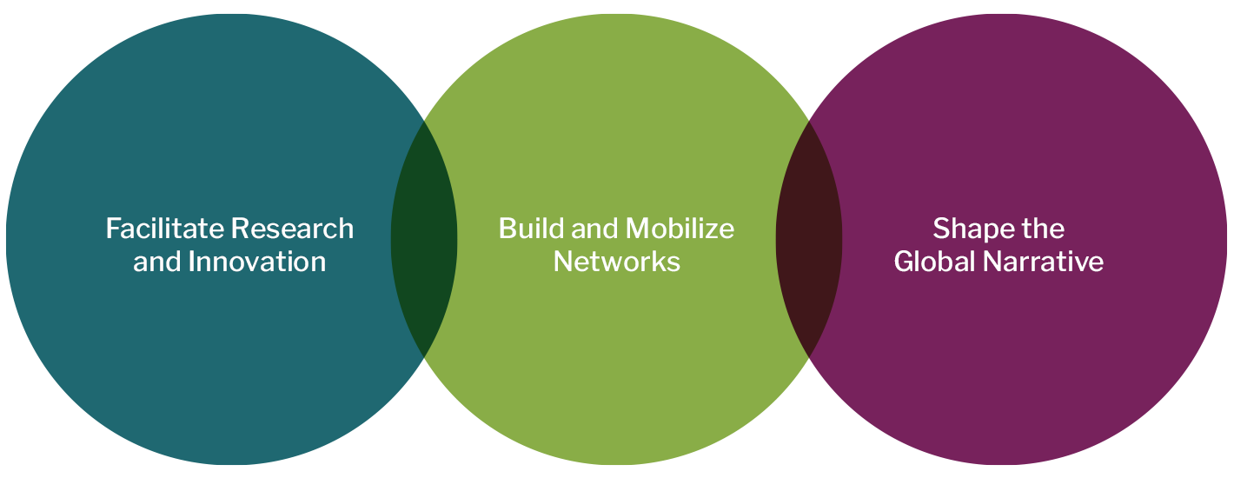
Context
Future Earth’s strategy is to develop the knowledge and tools that government, communities, and companies need to meet the United Nations 17 Sustainable Development Goals (SDGs) that comprise the Global 2030 Agenda. By understanding connections among environmental, social, and economic systems, Future Earth works to facilitate research and innovation, building and mobilising networks and shaping the narrative to turn knowledge into action.

Slide 4
Context (cont.)
For Africa, Future Earth is a critical platform for sustainability research that can shape policies and offer tangible solutions that impact communities on the ground and, in the context of Africa’s youth bulge, to support the development of early career professionals thus, enabling researchers to work increasingly across geographies, communities (academic, public, and private) and disciplines to deliver pertinent and relevant evidence-based information in support of sustainability is at the core of the NRF’s mission and objectives.
Environment,
Economics aligned
Ecology and
Climate change
to national
Biodiversity
development
Water systems
Sustainable Oceans
Water, energy, and
Earth and planetary
Urbanisation
food (WEF
sciences
Energy systems
-
nexus)
Biosciences &
Agricultural
Biotechnology
multidisciplinarity
Heath
Food systems
multidisciplinarity
transformation
Humanities for the
environment (social
sciences)
African
-
focused research themes

Slide 5
The Value of the Global Secretariat Hub in Africa (& the global South)
Expanding global hubs to the Global South and linking them all to a mechanism that creates a common pool of resources for parallel activities will result in tasks being assigned more efficiently over geographies and time-zones. The proposed Africa Hub will align and build on the NRF’s extensive collaborative network of partners in Africa and other global south partners, providing an organising framework that will increase the momentum of addressing the complex challenges faced by the planet. The significant engagement and work of FEROSA in Southern Africa already sets a basis for invaluable expansion to the rest of the continent

Slide 6
The Journey
Application submitted on November 2021
Feedback December 2021
Resubmission January 2022
Outcome March 2022
Onboarding and induction - in progress

Slide 7
Mission and Vision of the Hub
The specific vision and mission for the African Hub should be complementary to and supportive of Future Earth’s broader, globally defined vision and mission. Accordingly:
The vision for the African Hub is of African leadership in global sustainability science.
The Hub’s mission is to advance research and scholarship in support of transformations to sustainability on the continent and globally.
.

Slide 8
Objectives of the Africa Hub
Coordinate and link the various sustainability initiatives across the continental regions.
Create communities of practice that bring African Scientists together in an African Sustainability Ecosystem.
Facilitate strong working connections with society, industry and government.
Play an enabling role within the sustainability landscape by:
Enabling engagements that go beyond the current narrative and rhetoric.
Positioning African scientists to play a leadership role in the global sustainability agendas – influence policy
Articulate a science agenda so that people [ government, NGOs, industry, society and academia] can identify with it
Support Young Scientist Initiatives
Link young scientists with government – create a government fellowship programme where young scientists are placed within government

Slide 9
Possible Operation Models
*reviewers proposed hybrid of the two

Slide 10
Global Secretariat Hub Hosted by the NRF
Model: Regional Nodes
Strategy
Regional nodes coordinate activities compatible with the FE research agenda in each region
The Global Secretariat Hub will play a convening and coordinating role at a high level and LC will coordinate activities between nodes
LEADERSHCNENTRE
Implementation
North Africa
East Africa
CentraAfrica
West Africa
Southern Africa
Feedback
Gov.
Univs
KANS
NGOs
Funders
Each region will have a consortium of multi-sectoral partners who will implement the FE mandate
GRNs
Think-tanks
Nat. Committees

Slide 11
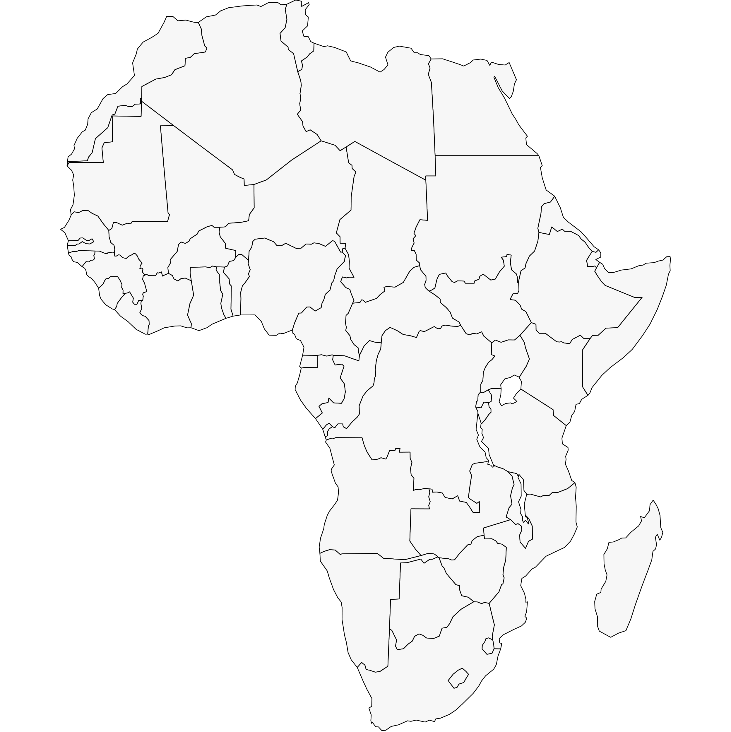
HOST: NORTH AFRICA
Model: Regional Nodes
Actor
MENA Regional Center
Actor
Actor
Regional Nodes coordinate activities compatible with the FE research agenda in each region
The Global Secretariat Hub will play a convening and coordinating role at a high level. Leadership Centre Coordinates activities
Actor
North Africa Regional interests
Actor
HOST: WEST AFRICA
HOST: EAST AFRICA
Actor
Actor
Actor
Actor
West and Central Africa Regional interests
Actor
East Africa Regional interests
Actor
Southern Africa Regional interests
HOST: S. AFRICA
Actor
Actor
Actor
Actor

Slide 12
Things to consider about partners
Each potential stakeholder
has mandates that aligns with that of Future Earth’s
as existing projects or initiatives that aligns well with Future Earth’s mechanisms to address global challenges
the principle of collaboration, and transdisciplinarity, is critical
has (potential) partners and donors who play significant role in the global sustainable development landscape.

Slide 13
Next Steps
 | May ‘22 | July ‘22 | Sep ‘22 | Nov ‘22 | Jan ‘23 | Mar ‘23 | May ‘23 | Jul ‘23 | Sep ‘23 | Nov ‘23 | Jan ‘24 | Mar/April ‘24
Pre-launch
Review & Consultation
Full Governance Structure
Formal Launch incl. Nodes
Support FE Secretariat Functions
.
Notes:
You can safely remove this slide. This slide design was provided by SlideModel.com - You can download more templates, shapes and elements for PowerPoint from http://slidemodel.com

Slide 14
Thank you

