Slide 1
An introduction
What are Future Earth and Global Research Hubs?

Slide 2
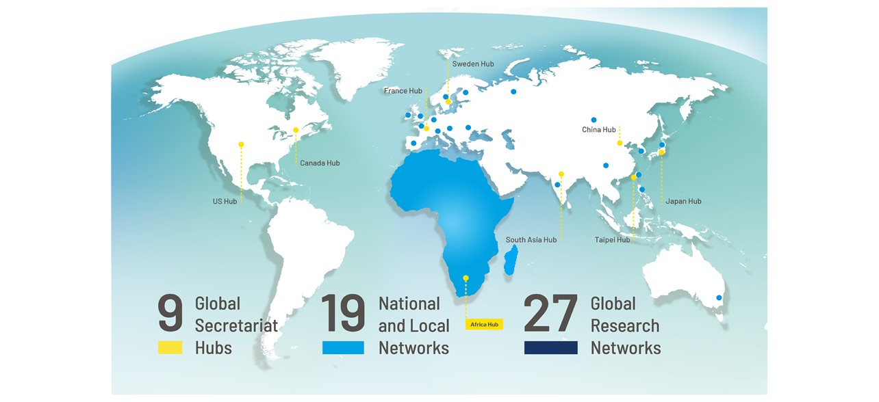
Future Earth Community
Future Earth is a global initiative focused on advancing sustainability science.
Future Earth’s vision is of a sustainable and equitable world for all, where societal decisions are informed by openly-accessible and shared knowledge.
Future Earth’s mission is to advance research in support of transformations to global sustainability.

Slide 3
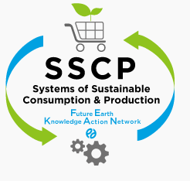
Future Earth covers wide range of Earth System Sciences
and promotes interdisciplinary and transdisciplinary researches
27 Global Research Networks
Biodiversity
Health
Modelling
Carbon emission
Atmosphere
EvolvES
(Evolution for Earth Sustainability)
oneHEALTH
Marine, water
Governance
Risk
Ecosystems
Consumption and Production
Natural Assets KAN
Water-Energy- Food Nexus KAN
Land use
Earth and human history
Monsoon Asia
Urban
Finance & Economics
Finance & Economics KAN

Slide 4
The Future Earth Africa Hub and its Leadership Centre
Advancing sustainability science in Africa
Sponsors
Implementing Partners
Consortium Partners

Slide 5
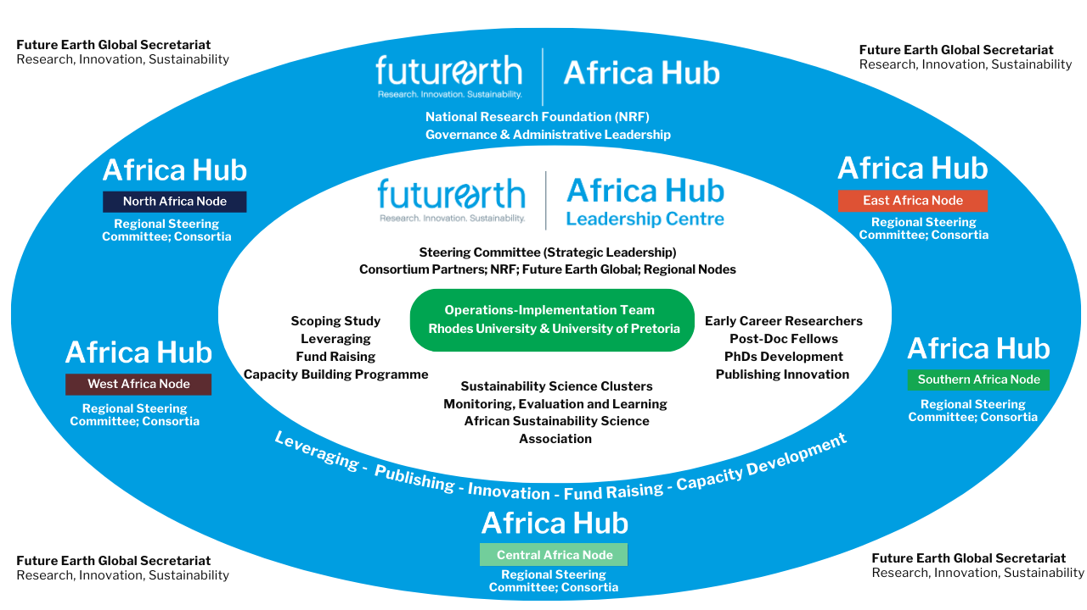
A Visual Configuration of the Future Earth Africa Hub

