Slide 2
Some background towards co-hosting the FEAHLC
IWR, ELRC and ISER responded to the NRF call in mid 2022 to host the Centre across the three units - for three years initially
We wanted the Centre to develop and promote sustainability science more than just coordinate SS groupings across Africa
We proposed we would each lead from our areas of strength – and with the backing of RU community research profile:
a. ELRC/SARCHI Chair in Global Change, Social Learning Systems & Environment and Sustainability
Education in Africa and worldwide
b. IWR as ARUA CoE for Water Research in Africa
c. ISER: on Land Reform Policy Research in Africa and Environmental Economic Benefits & Cost
estimations
But these are not the only urgent or important research areas in Africa – so we had to have a plan for as many other areas in the future

Slide 3
What and how we proposed we can do?
So we came up with the idea of establishing Science Clusters (initially we called them nodes – but left the label for NRF use)
Establishing these Clusters would be the key distinctive feature of the co-leading SS development projects
We would also use the limited NRF budget to ask consortium partners outside RU to co-develop and lead Science Clusters they were strong at (e.g. FHISER, Wits GCI, UL SARCHI Chair in Ecosystem Health)
We also proposed that our work would be delivered in three distinctive packages over the agreement period of 3 years
The packages would carry specific programmatic activities including the following:
Scoping exercise in the first months as initial and limited project
SS Cluster development – as anchor and growing project
Open African Sustainability Science Association (ASSA) – were careful about (AASS)
Capacity Development of Early Career Researchers, Post Docs, PhDs, community, public and other stakeholders, publishing capacity
Monitoring, Evaluation and Learning – in the 2nd year of the agreement
For the list of all proposed programmes - consult page 3 of the Brochure in front of you or in chat box online
While most scientific research leadership is lead and coordinated from RU, UP provides the state of the art physical and logistical infrastructure plus international policy networks

Slide 4
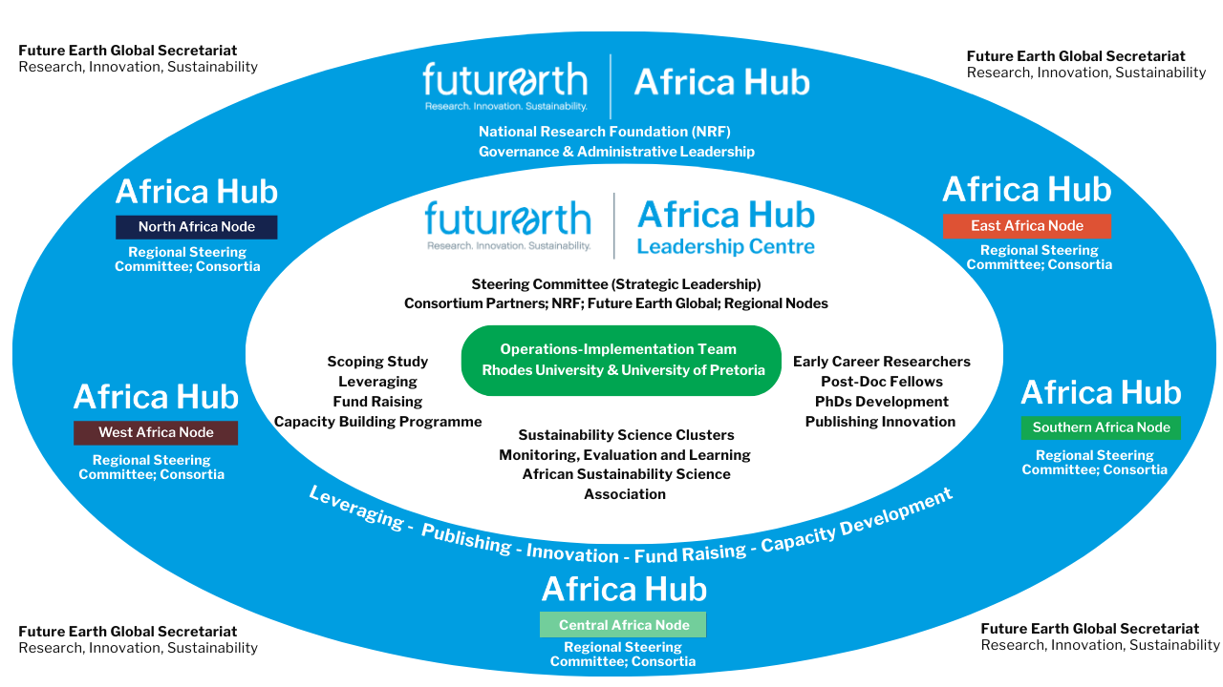
What and how we proposed we can do? In how we are structured
The White & Green Circles

Slide 5
What and how we proposed we can do?
You might already have ideas of how you can support these programmes – and this is why we are having this initial discussion
Over to Prof. Heila on some meanings of SS and then Dr Nnadozie on how we have conceptualized SS

Slide 6
Land & Investments: Uses and Management
The main question: how are we investing (labour and capital) to use and manage land and its resources sustainably?
Agreement/s:
Current focus area (5 years) on uses and management: Agriculture, Conservation & Human Settlements as agreed by the initial group - based on strengths and location
Each focus area led from each region BUT each team has reps in each region
This should allow us to collect cases on each focus area from each region for cross lessons
Agreement – focus areas evaluated every 5 years
– FEAHLC welcomes parallel clusters e.g. focusing on other areas uses like mining, waste, etc.
Agreement: responsibility to raise & use resources – shared equally
Current group is located in Kumasi/Accra – Ghana; Nairobi (KU & UN)-Kenya; Morogoro – Tanzania; Zimbabwe and SA (3 regions out of 5 represented – we need initial connections in Central and North)

