Slide 1
Citation Analysis
Your article
Scopus
InCites
Altmetrics
Other?
Jill Otto
Rhodes Library Services

Slide 2
Citation Analysis – what is it all about? And why would you care?
Why would you want to know if your work is cited?
To prepare for promotion
To apply for funding
To look for possible collaborators
Someone has read your work ☺
This presentation will cover the following:
H-Index
Scopus: Citation Analysis & Journal Impact Factors
Web of Science: Citation Analysis & Journal Impact Factors
Altmetrics – briefly!

Slide 3
H-Index – the what and why…
What – The h-index captures output based on the total number of publications and the total number of citations to those works.
An h-index of 6 means that an author has published at least 6 papers that have each received at least 6 citations.
Why – It can be an indicator of how productive and influential a researcher is.
BUT there are disadvantages: the h-index cannot be compared across disciplines; h-scores are open to manipulation through practices like self-citation; authorship – single author or co-author?
Citation rates vary across disciplines.*
Notes:
Scopus database: https://0-www.scopus.com.wam.seals.ac.za/home.uri
Author search & Affiliation

Slide 4
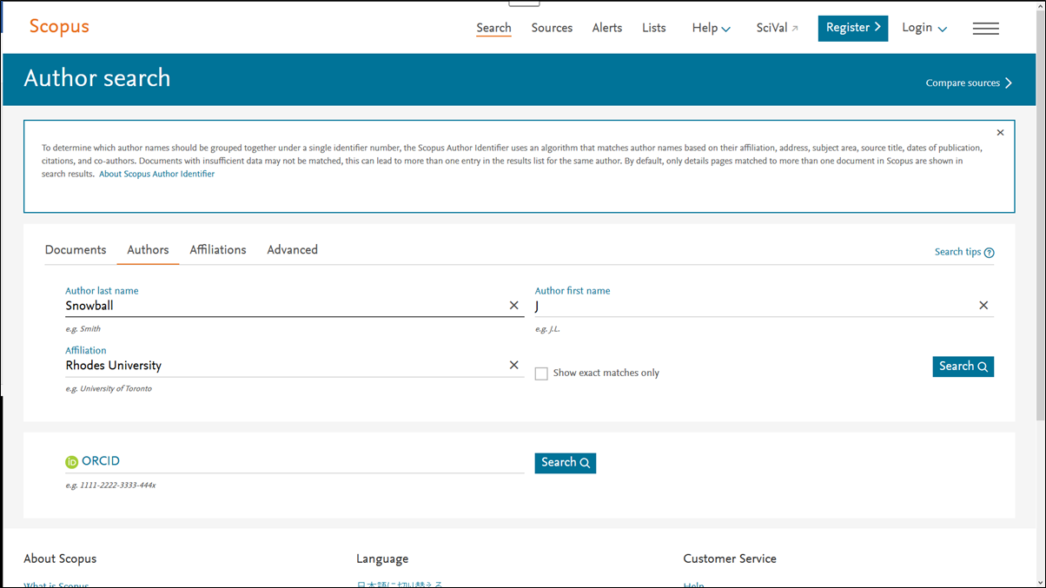
Search Scopus database: Profile: Professor Jen Snowball, Economics Dept, RU.
https://0-www.scopus.com.wam.seals.ac.za/home.uri
Author & Affiliation search
Note Help button!

Slide 5
Profile: Prof Jen Snowball, cont.
Author: Note different version of Prof Snowball’s name.
Documents: 40
Subject areas: Social Sciences; Economics etc.
NB – click on “View citation overview”.
Notes:
Author: Note different version of Jen’s name.
Documents: 40
Subject areas
NB – click on “View citation overview”

Slide 6
The citation overview
40 cited documents.
Author h-index = 9
Click View h-graph to generate the h-index information.
NOTE date range & that Scopus updating pre-1996 references.
NOTE option to exclude self citations.

Slide 7
The h-index is 9. Click on the 9 citations to view
Also note Citations & Co-authors; date range.
Click on the 9 to see the list of those citations.

Slide 8
View the 9 h-index citations

Slide 9
Scopus: Journal Impact Factors On the Search screen, click Compare sources.

Slide 10
Search for “agricultural economics”, by Agricultural and Biological Sciences (or Economics) subject area.
You can search for a source by entering a subject, title, ISSN or publisher name.

Slide 11
From the list, select the journals to compare. You can select up to 10 sources to analyse and compare. See Chart metrics below.
Compare sources calculations - ranking metrics explained.

Slide 12
Click the other tabs to see the journals compared by different ranking metrics.
Metric explanations:
CiteScore calculates the average number of citations received in a calendar year by all items published in that journal in the preceding three years.
For more information, see What is CiteScore?
SJR compares the scientific prestige of sources, based on the value of weighted citations per document.
A source transfers its own 'prestige', or status, to another source through the act of citing it. A citation from a source with a relatively high SJR is worth more than a citation from a source with a lower SJR.
For more information, see How is SJR (SCImago Journal Rank) used in Scopus?
SNIP compares the citation impact of sources in different subject fields. SNIP is the ratio of a source's average citation count per paper, and the 'citation potential' of its subject field.
For more information, see How is SNIP (Source Normalized Impact per Paper) used in Scopus?
See also the tabs: Citations; Documents; % Not cited; % Reviews.

Slide 13
SJR compares the scientific prestige of sources, based on the value of weighted citations per document.

Slide 14
Switch from Chart to Table to compare metrics between the selected journal titles.

Slide 15
Web of Science. Register or Sign in, then click on InCites

Slide 16
Web of Science: InCites analytics.
To search for personal citation analysis, click on the People option

Slide 17
Search: for example, Snowball, J (Prof Jen Snowball, Dept of Economics, Rhodes)
From the list of results, select all the versions which are relevant. Click “Update results”

Slide 18
Results – displaying rank, affiliation, WoS documents, times cited…
Note Affiliation: University of Rhode Island? Incorrect!
University of Newcastle? Collaboration!
Click on article
Rank 10 & 11 – This J. Snowball is another person altogether, publishing in the Nursing & Medical field.

Slide 19
Note this article information, including the Journal Impact Factor. (SAJEMS = .19)

Slide 20
Click on dropdown arrow to open further information around collaborations, funding, research areas, affiliations and more.

Slide 21
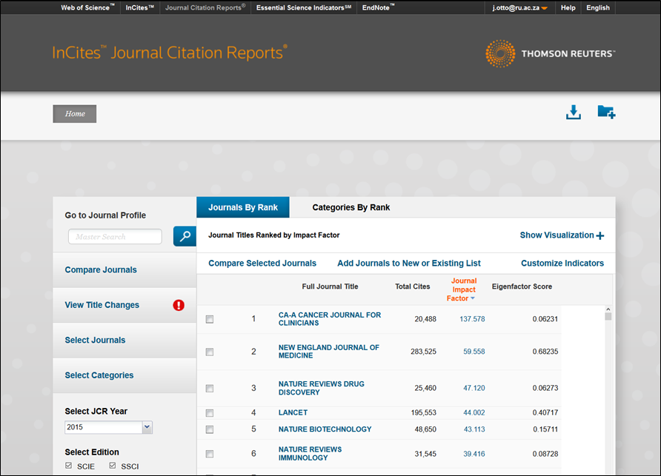
Web of Science: Journal Citation Reports NB: the Help option at the top of the screen!
Click on “Compare Journals”

Slide 22
There are two basic ways you can create a selection of journals to compare. 1. If you know which journals you wish to compare:
1. Start by clicking Compare Journals on the Journals by Rank page. The Compare Journals screen will appear.
2. Choose your comparison type from Quartile or Trend. Further information on both comparison types can be found here.
3. Select Journals by searching for journal names in the Search Journals window that appears. Add journals by continuing to search and clicking on the journal titles that appear.
4. Select a JCR Year or years, depending on the comparison type you choose.
5. Select Metrics.
6. Select the Category for which you would like to see JCR Year and Metric comparison information. You can only compare journals in the same category. If you select journals that do not have a category in common, they will not be included in the results.
7. Click Submit.

Slide 23
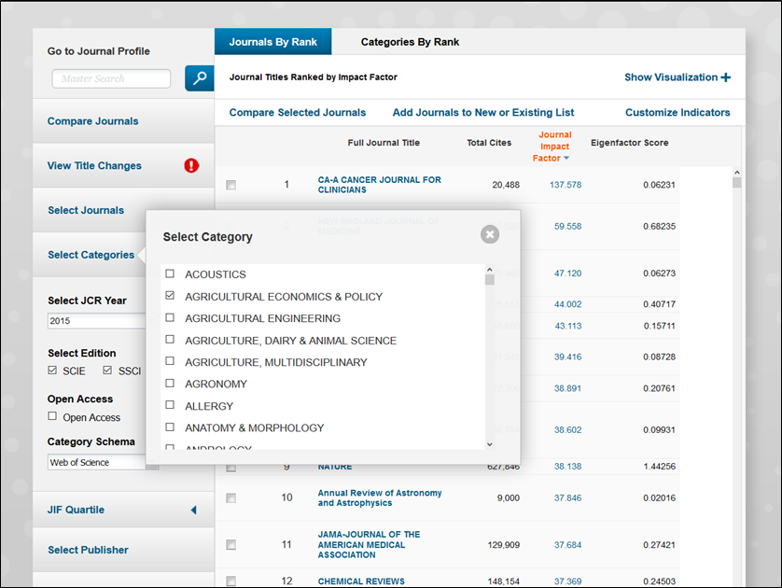
2. If you want to start at the journal category level.
Starting at the category level allows you to retrieve a complete list of journals categorized under a certain research area, and choose from that ranking those journals you wish to compare.
Select categories: e.g. Agricultural Economics and Policy; and Economics.
Click Submit.

Slide 24
Select journal titles
Note Journal Impact factors.
Check boxes for journals you wish to compare.
Click “Compare Selected Journals”.

Slide 25
Compare journal Quartile. This enables users to compare various quartile metrics for selected journals within a given subject categorization.
Select a metric

Slide 26
Compare journal trends – the journals’ progress across a number of years.
Select Comparison: Trends
Select JCR Years. E.g. 2010 and 2015

Slide 27
Comparing the two journal titles

Slide 28
Altmetrics
Altmetrics are metrics and qualitative data that are complementary to traditional, citation-based metrics.
The slow pace of academic publishing means that it can take months or years before an article begins to appear in journal citations. The relative speed of Altmetrics provides a new way of measuring scholarly output that helps scholars to keep abreast of the developments in their field by identifying important new scholarship.
They can include (but are not limited to) peer reviews on Faculty of 1000, citations on Wikipedia and in public policy documents, discussions on research blogs, mainstream media coverage, bookmarks on reference managers like Mendeley, and mentions on social networks such as Twitter.
https://www.altmetric.com
A beginner's guide to Altmetrics
https://www.youtube.com/watch?v=M6XawJ7-880
RUL subject guide on Altmetrics:
http://ru.za.libguides.com/c.php?g=174135&p=1579138

Slide 29
YouTube help!
JCR on InCites: Quick Tour
https://www.youtube.com/watch?v=IIfF5jvowSM
Using Journal Citation Reports
https://www.youtube.com/watch?v=zK26Lez2dFQ
Journal Citation Reports: Impact Factor
https://www.youtube.com/watch?v=0RPsvgfi0RY

Slide 30
Please contact your Principal Faculty Librarian for further assistance:
Science & Pharmacy: Thandiwe Menze (Level 2) v.menze@ru.ac.za
Commerce & Law: Jill Otto (Level 3)
j.otto@ru.ac.za
Humanities (Social Sciences) & Education:
Fiona Still-Drewett (Level 3)
f.still@ru.ac.za
Humanities: Linda Cartwright (Level 4)
l.cartwright@ru.ac.za

Slide 31
References
https://www.slideshare.net/AnneWilHarzing/citation-analysis-with-publish-or-perish-and-google-scholar
https://www.altmetric.com

