Slide 1
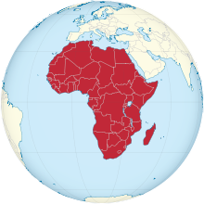
Building Chinese-African Partnerships A call for cross-cultural analysis at organizational level
Tony Fang, PhD Professor of Business Administration Stockholm University (For Rhodes University, 2013-10-31)

Slide 2
Structure
Tony Fang presentation
China-Africa trade and so what?
China’s relationships with Africa
"China in Africa” literature and media texts
Literature review findings
Conventional wisdom questioned
China in Africa: A new research agenda

Slide 3
China-Africa Trade (USD bn) and so what?
$198.5 billion

Slide 4
China’s relationships with Africa
Tony Fang presentation
Zheng He’s naval expeditions (1405-1433)
Egypt became the first African state to establish diplomatic ties with the People’s Republic of China (PRC) on May 30, 1956.
China’s aid to Africa: 1950’s-1970’s including the legendary $500 million TanZam Railway (1970-1976).
African support for the PRC’s entry into the UN on October 25, 1971.
China’s rapidly increasing investment in Africa has started since the mid-1990’s.
China became Africa’s most important trading partner in 2009.
China's trade with Africa reached $166 billion in 2011, a more than tenfold increase within ten years; $198 billion (2012); $385 billion (2015). China doubles loans for African countries to US$20 billion over the next three years.

Slide 5
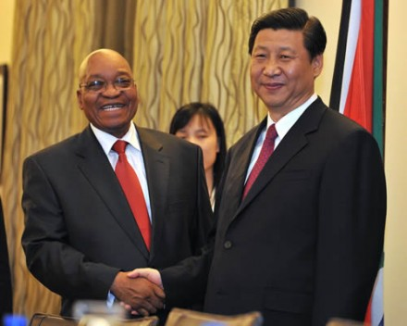
"China in Africa"
Tony Fang presentation
“Weapons, oil and dirty deals: How China pushes the West out of Africa” (“Waffen, Öl, dreckige Deals: wie China den Westen aus Afrika drängt”) (Von Hasnain Kazim in Der Spiegel, 2007)
China’s unrestricted lending has “..undermined years of painstaking efforts to arrange conditional debt relief”, and where purported Chinese disregard for human rights has become an issue (Campbell, 2008, quoting Paul Wolfowitz for the World Bank and IMF).
“Self-interested Chinese policies and attitudes that show scarce concern for worker welfare have already generated resentment in local African communities. Many infrastructure deals signed by Chinese firms mandate that the majority of labor for the project must be Chinese, precluding Africans from fully benefitting from the inflow of Chinese investment. This deprives locals of jobs and fosters discontent, as workers cannot reap the expected benefits of the influx of new projects.” (Hu, 2011, in American Foreign Policy)

Slide 6
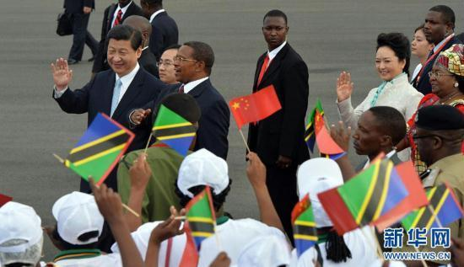
Tony Fang presentation
“Chinese leaders must consider the deeper problems with current investment practices. Local policies and attitudes that neglect worker welfare, crowd out employment, and collude with dictatorial regimes are fostering grassroots resentment that may undermine China’s ability to continue business with Africa in the long term.” (Hu, 2011 in American Foreign Policy)
"The way it looks, one day there will be a big fight with them, … One day there will be blood.“ (see “Reuters: Insight: In Africa's Warm Heart, a Cold Welcome for Chinese”)
“Africa must attract broad investment, not rely on handouts, if we are to sustain development.” (Paul Kagame, 2009, “Why Africa welcomes the Chinese”)

Slide 7
Swedish media
Tony Fang presentation
”De afrikanska länderna har inga behov att få en ny Big Brother. ... Kina träder nu fram som den stora investeraren i Afrika. Det dikteras av Kinas behov av att säkra energikällor för sin utveckling: därför investerar Kina främst i olje-och gassektorn.” (Disa Håstad, “Kina siktar in sig på Afrika”, Dagens Nyheter, 2006)
”Kinas gigantiska frammarsch i Afrika väcker oro i många läger men kan vara ett hopp för kontinenten. Men då måste de afrikanska ledarna bli bättre på att förhandla.” (Ola Wong, ”Afrika måste lära sig att förhandla”, Svenska Dagbladet, 2009)
”Afrika är det nya Kina, säger Anders Borg till SvD Näringsliv i den lummiga trädgården vid den svenska ambassadören Lena Nordströms residens på Leopards Lane i Lusaka i Zambia. ” (Janne Andersson, ”Anders Borg: ’Afrika är det nya Kina’ ”, Svenska Dagbladet, 2012)
FOTO: JOHNNY FREDBORG

Slide 8
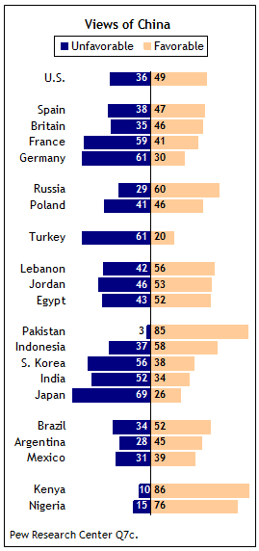
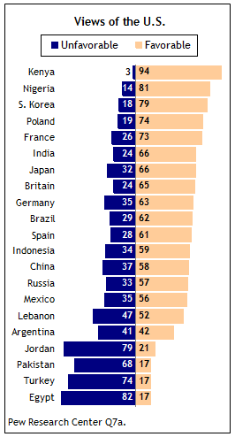
View of China vs. USA
Tony Fang presentation
Pew Global Opinion Polls, 2010

Slide 9
Literature review findings
Tony Fang presentation
Extant literature appears confined to macro-issues such as level of FDI and the intent of China towards Africa (Biggeri & Sanfilippo, 2008; Cheru & Obi, 2010; Lagerkvist, 2011; Strauss & Saavedra, 2009).
An overwhelming majority of reports in the West is directed towards criticizing China and Chinese firms in handling government and labour relations with negative evaluations. Almost no attention has been given to studying positive role models concerning Chinese organizations in Africa.
Research taking cross-cultural issues into consideration is extremely rare (Horwitz, Hemmant, & Rademeyer, 2008; Jackson, Louw, & Zhao, 2011).
Methodologically, the ”China in Africa” debate is replete with sensational journalistic reports of anecdotal nature with normative assertions made at geopolitical and international relations levels without in-depth organizational level analysis.
”As the debates unfolded in conference rooms, blogs, and media outlets in the West and in Africa, ... it was obvious that debaters, bloggers, and journalists were drawing conclusions with only scant information.” (Brautigam, The Dragon’s Gift: The Real Story of Chin in Africa, 2009)

Slide 10
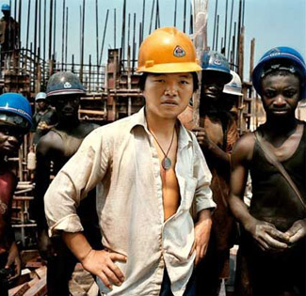
Tony Fang presentation
“…Chinese companies do bring a larger proportion of their workforce from home than Western firms, but this is the case mainly for construction projects in oil-rich countries like Algeria, Libya, or Angola where local labour is expensive. In other places, with few exceptions, Chinese projects have a majority of Africans in their workforce… It is the poor conditions of this employment, and not its absence, that is a constant complaint among African workers.” (Bräutigam, 2011)
“Chinese organisations simply apply the same standards that have been common in many parts of China, particularly in smaller enterprises.” (Bräutigam, 2009)

Slide 11
Conventional wisdom questioned
Tony Fang presentation
“The conventional wisdom on Chinese aid is largely wrong in three of its central beliefs: the size of China’s aid flows, the role of resources, and the impact on governance and human rights.” (Berger, Brautigam, & Baumgartner, 2011, ”Why are we so critical about China’s engagement in Africa?”)

Slide 12
Questioning the China’s aid flows thesis
Tony Fang presentation
“First, China’s aid programme is far smaller than we are led to believe. The estimated US$1.6 billion of official assistance that China transferred to Africa in 2009 is much smaller than aid flows from Africa’s main donors, including Germany. Together, the West disbursed nearly US$30 billion in official development assistance (ODA) to Africa in 2009.” (Berger, Brautigam, & Baumgartner, 2011)

Slide 13
Questioning the resources thesis
Tony Fang presentation
”Second, we often hear that China’s alleged hunger for natural resources is the main driver for Chinese aid. However, a closer look at facts shows that Chinese aid is distributed fairly evenly around the continent, and is primarily used for diplomacy, or as part of a framework of economic cooperation. In fact China’s aid, with its focus on infrastructure and smallholder agriculture, is complementary to Western aid as these are sectors often neglected by traditional donors.” (Berger, Brautigam, & Baumgartner, 2011)

Slide 14
Questioning the human rights thesis
Tony Fang presentation
”Last but not least, the Western media often portrays China as undermining the West’s ability to use conditionality to support human rights and governance initiatives. A more nuanced picture would show Beijing voting in favour of sanctions on Libya, pushing Sudan to allow a joint UN-African peace-keeping force into Dafur, and successfully pressing Robert Mugabe to form a government of national unity with Zimbabwean opposition. ... More generally, there is no evidence at all that in Africa Beijing prefers to cooperate with poorly governed, authoritarian governments instead of democratic regimes. Some of China’s best business partners in Africa include robust democracies: South Africa, Ghana, and Mauritius.” (Berger, Brautigam, & Baumgartner, 2011)

Slide 15
China in Africa: A new research initiative
Tony Fang presentation
Refocus our research and understanding from the dominant geopolitical analysis at macroeconomic and international relations levels to cross-cultural analysis at organizational level. For example, see “China in Africa” from the perspective of building Chinese-African partnerships at one of the most vibrant frontiers of international business.
Importance to be given to studying how Chinese and African organizations, despite different political, economic, technological, cultural and religious backgrounds, interact, negotiate and create mutually beneficial projects and how these projects are implemented, sustained, and eventually succeeded or failed, and how the projects are evaluated by the business partners and all the stakeholders including local African communities.
Methodololgy: Beyond North American dominance. Rich storytelling and ”thick-descriptive” case study at the organizational level. Cross-sectional and/or longitudinal research on Chinese firms, African firms, and all the stakeholders networks: Positive, negative, over time; Research questions: What? Where? When? How? Why? Implications for theory and practice?

Slide 16
China in Africa: A new research initiative (continued)
Tony Fang presentation
Building up a “China in Africa” research community.
Involving both Western and Chinese organizations/firms/politicians/Academics in our research community
A yearly “China in Africa” conference?
A continuously updated website
Journal and book publication!

Slide 17
African-Chinese business negotiations
Tony Fang presentation
“South African negotiators perceive the Chinese negotiators to value status, respect hierarchical decision-making, and appreciate long-term relationships. In addition, the perceptions on the importance of trust, guanxi and face were strongly evident” (Horwitz, Hemmant, & Rademeyer, 2008: 11).
“In the future, we need to answer, for example, whether the Chinese also use those tactics employed on Western business people to deal with other Third World business people.” (Fang, 1999: 182).

Slide 18
Chinese wisdom
Tony Fang presentation
”要致富, 先修路” ”Yao zhifu, xian xiulu”
(“To get rich, build roads first.”)

Slide 19
Tony Fang presentation
Thank you!

