Slide 1
Confessions: Coloured Kind

Slide 2
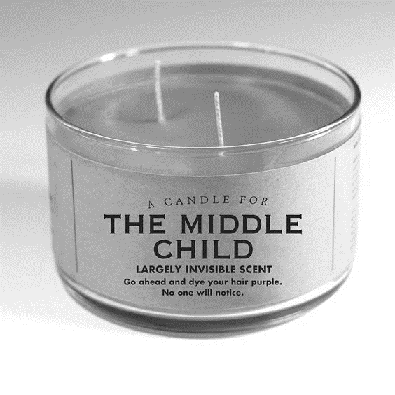
Too white to be black Too black to be white Jy treat my soes daai awkward middle child

Slide 3
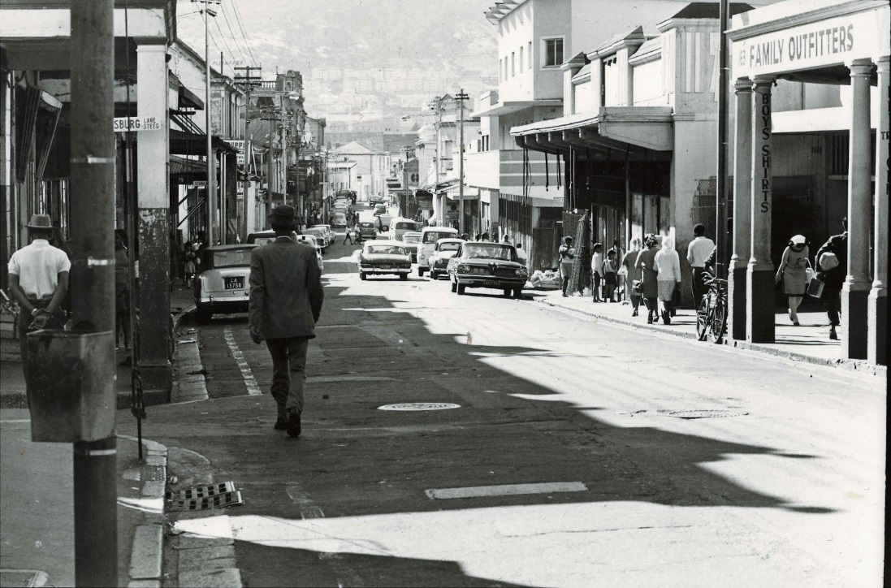
Slawerny kon ons nie skei nie Distrik Ses kon ons nie breek nie Vooroordeel kan ons nie verskeur nie

Slide 4
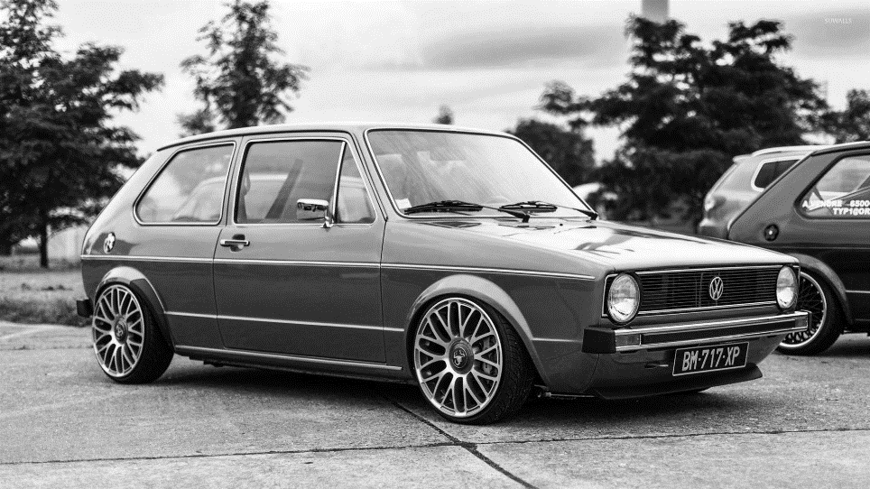
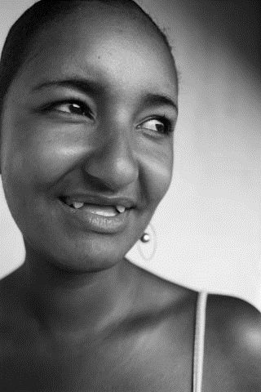
We are territorial Ons is gebruikte VolksWagen karre We are passion gaps Ons is Afrikaaps

Slide 5
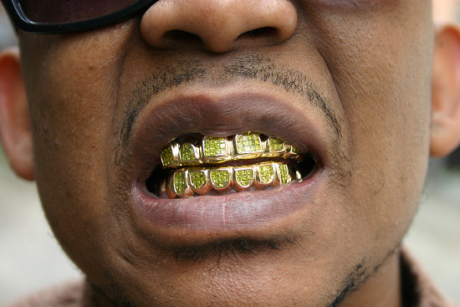
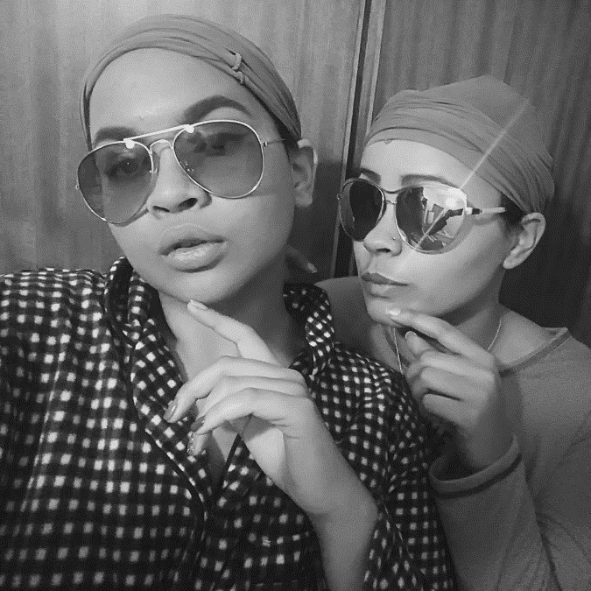
We are golden teeth Ons is soolkouse en kopdoeke We are also Black Label Beer Ons is weeklikse lone

Slide 6
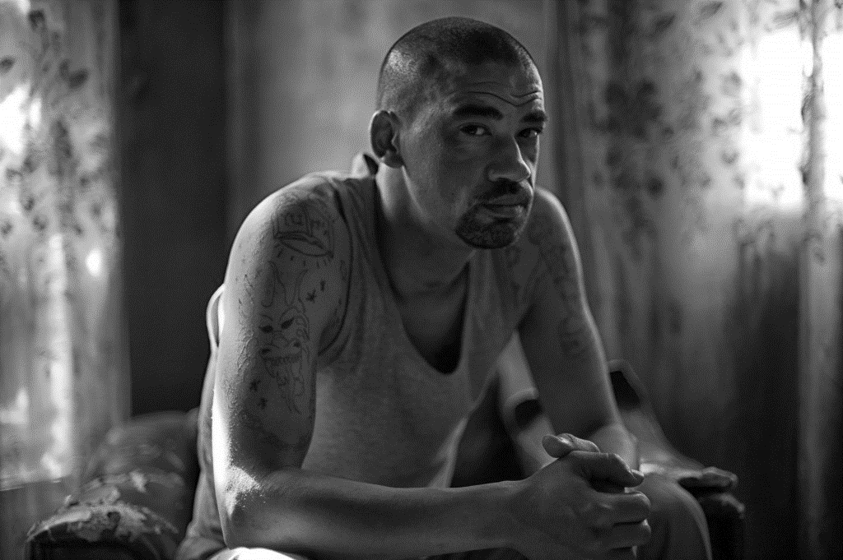
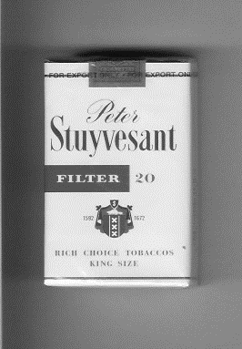
We are underpaid Ons is tronkvoele We are high school drop-outs Ons is Stuyvesant Rokers

Slide 7
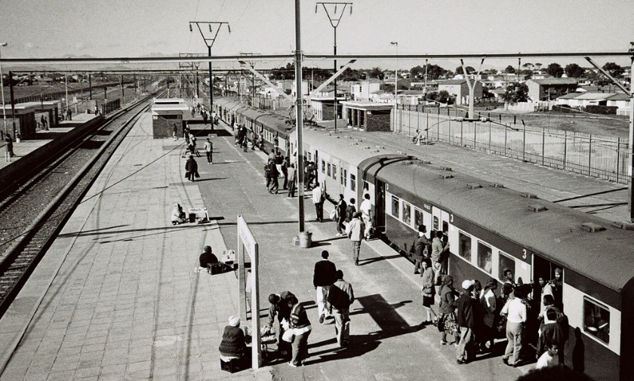
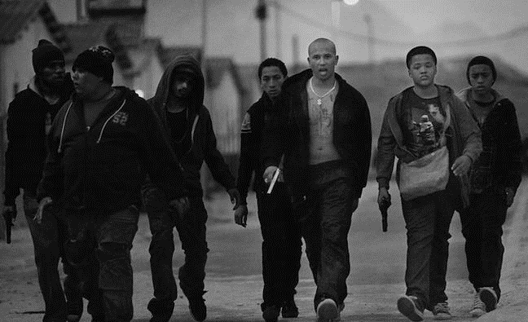
We are gangster music Ons is die Cape Flats We are Fishermen

Slide 8
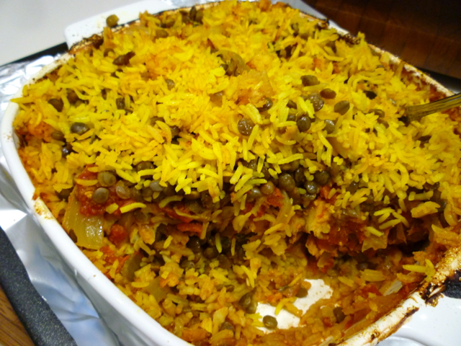
Ons is Breyani op Sondag middag We are also more than that We are a people

Slide 9
Jy subordinate my pa Jy underpay my ma Jy noem my ‘n coconut

Slide 10
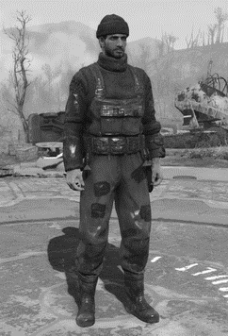
Ons is overalls We are a mixed race Ons praat Afrikaans

Slide 11
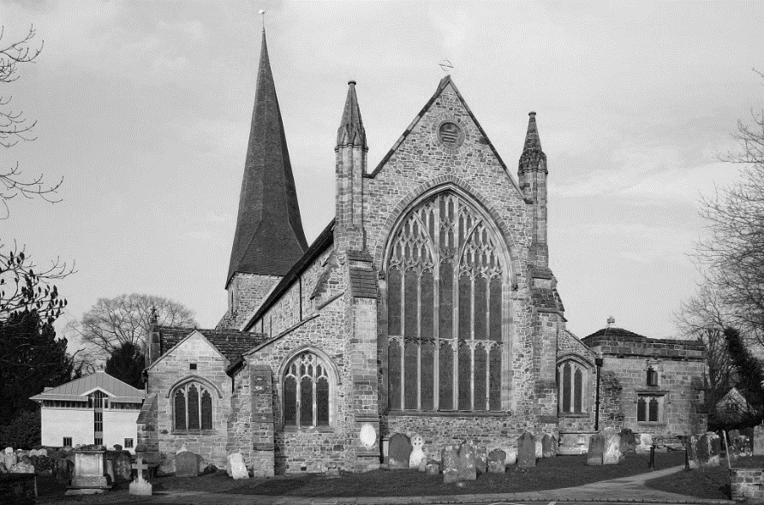
We Speak English Ons is party op Saterdae We go to church on Sundays

Slide 12
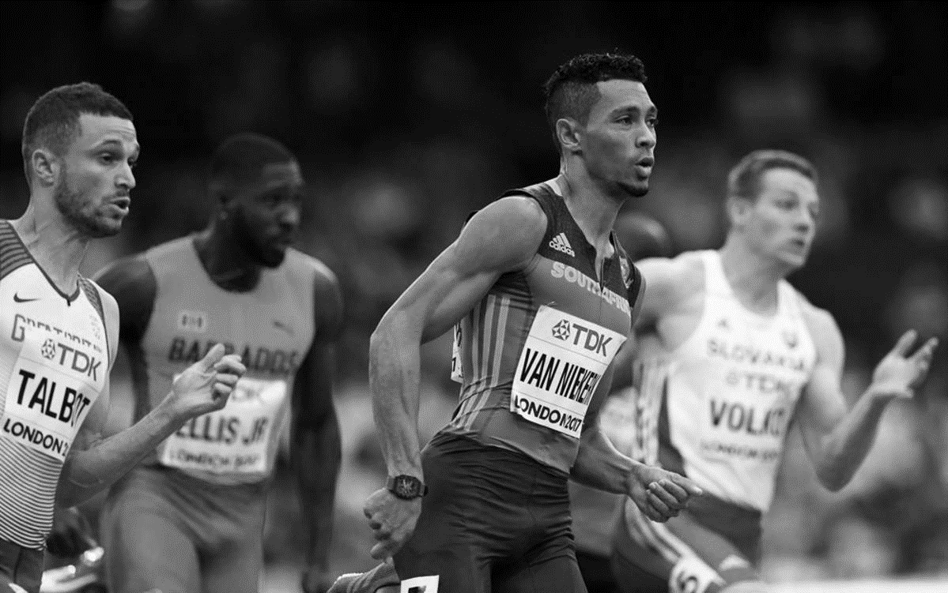
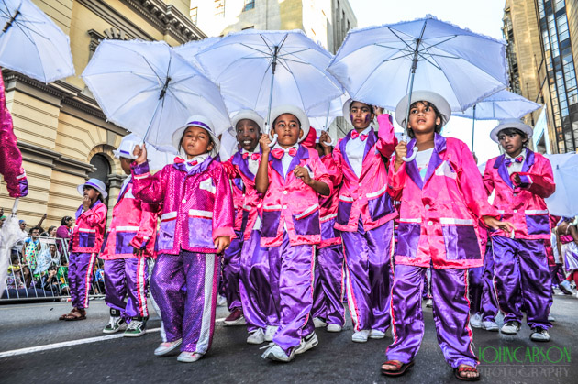
Ons is die Kaapse Klopse We are Grasshoppers at school Ons is hair faders We are athletes Ons is geleerd

Slide 13
We are not here for your amusement We are survivors We are a people

Slide 14
That is my story My Language MY IDENTITEIT

