Slide 1
Sub wardens' orientation 2022
Housekeeping department

Slide 2
Welcome
Housekeeping Team
Our role
Sub warden's role
Questions
Thank you

Slide 3
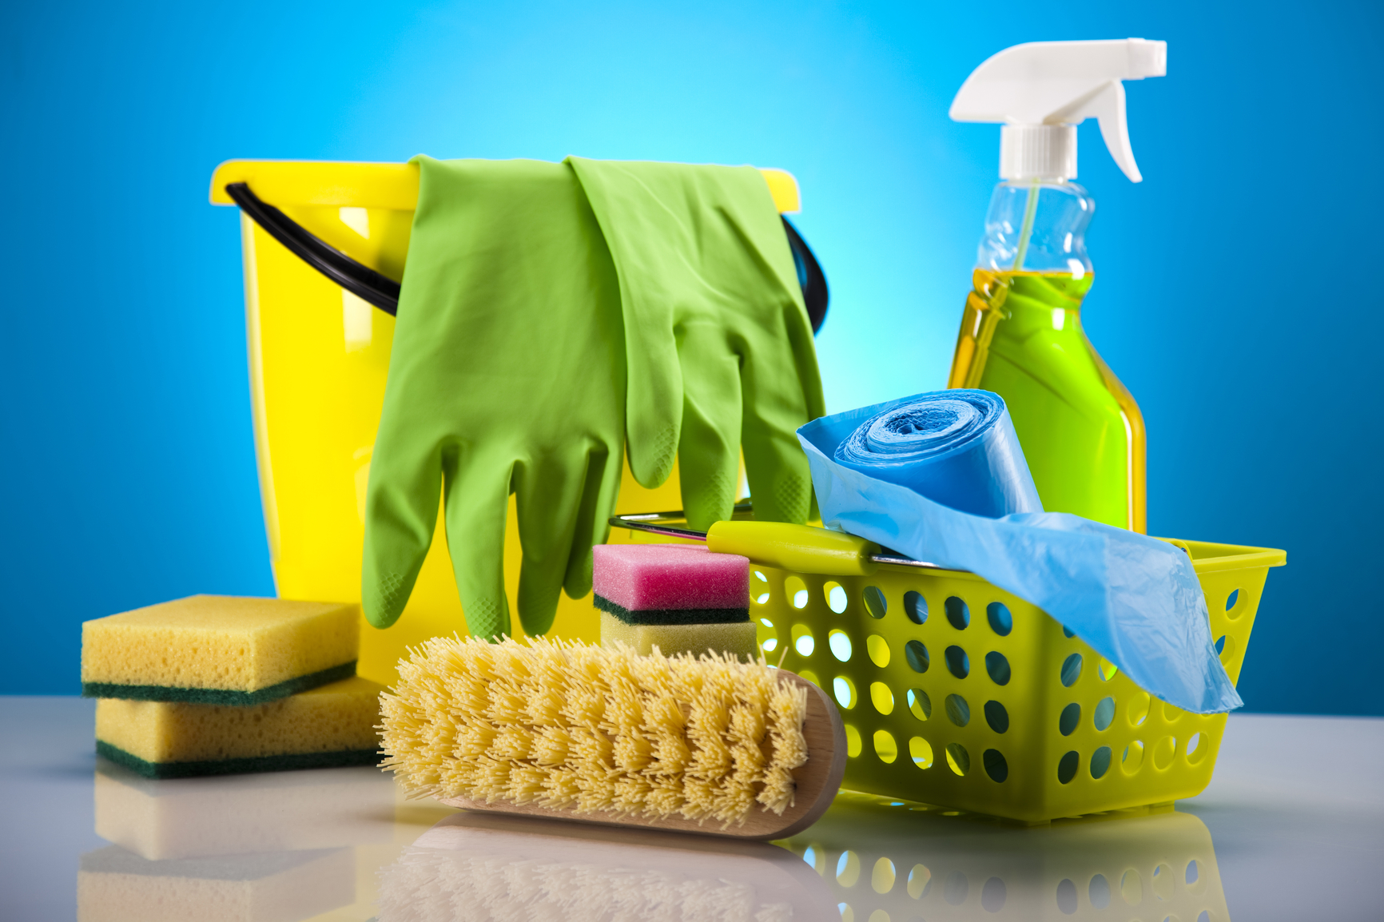
We thrive and support academic project by maintaining health and safety spaces for students.

Slide 4
Housekeeping Team
Our role is to provide cleaning services to the entire university, including residences and office spaces and we are also responsible for creating leaving and learning spaces for students.
We are responsible for overseeing 13 halls; each hall has 4 residences.
Our staff compliment we have 80 staff members that are responsible for looking after these residences

Slide 5
Sub warden’s role
Linen room statement
Bed bugs
Water outages
Cleanliness and linen change

Slide 6
Questions ?
Does everyone understand the processes followed for bedbugs ?

Slide 7
Thank you
Housekeeping management

