Slide 1
What’s in a Cigarette?

Slide 2
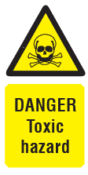
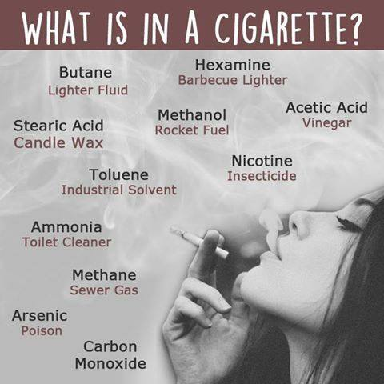
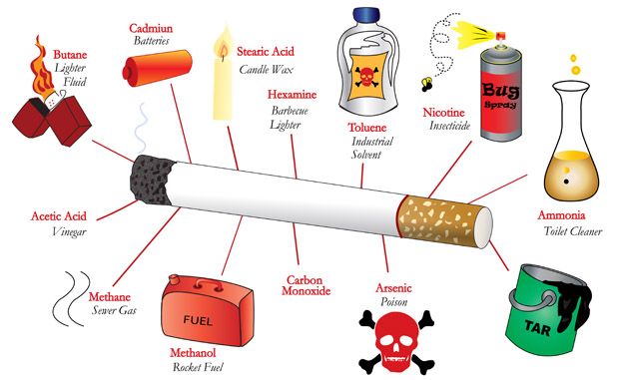
Scary Stuff!

Slide 3
Please note: RU Smoking Rules
Both the OHS Act and the Tobacco Products Control Act apply on campus.
Smoking is not permitted inside any University building or partially enclosed public space (e.g. covered patios, verandas, balconies, walkways and parking areas).
Smoking outside may not be closer than 10 metres from any window, entrance or air inlet.

Slide 4
When you are done, please...
Safely dispose of extinguished cigarettes into designated butt bins.

Slide 5
Better still...
Kick the habit!

