Slide 1
French Studies Orientation Lecture
2022

Slide 3
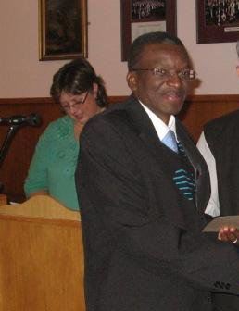
The Team
Prof. Arthur Mukenge
Head of French Studies

Slide 4
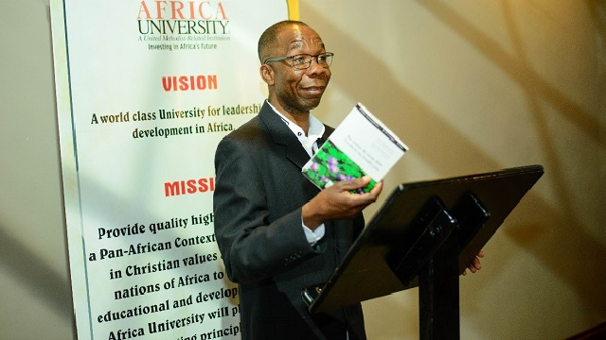
Prof. Patrice Mwepu

Slide 5
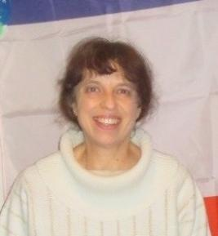
Dr. Claire Cordell
On Research Leave For 2022

Slide 6
Dr Dami Naancin Emmanuel
Postdoctoral Fellow

Slide 7
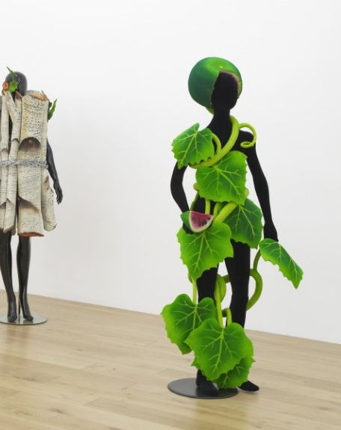
Why study French?
It is the second most useful language in the world of business.
It is the most romantic language in the world.
It is a language of culture with phenomenal cooking, theater, fashion, architecture, music, and movies to explore.
It goes well with other humanity courses.
The ability to speak both French and English is an advantage for finding a job in many multinational companies using French as their working language, in a wide range of sectors or companies (retailing, automotive, luxury goods, aeronautics, etc.).
Studying French increases your appreciation of other people and their cultures.
Learning French is really fun.

Slide 8
What can I do with French? I can be
a translator
an interpreter
a publisher/editor
a writer
a teacher / lecturer
a diplomat / an ambassador
I can work for an NGO or for a business enterprise in Europe, in
Africa, etc.
I can be a voice over artist and many more.
NB.: French is your passport to this world of globalisation.

Slide 9
French as a Major Subject
French is a potential 3 year major subject i.e once you pass French 1, you may proceed to French 2 and provided you pass that course you may then enrol for French 3.
Then you may consider doing French Honours, Masters, and Finally PHD.

Slide 10
The different levels of French
The Common European Framework of Reference (an international standard for describing language ability) is used to provide an idea of the language level you are likely to reach.
French 1:A1- A2 LEVEL (Basic communication)
French 2:B1 LEVEL (Intermediate communication)
French 3:B2-C1 LEVEL ( Advanced communication)

Slide 11
TO REGISTER YOU NEED:
*NO PRIOR OF FRENCH KNOWLEDGE EGA-LEVEL,O-LEVELS, Matric
French or any qualification
For more information, please email the French / Head of Subject, Prof. Mukenge: a.mukenge@ru.ac.za
And the COURSE CODE: 12011A0

Slide 12
When and where are the lectures for French 1?
FRENCH 1 TIMETABLE-LECTURES
**************************
Mondays 11h25, Wednesdays 8h40, Thursdays 09h30, Fridays 10h30 in SOLL Major
Tutorials
Tuesdays(Time and venues will be confirmed)
We look forward to welcoming you and helping you to discover the wonderful world of the French language and francophone cultures.

Slide 13
What will I be doing French I?
Learning to speak, read, write and understand French on multiple occasions.
Discovering exciting things about France and francophone cultures.
There will be daily tasks to help you work through the material posted on reconnected.
A test at least once a term.
Exams (oral and written) at the end of each semester.

