Slide 1
Original Pharm Chem Lab - 1963

Slide 2
Original Pharmacy Dispensing Lab - 1965

Slide 3
Old Wool Research building

Slide 4
Current home in Artillery Rd

Slide 5
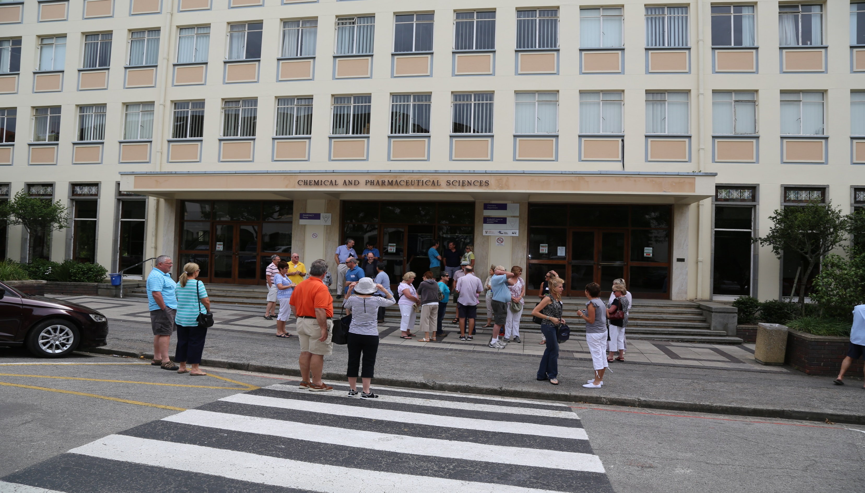
Current Faculty of Pharmacy Location – Artillery Rd

Slide 6
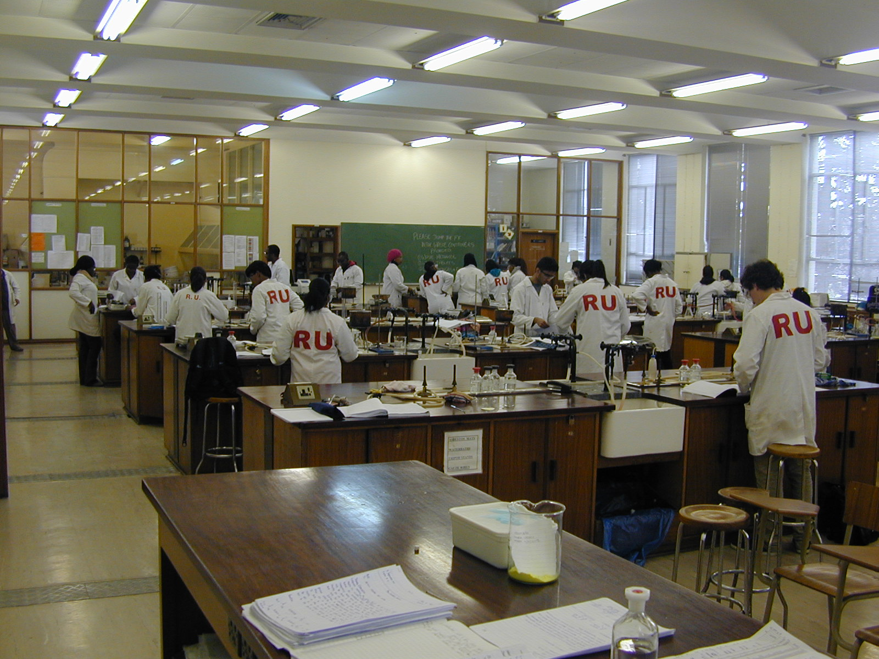
Undergraduate practical lab and class

Slide 7
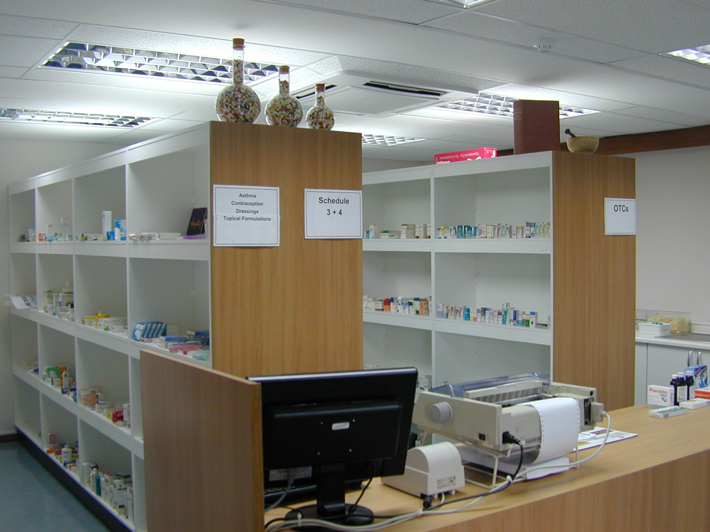
In-house teaching Dispensary

Slide 8
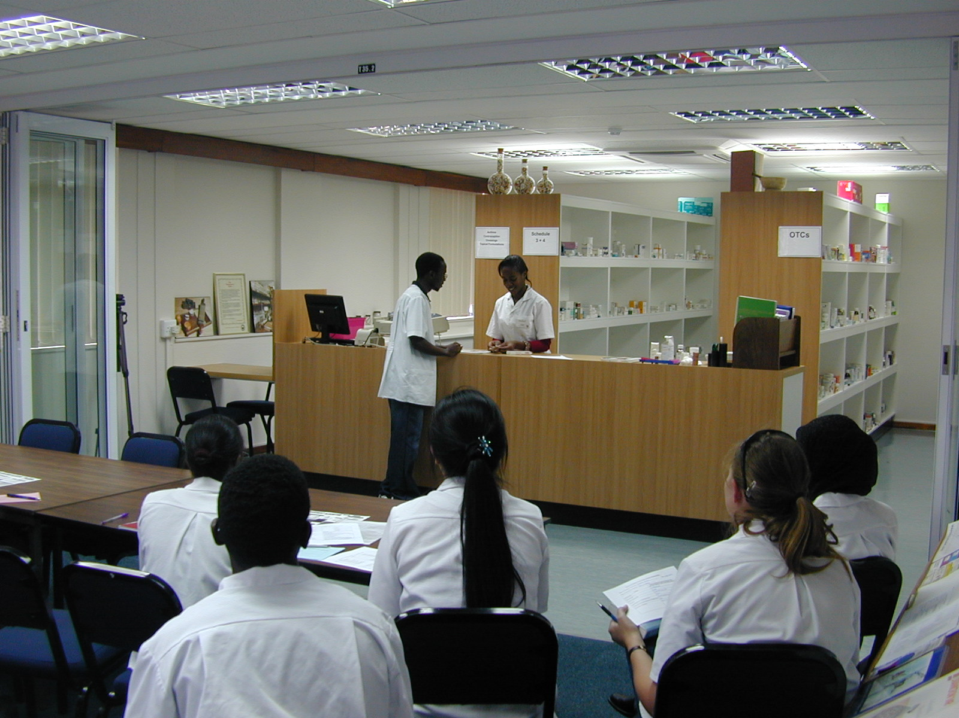
Dispensary

Slide 9
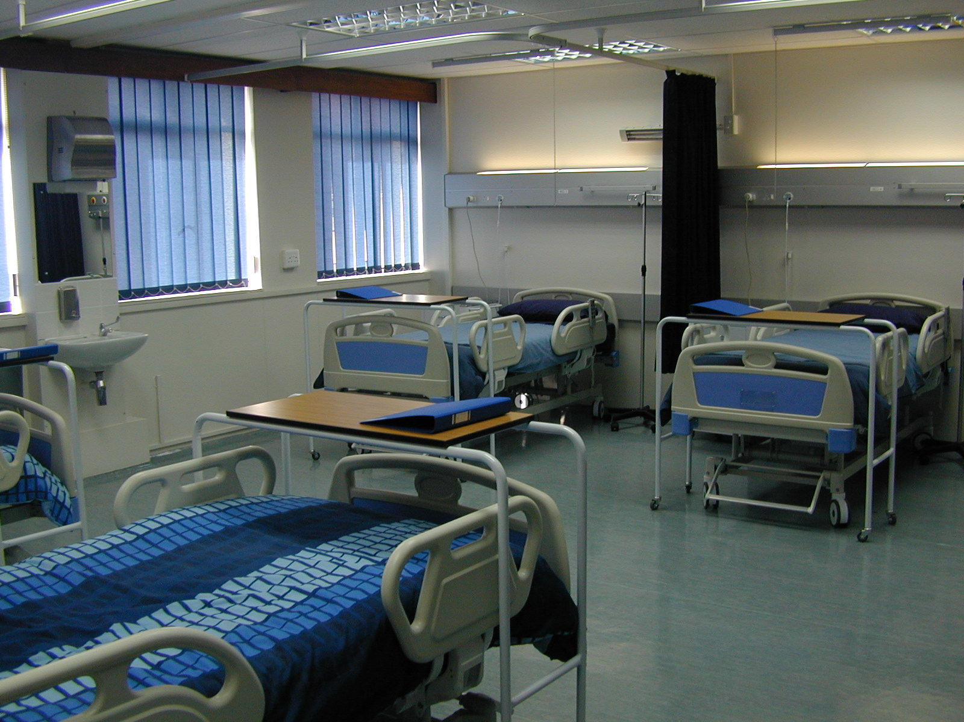
Clinical Teaching Facility

Slide 10
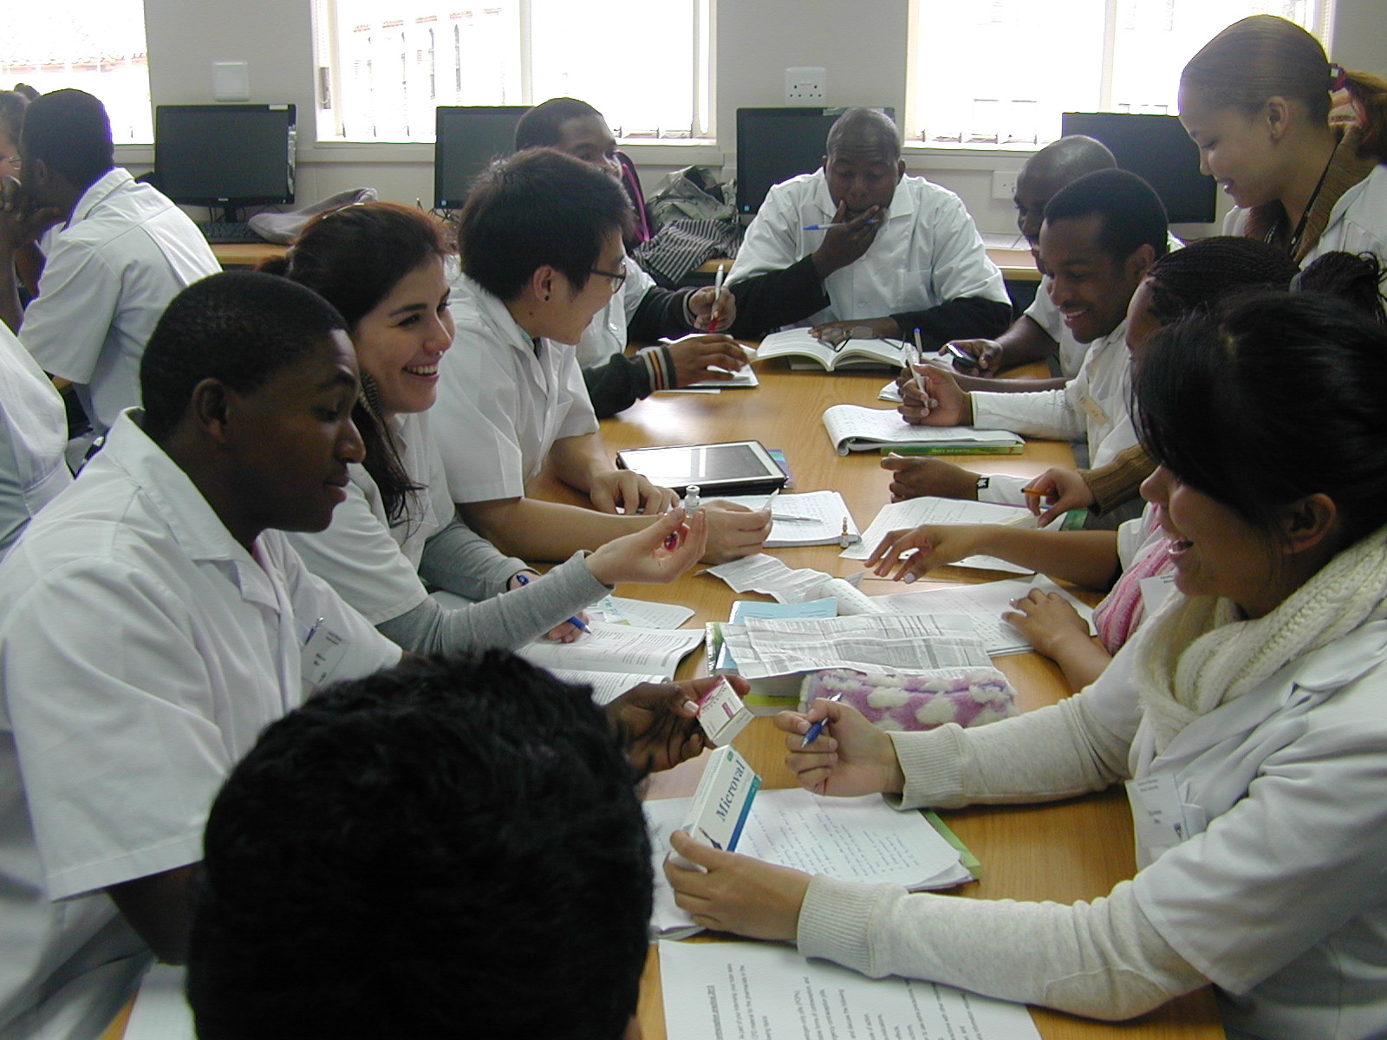
Pharmacy Practice

Slide 11
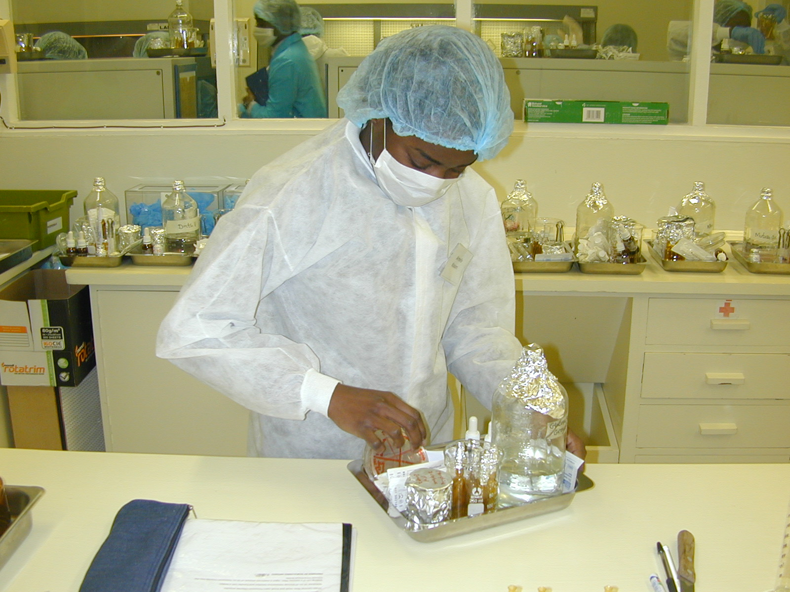
Sterile products

Slide 12
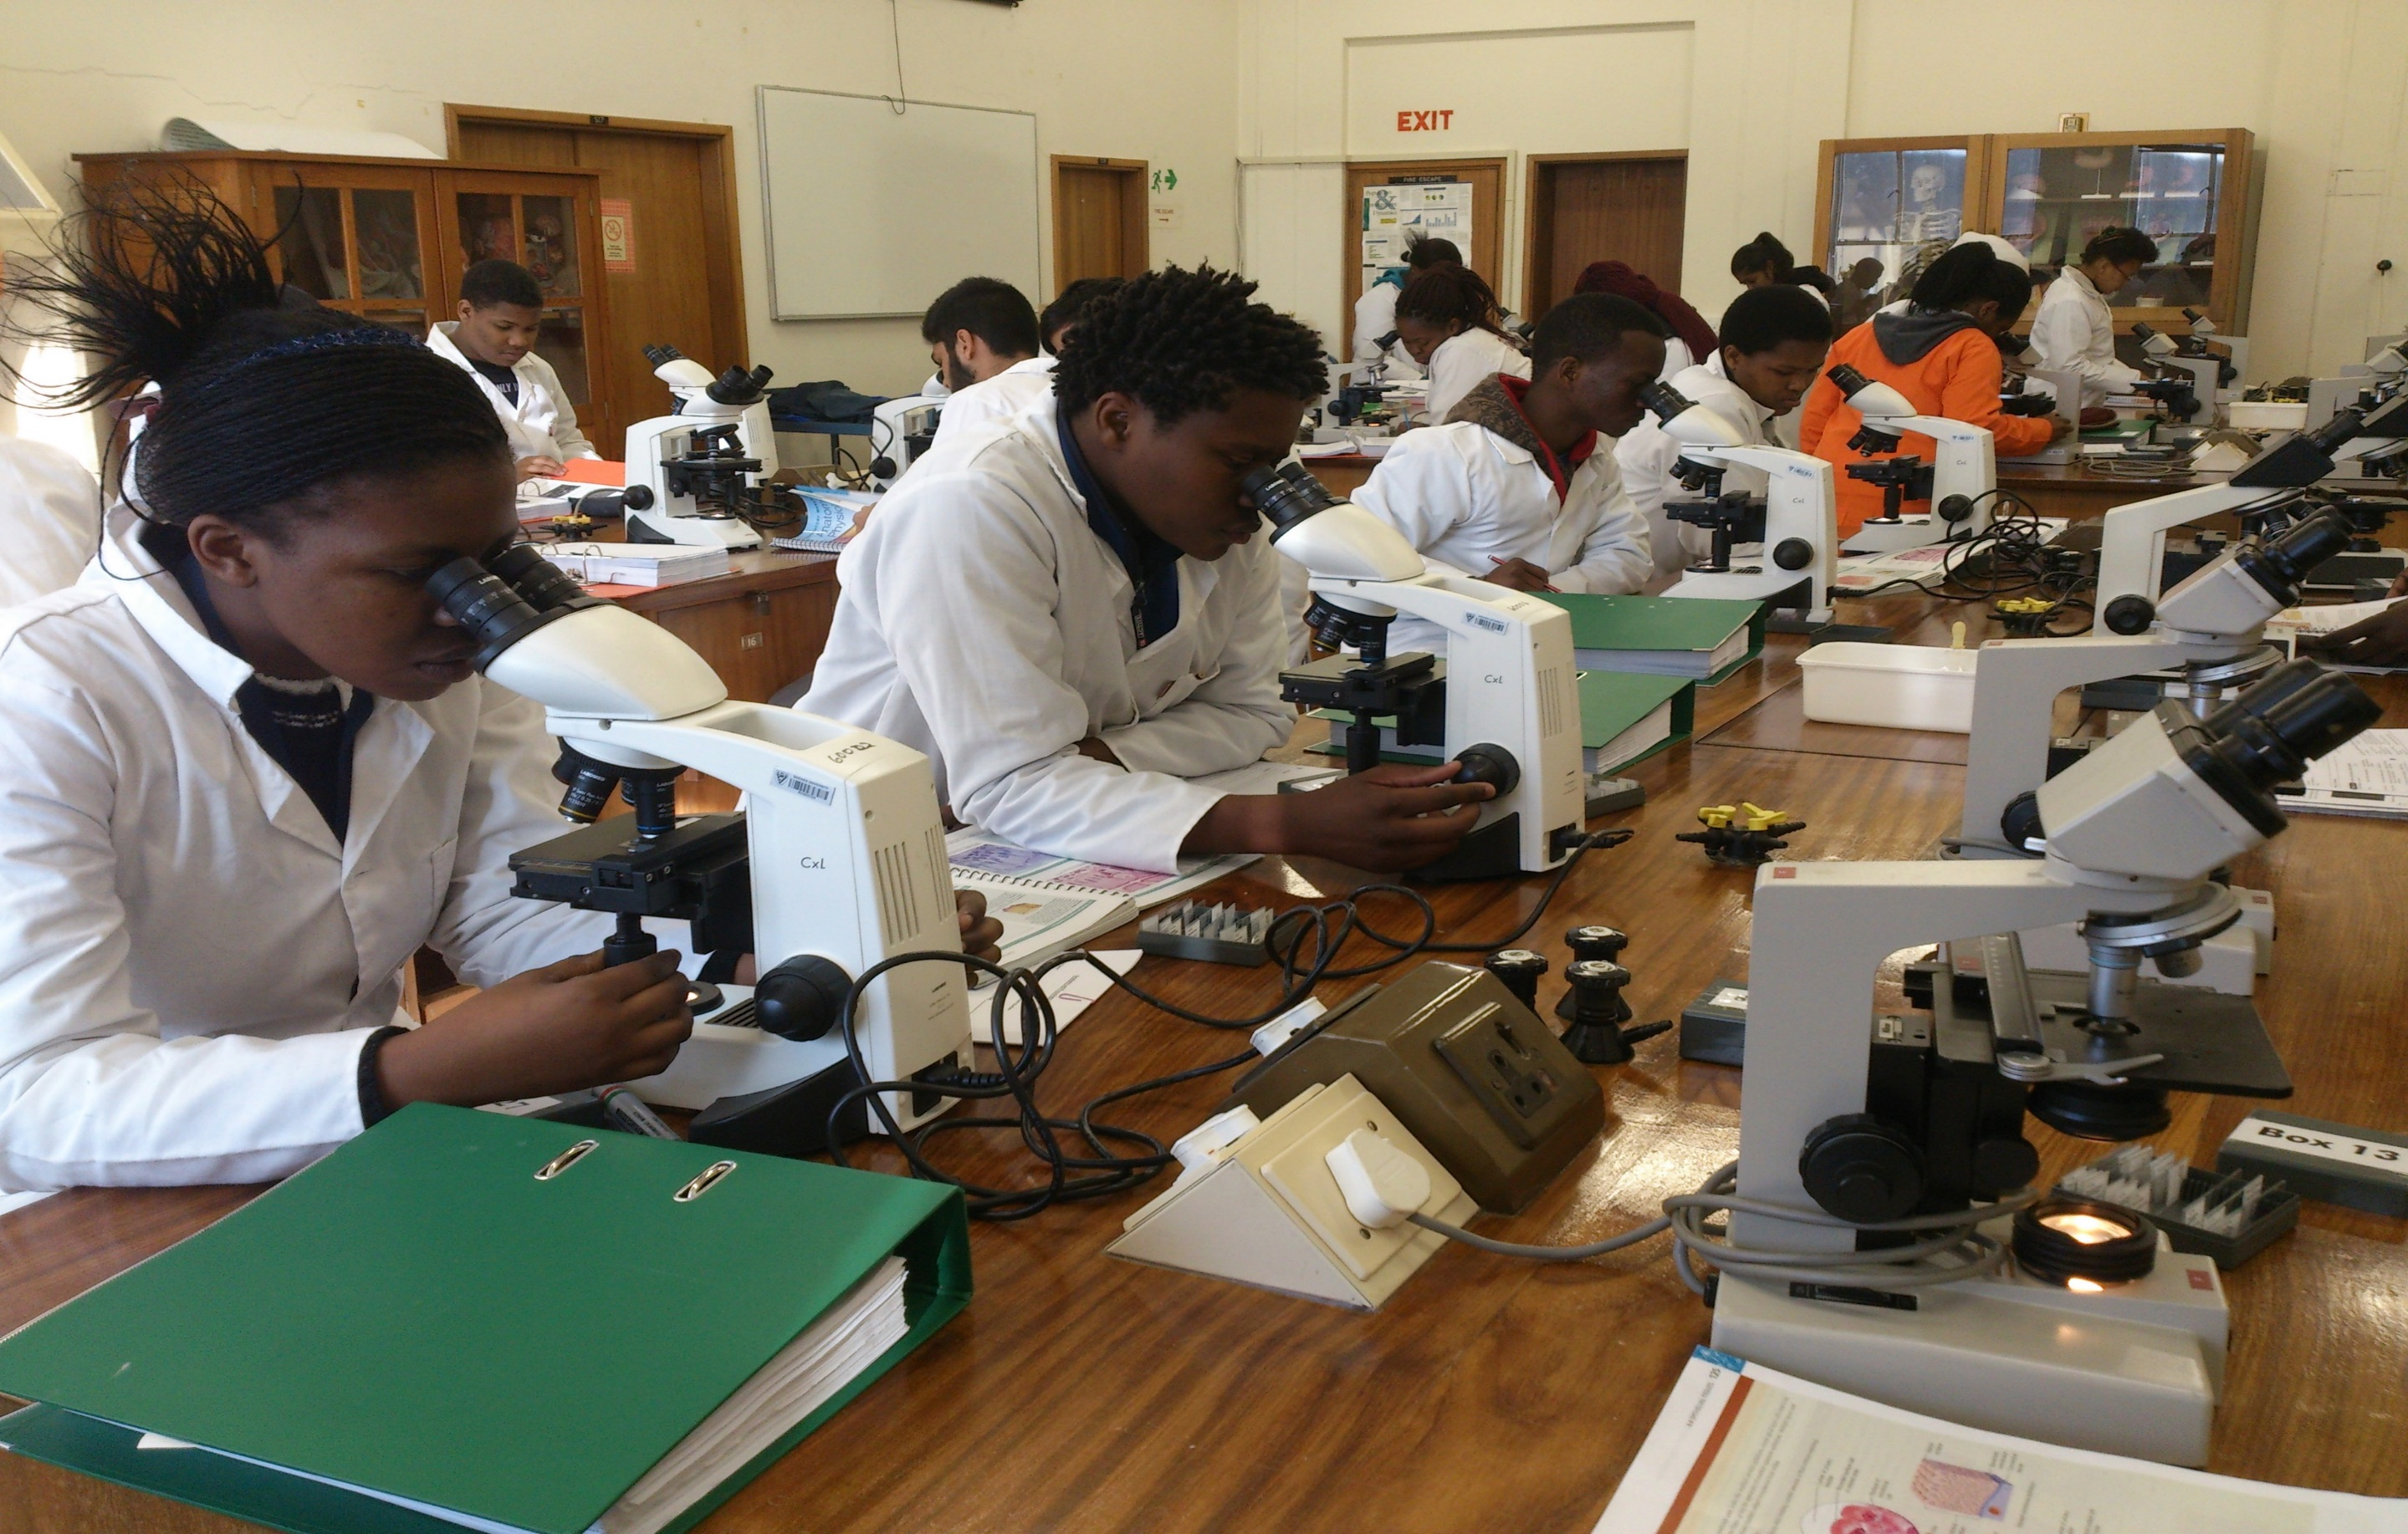
Anatomy prac

Slide 13
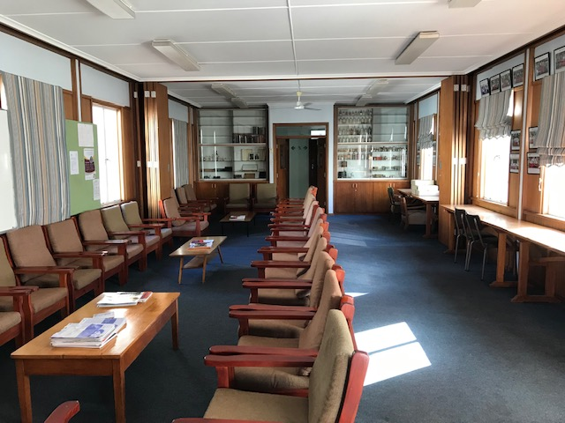
Staff T Room

Slide 14
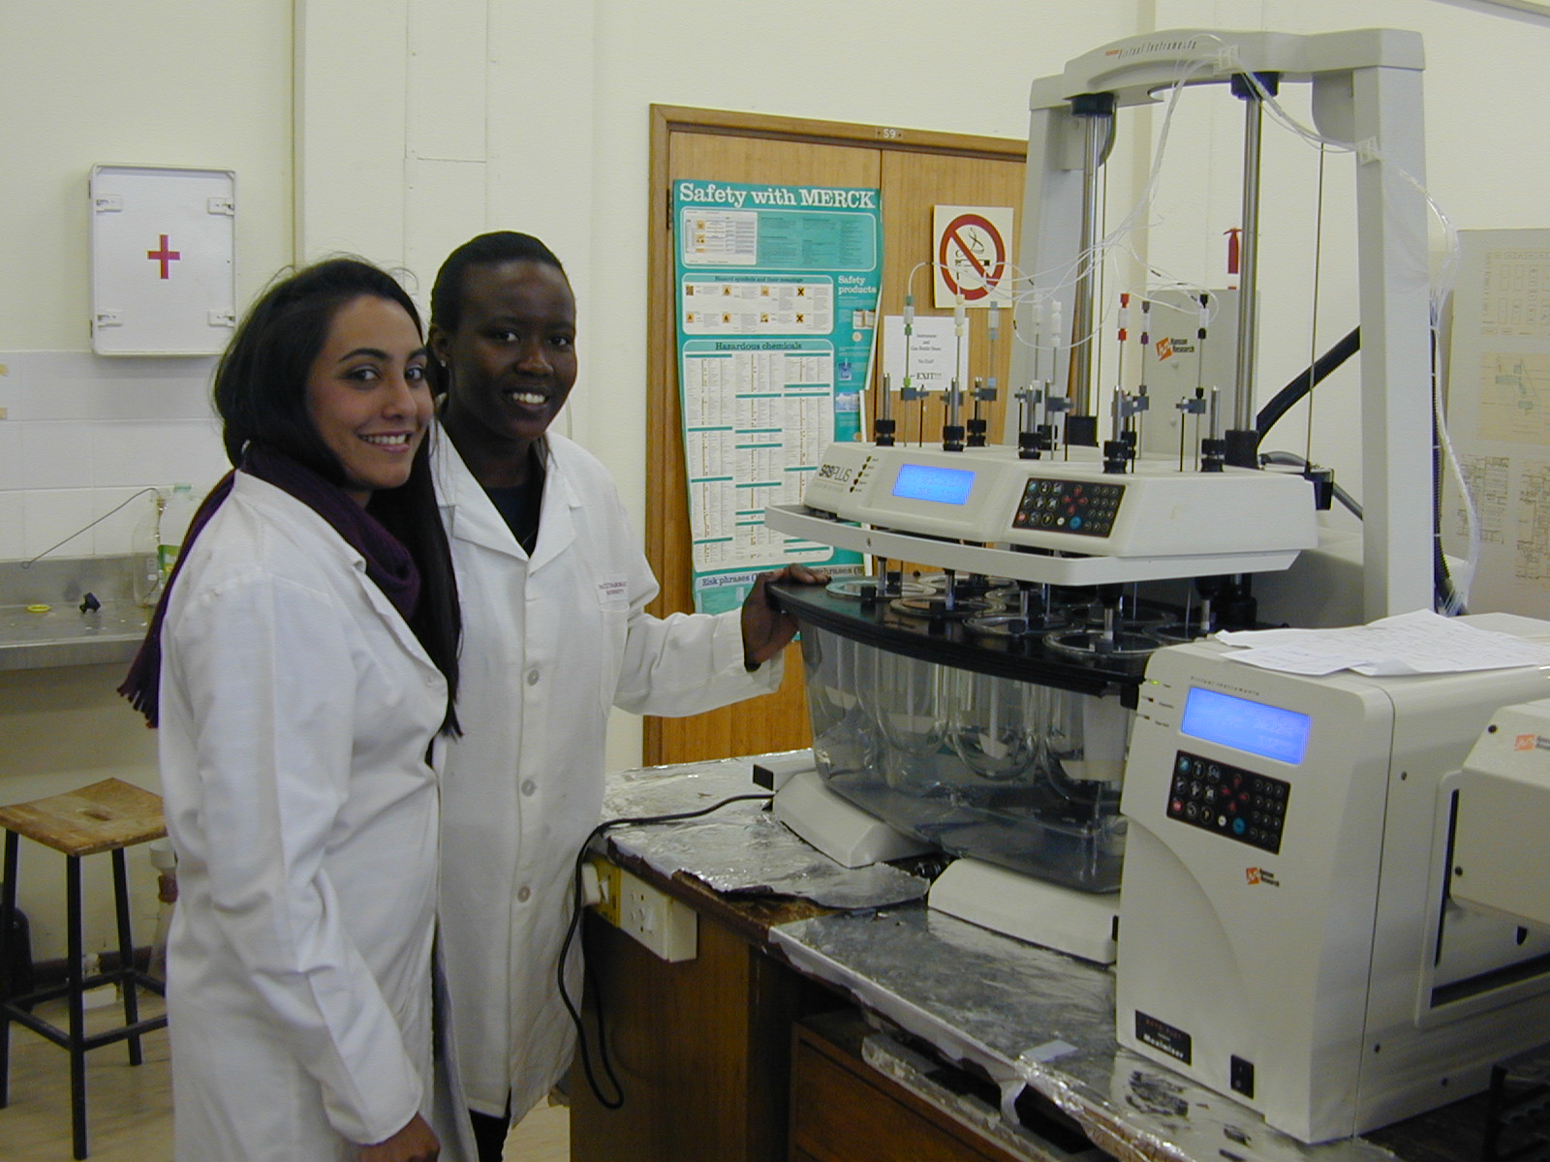
Pharmaceutics Post-Grads

Slide 15
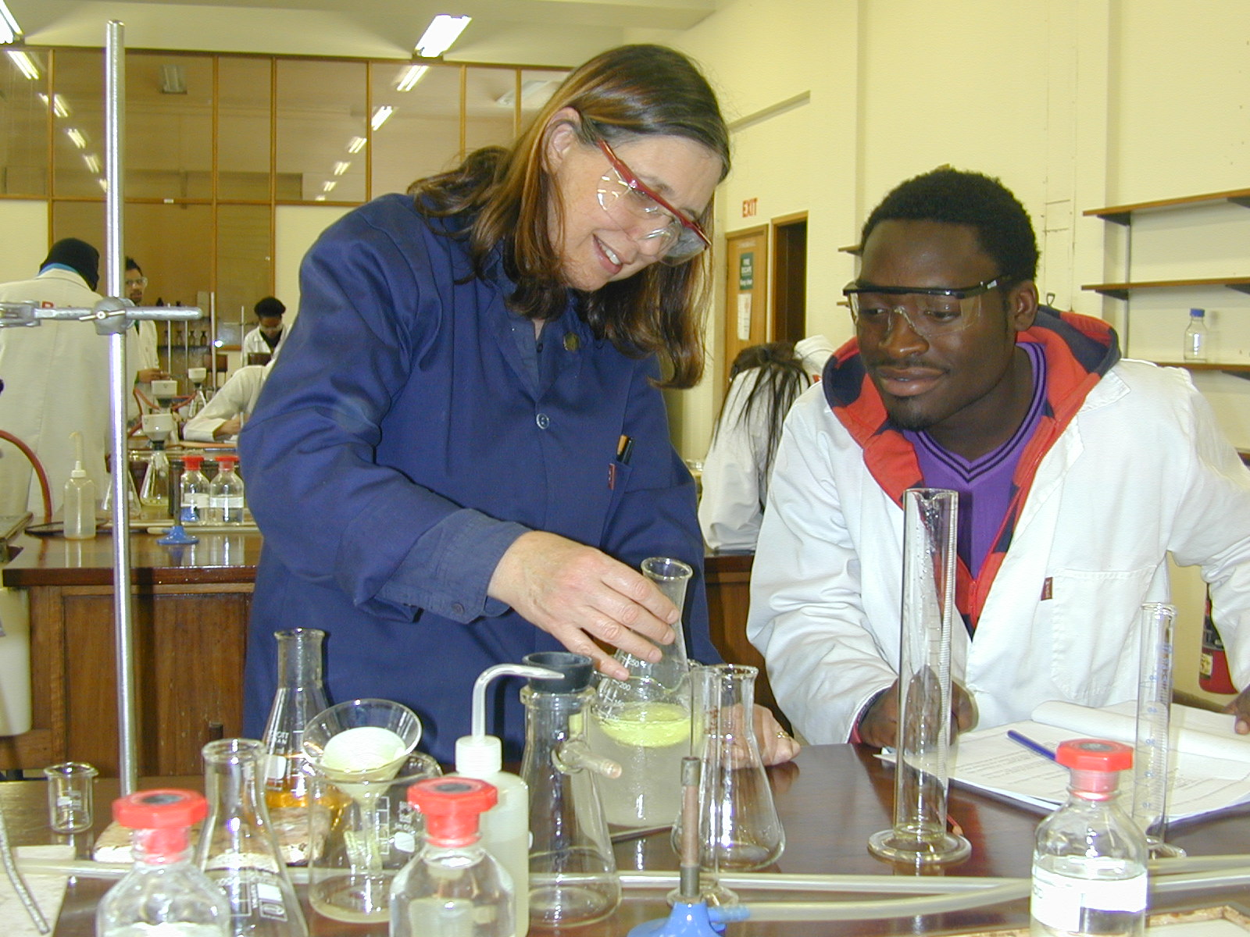
Pharm Chem Post-Grad

Slide 16
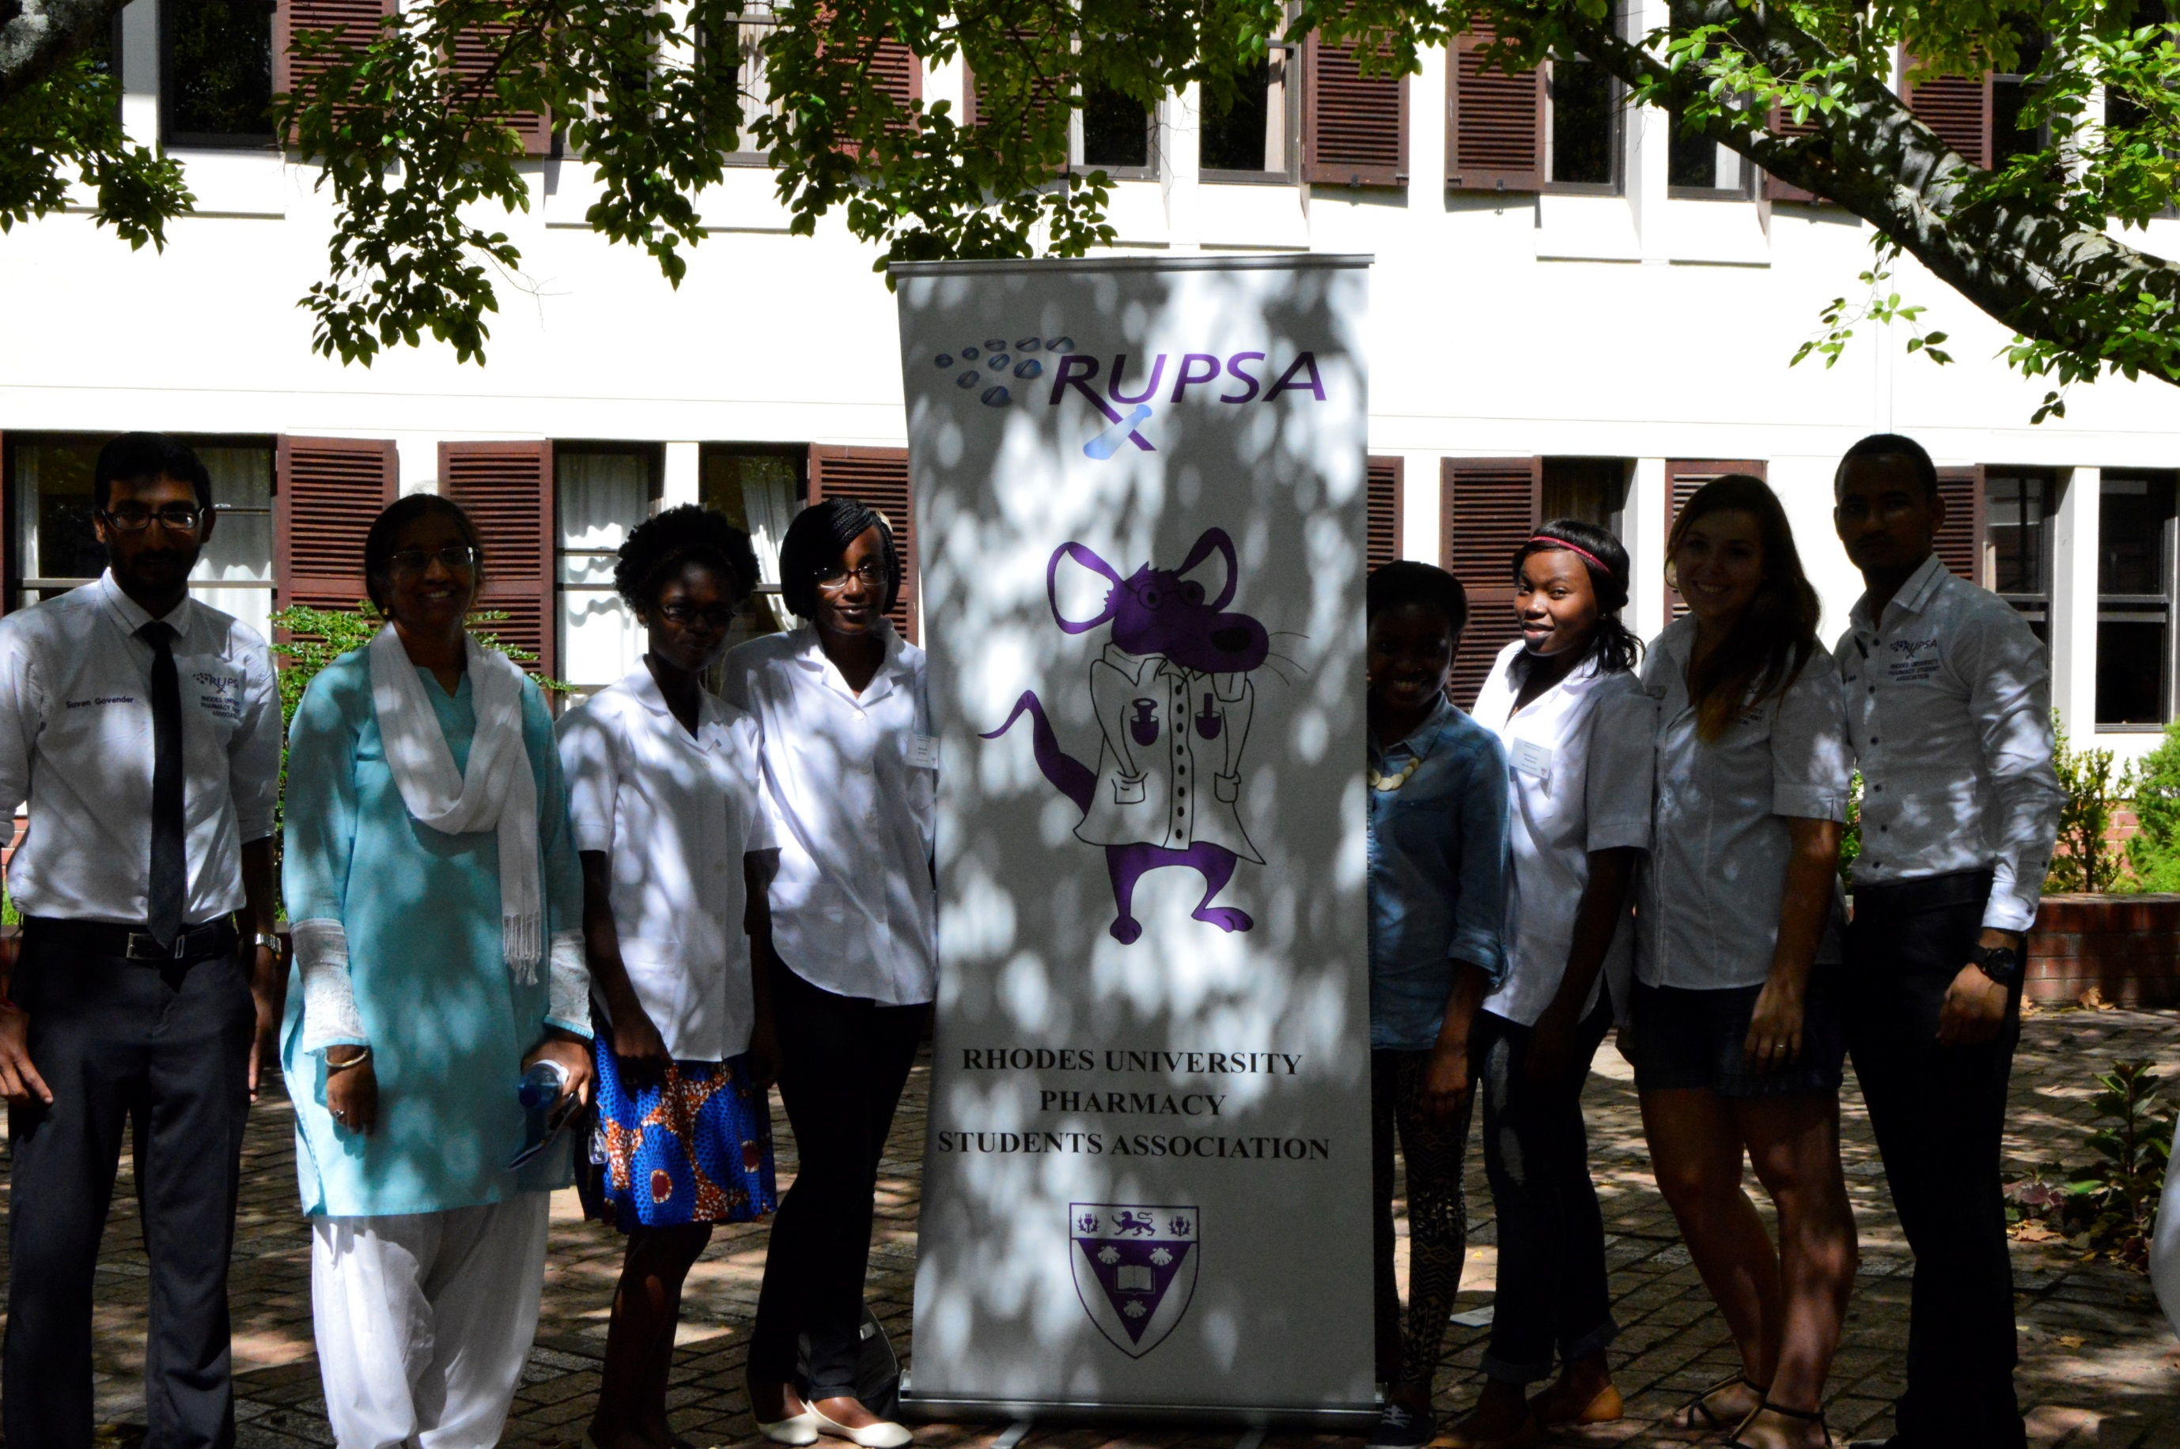
RUPSA

Slide 17
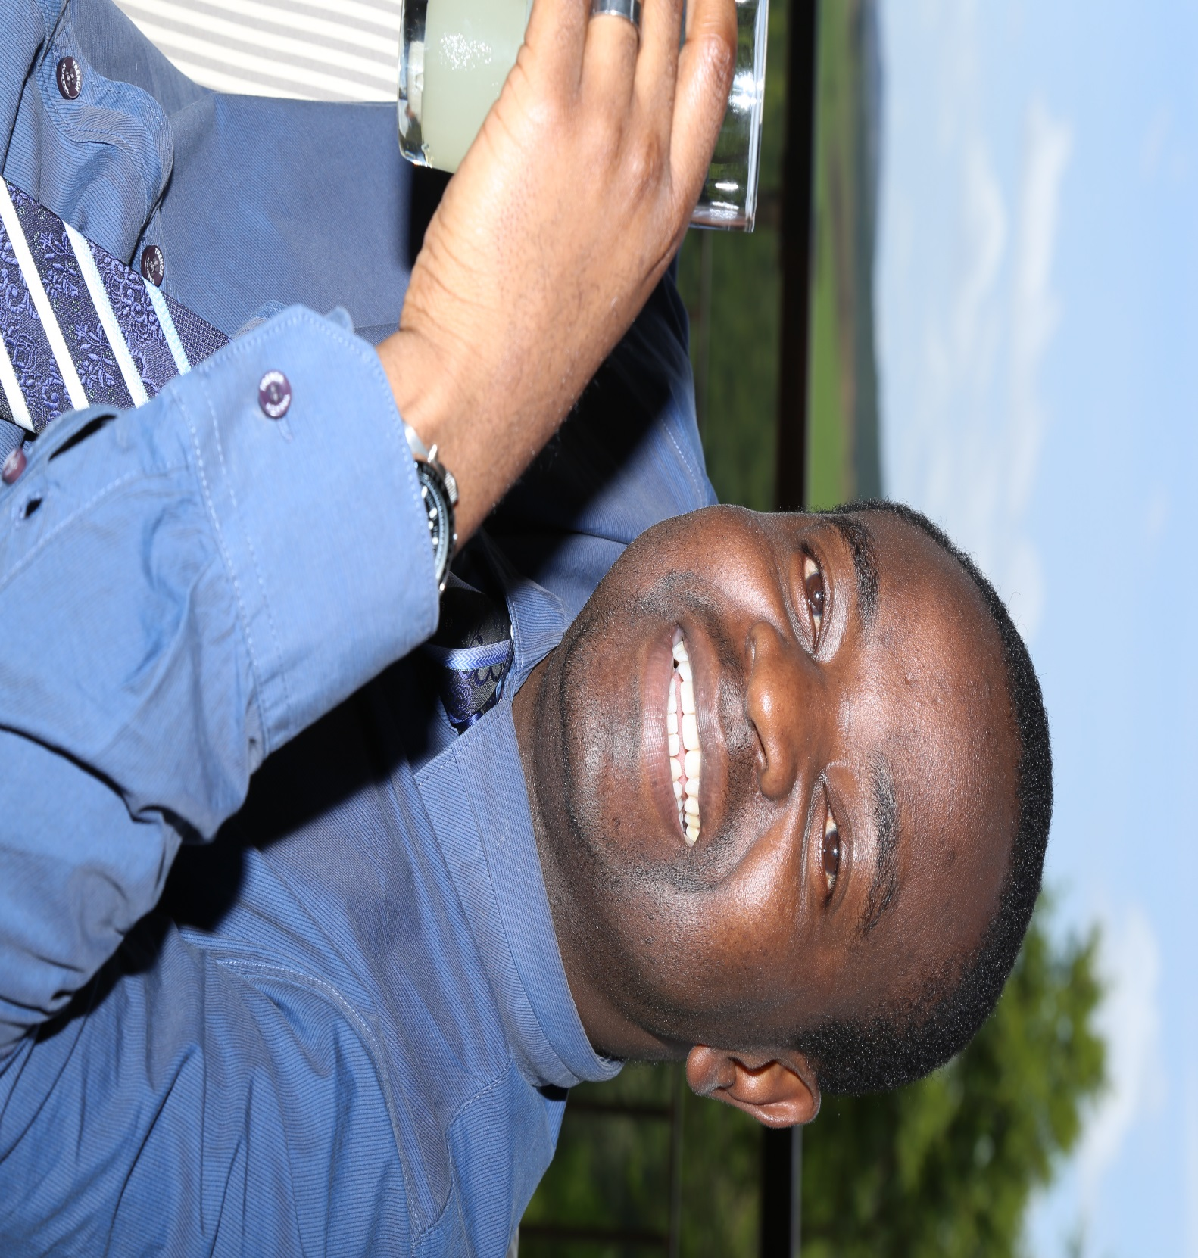
Current Dean – Professor Sandile Khamanga

Slide 18
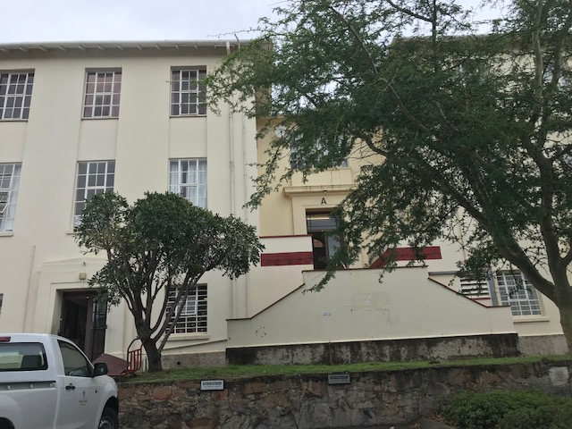
Old Pharmacy Building 1969 – A Block

Slide 19
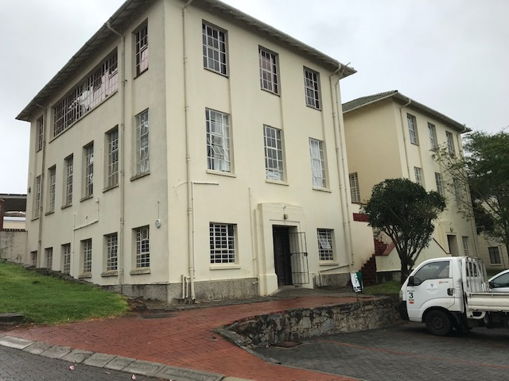
A Block Old Pharm 1969

Slide 20
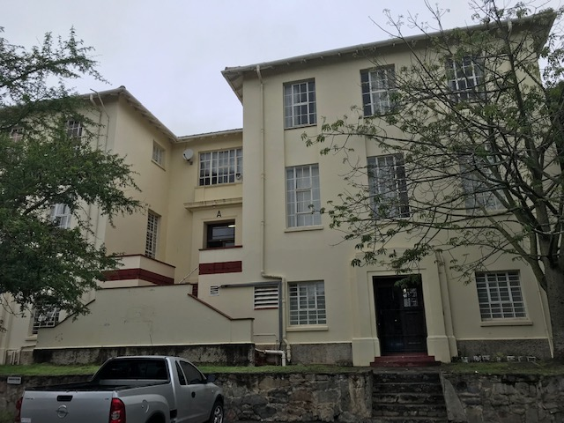
Another view of Block A

Slide 21
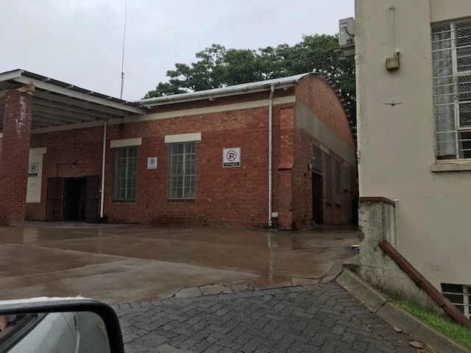
Lecture Theatre Block B and adjacent Pharmacog Lab

Slide 22
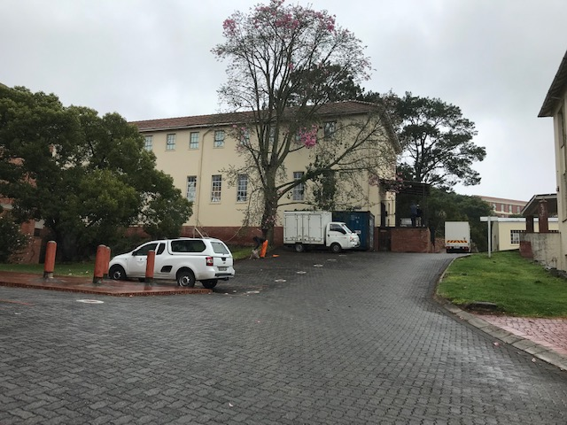
Physiology Lab – Block C

Slide 23
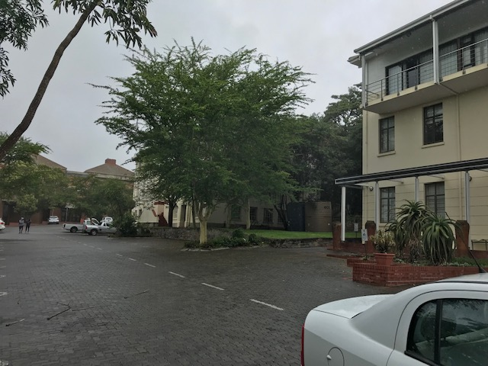
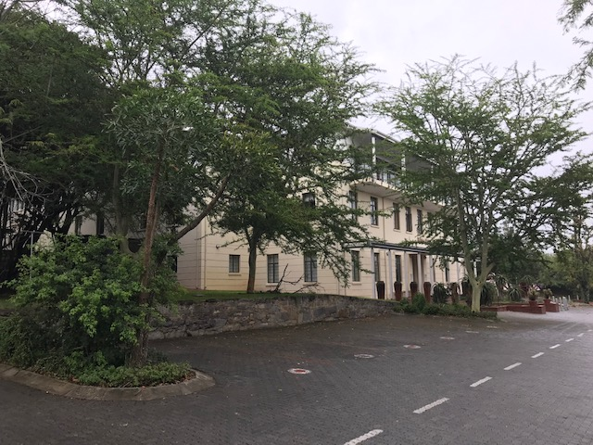
Previous Leather Industries Research Institute (LIRI)

Slide 24
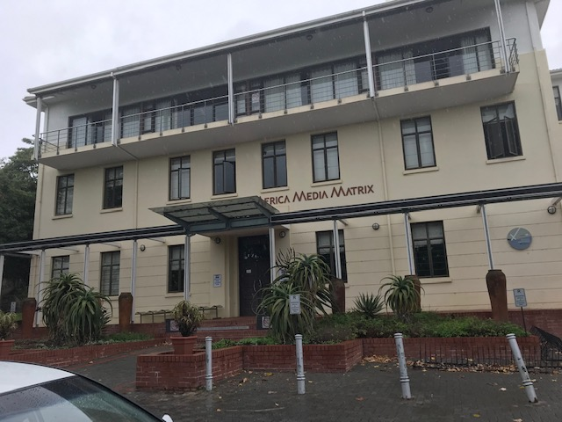
Old LIRI now Africa Media Matrix – Dept of Journalism

Slide 25
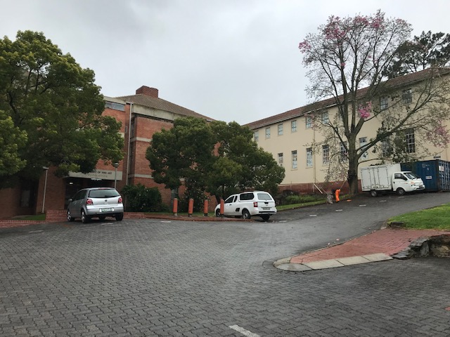
Addition to old Pharm Building in 1972 – now Dept of Fine Art

Slide 26
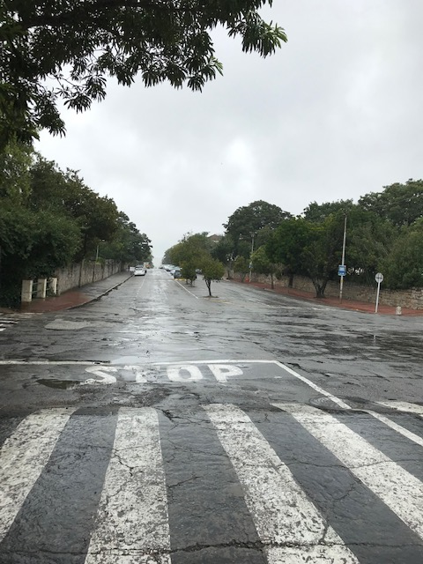
View down P A Street from Old Pharmacy Building

Slide 27
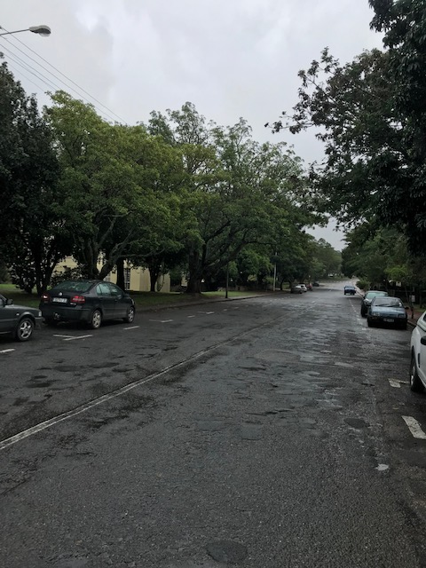
Looking up PA Street toward Old Pharm Building

Slide 28
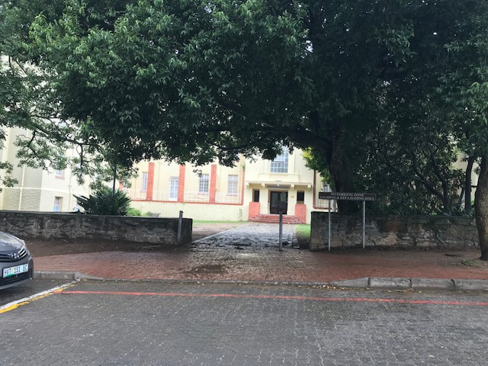
Jan Smuts HS – now Robert Sobukwe HSE

Slide 29
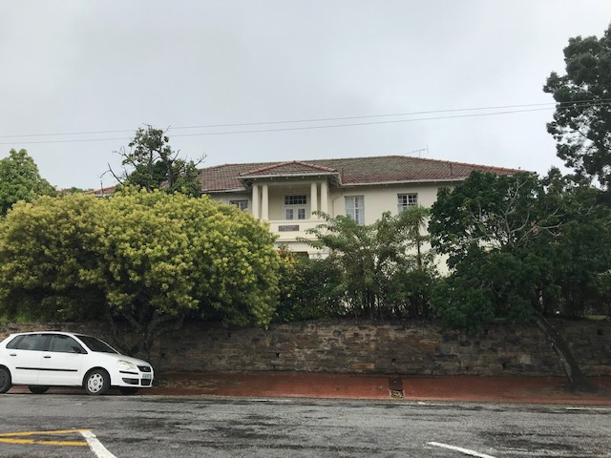
Matthews House

Slide 30
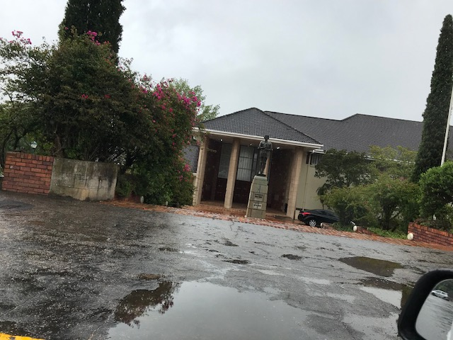
Great Hall

Slide 31
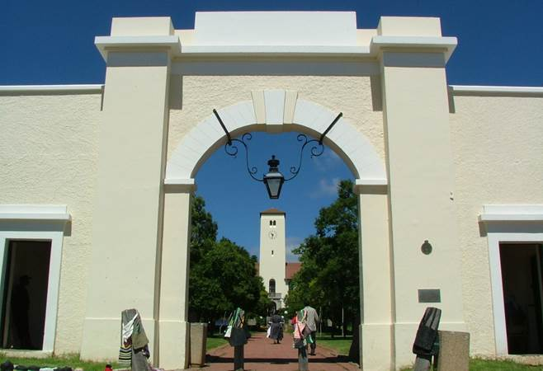
THE DROSTDY ARCH

