Slide 1
CPGS: Planning your studies
Sioux McKenna
CPGS@ru.ac.za

Slide 2
What is the key requirement for your qualification?

Slide 3
HEQSF (DHET 2013)

Slide 4
HEQSF (DHET 2013)

Slide 5
HEQSF (DHET 2013)
The doctorate provides training for an academic career. It requires a candidate to undertake research at the most advanced academic levels culminating in the submission, assessment and acceptance of a thesis. However, candidates may also present peer-reviewed academic articles and papers, and, in certain fields, creative work such as artefacts, compositions, public performances and public exhibitions in partial fulfilment of the research requirements. Coursework may be required as preparation or value addition to the research, but does not contribute to the credit value of the qualification. The defining characteristic of this qualification is that the candidate is required to demonstrate high level research capability and to make a significant and original academic contribution at the frontiers of a discipline or field. The work must be of a quality to satisfy peer review and merit publication. The degree may be earned through pure discipline-based or multidisciplinary research or applied research. This degree requires a minimum of two years’ full-time study, usually after completing a Master’s Degree. A graduate should be able to supervise and evaluate the research of others in the area of specialisation concerned.

Slide 6
 | Honours | Masters | Doctorate
NQF level | NQF 8 | NQF 9 | NQF 10
Credits | 120 | 180 | 360
Notional Hours | 1200 | 1800 | 3600

Slide 7
1200 hours | 1800 hours | 3600 hours
1 year – 40 weeks | 1 year – 48 weeks 2 years – 96 weeks | 2 year – 96 weeks 3 years – 144 weeks 4 years – 192 weeks
30 hours per week | 37,5 hours per week 18,74 hours per week | 38 hours per week 25 hours per week 19 hours per week

Slide 8
Where will you find these hours?
How many hours are you currently putting into your studies?
Classes
Library
Reading
Laboratory
Field
What are your biggest distractors and work avoidance behaviours?
What will you give up to make space? Where will you find the time?
Don’t make your studies a punishment.

Slide 9
Working back from your submission
Submission Date (eg: November 2018, November 2019, November 2020)
Write up month working back from there
Submission date: November 2018
October 2018
September 2018
And so on to
February

Slide 10
Types of Activities
Concrete activities: developing materials, piloting interviews, doing focus groups, collecting samples, running experiments
Process activities: reading the literature, writing notes of readings, developing draft literature review, meetings with supervisor, completing modules
Concrete deliverables: draft chapter submissions, end of year report, thesis completion

Slide 11
Allow for slippage
To re-schedule when things go wrong.
Be as detailed in your planning as possible,
It’s never too early to start writing

Slide 12
Column for ‘other’
Sister’s wedding, field work timing constraints, etc.
All data generation time constraints

Slide 13
Tell others…
Share your plan with others in the room, share your plan with your supervisor
Publically commit to how, when and where you’ll be doing the work

Slide 14
Have to include NOW, THIS WEEK!
What are you doing this week?
What do you spend all the hours on?

Slide 15
Managing your supervisor
Sioux McKenna

Slide 16
Task 1: 5 characteristics of a good supervisor
How well does your own supervisor do on these characteristics? (What aspects will you need to manage most carefully?)
Discuss with your group what the key characteristics of a good supervisor are..

Slide 17
5 characteristics of a good supervisor
Is it possible or likely that any supervisor would encompass all of these traits all of the time?
The literature suggests the following:
Active scholar - understands how the discipline works
Developmental – mentors your research development, gives regular constructive feedback
Networked and connected – inducts you into the community, finds funding and collaboration opportunities
Kind, caring, compassionate – cares about your wellbeing and believes in your ability
Accessible – is available (physically and emotionally)

Slide 18
Task 2: 5 characteristics of a good PG scholar
How many of these characteristics do you embody? How well do you score?
Discuss with your group what the key characteristics of a good postgraduate student are.

Slide 19
How to manage your PhD supervisor
Kevin O'Gorman and Robert MacIntosh
https://www.timeshighereducation.com/blog/how-manage-your-phd-supervisor
Take notes
Schedule meetings
Establish expectations
Think like a detective
Get feedback
Don’t go off grid
Be honest

Slide 20
Figuring out your own strengths and weaknesses
Complete the questionnaire, rating yourself from 1 (not at all) to 5 (very much)

Slide 21
Assertiveness | Where 1 is ‘I’m really scared of my supervisor and hide when I see her coming’ and 5 is ‘I negotiate all my expectations with my supervisor and inform her of my needs’
Self-management | Where 1 is ‘I’m a bit disorganised and inclined to double-book appointments and lose things’ and 5 is ‘I am super-organised and put in place systems for project management
Assistance-seeking | Where 1 is ‘I don’t like to ask for help because I feel embarrassed’ / ‘I don’t ever need any help’ and 5 is ‘I look for opportunities to try out ideas and get input from others, I ask when I get stuck’
Hard-working | Where 1 is ‘I’m a bit on the lazy side, I mean to work on my study but then …’ and 5 is ‘I am committed to my study and plan my life around it’
Resilient | Where 1 is ‘I get really down when there is a knockback of any kind and that can stop me working for days’ and 5 is ‘I expect things will be a bit bumpy at times and I take it in my stride’
Uses feedback | Where 1 is ‘I know what I’m doing and don’t really need feedback’ / ‘I get devastated by negative feedback and cannot go on for days’ and 5 is ‘Sometimes feedback can be hard to hear but I always engage and consider how it can improve my work’
Communication and collegiality | Where 1 is ‘I’m not really a people person’ and 5 is ‘I learn through discussion and sharing, when one of us does well, we all benefit and so supporting each other is part of the process’
Knowledge | Where 1 is “Yikes, I’m clueless’ and 5 is ‘I’m already published in the field’

Slide 22
Task 5: Freewriting
What aspects of my behaviour work against me in the supervision relationship?

Slide 23
Task 6: Freewriting
What aspects of my supervisor’s approach requires the most management by me?

Slide 24
Higher Degrees Guide & Supervision Policy
You need to read these – lots of very useful information for you

Slide 25
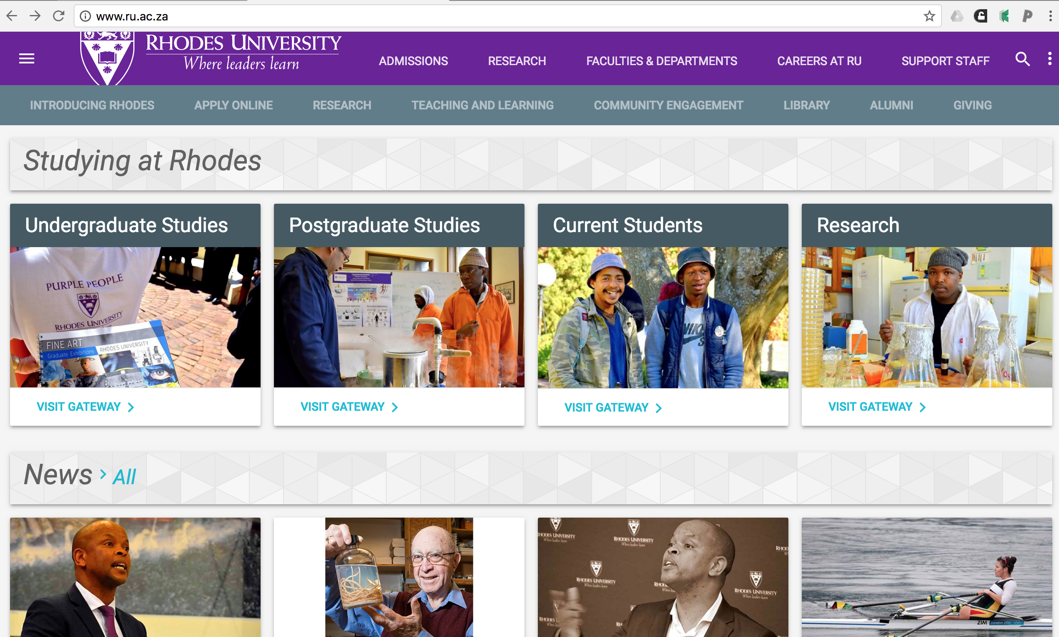

Slide 27
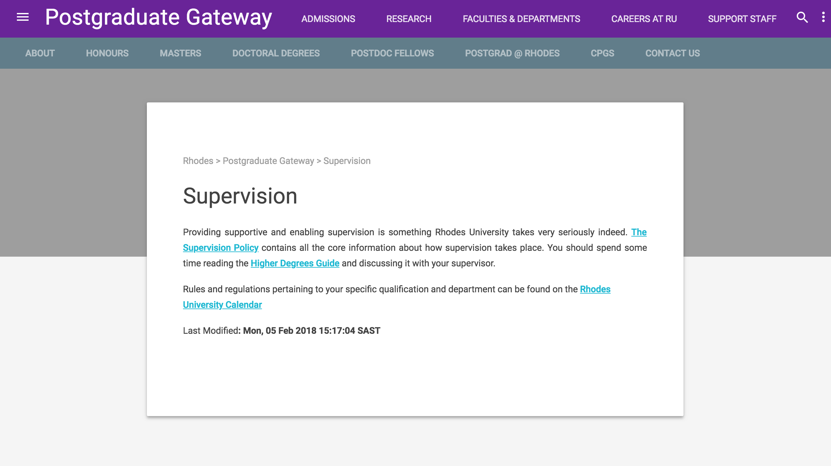

Slide 31
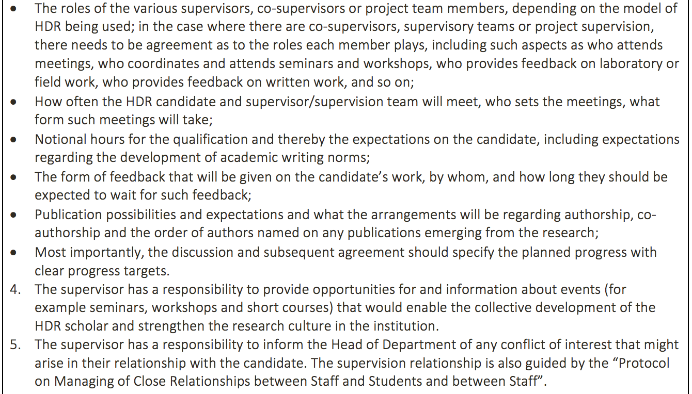

Slide 32
