Slide 1


Internationalisation and the role of student governance

Slide 2

framing
Internationalisation: The process of developing, implementing and integrating an international, intercultural and global dimension into the purpose, functions and delivery of higher education.
Global citizenship is the idea that all people have rights and civic responsibilities that come with being a member of the world, with whole-world philosophy and sensibilities, rather than as a citizen of a particular nation or place.
Nationalism is a political, social, and economic ideology and movement characterized by the promotion of the interests of a particular nation, especially with the aim of gaining and maintaining the nation's sovereignty over its homeland.

Slide 3
What is expected from Rhodes university
Internationalisation Committee of Senate ensures that the University meets its commitment to internationalisation as defined in its policy and described in its mission and vision statement
That the internationalisation policy is implemented, monitored and regularly reviewed
The implementation of the IEASA (International Education Association of South Africa) Code of Conduct for International Students is monitored
That there is internationalisation of research and collaboration with foreign research partners is fostered
Senate and Council are advised on the internationalisation of curricula
Senate and Council are advised on new developments in the realm of internationalisation in higher education

Slide 4
What to expect from the international affairs Councillor in order to promote Internationalisation at home and nationally
Co-ordinates SRC International Programmes.
Develops and maintains an International Dialogue
Constitutes an International Students’ Forum in consultation with ISASA
Represents the SRC on international student interests in International Forums.

Slide 5
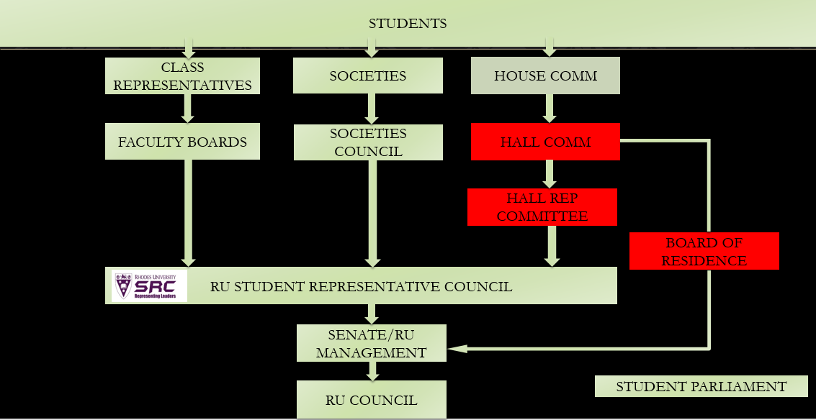
Internationalisation at different student governance levels

Slide 6
YOU ARE IMPORTANT AND PLAY A VITAL ROLE
Student leadership is in a vitally strategic position to further internationalisation in the Higher Education sector and at Rhodes University.
Think
Design
Incorporate
Create
Play attention to
Be mind full off

Slide 7
Internationalisation @ Home
The purposeful integration of international and intercultural dimensions into the formal and informal curriculum for all students within the domestic learning environments.

Slide 8

Anti-Xenophobia march

Slide 9

International Week

Slide 10

PAN AFRICA YOUTH DIALOGUE – Africa DaY Lecture

Slide 11
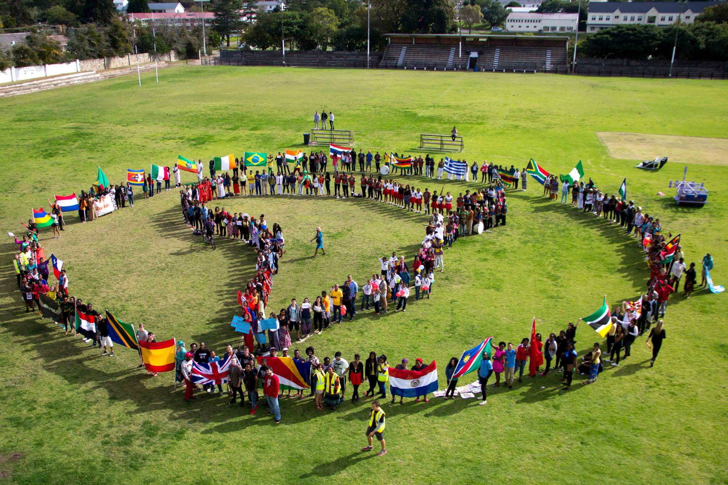
International PARADE
Internationalisation takes the local seriously

Slide 12
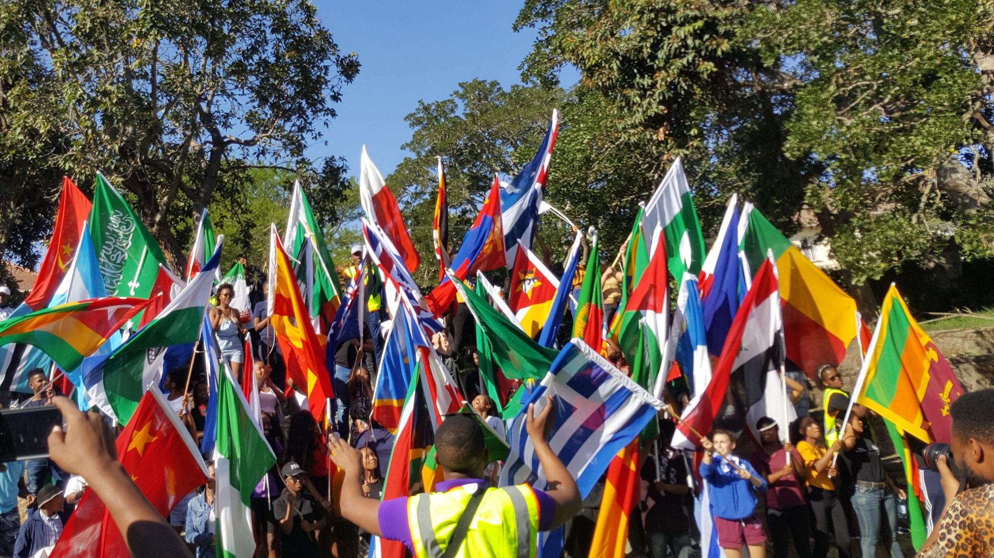
International PARADE

Slide 13
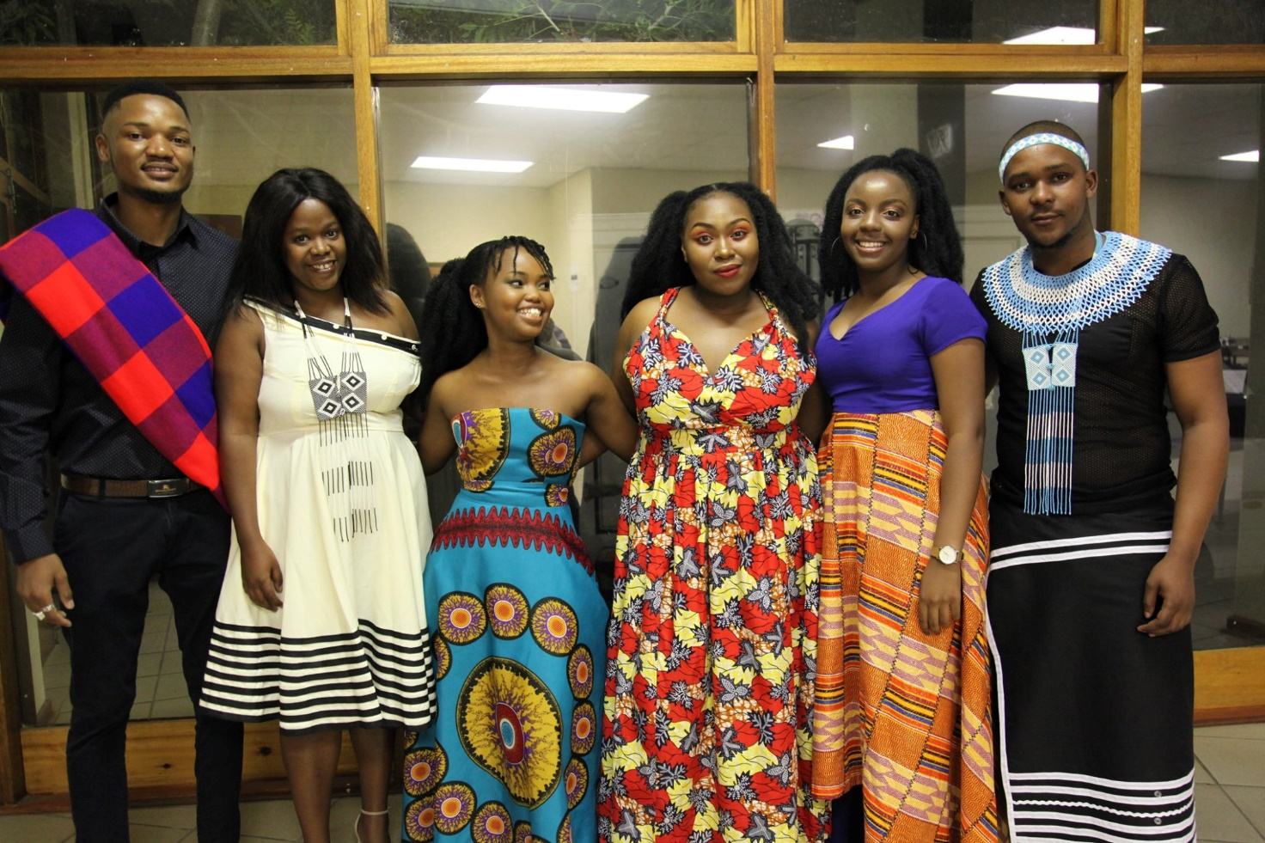
Africa Ball

Slide 14
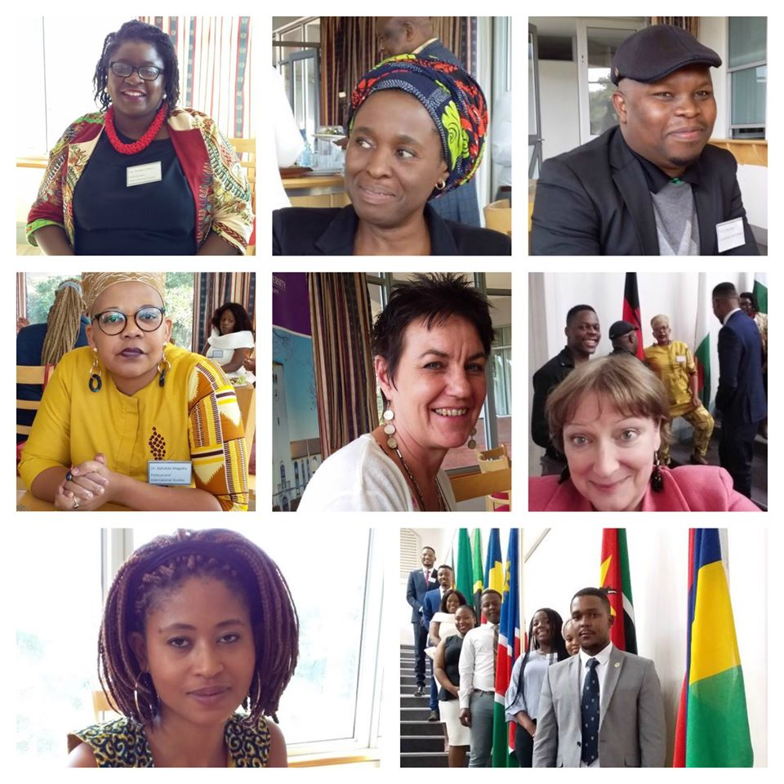
Internationalisation summit

Slide 15
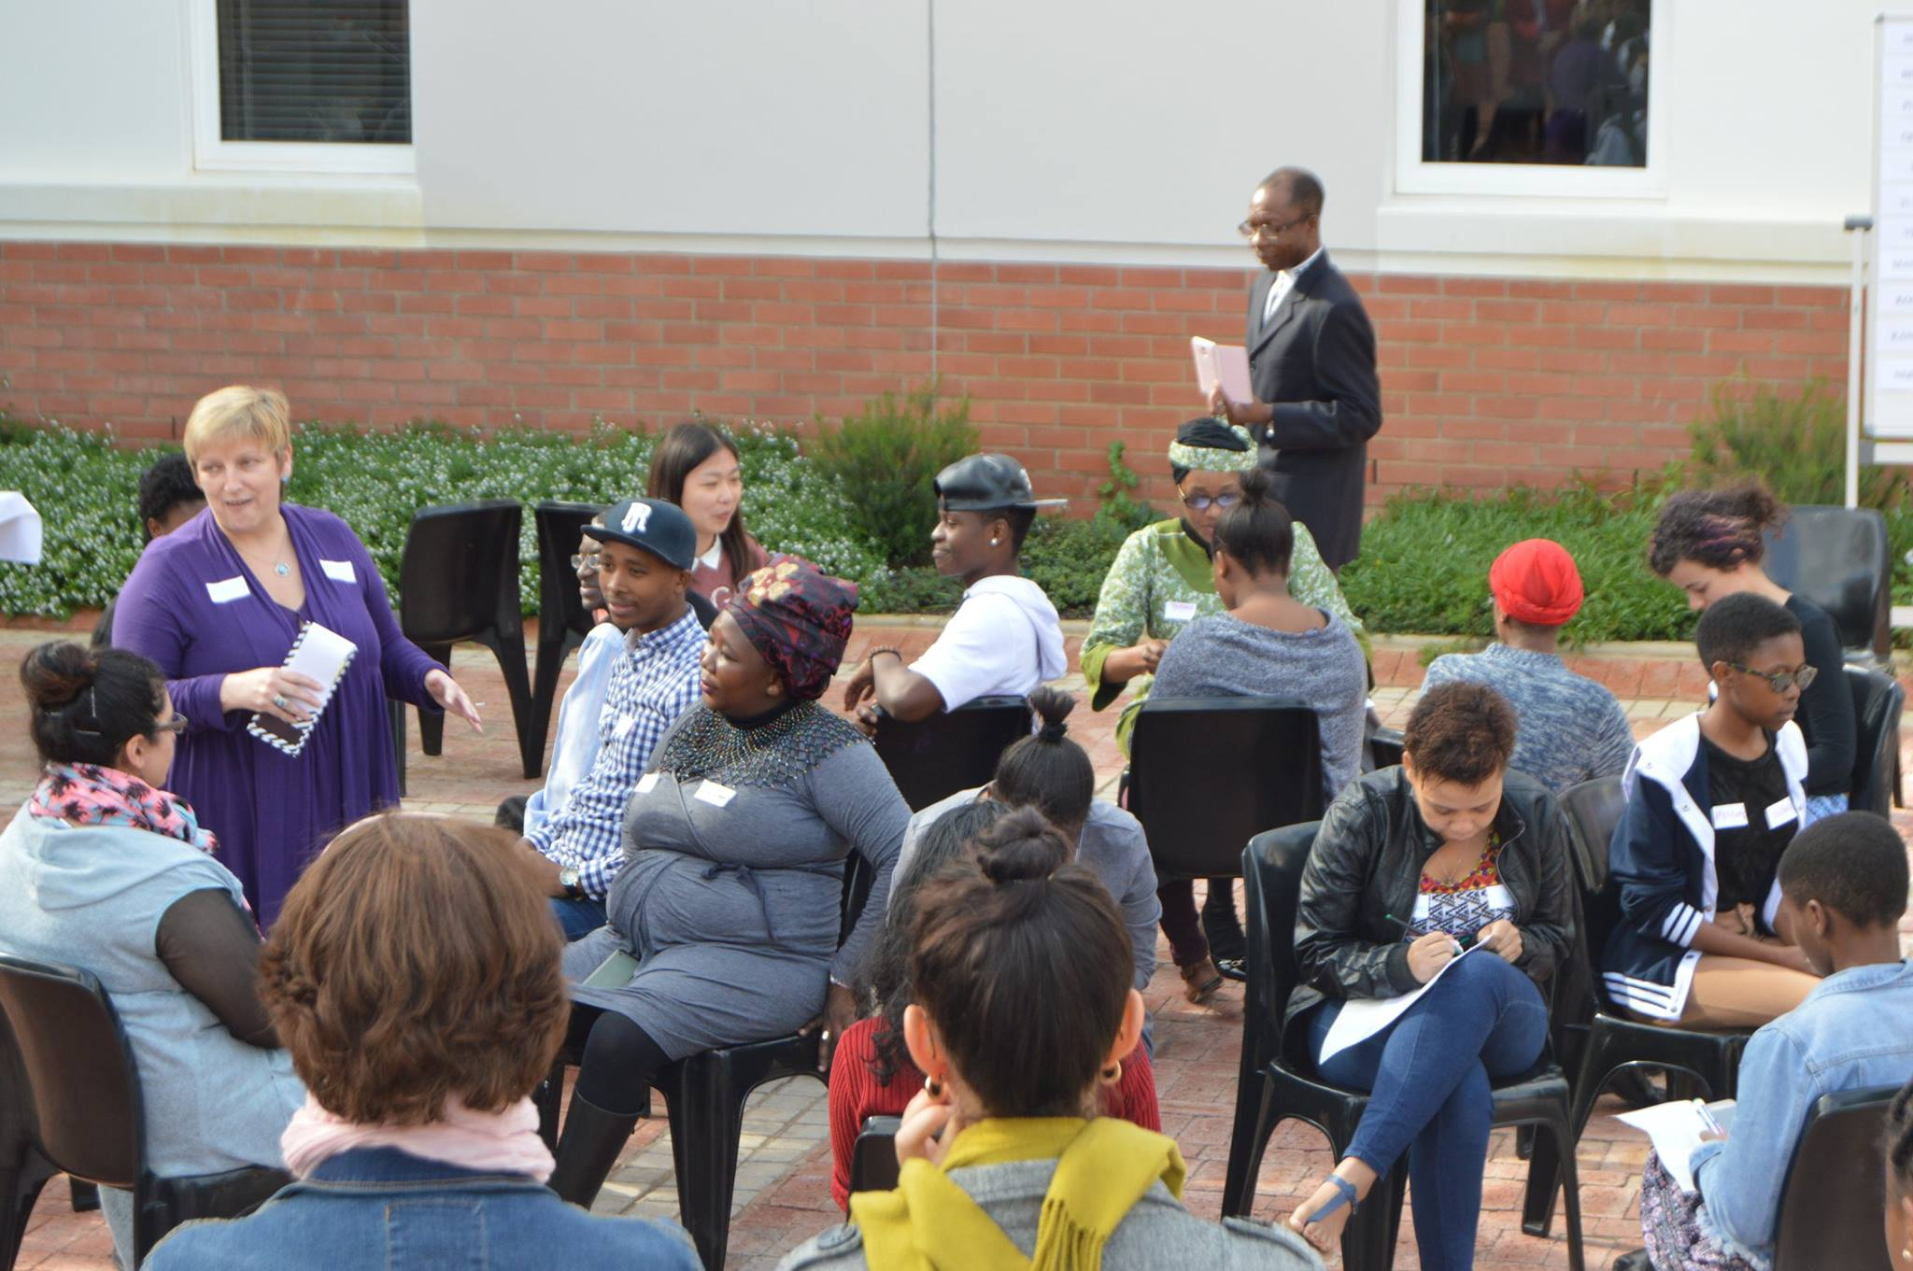
Language Carousel

Slide 16
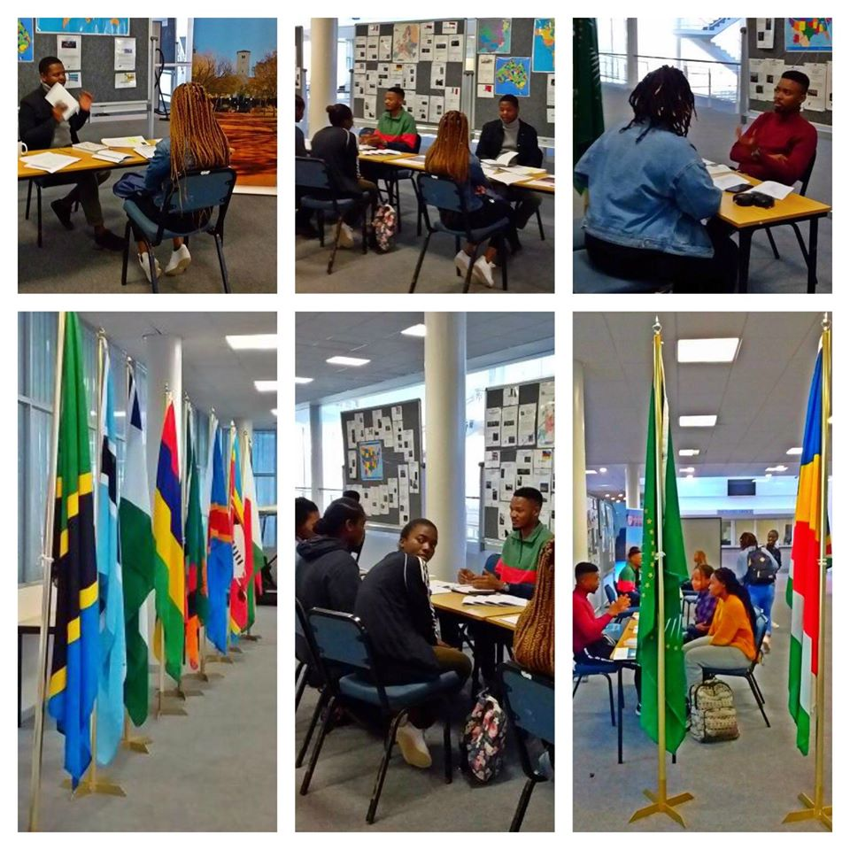
Rhodes university study abroad / exchange

Slide 17
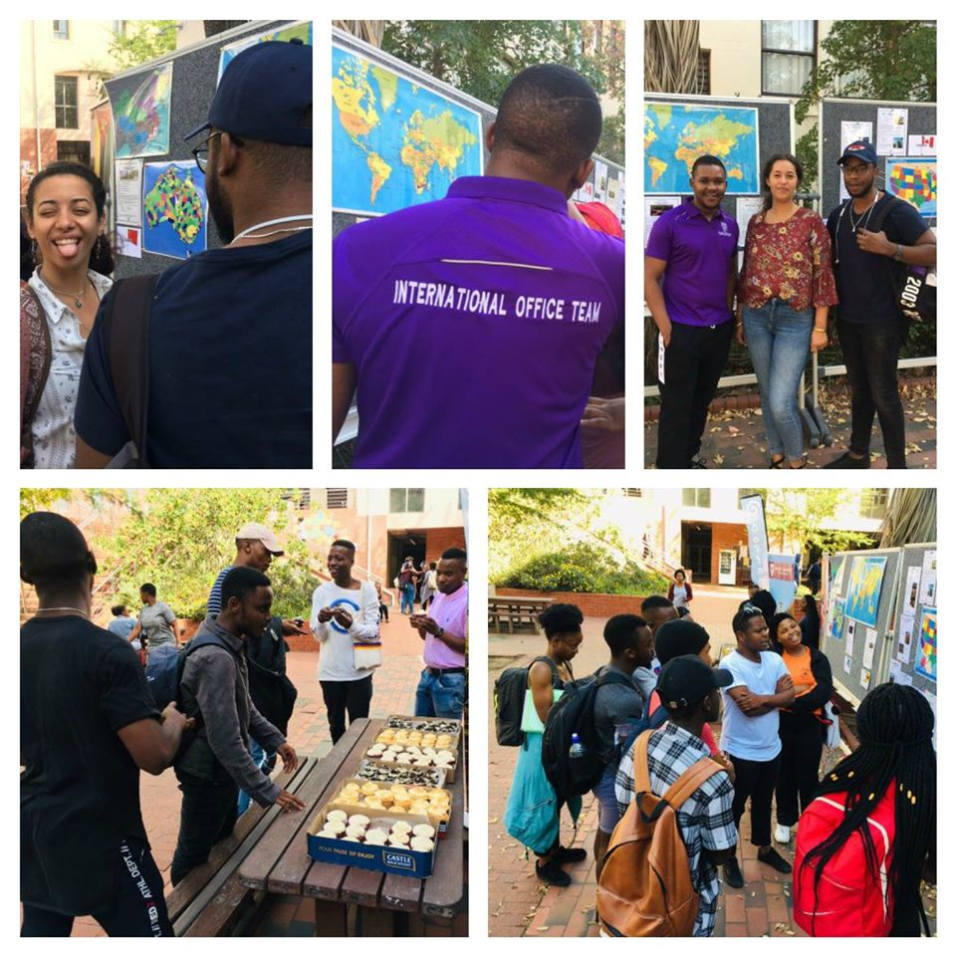
Rhodes university study abroad / exchange

Slide 18
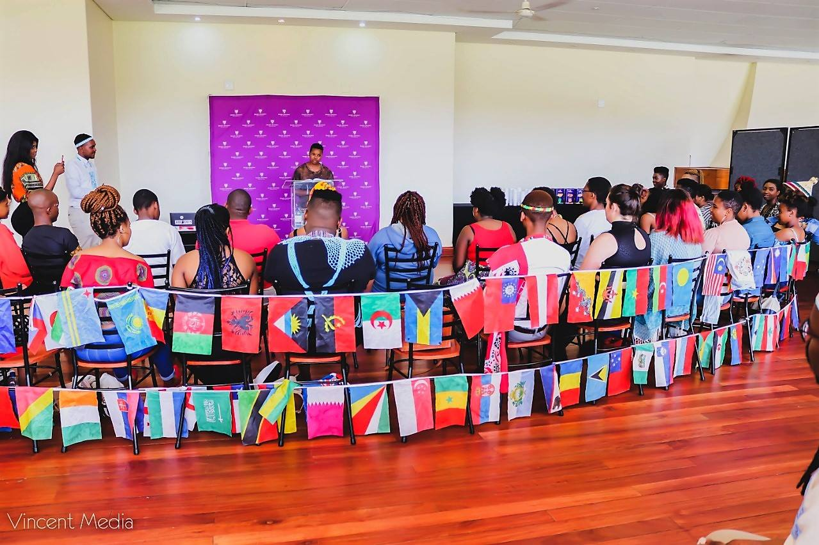
Heritage Day

Slide 19
The end
THANK YOU

