Slide 1


PROMOTING MENTAL HEALTH
Rhodes University Counselling Centre

Slide 2

Today’s Overview
Icebreaker
Defining Mental Health
Domains of Mental Health
Practical Tips to promote own mental health
Services offered at Rhodes University

Slide 3

Icebreaker
‘Stand up if yes’
Stand up if your answer is yes to the each of the following questions:
Stand up if you would choose sleeping over eating
Stand up if you would rather trade some intelligence for looks
Stand up if you would rather go 30 days without your phone than go a lifetime without eating dessert

Slide 4
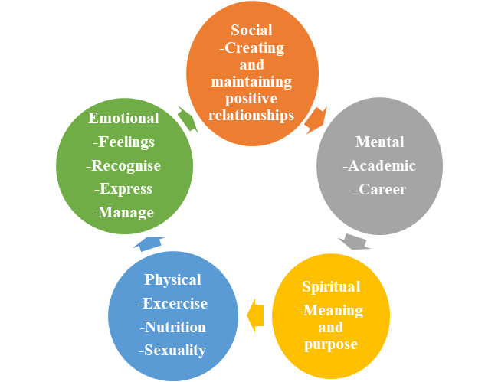
Mental Health
Mental health is a state of well-being that allows an individual to cope with their normal life stresses, realise their own capabilities, make a contribution to their community and work productively and fruitfully.
“To be mentally well, one needs to be well in all other areas (SMSPE). Lack of wellness in an area of our lives can drain energy from our mental wellness and leave us battling to give our attention to our studies.”

Slide 5
SOCIAL
Creating and Maintaining positve relationships.

Slide 6
Social
Definition: Social wellness involves building and maintaining healthy and supportive relationships as well as fostering genuine connections within these relationships.
Social wellness is important as having a supportive social network allows one to:
build interpersonal skills
increase self-esteem
exercise trust
develop communication as well as conflict management skills

Slide 7
Social
Possible Mental Health challenges to Expect:
Other factors to consider that influence social wellness:
Social Anxiety (Intense or persistent fear of being watched or judged)
Agoraphobia (Extreme or irrational fear of entering open or crowded places, of leaving one’s own home or of being in places from which escape is difficult)
Panic disorder (Recurrent unexpected panic attacks)
Substance use disorders
Time management:
-i.e. student’s allocating majority of their time to being social and leaving no time to other areas of their life (eg: their academics)
-OR, student’s allocating no time to being social at all.
Conflict within the residences affecting overall individual wellness

Slide 8
Social
Responsibilities and Implementation:
Understand that there are different personalities, i.e. introverts, extroverts and ambiverts.
Being creative in accommodating all these different personalities in university spaces. i.e. being mindful of having activities that only extroverts will enjoy.
Being cognisant of the fact that there are individuals who struggle with alcohol misuse and so not encouraging alcohol availability at socials could help.
Understanding that sleep is important for overall wellness and does contribute to mental health, so allowing enough rest.
Encourage membership to clubs and societies.
Ideas on how to help 1st years make friends in O-Week

Slide 9
MENTAL
Academic
Career

Slide 10
Mental
Definition: The mental domain recognises one’s creative and mental abilities. It looks at academics, career and mindset.
Questions to ask yourself: Am I impulsive? do I learn from my mistakes? How is my self-talk (things that I tell myself)?
Responsibilities- To create a space that is not only supportive when there are challenges, but also encourages students to thrive in this area.
  Encourage a culture of academic excellence and students to ask questions about their careers and professional development.
  When interacting with students- Unconditional positive regard (non-judgemental), Empathy, Genuine, caring, respect, acceptance & understanding

Slide 11
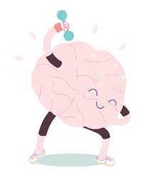
Mental
Possible Mental Health challenges to Expect:
Other factors to consider:
Anxiety Disorders
Stress
Depression
Attention deficit hyperactivity disorder
Time management
Motivation
Socio-economic factors
Environmental factors such as academic support from peers and lecturers

Slide 12
Mental
Useful Services:
Career centre (30 minute one-on-one appointments from 11h00-15h00, career assessments, career guidance and workshops on CV writing, interview skills and career success)
RU Counselling Centre
Psychology clinic
Res and hall mentorship programmes

Slide 13
SPIRITUAL
Meaning
Purpose

Slide 14
Spiritual
Definition: Spiritual Wellness is inclusive of religious faith, values, ethics and morals.
Spiritual wellness is important because it aids in developing harmony with one’s inner self and the outside world.
Responsibilities and Implementation:
To promote the importance of spiritual wellness
To embrace an inclusive and non-judgemental stance on different beliefs and to encourage others to do the same.
Other factors to consider:
Encouraging students to find a community of people that share the same values that they have.

Slide 15
PHYSICAL
Responsible
Exercise
Nutrition
Sexuality

Slide 16
Physical
Definition: Combination of beneficial physical activity/ exercise and healthy eating habits. This also entails personal responsibility and care of minor health challenges and knowing when professional medical attention is needed.
Responsibilities and Implementation:
  Encourage participation in sport activities.
  Not everyone is good in sports, which is okay, so have different activities that different people can enjoy and participate in.
  Encourage healthy eating habits
  Risky behaviour. Promote safe sex (condom use, PrEP, encourage getting tested, pap smears and contrantraceptives), Drinking culture, Drugs etc.
Useful services:
  Health Care Centre (Doctor available Monday-Friday lunchtime)
  Settlers Hospital
  RU Sports

Slide 17

Possible Mental Health challenges to Expect:
Other factors to consider:
Eating Disorders
Substance or alcohol misuse and abuse
Rest
Physical check ups such as checking cholesterol, sugar, blood pressure (All free at clicks on Wednesday).

Slide 18
EMOTIONAL
Feelings
Recognise
Express and
Manage

Slide 19
Emotional
Definition: Emotional wellness refers to an awareness, understanding and acceptance of one’s emotions.
Additionally, it refers to the ability to regulate and manage emotions effectively through life’s challenges
Emotional wellness is important because how one feels affects:
Their relationships
Their ability to carry out activities
Their overall mental health

Slide 20

Emotional
Possible Mental Health Challenges to expect:
Other factors to consider that may influence emotional wellness:
Depression
Bipolar disorders (Marked by periods of elation and depression.)
Anxiety disorders
Death of a loved one
Ending of significant relationships

Slide 21
Emotional
Responsibilities and implementation:
Promoting emotional wellness:
Paying attention to the students that appear to be battling emotionally and referring them to the various support services available.
Requesting workshops from the CC for students.
Useful Services:
-Counselling Centre- 8am-5pm (includes on call slots for emergencies)- on the top floor at the Steve Biko Building- counsellingcentre@ru.ac.za- 046 603 7070
-Psychology Clinic- Rhodes Avenue, Grahamstown- 046 603 8502- psychologyclinic@ru.ac.za

Slide 22

Emotional
-ER 24 Crisis line- 24 hours- 010 205 3068
-South African Depression and Anxiety Group-24 hours- (online substance abuse help available)- 011 234 4837

Slide 23
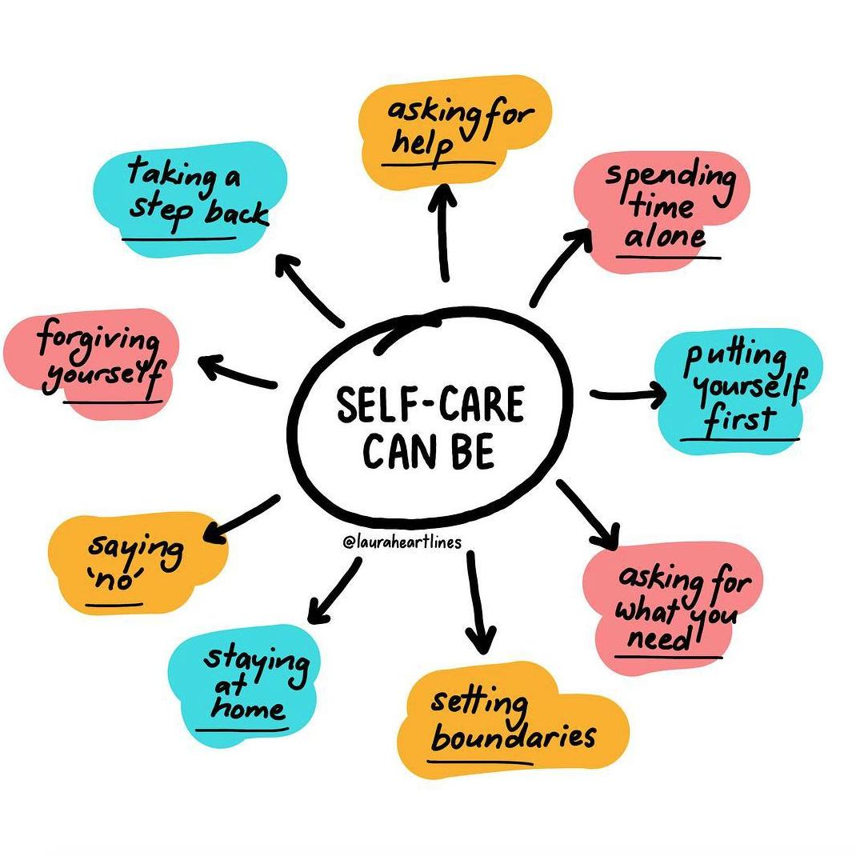

Personal Mental Health
Burnout: Emotional, mental and physical exhaustion caused by prolonged stress. Commonly known as “going through the most”
Practical Tips to prevent burnout
Monitor your own mental health (Wellness monitor and wellness assessment on Rhodes website).
Implement healthy boundaries
Self-Awareness. Know what you can handle and when you are not in a good space.
Work as a team

Slide 24

Wellness Services offered
Harassment Office
Contact Dr Zethu Mkhize
-046 603 8181
-studentaffrairs@ru.ac.za
Rhodes University Counselling Centre
046 603 7070
counsellingcentre@ru.ac.za
Psychology Clinic
046 603 8502
psychologyclinic@ru.ac.za
Career Centre
046 603 7070
careercentre@ru.ac.za
Health Care Centre
046 603 8523
healthcarecentre@ru.ac.za

Slide 25

In closing:
Evaluation and Register

