Slide 1
Southern African Journal of Environmental Education
writing an academic paper for sajee | author development workshop |prof Eureta Rosenberg (Editor in chief) |Kim ward (copy editor) | carlene royle (journal manager) | Dr Presha ramsarup(Guest editor)

Slide 2
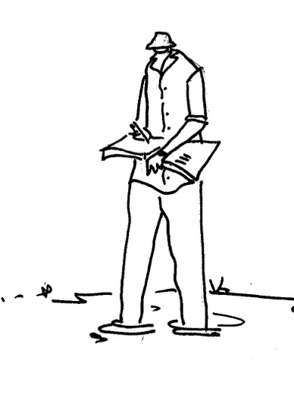
CONTENTS
Why write for SAJEE?
Range of papers published
Different kinds of research welcome
DISCUSSION
Writing guidelines
Online submissions
DISCUSSION
Special Issue on TVET

Slide 3
CONTENTS
Why write for SAJEE?
Range of papers published
Different kinds of research welcome
DISCUSSION
Writing guidelines
Online submissions
DISCUSSION
Special Issue on TVET

Slide 4
We write to be heard
To advance our careers, our work, our field To create, share and co-create knowledge
SAJEE is an accredited journal and international equivalent SAJEE is a Diamond Open Access Journal

Slide 5
CONTENTS
Editorials
Research papers
Think Pieces
Why write for SAJEE?
Range of papers published:
Different kinds of research welcome
DISCUSSION
Writing guidelines
Online submissions
DISCUSSION
Special Issue on TVET
Viewpoints
Keynote addresses
Reviews (of books, new journals, conferences, etc)
What distinguishes these works? Scholarly contribution
EEASA Bulletin publishes case stories, examples of practice, announcements of new resources

Slide 6
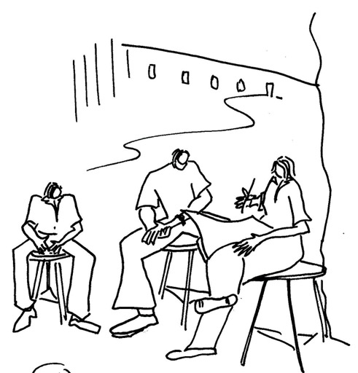
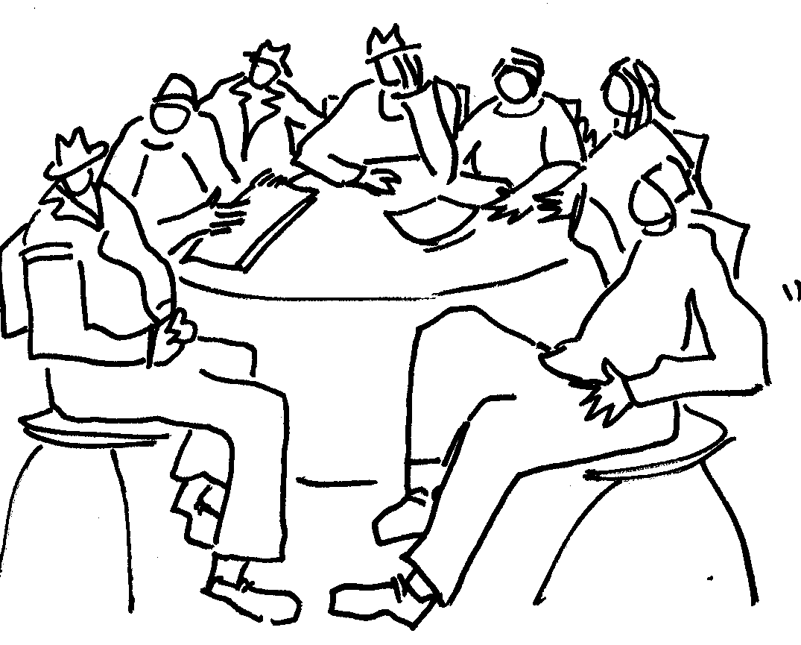
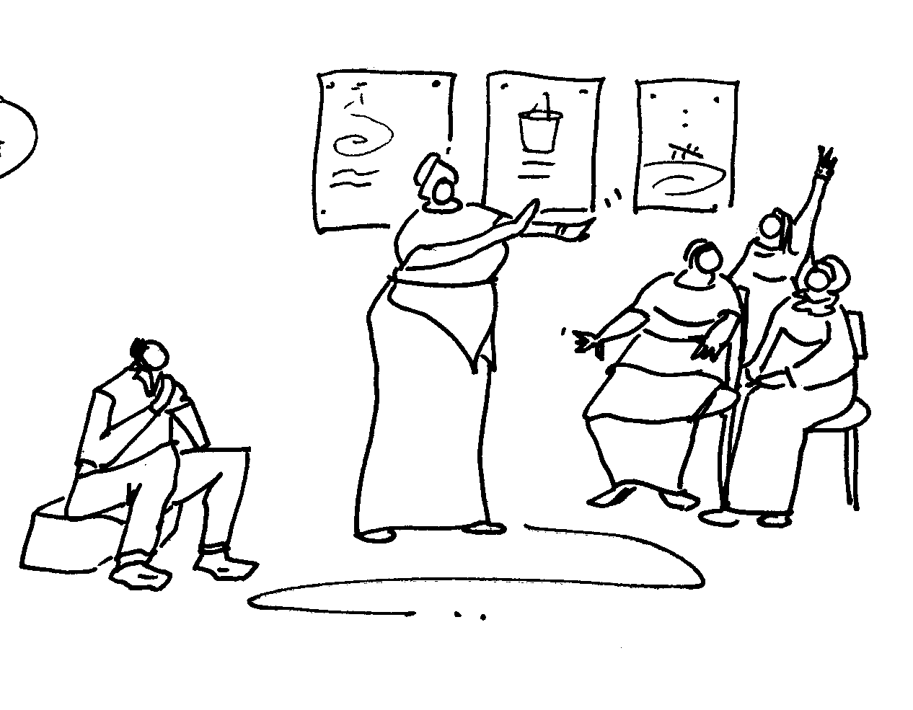
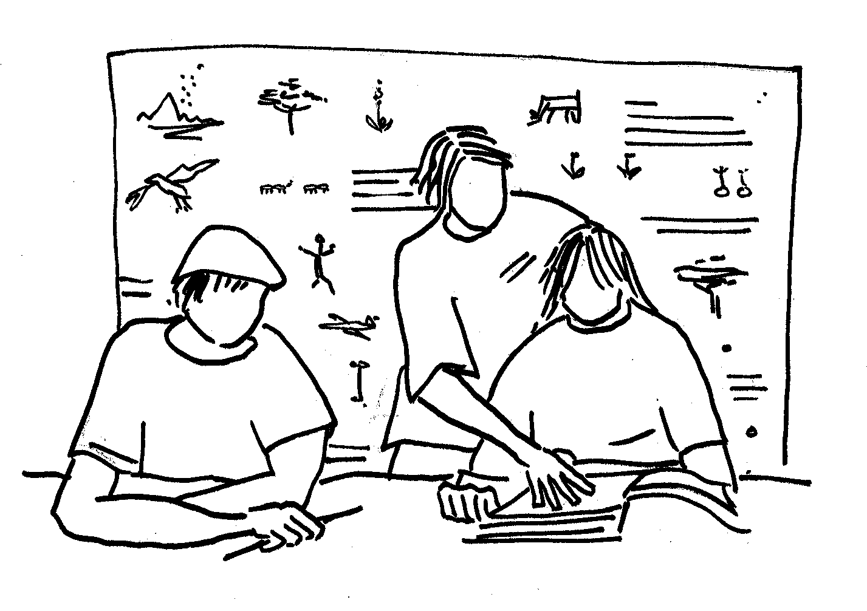
CONTENTS
Why write for SAJEE?
Range of papers published
Different kinds of research welcome
DISCUSSION
Writing guidelines
Online submissions
DISCUSSION
Special Issue on TVET

Slide 7
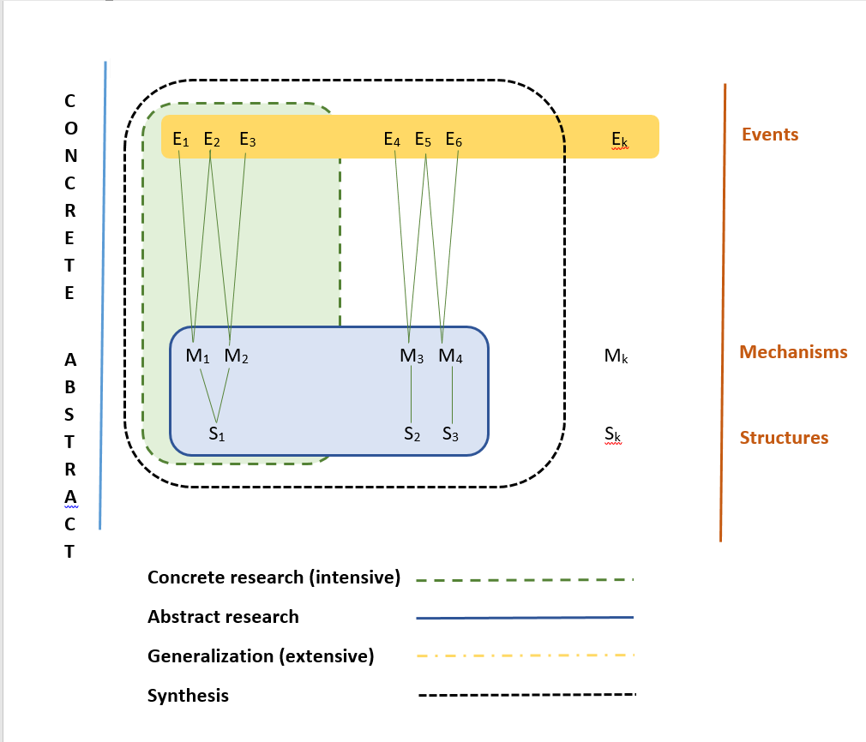
Different kinds of research: Sayer
Sayer, Andrew. 2010. Problems of Explanation and the Aims of Social Science. Routledge.
Case studies
Large scale Surveys
Systematic reviews/meta-syntheses

Slide 8
Different kinds of research: Multimodal knowledge generation
Coole, D., and S. Frost. 2010. New Materialisms: Ontology, Agency and Politics. Durham: Duke University Press.

Slide 9
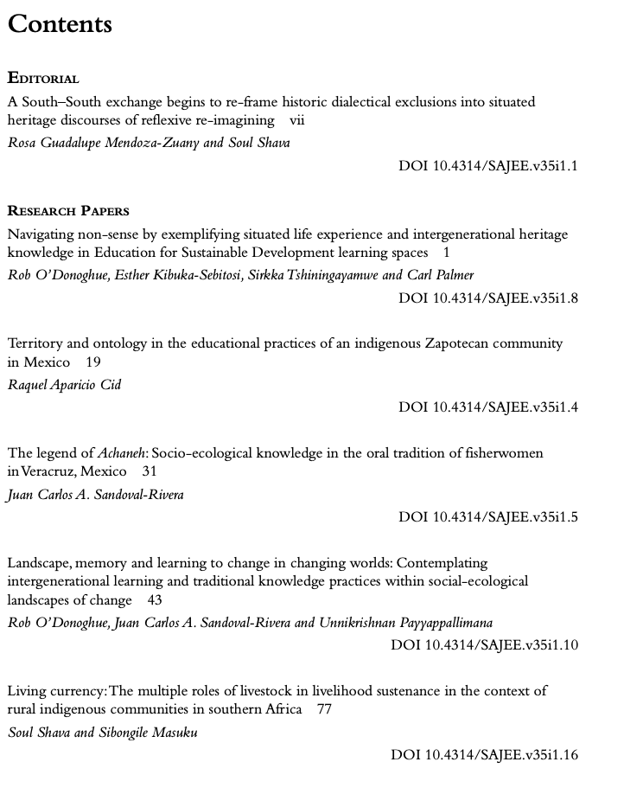
Different kinds of research: Diversity of Knowledges: ”One lens is not enough”
Knowledge Ecology - De Sousa Santos, Nunes and Meneses
“The democratization of science”

Slide 10
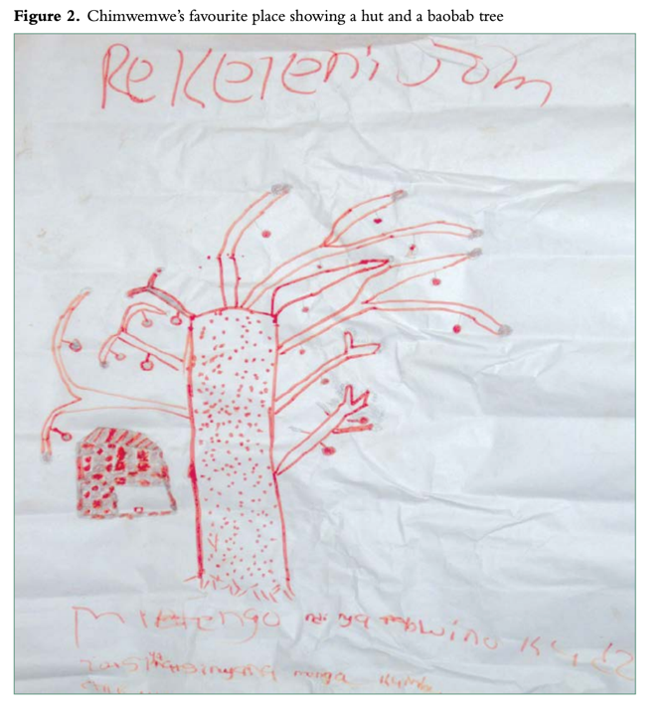
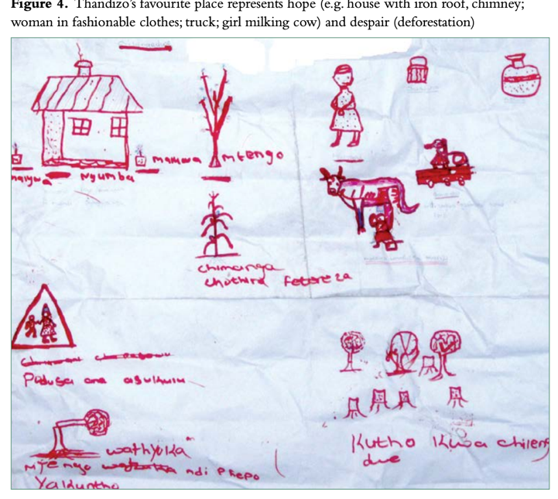
Different kinds of research
What makes a description worth sharing?
Descriptive studies
Explanatory studies
Generative studies
Interventionist studies e.g. participatory action research

Slide 11
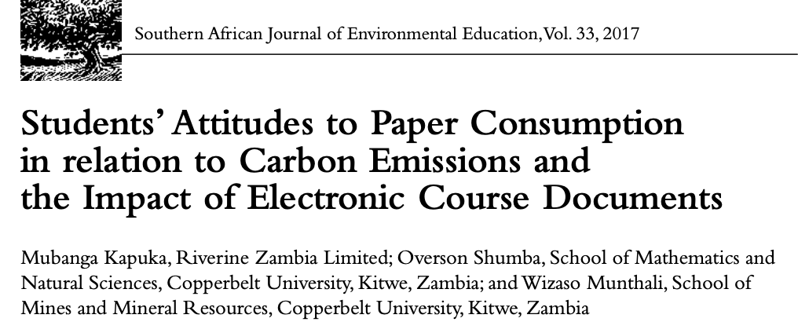
Different kinds of research
Descriptive studies
Explanatory studies
Generative studies
Interventionist studies e.g. participatory action research

Slide 12
Different kinds of research
Descriptive studies
Explanatory studies
Generative studies
Interventionist studies e.g. participatory action research

Slide 13
CONTENTS
Why write for SAJEE?
Range of papers published
Different kinds of research welcome
DISCUSSION
Writing guidelines
Online submissions
DISCUSSION
Special Issue on TVET
Discussion Time!

Slide 14
Writing Guidelines | Kim Ward | SAJEE Copy Editor

Slide 15
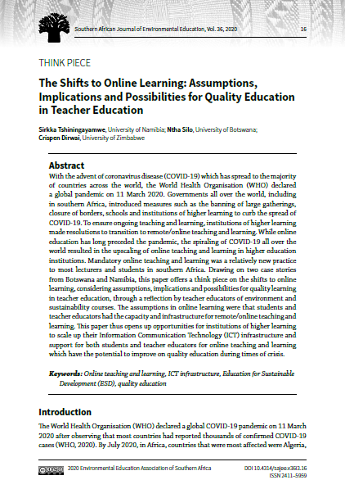
The first page…
Title (15 words max)
Abstract (150-200 words)
Keywords – the key to open the door to your paper!

Slide 16
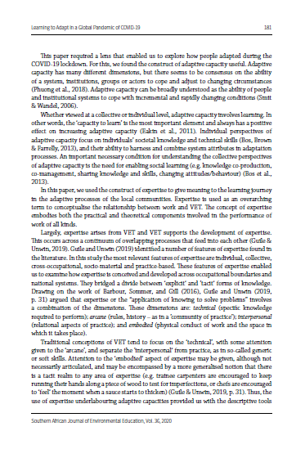
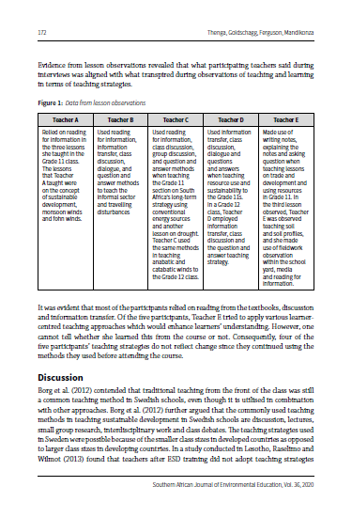
Headings, figures & tables
Compare these two pages

Slide 17
Headings
break up big blocks of text, give the reader a ‘meaningful handle’
Main Heading (bold, bigger, initial caps)
Section or sub-heading (bold)
Sub-section heading (bold, italics)

Slide 18
References
Only put the refs in paper into list. All refs in paper must be in list. Print the list and read through the paper, ticking as you go.
Guidance for style on website (APA)
For missing bits, copy and paste what you have into a google search and you will often find what you need.

Slide 19
Online Submissions| Carlene Royle| Journal Manager

Slide 20
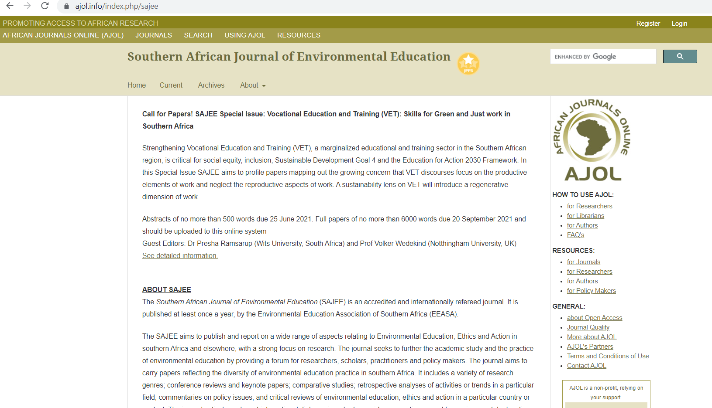
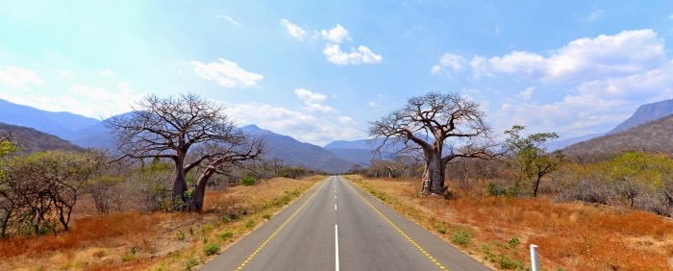
Online Submissions
SAJEE Journal Manager | Carlene Royle

Slide 21
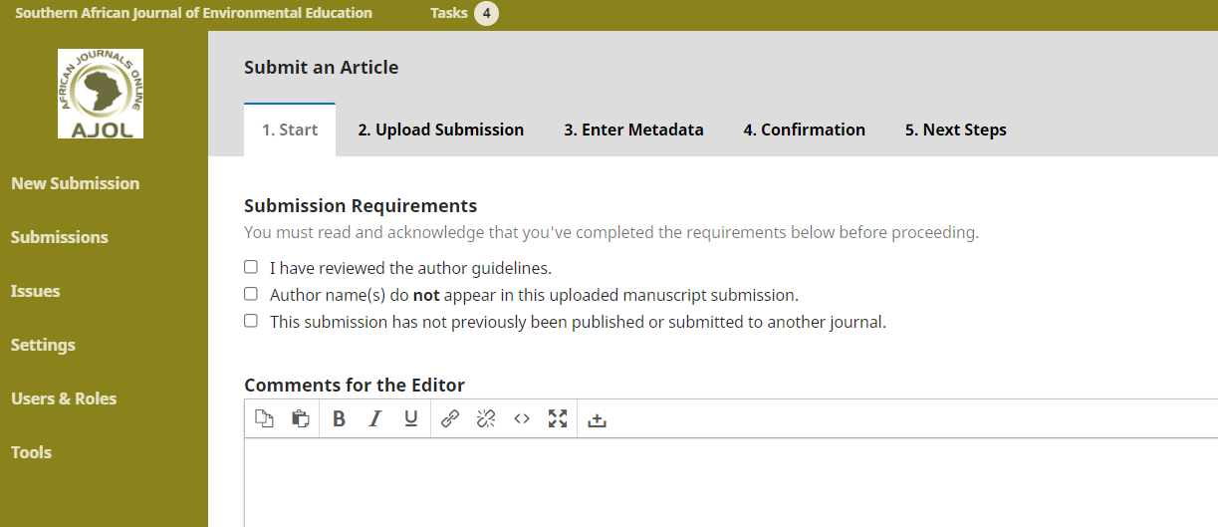
Online Submissions| Carlene Royle| Journal Manager
5.
6.
7.
8.

Slide 22
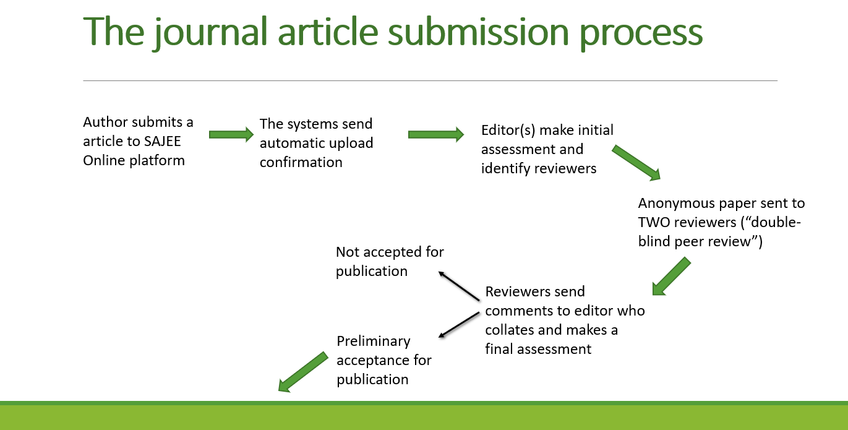
Online Submissions| Carlene Royle| Journal Manager
Olvitt, L EEASA 2019

Slide 23
Online Submissions| Carlene Royle| Journal Manager
Olvitt, L EEASA 2019

Slide 24
CONTENTS
Why write for SAJEE?
Range of papers published
Different kinds of research welcome
DISCUSSION
Writing guidelines
Online submissions
DISCUSSION
Special Issue on TVET

