Slide 1
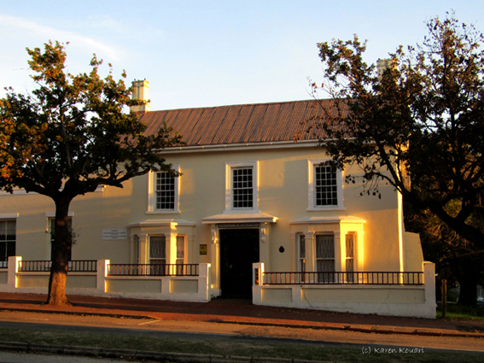
Welcome to the Faculty of Humanities
Rhodes University
https://www.ru.ac.za/facultyofhumanities/

Slide 2
The Dean
Awards degrees and diplomas
Leads and strategically develops the
Faculty
Guides students
Approves courses and degrees
Congratulates students on good
academic performance
Warns students of bad performance
Excludes students from the Faculty and
University for bad performance

Slide 3
The Deanery:
Dean: Professor Enocent Msindo
Deputy Deans:
  Deputy Dean – UG Studies &Teaching
Professor Maureen De Jager
  Deputy Dean – PG Studies & Research
Professor Patrice Mwepu
Senior Faculty Officer:
Ms Karen Kouari

Slide 4
What are the Humanities?
Studies about & of human beings:
How and what they think about
How they behave and how they
co-exist between selves, nature and the
intangible
How they communicate (language,
literature, art, drama, dance, music)
Their past and their future

Slide 5

Departments and Schools
11 Departments: | Literary Studies in English
Anthropology | Music
Drama | Philosophy
Fine Art | Politics
History | Psychology
Linguistics | Sociology
2 Schools:
Journalism & Media Studies Languages and Literatures: (African Languages, Afrikaans, Chinese, French, German, Latin, Greek, Classical Studies)

Slide 6
Subjects taught by other faculties that are frequently taken by Humanities students include:
Commerce: Economics, Management, Information Systems
Science: Geography, Environmental Science,
Human Kinetics and Ergonomics
Law: Legal Theory
BUT – Make sure that AT LEAST one of your majors are in Humanities and 50% of your subjects overall are Humanities subjects
Inter-faculty Subjects

Slide 7
Degrees in the Humanities
BA | 3 year degree
BSocSci | 3 year degree Must major in at least one of: Anthropology, Economics, Journalism, Politics, Psychology (General or Organisational), Sociology (General or Industrial & Economic) Must also have at least 2 other subjects from this subject group
BFA | 4 year deg. with compulsory Fine Art subjects
BMus | 4 year deg. with compulsory Music subjects
BJourn | 4 year degree with compulsory JMS subjects

Slide 8
Typical structure of Bachelor of Arts/Bachelor of Social Science
(NQF Level 7 = 360 NQF credits)
Year 1
A1 + B1 + C1 + D1
Year 2
A2 + B2 + D2 + E1
Year 3
B3 + D3 (majors)

Slide 9
Typical structure of the Bachelor of Journalism Degree
(NQF Level 8 = 480 NQF credits)
Year 1
JOURN 1+A1+B1+C1
Year 2
JOURN 2+XHOSA FOR JOURN+C2+D1
Year 3
JOURN 3 + C3
Year 4
JOURN 4

Slide 10
Typical structure of the Bachelor of Fine Art Degree
(NQF Level 8 = 480 NQF credits)
Year 1
FAP1A+FAP1B+AHV1+A1
Year 2
FAP2A+FAP2B+AHV2+A2 orB1
Year 3
FAP3 + AHV3
Year 4
FAP4 + AHV4

Slide 11
Typical structure of the Bachelor of Music Degree
(NQF Level 8 = 480 NQF credits)
Year 1
3 X MUSIC SUBJECTS (A1+B1+C1) + D1
Year 2
3 X MUSIC, 2 SUBJECTS CONTINUED FROM ACY1 + D2/B1
Year 3
2 X MUSIC 3 SUBJECTS CONTINUED FROM ACY 2
Year 4
MUSIC 4

Slide 12
A 3 year degree can take longer than 3 years due to:
Changes in subjects (esp. majors)
Changing from a 3-year degree (e.g. BA) to a 4-year degree (e.g. BFA)
Failing - A degree WILL take an extra year
if a student fails to obtain necessary credits
You have 5 years to complete your degree on condition you adhere to the G7 rule (next slide)

Slide 13
Rule G7: signalling that you are at risk of being academically excluded from the university
Students need to pass a minimum of:
60 NQF credits (2 x full year or 4 x semester
courses) in their 1st year of study
120 NQF credits by the end of 2nd year of study
180 NQF credits in the 3rd year of study
(60 of which should at least be a 3rd year subject)
Do not ignore a G7 warning. Take action!

Slide 14
Learning at Rhodes
Fees do not buy a degree, studying hard earns you a degree
Registering at Rhodes University begins a new journey for you – it is different from Matric or A’ Levels – expect serious challenges
Co-operate with the academic demands of your lecturers, ask if you do not know
Time flies – do coursework as soon as you receive it, no procrastination

Slide 15
Our focus is on developing the whole person, with an emphasis on education rather than vocation
The graduates we want to develop:
creative and critical thinkers
compassionate
clear communicators
with a capacity for life-long learning

Slide 16
Assumptions we make about our students…
Want to be at Rhodes University
Want to learn
Want to cooperate with peers & staff
Want to perform at their best
Want to take responsibility for their studies
Want to ask questions & are proactive
Want to work independently

Slide 17
Dean’s Advice
Manage your time:
  academic (lectures, assignments, projects, assessments)
  Sport, exercise, hobbies
  social and entertainment
Develop patterns of behaviour:
  get up, eat, attend ALL lectures & tutorials,
  study, exercise, socialise (responsibly), sleep
  listen/look/experience, question, clarify,
  debate, understand, write down, file, review

Slide 18
When Things Go Wrong?
Don’t panic, and don’t hide.
We cannot help you if we don’t know you need
help.
Go and talk to:
  Tutor, Lecturer, Course Co-ordinator, Head of Department, Dean, Faculty Officer
  Sub-warden, Warden
  Counselling Centre (variety of services, such
  as study skills, career advice, psychological
  counselling)

Slide 19
Questions?
E-mail humanities@ru.ac.za
We wish you all the best with your studies here at Rhodes University.
Thank you.

