Slide 1
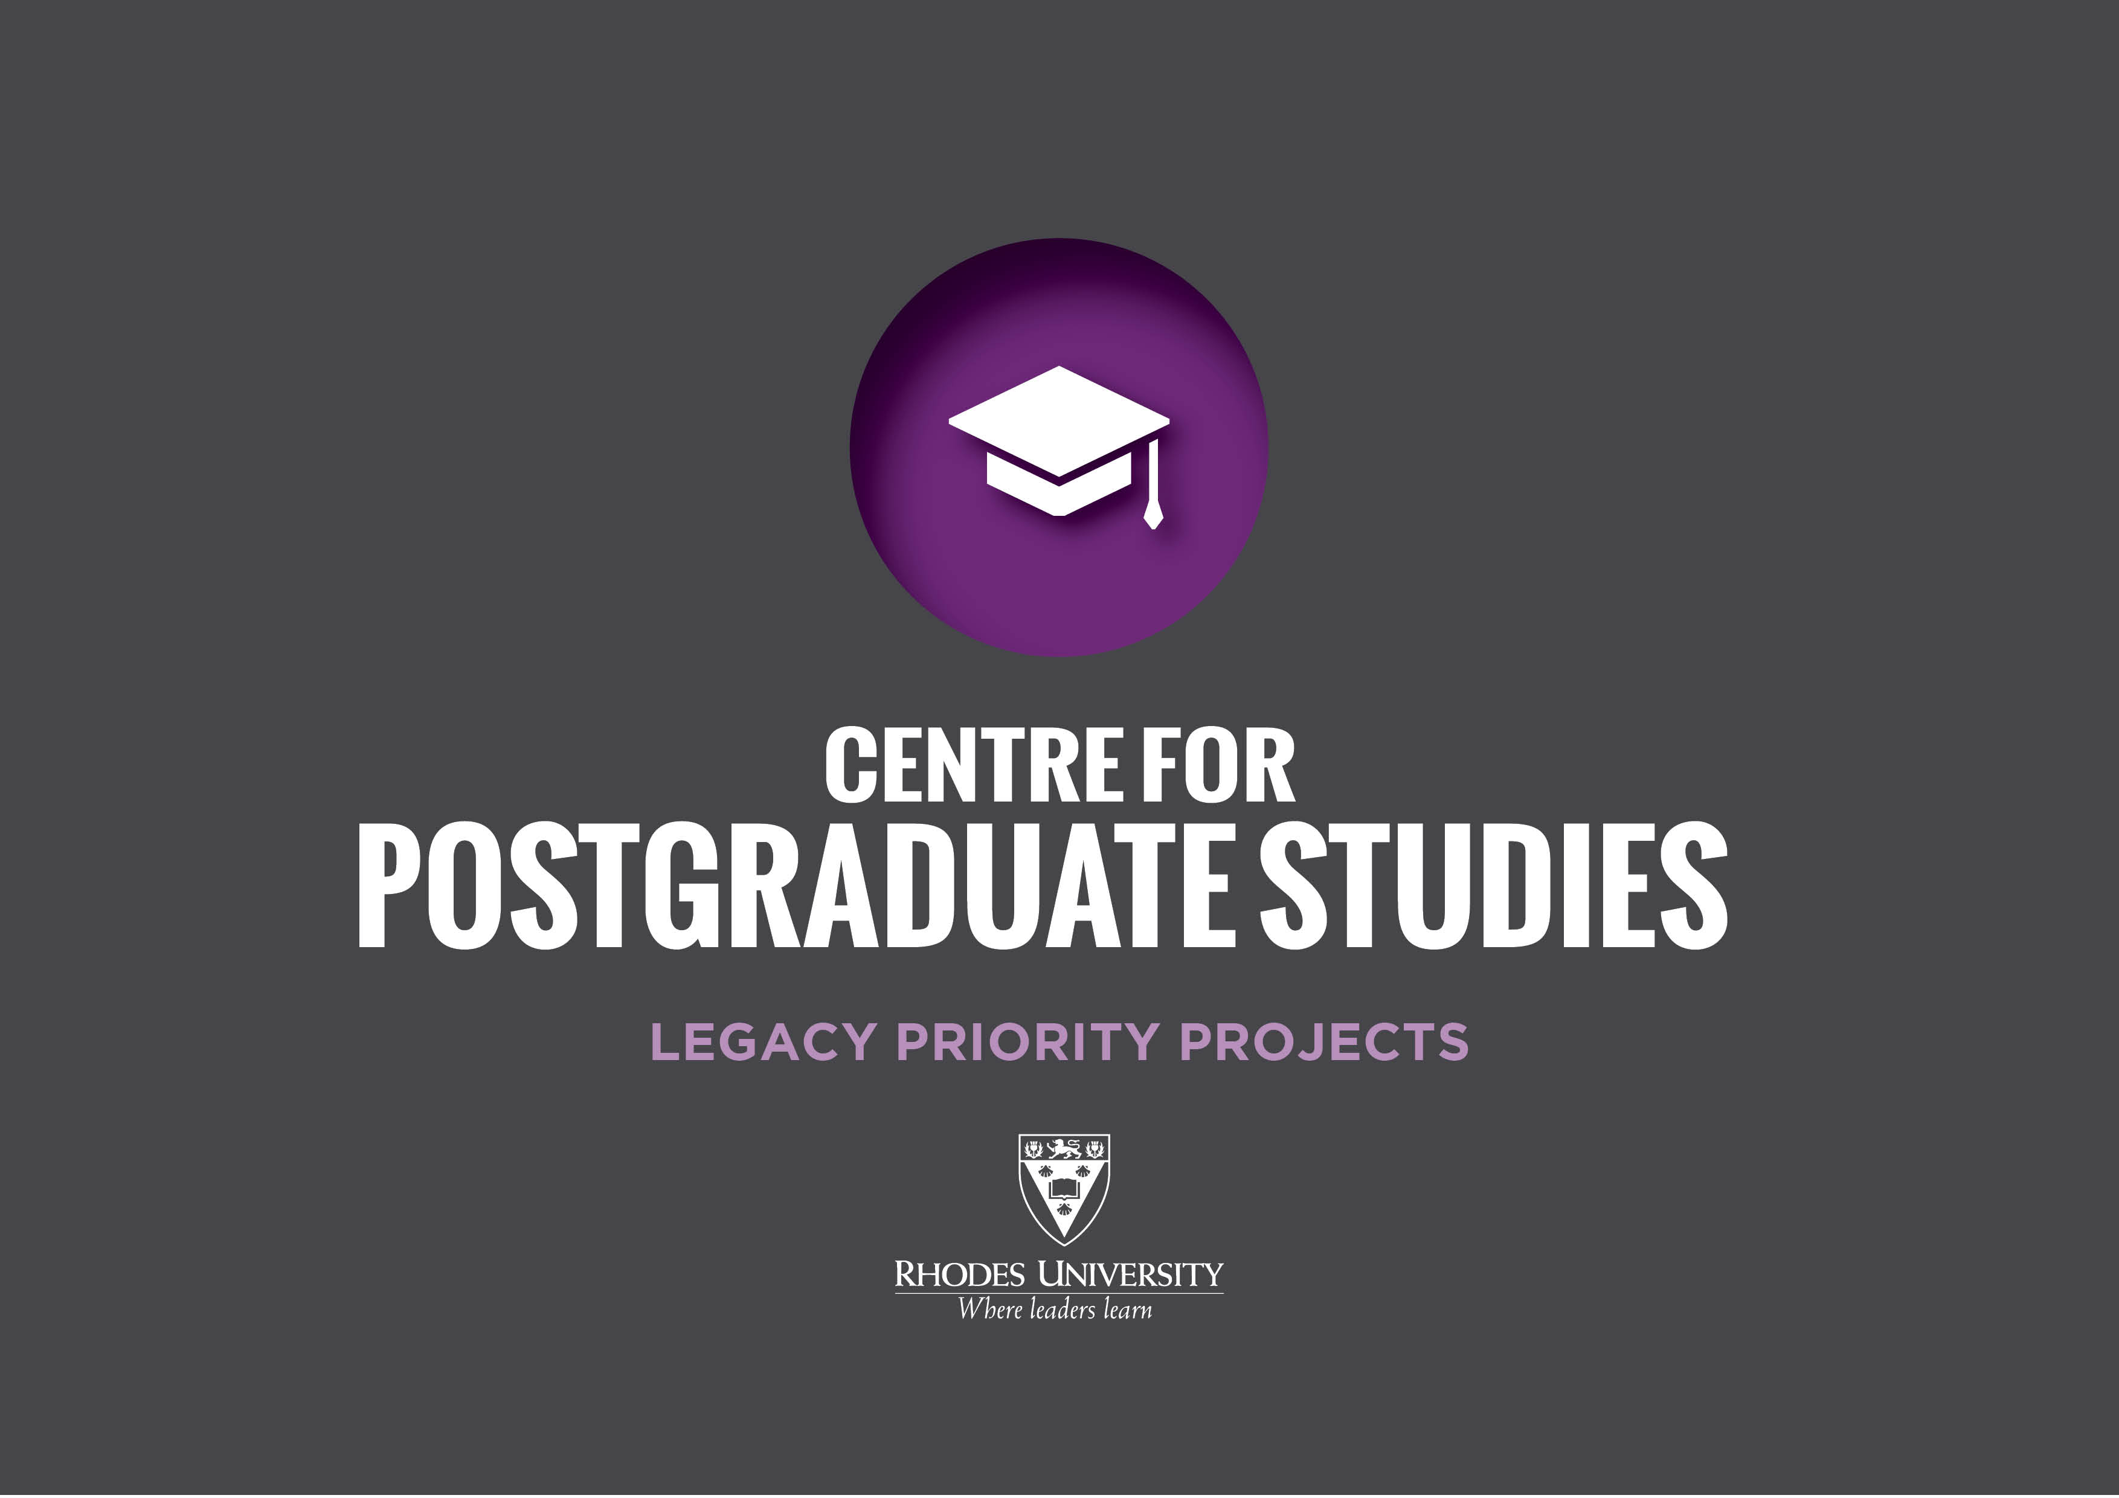

Slide 2

“Our goal is to produce a new generation of postgraduate public intellectuals and researchers who can lead efforts against a mounting tide of anti-intellectualism, which threatens to undermine efforts to forge a national knowledge economy.” Prof Sizwe Mabizela, Vice-Chancellor
ABOUT THE PROJECT
RU is the lead institution for the Strengthening Postgraduate Supervision course
The course has been presented 60 times at more than 20 South African universities.

Slide 3
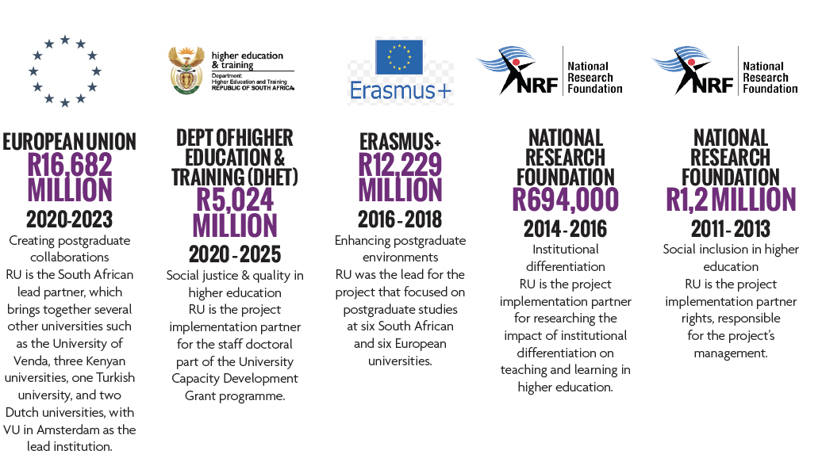
Creating postgraduate collaborations
RU is the South African lead partner, which brings together several other universities such as the University of Venda, three Kenyan universities, one Turkish university, and two Dutch universities, with VU in Amsterdam as the lead institution.
Enhancing postgraduate environments
RU was the lead for the project that focused on postgraduate studies at six South African and six European universities.
Institutional differentiation
RU is the project implementation partner for researching the impact of institutional differentiation on teaching and learning in higher education.
Social inclusion in higher education
RU is the project implementation partner rights, responsible for the project’s management.
Social justice & quality in higher education
RU is the project implementation partner for the staff doctoral part of the University Capacity Development Grant programme.

