Slide 1


Slide 2

“ukuphonsa itshe esivivaneni”
isiZulu phrase for throwing a stone into a pile of stones
Meaning marking a significant journey
About the fund
Rhodes University launches the 10-year Isivivane fundraising campaign
Responds to diminishing state funding for the higher education sector
Growing demand for financial support from the missing middle students
Students come from families who fall outside of the National Student Financial Aid Scheme threshold of R350,000 annual income & cannot afford university fees
Helped students to obtain qualifications & progress onto postgraduate or started their life journeys
136 students (on average) assisted by the fund each year.

Slide 3
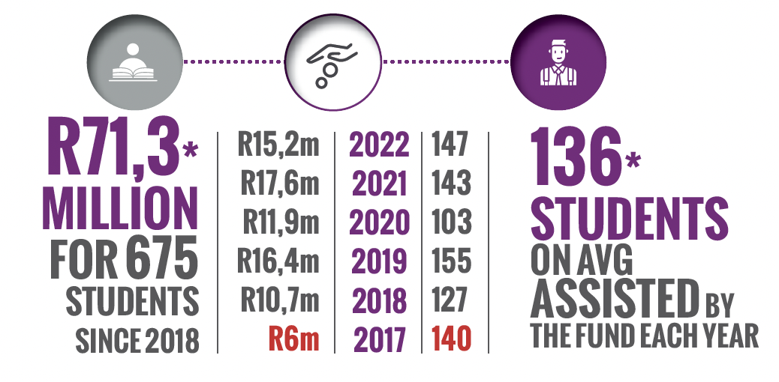
Fund is helping hundreds of students since 2018

Slide 4


Donors that are securing funds
“Through Rhodes University’s generous student financial aid, we have managed to transform lives and create dreams & hope where there was none before.” Prof Sizwe Mabizela, Vice-Chancellor

