Slide 1
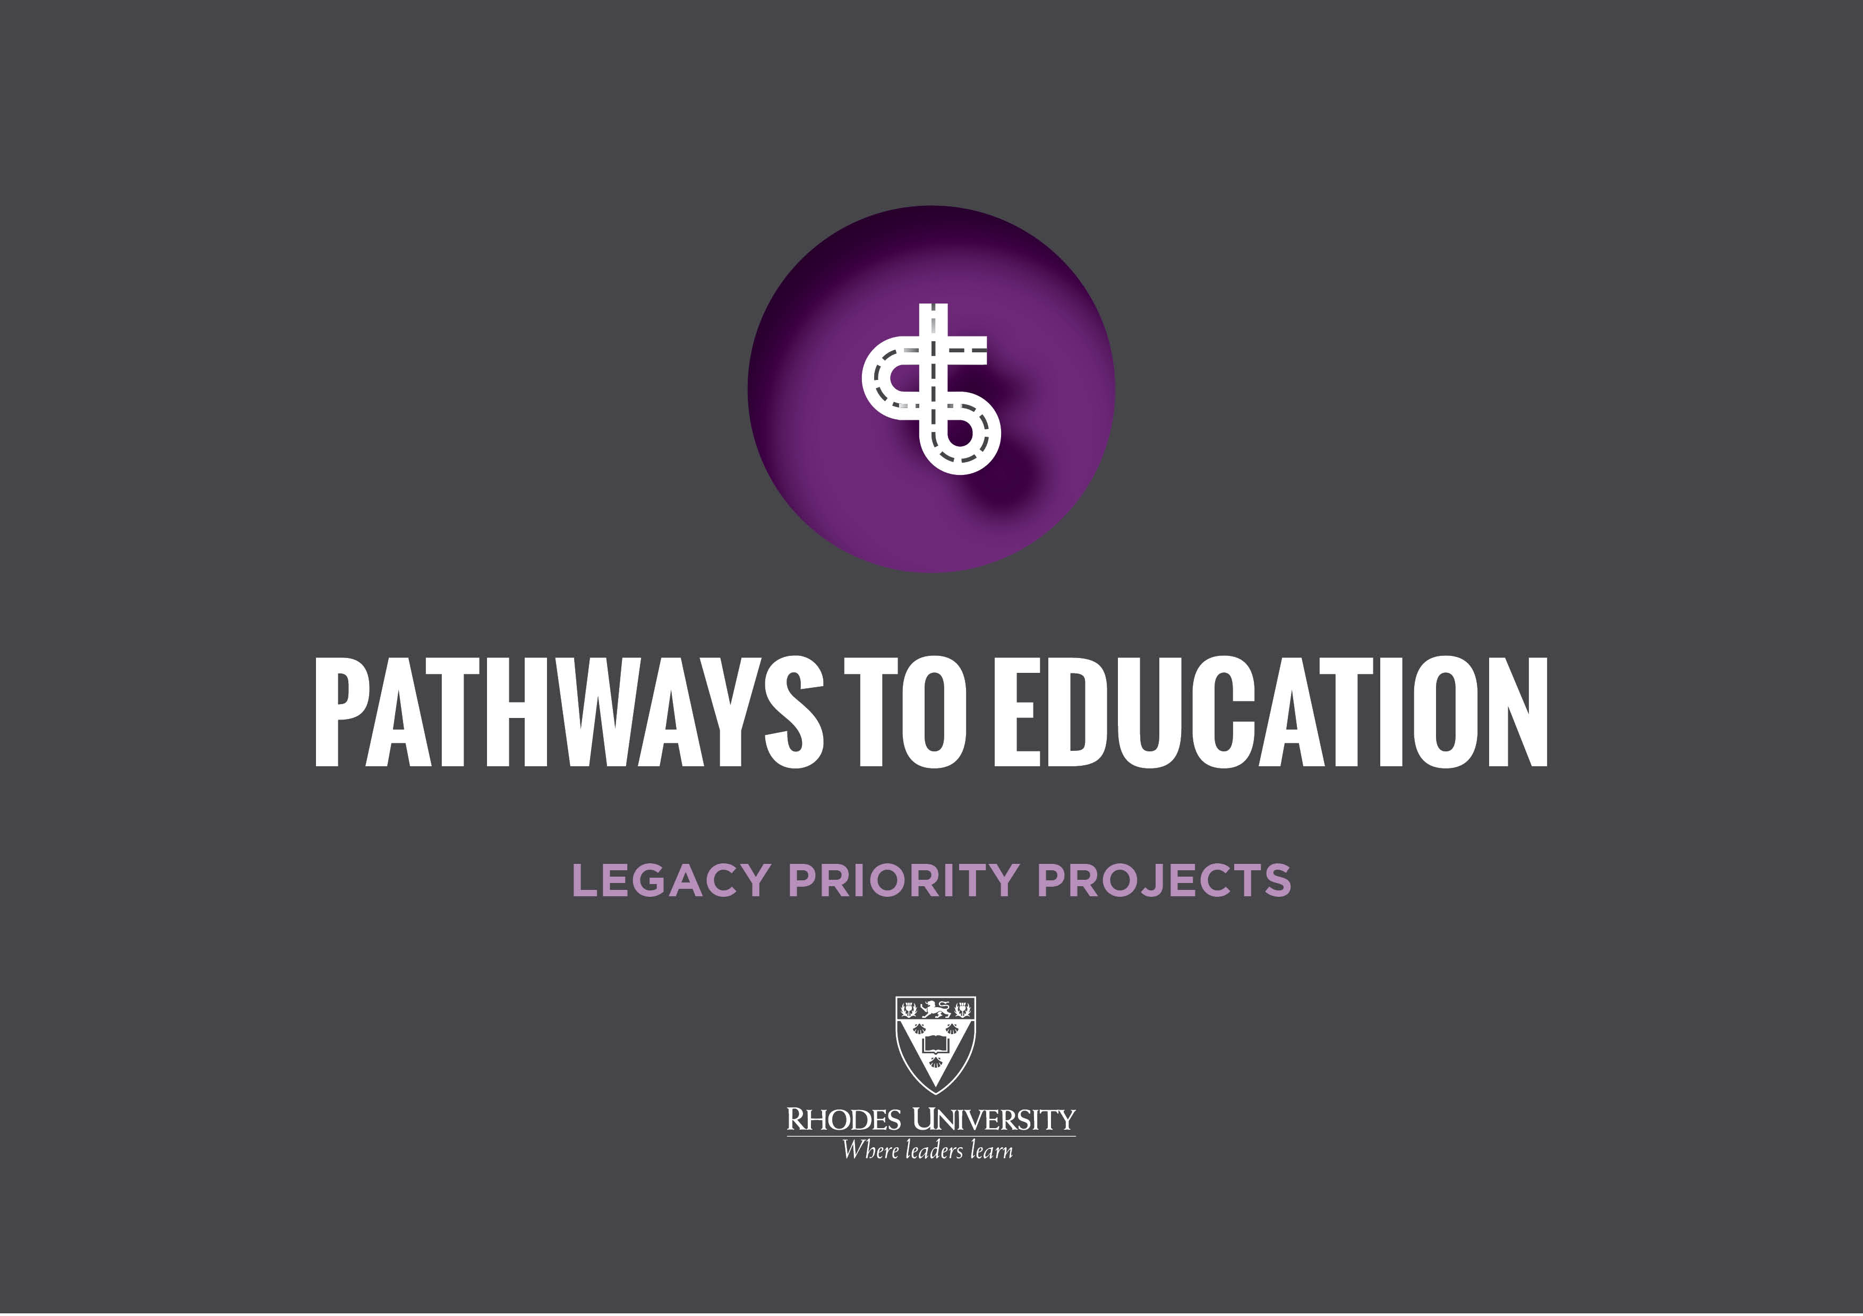

Slide 2
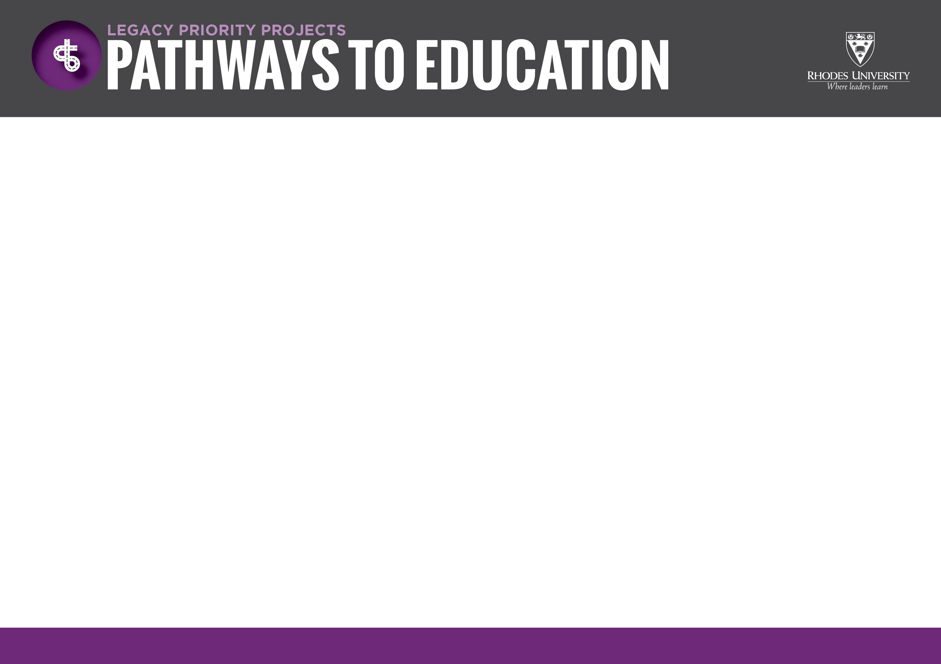
“As an institution of higher learning, we cannot site and watch when young people amongst us are condemned to a life without hope; a life of despair because of the failure to provide them with the education they need and deserve. We must brighten the corner where we are .” Prof Sizwe Mabizela, Vice-Chancellor
ABOUT THE PROJECT
Pathways - a project to enhance the capacity of the historically disadvantaged schools in Makhanda
It’s the University’s investment in the Makhanda community, conceptualised & implemented in collaborative partnerships
Two civic bodies at forefront of facilitating shared growth & development in our town
Strategies cover two areas:
Provide second chances to underprivileged senior grades learners in the townships
Strengthening wide civil society cooperation for open, transparent & accountable governance of the city.

Slide 3
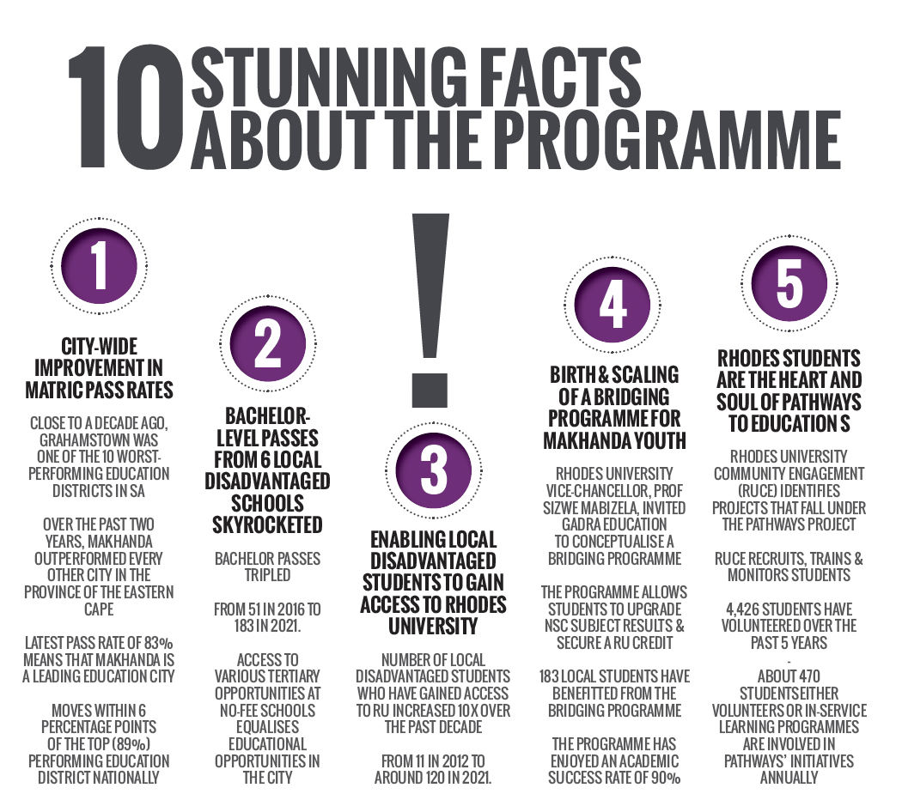
City-wide improvement in matric pass rates
Close to a decade ago, Grahamstown was one of the 10 worst-performing education districts in SA
Over the past two years, Makhanda outperformed every other city in the province of the Eastern Cape
Latest pass rate of 83% means that Makhanda is a leading education city
Moves within 6 percentage points of the top (89%) performing education district nationally.
Bachelor-level passes from 6 local disadvantaged schools skyrocketed
Bachelor passes tripled from 51 in 2016 to 183 in 2021.
Access to various tertiary opportunities at no-fee schools equalises educational opportunities in the city.
Enabling local disadvantaged students to gain access to Rhodes University
Number of local disadvantaged students who have gained access to RU increased 10x over the past decade
From 11 in 2012 to around 120 in 2021.

Slide 4
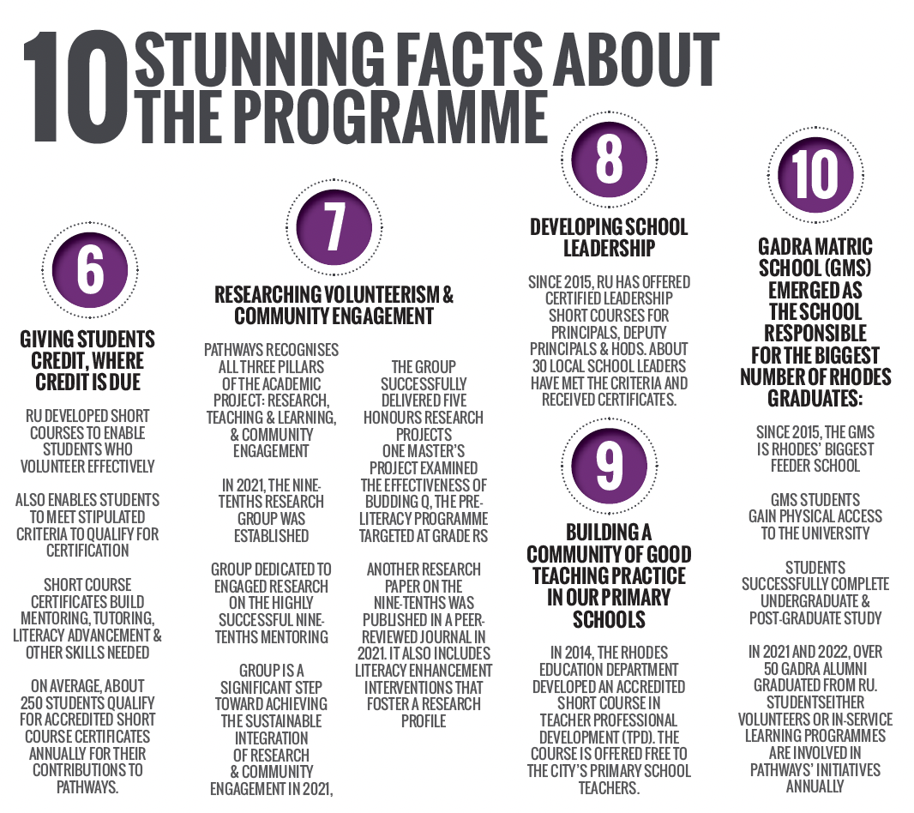
RU students are the heart and soul of Pathways to Education
Rhodes University Community Engagement (RUCE) identifies projects that fall under the Pathways project
RUCE recruits, trains & monitors students
4,426 students have volunteered over the past 5 years
About 470 students - either volunteers or in-service learning programmes are involved in Pathways’ initiatives annually.
Giving students credit, where credit is due
RU developed short courses to enable students who volunteer effectively
Also enables students to meet stipulated criteria to qualify for certification
Short course certificates build mentoring, tutoring, literacy advancement & other skills needed
On average, about 250 students qualify for accredited short course certificates annually for their contributions to Pathways .
Birth & scaling of a bridging programme for Makhanda youth
Rhodes University Vice-Chancellor, Prof Sizwe Mabizela, invited GADRA Education to conceptualise a bridging programme
The programme allows students to upgrade NSC subject results & secure a RU credit
183 local students have benefitted from the bridging programme
The programme has enjoyed an academic success rate of 90%.

Slide 5
In 2021, the group successfully delivered five honours research projects
One master’s project examined the effectiveness of Budding Q, the pre-literacy programme targeted at Grade Rs
Another research paper on the Nine-Tenths was published in a peer-reviewed journal in 2021. It also includes literacy enhancement interventions that foster a research profile
Researching volunteerism & community engagement
Pathways recognises all three pillars of the academic project: Research, teaching & learning, & community engagement
In 2021, the Nine-Tenths Research Group was established
Group dedicated to engaged research on the highly successful Nine-Tenths Mentoring
Group is a significant step toward achieving the sustainable integration of research & community engagement
Developing school leadership
Since 2015, RU has offered certified leadership short courses for principals, deputy principals & HoDs. About 30 local school leaders have met the criteria and received certificates.

Slide 6
Gadra Matric School (GMS) emerged as the school responsible for the biggest number of Rhodes graduates:
Since 2015, the GMS is Rhodes’ biggest feeder school
GMS students gain physical access to the university
Students successfully complete undergraduate & post-graduate study
In 2021 and 2022, over 50 GADRA alumni graduated from RU.
Building a community of good teaching practice in our primary schools
In 2014, the Rhodes Education Department developed an accredited short course in Teacher Professional Development (TPD). The course is offered free to the city’s primary school teachers.

Slide 7
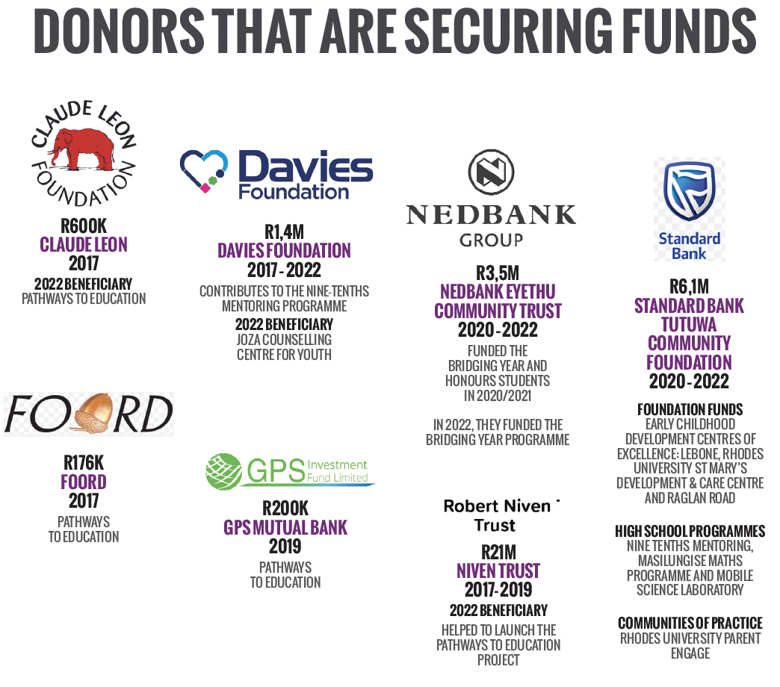

Pathways to Education
Contributes to Nine-Tenths Mentoring Programme
2022 beneficiary: Joza Counselling Centre for Youth
Pathways to Education
Pathways to Education

Slide 8
Funded the bridging year & honours students in 2020/2021
In 2022, they funded the Bridging Year Programme
Foundation funds:
Early Childhood Development Centres of Excellence: Lebone, Rhodes University St Mary’s Development & Care Centre & Raglan Road
High school programmes: Nine Tenths Mentoring, Masilungise Maths Programme & Mobile Science Laboratory
Communities of Practice: Rhodes University Parent Engagement Programme & School Leadership Programme
Helped to launch the Pathways to Education Project

