Slide 1
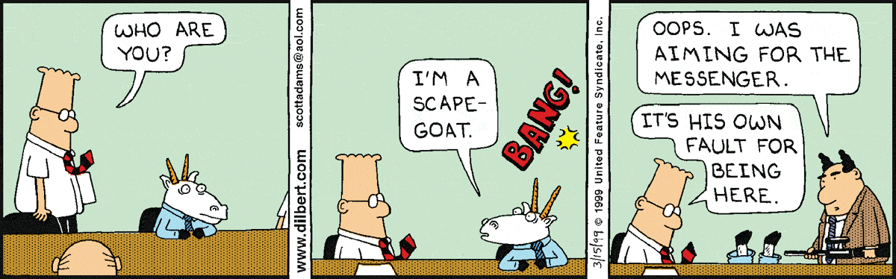
Ethical approval of research using aquatic animals
Past, present and future

Slide 2

… the Journal will not publish studies that might cause unnecessary, avoidable or insufficiently justified adverse effects, or lasting harm, to a sentient animal.”
… evidence is required to show that protocols involving the use of animals have undergone an ethical review process …

Slide 3
Terms
RUESC – Rhodes University Ethical Standards Committee
RUESC-AE - Rhodes University Ethical Standards Committee – Animal Experiments
NHREC - National Health Research Ethics Council
SANS - South African National Standards (a division of the SA Bureau of Standards)

Slide 4
The current scenario
For RU to be accredited, we need to follow NHREC rules.
Recently NHREC requested to abandon all departmental reviews and allow approval only by RUESC.
The problem
  RUESC lacks expertise (for example in aquatic animal research).
  The process takes longer than using departmental committees, and it includes revisions.
  The process will be audited regularly to maintain accreditation status.
  Urgent need for dedicated staff on RUSESC (but very little support from RU)

Slide 5
SANS official definition of an animal
… any live, sentient non-human vertebrate, including eggs, foetuses and embryos, that is, fish, amphibians, reptiles, birds and mammals, and encompassing domestic animals, purpose-bred animals, farm animals, wildlife … and higher invertebrates such as the advanced members from the Cephalopoda and Decapoda…
Abalone are not animals?
SANS, 2002, page 6, 3.1,

Slide 6
The three Rs
Reduction
Replacement
Refinement
But: A review of ethical applications should not become a review of experimental design!

Slide 7
The current process at the DIFS
Research proposal (student or project supervisor, or teaching exercise)
Collection of proposals by a coordinator
Present proposals to all staff members to get comments; if the proposal is deemed acceptable, approve internally.
Collate all proposals and send them to RUESC.
Ratification and archiving of all documents to make them available to interested parties.
If approved,
research starts.

Slide 8
The process requested by NHREC
Research proposal (student or project supervisor, or teaching exercise)
All proposals must go directly to the RUESC.
RUESC reviews them by at least two “experts”, chosen by the RUESC chairperson.
Feedback to applicant(s) and revisions, if needed (2-3 weeks).
Review revisions, approve (2-3 weeks)
If approved,
research starts.

Slide 9
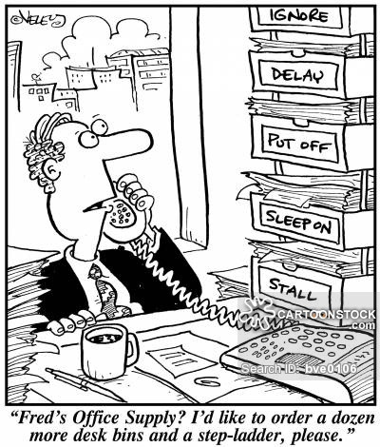
Consequences
More work for RUESC
  (300-400 applications/year)
Lack of staff and expertise
Delays
“Reviewer fatigue”
“Rhodes office supply? I’d like to
order a dozen more desk bins and
a step-ladder, please”.

Slide 10
The proposed new process
Research proposal (student / project supervisor, or teaching exercise)
Collection of proposals by DIFS coordinator
Present proposals to two internal reviewers to get comments. If the proposal is deemed acceptable it will be tentatively approved.
Collate all proposals and reviewers’ comments and send them to RUESC.
Ratification and archiving of all documents to make them available to interested parties.
When approved,
research starts.

Slide 11
The internal review process
The positive side
  Done by experts
  Fairly fast
The problem
  Poor reputation
    “Colleagues review colleagues”
    “Will projects ever be rejected”?
The solution
  Regular auditing

Slide 12
Step 1: “Risks and major concerns”
Is there a risk that animals will be harmed unnecessarily?
Has the applicant ignored the three “Rs”?
Is the proposed study very obviously unethical?
Unsolvable conflicts of interest?
YES
No
No internal review
Proposal goes to RUESC
RUESC to make decisions
Continue internal review
RUESC to check, ratify or moderate

Slide 13
Step 2: Internal review questionnaire
Did the applicant attend to the 3 Rs?
Will harm to animals be minimised?
Is the study scientifically sound and ethically acceptable?
Are the methods of euthanasia acceptable?
Will dead animals be properly discarded?
Are there environmental impacts?
  Conservation status of animals
Monitoring and tracking of specimens!

Slide 14
Departmental review: The basic requirements
Compliance
  Reviewers must make comments.
  All students, staff and post-docs, must submit applications.
  Departmental committees must be seen as being reliable and consistent.
Accountability
  Dating and archiving of documents

Slide 15
FAQs

Slide 16
Are fish sentient?
Do fish feel pain?
Wrong questions!
Fish are listed as “animals” by SANS and NHREC, thus also by the RUESC.
Many journals will refuse manuscripts without ethics approval.
Therefore, ethical issues apply, irrespective of scientific knowledge.

Slide 17
How to kill fish? (1)
General term of reference
  Method should render fish unconscious until death without avoidable excitement, pain or suffering. (de Vis et al. 2013)
Problem
  Physiological differences between species

Slide 18
How to kill fish? (2)
  Atlantic salmon
    No obvious best method; possibly electrical stunning, but more research is needed
  Gilt-head seabream
    Concussion and electrical stunning
  Eel
    Electricity in combination with nitrogen gas
  Zebrafish
    Rapid cooling – but the methods is still controversial

Slide 19
Comments?
DIFS / SAIAB?
Invertebrates?
Circulate a draft questionnaire for reviewers and implement your suggestions?
Improve methods to streamline the departmental process to save time and administrative effort.

Slide 20
References
South African National Standards Document
  The care and use of animals for scientific purposes
RUESC website
SAIAB Ethics Policy and application form
Canadian Council on Animal Care
  “Guidelines on: the care and use of fish in research, teaching and testing”
Procedures used by many other Universities

