Slide 1
References used according to the letters given at the bottom of the slides
A: Santer, RM, Walker, MG Emerson, L, Witthames, PR (1983) On the morphology of the heart ventricle in marine teleost fish (Teleostei), Comp. Biochem. Physiol. Vol. 76A, No. 3, pp. 453-457.
B: Ostrander, GK (2000) The Laboratory Fish. Academic Press.
C: Farrell, AP (1991) From Hagfish to Tuna: A Perspective on Cardiac Function. Fish Physiological Zoology, 64, (5), 1137-1164; URL: http://www.jstor.org/stable/30156237
D: Evans, HE, Clairborne, JB (2006) The Physiology of Fishes, Third edition. CRC, Taylor and Francis. Marine Biology Series.
E: Root, RW (1931) The respiratory function of the blood of marine fishes. Biological Bulletin of the Marine Biology Laboratory, Woods Hole, 61, 427-457.
F: Radull, J (2002) Investigations on the use of metabolic rate measurements to assess the stress response in
juvenile spotted grunter, Pomadasys commersonnii (Haemulidae, Pisces). PhD thesis, Rhodes University.
G: Kaunahama, K (2008) Effect of salinity on stress response of juvenile white steenbras, Lithognathus lithognathus. MSc thesis, Rhodes University
H: Jobling, M (1998) Fish bioenergetics. Chapman and Hall, London.
I: An Overview of the Histological Study of Marine Finfish; http://research.myfwc.com/features
J: Hontela and Stacey 1990. General Concepts of Seasonal Reproduction. In: Munro, A.D., Scott, A.P., Lam, T.J. (Eds.), Reproductive Seasonality in Teleosts: Environmental Influences. CRC, Press, Boca Raton, pp. 53–78.
K: Arukwe, A, Goksøyr, A (2003) Eggshell and egg yolk proteins in fish: hepatic proteins for the next
generation: oogenetic, population, and evolutionary implications of endocrine disruption. Comparative Hepatology, 2:4, 1-21.
L: Hibiya, T (1982) An atlas of fish histology. Normal and Pathological Features. Gustav Fischer Verlag.
M: Atlas of fathead minnow normal histology; http://aquaticpath.umd.edu/fhm/resp.html
N: Fielder, DS, Allan GL, Pepperall, D, Pankhurst PM (2007) The effects of changes in salinity on osmoregulation and chloride cell morphology of juvenile Australian snapper, Pagrus auratus, Aquaculture 272: 656–666.
O: de Jesus, EG, Toledo, JD, Simpas, MS (1998) Thyroid hormones promote early metamorphosis in grouper (Epinephelus coioides). General and Comparative Endocrinology, 112: 10-16.

Slide 2
Fish physiology
Horst Kaiser
Ichthyology II, 2012

Slide 3
Respiration

Slide 4
Life in water (1/2)
Water is 840 times more dense and 60 times more viscous than air.
Oxygen:
  Air: 210 ml/L O₂ at 21% partial pressure
  Water: up 15 mg/L O₂ (dep. on temperature)
  Sea water holds 18% less O₂ than freshwater
Oxygen consumption in fish
  17 mg/kg/h @10°C
  100-500 mg/kg/h @ 30°C
More than 40 genera of fishes breath oxygen using other methods than their gills.

Slide 5
Life in water (2/2)
Energy demand to accomplish respiration:
  approx. 50% of total demand but can be up to 90%
Blood volume: 2-4 mL / 100 g; (nucleated RBC)
Gill surface area: 150–300 mm² / g tissue
Systolic blood pressure: about 44 mm Hg
Gill irrigation: 5-20 L H₂O / kg BM / h
Opercular beat counts: 40-60 / minute

Slide 6
Henry’s law
VO₂ = α PO₂
VO₂ = O₂ concentration in ml/L (or mg/L)
α = solubility coefficient: the volume of O₂
dissolved in water: ml O₂/L/atm
PO₂ = PO₂ partial pressure (atm)

Slide 7
Metabolism of trout vs turtle
 | Trout | Turtle
Oxygen requirement | ~ 5 ml / min / kg | ~ 5 ml / min / kg
Ventilation volume | 600 ml H₂O / min / kg | 50 ml air / min / kg
Routine costs for ventilation | 10 % | 2 %
ref. D

Slide 8
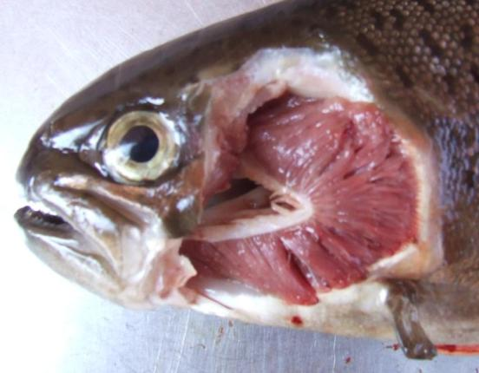
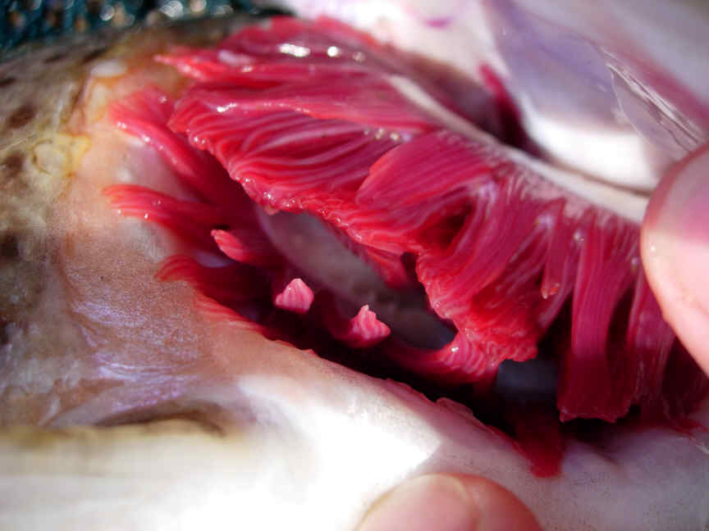
Water flow
Blood flow
Water flow
Blood flow
Water flow

Slide 9
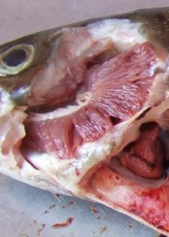
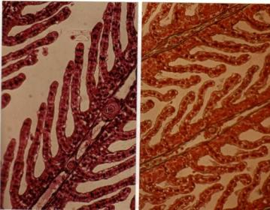
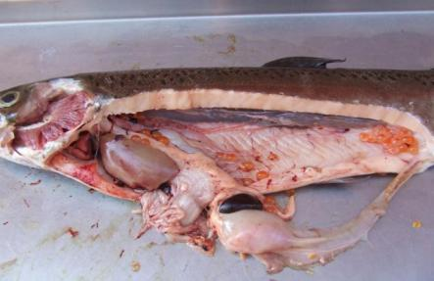
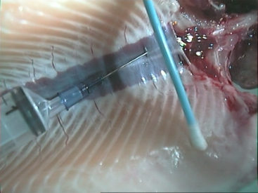
Gills and kidney: Osmoregulatory organs

Slide 10
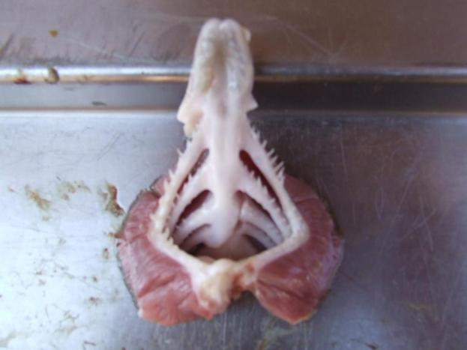
PAIRED HOLOBRANCHS
tongue
Gill rakers
Four paired holobranchs

Slide 11
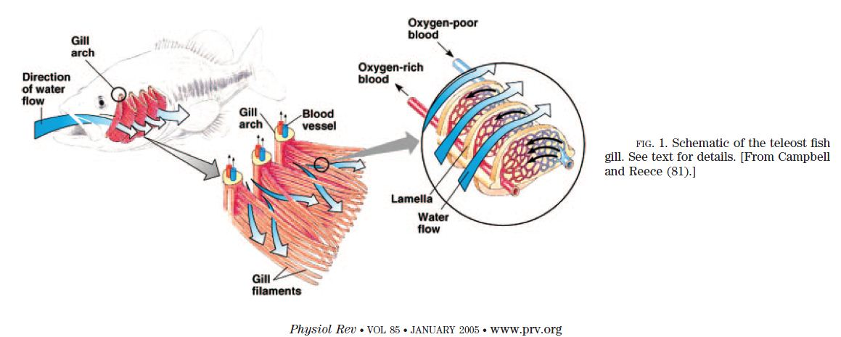

Slide 12
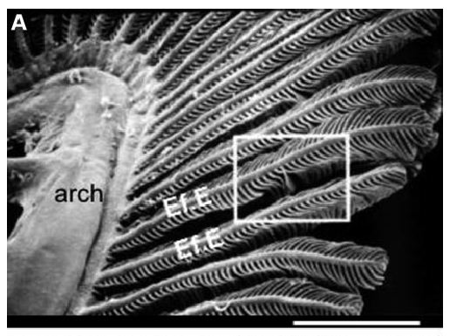

Slide 13
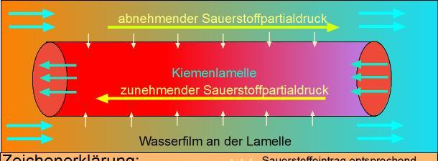
Countercurrent exchange
The difference in oxygen partial pressure PO₂ between water and plasma strongly influences the uptake of oxygen at the gill lamella / water interface!
Decreasing oxygen level
Increasing oxygen level
Water interface at the lamella

Slide 14
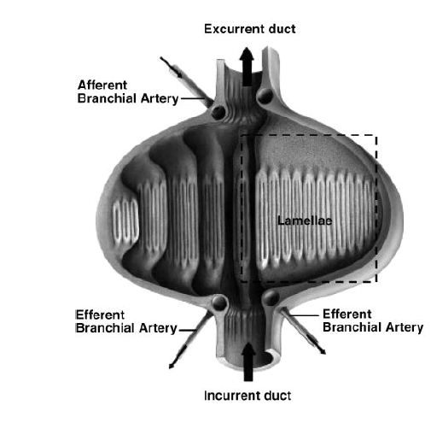

Hagfish gill pouch

Slide 15
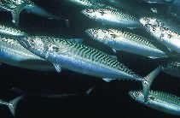
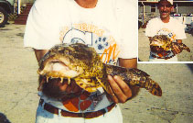
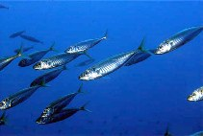
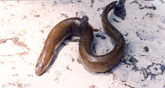
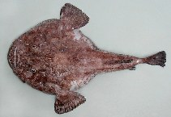
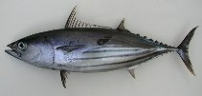
Oyster toadfish
Opsanus tau
Atlantic mackerel
Scomber scombrus
Horse mackerel
Trachurus trachurus
Eel, Anguilla japonica
Skipkack tuna, Katsuwonus pelamis
Angler
Lophius piscatorius

Slide 16
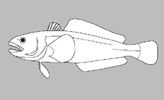
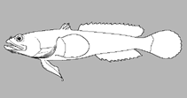
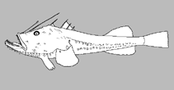
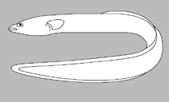
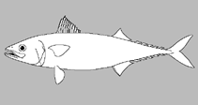
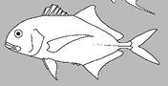

Slide 18
Oxygen consumption in grunter
Data are from John Radull’s thesis

Slide 19
Oxygen consumption in grunter
Data are from John Radull’s thesis

Slide 20
Possible explanations for metabolic rate changes with size
Developmental changes of relative weights of different organs
  Liver and gills weigh relatively less
  Swimming musculature becomes more developed
Metabolic intensities of different tissues may decline with increasing size (age)
Differences between species
Possible effect of test temperature
Possible interactions between temperature and species
Salinity?

Slide 21
Metabolic rate in fish
Standard metabolic rate (SMR)
Routine metabolic rate (RMR)
Active metabolic rate (AMR)
Metabolic scope (MS): MS = SMR – AMR

Slide 22
ref. F

Slide 23
Intermittent respirometry
Mechanical stirrer
Oxygen probe
Syringe
Water flow
Glass flask
Water flow
ref. G

Slide 24
Intermittent respirometry and its applications
Some research examples and applications

Slide 25
The effect of handling stress on metabolic rate changes in spotted grunter
Ref.: Radull et al. 2000

Slide 26
ref. F

Slide 27
Let’s design an intermittent respirometer:
Basic data for a small fish species
  Oxygen consumption: 500 mg O₂ / kg / hour
  Fish biomass: 12 g (we will use 1 fish)
  Oxygen consumption per fish: ? mg O₂ / hour
  O₂ at start of measurement: 9 mg / L O₂
  Critical lower limit: 6 mg / L O₂
  How many minutes should one measurement take assuming the volume of the respirometer is 1000 mL (1 Liter)?

Slide 28
Let’s design an intermittent respirometer:
Basic data for a small fish species
  Oxygen consumption: 500 mg O₂ / kg / hour
  Fish biomass: 12 g
  Oxygen consumption: ? mg O₂ / hour
    500 mg O₂ / (1000 g / 12 g) / hour = 6 mg / hour
  O₂ at start of measurement: 9 mg / L O₂
  Critical lower limit: 6 mg / L O₂
    Consumption: 9 – 6 mg = 3 mg O₂
  How many minutes should one measurement take?
    3 mg O₂ / (6 mg O₂ / hour) = 0.5 hours = 30 minutes

Slide 29
Respiration
Ventilation
O₂ diffusion
O₂ diffuses across capillary walls & cytoplasm to mitochondria
Once O₂ has been offloaded CO₂ diffuses into the RBC
CO₂ is transported to gills and excreted
O₂ dissolves into plasma
O₂ binds to haemoglobin in RBCs

Slide 30
Osmo-regulation
Acid-base
balance
Respiration
Nitrogen-
excretion

Slide 31
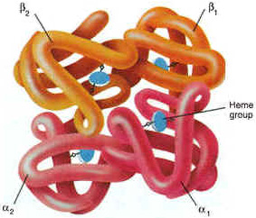
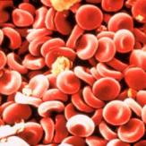
Hemoglobin (Hb)
Fish have nucleated red blood cells!
Some species have more than 1 type of Hb
Each protein molecule has 4 globin subunits each with one haem group to bind O₂
Hb exists in 2 states, a tense (T) state with low affinity to O₂, and a relaxed state (R) with high affinity.
A shift from T -> R increases O₂ binding capacity
The four units cooperate to increase O₂-uptake
What changes the state from T to R?

Slide 32
Carbon dioxide transport – the chemistry of CO₂ in water
CO₂
+
H₂O
H₂CO₃
HCO₃⁻
+
H⁺
Carbon dioxide
Carbonic acid
Bicarbonate ion

Slide 33
Carbonic anhydrase speeds up carbon dioxide dissociation in the cell
Extracellular
Slow reaction
CO₂
+
H₂O
H₂CO₃
HCO₃⁻
+
H⁺
Carbonic anhydrase
Fast reaction
CO₂
+
H₂O
H₂CO₃
HCO₃⁻
+
H⁺
Red blood cell

Slide 34
Carbonic anhydrase speeds up carbon dioxide dissociation at the tissues
HCO₃⁻ transport to plasma
in exchange for Cl⁻
Carbonic anhydrase
Fast reaction
CO₂
+
H₂O
H₂CO₃
HCO₃⁻
+
H⁺
Drop in pH !
Hemoglobin changes state
and releases O₂
O₂ diffuse to plasma
and tissues

Slide 35
Carbonic anhydrase speeds up carbon dioxide dissociation at the gills
Carbonic anhydrase
CO₂ diffusion to plasma
and water
Fast reaction
HCO₃⁻
+
H⁺
H₂CO₃
CO₂
+
H₂O
HCO₃⁻ transport to blood
cell in exchange for Cl⁻
Release of CO₂ increases pH
Hemoglobin changes state and is
ready to pick up O₂ at the gills.

Slide 36
Bohr effect
higher pH
(gills)
lower pH
(tissues)
Exponential increase
due to Hb subunit
cooperation
Percent saturation of Hb with O₂
Dissociation curves parallel
Partial pressure of oxygen (PO₂)
Reduced affinity under acidic conditions
ref. B

Slide 37
Bohr effect – species differences
Sessile species with high Hb-affinity to oxygen
Can cope with low-oxygen conditions
Percent saturation of Hb with O₂
Active species with low Hb-affinity to oxygen
Requires high oxygen levels to survive.
Partial pressure of oxygen (PO₂)
Reduced affinity under acidic conditions
ref. B

Slide 38
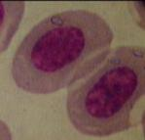
CO₂
Gill interface
Blood stream
O₂
CO₂
pH
pH
O₂
to organs
Increased Bohr and root effect
Excess CO₂ through respiration,
and in water
O₂
CO₂
Hyper-
capnia
Reduced opercular movement
-> impaired CO₂ excretion
Hyper-
lacticaemia
Drop in blood pH (lactic acid, stress,
excessive swimming)

Slide 39
Why is the Root effect unique to fish?
Oxygen supply to the retina
Gas bladder function

Slide 40
Release of gas from the gas bladder
Physostomous fishes
  Pneumatic duct to the gut in most but not all species
Physoclistous fishes
  Closed gas bladder
  Release gas into the blood (specialised oval area)
  Excess gas is carried to the gills

Slide 41
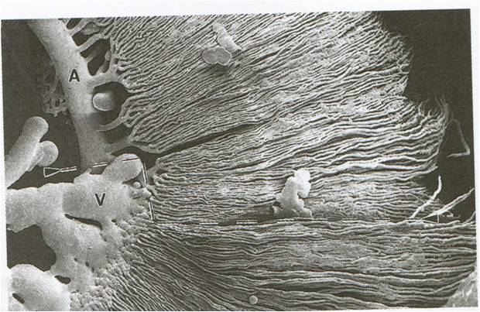
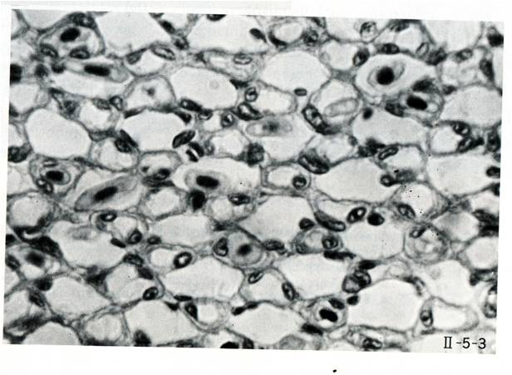
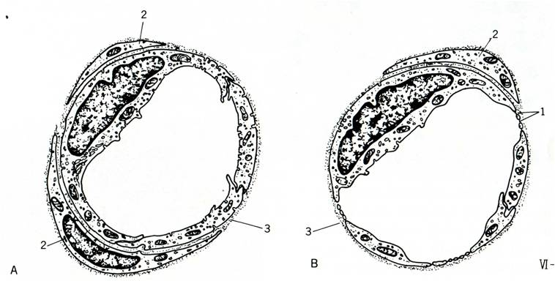
The rete counter-current system
Eye
Example: gas bladder rete in eel
Cross section: 5 mm²
Volume: 21 mm³
Surface area: 30 cm²
Capillaries: 20.000 to 40.000
Artery diameter: 9 - 10 µm
Venous capillary: 11 – 13 µm
Diffusion distance (capillaries): 1 µm
Capillary length: 4 mm
Holes in capillary: 20 – 80 nm
Hole diaphragm: 5 nm
Gas bladder
ref. B

Slide 42
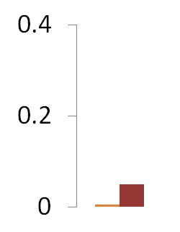
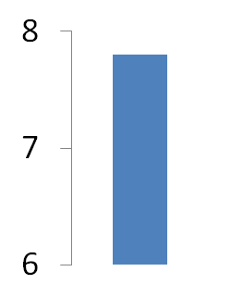
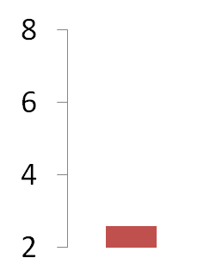
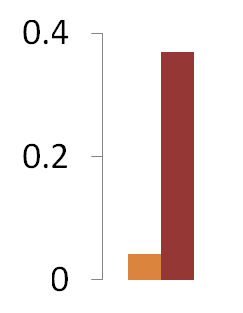
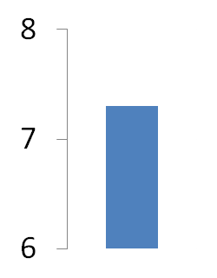
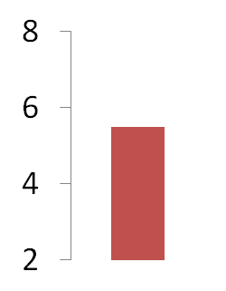


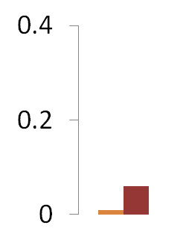
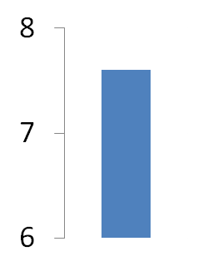
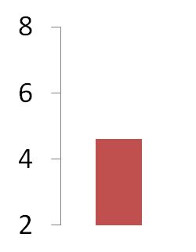
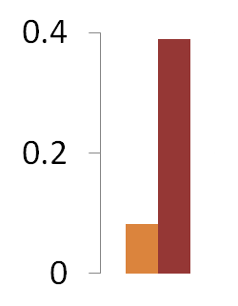
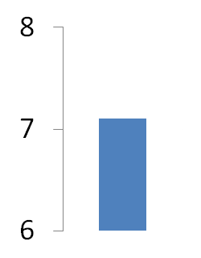
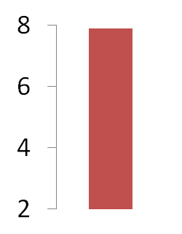
Pre-rete Arterie
Rete mirabile: Changes of gas content, pH
and lactate in the capillaries
PCO₂ / PO₂
pH
Lactate
PCO₂ / PO₂
pH
Lactate
Post-rete Arterie
Gas
gland
epithelium
O₂
Rete
mirabile
CO₂
PCO₂ / PO₂
pH
Lactate
PCO₂ / PO₂
pH
Lactate
Bladder caps
Pre-rete Vein
Three processes:
Bohr / Root shift
Salting out
Counter-current diffusion
Secretory bladder
Post-rete Vein
ref. D

Slide 43
Root effect
O₂ Saturation is not reached
even if sufficient O₂ available!
higher pH
(gills)
Subunit
cooperation
Percent saturation of Hb with O₂
Some subunits fail to load O₂
much lower pH
(retina / swimbladder)
Partial pressure of oxygen (PO₂)
Decreased capacity under acidic conditions

