Slide 1
post-school
education
and the labour market in south africa
edited by michael rogan

Slide 2


Labour Market Intelligence Partnership (LMIP)
http://www.lmip.org.za/
The LMIP project is undertaken by a research consortium led by the Human Sciences Research Council, and is funded by the
Department of Higher Education and Training
Theme 5:
Pathways through Education and Training and into the Labour Market

Slide 3

Policy Framework:
Increase total PSET enrolments to 5.6 million by 2030- a roughly 150% increase in total enrolments between 2015 and 2030
Increase enrolments in vocational education in particular
Three-fold increase in university enrolments in SET (Science, Engineering and Technology) qualifications by 2030

Slide 4
South Africa In Global Comparison

Slide 5
South African Context:
A low (19.4%) tertiary enrolment rate (in global comparison)
High levels of youth (15-24 inclusive) unemployment- 54.2% - 62.5%
Not in employment, education, or training (NEETs)

Slide 6
‘NEETs’ by age group, 2016
Source: Own calculations from the QLFS (2016:3)

Slide 7
‘NEETs’ status by levels of education (age 20-34)
Source: Own calculations from the QLFS (2016:3)

Slide 8
‘NEETs’ status by levels of education (age 20-34)
Source: Own calculations from the QLFS (2016:3)

Slide 9
‘NEETs’ status by levels of education (age 20-34)
Source: Own calculations from the QLFS (2016:3)

Slide 10
Theme 5 questions:
1) Why are so many young people not in either employment or education?
2) Why are some young people with a post-schooling education not in employment or education?

Slide 11
Selected Findings

Slide 12
The 2008 NSC cohort (van Broekhuizen et al.- Chapter 5)
Source: Authors’ own calculations using integrated unit-record 2008 NSC and 2009 – 2014 HEMIS data.

Slide 13
The 2008 NSC cohort (van Broekhuizen et al. - Chapter 5)
Estimated conditional university access, completion, and dropout premiums for learners from quintile 2 – 5 schools, relative to quintile 1 learners from the 2008 NSC cohort.
 | 1-year access | 6-year access | 4-year completion | 6-year completion | 5-year dropout | 6-year conversion
 | (All undergraduate programmes)
Quintile 2 | -0.2** | -0.1 | -2.6*** | -1.1 | 0.9 | -0.3***
Quintile 3 | 0.6*** | 0.7*** | -4.8*** | -5.4*** | 4.7*** | -0.5***
Quintile 4 | 2.6*** | 3.0*** | -8.0*** | -7.1*** | 3.4*** | -0.1
Quintile 5 | 6.2*** | 5.6*** | -8.4*** | -6.7*** | 2.6*** | 0.7***
 | (Undergraduate degree programmes only)
Quintile 2 | -0.4*** | -0.3*** | -4.1*** | -2.2 | 0.6 | -0.4***
Quintile 3 | -0.4*** | -0.5*** | -7.2*** | -7.2*** | 5.0*** | -0.7***
Quintile 4 | 0.0 | -0.5*** | -12.0*** | -10.9*** | 4.0*** | -1.3***
Quintile 5 | 3.1*** | 1.9*** | -11.6*** | -9.7*** | 3.3*** | -0.3**

Slide 14
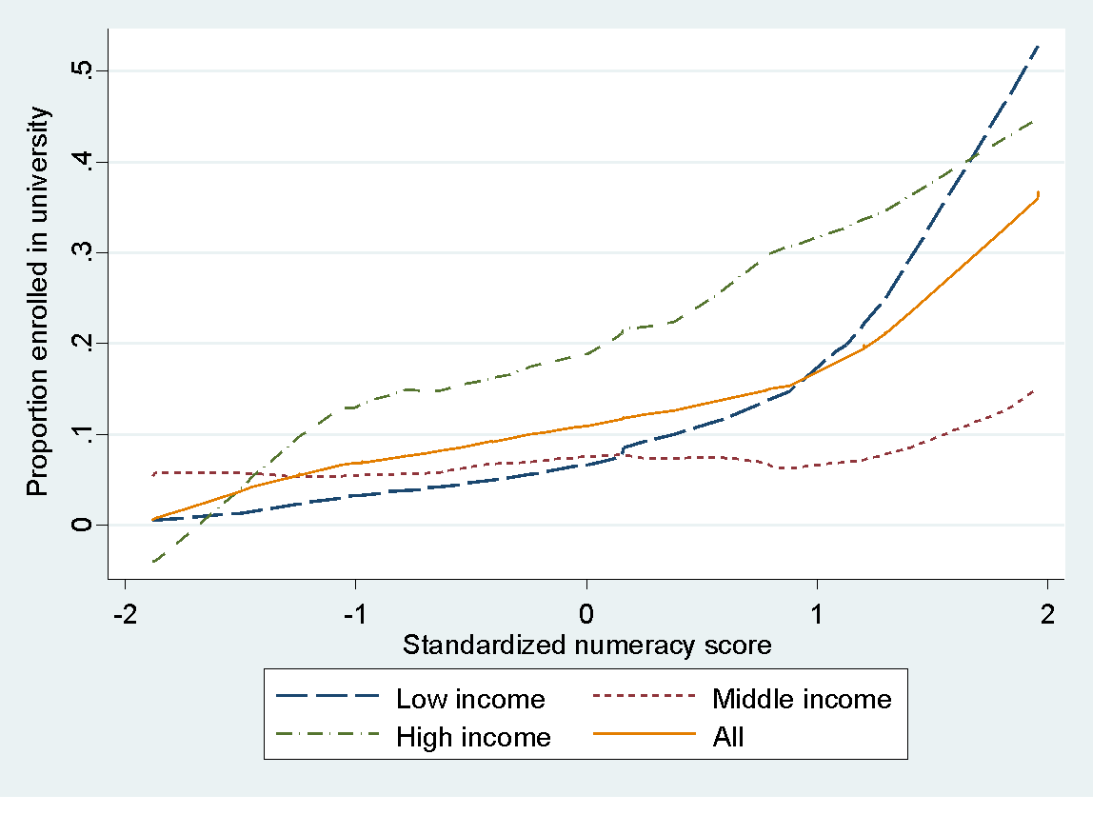
University enrolment (Branson and Kahn- Chapter 3)
Source: Authors’ own calculations from the National Income Dynamics Study

Slide 15
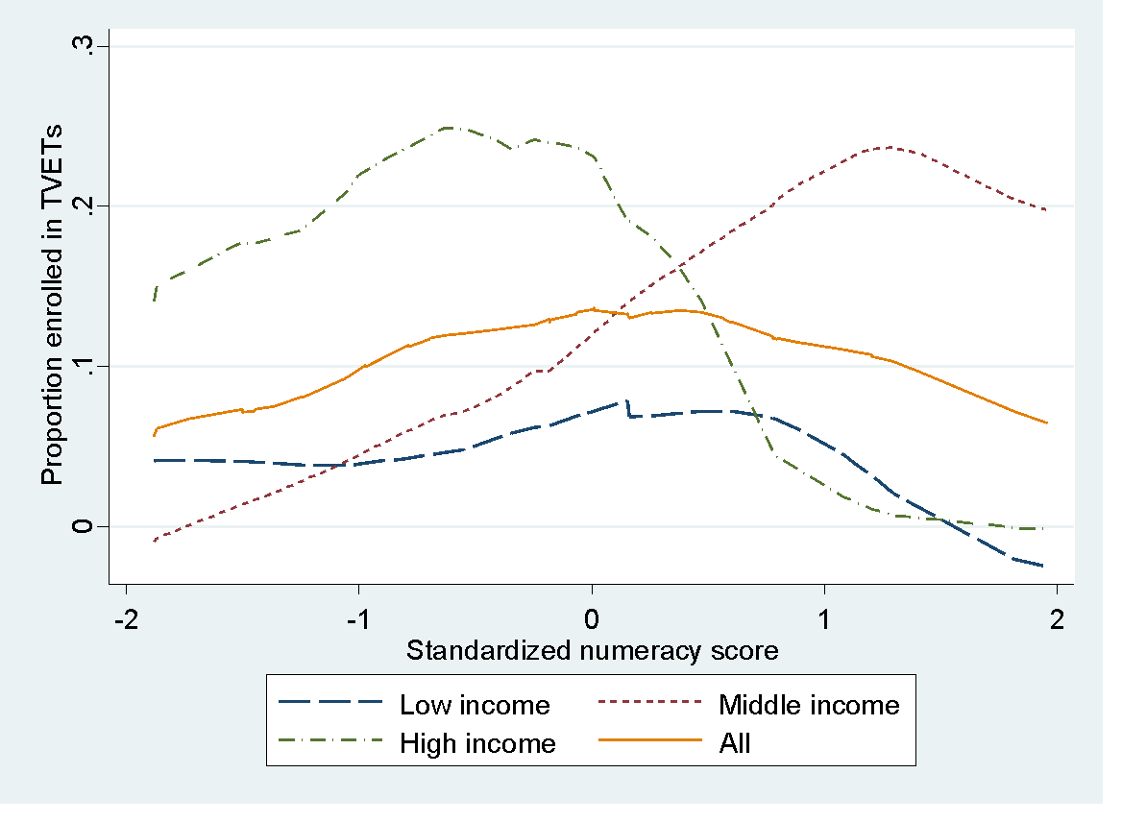
TVET enrolment (Branson and Kahn- Chapter 3)
Source: Authors’ own calculations from the National Income Dynamics Study

Slide 16
Graduate over-qualification and schooling quality (Rogan- Chapter 6)
 | Rhodes |  |  | Fort Hare
 | (1) | (2) | (3) | (4) | (5) | (6)
Female | 0.0899 (0.174) | 0.0408 (0.182) | -0.00104 (0.189) | -0.0286 (0.145) | 0.0536 (0.155) | 0.0347 (0.160)
Black | -0.266 (0.180) | -0.317* (0.190) | -0.260 (0.192) | --- | --- | ---
Schooling
Quintile 1-4 | 0.359* (0.208) | 0.335 (0.216) | 0.321 (0.217) | 0.362** (0.153) | 0.434*** (0.160) | 0.425** (0.170)
Higher grade math or science | -0.195 (0.178) | -0.207 (0.188) | -0.227 (0.197) | -0.193 (0.275) | -0.226 (0.296) | -0.125 (0.314)
Higher education
SET degree |  | -0.167 (0.232) | -0.242 (0.246) |  | 0.0111 (0.216) | -0.0831 (0.228)
Commerce degree |  | -0.167 (0.230) | -0.160 (0.230) |  | 0.367** (0.169) | 0.231 (0.181)
Distinction |  | -0.120 (0.293) | -0.303 (0.312) |  | 0.238 (0.280) | 0.0866 (0.305)
Employment characteristics
Public sector |  |  | -0.256 (0.266) |  |  | -0.116 (0.177)
Part-time |  |  | -0.0233 (0.275) |  |  | 0.551* (0.282)
Permanent |  |  | -0.466** (0.195) |  |  | -0.399** (0.168)
_cons | -1.239*** (0.212) | -1.133*** (0.227) | -0.718*** (0.260) | -1.375*** (0.152) | -1.505*** (0.187) | -1.166*** (0.250)
(unweighted) N | 376 | 368 | 354 | 504 | 437 | 418
Source: Authors’ own calculations

Slide 17
Conclusions:
Unevenness in access to higher education and vocational training
Inequalities persist in race and in schooling quality
Some of these disadvantages carry over into the labour market
Strong differences across the components of the PSET as well as between institutions (e.g. HBUs vs. HWUs)
An urgent need to improve the quality of data in order to monitor the outcomes of the ‘massification’ of the PSET system

Slide 18
Thank you

