Slide 1

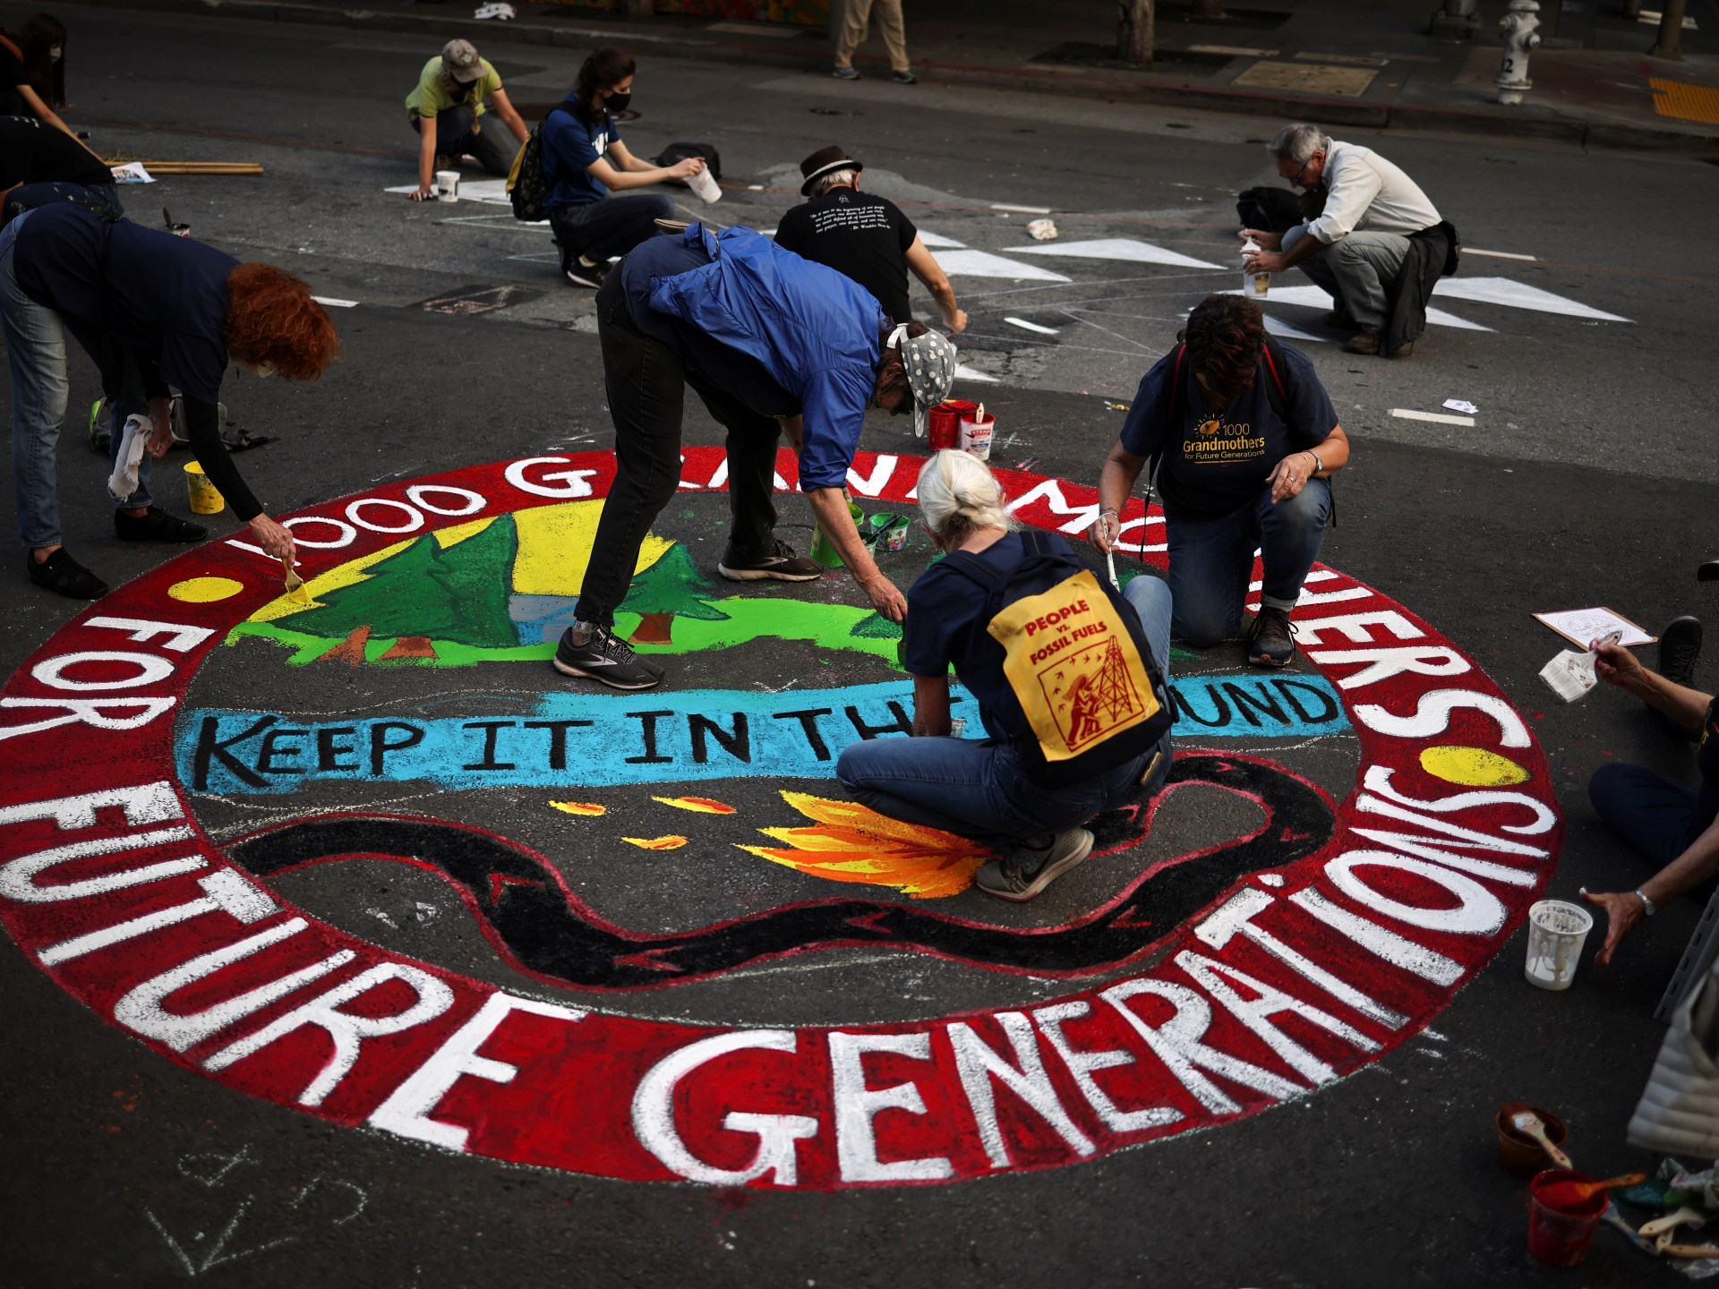
Science Cluster: Transformative Social Learning and Regenerative Sustainability Education
“Education systems are potentially powerful arenas for nurturing, or hindering, the younger generations’ development into smart radicals.” (Lopes Cardozo, 2022)
Focus: Education, Skills Development, Youth Learning Pathways, Regenerative Futures
Problem: Education systems are ‘out of sync’ with sustainability challenges, and are not providing well for young people’s futures ; the futures of work and learning are changing ; they need to be more inclusive, regenerative and visionary
Research community: Regional Environmental Education and ESD networks, youth movements involved in sustainability concerns in Africa
Research agenda: To be co-defined but our main focus will be how to better couple Transformative Learning, Education, Skills Development, Youth Learning Pathways, Regenerative Futures and meaningful responses to sustainability in and through education systems and practices

