Slide 1


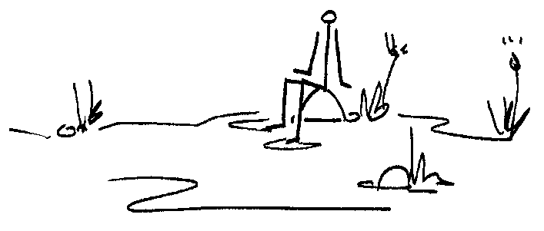
Too slow and too difficult?
Participatory Governance as a lever for Sustainable
Research-Based Interventions
Tally Palmer
Institute for Water Research

Slide 2
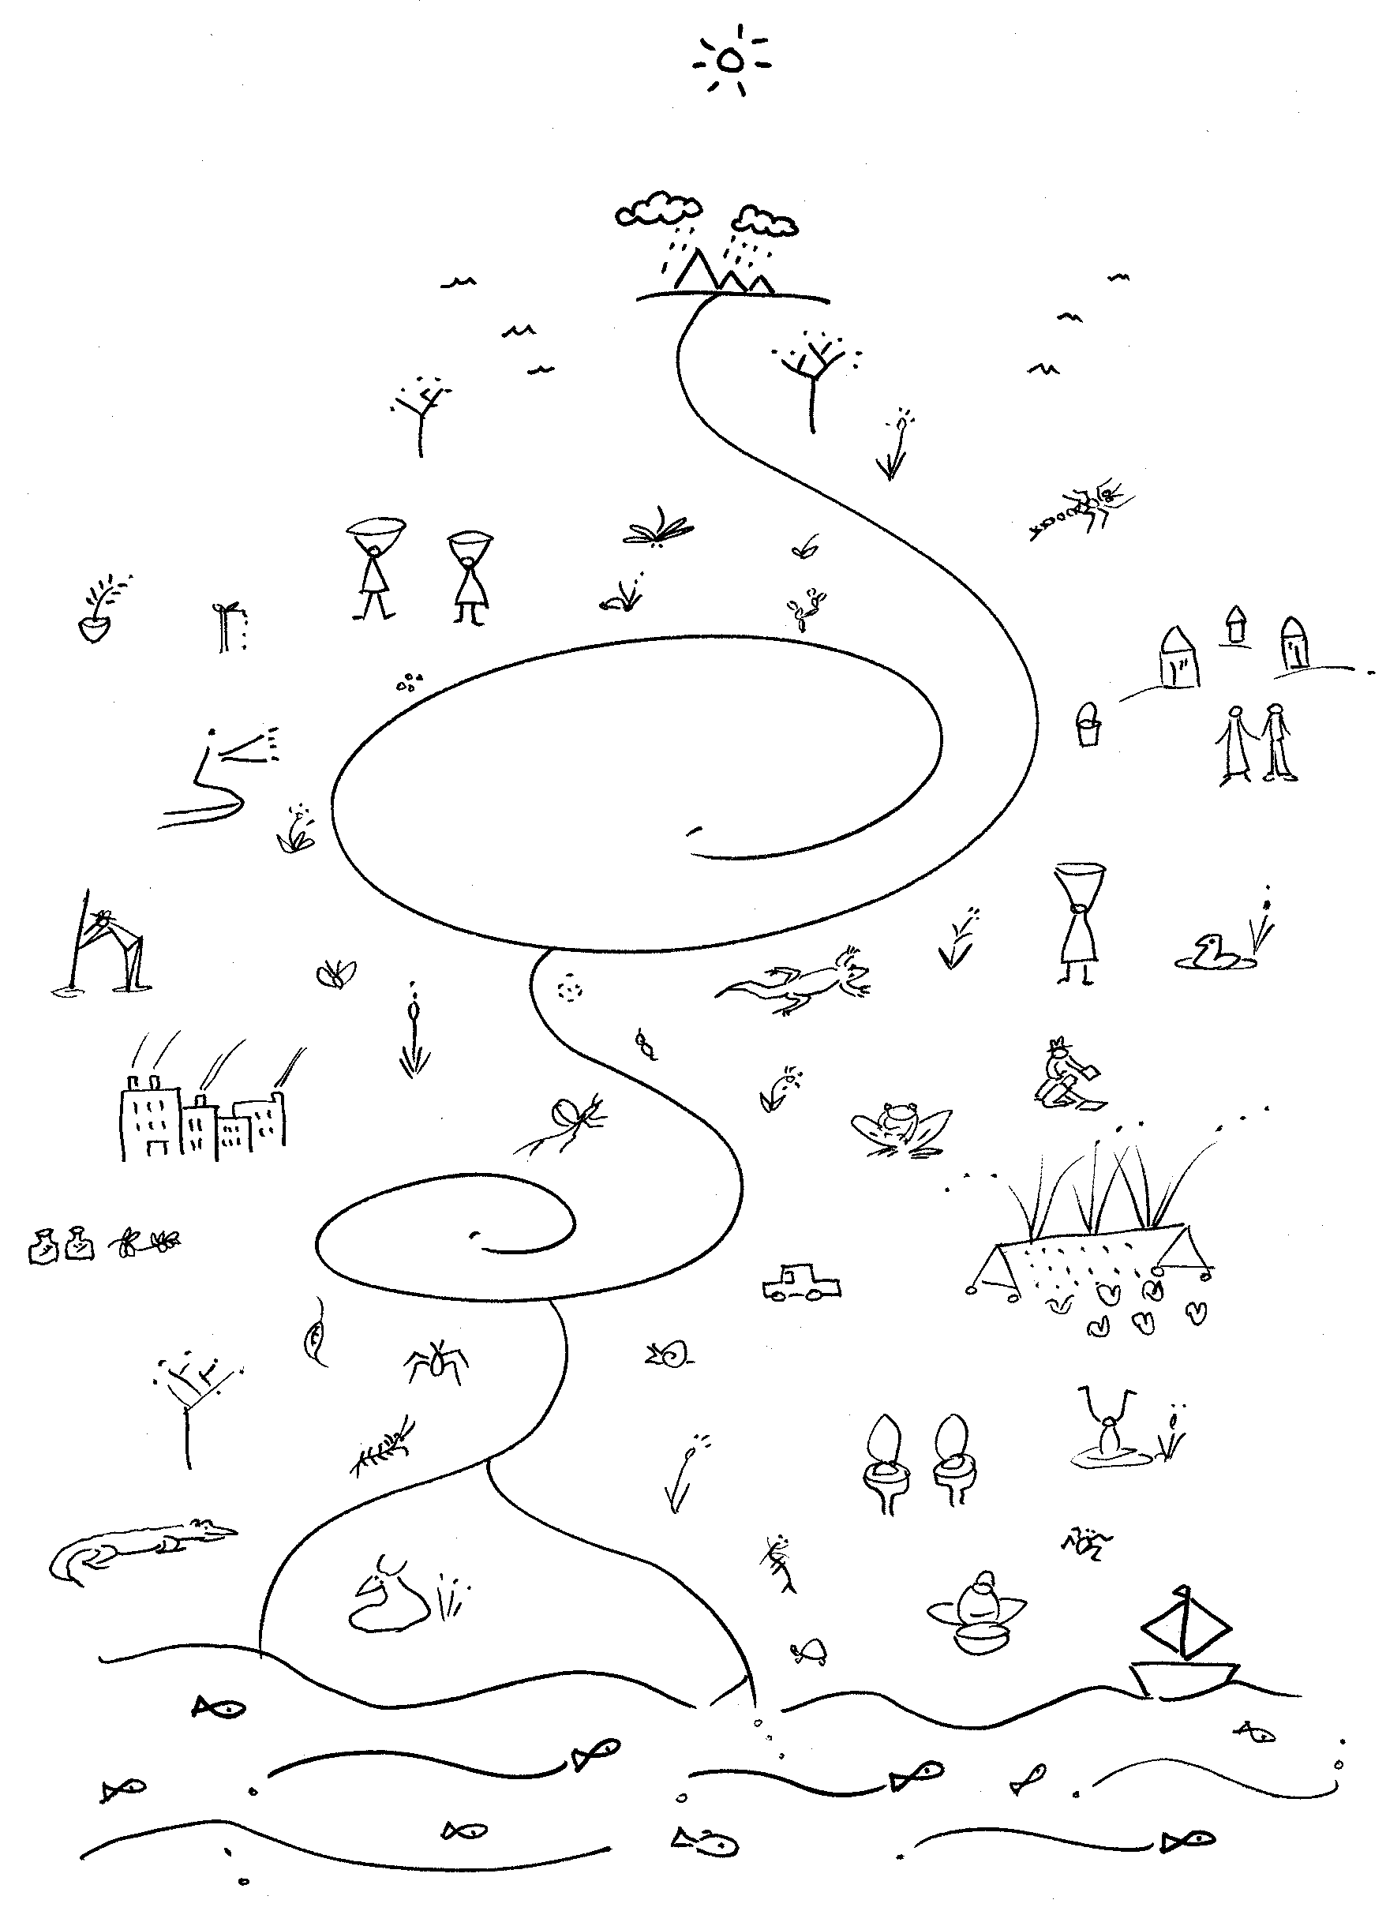
We all live on this planet, in a catchment
Human
&
Planetary Well-being
Social –
Ecological
Justice

Slide 3
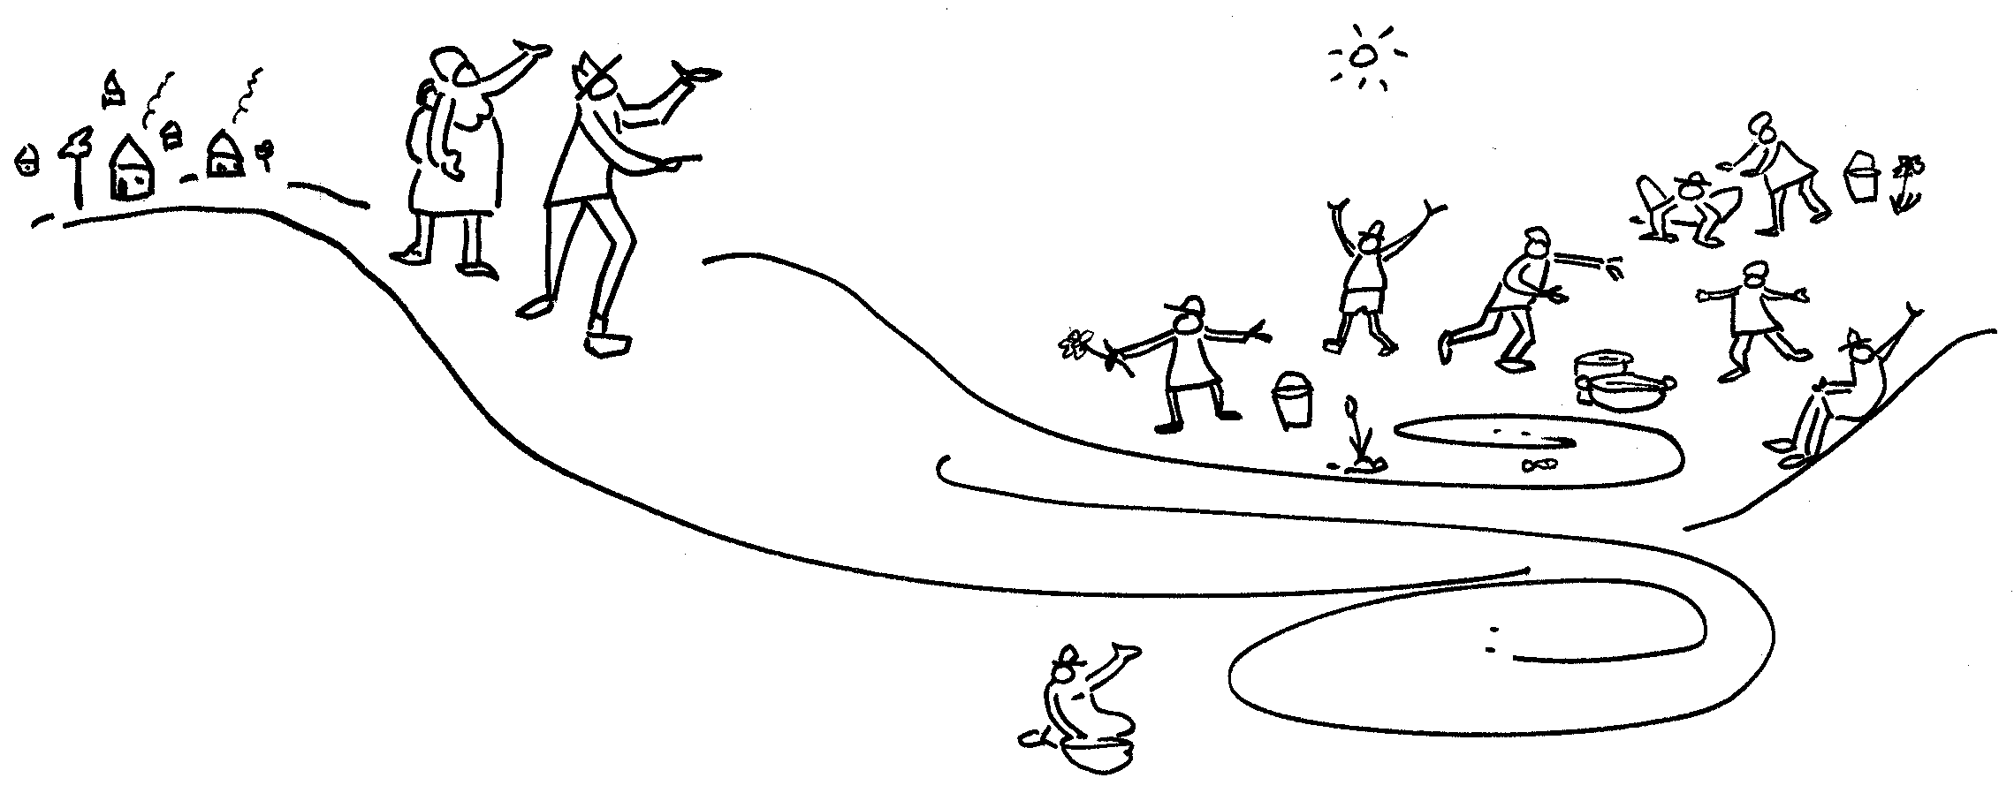
Research/Development Interventions
Funders increasingly want social impacts
Interventions have a history of ambiguous outcomes & outright failures.
How can research-based interventions
  with stakeholders:
  government, industry, agriculture, researchers, &
  civil society / residents / “communities”
  result in sustainable outcomes that persist beyond the intervention
  - move towards behavior-change, &
  social-ecological justice in a system?
Engaged, transdisciplinary action-research

Slide 4
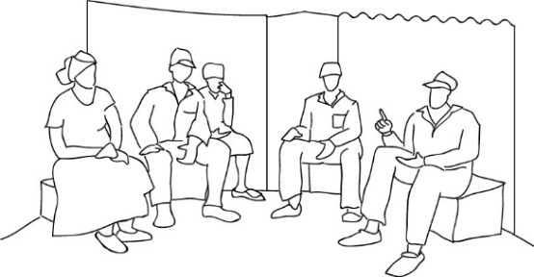
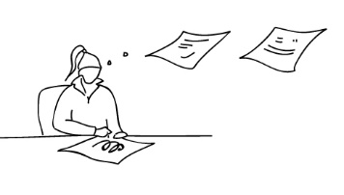
Stakeholders
Mutual Learning
Shifting power relations
Improved decision making
Improved mandate delivery
Researchers
New ideas,
approaches,
concepts
& methods
Towards Social-Ecological Justice
National, Regional &
Local Government
Complexity
Systems thinking & analysis
Natural Resource Management Agencies
Transdisciplinarity
Integration, reflection, collaboration
Learning & social learning
Strategic Adaptive Management
Resource users – industry, agriculture,
domestic
New discourse
(language)
New practice
(doing)
Resilience
Stakeholders: residents,
communities, civil society
+ all above
Political ecology
Citizen Activities
Case
Studies

Slide 5
Why participatory governance ?
Government: law, policy, strategy guide governance - exercised through institutions
Good governance: the power to allocate resources & effectively manage them, for common/public good
In South Africa we seek to deepen democracy & enable people to act in their own spaces, in their own interests.
When projects end, we need to leave a sustainable legacy.
We aim to empower communities to participate in existing governance structures,
to communicate issues and influence decisions:
> AGENCY

Slide 6
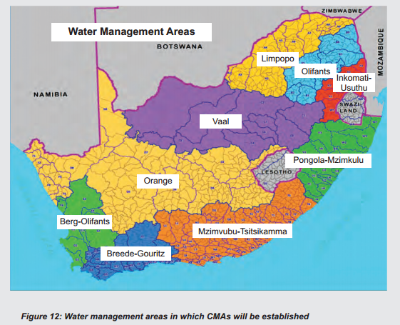
Notes:
We start the tale with a brief explanation of water governance in SA
Address past inequalities, sustainable water for all, look after eco system
NWA and WSA
9 WMA

Slide 7
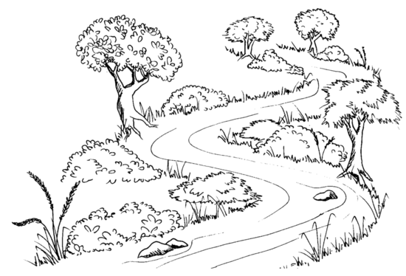

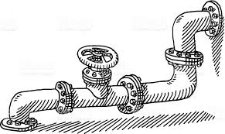
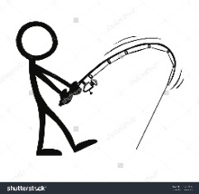
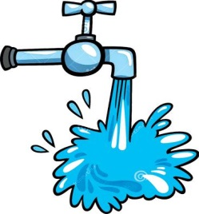
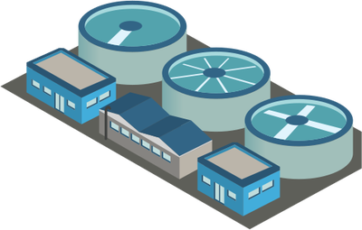

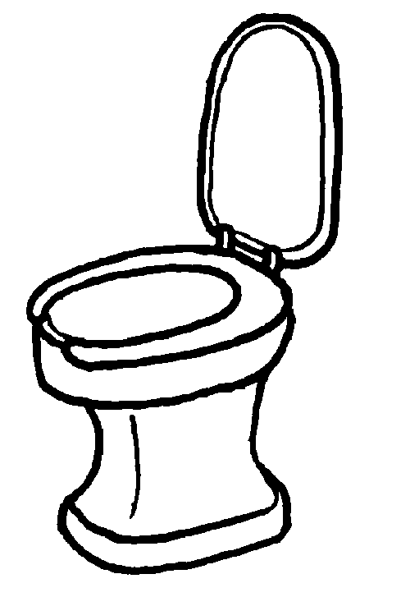

raw water
Pipes
Water Resource
Management:
Water Treatment Works
National Water Act
Water supply & sanitation:
Water Services Act
Waste Water Treatment Works
Waste
Potable drinking water
Waste
6000l/household per month

Slide 8
Key
statutory accountability
contract
representation
cooperation /
consultation
Minister
[Water]
Minister
[CoGTA]
Department of Water Affairs *
Department of CoGTA
cooperation
Regional Office
Provincial MEC
accountability
accountability
Catchment
Management Agency
WMA /
account-
ability &
support
account-
ability
Water board
representation &
cooperation
consultation &
representation
services
contract
Catchment forum
District
Municipality
representation
account-
ability
accountability
&
representation
Water Service Authority
support & cooperation
representation
services
contract
account-
ability
services
contract
Local municipality
Water User Association
Water Service Provider
[SRVM]
Water Resources Management
(National Water Act of 1998)
Water Services
(Water Services Act of 1997)
Local Government
(Muni. Structures Act of 1998)
(Muni. Demarcation Act of 1998)
(Muni. Systems Act of 2000)
(Muni. Finance Man. Act of 2003)
Notes:
Since NWA, challenges in engaging communities – research is challenged to engaged in a more co-planned and co-created knowledge process and the benefits and responsibilities of all parties need to be clear.
In this institutionally complex space, a CMF is the enabling space in which all stakeholders can contribute to the writing of the CMS. It provides a forum for participation and representation across scale as it includes DM, LM, WUAs, education, NGOs and all water users.
My research looks into meaningful stakeholder participation in the emerging CMF giving feedback to the CMA and CMF, providing a forum for discussion and debate about best practices in the landscape and leveraging the restoration work currently taking place in the area.
Opportunities for continued catchment rehabilitation beyond the lifespan of the restoration work DEA is doing.

Slide 9
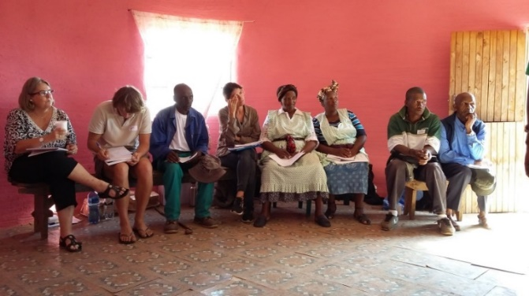
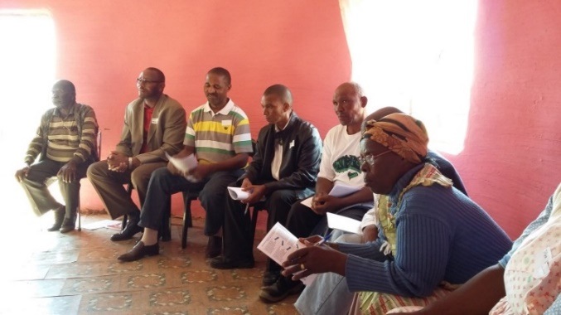
Case studies
Sundays River Valley Municipality
  Water supply system
  Domestic water supply
  Waste-water treatment works
2. Makana Municipality
- Citizen activism
- A Water Forum
3. Crocodile River Catchment
- Co-operative water quality
management
- Sugar cane
- Waste-water treatment works
- Coal mining
4. Tsitsa River Catchment
- building a participatory
forum / network

Slide 10
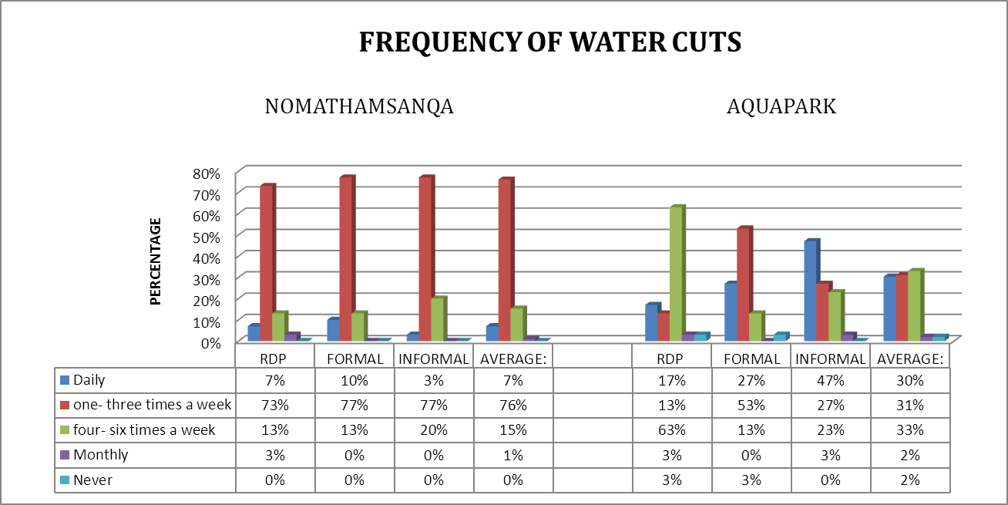
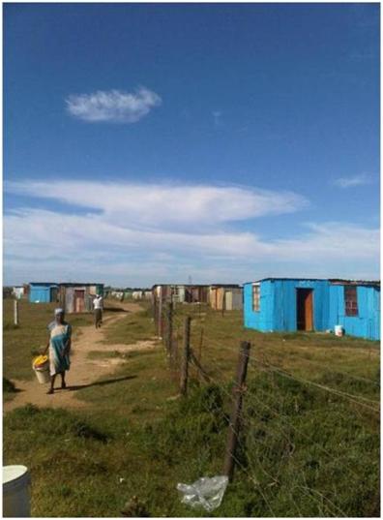
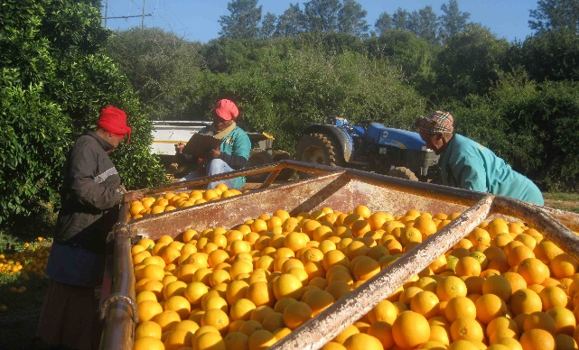
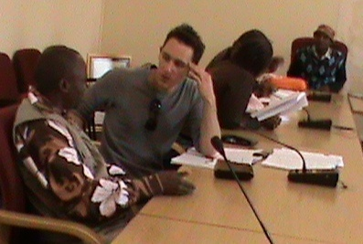
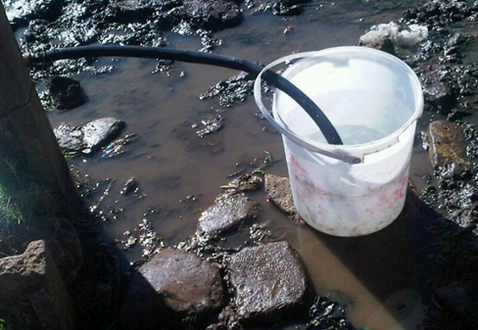
A snapshot of case studies:
1. Sundays River Valley Municipality
A land of happy orange trees and unhappy people

Slide 11
Multiple drivers of municipal failure
DELAY

Slide 12
Interconnected ‘modes of failures’
DELAY

Slide 13
Interconnected ‘modes of failures’
DELAY

Slide 14
Interconnected ‘modes of failures’
DELAY

Slide 15
Interconnected ‘modes of failures’
DELAY

Slide 16
Interconnected ‘modes of failures’
DELAY

Slide 17
Interconnected ‘modes of failures’
DELAY

Slide 18
Interconnected ‘modes of failures’
DELAY
DELAY

Slide 19
Interconnected ‘modes of failures’
DELAY
DELAY

Slide 20
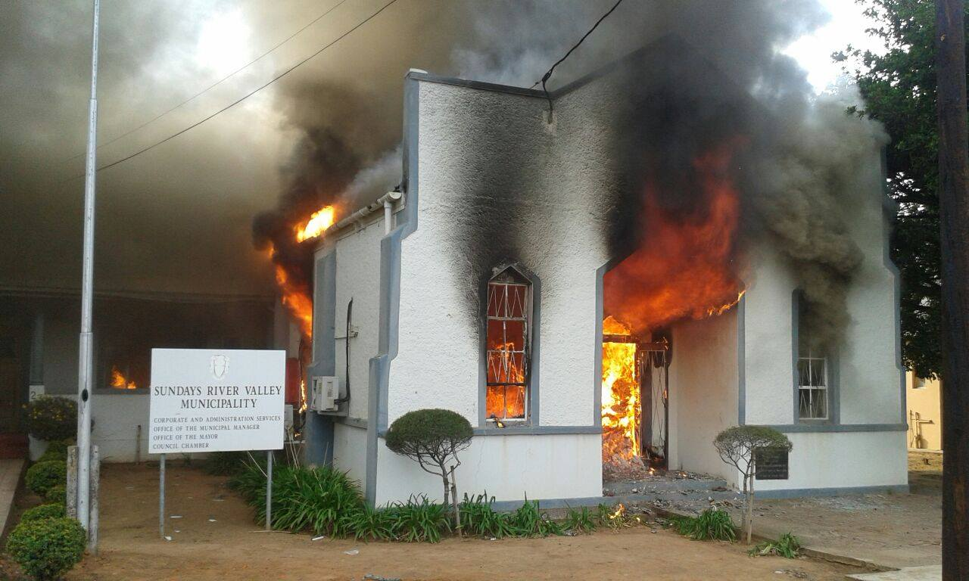
23rd September 2014: service delivery protests

Slide 21
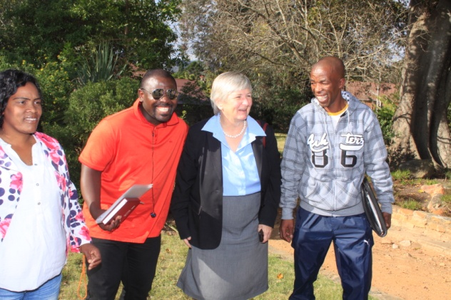
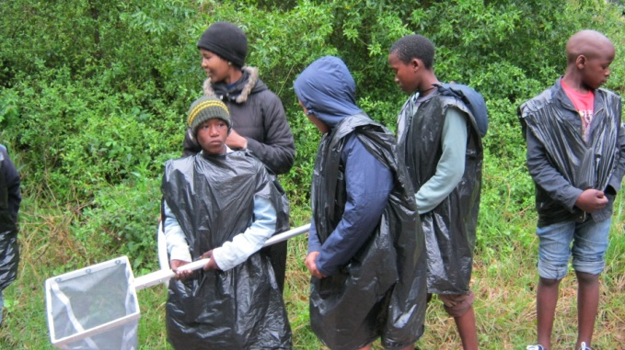
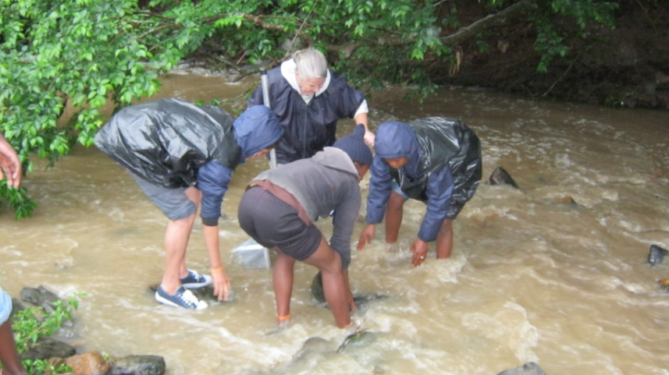
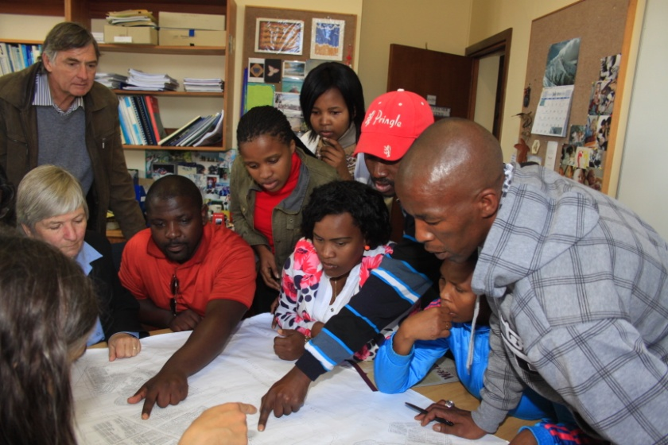
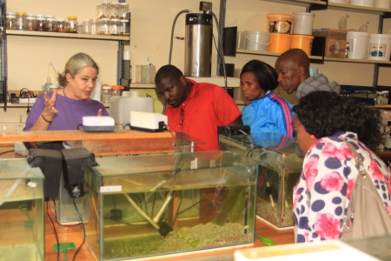
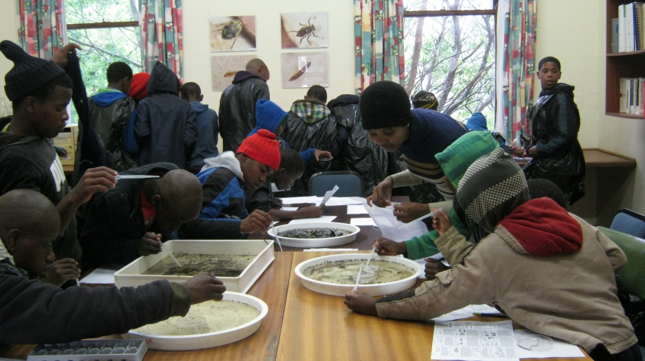
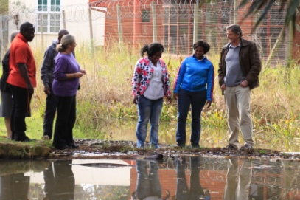
2. Makana Municipality
From community activists to a Water Forum

Slide 22
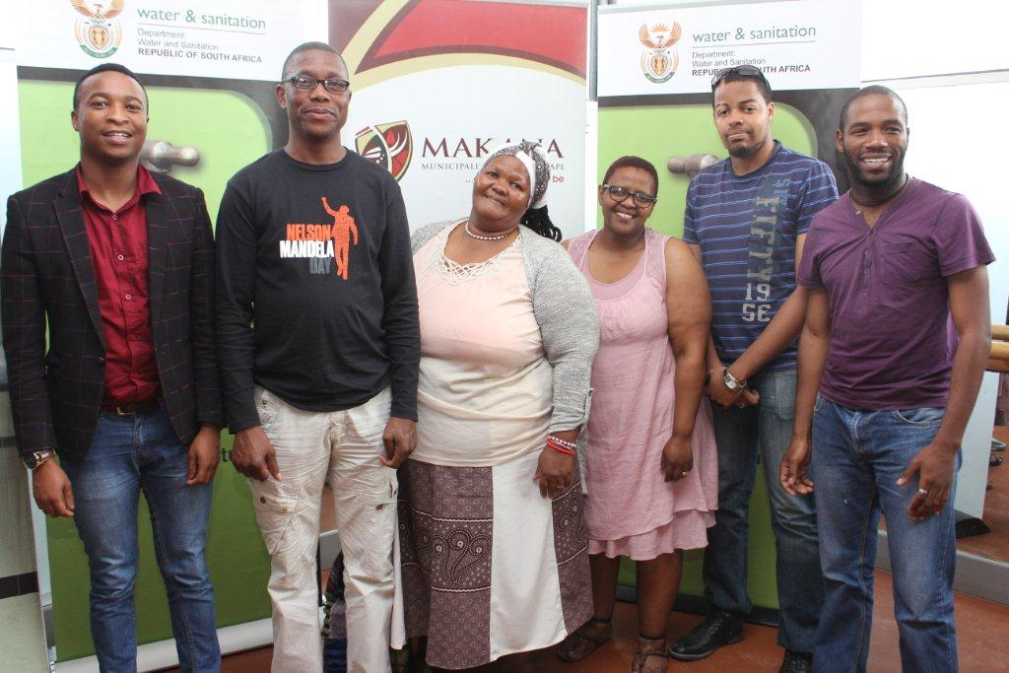
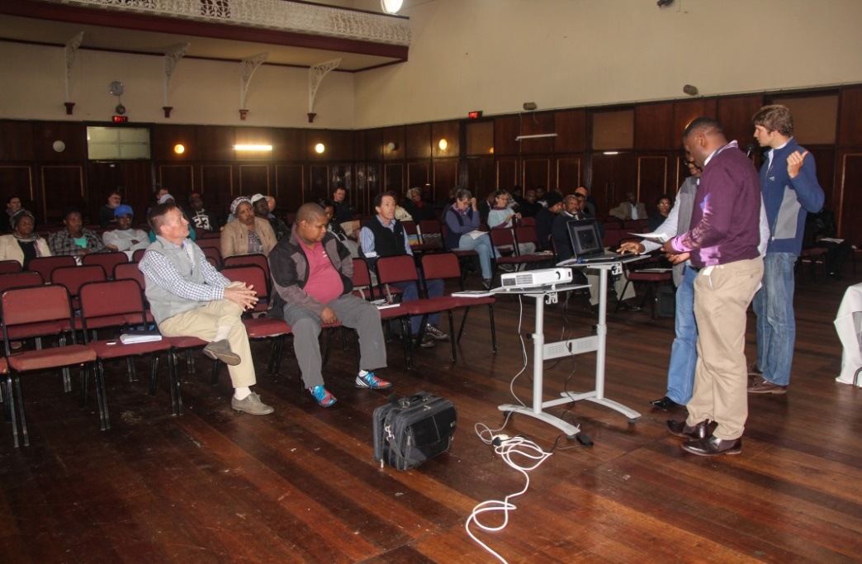
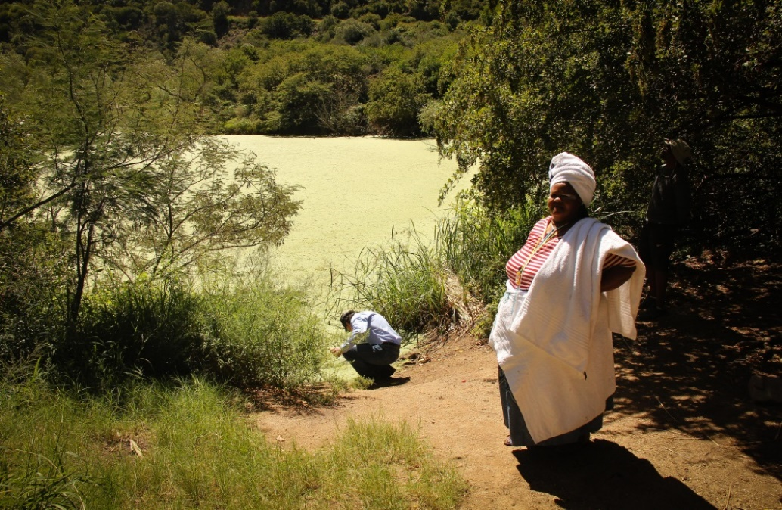
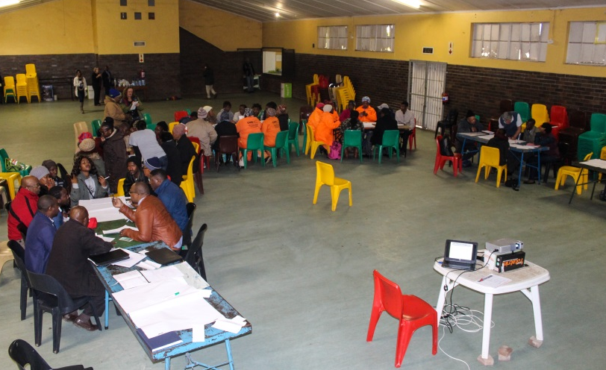
The Makana Water Forum
Makana Water Forum
Enable and facilitate collaborative stakeholder engagement to improve water, sanitation and catchment management.
Notes:
Platform for bringing diverse stakeholders together to engage in water related issues.
Stakeholder capacity development workshops.
Platform for key decision makers and actors – government officials from the Municipality and the DWS to engage, report with citizens about water services and water resource management.
Facilitate the development of a sub-Catchment management strategy or Makana Water Plan

Slide 23
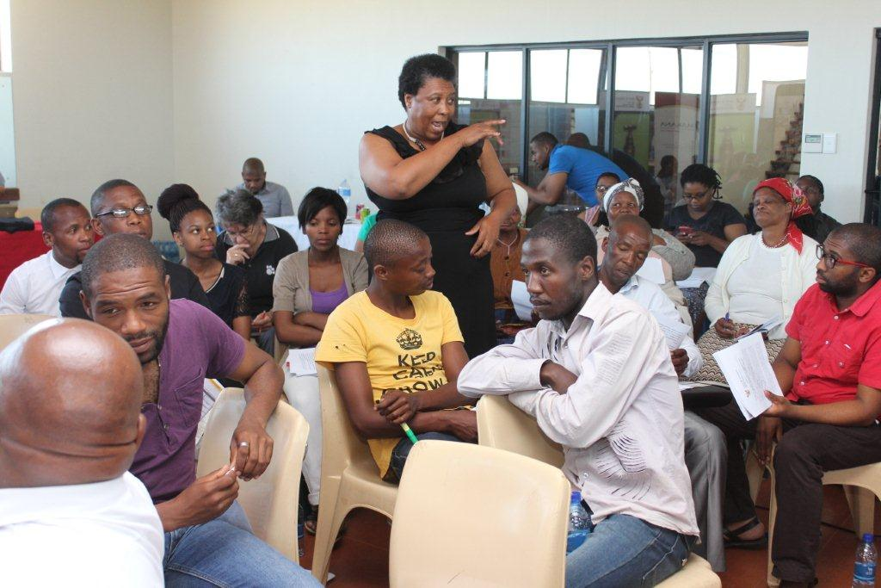
Teething problems
Early problems
Lack of by-in from the MLM
People do not know about the Forum
Forum lost credibility in the eyes of skeptical stakeholders
Not all stakeholders and sectors represented
The Forum lacks clear focus
Lack of water-related knowledge competence of Committee members
Conscious collective decision to improve
Notes:
Interventionist research to understand the challenges that the forum faces and model solutions to get around them (TD discussion points, case study points, citation points) -
Learning and reflection slots during Forum meetings and Forum committee meetings - interviews, observations.
Expansive learning cycle
Problem constellation developed - can be interpreted as contradictions and important points of focus to promote expansive learning.

Slide 24
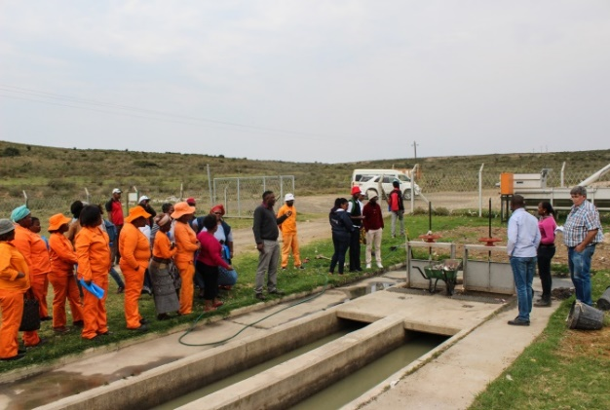
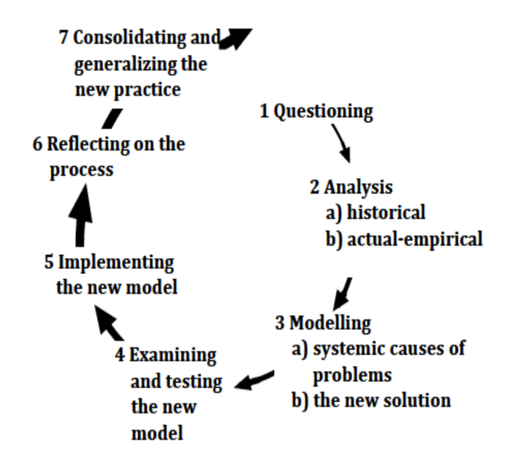
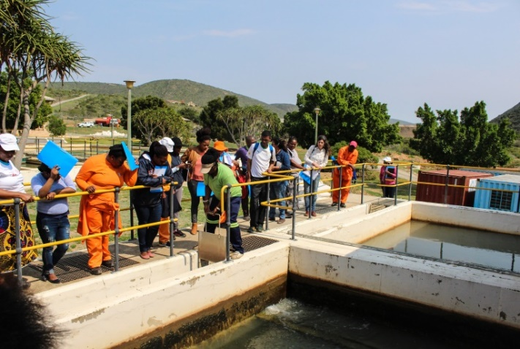
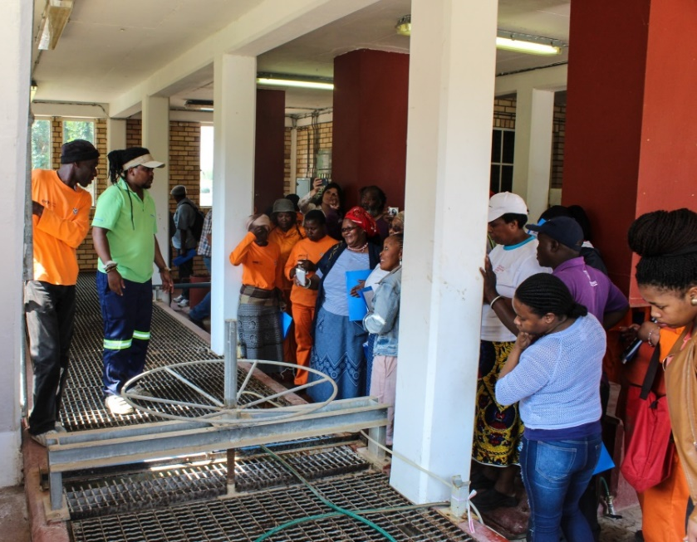
Implementing the new model
New tool: Water Tour
SUNDAY :
Makhanda DECLARED A DISASTER AREA
Notes:
Forum actors facilitating a learning journey of Makana’s water resources and infrastructure to see first-hand how water management takes place and what infrastructure upgrades are underway.
The water tour provided a valuable space for relationships to be built between government officials and water stakeholders. The MLM and DWS shared critical challenges they faced in maintaining the systems. e.g. theft and vandalism (telemetry equipment providing early warning to MLM of potential pipe breakages) theft of this now results in delayed response and longer periods of water outages.

Slide 25
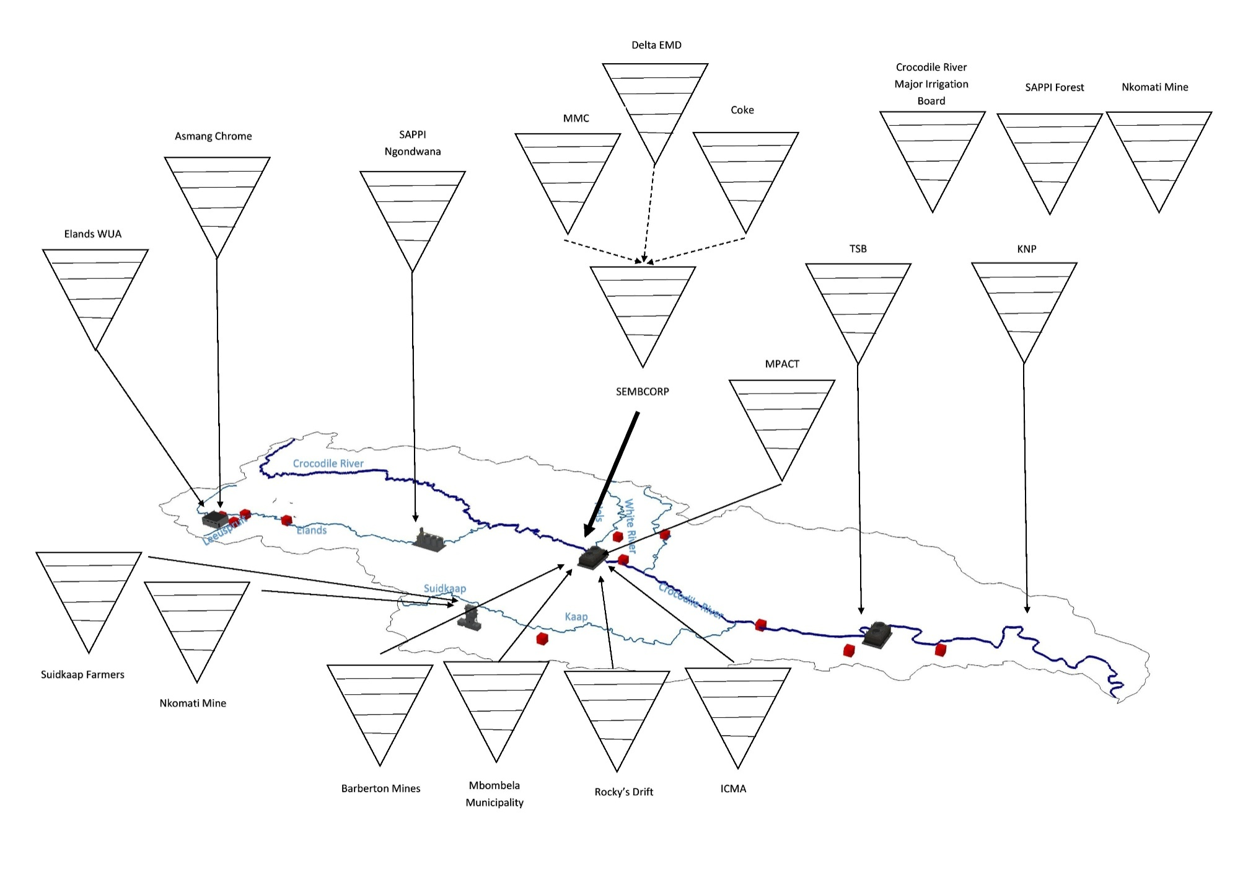
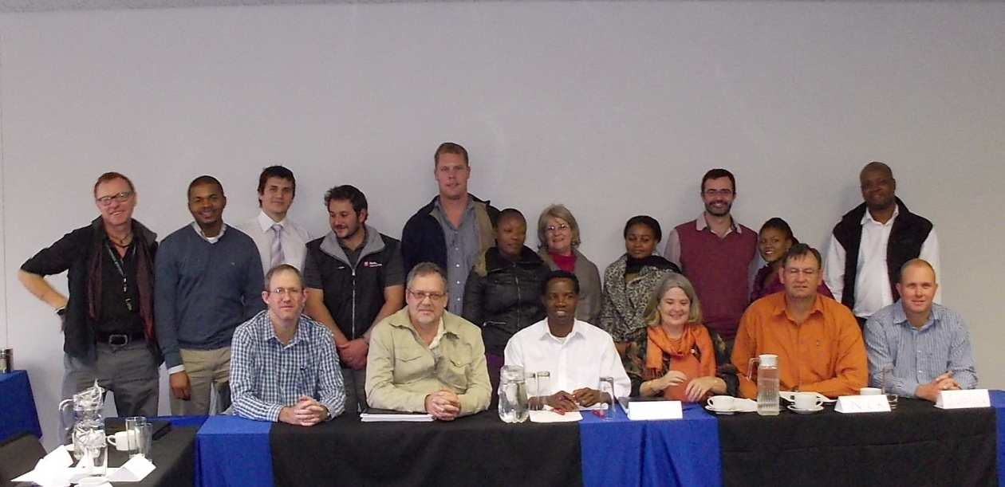
3. Crocodile River Catchment
Industry stakeholders

Slide 26
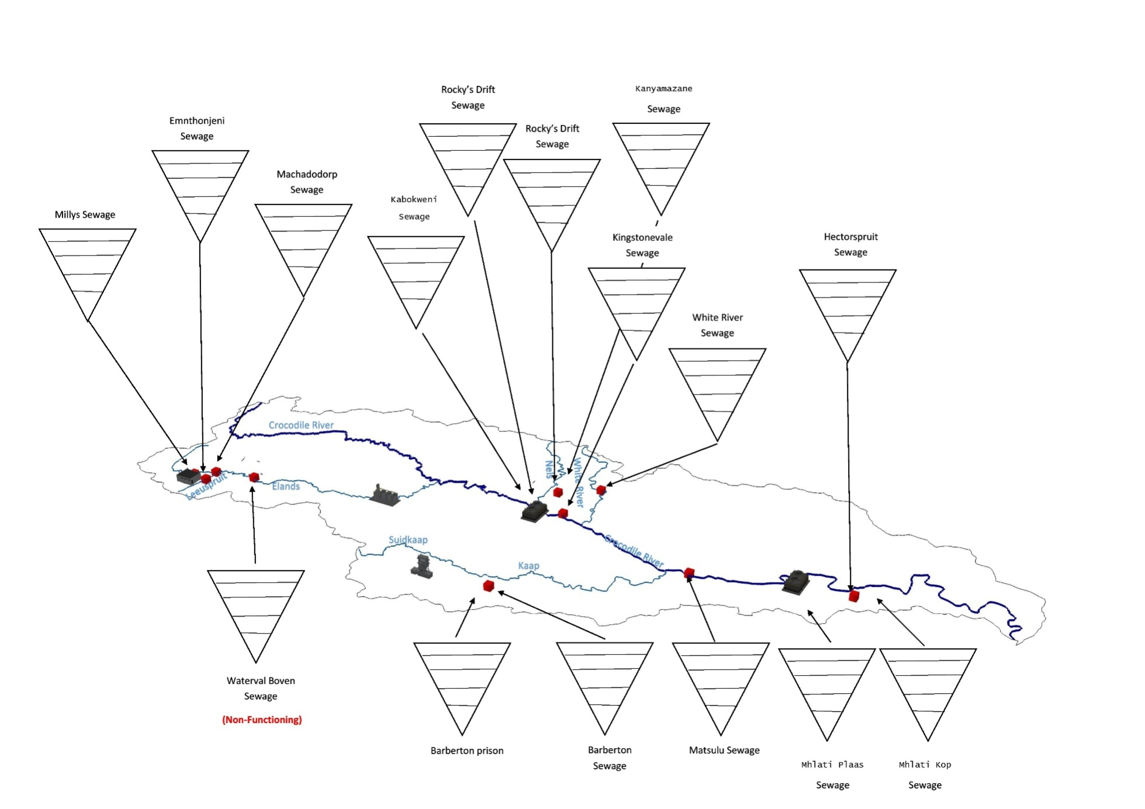
WWTW in the Crocodile R Catchment

Slide 27
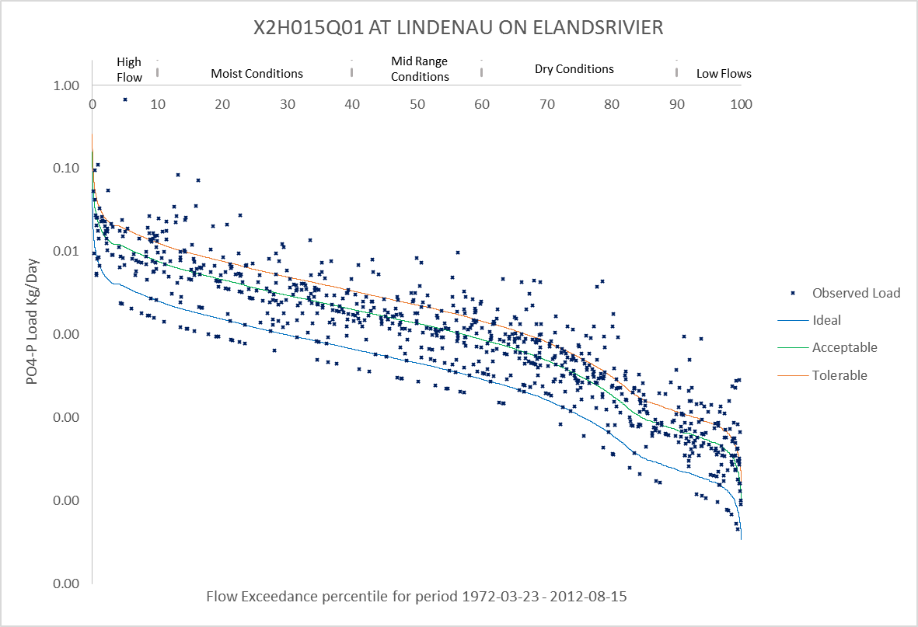
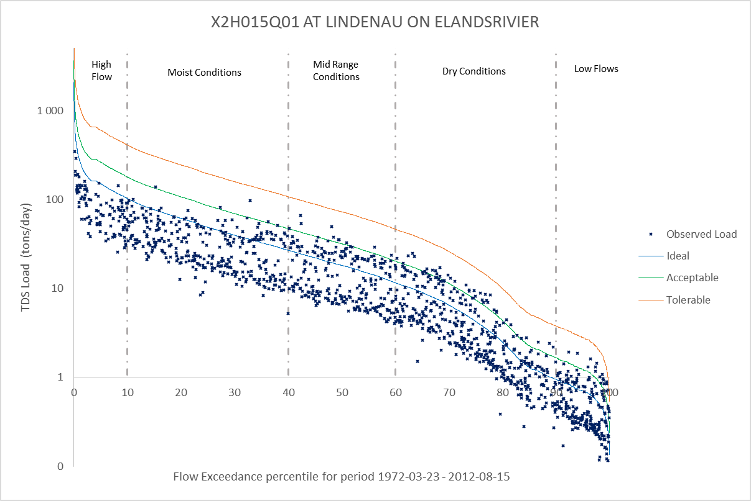
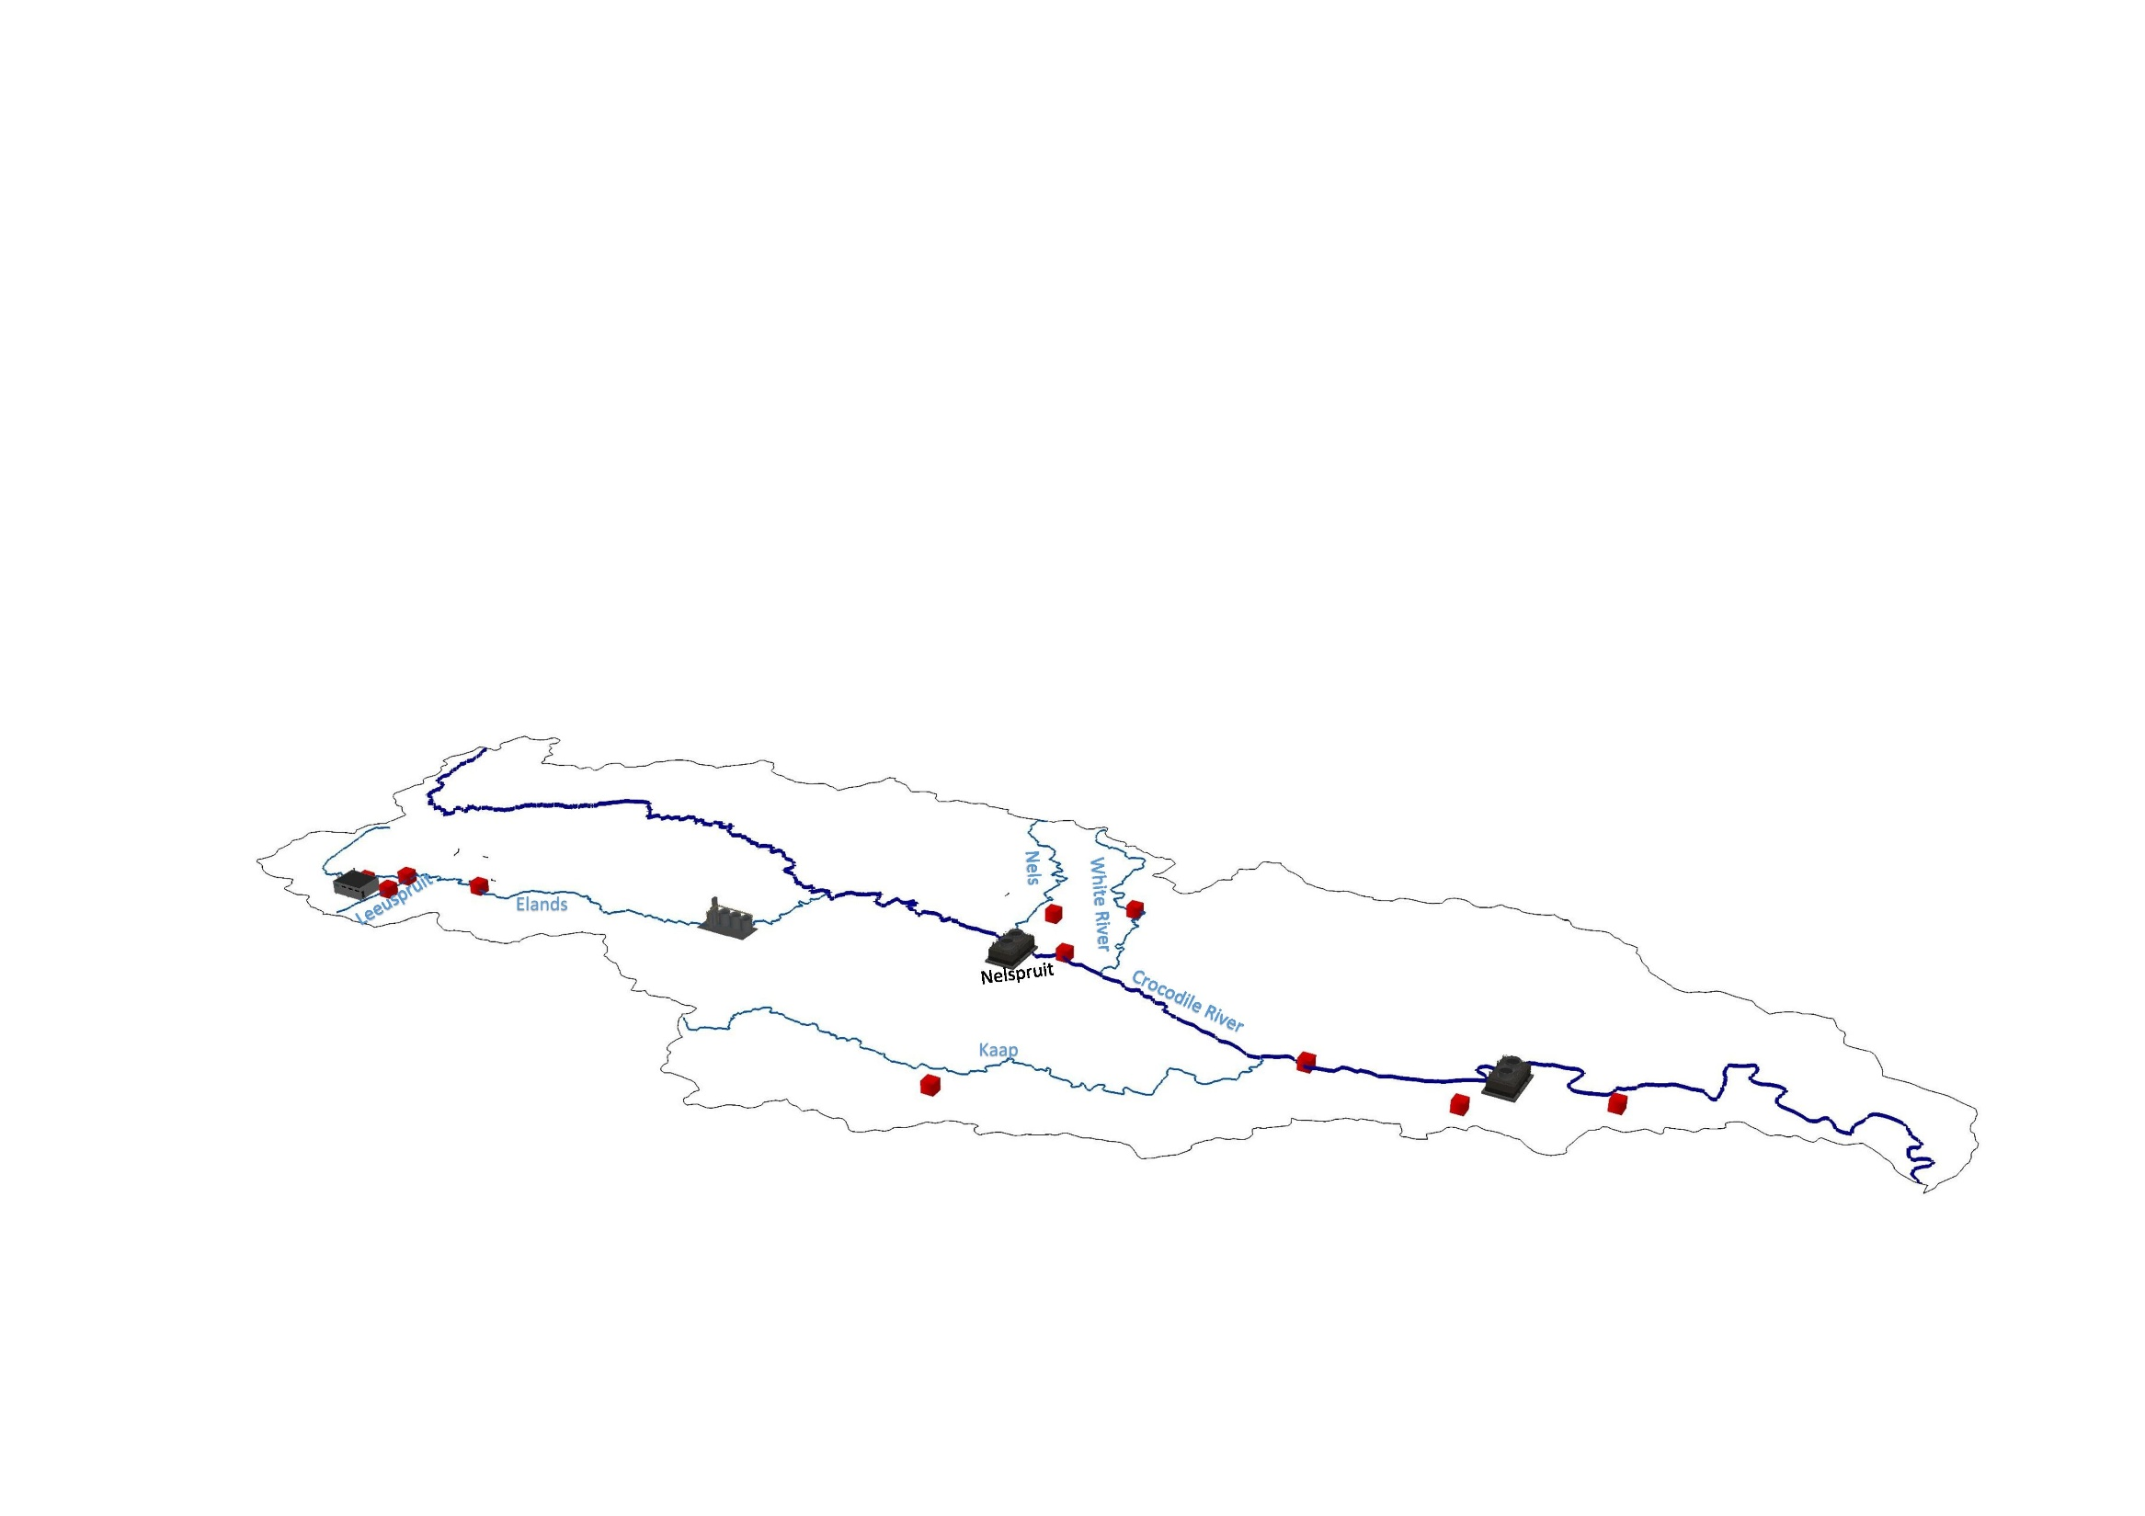
Phosphate & Salts
Stakeholders
Asmang Chrome
Elands WUA
Millys Sewage
Emnthonjeni Sewage
Machadodorp Sewage
Waterval Boven Sewage
SAPPI Ngondwana
Systemic basis to National WQ Policy and Strategy 2017
Since 2014 Crocodile River in Kruger –
mainly meets Resource Quality Objectives

Slide 28
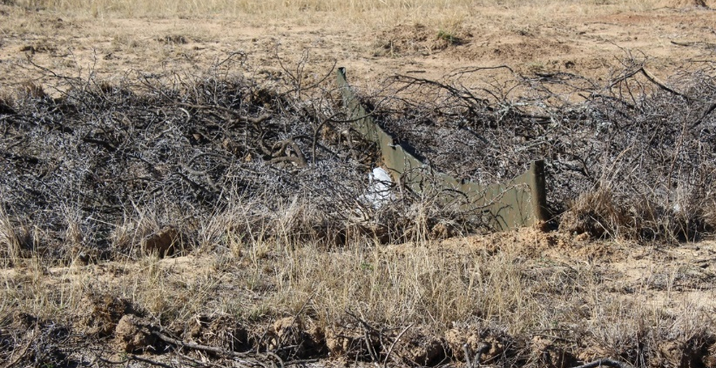
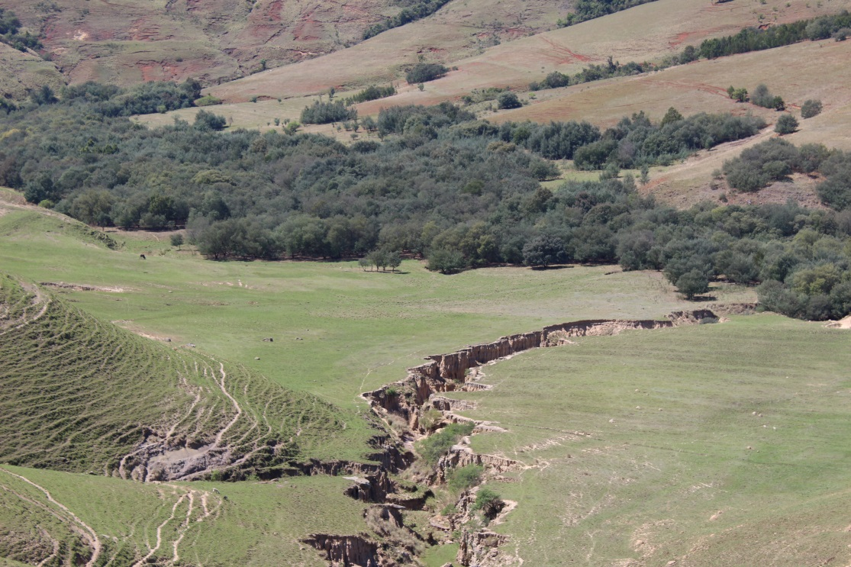
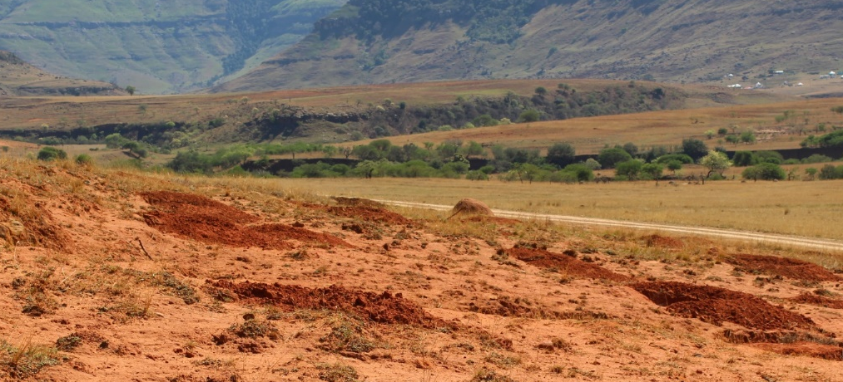
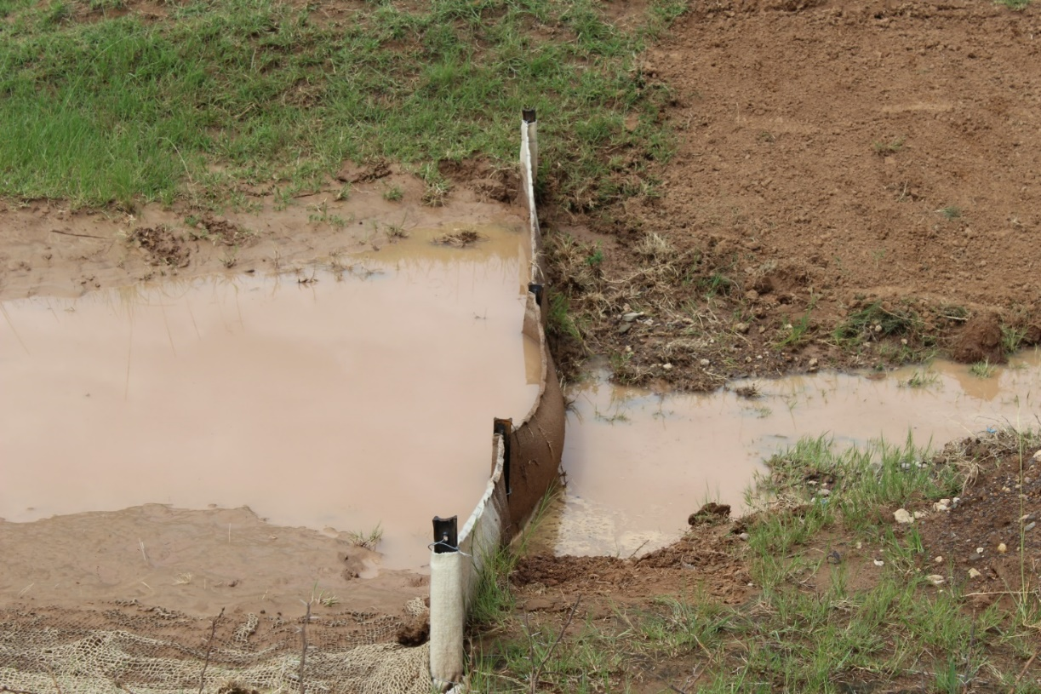
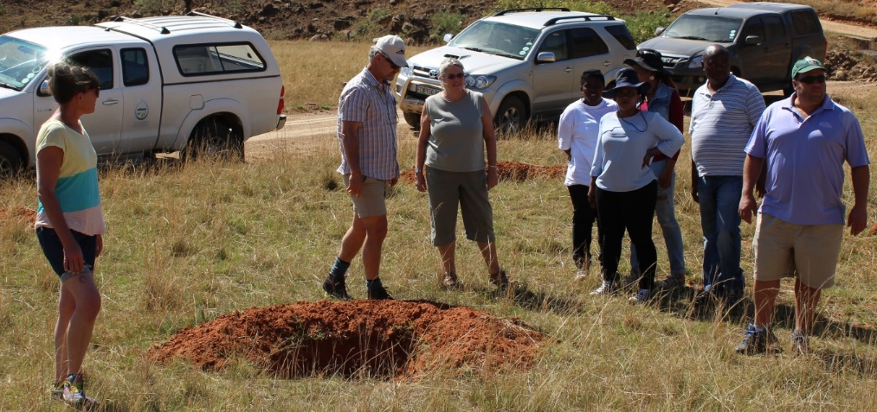
4. Tsitsa River Catchment
Silt trap
Pod
Holding back silt, allowing water to seep through

Slide 29
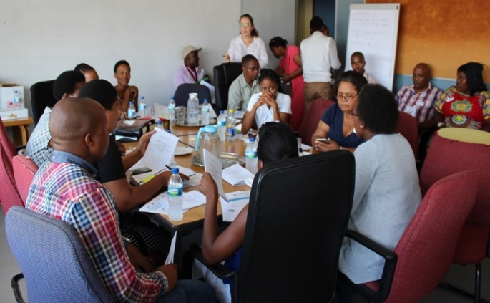
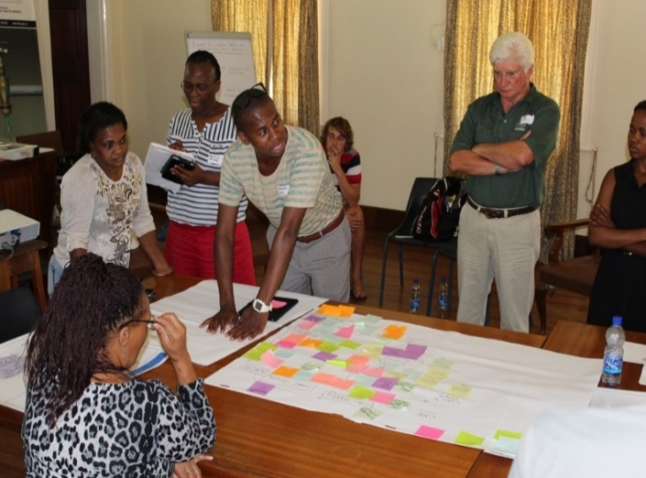
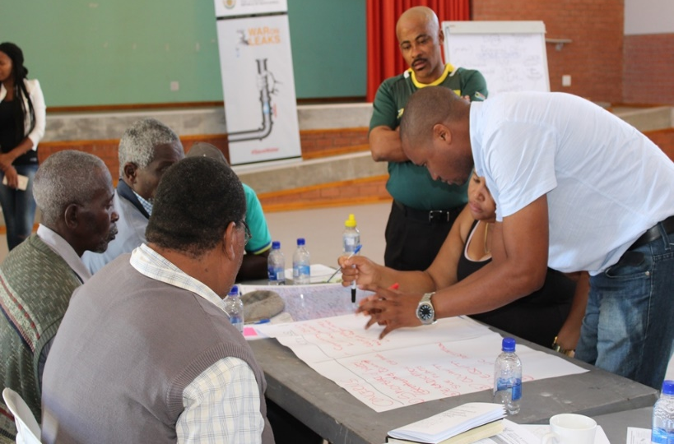







Forum / Network formation
Notes:
During the CMF workshops the team (Tally, Notiswa and I) asked participants to form groups with other people at the workshop that lived in the space area as them.
We asked each group, to discuss their concerns for their area and then rank the top 5 concerns and the ACTIONS they felt could be taken to start the process of improving the area – concerns ranged from Sand mining to ………
One of the possible motivators for involvement in landscape rehabilitation and restoration as a group or community is the positive impact that this has on the landscape.
LEARNING for researchers – dynamics and building relationships

Slide 30
A shared future: Tsitsa River Catchment Vision
The Tsitsa River Catchment will be sustainably and adaptively managed to improve the health of the veld and the rivers and therefore better livestock production, less erosion, and healthy people. Good political leadership will ensure transparent communication to all the people. Natural and financial resources will be used honestly to the benefit of all the people.
Empowered, knowledgeable people will live in a safe, low conflict, well serviced, catchment.
iTsitsa River catchment izakuba yindawo ephetheke kakuhle okanye ekhathalelekileyo kwaye iphathwe ngendlela ezisebenzisa amacebo angcono ukuphucula ubume bamadlelo kunye nemilambo yonke. Lonto ke izakuthi ikhokhelele ekubeni nemfuyo eyondlekileyo, kunciphe nokhukhuseliseko lomhlaba, kunye nabantu abasempilweni.
Iinkokheli zopolitiko ezihlakaniphieyo zizakuqinisekisa ukunyaniseka kunxibelelwano nabo bonke abantu.
Imithombo yendalo (umhlaba, amanzi, nazo zonke izinto eziphilayo) kunye neyemali iyakusetyenziswa ngendlela enyanisekileyo ukuze wonke umntu axhamle.
Abantu abanikezelwe ngamandla kwaye abanolwazi bayakuhlala kwindawo ekhuselekileyo, engenangxwaba-ngxwaba enenkonzo ezaneleyo.

Slide 31

Research outcomes 2015-18
  PhD 6
  MSc 15
  ISI Papers 20
Social-Ecological Justice outcomes ?
Intention
Insitutional strength
NGO / Government decadal projects
Notes:
During the CMF workshops the team (Tally, Notiswa and I) asked participants to form groups with other people at the workshop that lived in the space area as them.
We asked each group, to discuss their concerns for their area and then rank the top 5 concerns and the ACTIONS they felt could be taken to start the process of improving the area – concerns ranged from Sand mining to ………
One of the possible motivators for involvement in landscape rehabilitation and restoration as a group or community is the positive impact that this has on the landscape.
LEARNING for researchers – dynamics and building relationships

Slide 32






Thank you

Slide 33


Government, governance & institutions
Government the group of people with the authority to govern a country or state
Governance is the process by which government operates.
Government answers the question: What or who acts?
Governance answers the question: How is action taken?
Institutions comprise the set of established rules and practices that characterise an organisation. Therefore, governance is closely related to institutional arrangements.
A government will use institutional arrangements to effect governance.

