Slide 1
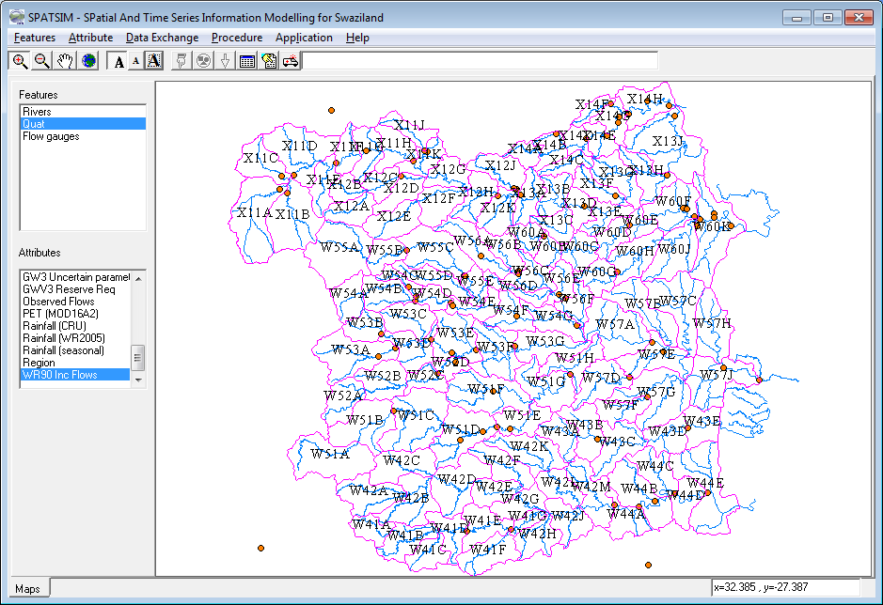
SP 1: Main SPATSIM interface
Menu options (drop down text & icons) for map display, data view, import & export, data analysis & model setup & running.
List of all loaded shape files (features) & highlighted one is active.
Map display of all loaded shape files.
List of data attributes associated with active feature.
Geog. coordinates of mouse cursor position.

Slide 2
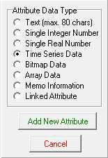
SP 2: Attribute types
New attributes names can be added by double clicking the attribute list or by using the ‘Attribute’ – ‘Add’ menu option.
Text: Used for storing names of spatial elements.
Single Integer Number: Used for index data, such as region number.
Single Real Number: Used for such as catchment area.
Time Series Data: Used for time series of such as climate or stream flow data and can include multiple time series (i.e. ensembles) output from an uncertainty model.
Bitmap Data: Photo, movie or graphical data. Could be used for river gauging station photos or short mpg files of river flow conditions.
Array Data: 1D or 2D tables for such as monthly distributions, parameter arrays, etc. The specific format of any array type attribute is defined by a template text file that specifies the number of rows and columns and the titles of each row and column (see any *txp file in the SPATSIM/text_data folder). The ‘Attribute’ – ‘Add Array Template’ can be used to create a new template.
Memo Information: Longer text that could be used for notes on model setups and calibration scheme.
Linked Attribute: Typically not used & can be ignored.

Slide 3

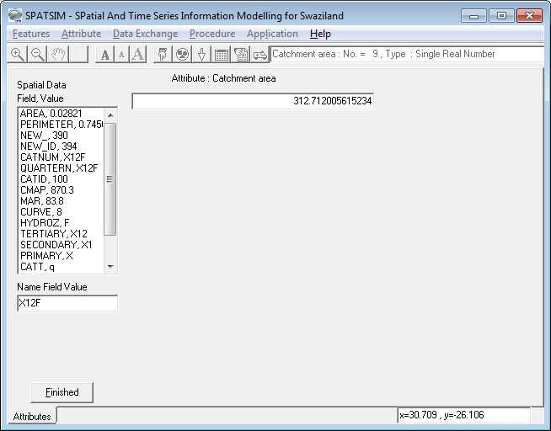
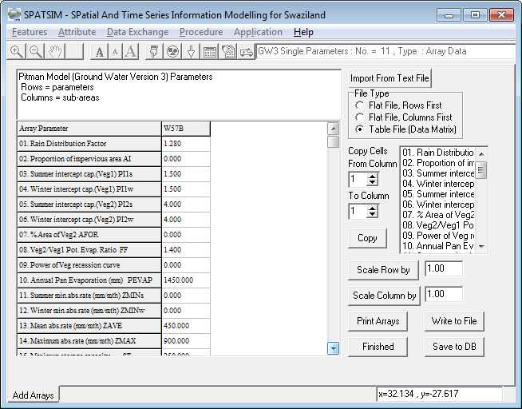
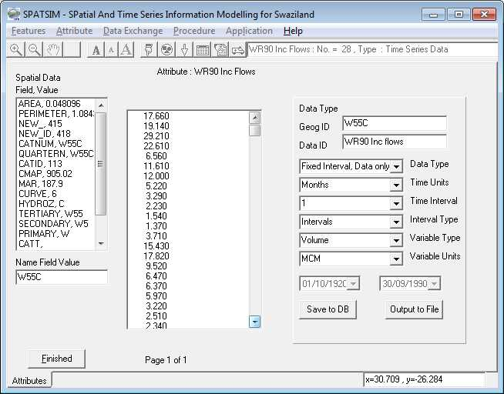
SP 3: Displaying and editing attribute data
Icon for displaying other attribute types.
Icon for displaying array type attributes.
Input or editing single number or text data.
Example of array data input & editing screen.
Displaying time series data (can edit some of the definitions but not the data).

Slide 4
SP 4: Importing bulk data (single values or text data)
X14H 359.78
X14F 117.46
X14G 204.16
X13J 789.30
X11J 186.20
X14E 177.30
X11F 182.51
X11D 590.35
X11H 265.13
X14D 128.58
X11G 263.73
X14B 185.23
X11C 318.79
X11K 210.69
X14A 140.80
X13H 305.47
X14C 165.76
X13G 334.71
X12J 295.66
X11E 241.39
X12G 238.73
X13F 216.86
X12C 186.13
X13A 244.79
Contents of a text file containing input data for a Single Real Number attribute type. The first column contains the same text information used for some or all of the spatial elements in the ‘Desc.’ field of the shape file (see Spage 1 for example), while the second column contains the data to be imported to the database.
This can be used for Text and Single Integer Number attributes as well.

Slide 5
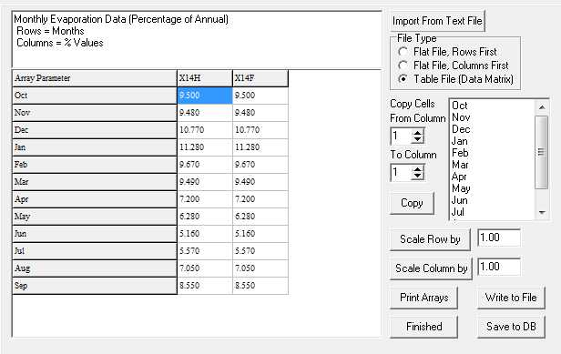
SP 5: Importing bulk data (1D Array Data attribute types)
X14H 9.500 9.480 10.770 11.280 9.670 9.490 7.200 6.280 5.160 5.570 7.050 8.550
X14F 9.500 9.480 10.770 11.280 9.670 9.490 7.200 6.280 5.160 5.570 7.050 8.550
X14G 9.500 9.480 10.770 11.280 9.670 9.490 7.200 6.280 5.160 5.570 7.050 8.550
X13J 9.500 9.480 10.770 11.280 9.670 9.490 7.200 6.280 5.160 5.570 7.050 8.550
X11J 9.500 9.480 10.770 11.280 9.670 9.490 7.200 6.280 5.160 5.570 7.050 8.550
X14E 9.500 9.480 10.770 11.280 9.670 9.490 7.200 6.280 5.160 5.570 7.050 8.550
X11F 9.500 9.480 10.770 11.280 9.670 9.490 7.200 6.280 5.160 5.570 7.050 8.550
X11D 9.500 9.480 10.770 11.280 9.670 9.490 7.200 6.280 5.160 5.570 7.050 8.550
X11H 9.500 9.480 10.770 11.280 9.670 9.490 7.200 6.280 5.160 5.570 7.050 8.550
Contents of a text file containing input data for an Array Data attribute with 1 column and 12 rows.
The lower part of the diagram shows the imported data displayed in SPATSIM for two spatial elements (X14H and X14F).
Note that the rows and columns are switched between the text file and the database display.
The SPATSIM menu item is ‘Attribute’ – ‘Import or Edit’ – ‘Text to Tables’.

Slide 6
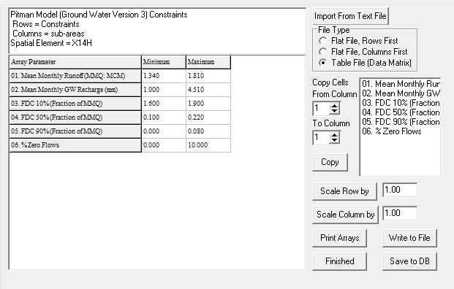
SP 6: Importing bulk data (2D Array Data attribute types)
X14H 1.340 1.000 1.600 0.100 0.000 0.000
1.810 4.510 1.900 0.220 0.080 10.000
X14F 2.820 7.580 1.700 0.490 0.200 0.000
3.820 14.330 2.300 0.740 0.350 0.000
X14G 1.220 1.710 1.600 0.100 0.000 0.000
1.650 6.110 1.900 0.220 0.080 10.000
X13J 2.070 0.700 1.600 0.100 0.000 0.000
2.800 3.660 1.900 0.220 0.080 10.000
X11J 3.580 4.080 1.800 0.400 0.250 0.000
5.370 10.060 2.800 0.800 0.400 0.000
Contents of a text file containing input data for an Array Data attribute with 2 columns and 6 rows.
The lower part of the diagram shows the imported data displayed in SPATSIM for one spatial element (X14H).
Note that the rows and columns are switched between the text file and the database display and that the ‘Desc.’ field contents is only added to the first row of the text file for each group of data.
The SPATSIM menu item is ‘Attribute’ – ‘Import or Edit’ – ‘Text Tables to Array’.

Slide 7
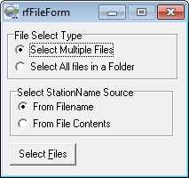
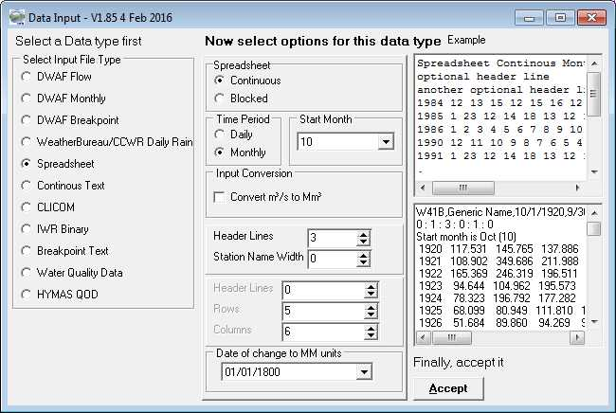
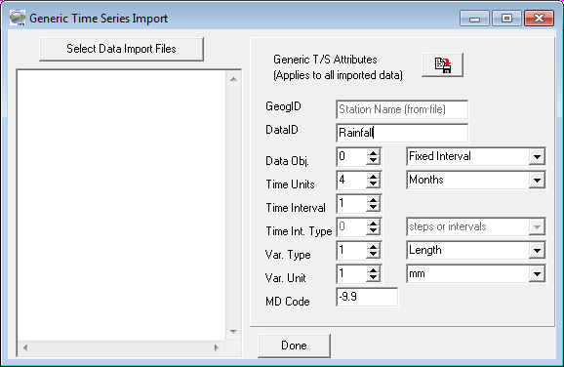
SP 7: Importing bulk data (Time Series Data attribute types)
Process for importing time series data using menu item ‘Attribute’ – ‘Import or Edit’ – ‘Import T/S’.
The first step (1) is to select the text files containing the data and typically this is done by naming the files using the ‘Desc.’ field contents for each spatial element (i.e. X14H.txt).
The next step (2) is to specify the file format (various options are available) and file structure (time step, header lines, etc.). Common file types are ‘spreadsheet’ (as shown) and continuous text (1 data value per line preceded by the start date).
The last step (3) is to specify the details of the time series (e.g. units and other information – see SPATSIM Help for further details). A summary of the import results is given in the window to the left after the import is completed.
1
2
3

Slide 8
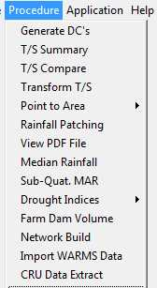
SP 8: SPATSIM internal data analysis procedures
General utility for summarising time series data including monthly & annual statistics, flow duration curves and baseflow analysis.
Utility for linear & non-linear scaling of time series data.
Utility for spatial interpolation from point data to spatial average data using inverse distance weighting (typically used for preparing catchment average rainfall time series from point rainfall data).
Utility for viewing a pdf file based on a text attribute containing the folder and filename source of the document (used for providing quick access to a report or publication).
Utility for performing a range of drought analyses based on monthly rainfall data (Smakhtin and Hughes, 2007).

Slide 9
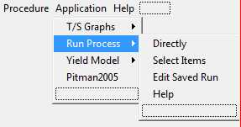
SP 9: External data analysis methods & models
External program (Tsoft.exe) for generic time series graphical display and analysis (see SP 10). The input is a ‘profile’ file (*.prf) that can include references to time series attributes within SPATSIM applications or to binary files of detailed model output. Two options are available from the menu, one to go directly to Tsoft and one to add SPATSIM time series data to a profile and then launch Tsoft.
The Run Process options are designed to facilitate the setting up , editing and running of external models (see SP 11 to SP 13).
‘Directly’ is used to launch a previously established model run.
‘Select Items’ is used to select the spatial elements (e.g. sub-basins or nodes) that are to be included in a model run, choose the model and then link the data requirements of the model to SPATSIM attribute data (see SP 12).
‘Edit Saved Run’ is used to modify the attribute data that are linked to an existing model run.

Slide 10
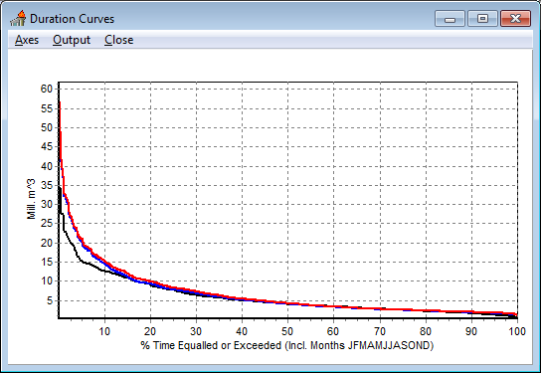
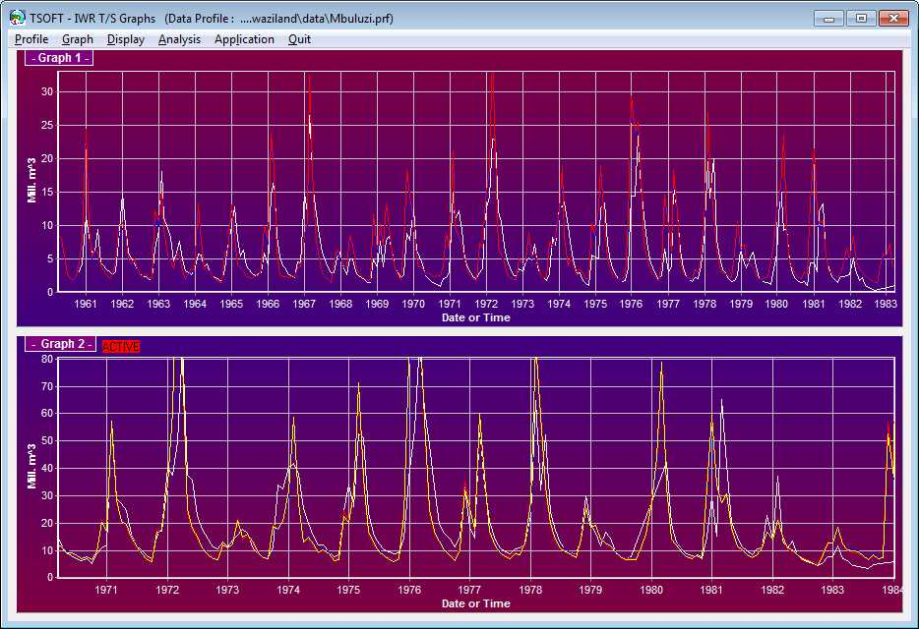
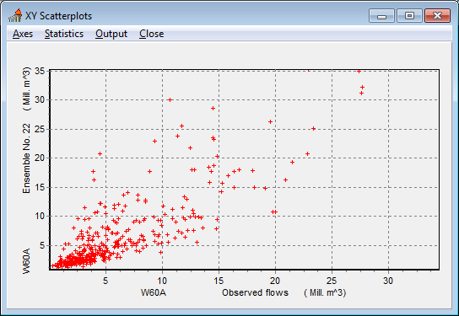
SP 10: Tsoft, generic time series display and analysis
Flow duration curve analysis.
Main Tsoft time series graph window.
Scatterplot analysis.

Slide 11
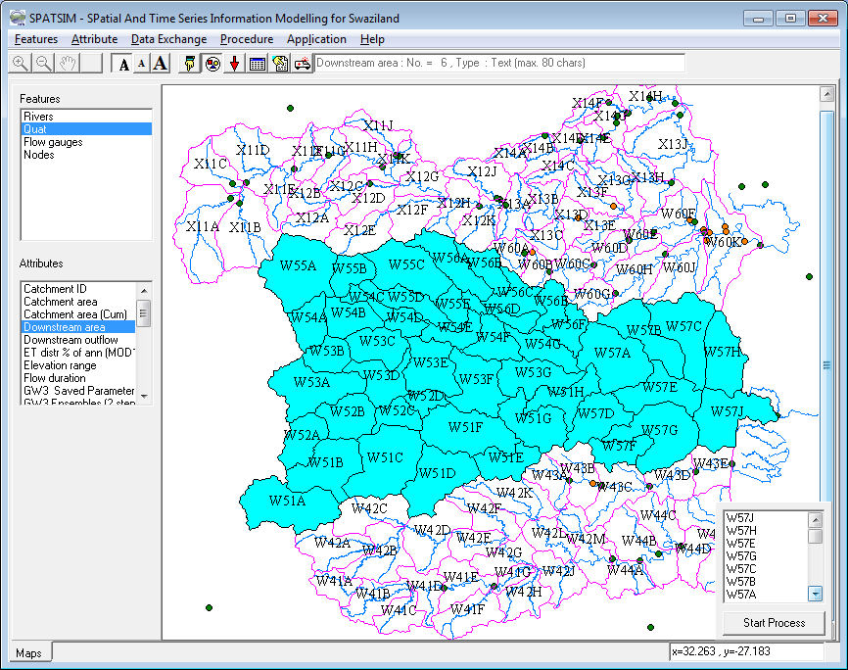
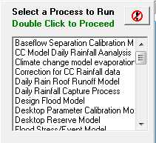
SP 11: Establishing a model application
Identify upstream elements icon.
‘Start Process’ button activates the list of all possible models to use.
Appropriate attribute for downstream links selected.
Included sub-basins highlighted & listed

Slide 12
SP 12: Model format files (see SPATSIM/text_data folder)
Model name.
GWV3 Global Options Model
1st parameter 0:Required, 1:Optional
2nd parameter=Table Type (-9:Multiple Var. File, 99: Other File)
1. EXE File
0 99 gwv3_global.exe
2. Output Requirement File
0 99 gwv3_Pitman.rqo
3. Not Applicable
1 -9
4. Catchment ID
0 0
5. Catchment Area
0 2
6. Cumulative Area
1 2
7. Uncertain Model Parameters
0 5
8. Reservoir/Wetland Parameters
1 5
9. Mean Monthly Evaporation
0 5
10. Mean Monthly Distribution Data
0 5
.
.
etc.
Model executable filename.
Model input & output data:
The 2nd line refers to whether required (0) or optional (1) and what attribute type of data (0=text, 1=single real, etc. – see SP 2).

Slide 13
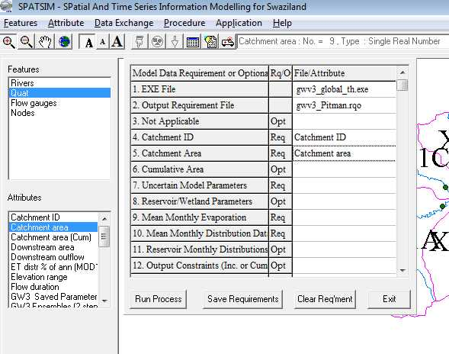
SP 13: Linking SPATSIM attributes to a model application
Model input & output data requirements (or options) are populated by highlighting the appropriate attribute from the list at bottom left and then double clicking the cell in the model data input/output table.

Slide 14
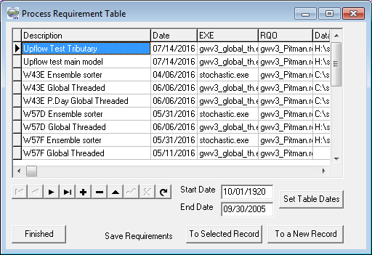
SP 14: Saving a model application for later use
Model applications are saved in a Proc_run database table that contains all of the information required to run a model. This includes the model executable file name, the spatial elements to be included in the model run and their sequence, the links to the SPATSIM attribute data to be used in running the model (or to be generated as output), that start and end dates of the model run, etc.
An entry in the Proc_run table is created when a model application is first established (SP 11 to SP13) and can be re-used by selecting the ‘Directly’ option shown in SP 9. A further option is available to ‘Edit Saved Run’ which allows the user to modify the model inputs or outputs and create a new model application.

Slide 15
SP 15: Detailed outputs from the single run version of the model
1. Rainfall (mm)
2. Interception (mm)
3. Potential evapotranspiration (mm)
4. Actual evapotranspiration (mm)
5. Soil moisture store (mm)
6. Potential dam store (mm)
7. Surface runoff (mm)
8. Soil moisture runoff (mm)
9. Recharge (mm)
10. Groundwater runoff (mm)
11. Ground water1 slope (%)
12. Ground water2 slope (%)
13. Ground water outflow (m³ * 10⁶)
14. Channel Losses (m³ * 10⁶)
15. Routed runoff volume (m³ * 10⁶)
16. Routed baseflow volume (m³ * 10⁶)
17. Upstream inflow (m³ * 10⁶)
18. Direct Abstractions (m³ * 10⁶)
19. Total sub-area runoff (m³ * 10⁶)
20. Reservoir storage volume (m³ * 10⁶)
21. Reservoir evaporation volume (m³ * 10⁶)
22. Required Draft (m³ * 10⁶)
23. Achieved Draft (m³ * 10⁶)
24. Regulated Releases (m³ * 10⁶)
25. Spills (m³ * 10⁶)
26. Total Downstream Flow (m³ * 10⁶)
These model variables (inputs, outputs & state variables) are output to a binary file for every month of the time series and these files cab accessed by TSOFT (SP 10) for plotting and further analysis.
Typical analyses include:
Comparison of all the contributions to stream flow (7 to 10) to identify dominant modelled processes.
Comparison of routed surface runoff and baseflow (interflow & groundwater) components (15 & 16).
Comparison of potential and actual evapotranspiration with changes in moisture storage (3 to 5).
Changes in groundwater storage using gradients toward the channel (11 & 12).

Slide 16
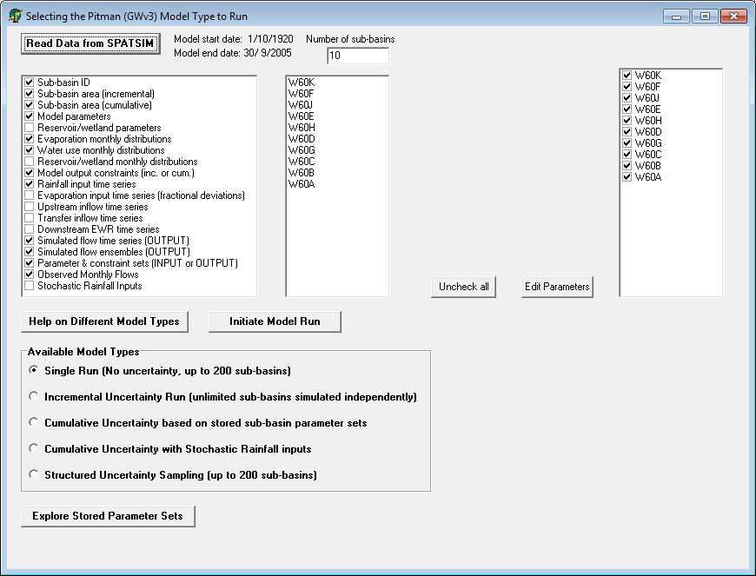
SP 16: Model versions available in SPATSIM
Model options available within SPATSIM through a single executable file. The screen shot represents the opening screen after the ‘Read Data from SPATSIM’ button has been clicked.
List of sub-basins associated with this model run.
List of data attributes that have been loaded for this model run.
Model version options (Click on the Help button to get a more complete description of the selected model version).
Option to edit the parameter inputs (see SP 17).

Slide 17
SP 17: Model input/output streams
SP 13 illustrates the model interface with SPATSIM. This slide explains the various input and output data streams for the so-called ‘Global Options’ version of the model, the starting screen of which is shown on a previous slide (SP 16). The bold italic inputs are compulsory, all the others are optional.
* Catchment ID: Identification name of the sub-basin (Text type attribute).
* Catchment Area: Incremental area (km²) of the sub-basin (Single Real number).
* Cumulative Area: Cumulative area (km²) of the sub-basin (Single Real number).
* Uncertain Model Parameters: Parameter inputs (2D Array type attribute – see SP 20).
* Reservoir/Wetland Parameters: Reservoir or wetland parameters (1D Array type attribute).
* Mean Monthly Evaporation: Mean monthly evaporation (% of annual - 1D Array type attribute).
* Mean Monthly Distribution Data: Table of values to distribute annual water demands (2D Array type attribute).
* Reservoir Monthly Distributions: Table of values to distribute annual water parameters in the reservoir or wetland sub-model (2D Array type attribute).
* Output Constraints: Table of minimum and maximum hydrological constraint indices (2D Array type attribute – see SP 21).
* Catchment Average Rainfall: Monthly rainfall inputs (mm): (Time series attribute).
* Catchment Average PE: A time series of fractional deviations of potential evaporation from the mean monthly values (used to allow for variations in calendar month PE across different years).

Slide 18
SP 18: Model input/output streams (continued)
* Upstream Inflow: A time series of upstream inflows (m³ * 10⁶) which can be an ensemble set. This input is used so that more than one basin model can be linked (i.e. the outputs from one basin model can feed into another basin model).
* Transfer Inflow: A time series of inter-basin transfers (m³ * 10⁶) that can be used to simulate the effects of water imported from another area.
* Downstream Reserve Requirements: A time series of environmental flow requirements (m³ * 10⁶) that is used as a demand as part of the reservoir sub-model.
* Simulated flows: An output time series attribute to store the results of the single run version of the model for the outlet of each sub-basin.
* Simulated flow ensembles: An output time series attribute to store the results of the cumulative uncertainty version (see SP 16) of the model for the outlet of each sub- basin.
* Output parameters & constraints: A output time series attribute (although the data are not a time series) to store the parameters and constraint index values for each sub-basin during the incremental uncertainty version of the model (see SP 16).
* Observed Monthly Flows: Time series of observed flows in m³ * 10⁶ (if available).
* Stochastic Rainfall Inputs: Ensemble of time series of rainfall (mm) inputs required if cumulative uncertainty with stochastic rainfall inputs version of the model is to be used (see SP 16).

Slide 19
SP 19: Format of the parameter input table
Array Parameter Mean St.Dev Dep.Index Dist.Type Min Value Max Value
01. Rain Distribution Factor 1.280 0.000 0.000 0.000 0.000 0.000
02. Proportion of impervious area AI 0.000 0.000 0.000 0.000 0.000 0.000
03. Summer intercept cap.(Veg1) PI1s 1.500 0.000 0.000 0.000 0.000 0.000
04. Winter intercept cap.(Veg1) PI1w 1.500 0.000 0.000 0.000 0.000 0.000
05. Summer intercept cap.(Veg2) PI2s 4.000 0.000 0.000 0.000 0.000 0.000
06. Winter intercept cap.(Veg2) PI2w 4.000 0.000 0.000 0.000 0.000 0.000
07. % Area of Veg2 AFOR 15.000 1.000 0.000 3.000 10.000 20.000
08. Veg2/Veg1 Pot. Evap. Ratio FF 1.400 0.000 0.000 0.000 0.000 0.000
09. Parameter not in use 0.000 0.000 0.000 0.000 0.000 0.000
10. Annual Pan Evaporation (mm) PEVAP 1400.000 0.000 0.000 0.000 0.000 0.000
11. Summer min.abs.rate (mm/mth) ZMINs 0.000 1.000 0.000 3.000 0.000 50.000
12. Winter min.abs.rate (mm/mth) ZMINw 0.000 1.000 0.000 3.000 0.000 50.000
13. Mean abs.rate (mm/mth) ZAVE 450.000 0.000 0.000 0.000 0.000 0.000
14. Maximum abs.rate (mm/mth) ZMAX 700.000 1.000 0.000 3.000 550.000 850.000
15. Maximum storage capacity ST 200.000 1.000 0.000 3.000 150.000 300.000
16. No recharge below storage SL 0.000 0.000 0.000 0.000 0.000 0.000
17. Power : storage-runoff curve POW 2.500 1.000 0.000 3.000 2.000 3.000
18. Runoff rate at ST (mm/mth) FT 12.000 1.000 0.000 3.000 5.000 20.000
19. Max. Recharge rate (mm/month) GW 15.000 1.000 0.000 3.000 5.000 30.000
20. Evaporation-storage coefficient R 0.500 0.000 0.000 3.000 0.200 0.700
21. Sub-area Routing Coeff. (mnths) TL 0.250 0.000 0.000 0.000 0.000 0.000
22. Channel Routing Coeff (mnths). CL 0.000 0.000 0.000 0.000 0.000 0.000
23. Irrig.area (km^2) AIRR 2.110 0.000 0.000 0.000 0.000 0.000
24. Irrig. return flow fraction IWR 0.000 0.000 0.000 0.000 0.000 0.000
25. Effective Rainfall fraction 0.000 0.000 0.000 0.000 0.000 0.000
26. Non-Irrig. Direct Demand (Ml/year) 0.000 0.000 0.000 0.000 0.000 0.000
27. Maximum dam storage (Ml) 0.000 0.000 0.000 0.000 0.000 0.000
28. % Catchment area above dams 0.000 0.000 0.000 0.000 0.000 0.000
29. A in area volume relationship 0.000 0.000 0.000 0.000 0.000 0.000
30. B in area volume relationship 0.000 0.000 0.000 0.000 0.000 0.000
31. Irrig. Area from Dams (km^2) 0.000 0.000 0.000 0.000 0.000 0.000
32. Channel Loss TLGMax(mm) 0.000 0.000 0.000 0.000 0.000 0.000
33. Power : Storage-Recharge curve GPOW 3.000 1.000 0.000 3.000 2.500 3.500
34. Drainage density 0.400 0.000 0.000 0.000 0.000 0.000
35. Transmissivity (m^2/day) 8.000 0.000 0.000 0.000 0.000 0.000
36. Storativity 0.004 0.000 0.000 0.000 0.000 0.000
37. Initial GW drainage slope 0.011 0.000 0.000 0.000 0.000 0.000
38. Rest water level (m below surface) 10.000 0.000 0.000 0.000 0.000 0.000
39. Riparian Strip Factor 0.200 1.000 0.000 3.000 0.200 2.000
Column meanings:
Mean: Default value or mean of a normal uncertainty distribution.
St.Dev: Standard deviation of a Normal distribution.
Dep.Index: sub-basin grouping index for uncertainty sampling.
Dist.Type: 0=No uncertainty, 1=Normal Dist., 2=Log Normal Dist., 3=Uniform Dist.
Min/Max Value: Minimum & maximum values of a Uniform uncertainty distribution.

Slide 20
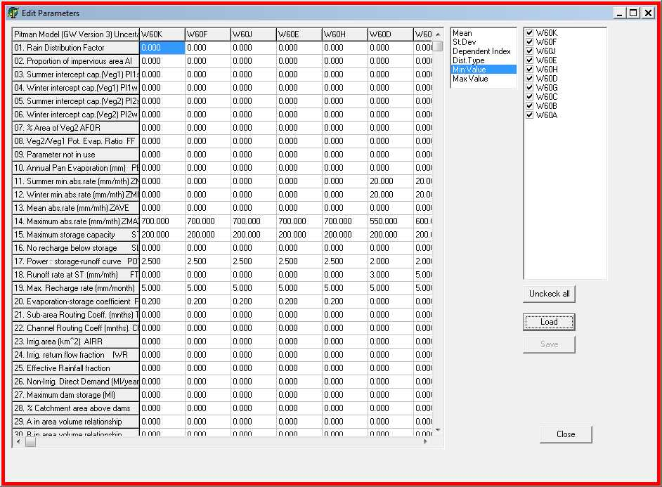
SP 20: Editing parameters within the model run
List of sub-basins (check to include in display).
Choice of which component of the parameter set to list and edit.

Slide 21
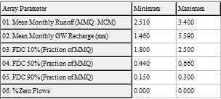
SP 21: Uncertainty constraint input table

Slide 22
SP 22: Structure of the text file output for the cumulative uncertainty option
These files are named pitmV3_2_{sub-basin ID}.un1 and have 1 line for each ensemble and 54 columns (as defined below). These data can be further analysed within conventional spreadsheets to identify the best fits to observed data, the range and frequency distribution of summary statistics, the relationships between parameter values and objective functions, etc.
Column 1: The ensemble number.
Columns 2 to 42: The parameter values used in the ensemble run in the same order as the parameter input data (see SP 17).
Column 43 to 49: Some summary statistics of the cumulative simulated flow at outlet of this sub-basin: Mean monthly runoff volume (m³ * 10⁶); Coeff. of variation of simulated runoff; Mean monthly GW recharge (mm); % Zero flows; FDC 10%; FDC 50%; FDC 90% (all expressed as a fraction of mean monthly runoff).
Column 50 to 54: Objective function values (if observed data are included in the model setup for this sub-basin): Nash Efficiency based on non-transformed data; Nash Efficiency based on natural log (ln) transformed data; not used at present; % bias based on un-transformed data; % bias based on ln transformed data. The % bias is calculated from {(mean simulated flow – mean obs. flow) * 100 / (mean obs. flow)}.

Slide 23
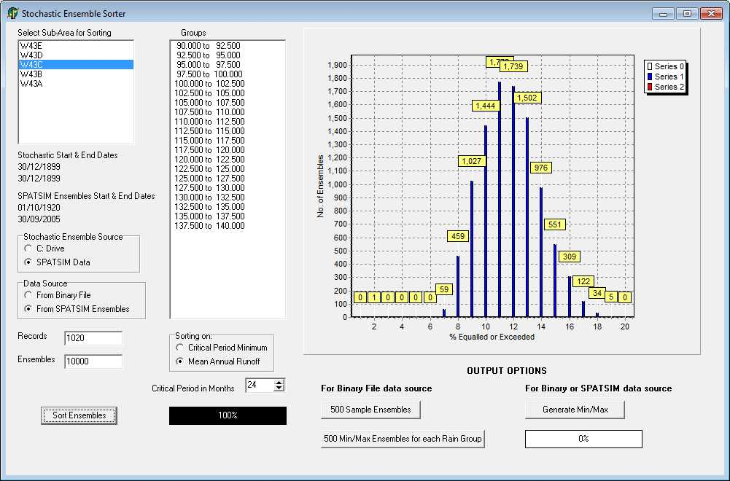
SP 23: Post-processing simulated ensembles
Histograms of either critical period or mean annual stream flow volumes (m³ * 10⁶).
List of sub-basins.
Input data specifications.
Output options for extracting a sample of ensembles for further use (e.g. in a systems yield model) and for generating the ensemble minimum, 95%, 50% & 5% exceeded and maximum stream flow for each month of the simulation period.

Slide 24
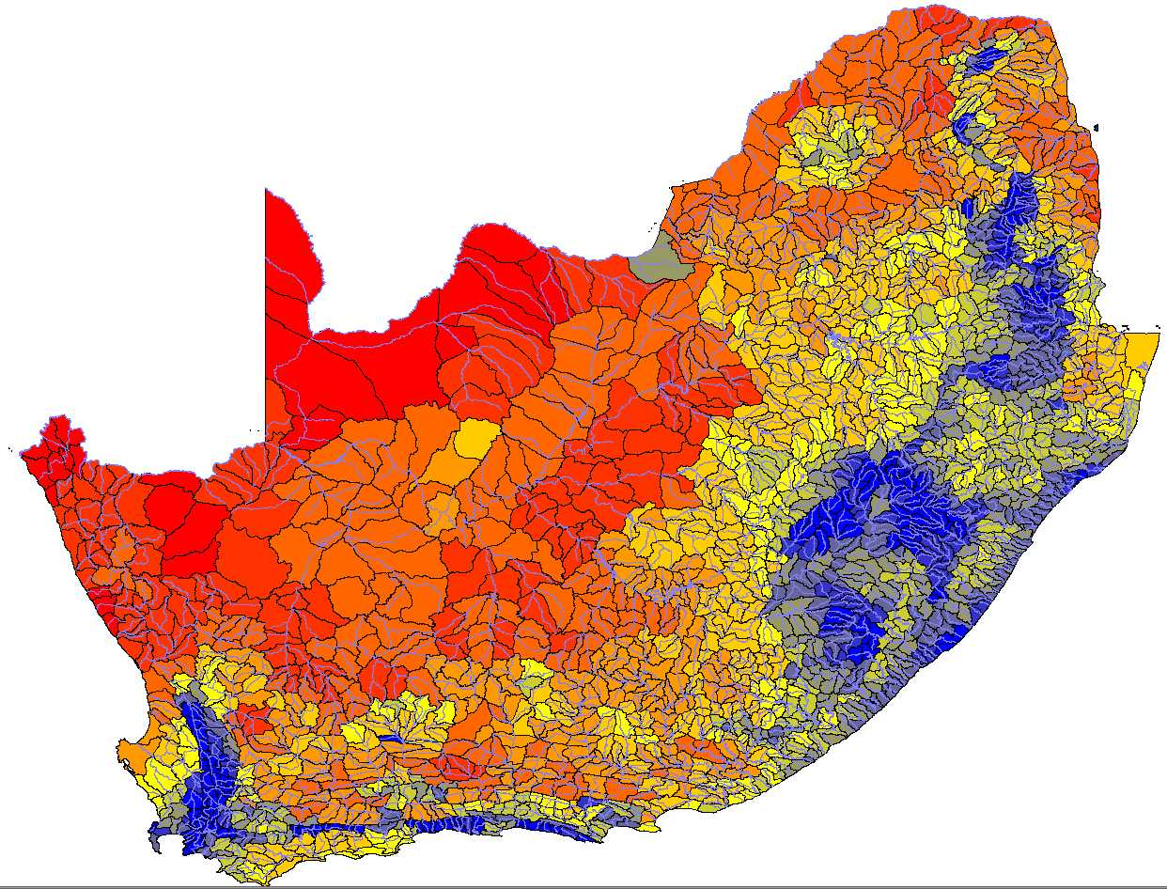

SP 24: Constraints – Spatial patterns for South Africa
Mean monthly runoff:
Expressed as runoff ratio (mean annual runoff / sub-basin area * mean annual rainfall). The actual constrain values would be determined from the regionalised Q Ratio, the catchment area and the mean annual rainfall.
Key
Q Ratio
0.0 – 0.25
>0.25 – 1.0
>1.0 – 2.25
>2.5 – 4.0
>4.0 – 6.25
>6.25 – 9.0
>9.0 – 12.25
>12.25 – 16.0
>16.0 - 20.25
>20.25 – 25.0
> 25.0

Slide 25
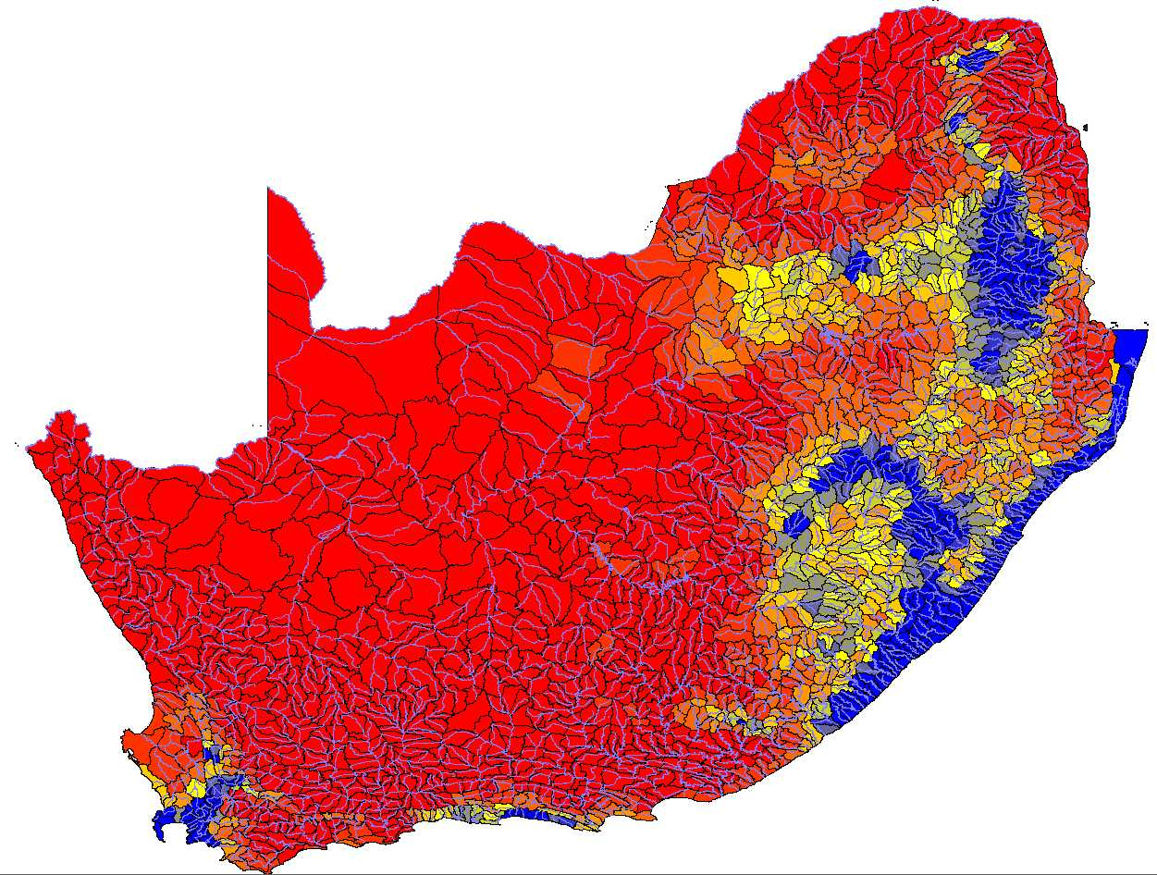
SP 25: Constraints – Spatial patterns for South Africa
Mean monthly recharge:
Plotted as mean annual recharge (mm) based on the lowest value in the GRAII (DWA, 2004) dataset.
Key
Recharge (mm)
0 – 5
>5 – 10
>10 – 15
>15 – 20
>20 – 25
>25 – 30
>30 – 35
>35 – 40
>40 – 45
>45 – 50
> 50

Slide 26
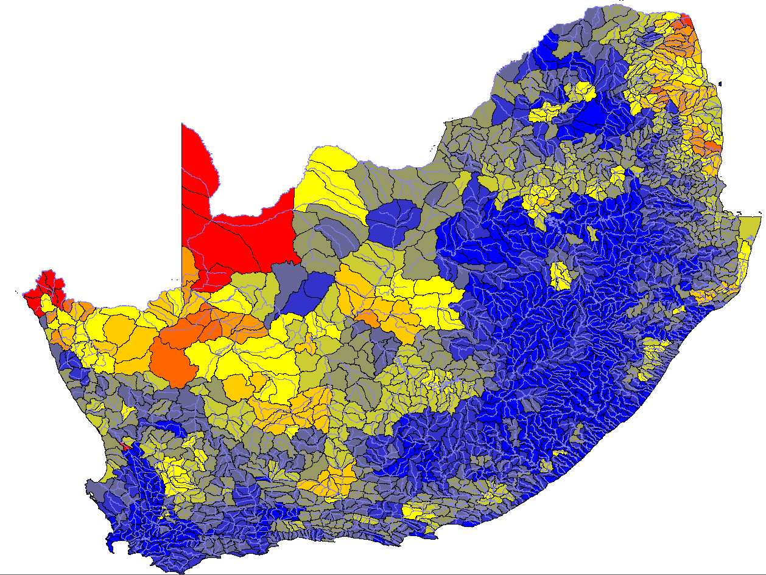
SP 26: Constraints – Spatial patterns for South Africa
FDC 10% / MMQ:
Expressed as the ratio of FDC 10% / mean monthly runoff.
Key
FDC 10%
0.0 – 0.25
>0.25 – 0.5
>0.5 – 0.75
>0.75 – 1.0
>1.0 – 1.25
>1.25 – 1.5
>1.5 – 1.75
>1.75 – 2.0
>2.0 - 2.25
>2.25 – 2.5
> 2.5

Slide 27
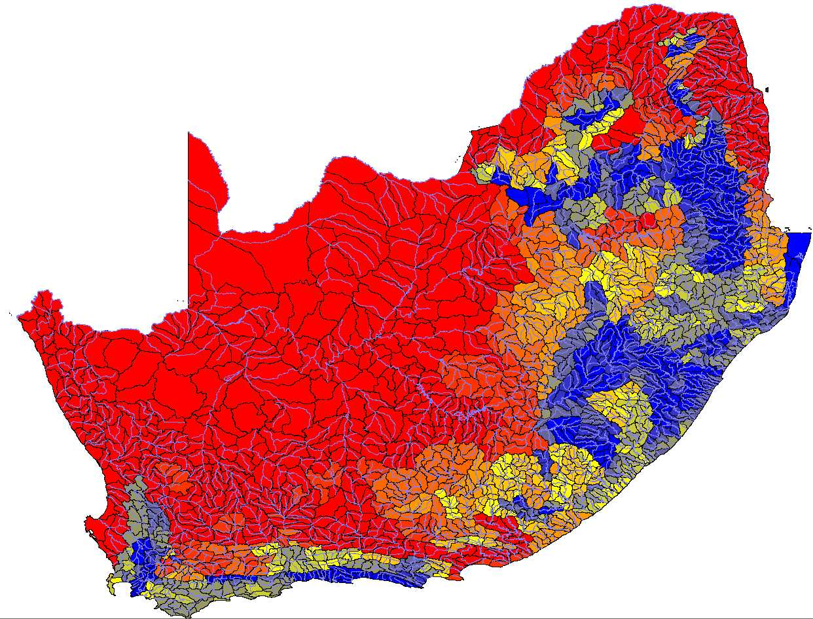
SP 27: Constraints – Spatial patterns for South Africa
FDC 50% / MMQ:
Expressed as the ratio of FDC 50% / mean monthly runoff.
Key
FDC 50%
0.0 – 0.05
>0.05 – 0.1
>0.1 – 0.15
>0.15 – 0.2
>0.2 – 0.25
>0.25 – 0.5
>0.5 – 0.55
>0.55 – 0.6
>0.6 – 0.65
>0.65 – 0.7
> 0.7

Slide 28
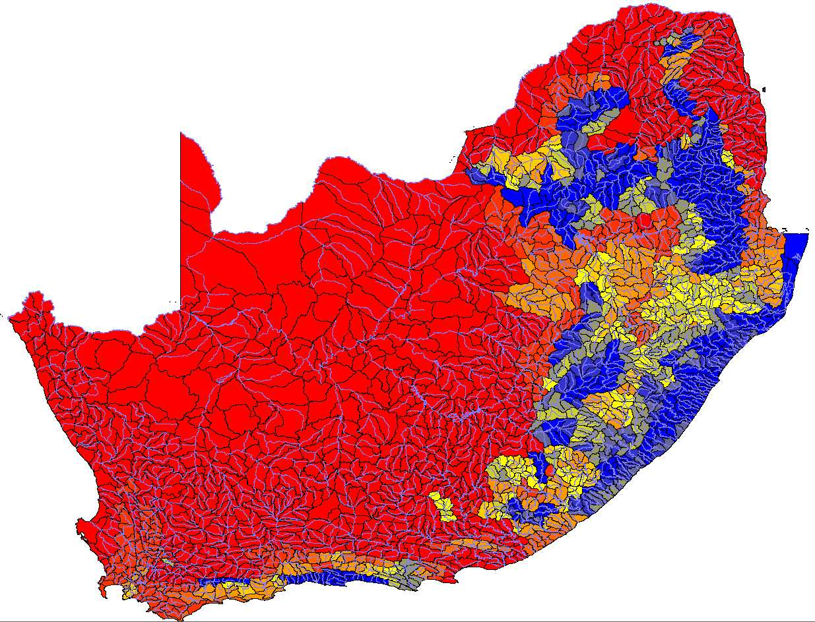
SP 28: Constraints – Spatial patterns for South Africa
FDC 90% / MMQ:
Expressed as the ratio of FDC 90% / mean monthly runoff.
Key
FDC 50%
0.0 – 0.015
>0.015 – 0.03
>0.03 – 0.045
>0.045 – 0.06
>0.06 – 0.075
>0.075 – 0.09
>0.09 – 0.105
>0.105 – 0.12
>0.12 – 0.135
>0.135 – 0.15
> 0.15

Slide 29
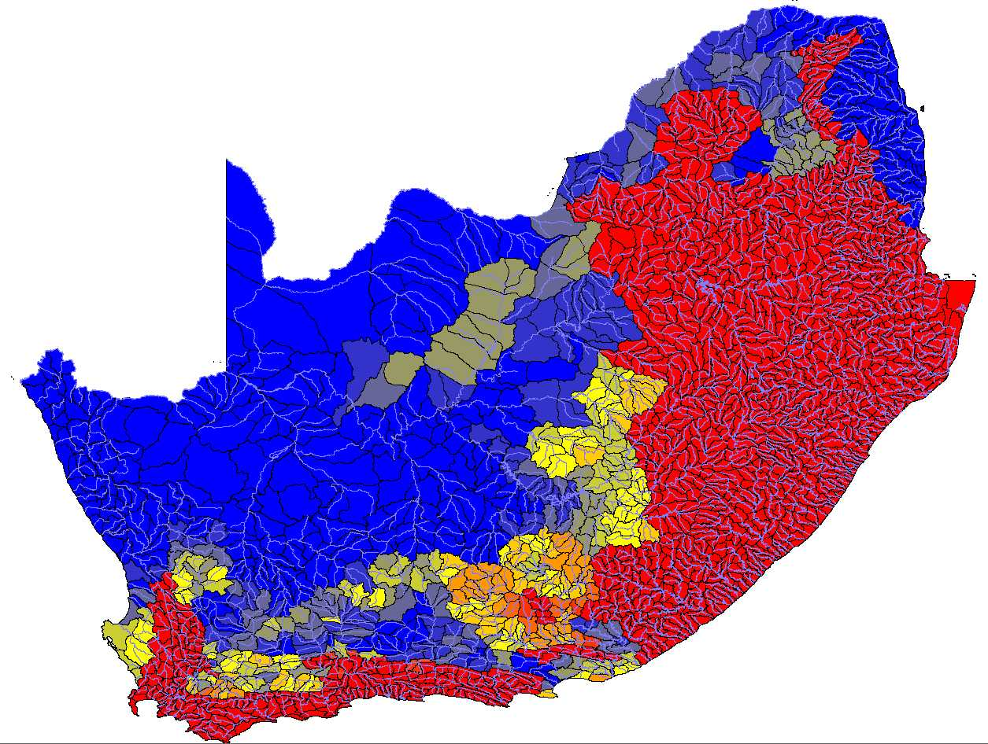
SP 29: Constraints – Spatial patterns for South Africa
% Zero:
Percentage months with zero flow.
Key
% Zero
0 – 5
>5 – 10
>10 – 15
>15 – 20
>20 – 25
>25 – 30
>30 – 35
>35 – 40
>40 – 45
>45 – 50
> 50

Slide 30
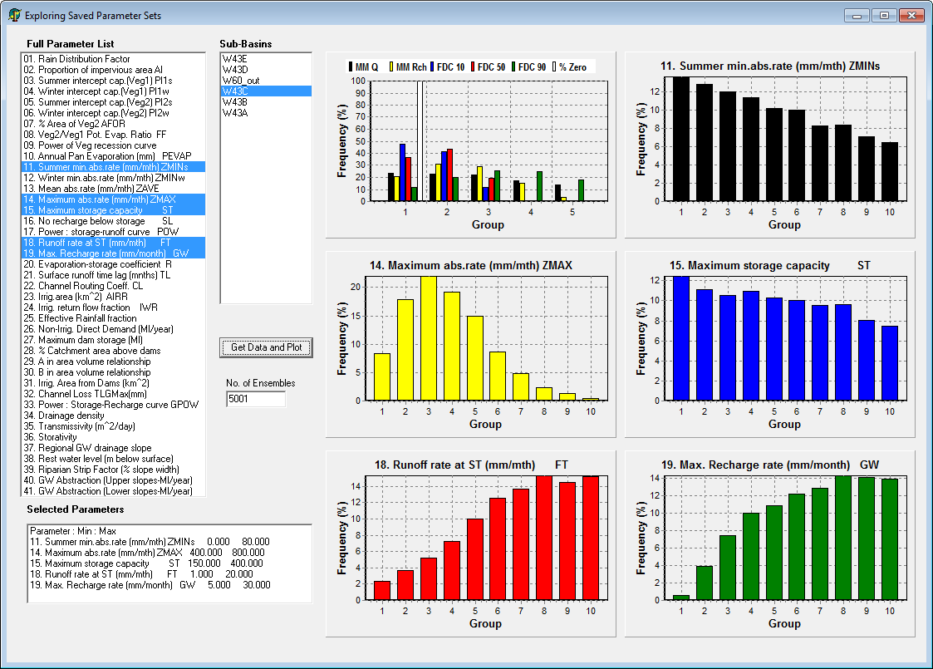
SP 30: Exploring saved parameter sets
Frequency of the constraints found in the behavioural ensembles based on 5 equally spaced groups between the min. & max. constraint value.
List of sub-basins.
Frequency of the
Values of the selected parameters found in the behavioural ensembles based on 10 equally spaced groups between the min. & max. parameter value.
List of parameters.
Ranges of the selected parameters.

Slide 31
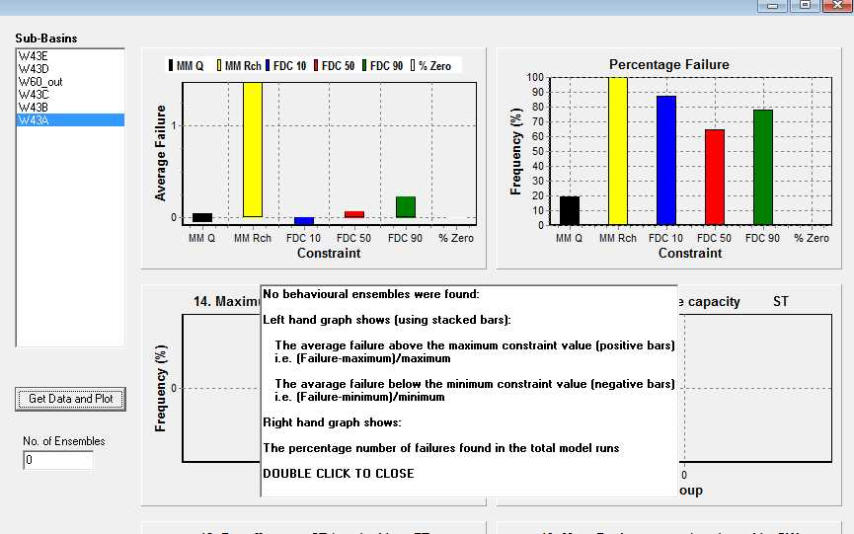
SP 31: Exploring saved parameter sets
Situation when no behavioural simulations are found, which is typically a result of incompatibilities between the constraints and the parameters.
The left graph shows the average relative failure for greater than the constraint max. value (+ve) and for less than the min. level (-ve). This is used to identify the main problem constraint and the direction of incompatibility (too high or too low).
The right graph shows the percentage failure out of all the trial model runs and is also used to identify the main problem constraint.
In this example the groundwater recharge constraint range (1.5 to 2.5 mm month⁻¹) is incompatible with the range of the parameter GW (maximum recharge rate: 35 to 50 mm month⁻¹).

Slide 32
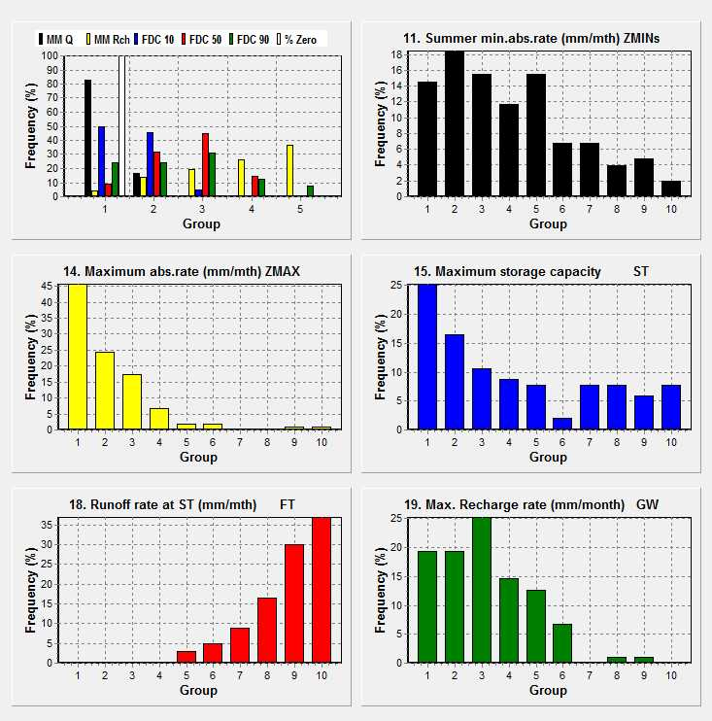
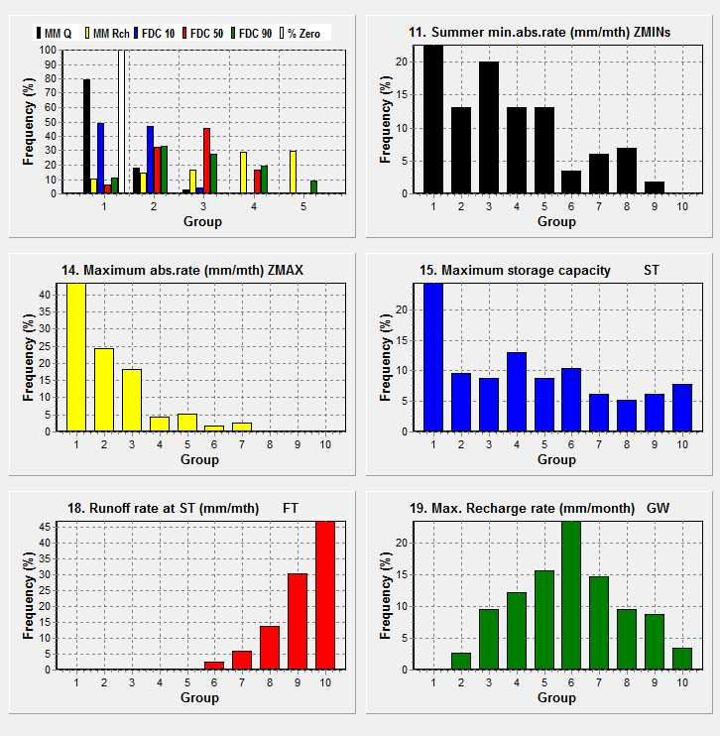
SP 32: Progressive improvement I
Starting point was SP 22 failures:
GW parameter changed from 35-50mm to 10-25mm.
103 behavioural out of 1 000 total runs.
Range of output recharge values is OK, but GW values biased toward lower end of range.
GW changed to 5-20mm and frequency distribution no longer biased. 115 behavioural out of 1 000 total runs. Problem of too low mean monthly volume (MMQ) needs addressing. Start with ZMAX which is biased toward lower end of start range 550-850mm.

Slide 33
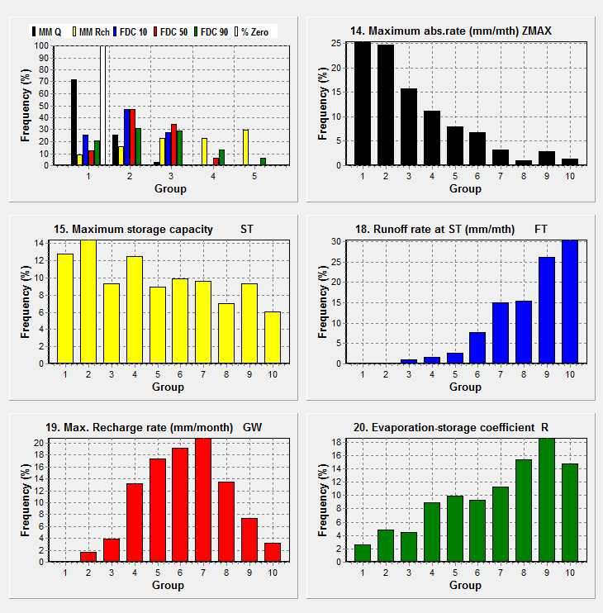
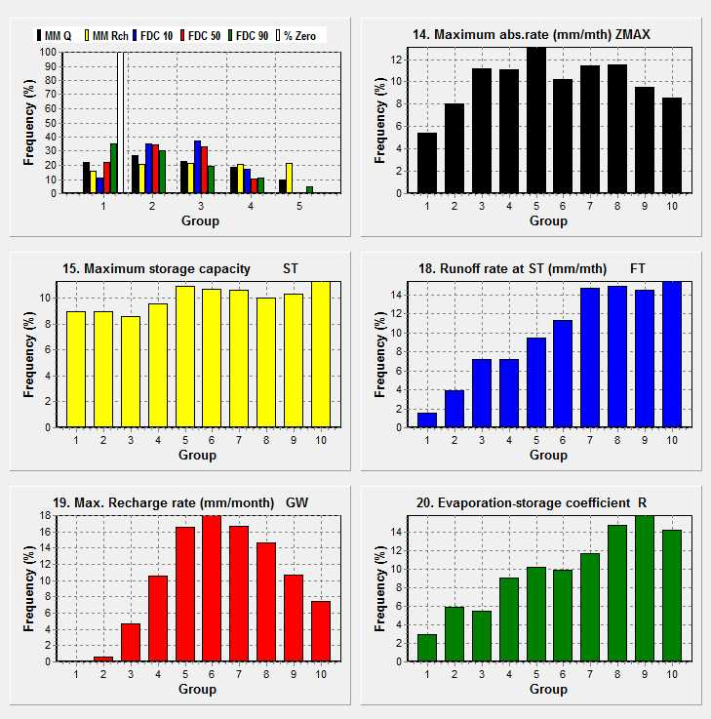
SP 33: Progressive improvement II
312 behavioural out of 1 000 total runs. But MMQ still too low, ZMAX remains biased and FT biased toward higher values.
ZMAX range reduced further (400-600mm) and FT range increased from 5-20mm to 10-30mm) to generate more interflow
Final result is quite well distributed constraint and key parameter values and 1 000 behavioural ensembles are achieved from 5 400 total runs.

Slide 34
SP 34: Parameter ranges I
Parameter | Range | Explanation
Rainfall distribution factor (RDF) | 1.28 (default) 0.6 – 0.8 in tropical areas. | Default value used for variable rainfall regimes (Pitman, 1973) but lower values are often better in tropical areas with high rainfalls that are quite evenly distributed throughout a wet season month.
Impervious area (AI %) | 0 (default) | Typically not used except in urban areas or areas with rocky surfaces in direct connection with channels.
Interception parameters (PI1 & PI2 mm) | 1.2 - 2.0 | Typical values for grassland and bush.
 | 3.0 – 4.0 | Typical values for denser forest or managed plantations.
Pot. evap. scaling parameter (FF) | 1.2 – 1.4 | Only used when a second vegetation type is specified to account for large differences in dominant vegetation, as with managed forest plantations.
Evaporation decay parameter (R) | 0.0 – 0.3 | Deep rooting vegetation or thin soils representing very effective evap. even at low moisture levels.
 | 0.2 – 0.7 | Typical default range when knowledge of evap. effectiveness is limited.
 | 0.6 – 1.0 | Shallow rooting vegetation or deep soils with limited evap. losses at low moisture states.

Slide 35
SP 35: Parameter ranges II
Parameter | Range | Explanation
ZMIN mm month⁻¹ | 0 – 25 | Typically low values used for semi-arid areas with quite high expected surface runoff.
 | 25 - 100 | Useful default range which can then be refined on the basis of the frequency graphs (SP 21).
 | 80 - 150 | Tropical areas with high rainfall and likely low surface runoff due to low topography or dense vegetation, for example.
ZMAX mm month⁻¹ (should always be higher than any ZMIN value) | 200 - 400 | Typically low values used for semi-arid areas with quite high expected surface runoff.
 | 400 – 800 | Useful default range which can then be refined on the basis of the frequency graphs (SP 21).
 | 800 - 1200 | Tropical areas with high rainfall and likely low surface runoff due to low topography or dense vegetation, for example.
ZAVE mm month⁻¹ | (ZMIN+ZMAX)/2 | The use of asymmetry in the surface runoff triangular distribution has not been adequately tested, but is relatively easy to assess using several single runs of the model with different ZAVE values and looking at the relationships between rainfall and surface runoff depth.

Slide 36
SP 36: Parameter ranges III
Parameter | Range | Explanation
Moisture storage (ST mm) | 100 - 200 | Semi arid areas with thin soils.
 | 200 - 400 | Temperate to sub-humid areas depending on soils and regolith depth. Weathered or highly fractured unsaturated zones can contribute to high interflow volumes and higher ST values.
 | 800 – 1 200 | Tropical areas with deep soils and high wet season rainfall.
Interflow (FT mm month⁻¹) | 0 | Fixed value when zero flows are expected unless small interflow volumes are removed with channel losses in some way.
 | 0 - 5 | Useful default range for areas with low FDC 90% constraints (< 0.1).
 | 5 - 20 | Useful default range for areas with moderate FDC 90% constraints (> 0.1 & <0.25).
 | 20 – 50 (or higher) | Steep catchments with deep soil or unsaturated zone storage.
Interflow (POW) | 1.8 – 3.0 or 2.5 – 4.0 | The POW range should be related to the expected non-linearity of the interflow response (can examine the seasonal hydrograph recession shape). The higher range might be linked to high FT values but rapid recessions into the dry season.

Slide 37
SP 37: Parameter ranges IV
Parameter | Range | Explanation
Groundwater recharge (GW mm month⁻¹) | Various ranges. 0 – 5 for low recharge. 30 – 50 for high recharge & GW contributions to stream flow. | Values should be informed by independent estimates of mean recharge if possible. A few single model runs followed by an examination of detailed model output (GW recharge time series) in TSOFT should be used to identify the likely range.
Groundwater recharge (GPOW) | 2.5 – 4.0 | The GPOW value is often fixed at 3.5. More permeable soils and geology might be expected to have lower values representing less variability.
Riparian strip width (%) | 0.2 – 2.0 | This parameter represents the evaporative losses from groundwater in the riparian zone and Google Earth can be used to look at riparian vegetation and valley bottom topography to obtain a likely range.
Drainage density | 0.2 – 0.5 | Not normally considered uncertain and a default value of 0.4 is often used unless the sub-area is very small. This parameter can have a large impact on GW outflows to downstream sub-areas.
GW Gradient | 0.01 | This is normally fixed at the default value. If a downstream sub-area is much smaller then GW outflows can cause instabilities & a much lower gradient could be used.

Slide 38
SP 38: Parameter ranges V
Parameter | Range | Explanation
Transmissivity (m day⁻¹) | 5 - 30 | This parameter is not normally treated as uncertain and is quantified from the regional geology characteristics. Note that this is a sub-area scale parameter and not the same as would be determined from a local pump test study.
Storativity | 0.001 – 0.1 | Not usually treated as uncertain and linked to an understanding of the regional geology (0.001 to 0.005 typically used in fractured rock aquifers of South Africa). Both transmissivity and storativity can be based on the expected variability of the GW contribution to stream flow (low variability = high storativity and low transmissivity).
GW rest water level (mm) | 10 to 30 | This parameter only has an affect when the GW levels drop below the channel (a losing stream situation or associated with GW abstraction) and is normally a fixed value of 25 m.
Channel loss parameter (TLGMax mm) | ? | There is very little experience of the use of this parameter and if it is to be used in a specific study, users are advised to run some tests first to identify the impacts of different parameter values. Further investigations of the effects of this parameter are part of a current study on the Limpopo River along the border between South Africa, Botswana, Zimbabwe and Mozambique.
Sub-basin (TL) and channel routing (CL) parameters (months) | TL = 0.25 CL = 0.0 – 0.3 | TL is frequently kept at the default value of 0.25, but could be increased for large sub-basins. CL is only used in very large sub-basins where attenuation of monthly flows is likely.

Slide 39
SP 39: Parameter ranges VI (water use parameters)
Parameter | Range | Explanation
% Area of veg. type 2 (AFOR %) | No default | Percentage of the sub-basin area under a managed land use such as plantation forest.
Interception parameters (PI2 mm) | 3.0 – 4.0 | This parameter was referred to in SP 31, but is mainly used to represent increased interception from the area (AFOR) covered by managed plantations.
Veg. type 2 potential evaporation ratio (FF) | 1.2 to 1.5 | This is used to scale the potential evaporation demand for the proportion of the sub-basin area (AFOR) under vegetation type 2.
Irrigation area (AIRR km²) | No default | Irrigation area supplied directly from channel abstractions. The volume of abstraction is determined using a monthly distribution of irrigation depth (mm) demands (separate data input).
Irrigation return flow fraction (IWR) | 0.1 to 0.2 | The proportion of irrigation water that returns to the channel.
Effective rainfall fraction | 0.2 to 0.5 | The proportion of monthly rainfall that is assumed to satisfy the irrigation demand before abstractions are required.
Non-irrigation direct demands (m³ * 10³ y⁻¹) | No default | Annual volume of direct river abstractions for non-irrigation purposes (e.g. for domestic or industrial use. The monthly distribution (fractions of annual) is provided as a separate data input.

Slide 40
SP 40: Parameter ranges VI (water use parameters)
Parameter | Range | Explanation
Maximum dam storage (m³ * 10³ y⁻¹) | No default | Storage volume of small dams that are within a sub-basin (i.e. not fed from upstream inflows).
% area above dams | No default | The proportion of the sub-basin that provides inflows into small dams within the sub-basin.
A and B parameters in the dam area-volume relationship | No default | Parameters in the relationship: Dam surface area (m²) = A * dam volume (m³)^{B}. Used to determine evaporation losses from small dams.
Irrigation area from dams (km²) | No default | Irrigation area supplied from small dams within the sub-area (the same monthly distribution of irrigation depth (mm) demands referred to in SP 36 is used).
GW abstraction volumes (m³ * 10³ y⁻¹) | No default | Two parameters are available to specify ground water abstractions that occur close to, and remote from, the channel. The monthly distribution (fractions of annual) is provided as a separate data input.

Slide 41
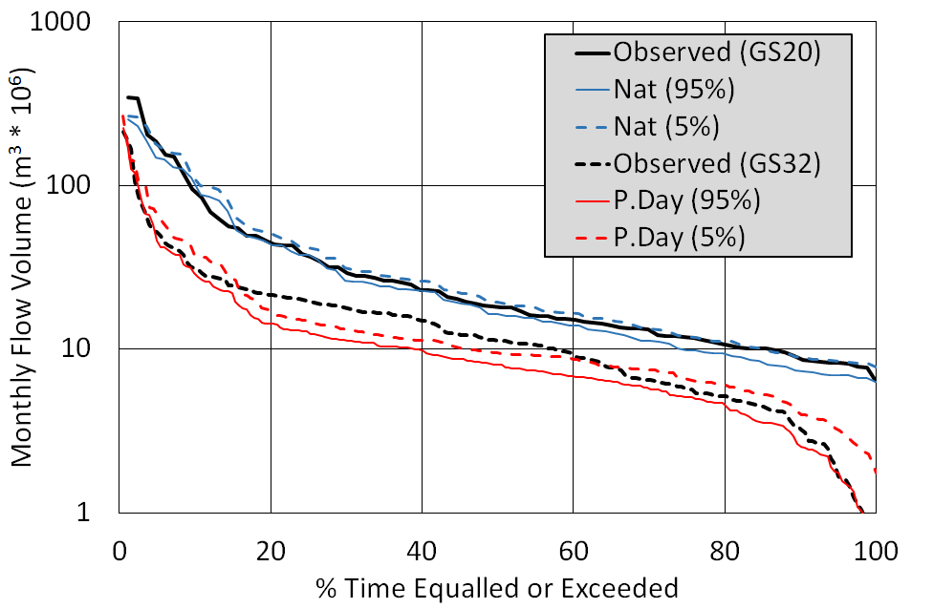
SP 41: Assessing ensemble outputs against observed flows
Flow duration curve (FDC) comparisons of ensemble ranges (using the 95% and 5% exceeded ensemble values for all months of the simulation period) with observed stream flow data using an example from the Mbuluzi River in Swaziland.
The blue lines (Nat.) represent the simulation results for a period prior to the construction of a dam to supply a large area of sugar cane irrigation in the lower reaches of the river.
The red lines (P.Day) represent the simulation results after adding the effects of the dam (and assumptions about the operating rules) as well as the downstream abstractions for the sugar cane irrigation. The relatively poor fit to the middle part of the FDC is ascribed to a combination of inadequate definition of the reservoir operating rules linked to some expected non-stationarity in the water use from dam construction in 1981 to the present day.

