Slide 1

Don’t you know who I am?
Building a collaborative academic space in an era of individualism

Slide 2

Examples of self-promotion of academic work in 21st Century?
What works and what flops terribly?

Slide 3



Why is self-promotion of our research now part of our work?

Slide 4
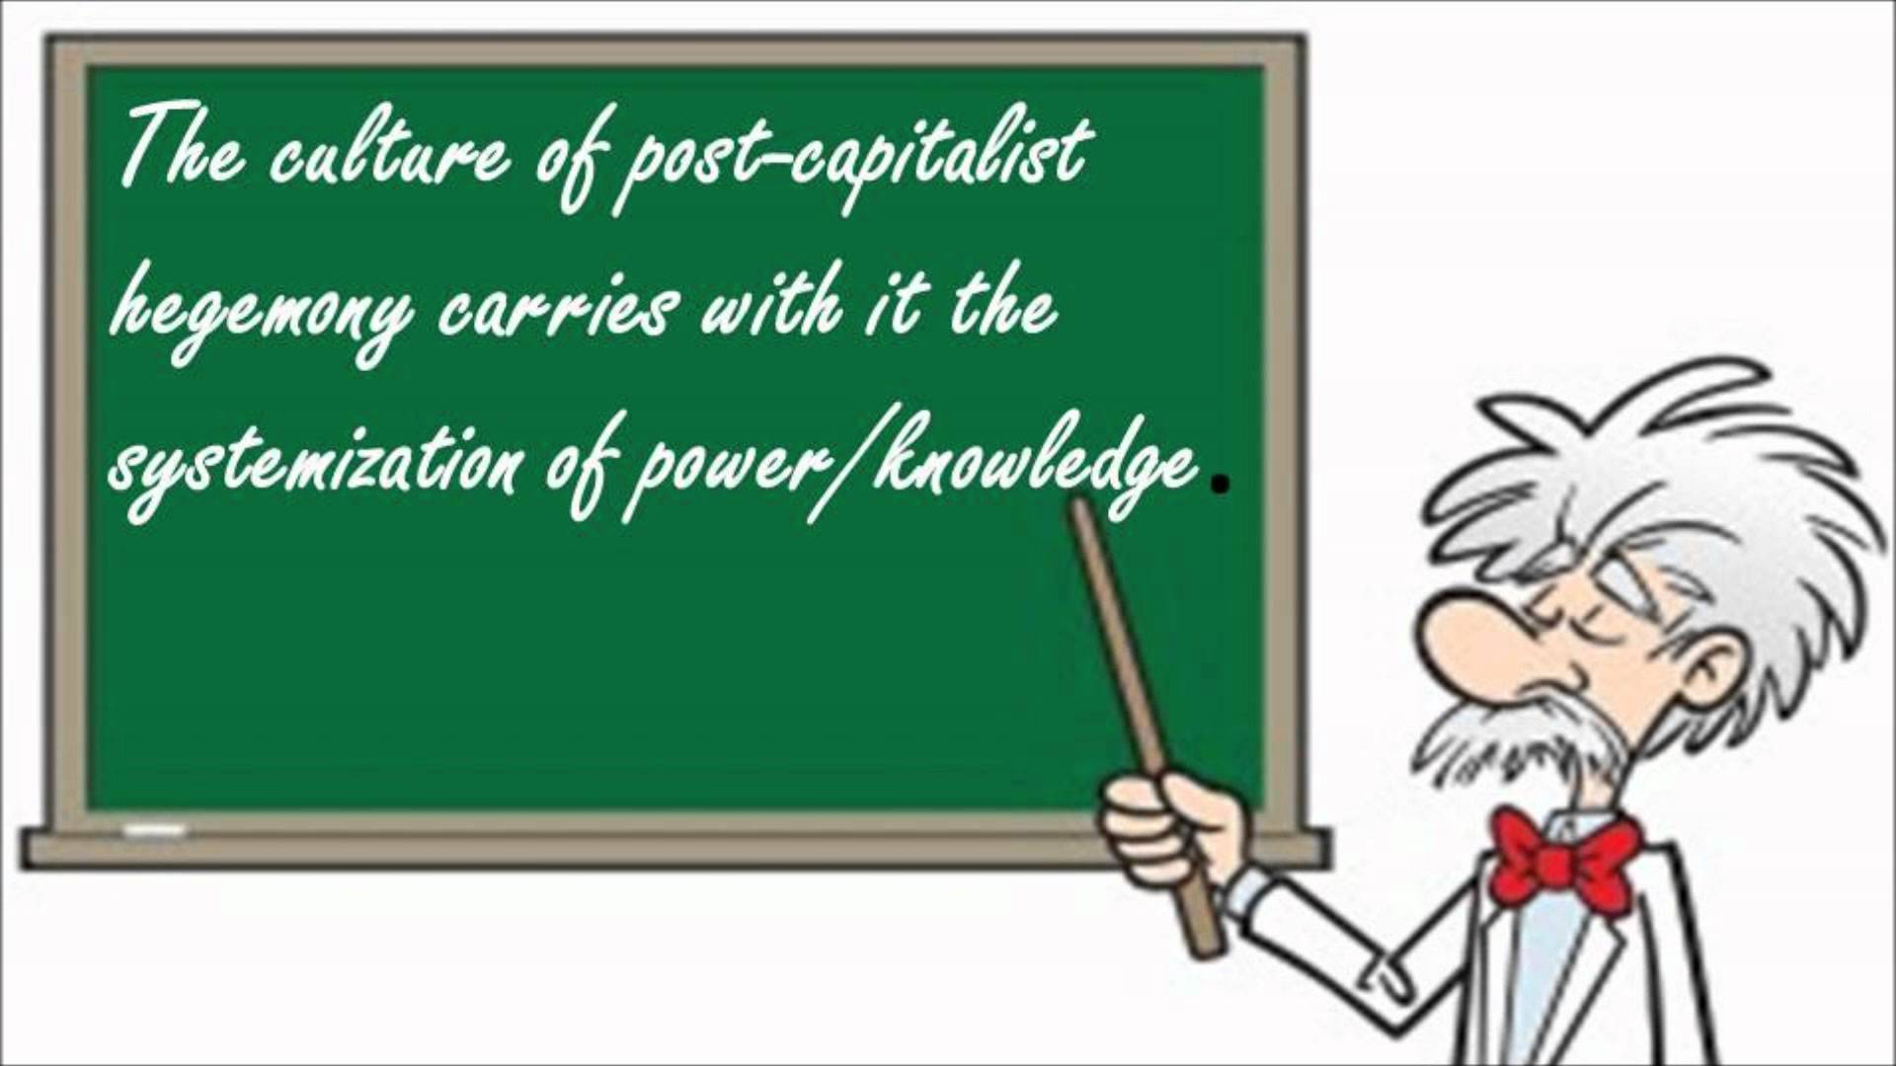
Are we simply part of the knowledge-economy?

Slide 5

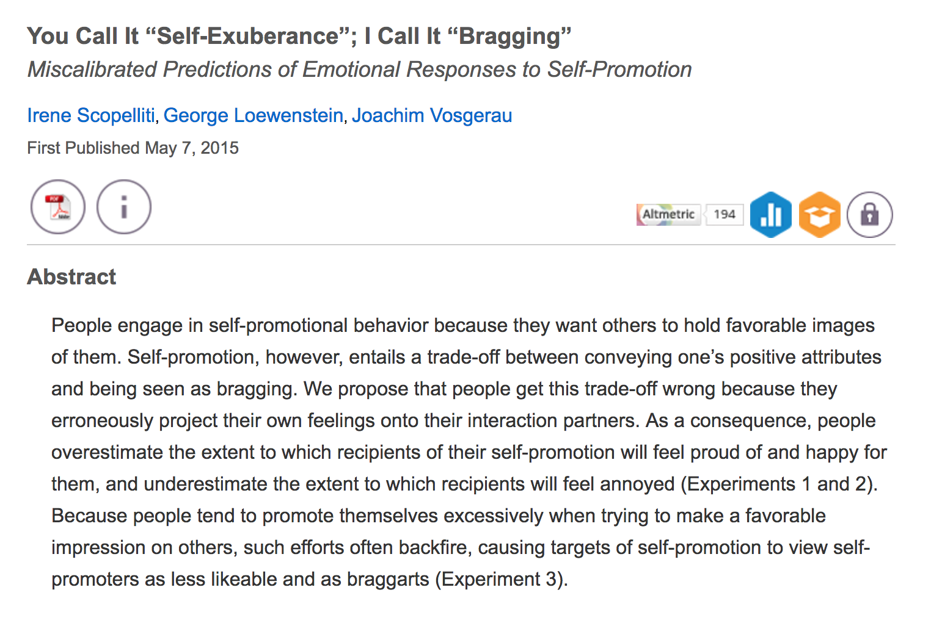
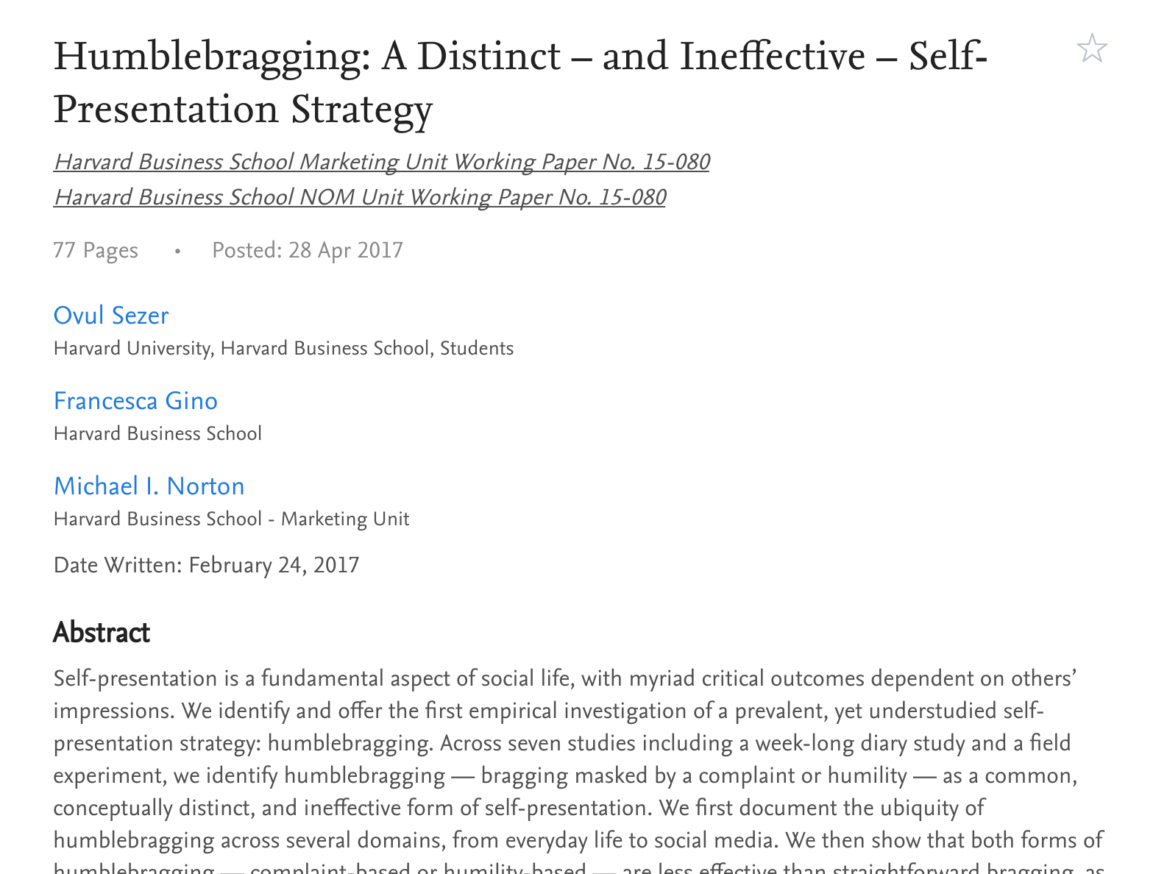
When self-promotion goes wrong

Slide 6
Bragging texts a common genre
Promotion applications and portfolios (the right tone of humility and brilliance)
NRF ratings
Funding applications
Job interviews
Ask others for input for self-promotion letters

Slide 7

But is speaking about your research always narcissistic?

Slide 8

Reasons to promote your research…
Dissemination
Knowledge grows through sharing
Information overload – need to make connections
Public good responsibility
It’s about the work. Not you!

Slide 9
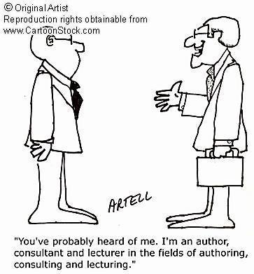
Spaces for promoting your work
Academia.edu
LinkedIn
Research Gate
Facebook
Email signatures
Free e-prints – colleagues, students
Email to authors you cite

Slide 10
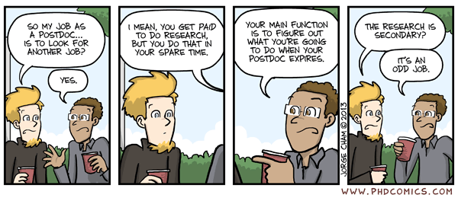

Slide 11
Building a community
The benefits of collaborative endeavours
Peer support networks
  Compact as to philosophy, explicit discussion of roles
Team approaches to research projects and postgraduate supervision
  Benefits and challenges
Promote others – promote your scholars, promote your students

