Slide 1

Internationalization of Research
Focus on Natural Sciences
Tebello Nyokong

Slide 2
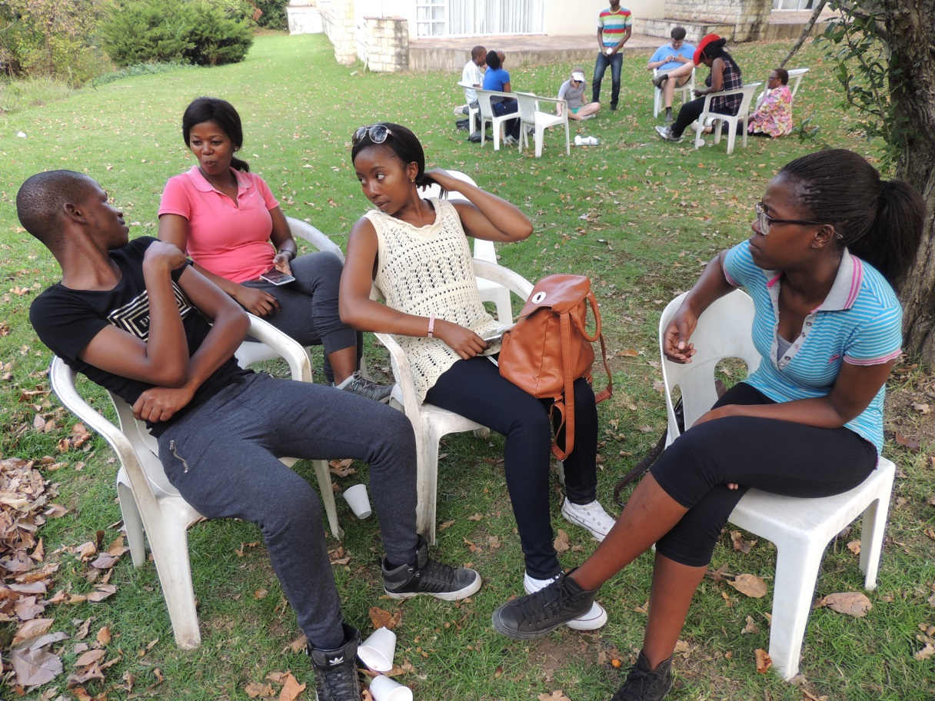
Research and Universities:
Universities - not just for teaching knowledge – they should create it
students - not just learning but serve as a think tank - bring new knowledge.

Slide 3
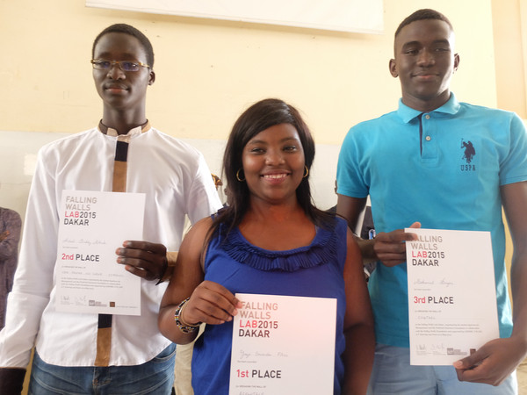
Innovation - not limited to Universities:
Scientific Innovation should also be encouraged from the general public
Falling Walls – Program for all
Senegal

Slide 4
Chicken and egg situation:
difficult to obtain funding unless you have established yourself
establishing yourself requires money
At the start – have to do more with less
Adapt your research to suit your financial situation

Slide 5
The making of a researcher
Use criticism to your advantage– you learn from the reviewers
Apply for any allowed funding.
Publish/Patent your work

Slide 6
Why publish/patent your work?
To make money for Rhodes?
Because you want to be promoted?
To share new knowledge – the top are benefits

Slide 7
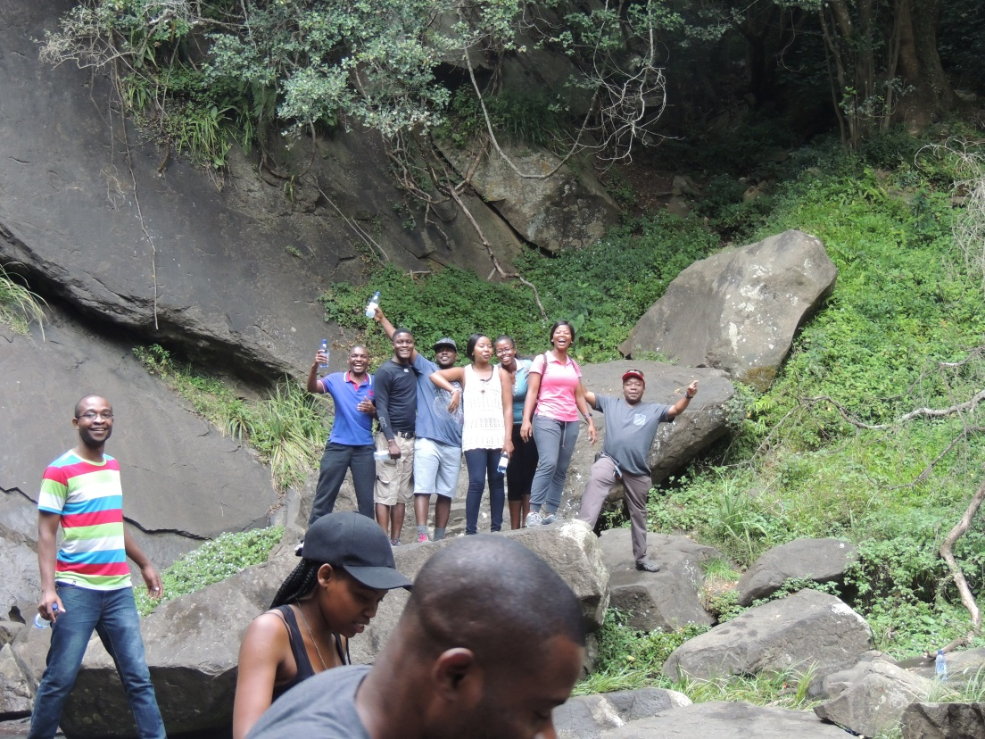
The making of a researcher
Re-invent yourself at all times – while having fun
Avoid administration with extensive responsibility
Attend top conferences
Speak out! Always go for oral presentation.

Slide 8
Success in Research: “Young” Researchers
Useful to have Mentors – someone to talk to
Assistance with application for funding
Research office: Alerting researchers on opportunities

Slide 9

Short (many) papers vs big pieces of work
Individual researchers know best for their area
Reviewers and editors – should reject such papers – do their job

Slide 10
Quality of journals??
Impact factor – Very variable for each discipline and sub-discipline
eg high in Biological Sciences, low in Maths
Journals require contribution of each author – good
Funding agents and promotion committees should check individual contribution

Slide 11
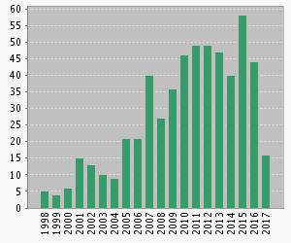
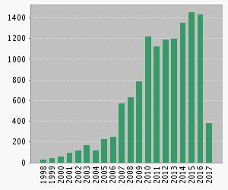
Being cited – very important
H index – ISI (more trusted)
Publications Citations

Slide 12
Why Internationalize Research?
Improved quality of research
Allows for deeper engagement with national, regional, and global issues
Prepares students as global citizens

Slide 13
Why Internationalize Research?
Access for students to programmes/facilities that are unavailable or scarce in their home countries.
Enhanced opportunities for academic staff improvement - decreased risk of academic ‘inbreeding’.
Making Africa a destination for quality research – My idea

Slide 14
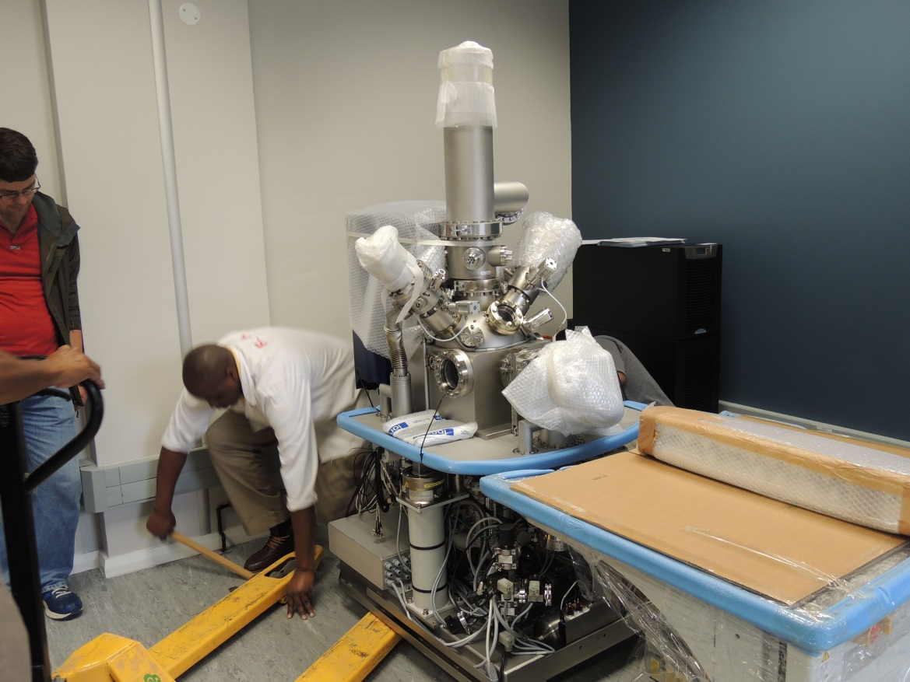
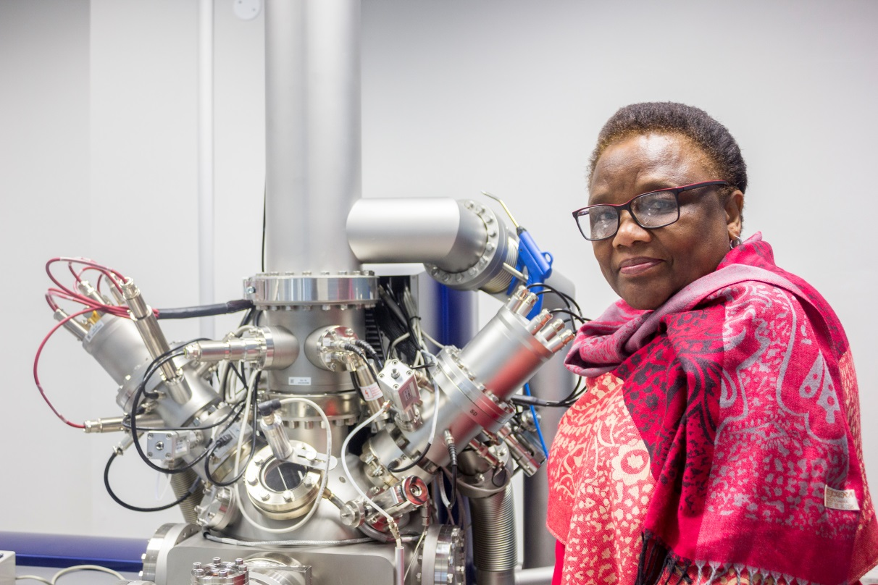
TOF-SIMS ~ R 20 000 000 XPS ~ R 7 000 000

Slide 15
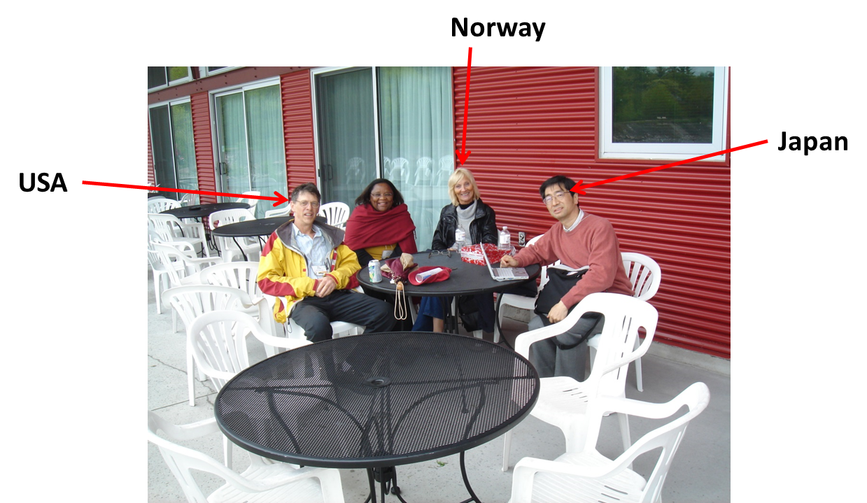
Internationalize through:
Exchange of knowledge through publications
Physical mobility (conferences, exchanges)
Collaborative research

Slide 16
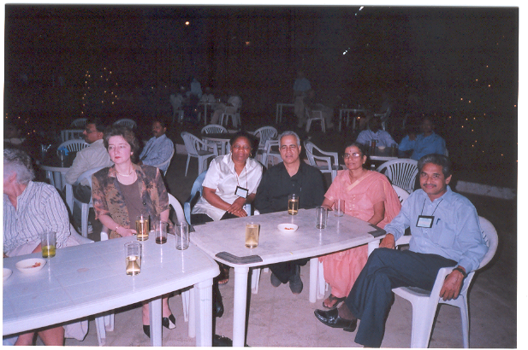
Internationalize through:
International exploitation of innovation
Being involved in global challenges

Slide 17
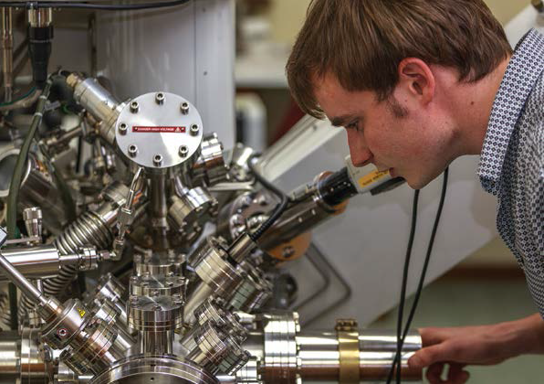
Why Collaborate:
To pool resources for common research and development goals.
  Costs of equipment
  Development of manpower
  (students) √
  Exchange of ideas

Slide 18
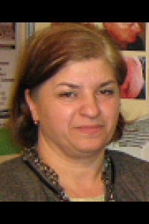
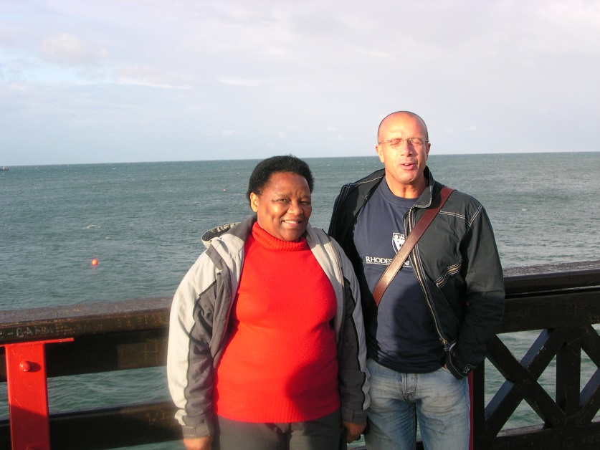
How to meet potential collaborators:
Visit international conferences
Publications
Prof Rodica Ion (Romania)
We met: Greece 1999
EU COST program 2004
(cooperation of science and Technology)
Romania /SA – 2011
Dr Bedioui (France) – Publications (from 2002, Japan)

Slide 19

Mike Cook (2002) Japan

Slide 20
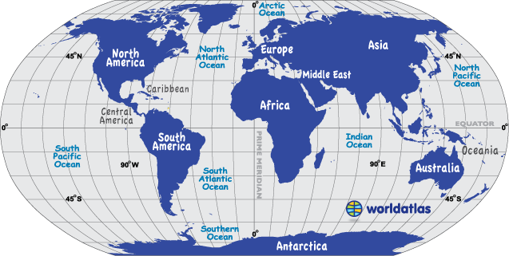
France, Norway, Belgium, Romania
Switzerland, Germany, Greece
Russia
Canada/USA
UK
Turkey
China
Japan
India
Kenya
Brazil
New Zealand
Chile
Collaborator Map:
blue- student visit map
Nigeria

Slide 21
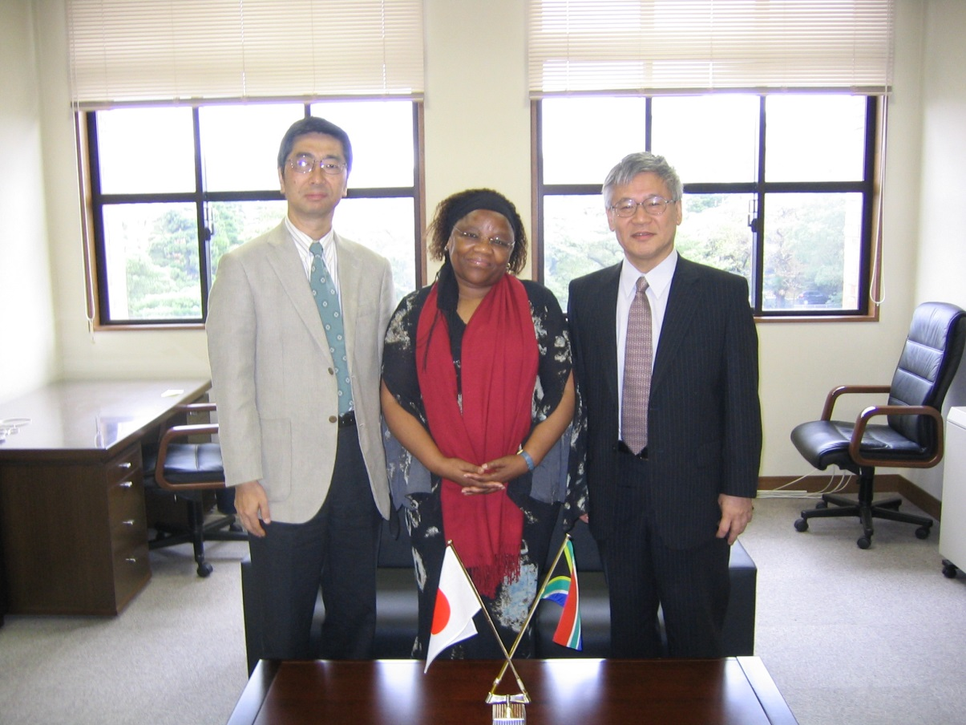
Successful Internationalization
Mutual respect
Appropriately designed funding formula (NRF bilateral)
Equal exchange of staff
and students

Slide 22
Indicators of successful collaboration: co-publications
40 publications with Turkey and one book
23 publication with France and two book chapters
15 with Japan
7 with Germany

Slide 23
Indicators of successful collaboration: student training
22 student exchanges with Japan (mainly SA to Japan)
13 student exchanges with France (equal exchange)
3 student exchanges - Romania
3 with Switzerland (only SA to Switzerland) 

Slide 24
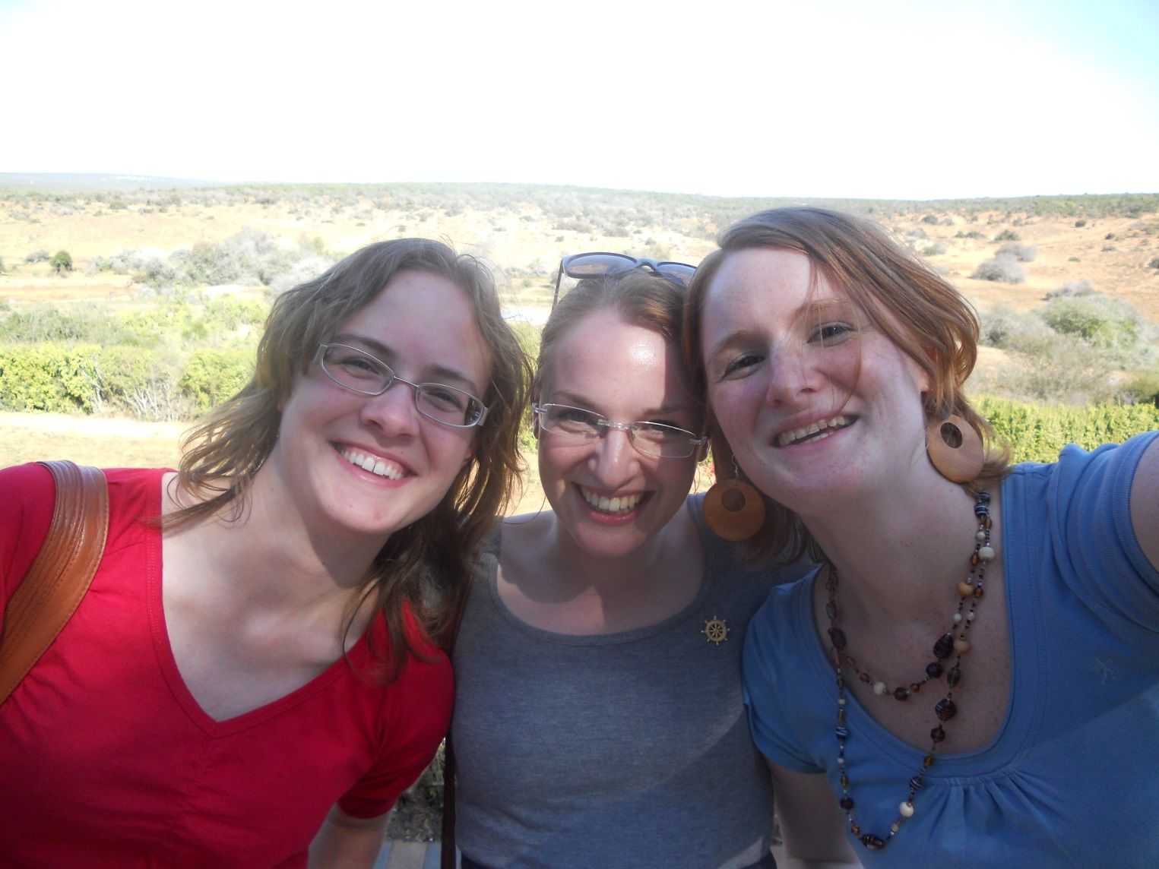
8 student exchanges with Germany (equal exchange)

Slide 25
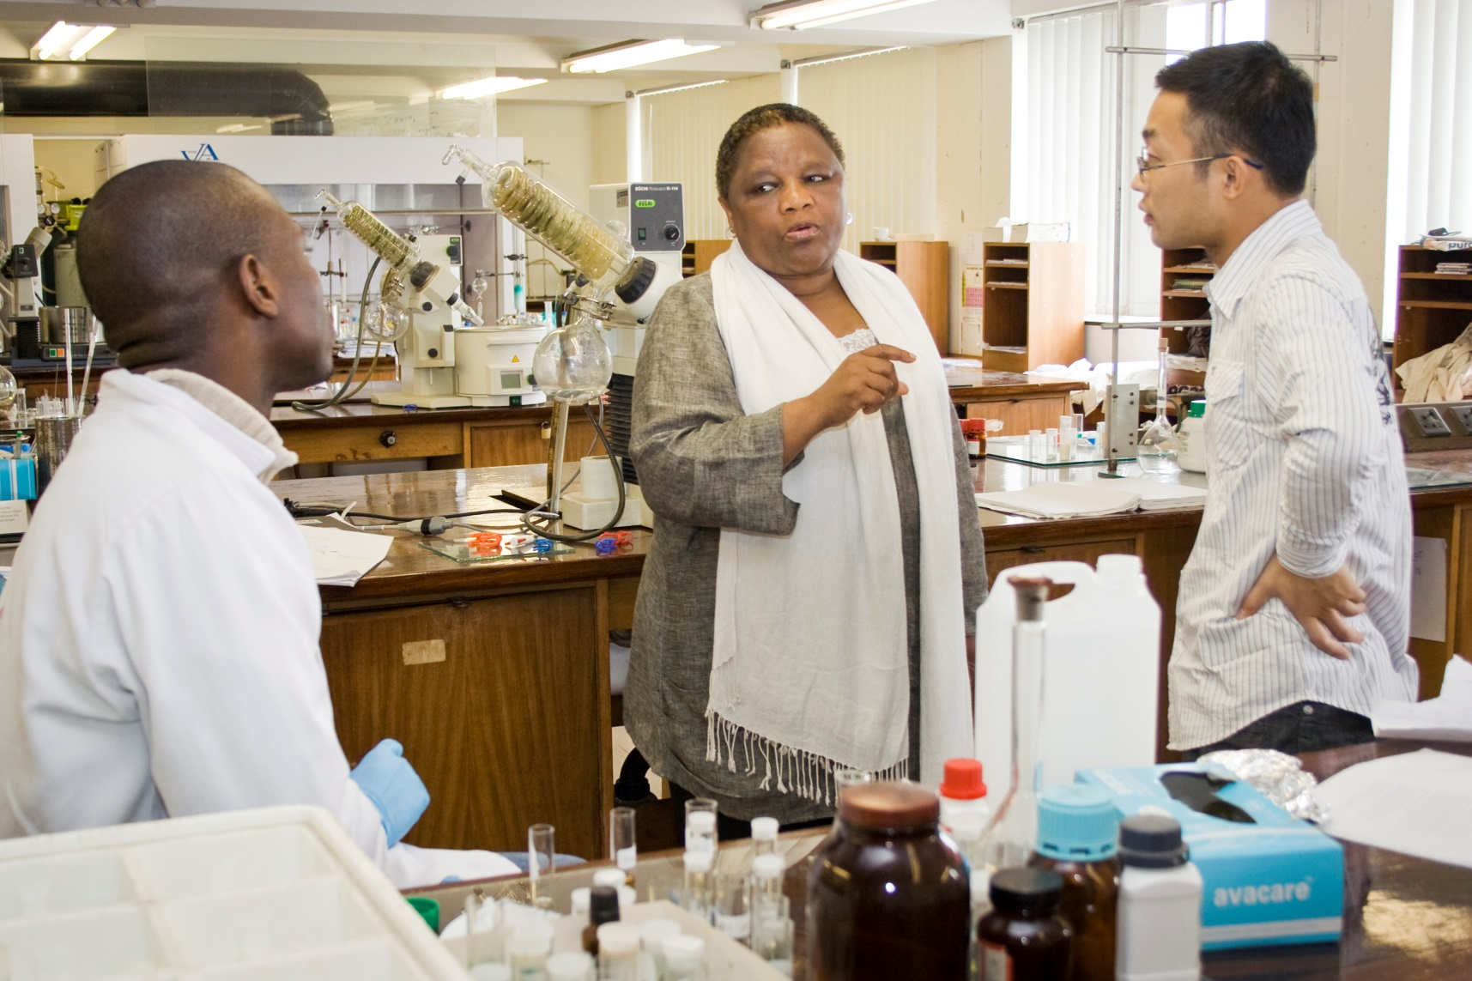
student exchanges with China (equal exchange)

Slide 26
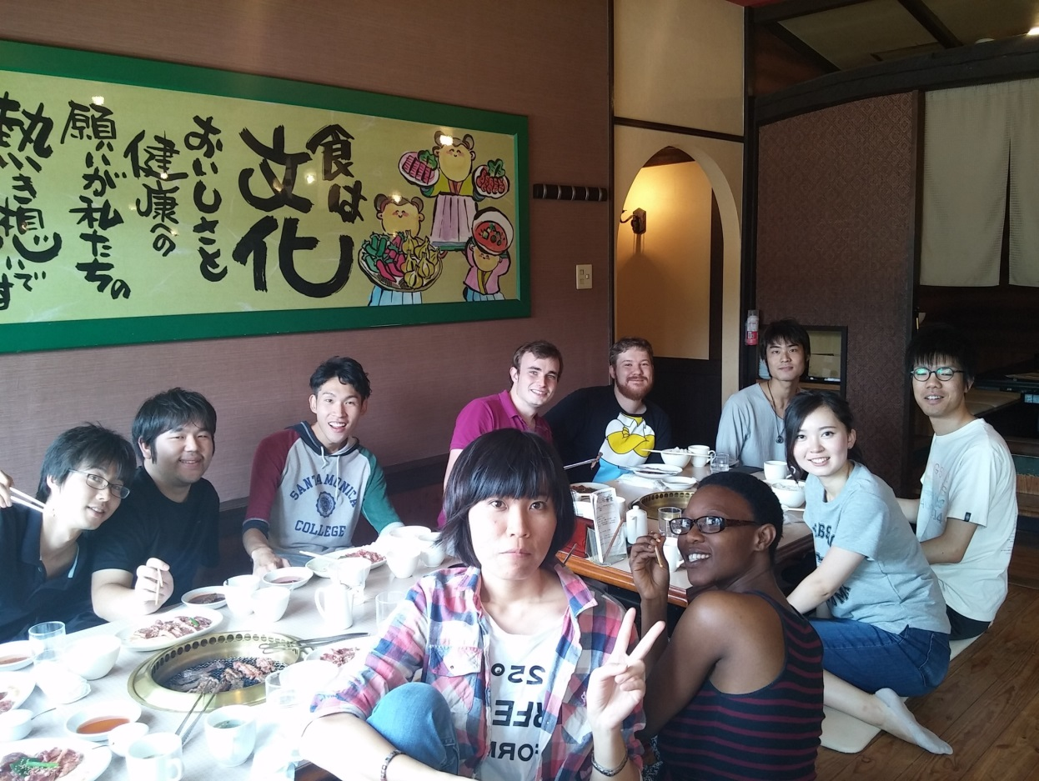
Internationalization (collaboration) and quality of Research
Science is the same
New ideas

Slide 27
Student (and post-doc) ORIGIN Map
Belgium/ France/ Germany/Turkey
Nigeria/Ghana/ DRC/ Cameroon
Chile
Lesotho/ South Africa/Swaziland
China/Russia
Angola
Kuwait
India/Kenya/Pakistan

Slide 28
Collaboration in Africa
Contribution from both sides
OWSD – organization for women in science
UN High Level Panel on STI supporting Mechanism for least developed countries
African Research Universities Alliance (ARUA)

Slide 29
Collaboration in Africa - cont
Centralized facilities – such as the Centre for Nanotechnology Innovation at Rhodes
Funding for travel

Slide 30
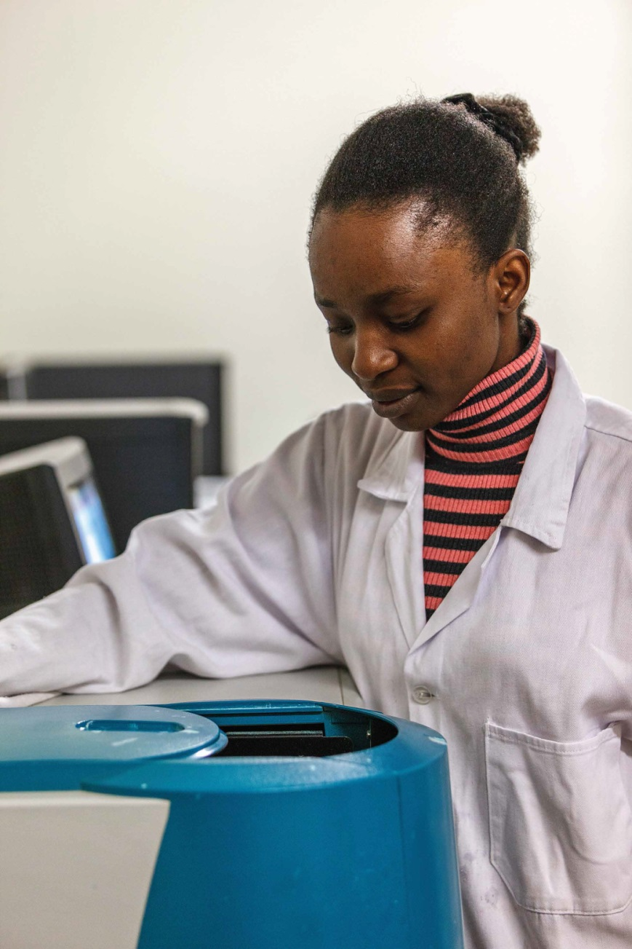
Building research capacity
Training the next generation
– from the continent
Training of staff to be lecturers
in other parts of Africa
and for South Africa

Slide 31
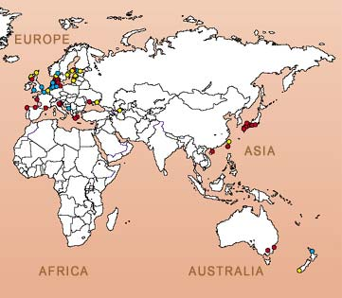
Nanotechnology facility use Map
Russia
Germany/
France
Senegal
China
Nigeria
Turkey
SA:
Mintek, CSIR, UKZN, UCT,UJ, UP, UFH, NWU, NMMU, Wits
Kuwait
Kenya

Slide 32
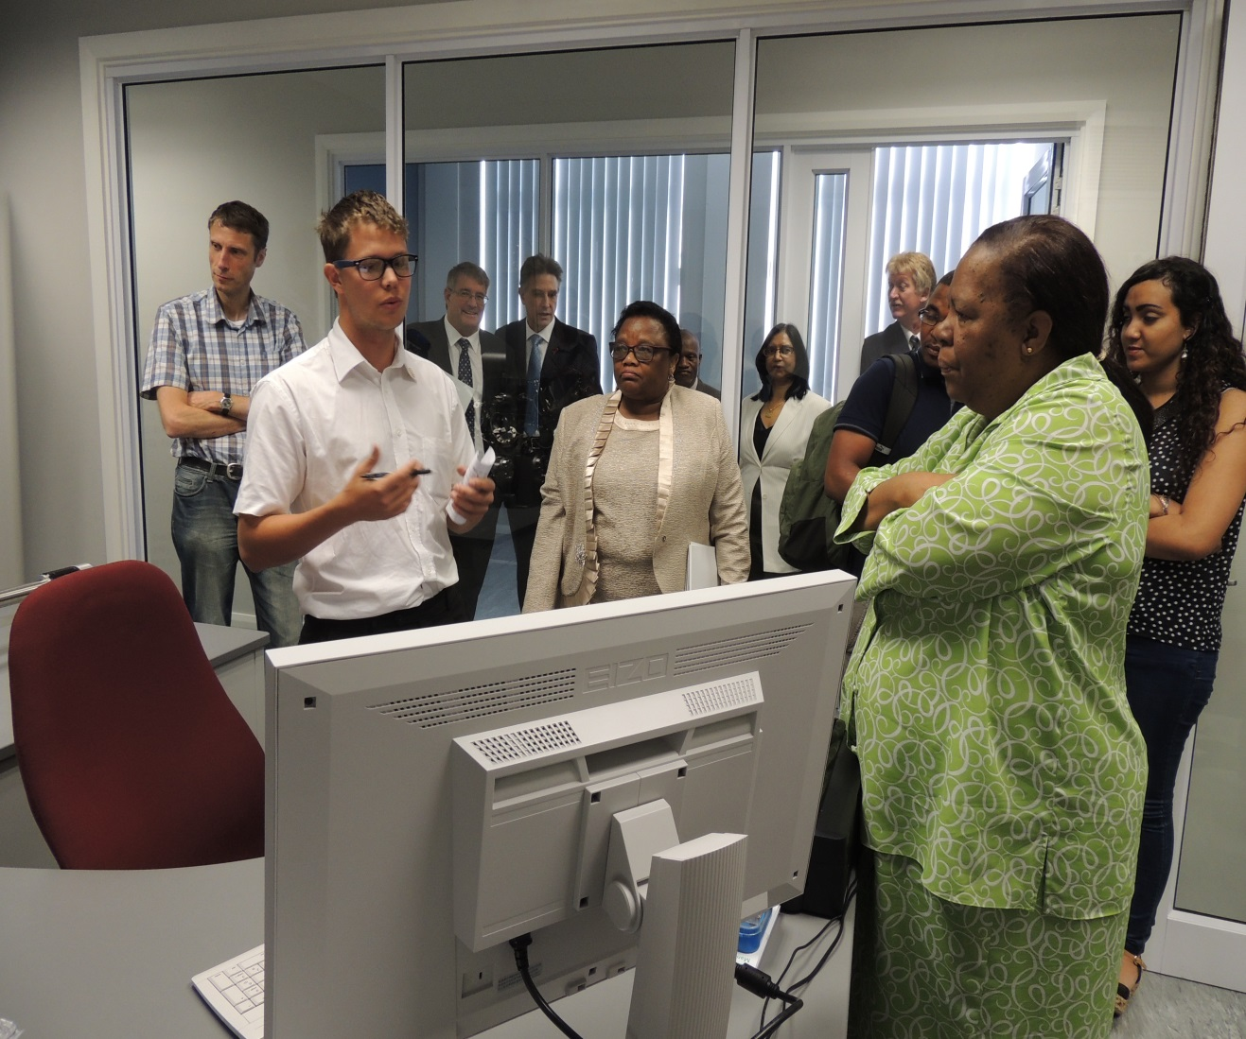
Educating Politicians about Research

Slide 33
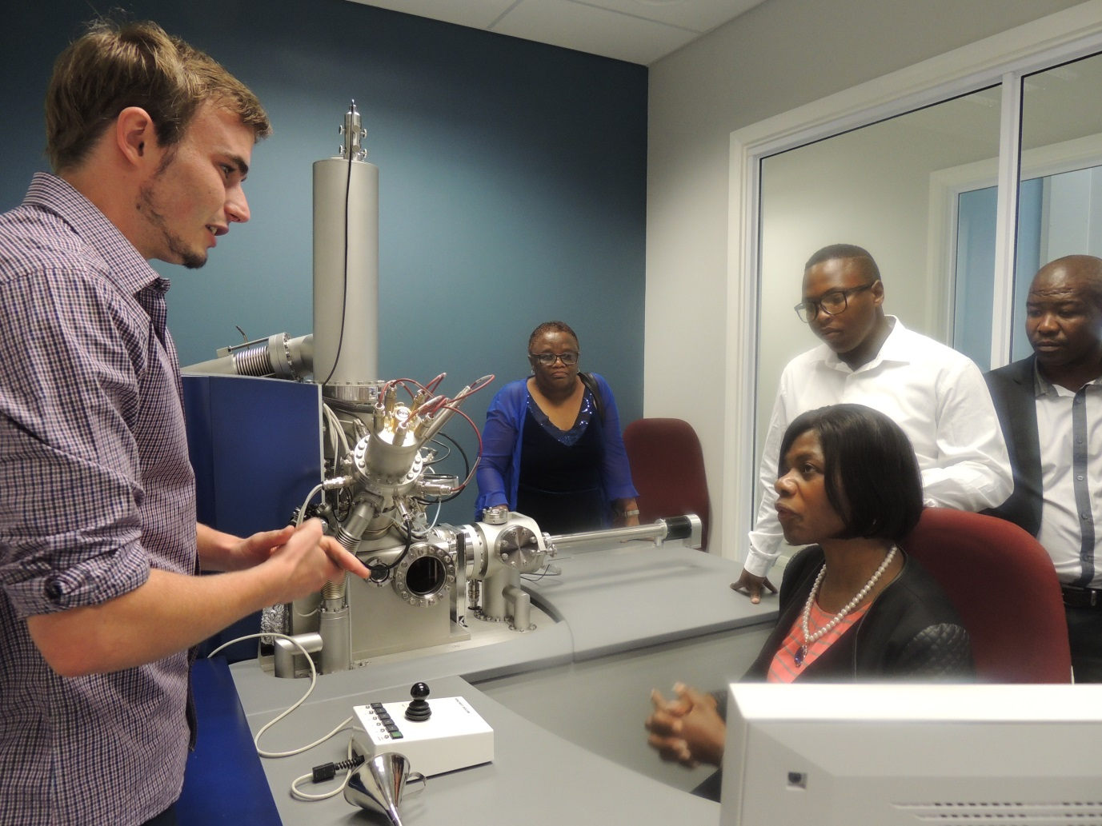
Educating All – the Public protector
Students must speak science in ENGLISH

Slide 34
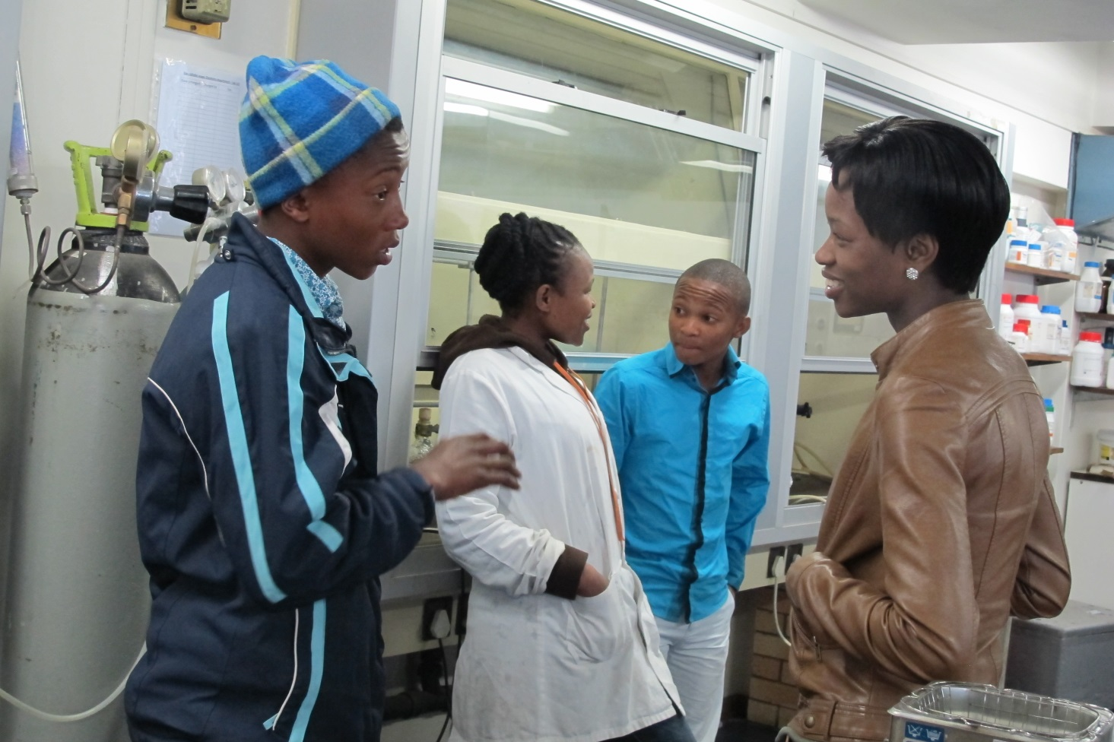
The young motivating the young!

Slide 35
Example of a global research project
Restoration of cultural heritage using Nanotechnology

Slide 36
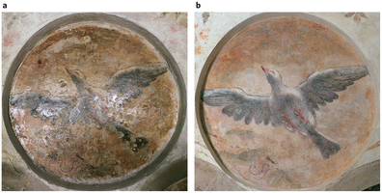
Before After

Slide 37
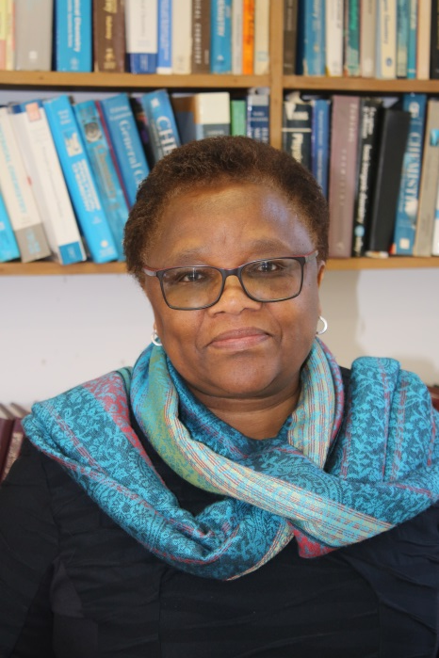
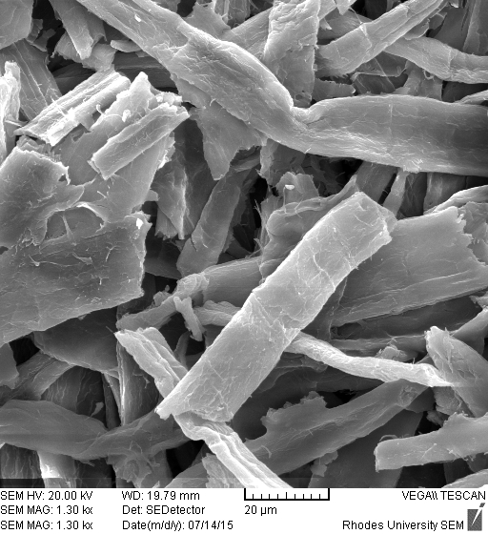
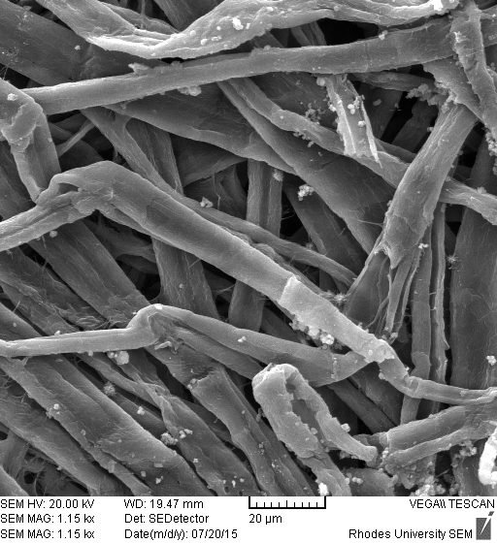
Our new project: Restoration of cultural heritage using Nanotechnology
South Africa
Romania
SEM Before SEM After treatment

Slide 38
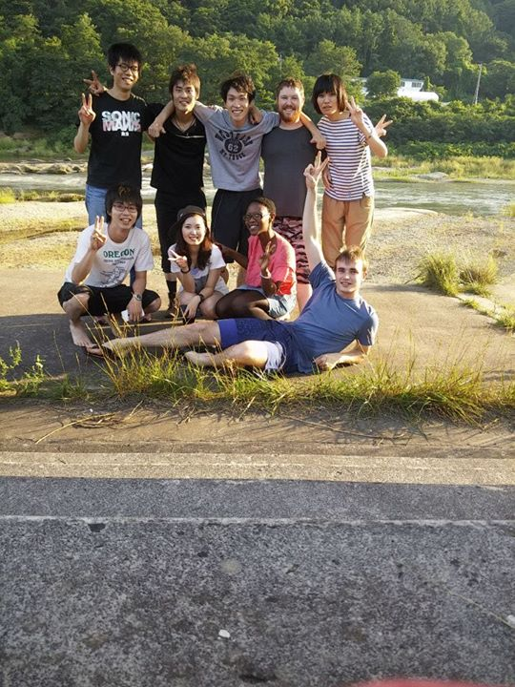
Example of a global research project
Treatment of cancer

Slide 39
New methods of treating cancer
Photodynamic therapy (PDT): use of (laser) light, a drug (dyes) and oxygen to treat disease (cancer):

Slide 40
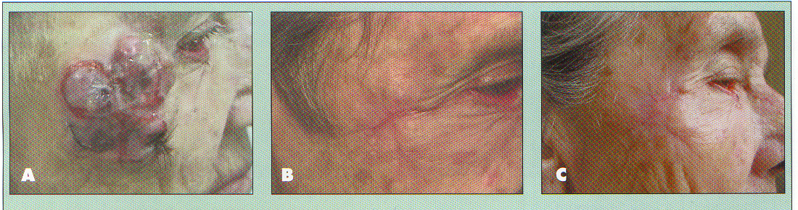
Before PDT
4 months after PDT

Slide 41
Product Development Map
Clinical practice - Russia
UK: Drug development
Germany, Switzerland: Pre-clinical testing
Japan- Drug development
China: Preclinical testing
SA- Drug development

Slide 42
Another global problem:
Laser attacks

Slide 43
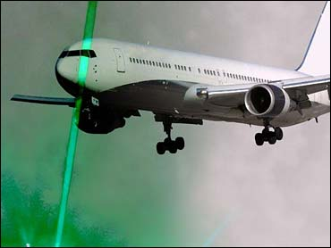
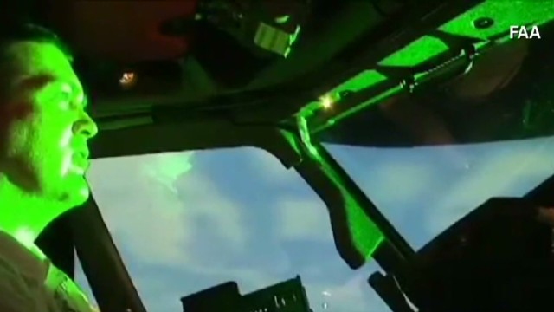
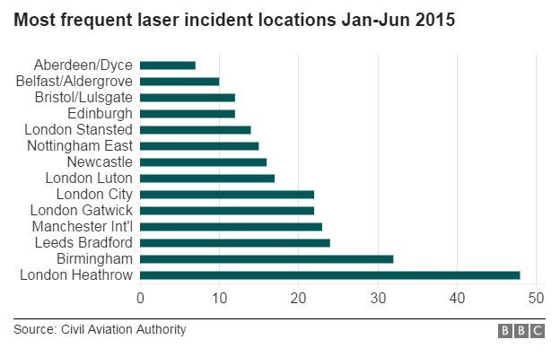
Protecting the eye against strong laser light:
Laser light (from a laser pointer) was directed at pilots landing at Seattle-Tacoma Airport - Feb 24th 2009

Slide 44

Laser incidents
Between Jan 1, 2010 and Feb 29, 2012, 181 lasing incidents in South Africa alone.
We developed thin films to place on glasses or cockpit to prevent laser attacks - Germany

Slide 45
