Slide 1

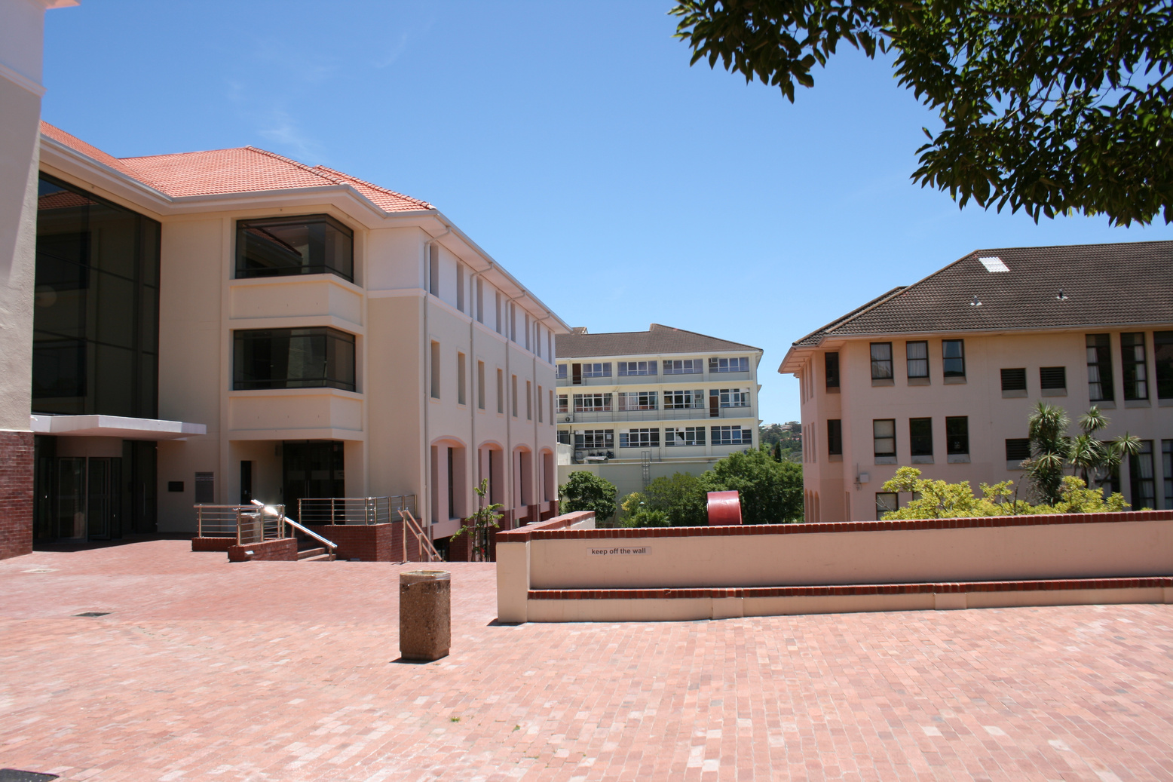
24 Jan 2024
The Rhodes University Library and Information Service adheres to the institutional vision, mission and goals; “to be foremost in the generation and advancement of locally responsive and globally engaged knowledge that seeks to create a just and sustainable society”.
Welcome to Rhodes
University Libraries
NEW ACADEMIC STAFF ORIENTATION
Wethu Danster

Slide 2
Outline
Introduction
About Us
Where to find us
Governance & Management
Strategic Alignment – IDP
RU IDP Goals 2023 - 2028
Purpose Statement
Strategic Framework
Teaching, Learning & Research Support
Service Delivery Model
Open Scholarship
Community Engagement Projects
Strategic Collaborations & Partnerships (Flagship projects)
Regional & National Collaborations
Library Spaces & IT Infrastructure
Conclusion
Jan 2024

Slide 3
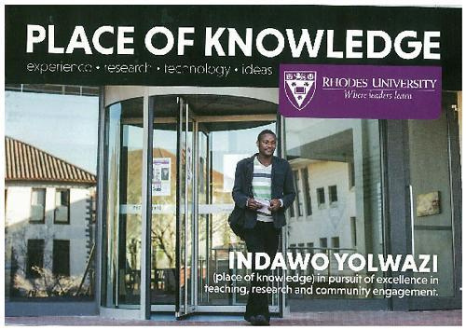
About Us
We are an academic support service and partner that prides itself with the provision of optimum access to diverse, contextual learning and research collections, services, spaces, and facilities that support the academic project.

Slide 4
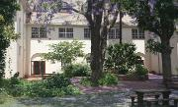
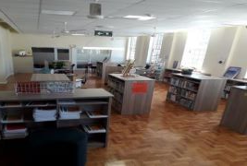
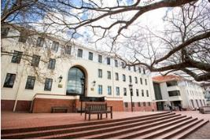
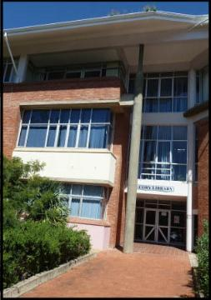
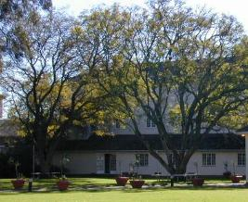
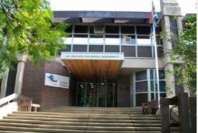
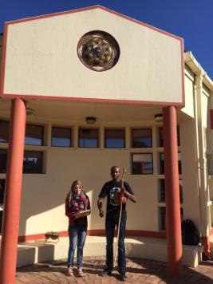
Where to find us
https://www.ru.ac.za/library/
Alastair Kerr Law Library – Lincoln House St Peters’ Campus
TRC Education Department
Corner Somerset & grey Road
Music Library – Music Dept.
Main Library - Artillery Road
Cory Library – Eden Grove
Affiliated Libraries
Margaret Smith - SAIAB
International Library of Music
for more information on each of these libraries, click here.

Slide 5
Governance & Management
Vice Chancellor
DVC: Research, Innovation & Strategic Partnerships (RISP)
Library Director & Staff
Library Committee
Senate
Council

Slide 6
Strategic Alignment - IDP
RU Vision
Our vision is to be foremost in the generation and advancement of locally responsive and globally engaged knowledge that seeks to create a just and sustainable society.
RU Mission
Our mission is to provide transformative education, rigorous scholarship, and research that
seeks to produce knowledge that advances the frontiers of science, human understanding and wisdom
cultivates knowledgeable and skilled graduates, innovative and critical problem-solvers; caring and engaged citizens; responsible, courageous and ethical leaders
enables and drives environmental sustainability, equitable and inclusive social and economic development based on respectful and mutually beneficial partnerships with diverse communities

Slide 7
RU IDP Goals 2023 - 2028
 | RHODES UNIVERSITY STRATEGIC GOALS
Goal 1 | Ensure quality scholarly teaching and learning to enable students to access powerful knowledge, engage in their learning and become critical problem-solvers who are socially responsible global citizens.
Goal 2 | Promote access to Rhodes University by academically qualifying students and create academic conditions which enable them to thrive and succeed.
Goal 3 | Create an engaging and transformative student experience that promotes holistic development, growth and academic success.
Goal 4 | Maintain and strengthen Rhodes University’s standing as a research-intensive university.
Goal 5 | Ensure financial and environmental sustainability practices through good governance, effective leadership and prudent resource management.
Goal 6 | Attract, develop, and retain quality staff.
Goal 7 | Invest in appropriate physical infrastructure, equipment, and digital technology.
Goal 8 | Position and promote Rhodes University as an institution for the public good.

Slide 8
Our Purpose Statement
Rhodes University Library and Information Services are committed to supporting the mission of Rhodes University in the pursuit of knowledge by students, researchers, scholars, and surrounding communities, by providing context relevant & quality learning resources, user- centered services, and the skills required to effectively participate in the knowledge economy and, a conducive physical and virtual learning environment, that enhances intellectual creativity, free and open exchange of knowledge and ideas.

Slide 9
Our Strategic Framework
FOCUS AREAS & Critical Success Enablers
Digital Literacies
Open Scholarship
Undergraduate Support
Teaching & Learning Support
Research & Postgraduate Support
Digital Scholarship
Faculty Liaison
Scholarly Communication
Learning Resources & Spaces
Research Support
Service Innovation & Digital transformation
RHODES UNIVERSITY LIBRARY
STRATEGIC FRAMEWORK
2023 - 2028
Open African Scholarship
Innovative spaces
Primary Schools
Digital tools & technologies
Student Experience
Community Engagement & Partneships
High Schools
Student Digital Competencies
Makanda ReGLAM
Leadership, Governance & Management
Membership & Partnerships
Student surveys

Slide 10
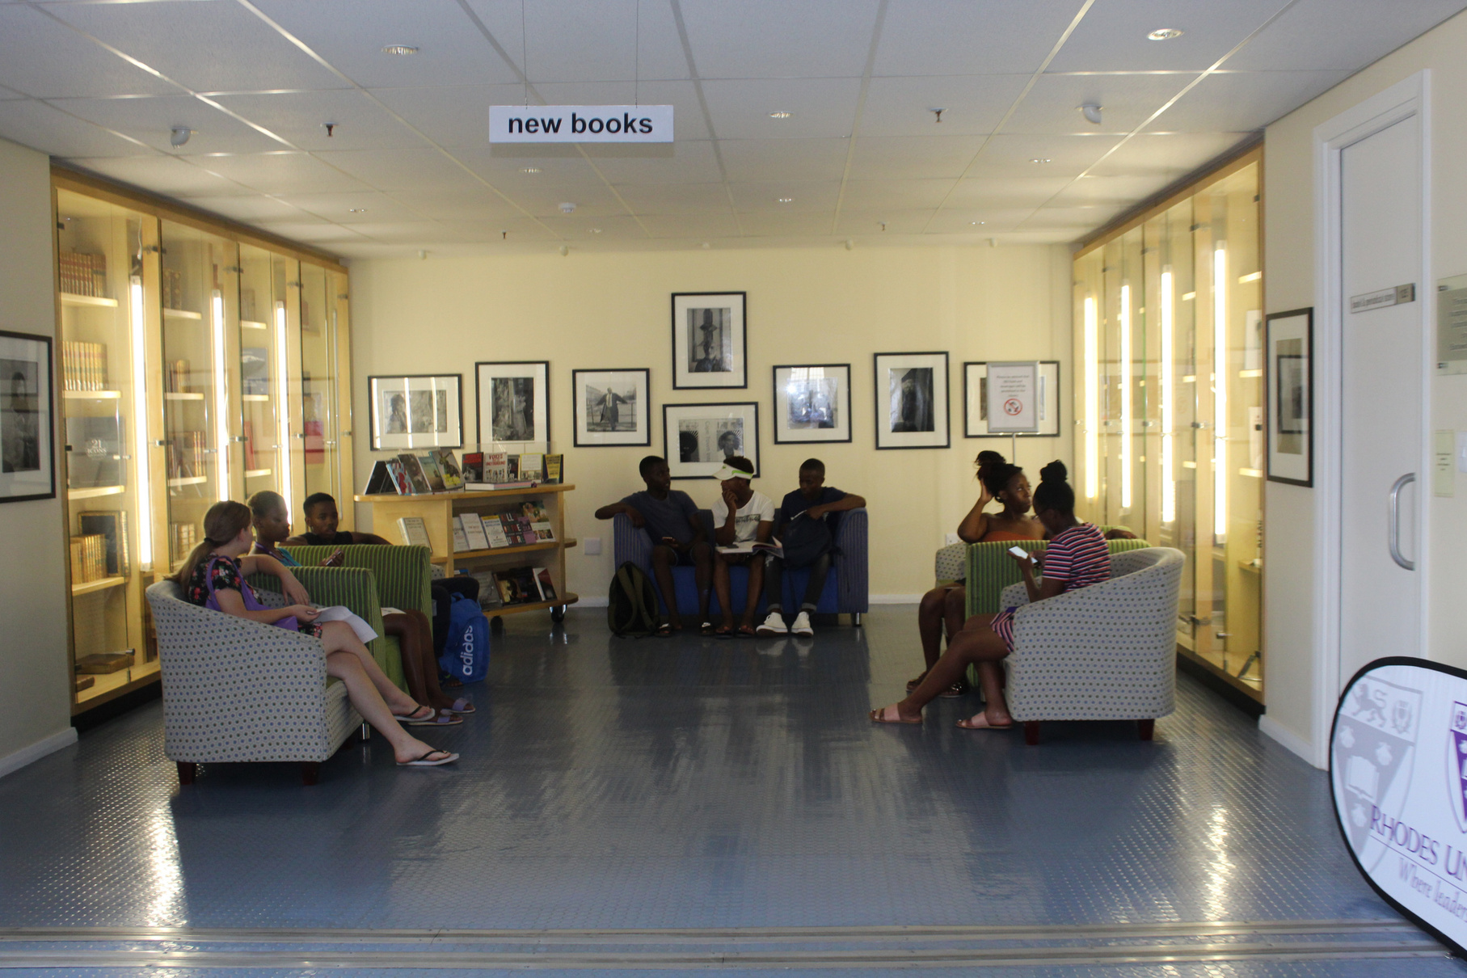



Strategy
We have just completed a Library Strategic Plan for 2023 - 2028. A number of sub-strategies and plans will flow out of this framework. NB the E-Strategy is an enabler that cuts across all the sub-strategies below
Teaching and Learning Support
Strategy
Research & Postgraduate Support Strategy
Collection Development
Strategy
ICT & Facilities Infrastructure
strategy
E-strategy
Notes:
(

Slide 11

TEACHING & LEARNING & RESEARCH SUPPORT
Learning Resources Development
Priority in the allocation of financial resources remains for the acquisition of access to materials required for the support of teaching, research and practice. A big chunk of the Library budget goes to acquiring learning resources.
350 000 digital items, 268 584 print books, 27 000 items in our IR collections. (recommend a purchase)
Regional Consortium – SEALS – Shared Library catalog
Browse Rhodes eJournals by subject
Interlibrary Loan system

Slide 12
TEACHING & LEARNING & RESEARCH SUPPORT
CONT
First Year Experience (FYE) Programme
Library Guide; O-week programme;
Extended Studies Programme
Information & Digital Literacy programme for all 1st Year UGs
PGs, New Academics & New HoDs
Faculty Liaison Programme - Faculty/Library Interface
Development of Discipline-specific learning resources that cut across curricular
Workshops & training sessions
Database training;
Accessing Learning resources remotely;
Navigate & search the learning resources per discipline;
Citing & referencing,
Literature & systematic reviews;
search strategies, etc)
Conduct Faculty/student needs & satisfaction surveys

Slide 13
Service delivery model
Hybrid model
Onsite Services
Lending/Circulation; Short Loan, Interlibrary Loans, IT & technology support; Information Literacy instruction; Faculty Liaison; Faculty hubs (discipline specific print collections); library spaces, facilities and services for the differently abled. For an overview of onsite services click here
Online Services
Online/Remote services include online tutorials on remote access to online resources and search all accessible through the library website a gateway to all our learning resources;chat to us using Libanswers, where you can ask librarians specific questions; subject libguides, opening hours, a virtual tour, and our popular online tutorial & videos

Slide 14
Centralized Services
Resource Description management
Metadata creation and cataloguing
Equitable Access to learning resources Management
Electronic Resources Management
Institutional Repository Management
Research Data Management
Library system & technologies
Website Management and Administration
ICT & Infrastructure Management
Development & Management of Archives & Special Collections
Development & Management of RU research output (IR)

Slide 15
Specialized Research Support
1.3. Digital Scholarship & Scholarly Communication Services
Research Data Management
Managing the Research & Researcher visibility
Academic publishing & networking
Bibliometrics (Citation Management)
Advance the awareness of the x17 UNSDGs - Sustainable Development Goals
Partnering with research Institutes/Centres to enhance the visibility and discoverability of discipline specific research. 30 Years of Scholarship project
Development & Management of Archives & Special Collections
Development & Management of RU research output (IR)

Slide 16
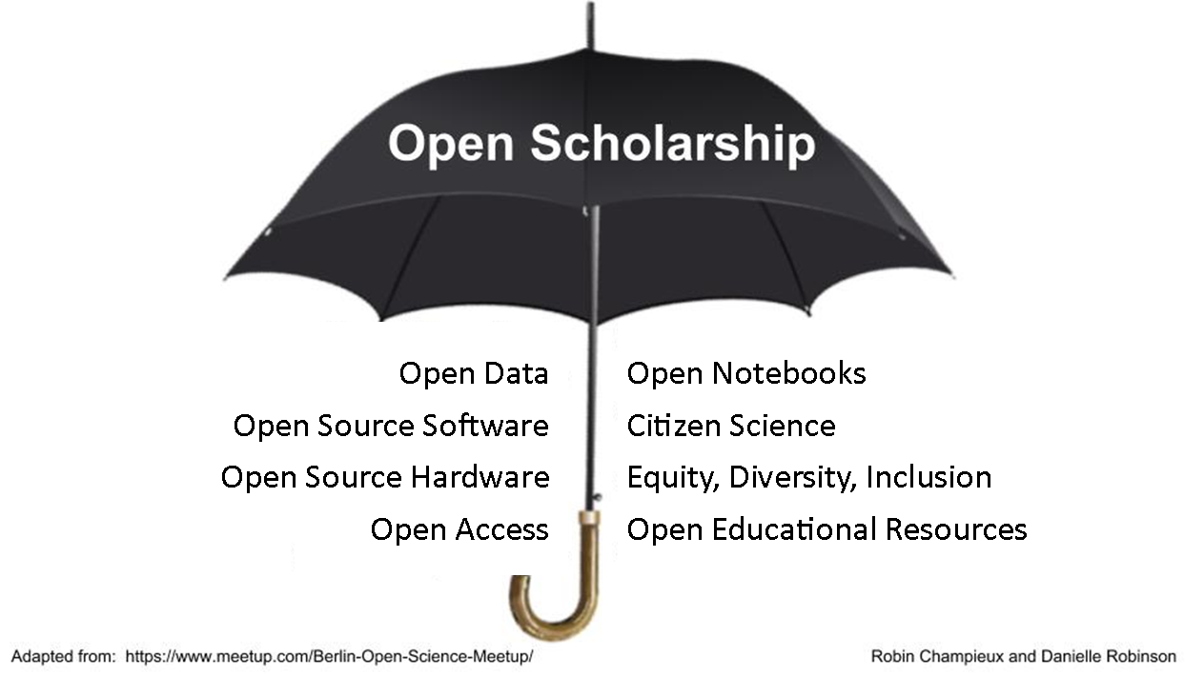
Open Scholarship/Open Science
Berlin Declaration on Open Access 2002
Budapest Open Access Initiative - 2003
Bethesda Statement on Open Access Publishing 2003
NRF Open Access Statement - 2015

Slide 17


Open Scholarship/Open Science
https://repository.up.ac.za/
https://open.uct.ac.za/
https://researchdata.ru.ac.za/
https://network.bepress.com/
https://doaj.org/
https://v2.sherpa.ac.uk/opendoar/
https://sites.google.com/ru.ac.za/sustainabledevelopmentgoals/home

Slide 18
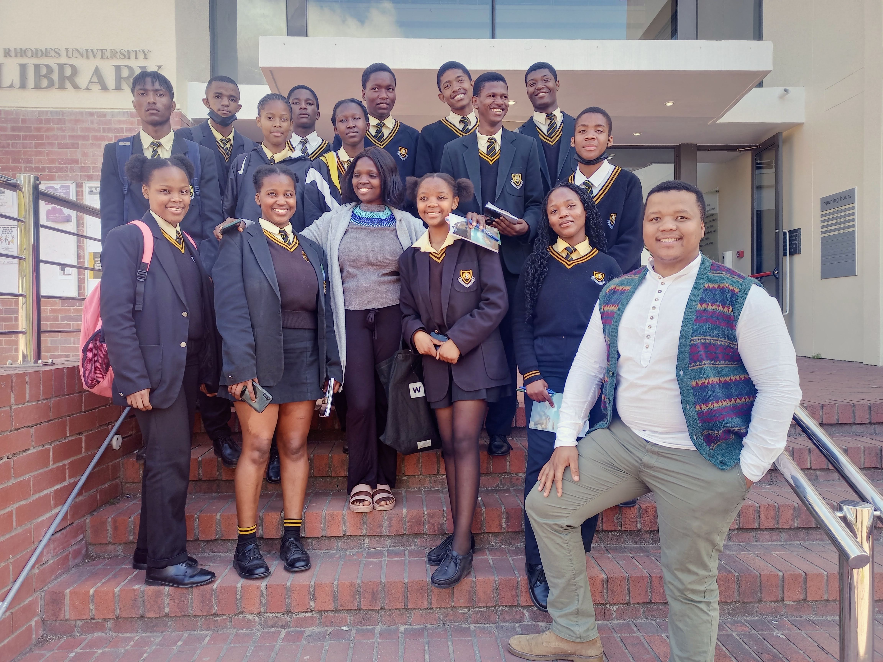
CE Projects Journal of Visualised Experiments (JoVE)

Slide 19
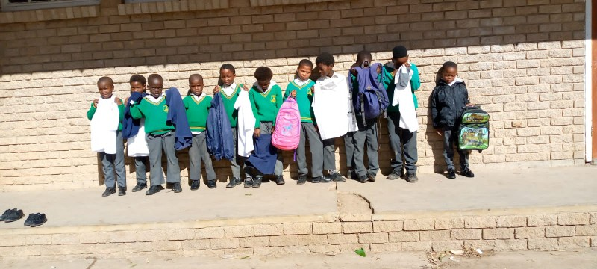
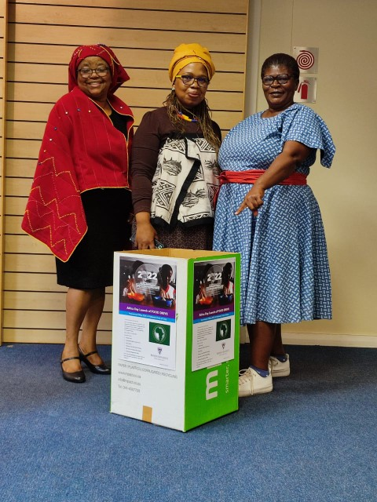
Other CE Projects
School uniform drive:
Makana Public School in
Joza township.
Food Campaign: Librarians observed the Africa month, the themed 2022 Africa Union on nutrition.

Slide 20
RUL Strategic Collaborations & Partnerships
National/Continental Projects
Five Hundred Year Archive: Archive and Public Culture (APC) UCT & RUL)
US Embassy/UCT Project: Towards a community of practice in conservation and preservation of special collections hosted at South African academic libraries.
Zietsman/Cradock 4 Inquest (NPA & the Hawks)
The Africa Multiple Clusters of Excellence (AMCCE):The University of Lagos (Nigeria), Moi University (Eldoret, Kenya), Université Joseph Ki-Zerbo (Ouagadougou, Burkina Faso) and Rhodes University (Makhanda, South Africa) University of Bayreuth
Digital Humanities Open Educational Resources (OER) Champions Initiative. Project management: North-West University’s UNESCO Chair on Multimodal Learning and OERs.

Slide 21
Regional & National Collaborations
South East Academic Libraries System (SEALS) (NMU, UFH, WSU & RU) SEALS Website
South African National Library & Information Consortium (SANLIC)
All (x26) University Libraries in SA
SANLIC Website
Committee of Higher Education Libraries of South Africa (CHELSA)
All (x26) University Libraries in SA
CHELSA Website
Library & Information Association of South Africa (LIASA)
SA Library fraternity
LIASA Website
International Association of University Libraries (IATUL)
IATUL Website
International Federation of Library Associations & Institutions (IFLA)
IFLA Website

Slide 22
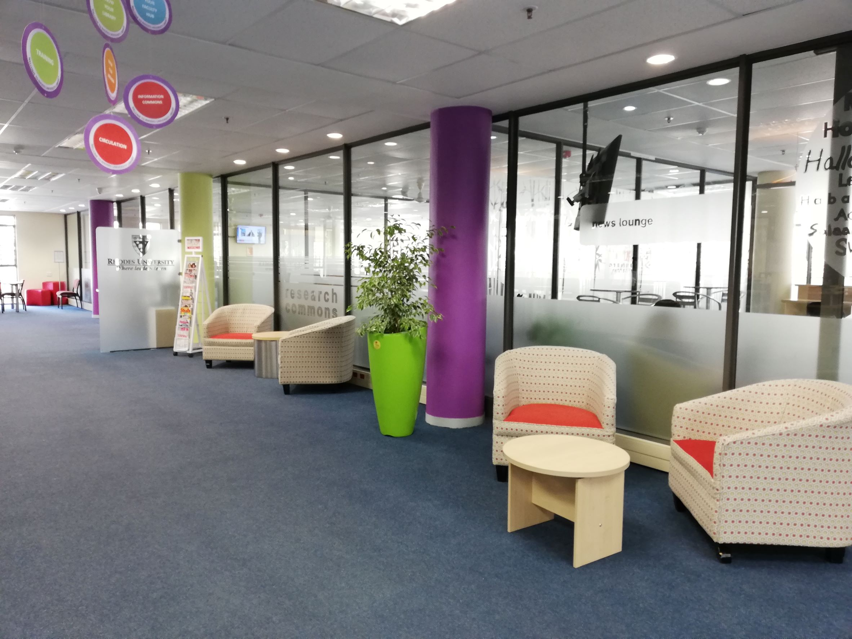
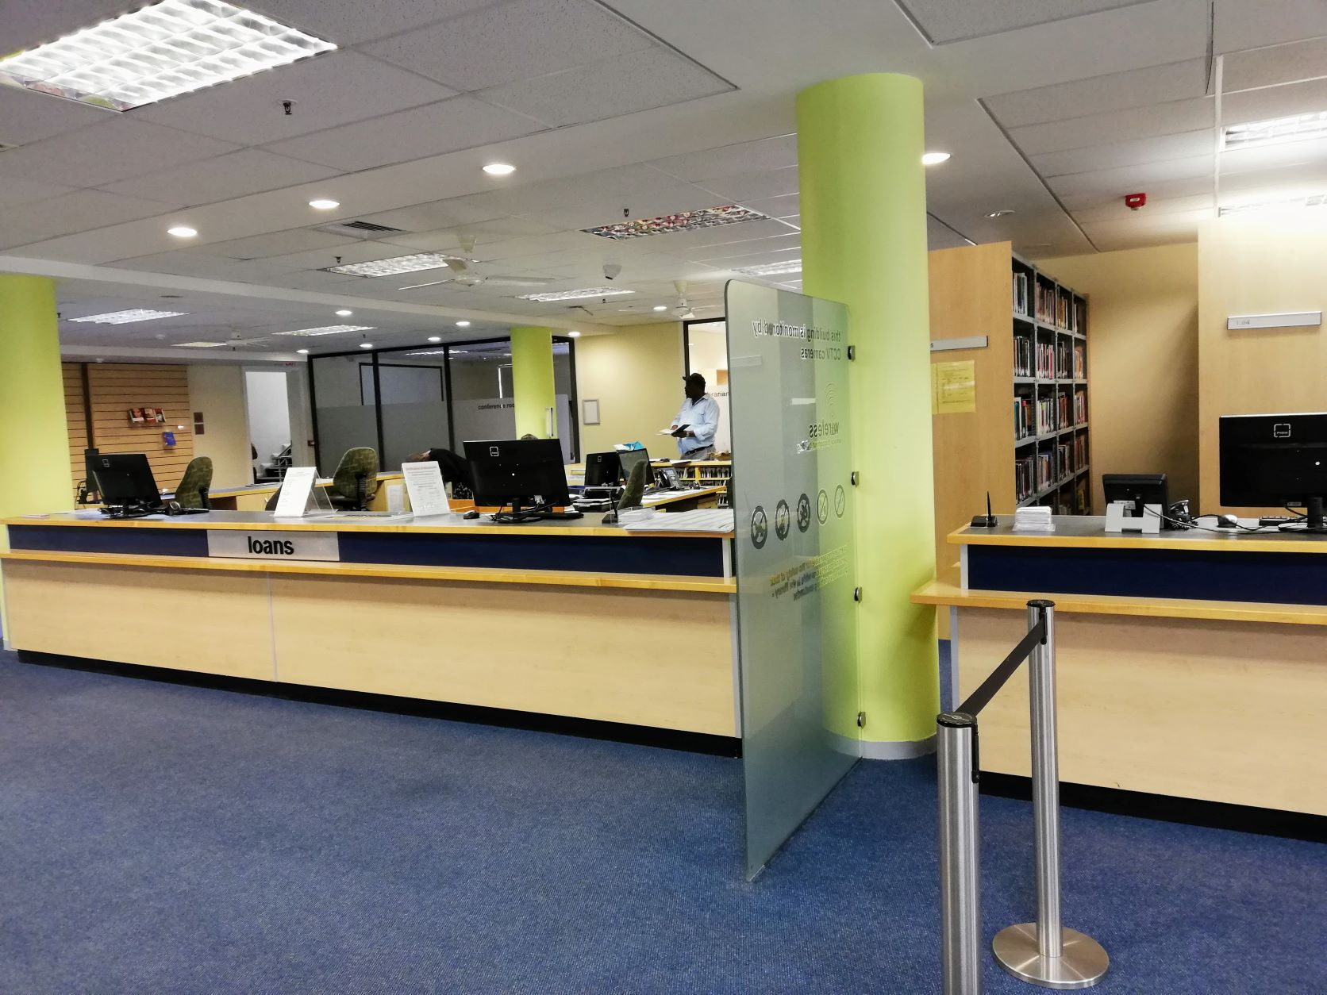
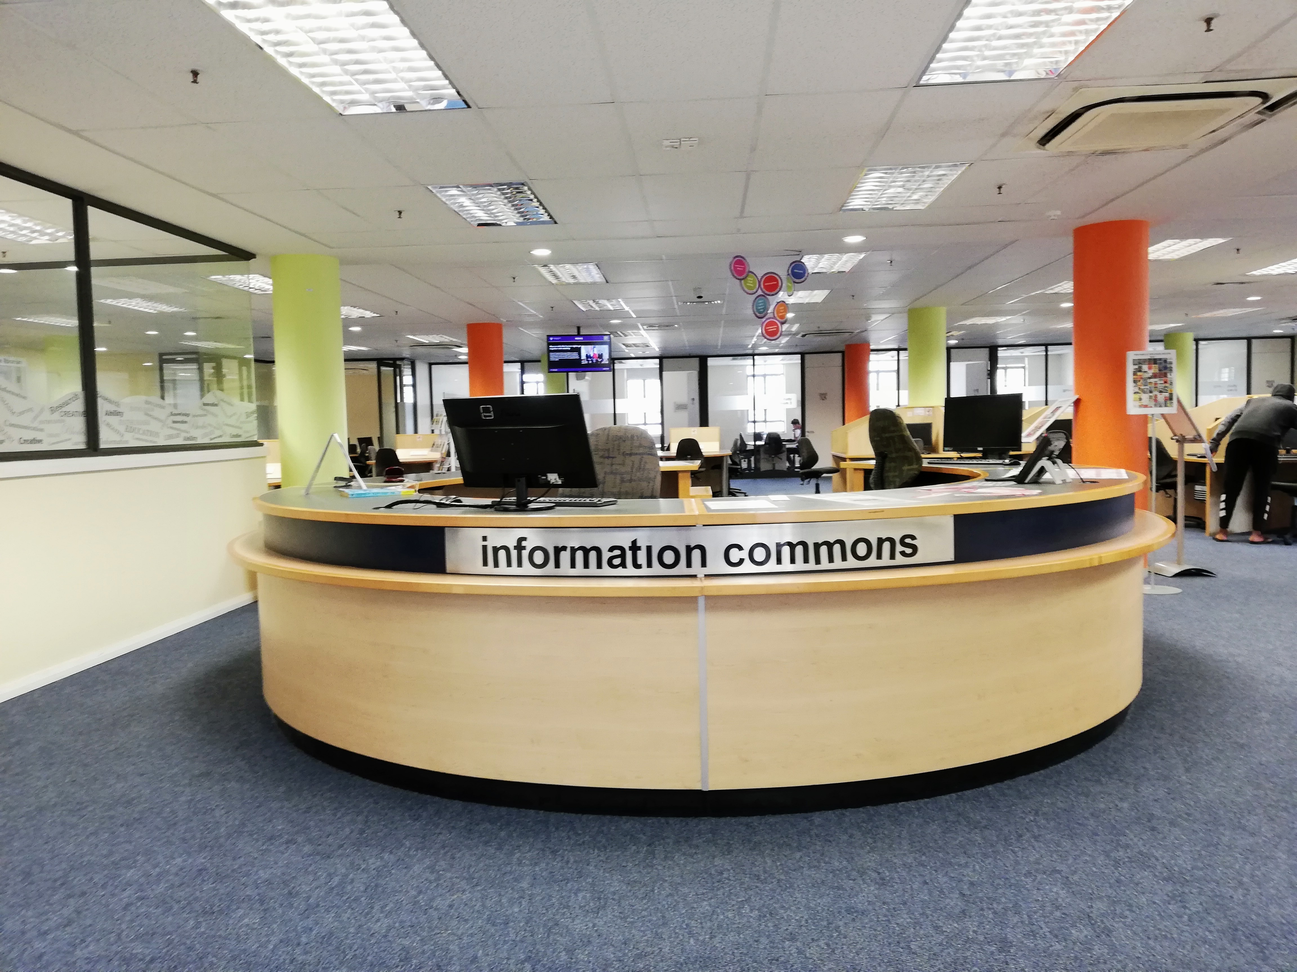
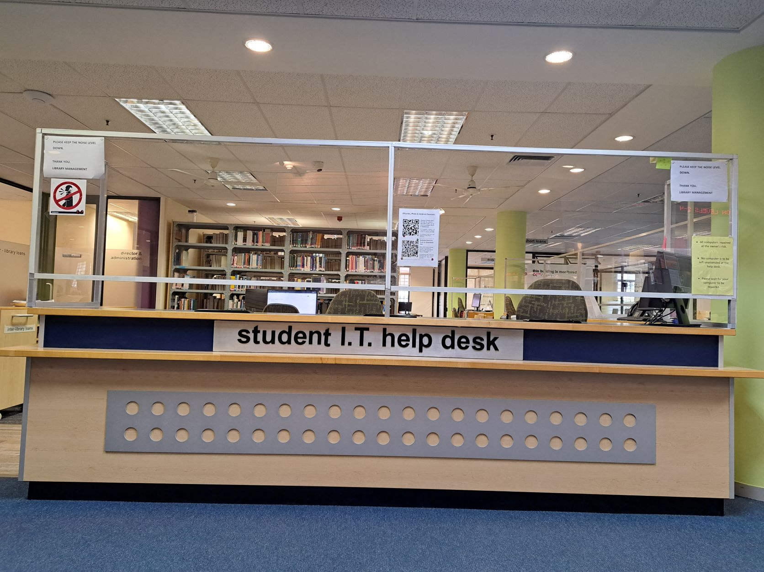
Library Spaces & IT Infrastructure
Our physical and digital learning environments are designed with the end-users in mind. The Main Library is not just the state of the art modern library but a welcoming learning spaces that ensure safety, security and comfort.
Entrance
Loans desk
UG space
IT Helpdesk

Slide 23
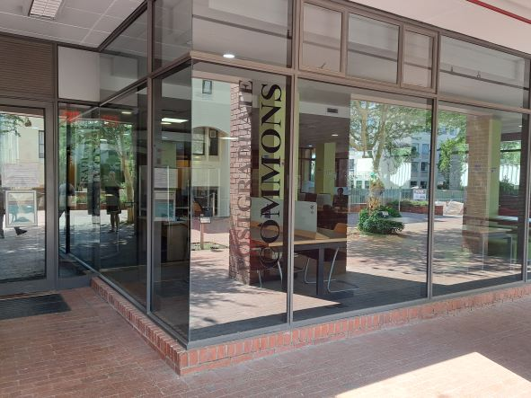

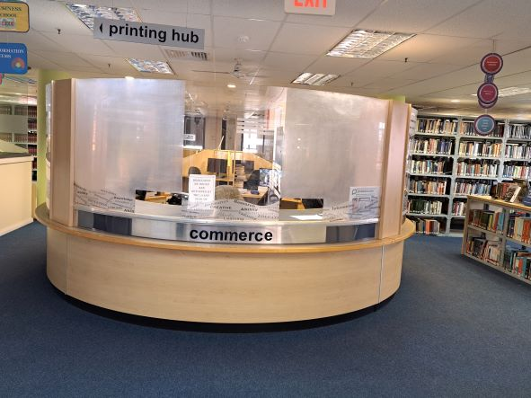
Learning Spaces

Slide 24
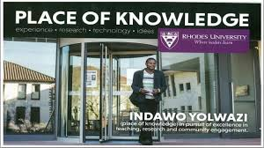
Conclusion
With more than 350 000 digital items, 300 000 print books, 30 000 items in our IR collections, the Library is a vital support for research, learning and teaching excellence at Rhodes University.
WELCOME TO YOUR SCHOLARLY HUB
Thank you

