Slide 1


Rhodes Digital Commons: Raising the visibility of your research
Research Week. 12th May 2017
Khawulile Radebe: Librarian: Repository & Metadata
Debbie Martindale: Librarian: Scholarly Communication

Slide 2
OUTLINE
The role of RUL in supporting the academic and research programme
Institutional Repository
Library role of the IR
User Services’ role
Technical Services’ role
Value of the IR

Slide 3
RUL supports the academic & research programme
The Rhodes Library’s primary function is to support the scholarly values and objectives of Rhodes University
Providing a rich collection of information resources (print and electronic)
Advocating trends to enhance research practices
Sustaining the information portal
Managing the Institutional Repository

Slide 4
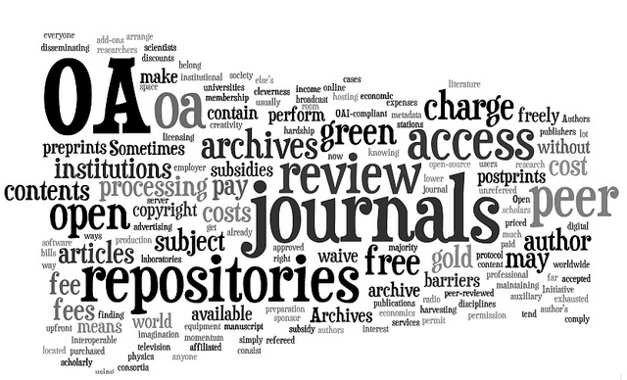
Institutional Repository
Definition
“Institutional repositories are digital collections of the outputs created within a university or research institution” (www.openscholarship.org)

Slide 5

Institutional Repository: Stakeholders
The IR is a collective responsibility of the:
Institution
Research Office
Academics & Researchers
Library
Open Access Policy
Advocacy of researchers to deposit their research output into the IR; Annual Research Reports
To take up the advocacy

Slide 6




The role of Rhodes University Library
Library: hosting and managing the IR

Slide 7
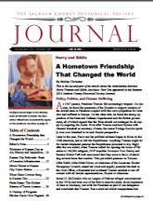




User Services’ roles
Focus on Articles and conference papers etc – but not exclusive
Collection Development of Rhodes research output
Archival and Preservation for re-use

Slide 8



User Services: Item Pre-upload
Source the article
Check for Copyright compliancy
Pre-prints / last version before publication
Publisher’s PDF

Slide 9


User Services: Upload into Rhodes Digital Commons
Metadata
- creator (author)
- article title
- journal title, volume, etc
- co-authors
- Digital Object Identifier (DOI) or url etc
- Integration of ORCID

Slide 10
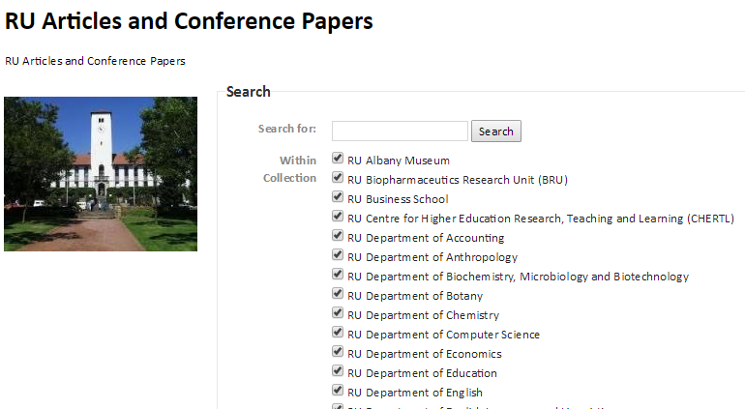
Rhodes Digital Commons

Slide 11
Rhodes Digital Commons
Use the metadata to create:
Authority profiles for each researcher
Lists of researcher’s supervision

Slide 12
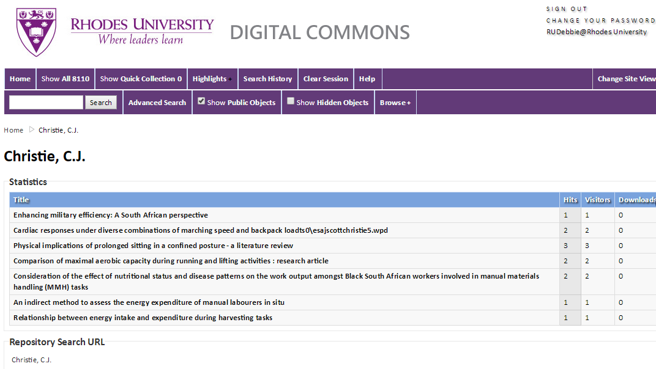
Rhodes Digital Commons
Authority profiles

Slide 13
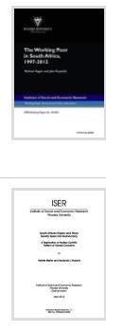
The Rhodes Digital Commons
Is publicly accessible digital research archive consisting of more than 12 000 unique items including:
  Rhodes Research output
    Theses and Dissertations (oldest 1928)
    Articles and conference papers
    Inaugural lectures
    Tebello Nyokong collection
    Reports,
    Etc.

Slide 14
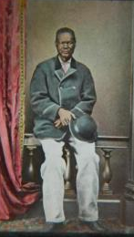
The Rhodes Digital Commons
Is publicly accessible digital research archive consisting of more than 12 000 unique items including:
  Primary resources
    Historical Manuscripts and Images
    Books published by Rhodes (e.g. ISER collection)
    Images (e.g. Skead collection)
    Sound (e.g. Hugh Tracy Collections)
    Vice-Chancellors collections

Slide 15
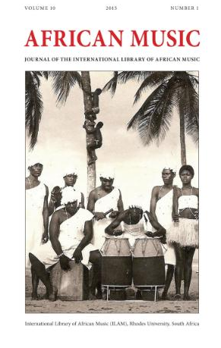
The Rhodes Digital Commons
Complemented by Open Journal Systems (OJS)
  Journal hosting platform
    African Music: Journal of the International Library of African Music and
    Southern African Journal
    of Gerontology

Slide 16
Value of the Rhodes Digital Commons
Increasing visibility and prestige of both the institution and the author
Increasing citation rates compared to non-open access research output
The RDC serves as a central archive of a researcher's work.
Assists in building a researcher’s profile.
Increase readership, re-use and dissemination of research outputs

Slide 17
Value of the Rhodes Digital Commons
It is used to support marketing activities to attract high quality staff, students and funding.
Centralisation and storage of all types of institutional research output.
Ability to keep track of and analyse research performance.
Breaking down of publishers’ costs and permissions barriers

Slide 18
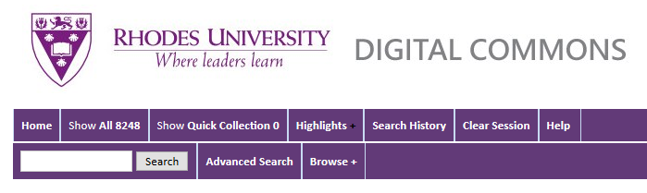
Access and exposure
See: http://vital.seals.ac.za:8080/vital/access/manager/statistics/Index/50?query=kunju&amp;queryType=vitalDismax

Slide 19

Thank You
Khawulile Radebe
Librarian: Repository & Metadata
k.radebe@ru.ac.za
046-6037681
(Level 4)
Debbie Martindale
Librarian: Scholarly Communication
d.martindale@ru.ac.za
046- 6037307
(Level 3)

