Slide 1


“Social Media in Research ~ friend or foe?”
Rhodes University Library Research Week 8-12 May
Rhodes University, South Africa.
Fiona Still-Drewett, 2017

Slide 2

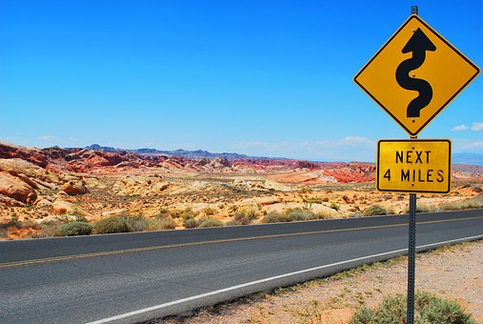
Roadmap
Global digital context
Social Media, a definition
Social Media policies?
Digital identity – the ‘research professional’
Social Media tools for academia?
Social Media – a new data source
Social Media in Research –
what considerations?
Citing Social Media sources
Value of Social Media?

Slide 3

We live in an Interconnected World
(proviso +- 40% humanity use the Internet Tim Berners-Lee BBC News 20/1/2015)
Internet embedded in the everyday
How can social media increase research impact and reach?
Social Media a new data source?
Can social media help grow your academic career?
Pic from Taylor & Francis white paper, Oct 2014
Notes:
Social media part of the scholarly communication / Information all pervasive & immediate via Mobile technology – smart phones/tablets / Q?

Slide 4
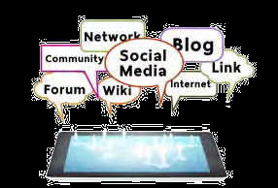
What is the future of Social Media ?
Engagement – students, colleagues, and staff – will be from this generation who are technologically sophisticated, well-connected on the social web, entrepreneurial, and oftentimes, impatient.
Content management “We need to dive in on the teaching front – students are taking on the role as educators.”
Changing technology “It is difficult to predict where it goes. So many applications … Social media is becoming the primary means for communication.”
Taylor & Francis White Paper, Oct 2014
http://www.tandf.co.uk/journals/access/white-paper-social-media.pdf
Notes:
Students know it / Academic teaching staff need to get with it / SM changing scholarly landscape re access & sharing of information plus OA movement

Slide 5
Web 2.0
Web 2.0 is not a technology, it is an attitude (O’Reilly 2005)
Web 2.0 about providing users with the means for producing and distributing content
Typical Web 2.0 qualities: dynamic, participatory, engaged, interoperable, user-centred, open, collectively intelligent… (Muster & Murphie 2009)
HINTON, S. & HJORTH, L. (2013) Understanding Social Media. London: Sage Publications
Notes:
Major theme which underlies the emergence of social media: tensions between control and freedom and between exploitation and empowerment

Slide 6
Definition of Social Media
Oxford dictionary: Websites and applications that enable users to create and share content or to participate in social networking https://en.oxforddictionaries.com/definition/social_media
'Social media' is the term commonly given to web-based tools which allow users to interact with each other in some way – by sharing information, opinions, knowledge and interests online. As the name implies, social media involves the building of online communities or networks to encourage participation and engagement https://www.york.ac.uk/admin/hr/resources/policy/social-media-guidelines.htm

Slide 7
One more definition…
“Social media isn’t media in the traditional sense, but platforms for interaction and relationships” Bryan Eisenberg 2007
Prominent examples:
Facebook, Twitter, Google+, Wikipedia, LinkedIn, Reddit, Pinterest. http://whatis.techtarget.com/definition/social-media

Slide 8
Use of Social Media
Institutional - University: employee/individual tasked with communicating on behalf of a unit or department or research project
Personal capacity: researcher profile, networking, research interests, doing research, communicating research & for personal use

Slide 9
Social Media policies?
code of conduct that provides guidelines for employees who post content on the Internet
Techtarget http://searchcompliance.techtarget.com/definition/social-media-policy
Universities usually have a social media policy or best practice guidelines for use developed by the HR or Communications Department
Guiding principals: ‘do no harm’ or ‘use your best judgement’ e.g. Harvard University https://provost.harvard.edu/files/provost/files/social_media_guidelines_vers_2_0_eff_081814.pdf

Slide 10
Research profiles & Social Media
“Naturally, in the digital age, it’s important for researchers to have profiles and be associated with their work. Funding, citations and lots of other good career advancing benefits flow from this”
“beneficial to showcase a broad range of output, so blogs, slide presentations, peer-reviewed publications, conference posters etc.”
Elizabeth Allen
Sep 2014
From the ScienceOpen.com blog

Slide 11
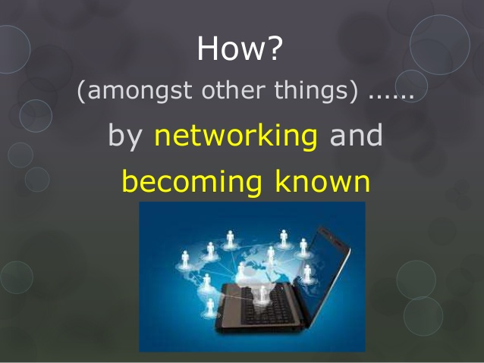
Grow your professional identity
Graduate student (and staff!) have two jobs:
Do good research & build a community around your research topic Phil Agre 2005
https://www.slideshare.net/EileenShepherd/raising-your-research-profile-39085420

Slide 12
Social Media tools for academia
Twitter : ‘up to the minute’ research ~
discover new research & communicate your research
Google Scholar : profile & citations
Blogs : reflect & promote your research
Academia.edu /ResearcherID: profiles~academic networking~peer review
Facebook : invitation only groups ~ subject focus ~ collaboration
LinkedIn : job hunt~share~connect
Notes:
Many more social media tools out there

Slide 13
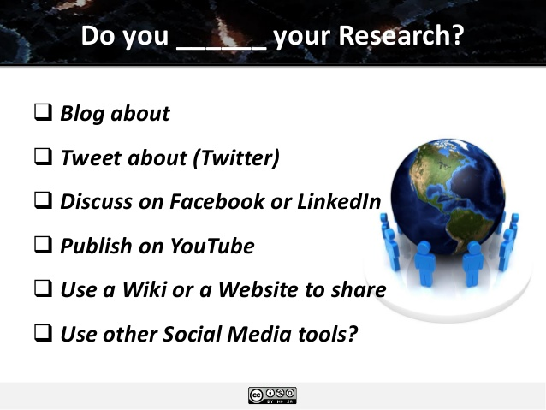
From: slide2 https://www.slideshare.net/zaid/social-media-for-research-17192868

Slide 14

Twitter
Do:
Follow high profile researchers in your field
Follow associations, publishers, libraries…
Alert RUL to new publications
Contact your Principal Faculty Librarian
Value?:
discover very latest research
Time efficient – via links of interest
‘virtual’ conference attendance
connect
@RhodesResearch
#RUZoo
Notes:
Register! Conference – virtual attendance, follow discussions & comment #RUHKE @Write4Research

Slide 15
Follow: @RhodesLibrary
Communicates library, research, and scholarly news as it happens. Stay current, resourced and information savvy!
“Official Twitter feed of the Rhodes University Library, a leading academic research support library in South Africa”
To date 1131 followers (includes students, staff, alumni, higher education institutions, recruiters, scholarly societies, librarians, publishers, visitors…), 627 tweets Start June 2012

Slide 16
Follow @RhodesResearch
Aim: Rhodes research visibility via regular tweets; supports national and global research communication and collaboration
Search: via the subject hash tags e.g. #RUJournalism, #RUPhysics … to view recent research by a RU department
Includes: articles, books, dissertations, theses, conference papers by Rhodes University researchers ~ staff & students
To date: 767 followers (includes students, academics, researchers, national & international professional /research
organisations…)3536 tweets Start June 2013

Slide 17
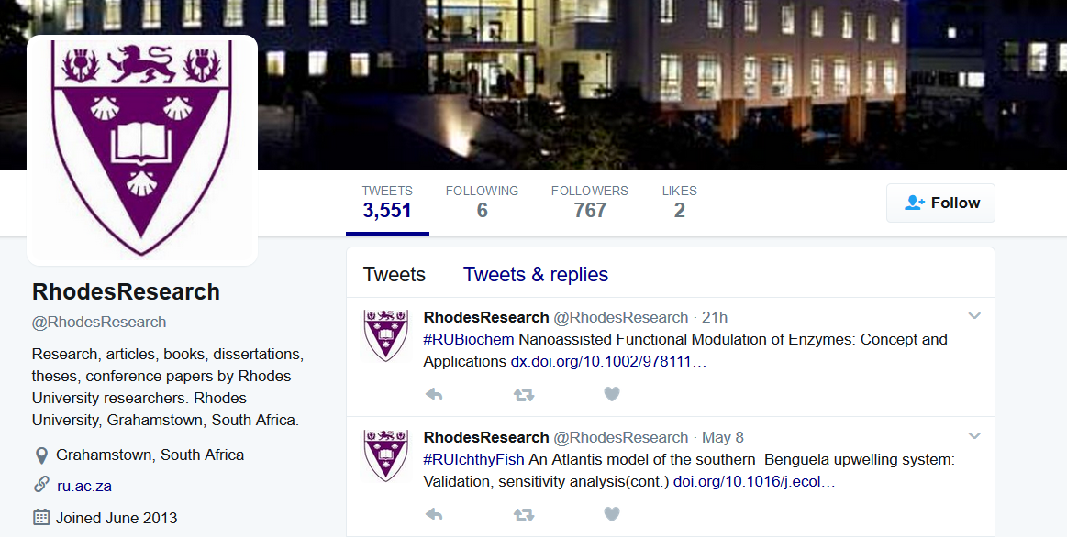
@RhodesResearch

Slide 18
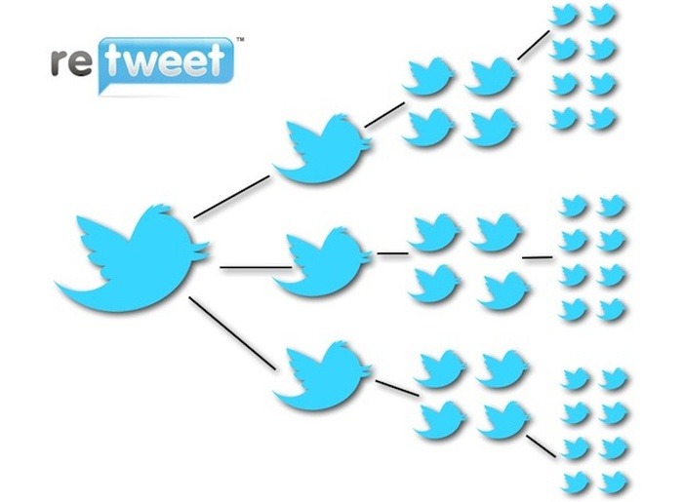
Twitter verse & visibility
Twitter adds value to research projects, use for every new publication, website update or new blog
Use hashtags
(#) for visibility – e.g. #phdchat, don’t be afraid to start your own
http://blogs.lse.ac.uk/impactofsocialsciences/files/2011/11/Published-Twitter_Guide_Sept_2011.pdf

Slide 19
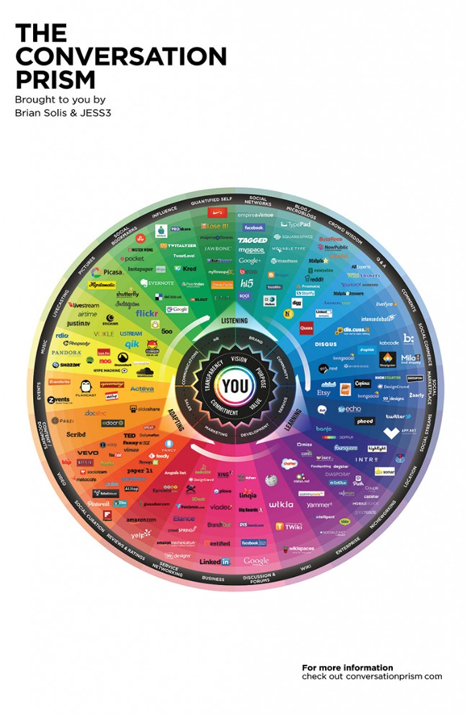
Social Media a new source of data?
Digital traces / Relational contexts
Conversations = research data
Developed in 2008 by Brian Solis, The Conversation Prism is a visual map of the social media landscape. It’s an ongoing study in digital ethnography that tracks dominant and promising social networks and organizes them by how they’re used in everyday life.
https://conversationprism.com/

Slide 20
Internet as a Research Medium
Online research methods attractive, especially to social sciences:
Survey research / computer tools to analyze qualitative data
Trend to research by the public, ‘citizen research’ or ‘citizen science’
Multiple access points for news, formal & informal – more difficult for researchers to judge quality and accuracy [era of fake news]
Data mining software for large data sets plus
Geospatial tools & Mash-ups (e.g. public data +Google maps) Sage Handbook of Online Research Methods

Slide 21
Issues around using social media in research
Privacy and confidentiality: posts public or private?
Accessing data: most often automated data collection not permitted or is limited
Demographics: need to be aware social media is not necessarily representative of any larger group
From http://www.apa.org/gradpsych/2011/11/social-media.aspx
Social media provides rich data but throws up ethical issues, particularly in health care research Swirsky, E. S., Hoop, J. G., & Labott, S. (2014). Using Social Media in Research: New Ethics for a New Meme?

Slide 22
Myriad of tools for analysis of social media
Text analysis
Content analysis
Sentiment analysis
Thematic analysis
Etc.
Twitter popular for social media and industry research
Many tools require no prior technical skills e.g. https://netlytic.org
Advanced data analysis/statistics e.g. R , Gephi
http://blogs.lse.ac.uk/impactofsocialsciences/2017/05/08/using-twitter-as-a-data-source-an-overview-of-social-media-research-tools-updated-for-2017/

Slide 23
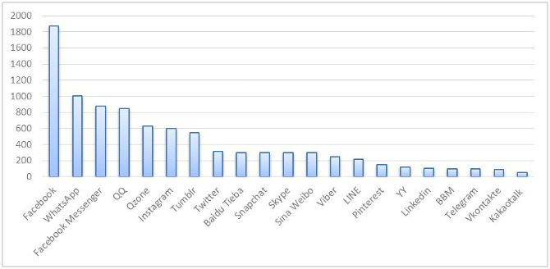
Active Social Media users
Number (in millions) of monthly active users across social media platforms. Created using data powered by statista
http://blogs.lse.ac.uk/impactofsocialsciences/2017/05/08/using-twitter-as-a-data-source-an-overview-of-social-media-research-tools-updated-for-2017/

Slide 24
Wasim Ahmed ~ overview of social media research tools
“It would be nice to have academic and social listening tools to retrieve data from other social media platforms, such as Facebook, Instagram, and Amazon, and also dark social media platforms such as WhatsApp. However, this may not be possible because these applications are not likely to provide all of their data to developers as Twitter does. Moreover, there may be ethical implications of accessing data from dark social media platforms”
http://blogs.lse.ac.uk/impactofsocialsciences/2017/05/08/using-twitter-as-a-data-source-an-overview-of-social-media-research-tools-updated-for-2017/

Slide 25
Social Media Citations?
Posts from social media such as Facebook and Twitter are generally not considered to be of a scholarly nature
‘How to?’ often are not covered in Style Guides.
However, you need to provide enough information for your reader to be able to access the information
Author or user name, date (if available), title of post, the type of post in square brackets (e.g. [Facebook update] or [Twitter feed]), the retrieval date and the URL.

Slide 26
Citation considerations
Cited pages may become inaccessible in the future due to the live update format of social media, not archiving apps/platforms
The Harvard Style guide notes for Social Media sources: NOT acceptable academic sources unless as objects of research
Monash University maintains an up to date guide
http://guides.lib.monash.edu/citing-referencing/apa-websites-social-media
Notes:
For restricted/closed sites it is good practice to request permission from the author before referring to a post in your work, may be appropriate to include a screenshot of the information in your appendix.

Slide 27
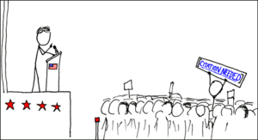
Also see website: Social Media for learning details how to cite in academic writing https://socialmediaforlearning.com/
Image source: https://en.wikipedia.org/wiki/Wikipedia:Citation_needed

Slide 28
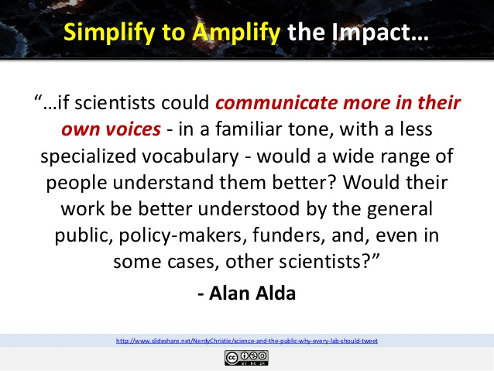
Slide 36: https://www.slideshare.net/zaid/social-media-for-research-17192868

Slide 29
Amplify your research impact
YouTube / Medtube : video share
Slideshare: upload & share private or public
Prezi: visual journey
Ebooks: publish open access
News forums
Academic rigour, journalistic flair
monthly audience of 4.8 million users, and reach of 35 million through Creative Commons republication
Write an article and join a growing community of more than 49,700 academics and researchers from 2,021 institutions
https://theconversation.com/global

Slide 30
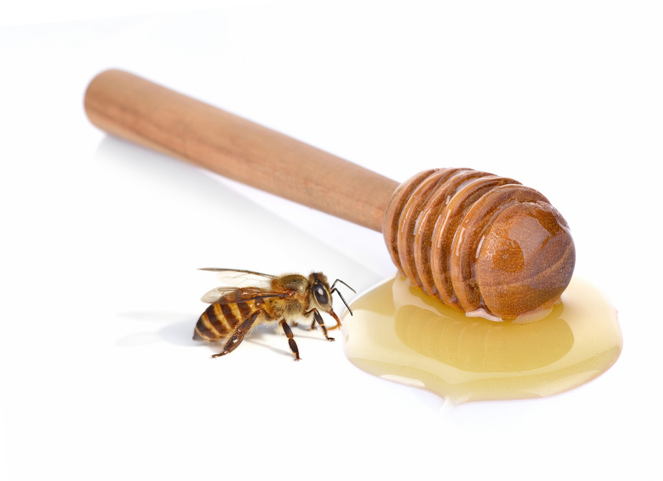
A scientist with a fascinating story? Some tips on how to make it soar
So…what stories will soar from the lab to the front page?..: a curious tale of honey fraud that captured media imaginations and left researchers with the sweet aftertaste of success.
March 2017 Stellenbosch University issued a press release about a group of its researchers who developed a method to detect whether honey fraud is a problem in South Africa
The Conversation Africa
March 26 2017, Marina Joubert

Slide 31

Food Science Researcher Prof. Marena Manley ‘when news goes viral be ready with’:
Clear and accessible press release
All facts and figures
Credit where due
Help from institution’s media staff
Ready key messages for each audience ~ live radio, TV
High resolution visuals
All hour contact details
The Conversation Africa March 26 2017, Marina Joubert

Slide 32
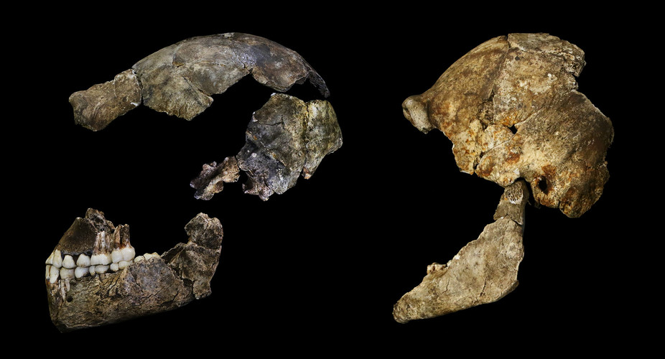
Homo Naledi : Using social media to tell the story
John Hawks “As our cavers and scientists worked underground in challenging conditions, we kept the world up to date on Twitter, Facebook and with our Rising Star Expedition blog”
September 28 2015 Conversation article retweeted 189x to date
eLIFE open access journal
3D scans on MorphoSource for copy models
Skulls of Homo naledi.
John Hawks, CC BY
news 24 Johannesburg - A year and a half after fossils belonging to the Homo Naledi species were discovered, scientists and researchers can now reveal that it is highly likely that the species lived alongside Homo sapiens (early humans) 9 May 2017

Slide 33
Homo naledi, a new species of the genus Homo from the Dinaledi Chamber, South Africa
Lee R Berger et al, WITS University as at 8 May 2017
DOI: http://dx.doi.org/10.7554/eLife.09560
Published September 10, 2015
HTML views: 308,345
PDF downloads: 31,712
Twitter: 318 tweets
Facebooks : 96 likes
Scopus: 28 citations
Google Scholar article citations: 88

Slide 34
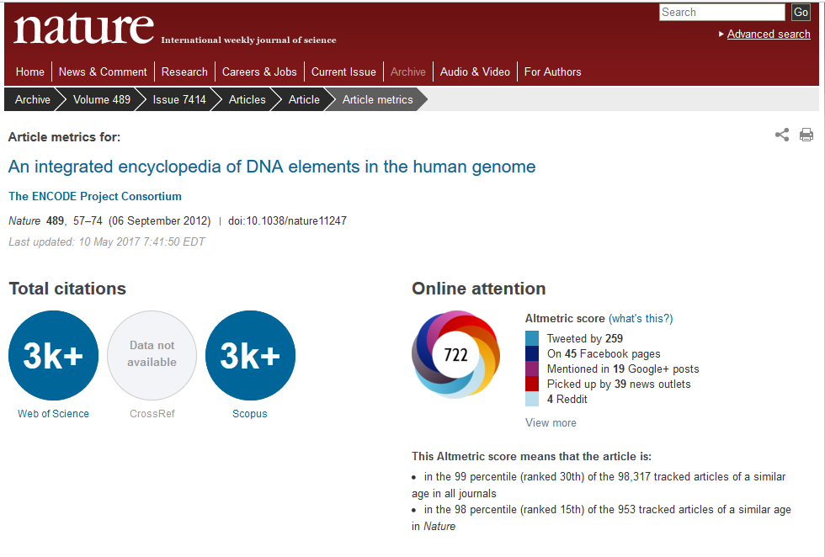
Embedded metrics, online in text

Slide 35
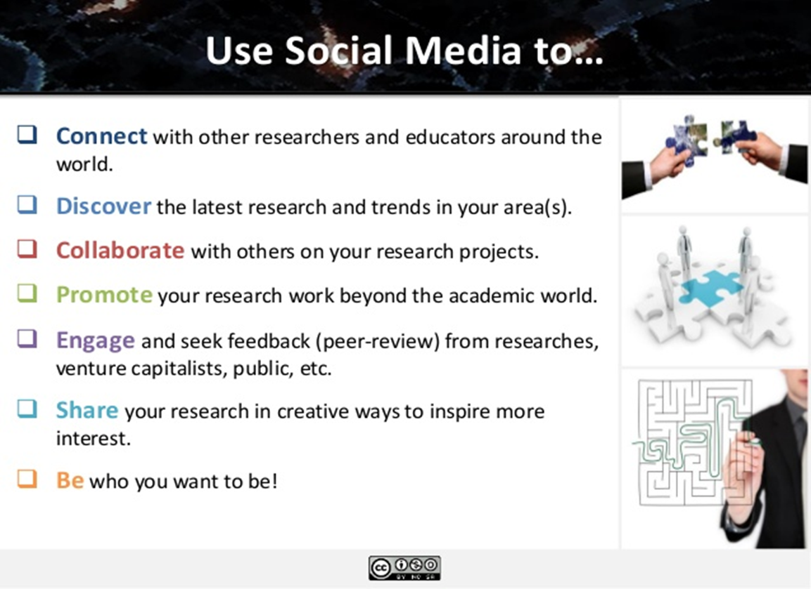
Slide 43: https://www.slideshare.net/zaid/social-media-for-research-17192868

Slide 36
Emerging Scholar essentials!
Select your Author ID & work on developing your online Research Profile
View Social Media as an integral part of the Research Cycle (discover, manage, research, collaborate, share, reflect)
Incorporate social media in all your academic related activities
Participate in the research landscape:.. engage in online scholarly communication!
Notes:
Researcher ID Thomson Reuters Integrates with Web of Science and is ORCID compliant / keyword searches

Slide 37
Highly recommended guide
Academics' online presence: a four-step guide to taking control of your visibility
(open UCT guide by Sarah Goodier and Laura Czerniewic)
Assess yourself: search for yourself and check your impact
“your Digital footprint vs your digital shadow”
Your profile as an individual: keep all profiles up to date
Improving the availability of your outputs: self archive & share what you can
Communicating and interacting: connect & interact online
http://hdl.handle.net/11427/2652
Notes:
your digital footprint is your active contribution to and interaction with the online world vs your digital shadow, content about you posted and uploaded by others, as well as automatically generated and collated content. You should try and maximise the former and watch the latter

Slide 38
To conclude: Value of Social Media
Enhances research impact via
real time/real world application of the research, helps grows citation counts, extends global reach, facilitates collegial collaboration & is a rich source of data
Use to develop your research career, contribute to institutional research output, & grow funds for research & higher education in South Africa!
Notes:
Societal use of research – real world

Slide 39
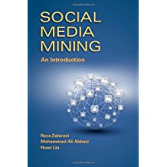
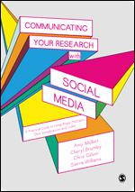
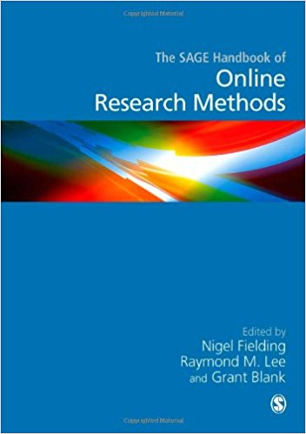
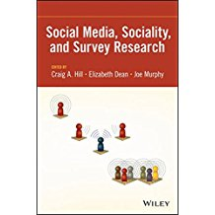

Getting Started!

Slide 40
Recommended websites
https://www.slideshare.net/NerdyChristie/science-and-the-public-why-every-lab-should-tweet
http://blogs.lse.ac.uk/impactofsocialsciences/files/2011/11/Published-Twitter_Guide_Sept_2011.pdf
http://www.sciencemag.org/careers/2013/06/creating-successful-online-presence

Slide 41
References (slide order)
http://www.tandf.co.uk/journals/access/white-paper-social-media.pdf
HINTON, S. & HJORTH, L. (2013) Understanding Social Media. London: Sage Publications
https://en.oxforddictionaries.com/definition/social_media
https://www.york.ac.uk/admin/hr/resources/policy/social-media-guidelines.htm
Eisenberg, Bryan. (2006) Waiting for your Cat to Bark. Nashville, Tennessee: Thomas Nelson, Inc.
http://whatis.techtarget.com/definition/social-media
http://searchcompliance.techtarget.com/definition/social-media-policy
https://provost.harvard.edu/files/provost/files/social_media_guidelines_vers_2_0_eff_081814.pdf
http://blog.scienceopen.com/
https://www.slideshare.net/EileenShepherd/raising-your-research-profile-39085420
http://www-personal.umich.edu/~csandvig/698F15/readings/Agre--ch3--excerpts.pdf
https://www.slideshare.net/zaid/social-media-for-research-17192868/2-Do_you_your_Research_Blog
http://blogs.lse.ac.uk/impactofsocialsciences/files/2011/11/Published-Twitter_Guide_Sept_2011.pdf
https://conversationprism.com/
Fielding, N et al. (2008). The Sage Handbook of Online Research Methods. London: Sage Publications
http://www.apa.org/gradpsych/2011/11/social-media.aspx

Slide 42
References cont.
Swirsky, E. S., Hoop, J. G., & Labott, S. (2014). Using Social Media in Research: New Ethics for a New Meme? The American Journal of Bioethics : AJOB, 14(10), 60–61. http://doi.org/10.1080/15265161.2014.948302
http://blogs.lse.ac.uk/impactofsocialsciences/2017/05/08/using-twitter-as-a-data-source-an-overview-of-social-media-research-tools-updated-for-2017/
http://guides.lib.monash.edu/citing-referencing/apa-websites-social-media
https://socialmediaforlearning.com/
https://www.slideshare.net/zaid/social-media-for-research-17192868/36-Simplify_to_Amplify_the_Impactif
https://theconversation.com/global
https://theconversation.com/a-scientist-with-a-fascinating-story-some-tips-on-how-to-make-it-soar-74704
https://theconversation.com/homo-naledi-fossil-discovery-a-triumph-for-open-access-and-education-47726
https://www.nature.com/nature/journal/v489/n7414/nature11247/metrics
https://www.slideshare.net/zaid/social-media-for-research-17192868/43-Use_Social_Media_to_Connect
Goodier, S. & Czerniewicz, L. (2014) Academics’ online presence [Online] 2014. OpenUCT Guide. Available from: Available at: http://open.uct.ac.za/handle/11427/2652 . [Accessed: 8 May 2017]

Slide 43


“I think we can conclude Social Media is
‘a friend’ in the context of academic research and scholarly communication”
Your take?
Thank you for your attention!
Questions?

