Slide 1
Your ORCID researcher identity: Enhancing the impact and visibility of your research web presence Research Week. 11th May 2017 Debbie Martindale: Librarian: Scholarly Communication

Slide 2
OUTLINE
Scholarly Communication
ORCID: Context
ORCID registration
Enhancing the researcher’s web presence
Rhodes Digital Commons

Slide 3
Scholarly Communication
Defined as “the system through which
research and other scholarly writings
are created, evaluated for quality,
disseminated to the scholarly community, and preserved for future use.
The system includes both formal means of communication, such as publication in
peer-reviewed journals,
and informal channels, such as electronic listservs.”
(Association of College & Research Libraries)

Slide 4
Scholarly Communications: Personal Identifiers
Researcher
ID

Slide 5
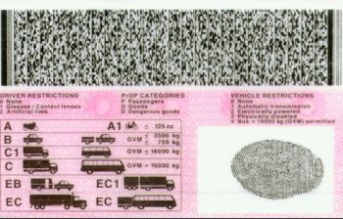
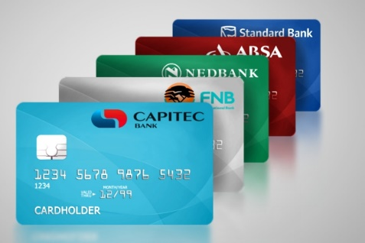
Scholarly Communications: Personal Identifiers
Researcher
ID
Drivers License
Passport
Bank Card
Staff card

Slide 6
Scholarly Communications: In Context
Researcher Identity
Discover
Create/Analysis
Manage
Publish/ Disseminate
Reuse

Slide 7
Scholarly Communications: Researcher Identifiers
Researcher Identity
Discover
Create/Analysis
Manage
Publish/ Disseminate
Reuse

Slide 8
Scholarly Communications: Researcher Identifiers
Researcher Identity
Discover
Create/Analysis
Manage
Publish/ Disseminate
Reuse

Slide 9
Scholarly Communications: Researcher Identifiers
Researcher Identity
Discover
Create/Analysis
Manage
Publish/ Disseminate
Reuse

Slide 10
ORCID: In context
Open
Researcher and
Contributer
ID
“ORCID’s vision is a world where all who participate in research, scholarship, and innovation are uniquely identified and connected to their contributions across disciplines, borders, and time.”

Slide 11
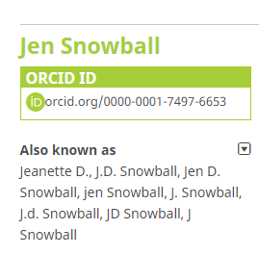
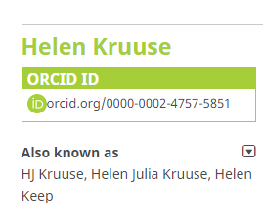
ORCID: Many authorship names: One identifier

Slide 12
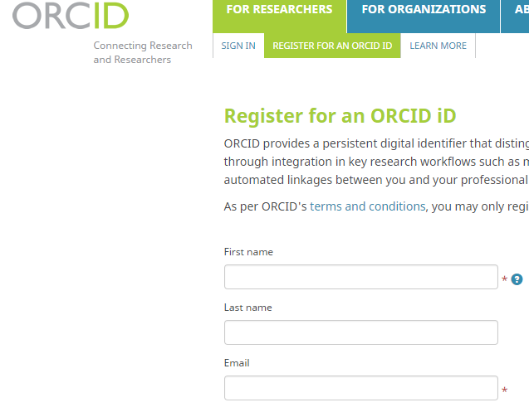
ORCID: Registration
https://orcid.org/register

Slide 13
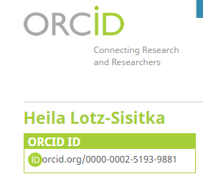
ORCID: Registration
Many researchers think this is where the journey with ORCID ends

Slide 14
ORCID: Enhancing the Researcher’s web presence
ORCID:
Raises the Researcher’s web presence
Raises the IMPACT of research
Enables NRF to access the information they require to:
Grant research funding
Grant academic rating (based on h-index, altmetrics, and levels of interest by peer-researchers in the field)
Enables RU Research Office to determine individual researcher’s research output

Slide 15
ORCID: Enhancing the Researcher’s web presence
Identity research focus area, Lit.Reviews, Data, Funding
Twitter, Facebook, Blogs, Wikis, Google Scholar, Mendeley (etc), Academia.edu, ResearchGate
Researcher Identity
Discover
Create/Analysis
Manage
Publish/ Disseminate
Reuse
Research/data collection & analysis
Google Apps, Wikis
Research Data Management (RDM)
for funding, CV , visibility
Publication:
High-impact journals
Open Access journals
OJS

Slide 16
ORCID: Enhancing the Researcher’s web presence
Identity research focus area, Lit.Reviews, Data, Funding
Twitter, Facebook, Blogs, Wikis, Google Scholar, Mendeley (etc), Academia.edu, ResearchGate
Researcher Identity
Discover
Create/Analysis
Manage
Publish/ Disseminate
Reuse
Research/data collection & analysis
Google Apps, Wikis
Research Data Management (RDM)
for funding, CV , visibility
Publication:
High-impact journals
Open Access journals
OJS

Slide 17
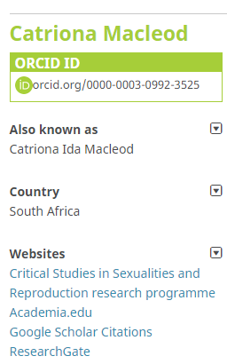
ORCID: Enhancing the Researcher’s web presence
ORCID Profile: Add Websites
Google Scholar Citations

Slide 18
ORCID: Enhancing the Researcher’s web presence
ORCID Profile: Add Websites
Rhodes Digital Commons
- Personal Page
- Supervision

Slide 19
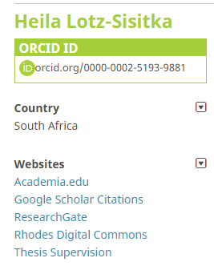
ORCID: Enhancing the Researcher’s web presence
ORCID Profile: Add Websites

Slide 20
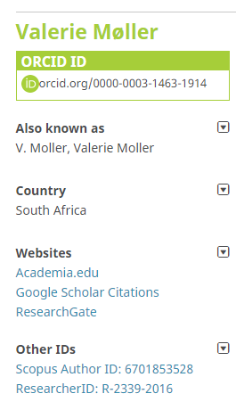
ORCID: Enhancing the Researcher’s web presence
ORCID Profile: Add Other IDs

Slide 21
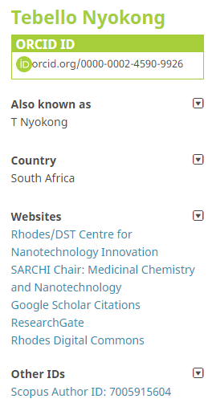
ORCID: Enhancing the Researcher’s web presence
ORCID Profile: Add Other IDs
Increased

Slide 22
ORCID: Enhancing the Researcher’s web presence
ORCID Profile: Add Works
1. Search and Link

Slide 23
ORCID: Enhancing the Researcher’s web presence
ORCID Profile: Add Works
1. Search and Link
2. Manual

Slide 24
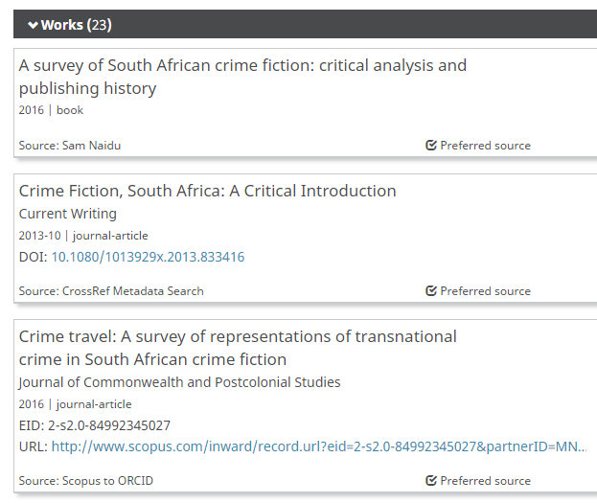
ORCID: Enhancing the Researcher’s web presence
ORCID Profile: Add Works

Slide 25
The Research LifeCycle: Web Presence
Identity research focus area, Lit.Reviews, Data, Funding
Twitter, Facebook, Blogs, Wikis, Google Scholar, Mendeley (etc), Academia.edu, ResearchGate
Researcher Identity
Discover
Create/Analysis
Manage
Publish/ Disseminate
Reuse
Dissemination:
Social Media
Self-archiving:
ResearchGate, FigShare
Institutional repository
Research/data collection & analysis
Google Apps, Wikis
Research Data Management (RDM)
for funding, CV , visibility
Publication:
High-impact journals
Open Access journals
OJS

Slide 26
Rhodes Digital Commons
Institutional Repository defined:
“Institutional repositories are digital collections of the outputs created within a university or research institution” (www.openscholarship.org)
Copyright compliant
Pre-prints / last version before publication
Publisher’s PDF

Slide 27
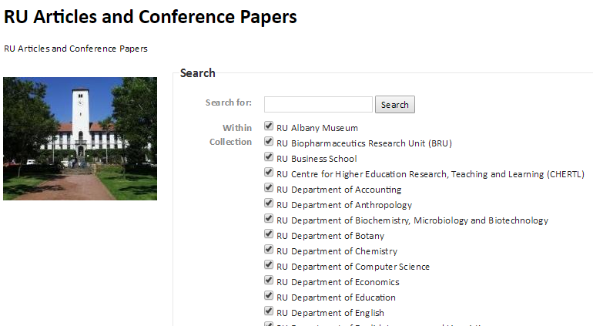
Rhodes Digital Commons

Slide 28
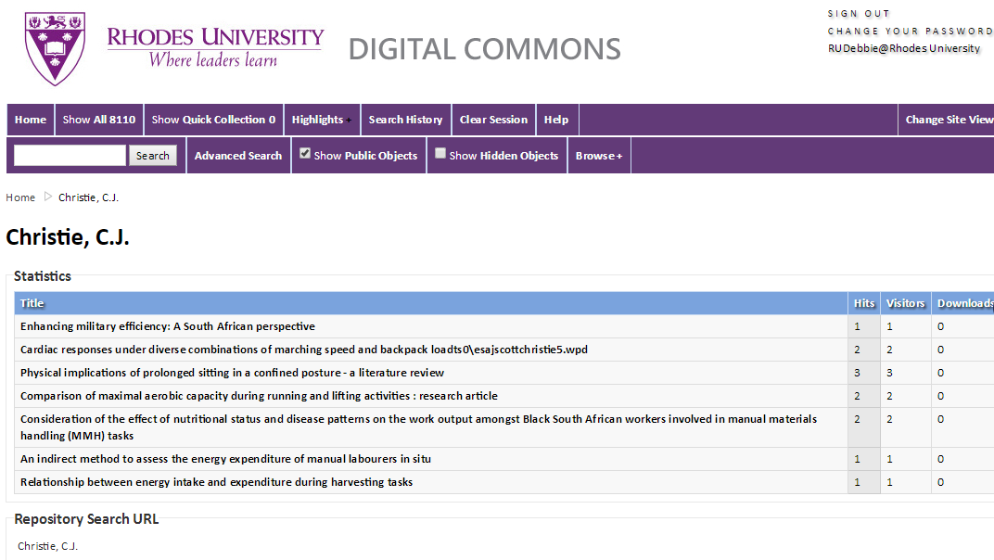
Rhodes Digital Commons
Authority profiles

Slide 29
Thank You
Debbie Martindale
Librarian: Scholarly Communication
d.martindale@ru.ac.za
046- 6037307
(Level 3)

