Slide 1

Snapshot of the Chinese
overseas investments

Slide 2
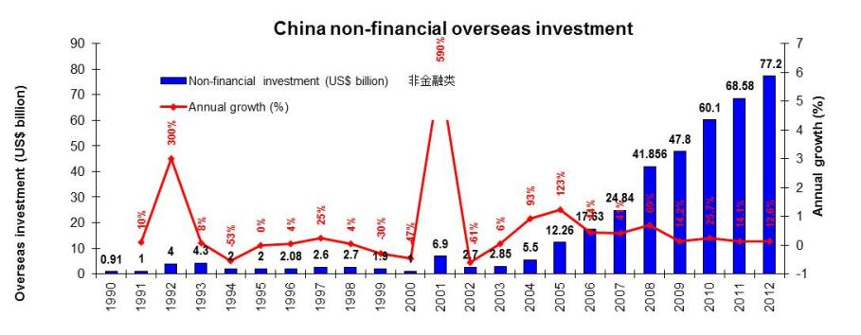
Overall picture
-In 2012, China’s non-financial overseas direct investment (ODI) reached to US$77.2 billion, a growth of 12.6% over the previous year. This growth rate is quite impressive, particularly under the influence of the global financial crisis (2008) which resulted in dramatic contraction of investment activities in the world.
-A large amount of the investment was for acquiring mineral resources to support the domestic economic expansion

Slide 3
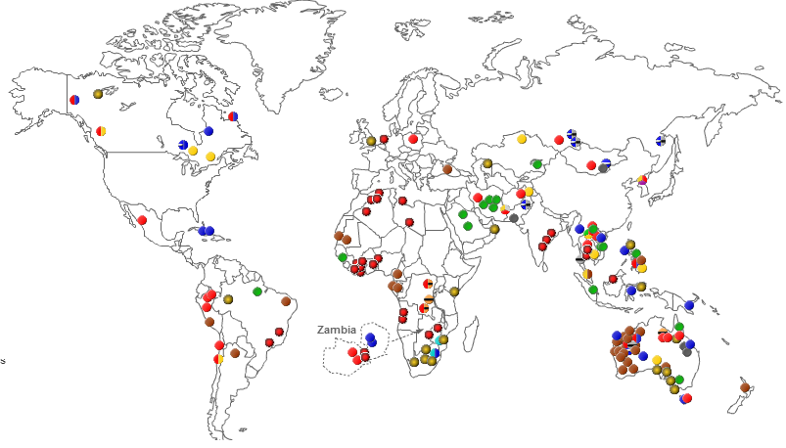
Where have the Chinese invested?

Slide 4
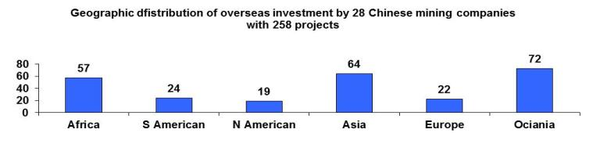
2010
2009
2008

Slide 5
Where is the Chinese money spent?
2010
2009

Slide 6
What commodities are favoured by the Chinese?
2010
2009
2008

Slide 7
Types of investment projects
-Although most investments are directly for mining (64% of total projects), the Chinese companies are also involved extensively in infrastructure and engineering projects (25%) and trading activities (10%) to support their mining initiatives.

Slide 8
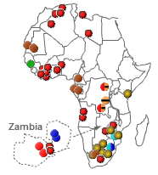
China’s mining investment in Africa

Slide 9
China’s mining investment in Africa
- DRC, South Africa, Zambia and Zimbawe are the main destination countries in Africa.
- Out of the total investment of US$26 billion, 81.6% or US$21 billion is for infrastructure development. Copper, iron ore and platinum are the focused commodities.

Slide 10
CLOSING REMARKS
-China is speeding up its investments in other parts of the world. The global financial crisis did not stop the Chinese ambition to secure raw materials supply.
Asia and Africa are the two main destinations for Chinese overseas investment. Australia has also become a major beneficiary of the Chinese money in the mineral sector.
Aluminium, iron ore, copper and nickel are the main target commodities of the Chinese investment. This is in line with the actual need of import of minerals in the Chinese domestic market.
Apart from the major state-owned mining companies, private Chinese investments have also become an important player in the overseas mining investment, although the latter is still relatively small in terms of capital capacity.

Slide 11
CLOSING REMARKS
- Chinese companies are flexible in terms of format of investment and have developed various models to suit different situations:
-In Asia, similarities in traditional culture and political system provide a good platform for Chinese investors to work together with the local partners. Companies often use governmental supports from both China and the host countries to advance their pursuit.
-In Africa, the Chinese companies take advantages of the strong historical ties and political relationships between China and African countries to strengthen their competitiveness in acquiring mineral resources.
-In their overseas quest for raw materials, Chinese companies often work together to combine their respective skills and expertise to enhance their competitiveness. They get involved not only just for development of mineral deposits, but also for infrastructures and agricultural projects. The host countries benefits more from such approach than simple mining. The Chinese investors could harvest from either mine development or infrastructure constructions or from both.

