Slide 1
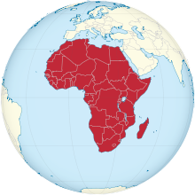
Negotiation in Chinese-African relations: What do we need to know?
Tony Fang, PhD Professor of Business Administration Stockholm University (For Rhodes University, 2013-10-31)

Slide 2
China-Africa Trade (USD bn) and so what?
$198.5 billion

Slide 3
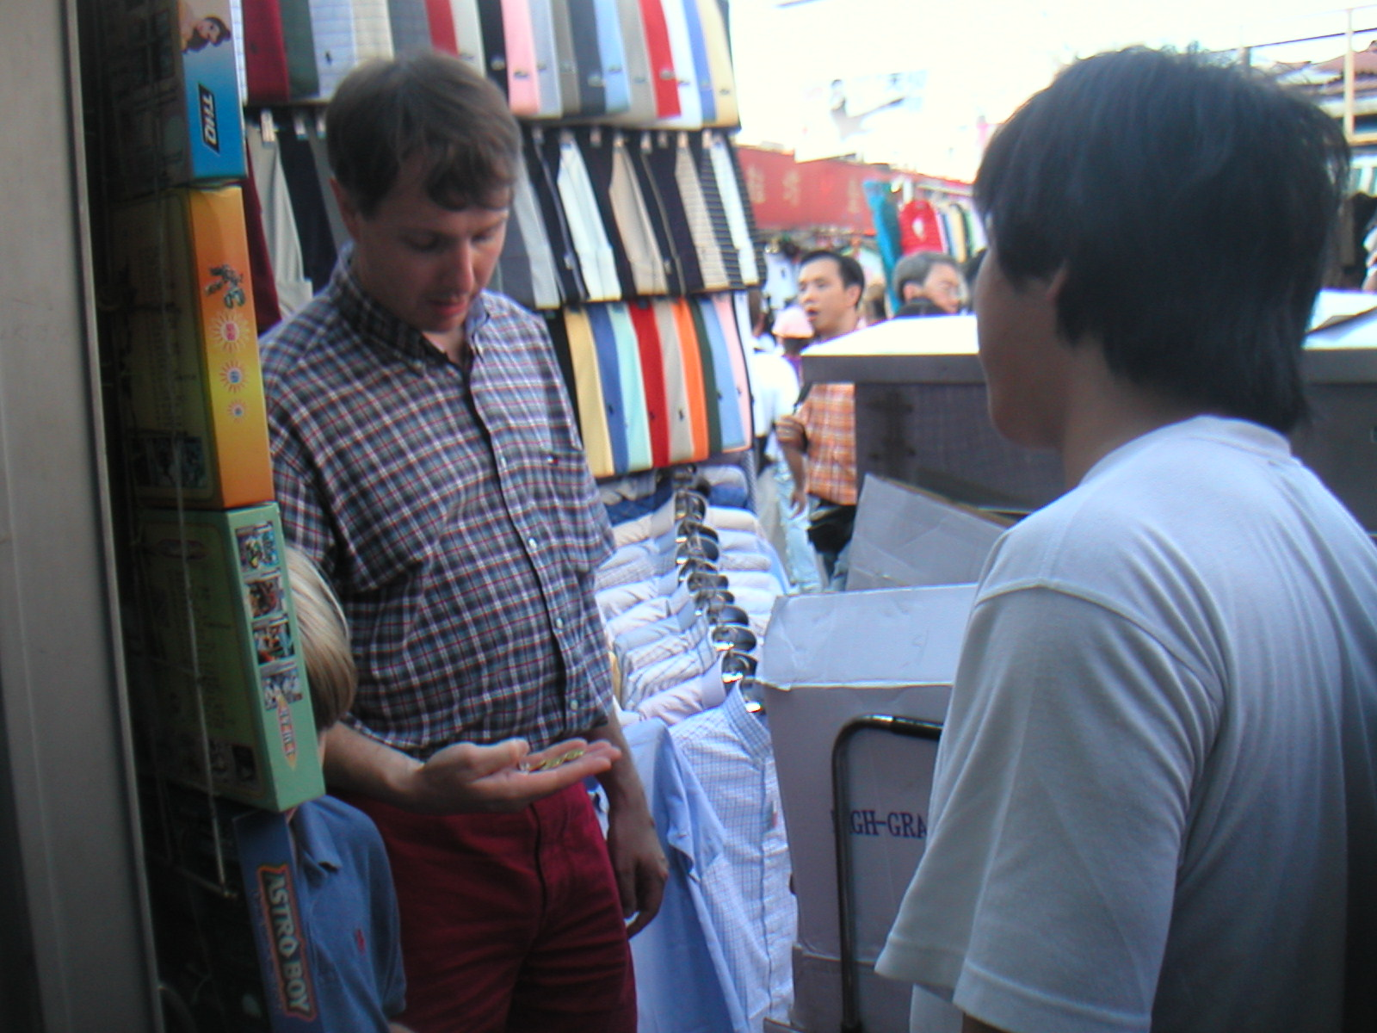
Negotiation: The Chinese concept
谈 判
Tan Pan
“Talk, discuss” “Criticize/Judge”

Slide 4
The Chinese concept of negotiating
Everyone must be happy; ”Win-Win” in the mind of each party. But the Chinese must feel they are winning a bit more, short-term or long-term.
The Chinese do not have a fixed bottom line. They have FBL – a Floating Bottom Line, depending on the dynamic relationship between the parties.
The Chinese are both short-term and long-term; they believe profits are generated over time.
Strategy:
(a) Never rush into the deal;
(b) Observe how local people deal with each other; and
(c) Use reference and precedence.

Slide 5
Yin Yang
A Chinese Philosophy and Life Style of
Embracing Paradox, dynamics, and Change
(holism, dynamism, dialectis)

Slide 6
中国谈判风格
信任度
低
高
竞争，注重短期效益
合作，注重长远效益
© 2001 Tony Fang, Ph.D

Slide 7
”Maoist
Bureaucrat in learning”
Trust
”Sun Tzu-like
Strategist”
”Confucian
Gentleman”
(Sage Publications, London, 1999)

Slide 8
Chinese Business Negotiating Style
General negotiation behaviour
How to deal with
· Large team, vague authority, dominance of technical and financial people, lawyers seldom show up.
· Exploit “agreed principles” in the form of MOU and LOI.
See difference between
SOEs and private
firms. Tech and financial
experts must be on your
team; lawyers show up later.
Emphasize ”mutual benefits” MOU/LOT is not binding. Nothing is agreed.
© 2013 www.tonyfang.com

Slide 9
General negotiation behaviour
How to deal with
Play home court
Buy the best technology and do business with famous companies; increasing emphasis on innovation
Mask interests
(”Foreign friends speak first.”)
Prepare mentally. ”Home court” OK if it can generate faster decision making. + Invite the Chinese to negotiate outside China.
Indicate that you are unique and innovative in your business; Use reference.
Prepare a two minutes statement emphasizing your China interest at national/political, corporate, and personal levels.
© 2013 www.tonyfang.com

Slide 10
General negotiation behaviour
How to deal with
Price-sensitive
Buy the best technology and do business with famous companies; increasing emphasis on innovation
Mask interests
(”Foreign friends speak first.”)
Direct discussions towards areas such as health, safety, better environment, life quality, etc.
Indicate that you are unique and innovative in your business; Use reference.
Prepare a two minutes statement emphasizing your China interest
at national/political, corporate,
and personal levels.
Make warm but balanced promise.
© 2013 www.tonyfang.com

Slide 11
General negotiation behaviour
How to deal with
Stalling, delays and indecision
Hierarchical
Non-legalistic approach
Take your time, buy open-tickets, use contacts to find out what is going on. You may need to help the Chinese with their internal negotiations.
Identify the real decision maker. Use political or diplomatic channels to meet the right person(s).
Take it as friendly gestures but emphasize that legal contract is a legal contract.
© 2013 www.tonyfang.com

Slide 12
General negotiation behaviour
How to deal with
Play competitors off against each other
Shaming technique
Change team leader and change the earlier agreed points.
Avoid direct competition. Indicate your strengths and show your list of long-term powerful customers.
Do not take the Chinese word to your heart too much! A game. Use humour to neutralize the Chinese tactics.
Make it clear in writing at the beginning of the negotation to prevent this situation from occuring.
© 2013 www.tonyfang.com

Slide 13
General negotiation behaviour
How to deal with
Show anger
Under the table deal
Friendship means obligation
“Richer bears heavier burden”
Re-negotiation
Mentally prepare for the worst. Use humour to bring the Chinese back to the negotiation table.
Resist it with wisdom and tactics. Identify the genuine human needs.
Keep calm; give warm help but do not overdo it.
China is getting richer and richer much faster than us!
Define the rules in the beginning;
Use re-negotiation positively.
© 2013 www.tonyfang.com

Slide 14
Observation….
Tony Fang presentation
“South African negotiators perceive the Chinese negotiators to value status, respect hierarchical decision-making, and appreciate long-term relationships. In addition, the perceptions on the importance of trust, guanxi and face were strongly evident” (Horwitz, Hemmant, & Rademeyer, 2008: 11).
“In the future, we need to answer, for example, whether the Chinese also use those tactics employed on Western business people to deal with other Third World business people.” (Fang, 1999: 182).

Slide 15
Tony Fang presentation
What do we need to know?
Q1 What are the major interests and contentious issues often involved in Sino-
African business negotiations?
Q2 What are the basic principles that guide Chinese firms to approach problems
in Sino-African business negotiations?
Q3 How are Chinese negotiation tactics employed in Sino-African business
negotiations compared with the existing knowledge of Sino-Western business
negotiations?
Q4 How to understand the dynamics of cultural differences and similarities
between Chinese culture and local African culture as shown in business
negotiations? and
Q5 What are the theoretical and managerial implications of Chinese negotiating
style shown in African business projects for a better understanding Sino-
African relationships in particular, and Sino-foreign relationships in the age of
globalization in general?

Slide 16
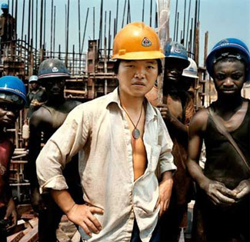
We intend to answer the above research questions by examining them in specific Sino-African business projects in a larger context of the internationalization of Chinese firms in the age of globalization. The nature of not just Chinese organizations but also the African counterpart and its broader regulatory framework and business environment need to be examined in a systematic manner. Negotiating with mutural benefits?

