Slide 1
The relationship between Leadership Styles and Quality of Work Life: An Exploratory Study of Chinese manufacturing organisations in South Africa
China in Africa
Implications for management, implications for change
Department of Management Symposium
Rhodes University
31 October 2013
R.C. Handley & M. Louw

Slide 2
Table of contents
Context of the research
Quality of work life
Leadership style
Research goals
Conceptual diagram
Research design and methodology

Slide 3
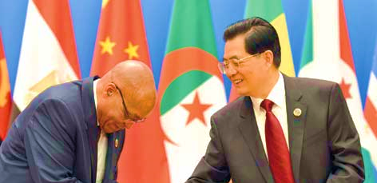
1. Context of the research
Increasing presence (Jackson et al., 2013; CCS, 2006)
Limited systematic research (Jackson et al., 2013, Park & Alden, 2013)
Mutually beneficial geopolitical relations (Jackson et al., 2013; Yong, 2012)
Manufacturing industry importance

Slide 4
1. Context of the research (cont.)
Human capital (Crook et al., 2003)
Humanisation of jobs (Dousti et al., 2012)
Profitably and productivity (Lau & May, 1998)
Improving quality of work life (QWL) (Nguyen & Nguyen, 2012; Crook et al., 2011; Lau & May, 1998)

Slide 5
2. Quality of work life
“Employee satisfaction with a variety of needs through resources, activities, and outcomes stemming from participation in the workplace” (Sirgy et al., 2001).
Behaviours and attitudes (Gelfand, Erez & Aycan, 2007; Raiger, 2005)
Framework

Slide 6
2. Quality of work life (cont.)
Diagram 1: A new measure of quality of work life based on need satisfaction and spillover theories
(Sirgy et al., 2001)

Slide 7
2. Quality of work life (cont.)
Multidimensional construct that may not be universal or eternal (Liu et al., 2005; Lau & May, 1998)
Form attitudes within cultural context (Zehir et al., 2011; Vagharseyyedin et al., 2011; Raiger, 2005)
Situational and Personal (Buitendach & Rothmann, 2009: 2; Sirgy et al., 2008)
Leadership style (LS) (Dousti et al., 2012; Zafer Acar, 2012; Harrison, 2005)

Slide 8
3. Leadership style
“Process by which a person influences followers to accomplish objectives and directs the organization in a way that makes it more cohesive and coherent” (Zafer Acar, 2012).
Highly influential (Kara et al., 2013; Nanjundeswaraswamy & Swamy, 2012; Stander & Rothmann, 2009; Harrison, 2005).
limited research regarding LS and the QWL.

Slide 9
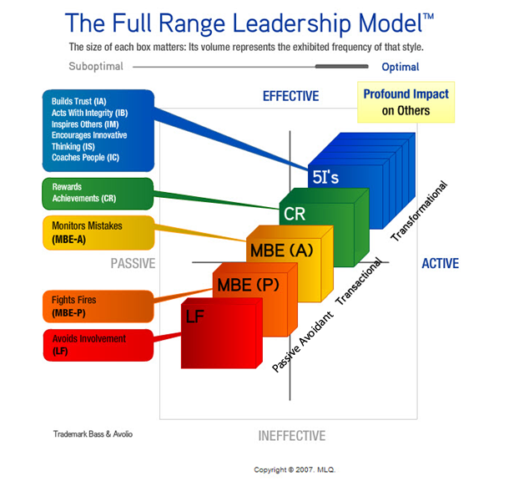
3. Leadership style (cont.)
Diagram 3: Bass & Avolio’s (1995, 2004) Full Range Leadership Model
(MLQ, 2008)

Slide 10
4. Goals of the research
QWL of managers and employees;
LS of managers;
Relationships between LS and QWL;
Relationships between QWL and selected biographical variables; and
Relationships between LS and selected biographical variables.

Slide 11
5. Conceptual diagram
a
b
c
e
d

Slide 12
6. Research design and methodology
Research paradigm
Positivistic (Sekaran, 2000)
Sampling
Assistance of the South Africa China Business Associations
Chinese subsidiaries or Chinese majority shareholding and a strong Chinese representation

Slide 13
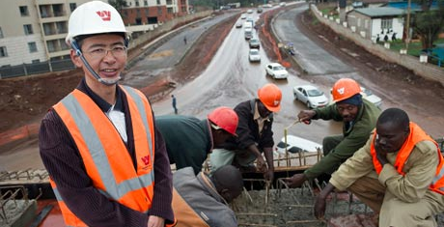
6. Research design and methodology (cont.)
Data collection
Questionnaire
Two measuring instruments, namely QWL and LS

Slide 14
6. Research design and methodology (cont.)
Research instruments
QWL:
Sirgy et al. (2001): A new measure of quality of work life based on need satisfaction and spill over theories
42 items, seven dimensions, four categories
7-point Likert scale
Valid and reliable (Kara et al., 2013; Sirgy et al., 2001)

Slide 15
6. Research design and methodology (cont.)
Research instruments
Leadership styles:
Bass and Avolio’s (1995, 2004) MLQ: Based on the Full Range Leadership Model
45 items, two versions
Reliable and valid (Hayward et al., 2008; Bass and Avolio, 1997)

Slide 16
6. Research design and methodology (cont.)
Data analysis
Collected and captured in STATISTICA (StatSoft Inc., 2011)
Patterns, relationships and errors
Descriptive and inferential analysis
Validity and reliability

Slide 17
The end
Thank you
Question and answer session
Research conducted under the auspices of and support by the Sandisa Imbewu Research project on “Chinese Organisations in Sub-Saharan Africa: New Dynamics, New Synergies” led by Prof. L. Louw.

