Slide 1
Gravitational Wave Astronomy
Nigel T. Bishop
Department of Mathematics
Rhodes University
Notes:
Since recorded history began, humankind has wondered about, and tried to understand, the Universe. Until about 400 years ago, the only tool available was the naked eye. In 1609 Galileo applied the new invention of the telescope to astronomy, and so opened a window to the cosmos. This window has been getting wider and clearer with every technological improvement. But always the medium bringing information about the Universe has been light, because radio waves, X-rays, gamma-rays etc. are light at different energies, or in other words different colours of light.
But that is changing. On 14 September 2015 we measured the first gravitational waves, and so opened a new window to the cosmos. And that window is very different to the one open to light in its various forms, because these are all emitted from the surface of an astronomical body. Gravitational waves are caused by the relative motion of matter, and as such are generated primarily in the deep interior of the body.

Slide 2
History
Einstein predicted GWs in 1916
Quadrupole formula, which relates GWs to matter sources, derived in 1918
Debate for the next 40 years about reality of GWs
Issue: In general relativity, there are no preferred coordinates

Slide 3
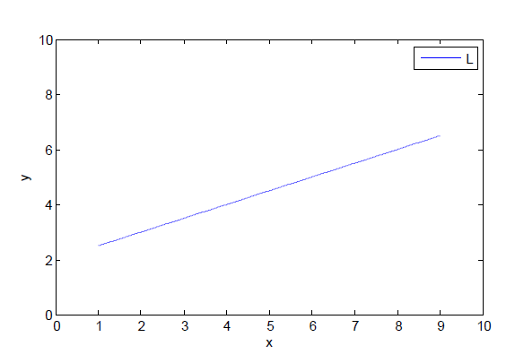
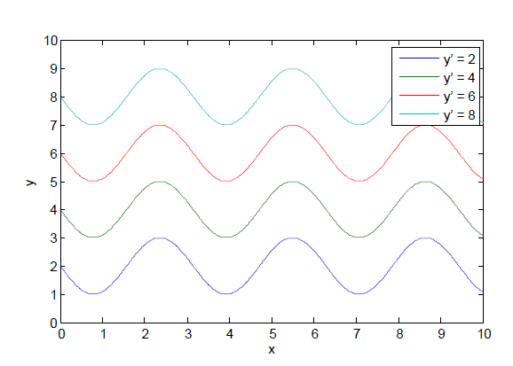
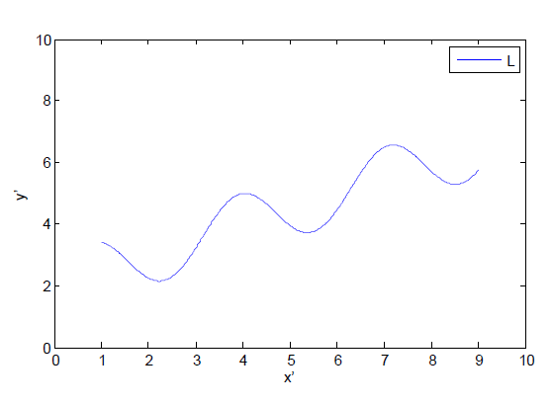
y → y’= y + sin (2x)
x → x’= x
B
A
B
A

Slide 4
1930s
Einstein concluded that GWs are not physically real, and submitted a paper to Physical Review
Referee said the paper was wrong
Einstein replied: We (Mr. Rosen and I) had sent you our manuscript for publication and had not authorized you to show it to specialists before it is printed. I see no reason to address the - in any case erroneous - comments of your anonymous expert. On the basis of this incident I prefer to publish the paper elsewhere

Slide 5
1930s
Einstein submits to Journal of the Franklin Institute
At proof stage, Einstein realized the error and corrects paper before publication

Slide 6

1950s
Wave-like solutions to the Einstein equations that are transverse to the direction of motion, cannot be transformed away
en.wikipedia.org

Slide 7
These waves can transfer energy to other matter: ring on a stick with friction (Feynman 1957)

Slide 8
How are GWs generated?
Einstein’s quadrupole formula: relative motion of matter
Efficient generators are very dense
  Neutron stars
  Black holes
and relative velocities are large
  Final stage of neutron star / black hole mergers

Slide 9
Earth
150 million km
Sun
Mass of Sun = 1 M = 2 x 10³⁰ kg= 1.5 km

Slide 10
Distant galaxy
Nearby star
1 pc = 3 x 10¹³ km
1 000 Mpc
Sun
8 000 pc
1 Mpc = 3 x 10¹⁹ km
Galactic centre
Nearby galaxy

Slide 11
Black hole
Neutron star
30 km
60 km and larger
Nothing, not even light,
can escape
Mass 1.4 M
Mass 10 M and larger
Supernova
remnant

Slide 12
Most galaxies contain a
supermassive black hole
Usually 10⁶ to 10⁷ M
Can be up to 10¹⁰ M
For our galaxy, it is 4 million M

Slide 13
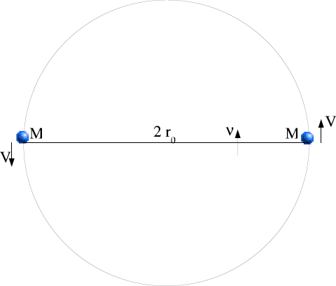
Generation of GWs
  Two equal mass stars in circular orbit
ω

Slide 14
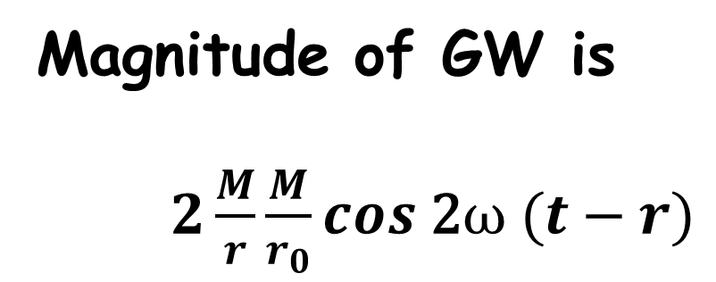
Magnitude of GW is
$2\frac{M}{r}\frac{M}{r_{0}}cos\text{ 2}ω (t−r)$
Twice orbital frequency
Less than 1, but maximized for 2 black holes at merger
Typical value of M is 10 M = 15 km
Typical values of r
  Nearby star 3 × 10¹³ km
  In our Galaxy 3 × 10¹⁷ km
  Neighbouring galaxy 3 × 10¹⁹ km

Slide 15
Observational evidence for GWs: PSR1913+16
Two neutron stars, each about 1.4 M, in eccentric orbit
Period of orbit: 7.75 hours
Period of pulsar: 59 ms
GW emission causes orbit to shrink, and period to decrease

Slide 16
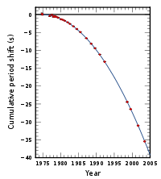
Weisberg and Taylor (2005)

Slide 17
Detection methods: Resonant bars
2 tonne aluminium cylinder,
cooled to 1°K ( ~ - 272°C )
v
v
1m
2m
Method pioneered by Joseph Weber in 1960s.
GW causes tidal distortion in the bar, leading to vibrations which are measured.

Slide 18
Detection methods: Pulsars
Pulsars are highly accurate clocks, beating at up to 10³ Hz
Measure received pulse times on Earth
Irregularity due to GWs
But pulsars can glitch, so requires data integrated over 5 to 10 years
An important task for SKA
Gravitational Wave Astronomy Group, Penn State, http://www.gwastro.org/for%20scientists/gravitational-waves-and-pulsar-timing-asia-earth

Slide 19
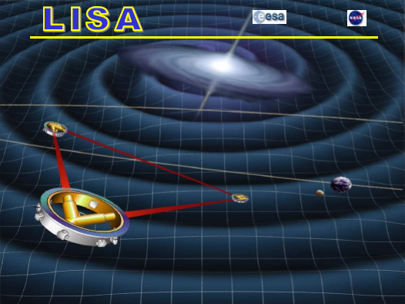
lisa.jpl.nasa.gov/gallery/lisa-waves.html
Mission delayed until at least 2028

Slide 20
Detection methods: LIGO
LIGO: Laser Interferometer Gravitational Observatory
First generation detectors, from 2001
  LIGO (Hanford, USA; 4 km)
  LIGO (Livingston, USA; 4 km)
  Virgo (Italy; 3 km)
  GEO (Germany; 0.6 km)

Slide 22
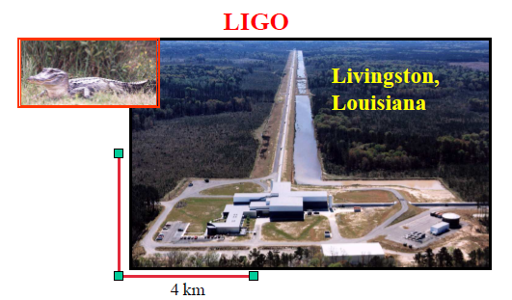
www.ligo.org

Slide 23
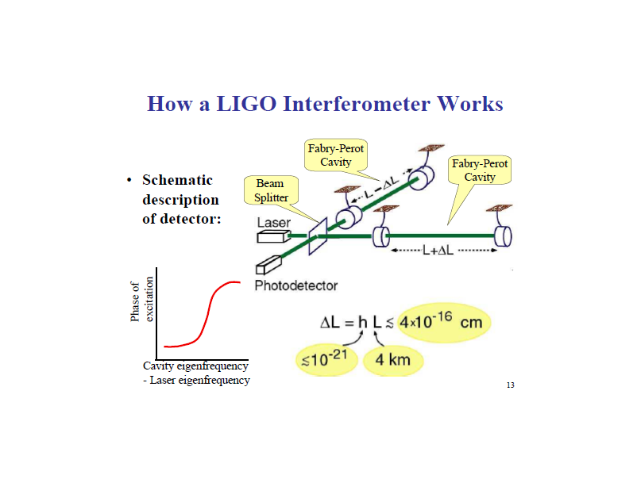
www.caltech.edu/~kip

Slide 24
Advanced LIGO detectors
Approved
  Hanford, USA, completed 2015
  Livingston, USA, completed 2015
  VIRGO, Pisa, Italy, completed 2017
  LCGT, Japan, completed 2019
  INDIGO, India, scheduled completion 2022
Locating a source in the sky, i.e. to do astronomy, requires at least three detectors to triangulate via timing.

Slide 25
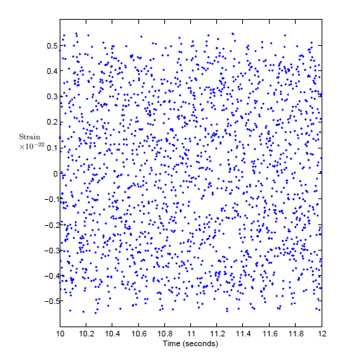

LIGO data analysis
Likely that signals will be masked by detector noise, and will be found later
Example: Does this data contain a sinusoidal signal at 10Hz?
$$a=\frac{2}{N}\sum_{i=1}^{N}{\sin\left(20πt_{i}\right)f(t_{i})}$$
$$=0.05$$

Slide 26
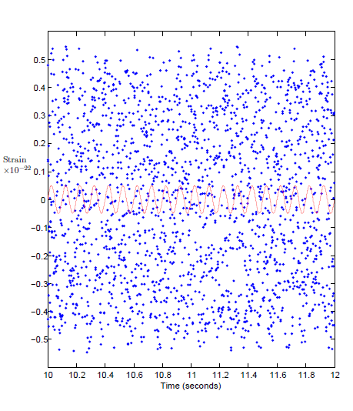
Even negative results can be useful:
Pulsar at centre of Crab nebula does not have a mountain higher than 1 metre

Slide 27
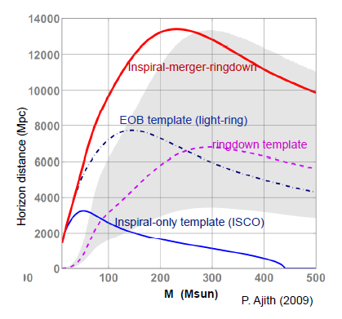

Slide 28
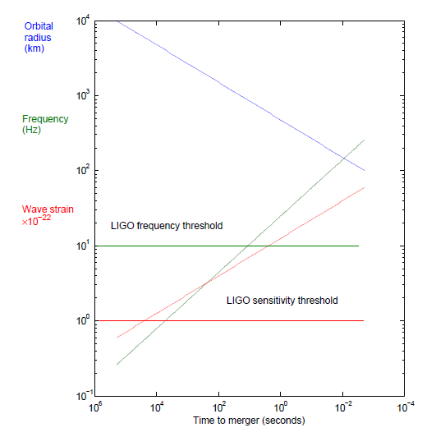
Last days of inspiral and merger of 2 black holes at 100 Mpc,
each 20 M
Limit of validity
of quadrupole
formula
Einstein’s quadrupole
formula assumes speeds
much less than that of
light, but this does not
apply just before merger
of compact objects
How do we calculate
the signal near merger,
when it is detectable?

Slide 29
Merger requires solution to full Einstein equations
Spacetime simulated by computer, but each run can take months
Simulation must be highly accurate

Slide 30
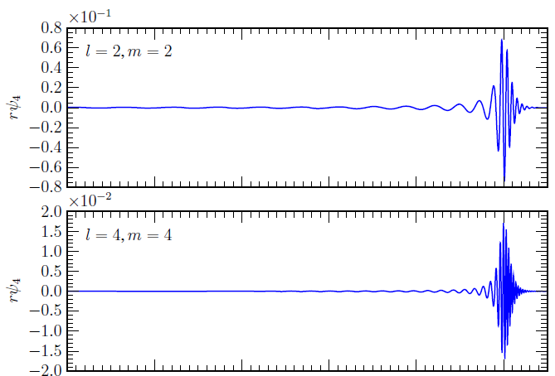
Example of a merger waveform (Reisswig, Bishop & Pollney 2010)

Slide 31
Video of merger of equal mass binary black holes (Max-Planck Institute for Gravitational Physics)
http://numarch.aei.mpg.de/numrel-webpages/movies/moving_punctures_AEI.mov

Slide 32
Video of black hole merger resulting in a kick (Rochester Institute of Technology) http://ccrg.rit.edu/movies/numerical-relativity/2-black-hole-merger-kick
  Kicks are usually about 300 km / s,
  but can be as large as 3 000 km /s, which would eject the remnant from its galaxy

Slide 33

Sound of GWs
LIGO is more like an ‘ear’ than an ‘eye’
Spinning neutron star
Supernova
Merger of two neutron stars
Merger of two 10 M black holes
Merger of two 50 M black holes
( http://www.black-holes.org/explore1.html and http://gmunu.mit.edu/sounds/comparable_sounds/comparable_sounds.html )

Slide 34
Astronomy
Merger rates: populations of black holes, neutron stars
Black hole / neutron star binary: Size, and so the composition, of a neutron star
Black hole mergers are standard sirens, so can measure the Hubble constant
Test GR and other alternative theories

Slide 35
and also …
Insights that only GW observations can provide
Gravitational wave propagation speed
And a view of hidden interiors
Gamma ray bursts, from compact object coalescence?
Supernovae: direct observations of the mechanism in the interior

Slide 36
LIGO in South Africa
Site selection study at Hartbeeshoek Radio Astronomy Observatory
  Flat topography
  Low seismicity
  Far from sources of noise or vibration

Slide 37
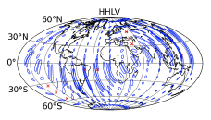
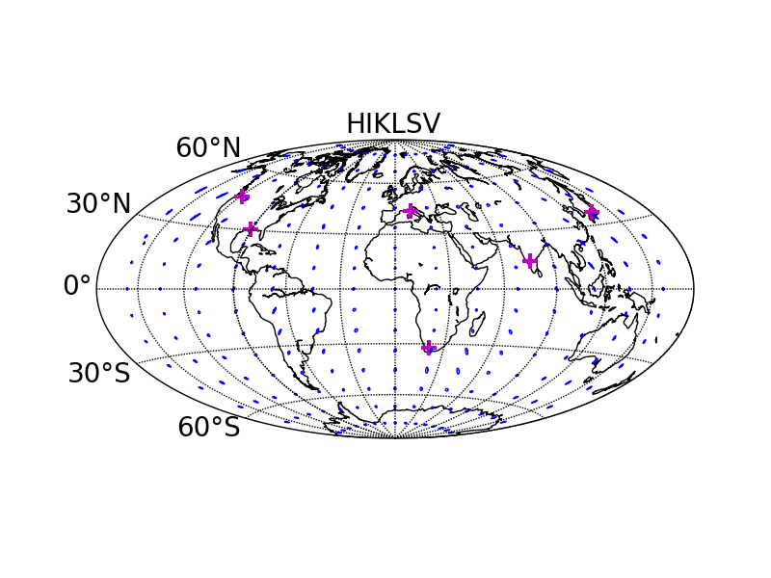
Source localisation: with and without
India, Japan, South Africa
S Fairhurst (2012)

Slide 38
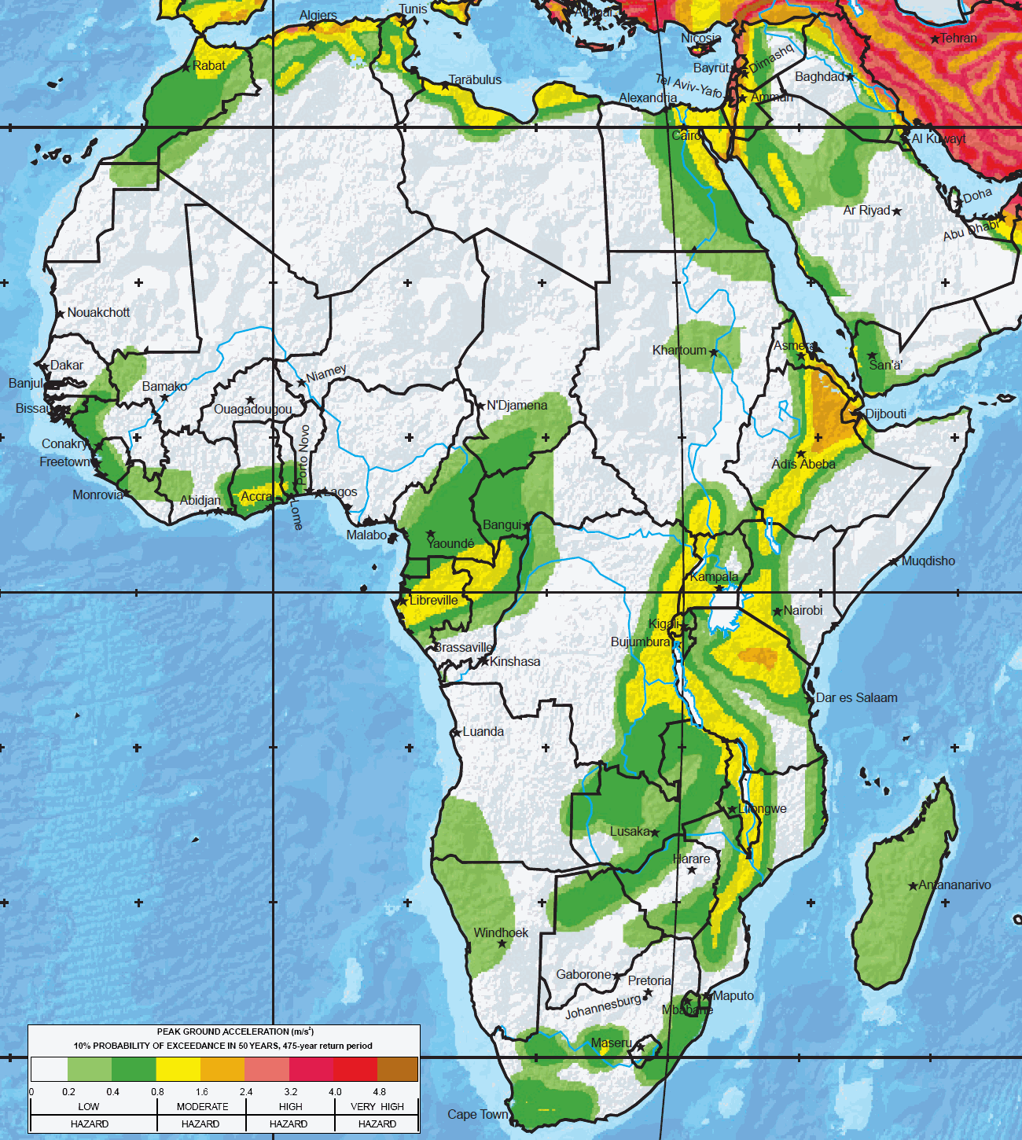
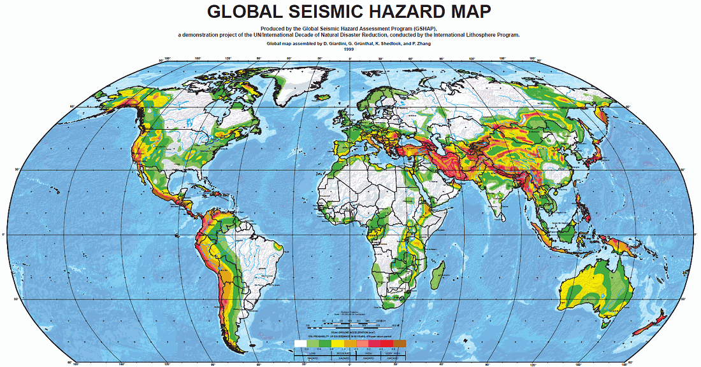
Seismic hazard map

Slide 39
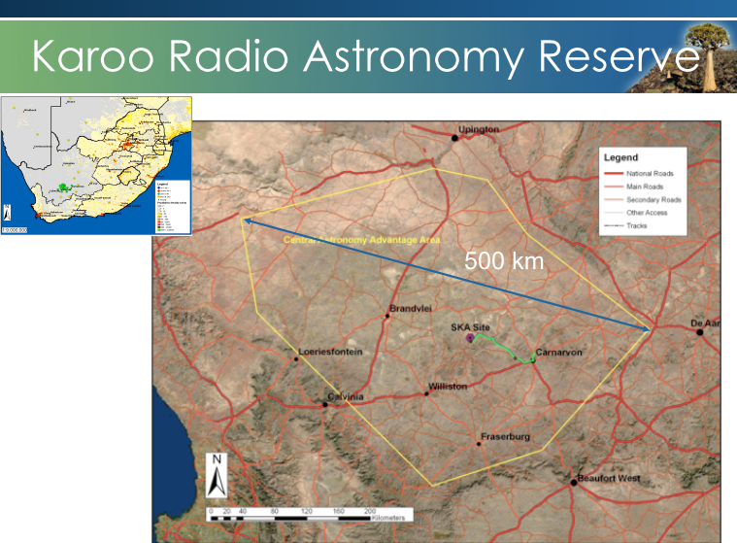
Protected zone preferred
AGAP zone
Source:SKA

Slide 40
GW150914 First GW event detected

Slide 42
Conclusion
What is the effect of GWs?
How can GWs be detected?
What causes GWs?
How can GWs be calculated?
What will GWs tell us about the cosmos?
Notes:
Here I would like to add something to the answers already given about properties of black holes, neutron stars, etc. Yes, we do expect to learn these things, but the history of astronomy has shown that the most exciting discovery resulting from a new technology is often something totally unanticipated. Galileo looked at the skies through a telescope not to find anything specific but out of curiosity. He made what was for that time an amazing and heretical discovery that Jupiter has moons, adding support to the Copernican idea that the Earth is not the centre of the Universe. So, perhaps the most important message that I would like to leave you with is …

Slide 43
Since we have a new window to the cosmos, expect…
The Unexpected!

Slide 44
Thank you!

