Slide 1
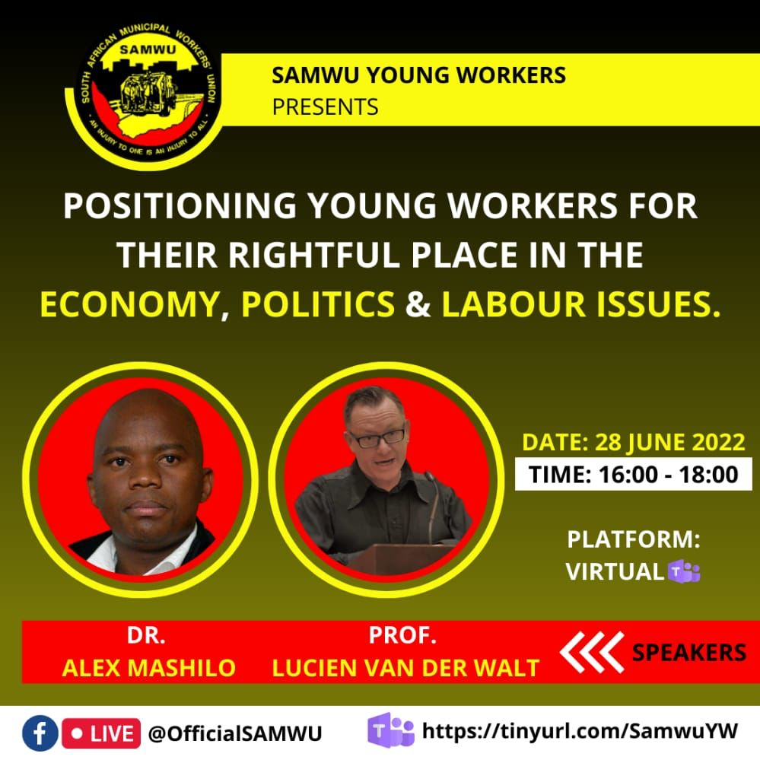
Positioning young workers for their rightful place in the economy politics &labour issues Prof Lucien van der Walt
Neil Aggett Labour Studies Unit (NALSU)
2022

Slide 2
1. Opening
COSATU “young workers forums”
Challenges
NALSU
l.vanderwalt@ru.ac.za

Slide 3
Unions matter
Largest, stable, formal civil society organisations (besides churches etc)
28% SA workforce
Southern Africa & North Africa have highest unionization rates (after Northern Europe)
Crucial to freedom struggle of (broad) working-class
Proven role in winning rights, wage gains, liberation struggles
Primary organisations of working-class majority

Slide 4
Unions & the long march of the working-class
Decades of struggle to:
Organise
Unite and level-up
Educate
Win gains
Shift wealth and power to working-class
The inter-generational character of unions
The surprising age of SAMWU

Slide 5
The importance of young workers to unions
The future of the workforce, unions, nation
New energy, experiences, ideas
Preventing discrimination

Slide 6
Challenges for youth and unions
Unions powerful despite attacks, erosion, internal issues
BUT losing “authority” in larger society, working-class
Old “pipeline” from youth activism to unions getting blocked
Mass unemployment: over 70% of youth
Social rupture between youth, past history of unions
The “patriotic history” of SA
The elevation of political parties
The search for a new Moses

Slide 7
The new-liberal world
Key parts: flexible labour, outsourcing, competition, job-hunting, poverty
The isolated “neo-liberal subject”
Politics of fear: crisis, short-termism, powerlessness, escapism
‘
Social decay in township, working-class communities, families
Weakening of social bonds, mass movements, associational life
Factionalism, intolerance, rage
“Woke” capitalism

Slide 8
Social media and info-wars
Advertising driven, censored, manipulated
The show: trending, “populist” shock, mobbing
“war journalism” and opinion-editorials
“Friends” and friends
The alienated consumer, not the organised people
“get rich or die trying”: the pretty picture
Imperialism and the news, ideas

Slide 9
The crisis of the left project
Widespread disillusion in politics, socialism, change
The collapse of the old state-centred models:
Anti-colonial nationalism e.g. Africa
Keynesian welfare state e.g. West Europe
“communism” e.g. USSR, Vietnam
It was not neo-liberalism that ended these ….
It was their crisis that opened the door to neo-liberalism

Slide 10
Current failure to have concrete, winnable projects
Capitulation to neo-liberalism e.g. Mbeki, Clinton, Deng
The rules have changed
Beating a dead horse
Crude identity politics not class solidarity
Lesser-evilism and “progressive capitalists”
The price of failure? Right-populism
Suffering working-classes
Eclipse of traditional formations: unions, parties, neighbourhoods
Left crisis
Johnson, Trump, Modi …
South Africa?

Slide 11
Restarting the long march
Rebuild and revitalise unions
Workers control
Organise the unorganised, don’t redivide the cake
Alternative mass media incl. social media, video
The working-class is not just (low-paid) workers
Rebuild union-community alliances
Service delivery
Whistle-blowing
Respect your neighbours

Slide 12
In unions and communities, (re)build
Anti-corruption politics
Solidarity and humanity
Interpersonal relations
End reliance on politicians, “big men”
Win-win actions
(bad ambulance example)
Foster associational life
Debate and political tolerance
Self-help e.g. policing, clean-ups

Slide 13
The big picture: a new society
Build capacities for self-governance
Organising democratically
Working-class autonomy from state, business, party system
Education:
Class consciousness
Social theory: what’s the problem?
Develop a popular counter-culture
Develop a popular counter-power

Slide 14
Build for a new society: from below
Mass job creation, reindustrialisation,
Not grants, “delivery,” dependence
Phase out the township system, education
Extend real working-class control over economy, society
Collectivise, democratically plan
State ownership? e.g. ESKOM
Private ownership? e.g. Lonmin

