Slide 1
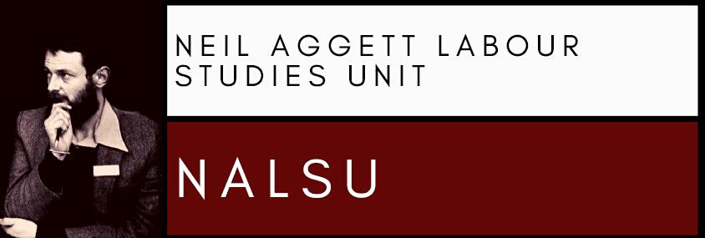
Radical Encounters: Christianity, Garveyism and Revolutionary Syndicalism in the ICU, 1919-1939 By Professor Lucien van der Walt l.vanderwalt@ru.ac.za
Neil Aggett Labour Studies Unit (NALSU)
25 August – 2022 – Labour Studies Seminar Series, Eden Grove 2, Rhodes University, Makhanda, South Africa

Slide 2
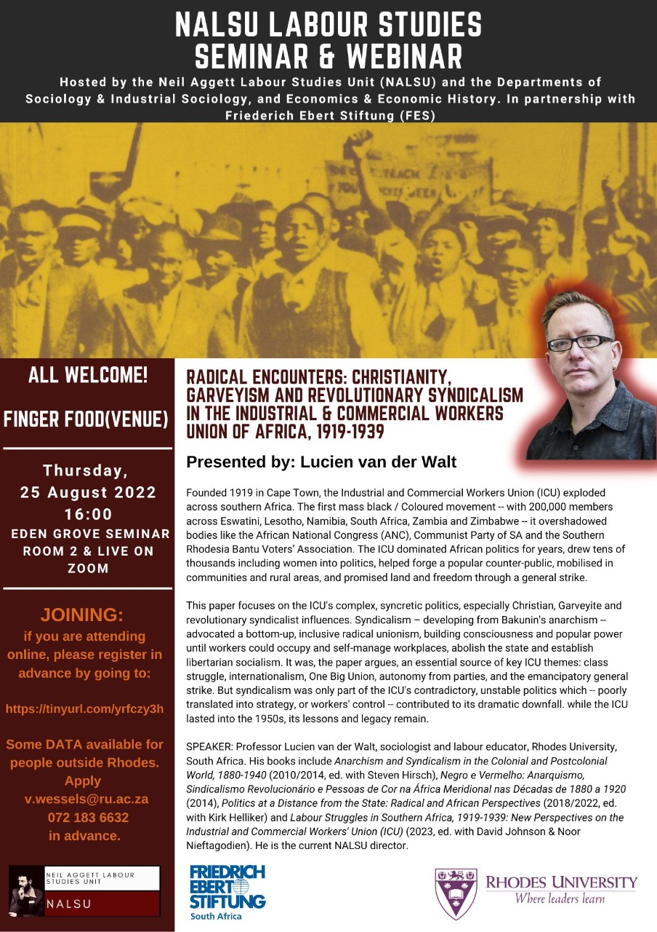
CITATION: Lucien van der Walt, 2022, “Radical Encounters: Christianity, Garveyism and Revolutionary Syndicalism in the Industrial & Commercial Workers Union of Africa, 1919-1939,” paper presented at Labour Studies Seminar Series: Neil Aggett Labour Studies Unit (NALSU), blended event (Eden Grove 2/ webinar), Rhodes University, Makhanda, South Africa, 25 August.

Slide 3
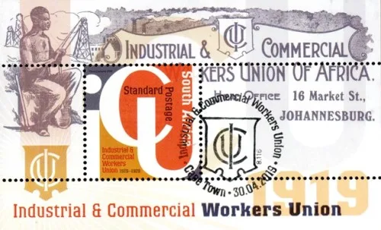
1. Introduction
ICU = Industrial & Commercial workers Union of Africa
Founded 1919, Cape Town
Spreads across 6 countries, lasts into the 1950s
Biggest black/ Coloured-based resistance (and union) movement of the era
Commemorative stamp for ICU centenary, South African Post Office, 2019

Slide 4
This seminar will discuss:
The context in which the ICU emerged
The size as well as regional dimension of the ICU
The importance of the ICU
The politics of the ICU esp. “revolutionary syndicalism”
What happened to the ICU?

Slide 5
2. Context: Capitalist revolution and empire
Before 1880s, most of what becomes SA is:
Isolated from world economy
Fragmented
Rural
Non-capitalist
Class-divided & quasi-feudal
inc. Afrikaner republics, black African states

Slide 6
Gold, steam and mielies: the capitalist revolution
1880s: massive foreign investment in Witwatersrand mines
Rise of world’s biggest gold industry
Witwatersrand produces 40% of world's gold (1913)
Mines soon centralised in 5 big “houses”
e.g. Wernher, Beit & Eckstein (“Corner House”)
“Houses” coordinated in Chamber of Mines

Slide 7
Rise of gold fosters:
Unprecedented urbanisation:
e.g. Cape Town: 45,000 (1875) to 170,000 (1904)
e.g. Johannesburg: 3,000 (1886) to 250,000 (1913)
= biggest, richest (ever) city in Africa south of equator
Rise of (locally owned) capitalist farming in interior
= feeding the cities
Some secondary industry e.g. cables, paint, metals
Electrification, railway and harbour expansion

Slide 8
Blood, iron and the British Empire
Wave of British conquests from 1880s
e.g. Pedi and Zulu empires (both 1879)
e.g. Afrikaner republics (1880-1881, 1899-1902)
e.g. end of Eastern Cape “frontier wars”(1877-1879)
“Union of SA” established in 1910
1909 Act of (British) parliament
Type of colony: self-governing “Dominion” (like Australia)
A racist state (franchise, laws, all-white parliament etc.)

Slide 9
New SA state establishes own banks, corporations
e.g. PIC (1911), Land Bank (1913)
e.g. SAR&H (Transnet) (1916), ESKOM (1923)
Like mining, these are highly centralised, monopolistic
From 1920s, SA state actively promotes
Basic industrial relations welfare
Promoting industry (protection, loans, cheap labour etc) through import-substitution

Slide 10
SA dominates southern Africa
Major investor e.g. Mozambique, Namibia, Zambia, Zimbabwe
Eswatini, Lesotho, parts of Mozambique: SA’s “labour reserves”
Namibia ruled by SA
Efforts made to formally “incorporate” Botswana, Eswatini, Lesotho, Namibia, Zimbabwe as additional provinces

Slide 11
3. Context: the divided working-class
SA example (the patterns in neighbouring colonies vary):
A highly centralised capitalism and state rest upon a vast, growing working-class
The growing urban workforce (1913, Witwatersrand):
195,000 black Africans on gold mines
43,000 in other jobs e.g. railways, warehouses
22,000 white workers on mines
15,000 in other jobs
The huge rural workforce (1920, national):
1 in 4 people in SA live in cities
i.e. 1,733,000 urban, out of 6,928,000 total

Slide 12
This growing working-class is fractured
(mainly Afrikaner) unskilled “poor whites” vs (mainly immigrant, “English”) white artisans
(mainly SA, black) township dwellers vs (hostel) rural “migrants”
Large-scale use of labour from southern African region
e.g. 49% black mine workforce are non-SA (1920)
e.g. black “Nyasa” (Malawian) clerks on mines

Slide 13
Basis of economy is cheap black labour
Racist laws e.g. pass system, exclusions in labour laws, coercive contracts
Racist practices: unequal wages etc
“Migrant’ labour system incl. from other countries
Job colour bar
“Maximum average system” (wage ceiling)
Farms

Slide 14
4. Born in a storm: the ICU
This growing working-class is militant
White workers form 1st unions in region
SA (1881)
Mozambique (1901)
Zimbabwe (1913)
Namibia (1914)
(Some) racially mixed unions in Cape, Mozambique
Black African-based unions start 1917, with Industrial Workers of Africa (IWA)

Slide 15
Massive strike wave across southern Africa, 1916-1924 (all races)
Angola: mass strike 1923
Mozambique: mass strikes 1917, 1920 and 1925-1926
Namibia: 1919-1920
South Africa
205 strikes from 1916-1922
1920: 46,000 black miners strike
1922: Rand Revolt – white workers’ armed revolt
Zimbabwe: 1919, 1921

Slide 16
ICU: founded in Cape Town:
Initial base: Coloured workers, esp. on docks
One of wave of new black, Coloured unions from 1917
1919: December docks strike, with :
ICU + (mainly black African) IWA
Backing by (mainly) white unions e.g. NURHAS on railways
1920: Bloemfontein congress of black, Coloured unions
IWA and others merge under ICU banner
ICU declares aim of “one great union south of Zambezi”

Slide 17
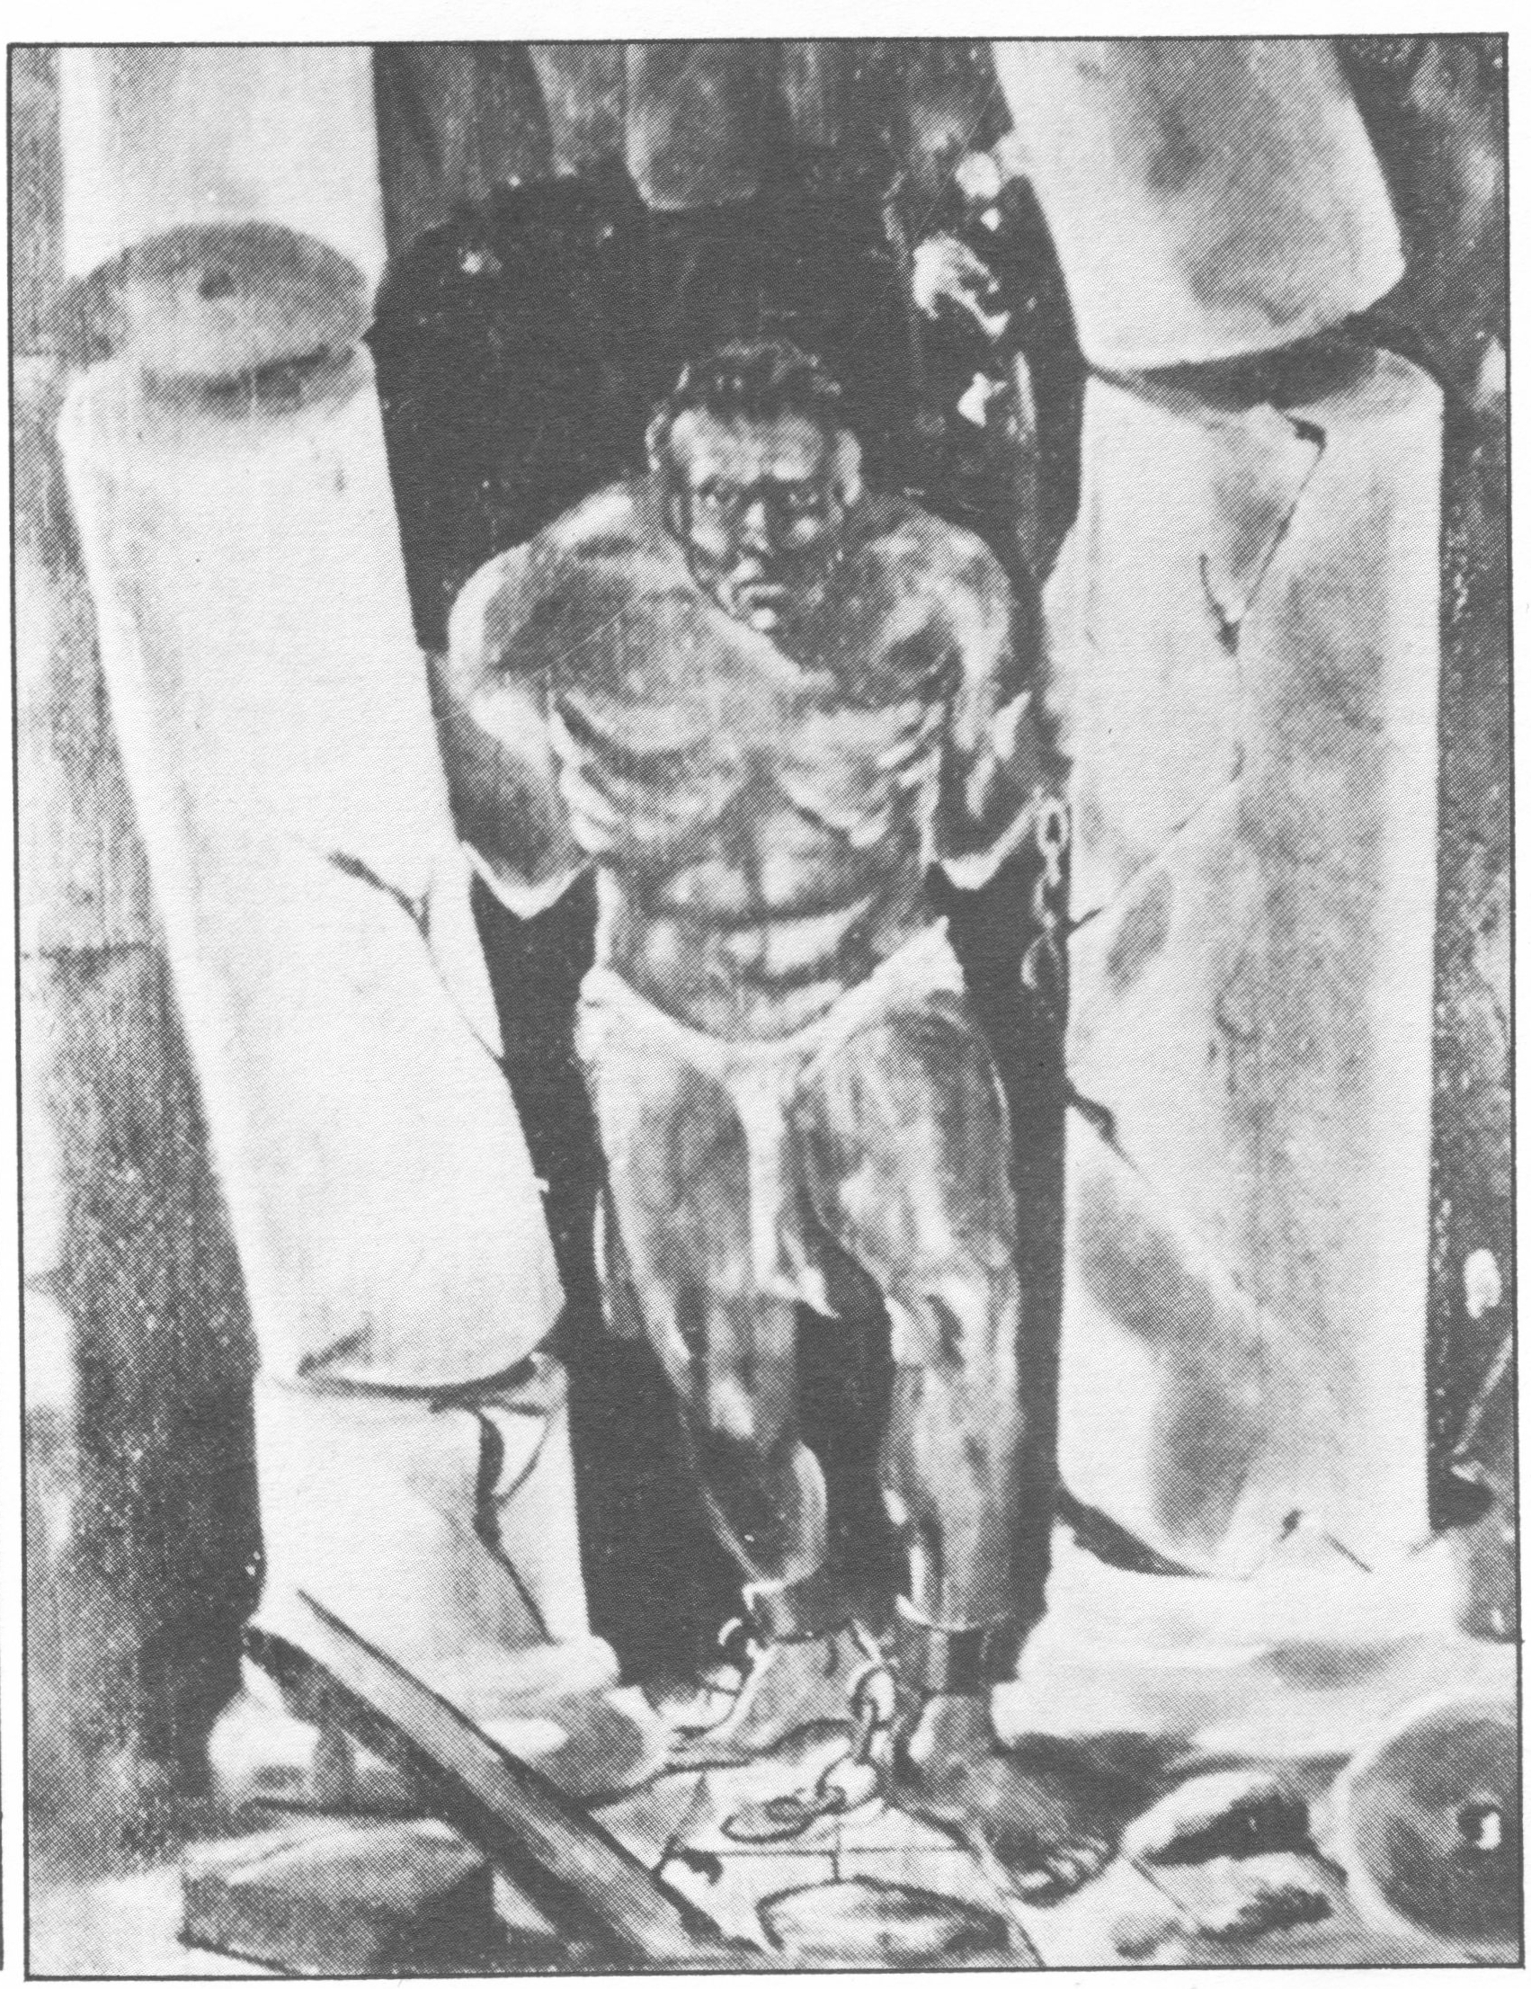
Portrait of Sampson, breaking the chains and bringing down the sinful: Johannesburg HQ of the ICU

Slide 18
Spread of ICU in South Africa
Before 1925: mainly in Cape province
From 1925: massive growth in interior, mainly black
Sections in most big cities
ICU “veld fire” in smaller towns, dorps, white-owned farms
e.g. more ICU members King Williams Town than Bloemfontein, Durban (1925)
Some presence in “native reserves”
(including some chiefs)

Slide 19
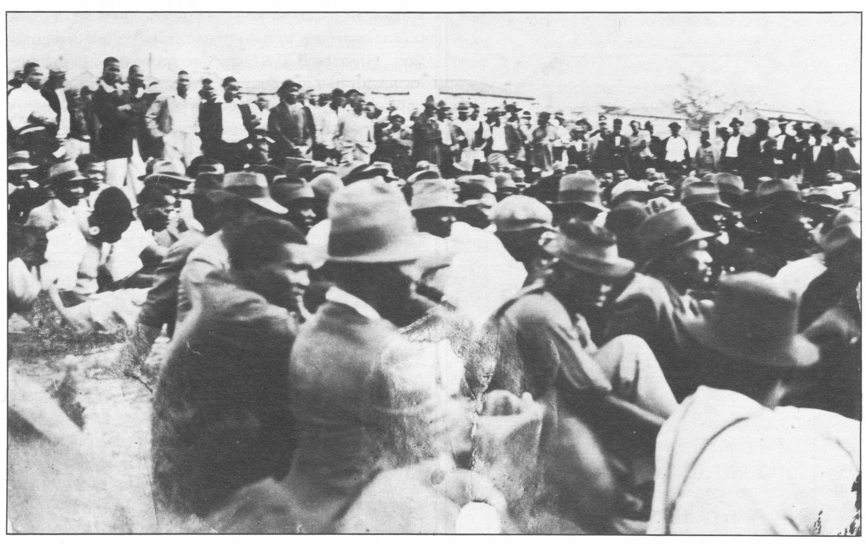
ICU
Mass meeting, ICU, South Africa, July 1929

Slide 20
Spread of ICU across southern Africa
1920: Namibia (South West Africa)
1927: Swaziland, Zimbabwe
1928: Lesotho
1931: Zambia
In 1927, ICU in SA (alone) claims 100,000 members
Actual figure over 200,000
(mainly white) SA Trade Union Congress: 35,000 (1927)
Communist Party of SA (1929): 3,000
ANC (before 1940s): 4,000
Marcus Garvey’s UNIA: 300,000 enrolled (worldwide)

Slide 21
The rise of the ICU reflects
The growth and centralisation of the black and Coloured working-class
Big employers e.g. government docks, diamond fields
Segregated neighbourhoods, hostels
Massive changes on white-farms:
tenants are pushed into wage labour, or evicted
A broader mood of militancy and hope
An ability to connect up to workplace and township issues
An ability to connect politics to a wide range of oppressed groups e.g. black women

Slide 22
Some of its significance:
Biggest black / Coloured revolt in region before 1940s
Biggest union movement for decades
Pioneered mass black/ Coloured “non-racial” unionism
Massive, unmatched rural base esp. SA, Zimbabwe
Regional form:
six countries, common issues
“globalisation from below”
Minimum wage for region (Henry Dee)
Radical: anti-capitalist, anti-imperialist, anti-racist

Slide 23
4. Looking at the politics of the ICU
ICU politics were an unstable mixture, drawing on different sources
Often contradictory
e.g. international working-class unity vs black, cross-class solidarity
“One Big Union” across race, borders, trying to ally with white unions
vs
“Africa for the Africans,” “the black man triumphs over the white man"
e.g. revolution vs moderation
“If other workers were freed by revolution they in South Africa must also adopt that course”
vs
Communists are “political murderers“ – ICU will "constitutionally overthrow capitalism“

Slide 24
e.g. repeated anti-party stance vs unusual alliances
“…this Organisation resolves unreservedly to dissociate itself from any political body whatever”
vs
Campaigning for the National Party, aid from D.F. Malan and J.B.M. Hertzog in 1924 elections
Changed over time, by place, speaker

Slide 25
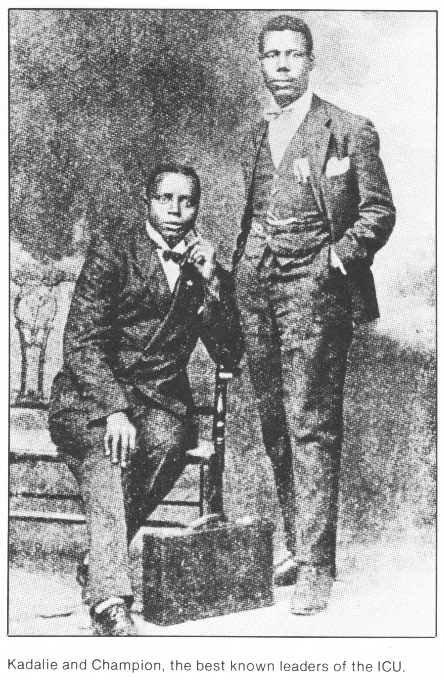
Clements Kadalie and A.W.G. Champion of the ICU in South Africa

Slide 26
Unsurprisingly, the ICU was also a mish-mash:
Mass rallies & promising an emancipatory general strike
Daily activity centred on court cases, lobbying
Land purchase and business schemes
Rumours and hopes
e.g. that Christmas Day 1927, ICU will take over white-owned farms

Slide 27
To understand the ICU’s politics, it is useful to suggest:
ICU politics were more than the sum of their parts
Reworked, blended themes: not passive
Adapted ideas to contexts, local idioms, concerns
Instability was a defining feature
ICU politics were “syncretic”
Merged and changed originally discrete traditions
Created something new, unique

Slide 28
There were numerous influences: I will look at just 3
Christianity: ICU used Christian themes and universalism
“Christ, when he lived on earth, challenged the existing order, and as the greatest agitator known to mankind, he became the victim of the rulers of the Jews"
“… the real object” of the ICU call for workers to run industry, “is an attempt to put into modern language the teachings of Christ, namely ‘Love thy neighbour as thyself’ … by ‘Doing unto others as ye would they should do unto you’”
Many ICU members and leaders were Christians

Slide 29
Garveyism:
ICU sections drew on Garvey’s messianic pan-Africanist movement: “Africa for the Africans”
“Africa shall be restored to us even if it be by blood“
“… a new and powerful race of people is to come shortly out of the sea, and an end will then be made of all tyranny and wrong”
“Ama Melika ayeza” (“the Americans are coming”)
There was some overlap between parts of the UNIA and ICU in 1920s Namibia, SA and Zimbabwe
Garveyism directly influenced ICU business schemes

Slide 30
Revolutionary syndicalism:
Comes from Bakuninist anarchism, not Marxism
Widespread (globally) into the early 1930s
SA influences include IWA, early left, parts of early Communist Party of SA
Core ideas
Political parties are dishonest, divisive, futile, bourgeois
The state, including elections, represents the ruling class

Slide 31
Build democratic, inclusive mass unions, across borders:
Accumulate power to resist, based on direct action, not courts, parties, elections
Build popular consciousness, education (political & technical)
Develop organisational structures, democratic experience
Fight on all issues affecting working-class
Seize means of production through a general strike
Run economy through unions, not state

Slide 32
Revolutionary syndicalism: a direct influence on ICU
“…we will give you a damned good lesson, by putting a stop to all your railways, mines and harbours and domestic services; then you may do without us”
The One Big Union would “assist in abolishing the Capitalist Class, who were in reality only a small body but owned practically everything”
“…our … definite objective is complete control of industry to those who work industries and the land to those who work the land”

Slide 33
The ICU is an "an industrial organisation" that aims at "industrial and political democracy by and through the emancipation … of the African worker," a "co-operative commonwealth," "nothing more and nothing less…” (The Truth About the ICU, 1927)
“… between the two classes, a struggle must always obtain about the division of the products of human labour, until the workers through their industrial organisations take from the capitalist class the means of production, to be owned and controlled by the workers for the benefit of all …” (1925 ICU constitution)

Slide 34
Syndicalist influences help explain the ICU’s:
Anti-capitalism and distance from parties
“One Big Union” vision
Expansive view of unionism
Transnational operations
Vision of emancipatory general strike
Aspirations for taking over farms (and factories)

Slide 35
5. Why were ICU links to syndicalism ignored in many studies?
Early commentary on ICU stressed these influences:
“… the natives … have adopted as their model in forming a union one of the most extreme and revolutionary types of union that exists in the world … the syndicalist union … more political than industrial"
(Harry Sampson, SA Labour Party, 1928, in parliament)
The ICU demonstrated "pronounced anarcho-syndicalist tendencies”
(Albert Nzula, Communist Party of SA, 1934, in the Negro Worker)

Slide 36
Syndicalist influence largely ignored in studies from 1960s
Why?
A heavy focus on the (empty) question of whether ICU was a “movement,” “party” or “union”
BUT ICU was simply a mass union, that was highly political
2. The effort to present ICU as a nationalist movement
BUT it was much more complicated

Slide 37
3. The global decline of syndicalism:
Unfamiliar to many later scholars/ caricatured in debates
Led to tendency to conflate the radical left with Marxism
And to conflation of left influences on ICU with CPSA influence
Also assumed that early CPSA was solidly Marxist-Leninist

Slide 38
3. Over-reliance on Communist Party-linked interpretations of
ICU
e.g. Andrews, Roux, Simons.
These date ICU leftism to entry of party into ICU (1924)
They claim ICU became “right-wing” after expelling party (1926)

Slide 39
BUT
Left incl. syndicalist influences on ICU precede 1924
SA had a large syndicalist milieu before the Communist Party of SA of 1921 (including the IWA)
Many CPSA founders had a syndicalist background, & “syndicalist concepts remained within the Communist Party for many years after its foundation”
(Lerumo, Fifty Fighting Years, official history of party)
ICU’s politics barely changed after the communists were expelled

Slide 40
6. Four conclusions
1. We cannot read ICU story off the story of the ICU in
SA
The ICU started to collapse in SA in late 1920s
BUT
It grew in Zimbabwe into 1930s, and was revived in 1940s
It first emerged in Zambia 1931

Slide 41
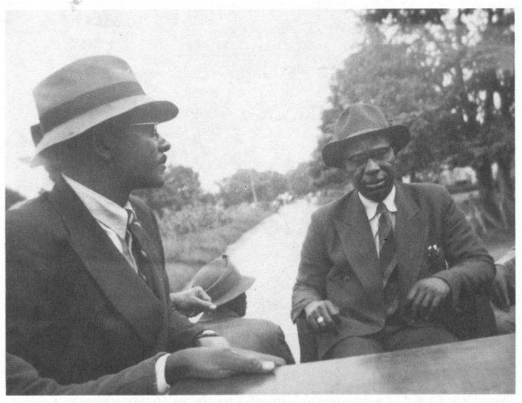
The ICU in Zimbabwe: Solomon Maviyane and Charles Mzingeli, 1952

Slide 42
2. The ICU cannot be understood without syndicalism
3. The ICU was not a syndicalist union
It was one of a number of politically syncretic movements that drew on syndicalism, or anarchism.
The first Zapatismo (Mexico, 1910s +)
The Ghadar Party (India, Kenya, USA, 1910s+)
The original Sandinistas (Nicaragua, 1920s +)

Slide 43
4. Diversity is not always strength
The ICU’s politics mitigated against clear strategy including for a general strike
The ICU leaned instead into promises, charisma
The ICU reliance on rallies led to limited workers’ control
This opened door to
corruption, splits
many rumours and millenarianism
disillusion as high hopes were dashed

Slide 44
Sources:
All sources for quotes from ICU available on request from l.vanderwalt@ru.ac.za
The paper on which this talk was based will appear in a forthcoming book

