Slide 1
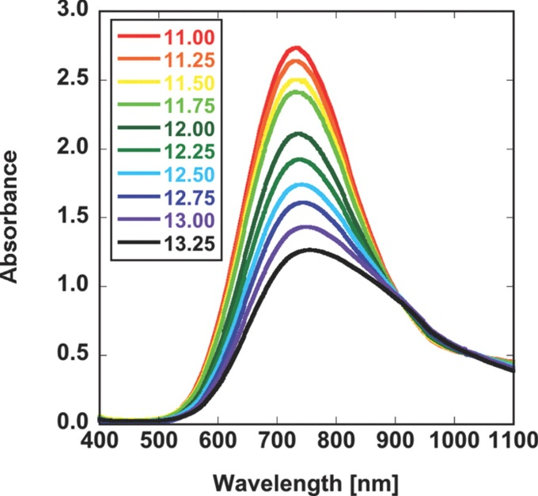
Solid State UV Spectroscopy
Nobuhle Ndebele

Slide 2
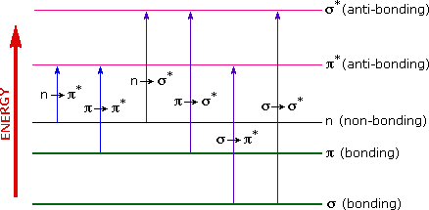
Introduction
Analytical technique used to:
  Prove the formation of complexes
  Identify if charge transfer reactions take place
Based on the molecules ability to absorb ultraviolet light
When a molecule absorbs light (energy) it is promoted to a higher energy state (HOMO to LUMO)
Pavia, D.L., Lampman, G.M and Kritz, G.S. Introduction to Spectroscopy, A Guide for Students of Organic Chemistry, 2nd ed.

Slide 3
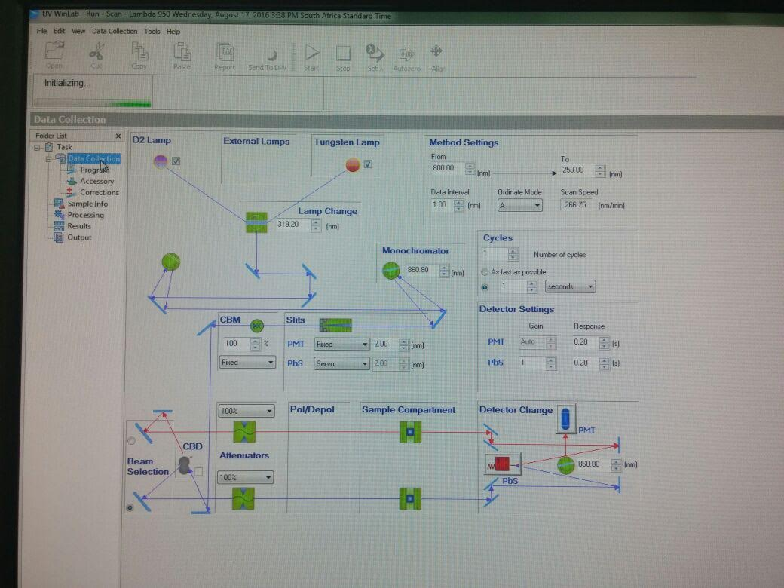
Instrumentation
Main components of a UV spectrophotometer:
  Light source
  Monochromator
  Detector

Slide 4
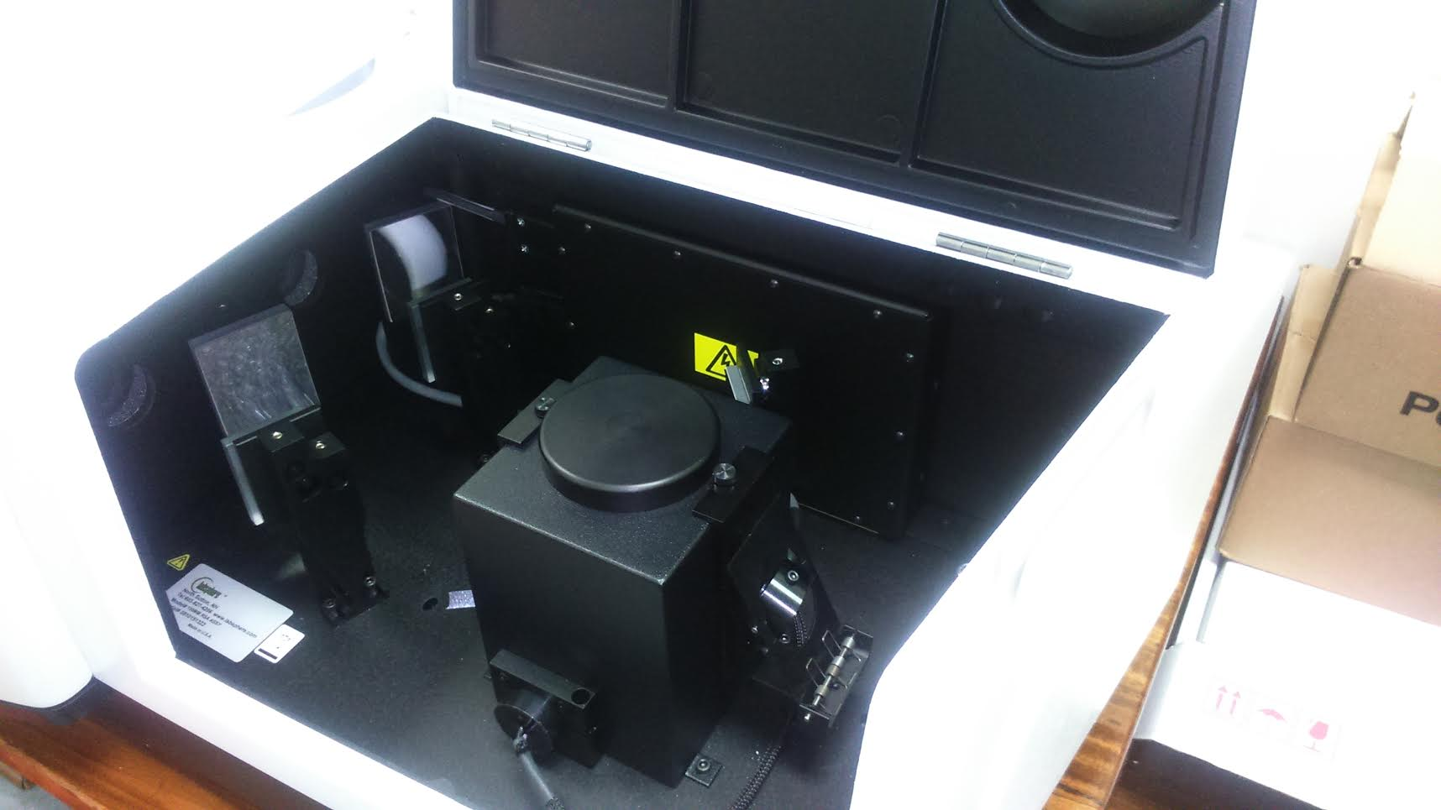
Instrumentation

Slide 5
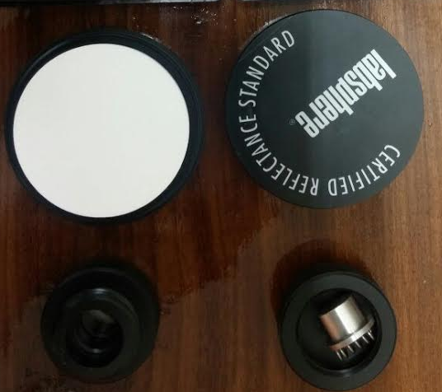
Sample Preparation
Reference
  Transparent, diluent solids that do not absorb radiation in the same region as the complex
  Calibrates the spectra
    e.g. KBr, NaCl, Cs or reference standard, whiteboard.
Sample
  Fine powder

Slide 6
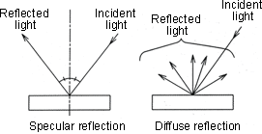
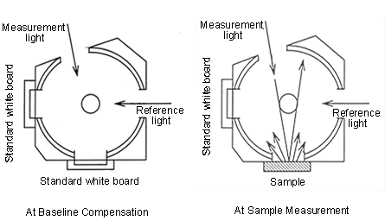
Mode of Operation
Measures reflectance
  Total reflectance or diffuse reflectance based on light used

Slide 7
Spectra

Slide 8
Acknowledgements
Dist Prof. T Nyokong
Dr Ngoyi
Donavan
Azole
S22 Colleagues

