Slide 1
STUDENT CONDUCT IN DINING HALLS
&
SUB-WARDENS DUTIES
STUDENTS LEADERSHIP TRAINING 2022
PRESENTER: Charmaine avery and rouxle hattingh

Slide 2
OVERVIEW
Food services is an in-house operated catering facility and our core function is to provide support to academic activities to both students and staff by providing quality nutritional well balanced meals in a safe, hygienic and hospitable environment.
“Home away from Home”

Slide 3

FOOD SERVICE DEPARTMENT AND THE TEAM
We have 10 kitchens around campus
Team of 198 staff member including managers, caterers and food service staff.
Caterers are responsible for daily operations in the units.

Slide 4





Menus
We have a two week /14 days cycle menu.
Offer five (5) diets daily ( Fast food option incorporated into the default option)
  Default
  African
  Halaal
  Vegetarian
  Health platter
140 meal options that students can select from in the two week/14 day cycle.
Provide 10500 meals a day
Cater to special diets with specific dietary requirement and needs - presentation of a medical certificate.

Slide 5
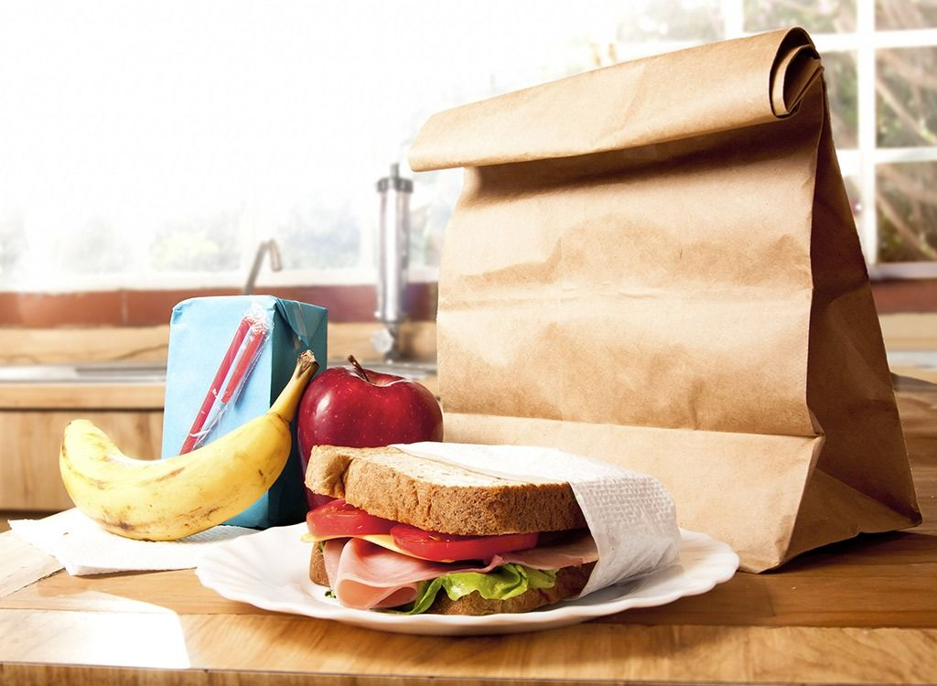
MEAL BOOKING SYSTEM
AND DAILY PROVISION
MEALS BOOKED 48HRS IN AVDANCE
DAILY PROVISION = DAILY COST PER PERSON
PACKED MEALS
SUPPLEMENTARY PACKED MEALS

Slide 6

DINING HALL RULES
NO BOOKED MEAL = NO ENTRY.
CUTLERY AND CROCKERY MAY NOT BE REMOVED FROM THE DINING HALL.
STUDENTS MAY NOT TAKE FOOD OUT OF THE DH EXCEPT FRUIT AND 2 SLICES OF BREAD.
NO MEALS SERVED IN ROOMS, EXCEPTION OF SICK/INJURED STUDENTS.
NO ALCOHOL OR SMOKING IN THE DINING HALLS.
NO SHARING OF MEALS.
RESPECT TO STAFF AND FELLOW STUDENTS IN THE HALLS AT ALL TIMES.
INDIVIDUAL DINING HALL RULES

Slide 7


COVID-19 REGULATIONS IN DINING FACILITIES
NO MASK NO ENTRY.
SANITISER DISPENSERS AT ENTRANCES AND MEAL SYSTEM BIOMETRIC MACHINES– 70% ALCOHOL.
ADHERENCE TO SOCIAL DISTANCING PRTOTOCOLS.
  FLOOR MARKERS ALLOWING 2M INTERVALS FOR QUES
  50 STUDENTS/STAFF
  5 STUDENTS PER TABLE

Slide 8

COMPLAINTS MANAGEMENT
Complaints may be addressed with the kitchen supervisor on duty.
Complaints book.
Food rep meetings.
ROSS.
“FOR EVERY PROBLEM ,THERE IS ALWAYS A SOLUTION”

Slide 9

THE END

