Slide 1

Introduction:
Fire Safety
Safety, Health & Environmental Office

Slide 2
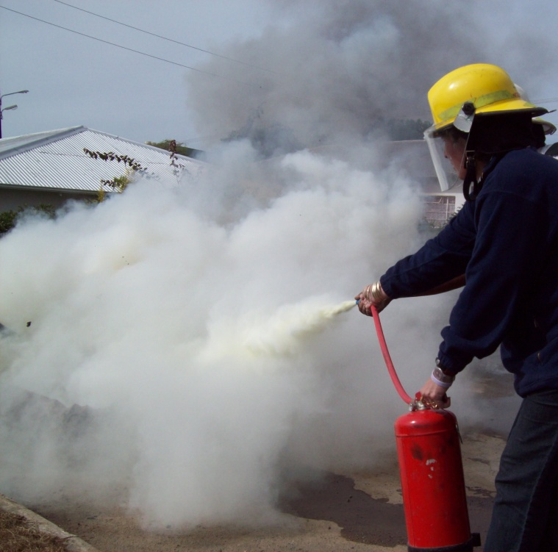

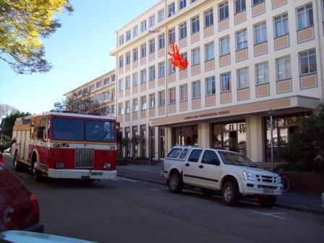
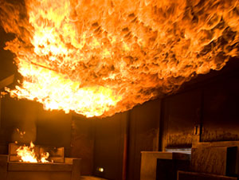
Put out
What if?
Get out
Best:
PREVENT FIRE!

Slide 3

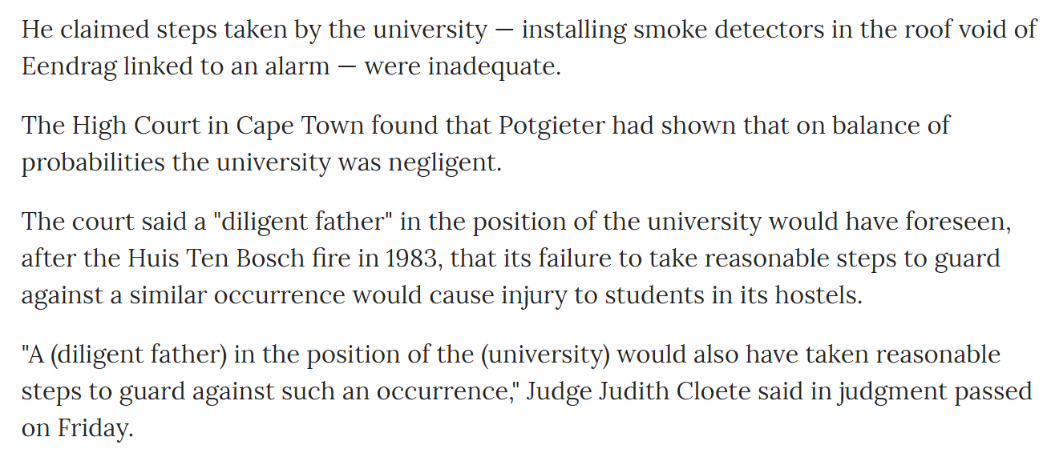
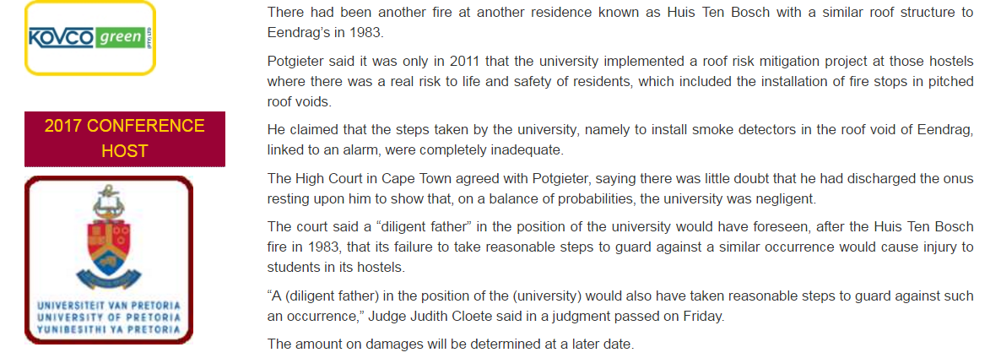

Slide 4

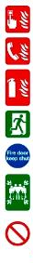
Emergencies – what to do
In the event of a fire or other emergency, think of the four golden rules:
Alarm: Raise the alarm to alert others – scream, whistle, push alarm, shout FIRE!
Emergency Services: Call no matter how small. Save on your cell phone. CPU Emergency 8999 | Makana Fire & Rescue 046 622 4444
Extinguish: Only try to extinguish if safe.
Evacuate: Everyone must get out; if necessary, crawl to avoid smoke/
heat suffocation.
Close windows and doors if you can, and help people with disabilities.
Meet at Assembly Point for roll call.
Don’t take risks: do NOT use lifts, do NOT open closed doors (there may be fire in room), do NOT go back inside – until instructed by Makana Fire Officer or by
Emergency Coordinator

Slide 5

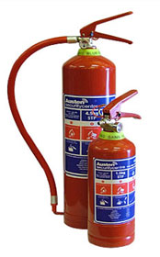
Be Responsible – ANYWHERE!
YOU need to know YOUR exit routes!
Work it out:
  How many steps / doors to the nearest exit…
  going LEFT?
  going RIGHT?
  Where is the nearest FIRE EXTINGUISHER?

Slide 6

Chemistry of Fire
Triangle of combustion:
  to start & keep burning …
  a fire needs fuel + oxygen + heat
How fire spreads:
  Direct flame – direct contact
  Conduction – heat moves through solid matter
  Radiation – heat given off, no direct contact
  Convection – heat moves through air!!!

Slide 7
Flashover
Heat moves through air by convection
build-up of smoke & heat
superheated thermal layer spreads
(heating the air in the whole building)
Building bursts into flame!
A fire fighter’s greatest fear!!

Slide 8
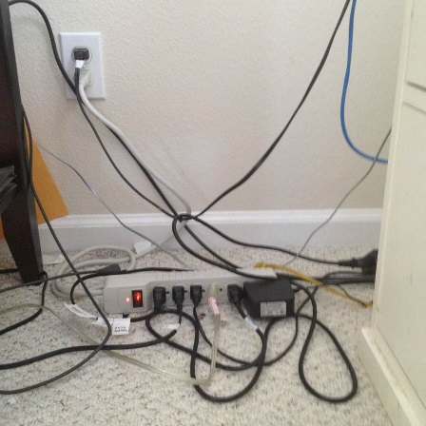
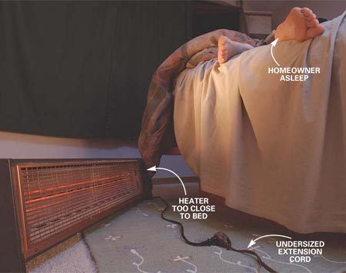
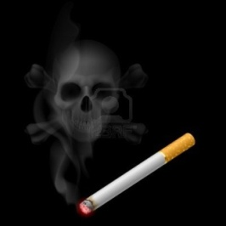
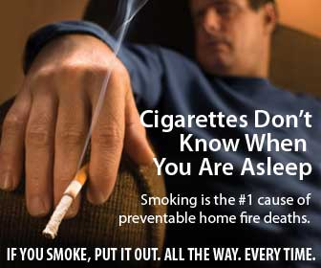

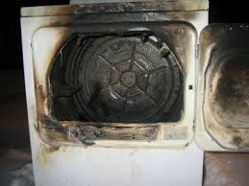
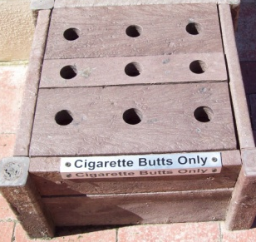
How Fires Start
Electrical equipment
  Electrical cords, heaters,
Smoking
  tumble driers, irons, etc

Slide 9
How Fires Start
Cause: Faulty switch → bread in toaster burned and caught fire.
Cause: paper lampshade & light bulb wattage too high → over-heating → lampshade caught fire.
Cause: Incorrect battery fitted to laptop.

Slide 10
Preventing Fire
Electrical - ensure:
  Wall sockets/multi-plugs NOT overloaded
  Appliances switched OFF when not in use
  Power point switched OFF BEFORE plugging/ unplugging
  CHECK wiring/appliances for damage - REPAIR or replace ASAP
  Cables/extension cords NOT run under carpets or across doorways/passages

Slide 11
Preventing Fire
Electrical - ensure:
  Extension cords NOT in permanent use.
  Extension cords NOT used in wet areas
  Extension cords have 3 pin plugs (2 pin - not earthed)
  Heaters/lamps NOT close to things that can burn
  Use bulbs that match the lamp's recommended wattage
  Appliances must have ‘breathing space’ (or they can overheat).
  NO candles/cigarettes/open flames in res. Dispose of butts in bins.

Slide 12
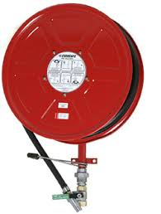
Controlling Fire
Most extinguishers at RU :
  DRY POWDER: for all types of fire - A/B/C/D
  FIRE HOSES: only good for solids - A

Slide 13
Controlling Fire
Remove one or more:
  fuel / oxygen / heat
Only attempt to extinguish a fire IF:
  It is small and not spreading
  You know how to use the fire extinguisher
  You have a SAFE EXIT behind you
  (so you can turn and get out quickly and safely!)

Slide 14
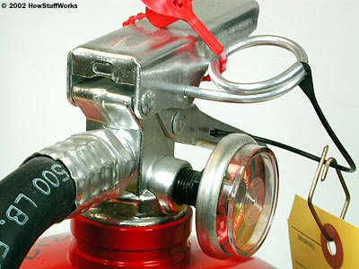

How to Use a Fire Extinguisher
Think P.A.S.S.
  P – Pull the pin
  A – Aim the nozzle at base of fire
  S – Squeeze the trigger
  S – Sweep the nozzle from side to side
Safety pin prevents us squeezing the trigger accidentally.

Slide 15
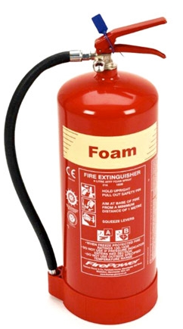
Know the Types of Fire
A. SOLIDS: ordinary solid flammable material e.g. wood, paper, coal, fabrics, plastic
  Extinguish with WATER
  or dry powder or foam

Slide 16

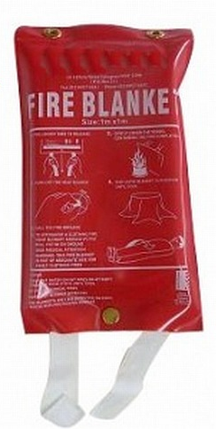

Know the Types of Fire
B. LIQUID/GAS: flammable liquids & gases e.g. petrol, paraffin, alcohol, oil, benzene
Extinguish with DRY POWDER
or fire blanket / CO2 / foam

Slide 17
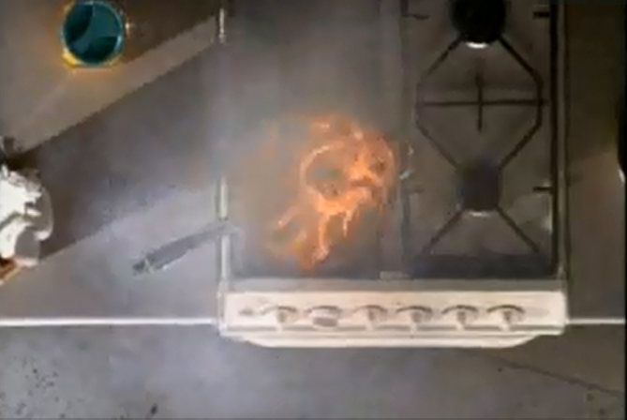
Know the Types of Fire
Cooking Oil Fire (Type B: flammable liquid/gas
  www.dailymotion.com/video/xby8hp_how-to-put-out-a-kitchen-fire-greas_school

Slide 18
Know the Types of Fire
C. ELECTRICAL: involves live electricity e.g. overheated portable electrical equipment, overloaded electrical cables, short circuits
Extinguish with CO2
or dry powder

Slide 19
Know the Types of Fire
D. METAL: involves combustible metals e.g. magnesium, titanium (used in lightweight equipment), lithium (batteries)
Extinguish with DRY POWDER

Slide 20
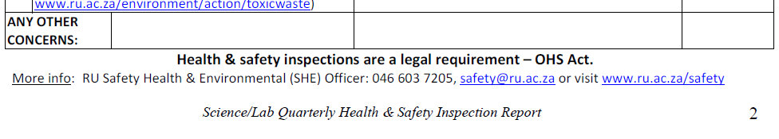
Importance of Inspections!

Slide 21
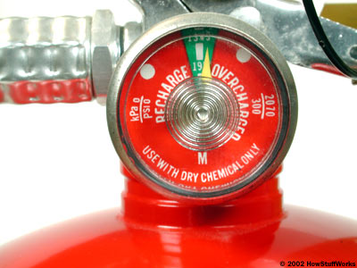
Importance of Inspections!
Check:
  Fire alarms
  Emergency exits & exit routes
  Fire fighting equipment
  Safe use of electrical appliances
  e.g. kettles, ironing, heaters, etc.
Report:
  Problems with any of the above
  Any (potential) fire hazards
NB: It is against the law to use safety equipment – such as fire extinguishers – for anything other than its intended purpose. If found guilty, you could be fined up to R50,000.

Slide 22
Importance of Fire Drills!
www.ru.ac.za/safety/fire/firedrills
Practice SAFE evacuation
3 minutes

Slide 23
Fire Safety Info www.ru.ac.za/safety/fire
Intro to Fire Safety PPT presentation
Health and Safety Training Materials‌ Part 7: FIRE SAFETY
Evacuation: Guidelines on emergency evacuation procedures
Extinguishers: Info on fire extinguishers and fire hose reels
Alarms: Info on fire alarms
Fire Drills: Guidelines on fire drills
RU Fire Marshals: List of all fire marshals on campus
Fire Safety Training: How to get training as a for fire marshals
SHE Office: www.ru.ac.za/safety

Slide 24
Be Safe!
Thank you!

