Slide 1

Introduction:
Fire Safety
Safety, Health & Environmental Office

Slide 2
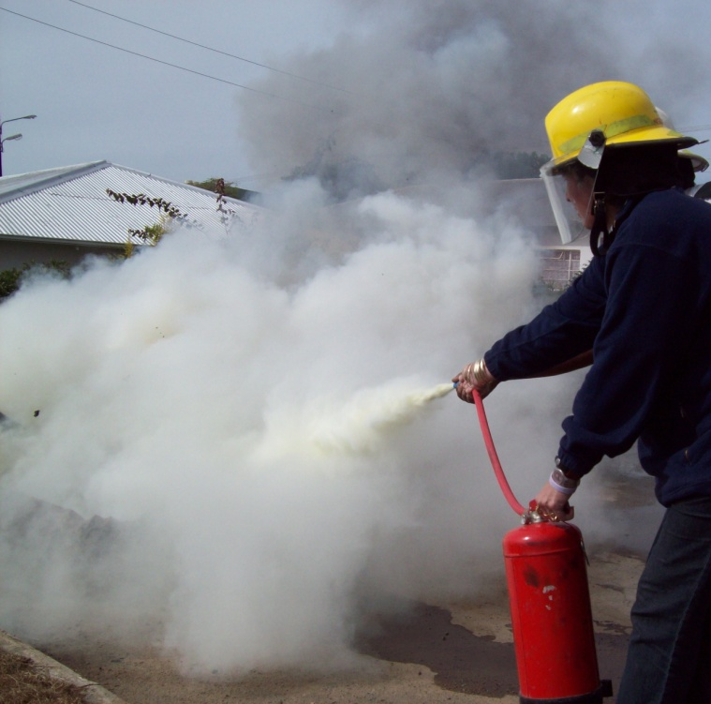


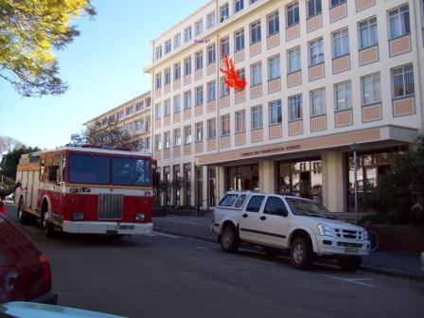
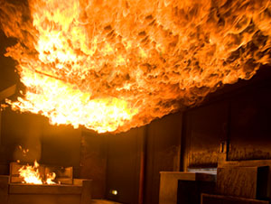
Put out
What if?
Get out
Best:
PREVENT FIRE!

Slide 3
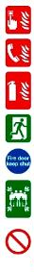
Emergencies – what to do
In the event of a fire or other emergency, think of the four golden rules:
Alarm: Raise the alarm to alert others – scream, whistle, push alarm, shout FIRE!
Emergency Services: Call no matter how small. Save on your cell phone. CPU Emergency 046 603 8999 | Makana Fire & Rescue 046 622 4444
Extinguish: Only try to extinguish if safe.
Evacuate: Everyone must get out; if necessary, crawl to avoid smoke/
heat suffocation.
Close windows and doors if you can, help people with disabilities.
Meet at Assembly Point for roll call.
Don’t take risks: do NOT use lifts, do NOT open closed doors (there may be fire in room), do NOT go back inside – until instructed by Makana Fire Officer or by
Emergency Coordinator

Slide 4

Chemistry of Fire
Triangle of combustion:
  to start & keep burning …
  a fire needs fuel + oxygen + heat
How fire spreads:
  Direct flame – direct contact
  Conduction – heat moves through solid matter
  Radiation – heat given off, no direct contact
  Convection – heat moves through air!!!

Slide 5
Flashover
Heat moves through air by convection
build-up of smoke & heat
superheated thermal layer spreads
(heating the air in the whole building)
Building bursts into flame!
A fire fighter’s greatest fear!!

Slide 6
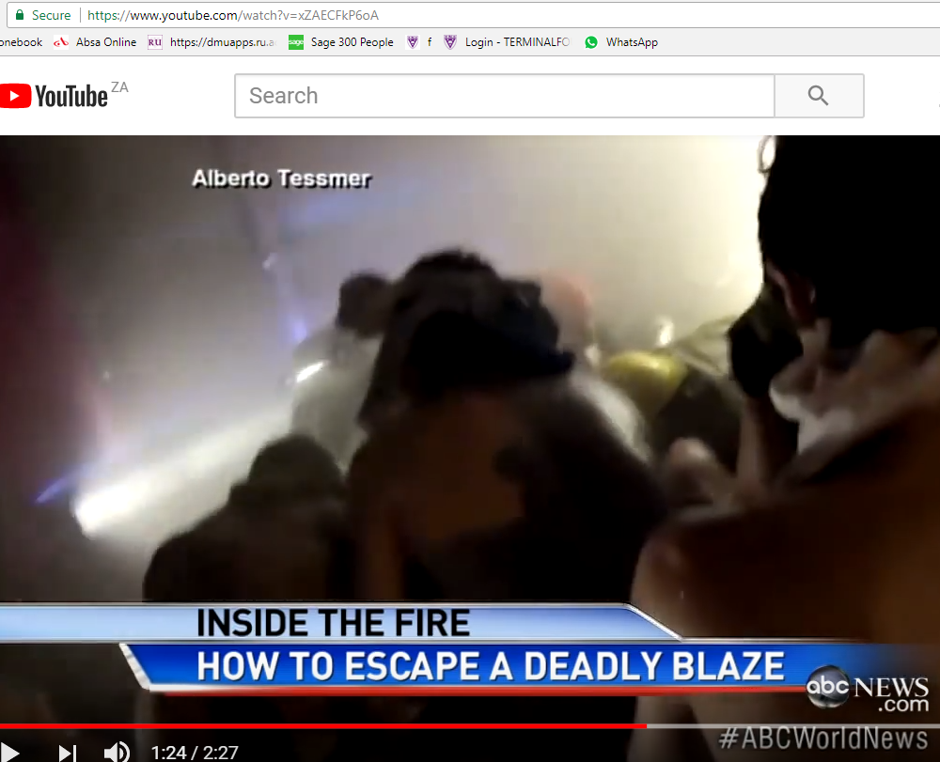
https://www.youtube.com/watch?v=xZAECFkP6oA
Fire can be fatal!

Slide 7
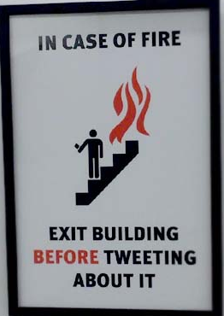
Importance of Fire Drills!
Four (4) fire drills per year must be held (one per term)
To practice SAFE evacuation (get out in under 3 minutes)
www.ru.ac.za/safety/fire/firedrills

Slide 8
Controlling Fire
Remove one or more:
  fuel / oxygen / heat
Only attempt to extinguish a fire IF:
  It is small and not spreading
  You know how to use the fire extinguisher
  You have a SAFE EXIT behind you
  (so you can turn and get out quickly and safely!)

Slide 9
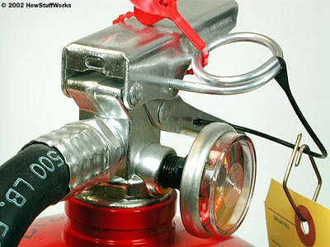

How to Use a Fire Extinguisher
Think P.A.S.S.
  P – Pull the pin
  A – Aim the nozzle at base of fire
  S – Squeeze the trigger
  S – Sweep the nozzle from side to side
This safety pin prevents us squeezing the trigger accidentally.

Slide 10
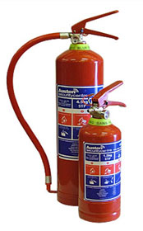
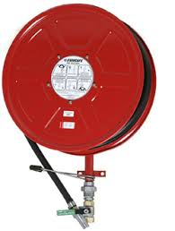
Controlling Fire
Most extinguishers at RU :
  DRY POWDER: for all types of fire - A/B/C/D
  FIRE HOSES: only good for solids - A

Slide 11
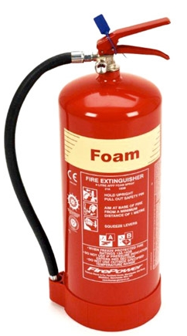
Know the Types of Fire
A. SOLIDS: ordinary solid flammable material e.g. wood, paper, coal, fabrics, plastic
  Extinguish with WATER
  or dry powder or foam

Slide 12

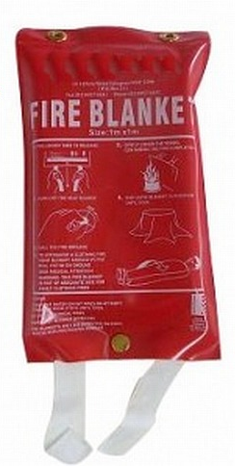

Know the Types of Fire
B. LIQUID/GAS: flammable liquids & gases e.g. petrol, paraffin, alcohol, oil, benzene
Extinguish with DRY POWDER
or fire blanket / CO2 / foam

Slide 13
Know the Types of Fire
C. ELECTRICAL: involves live electricity e.g. overheated portable electrical equipment, overloaded electrical cables, short circuits
Extinguish with CO2
or dry powder

Slide 14
Know the Types of Fire
D. METAL: involves combustible metals e.g. magnesium, titanium (used in lightweight equipment), lithium (batteries)
Extinguish with DRY POWDER

Slide 15
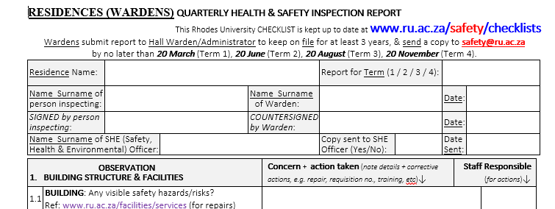
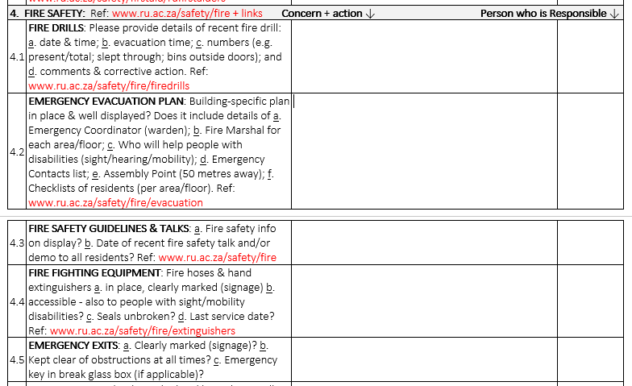
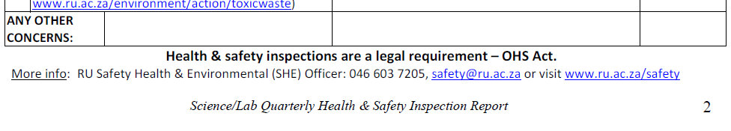
Importance of Inspections!

Slide 16
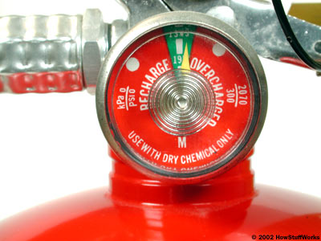
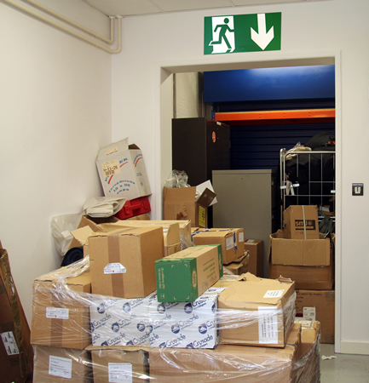
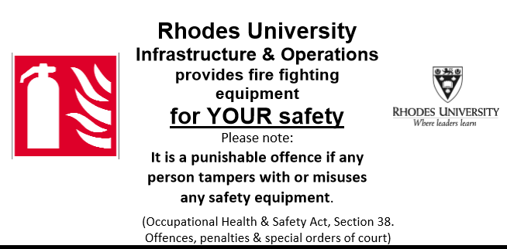
Importance of Inspections!
Check:
  Fire alarms
  Emergency exits & exit routes
  Fire fighting equipment
  Safe use of electrical appliances
  e.g. kettles, ironing, heaters, etc.
Report:
  Problems with any of the above
  Any (potential) fire hazards

Slide 17
How Fires Start
Cause: Faulty switch → bread in toaster burned and caught fire.
Cause: paper lampshade & light bulb wattage too high → over-heating → lampshade caught fire.
Cause: Incorrect battery fitted to laptop.

Slide 18
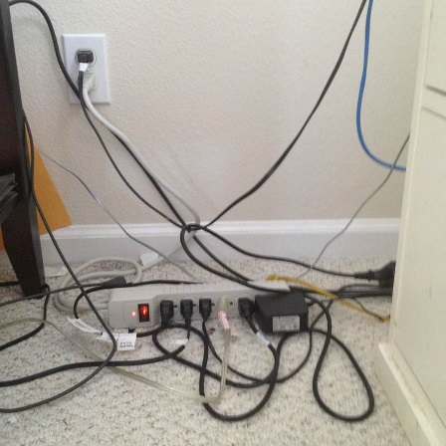
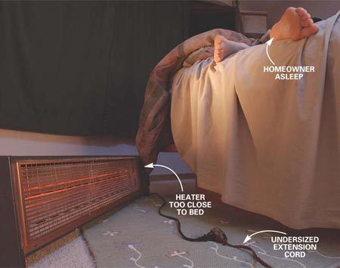
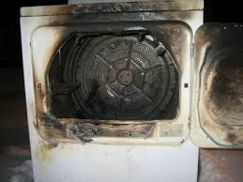
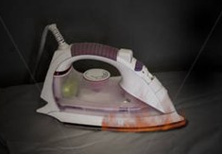

How Fires Start
Electrical equipment
  Electrical cords, heaters,
  tumble driers, irons, etc

Slide 19


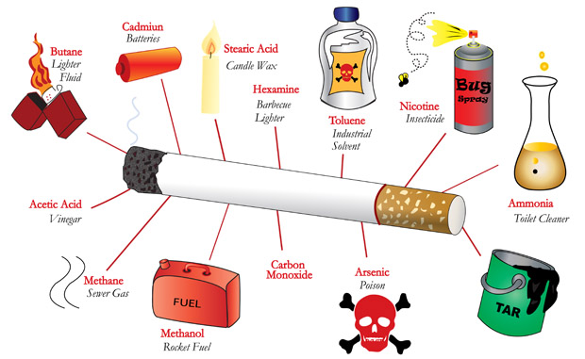
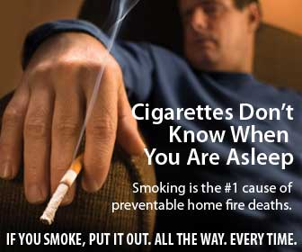

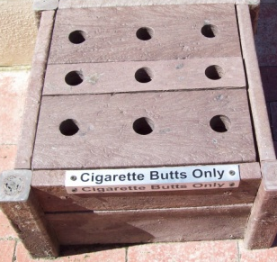
DID YOU KNOW?
Cigarette butts = toxic trash, most commonly discarded waste worldwide (1.69 billion pounds = 177,895 elephants)
Buying tobacco: keeps families in poverty (in SA a smoker spends 10.6% of national median income on 10 cheap ciggies a day).
www.ru.ac.za/safety/resources/smoking
Smoking

Slide 20
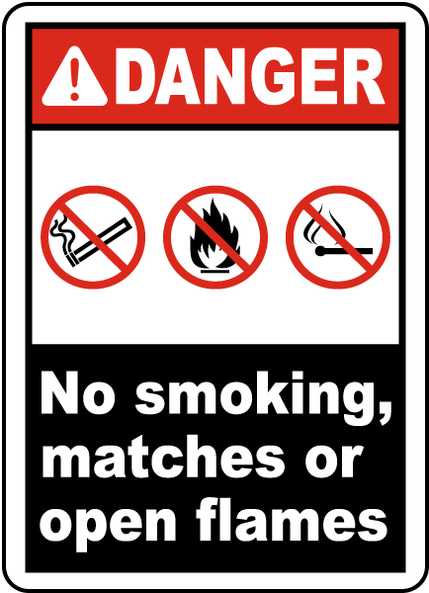
Preventing Fire
RU residence RULE: NO open flames (candles, cigarettes, etc).
Cigarette butts in butt bins / sand pots
away & downwind from windows,
doors, air con inlets.
Appliances must have ‘breathing space’ (or they can overheat).
If wiring/appliance looks damaged, have it checked by an electrician and repaired/replaced ASAP.

Slide 21
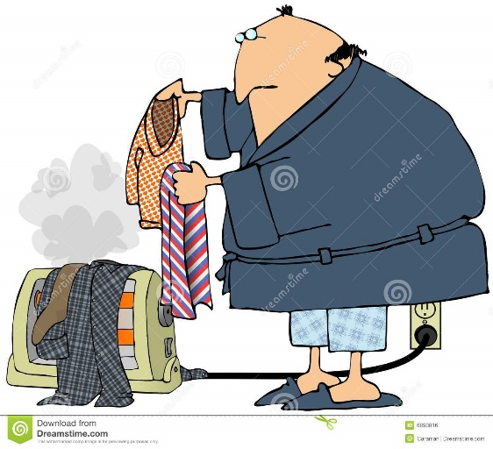

Preventing Fire – Electrical Safety
RU residence RULE: NO illegal appliances in students’ rooms (irons, microwave ovens, hot plates, immersion heaters, gas cookers, fridges, etc)
Do not tamper with any electrical fittings.
Never place a heater close to furniture, curtains, etc.
Never hang anything on or cover a heater
More info www.ru.ac.za/safety/resources/electrical

Slide 22
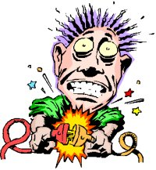
Electrical Safety
Extension cords
  should have a 3-pin plug (earthed).
  should NOT be used in a wet area.
  Should NEVER be run under a carpet or across doorway/passage.
  should NOT be used as a permanent fixture.
Wall sockets/multi-plugs should NOT be overloaded.
Power point switched OFF – BEFORE plugging in or unplugging.
Light bulb must be recommended wattage for lamp.

Slide 23
Be Responsible – ANYWHERE
Oppidans be proactive about fire safety:
Switch OFF electrical appliances when not in use.
If electricity goes off while you are cooking, switch off the appliance – the power could be restored any time.
Never leave a stove (gas/electric/paraffin) / open fire / braai / etc unattended.
If you have a braai, don't let the fire get too big & out of control; put it out if the wind gets strong.
If you have a garden hose, keep it rolled up and ready for use in case of a fire.
If you have no extinguisher, have a bucket of sand ready, or an empty bucket for water.
Make sure you know HOW to use a fire extinguisher.

Slide 24
Be Responsible – ANYWHERE
EMERGENCY NUMBERS
Save this on your cell phone!
Fire Department: 046 622 4444
Oppidans be proactive about fire safety
– don’t let your digs become a firetrap:
Fire drills: Have a fire escape plan, practice it together (1 a term).
Fire extinguishers: Ensure there are functioning fire extinguishers, especially in the kitchen and passageways – these are required by law.
Smoke alarms: Get portable smoke alarms (for each room if possible), if your landlord isn’t willing to install smoke detection system.
Electrical safety: Ask your landlord to show you an up-to-date wiring certificate. You have a right to know if the electrical system is safe.
Emergency contacts: Keep a list of emergency contacts (in each room), save the Fire Department number on your cell phone.

Slide 25

Be Responsible – ANYWHERE
YOU need to know YOUR exit routes!
  How many steps / doors to the nearest exit…
  Where is the nearest FIRE EXTINGUISHER?
  ... going LEFT?
  ... going RIGHT?
It is against the law to use safety equipment - e.g. a fire extinguisher - for anything other than its intended purpose.
If guilty, you could be fined up to R50,000.

Slide 26
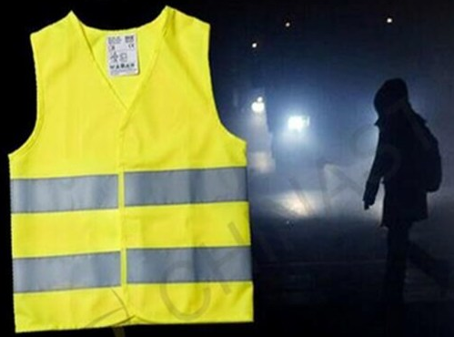
Road Safety – Pedestrians
Stay on the pavement wherever possible.
Walk facing oncoming traffic wherever possible.
Be aware of your surroundings (earplugs block out traffic/warning noises).
Don’t use the roads under the influence of alcohol.
At night: Be Seen, Stay Safe (wear bright or reflective item - more visible to traffic).

Slide 27

Road Safety – Pedestrian Crossings
Use a pedestrian/zebra crossing to cross a road, wherever possible.
Give traffic plenty of time to see you and stop – before you start crossing.
Ensure that vehicles are going to stop – do not assume they will stop.
Walk quickly when crossing – for your own safety, and to avoid causing a traffic jam.

Slide 28
Limit Safety Risks
Do NOT:
Walk alone in town at night.
Walk in deserted areas or dark roads.
Walk around under the influence of alcohol.
‘Display’ your goods or openly use cellphones, iPads or other expensive gadgets while in public places.
Leave valuables unattended.
Trust strangers.

Slide 29

Limit Safety Risks
DO:
Use Blue Route at night.
Walk in groups.
Arrange a lift home with a reliable person.
Keep to well-lit areas.
Be aware of your surroundings, be vigilant & alert.
Park your vehicle close to a street light wherever possible.

Slide 30
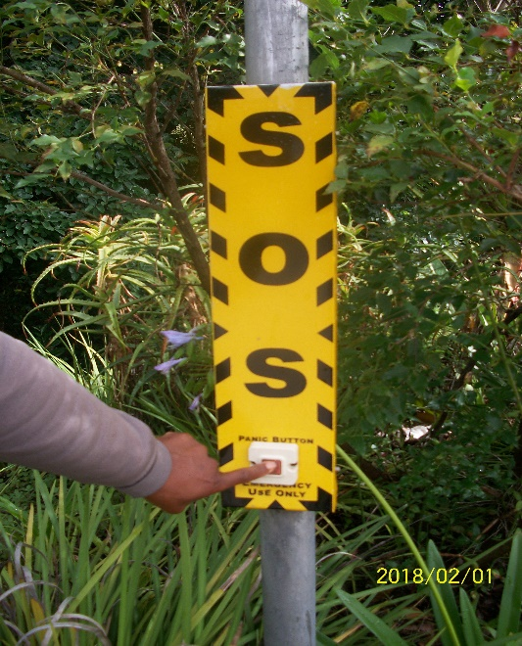
Blue Security Route
Use CPU Blue Security Route
  Prince Alfred Street
  St Peters Campus
  Hill top residence
  signposted
  well lit
  SOS (panic button)
  Guard on patrol
Call CPU on 046 603 8146 / 8147
Emergency number: 046 603 8999

Slide 31
Safety & Security in Res
Obey house rules for visitors (security risk).
Make sure you know who lives in your res!
Do not let in strangers.
Make sure you are not ‘tailed’ into res.
Report suspicious/unauthorized persons to wardens or CPU immediately.
Report to your warden if anything is broken or damaged (doors, windows, etc) → to be repaired as soon as possible.

Slide 32
Safety & Security in Res
Whenever you leave your room (even for a short while):
Lock your door.
Close the windows.
Lock away valuables.
Do NOT leave a message on your door to indicate that you will be away for any length of time.

Slide 33
Oppidan Safety & Security
Oppidan student digs are often “soft targets” for petty crime.
Be proactive about safety:
  Choose secure digs
  Join neighbourhood WhatsApp security group
ALWAYS take basic safety precautions:
  Set house alarm when you go out
  Close windows and lock doors.
  Always keep garden gate closed.

Slide 34
Campus Protection Unit Info
www.ru.ac.za/campusprotection
Report all incidents on campus to CPU
046 603 8146 / 8147 or 8999
Report incidents off campus to SAPS 10111
or 046 603 9152 or 046 603 9146/7

Slide 35
Safety Info
www.ru.ac.za/safety
Fire safety:
  Evacuation: Guidelines on emergency evacuation procedures
  Extinguishers: Info on fire extinguishers and fire hose reels
  Alarms: Info on fire alarms
  Fire Drills: Guidelines on fire drills
  Fire Safety Training: How to get training for fire marshals
  Thank you!

