Slide 1

Sci/Labs: Intro to
Health & Safety
Nikki Kohly, SHE Officer, Rhodes University
February 2017

Slide 2
INTRODUCTION
Intro
Lab Safety
Hazmat
Fire
Waste & Recycling

Slide 3
Health & Safety: Why?
Prevent accidents and injuries
  Moral reasons (duty of care, Ubuntu)
  Social reasons (employee health & wellbeing, productivity, income, standard of living, family wellbeing)
  Financial reasons (disruptions, lost time, replacement & training costs, medical costs, repair/replacing damaged equipment)
  Legal reasons (Occupational Health and Safety Act, 85 of 1993)

Slide 4
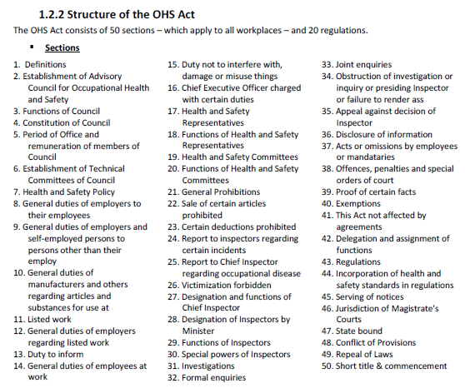
OHS Act
Occupational Health & Safety Act

Slide 5
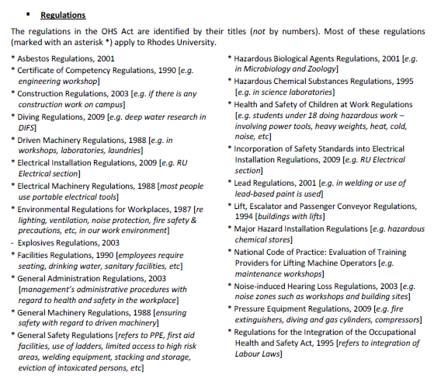
OHS Act

Slide 6

Health & Safety: Who?
  delegates responsibility (not accountability)
16(1) Vice-Chancellor
  through the various lines of management
16(2) ERM
16(2) Director
16(2) Deputy VC
16(2) Other / Deans
16(2) Director
16(2) Deputy VC
16(2) Director
SHE Officer
8(2) Manager / Head of Dept
GMR 2
8(2) Manager / Head of Dept
8(2) Manager / Head of Dept
8(2) Manager / Head of Dept
8(2) Manager / Head of Dept
8(2) Manager / Head of Dept
GAR 6 Union
GAR 6 Union
All are responsible for
health and safety
17(1) H&S Reps
17(1) H&S Reps
GSR 3 First Aiders
GSR 3 First Aiders
GSR 2 Fire Marshals
Employees / Other
GSR 2 Fire Marshals
Employees / Other

Slide 7
Health & Safety: Who?
Managers / HODs
  Responsible for ensuring day-to-day health and safety management in their area of responsibility:
  OHS Act Section 8. General duties of employers to their employees:
    1) Every employer shall provide and maintain; as far as is reasonably practicable; a working environment that is safe and without risk to the health of his employees.;
    2) … include in particular:
  ... can also delegate responsibility (not accountability)

Slide 8
Health & Safety: What?
    Managers / HODs ensure:
    a) the provision and maintenance of systems of work; plant and machinery that; as far as is reasonably practicable; are safe and without risks to health;
    b) taking such steps as may be reasonably practicable to eliminate or mitigate any hazard or potential hazard to the safety or health of employees; before resorting to personal protective equipment;
    c) making arrangements for ensuring; as far as is reasonably practicable; the safety and absence of risks to health in connection with the production; processing; use; storage or transport of articles or substances;
    d) establishing, as far as is reasonably practicable, what hazards to the health or safety of persons are attached to any work which is performed… and …. as far as is reasonably practicable; further establish what precautionary measures should be taken … in order to protect the health and safety of persons and … provide the necessary means to apply such precautionary measures;

Slide 9
Health & Safety: What?
HIRA:
Hazard Identification & Risk Assessment
Baseline: e.g. hygiene & health surveys (noise, lighting, ventilation, extreme temps); environmental impacts; fire safety inspections.
Issue-based: e.g. after accident or ‘near miss’; introduction of new equipment; change in work system;
Continuous: e.g. regular inspections; audits; medical surveillance.
    … establishing … what hazards … are attached to any work….
HAZARD: anything that acts as a source of or exposure to danger that can cause injury, illness or death.
www.ru.ac.za/safety/resources/riskassessment

Slide 10
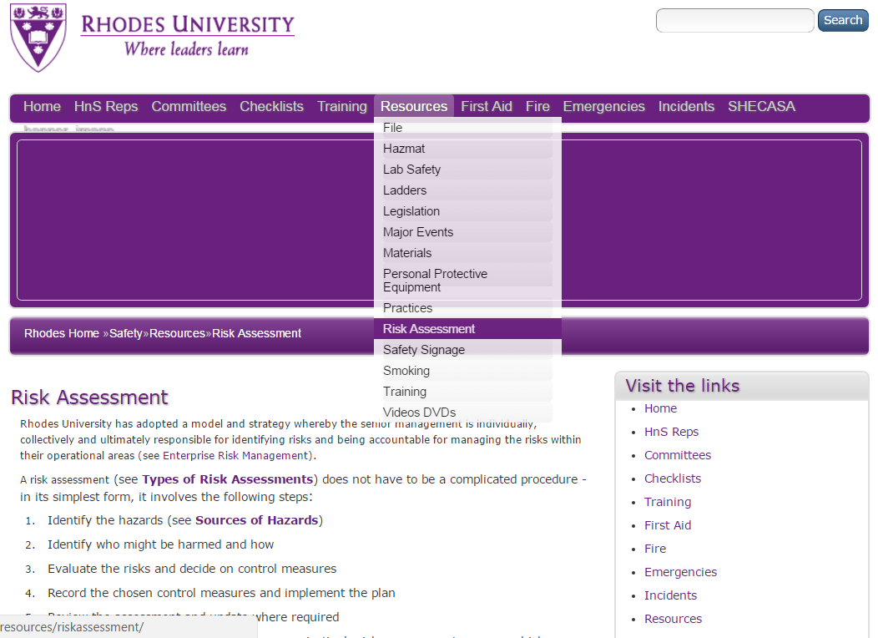
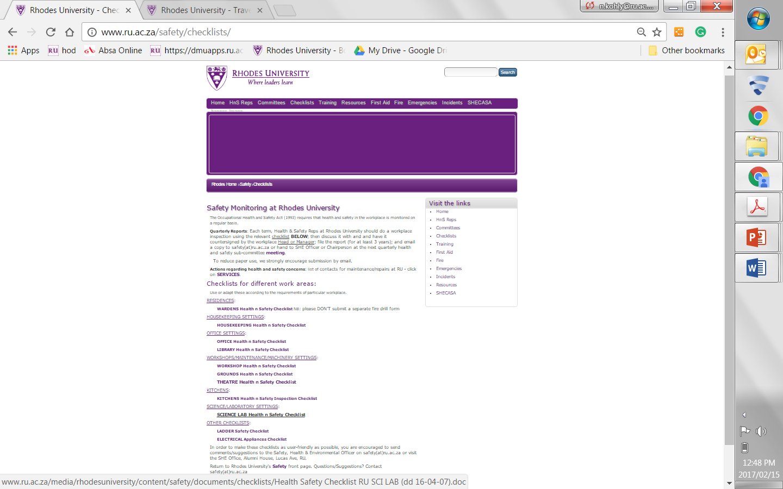
Hazard Identification & Risk Assessment
www.ru.ac.za/safety/checklists
www.ru.ac.za/safety/resources/riskassessment

Slide 11

Health & Safety: What?
    Managers / HODs ensure:
    e) providing such information; instructions; training and supervision as may be necessary to ensure; as far as is reasonably practicable; the health and safety at work of his employees;
    f) as far as is reasonably practicable; not permitting any employee to do any work or to produce; process; use; handle; store or transport any article or substance or to operate any plant or machinery; unless the precautionary measures contemplated in paragraphs (b) and (d); or any other precautionary measures which may be prescribed; have been taken;
    g) taking all necessary measures to ensure that the requirements of this Act are complied with by every person in his employment or on premises under his control where plant or machinery is used;
    h) enforcing such measures as may be necessary in the interest of health and safety;

Slide 12
LAB SAFETY
Intro
Lab Safety
Hazmat
Fire
Waste & Recycling

Slide 13
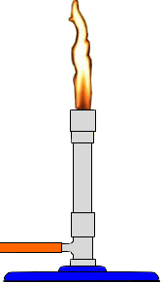
Lab Safety - General
DO NOT:
Eat, drink, or handle unnecessary items (cell phones, clickers, etc)
Taste, touch, or smell any reagent (unless directed - use wafting motion)
Discard chemicals, insoluble materials, etc in the sink
Pour used chemicals back into containers
Operate any lab equipment without proper instruction on its use
Play the fool or cause trouble or act disrespectfully to others
Carry out unauthorized experiments
Move a lit Bunsen burner

Slide 14
Lab Safety - General
DO:
Lab safety protocols – must be in place
Material Safety Data Sheets – must be readily available in every lab
Work area – must be organized, clean and tidy
Personal Protective Equipment – must be used as required, e.g. lab coats, goggles, gloves, etc
Emergency equipment – all must be familiar with first aid kit, eyewash bottle, fire extinguisher, emergency procedures, phone & contact numbers, etc
Report ALL incidents/accidents to supervisor – immediately
Dispose of hazardous waste etc correctly.

Slide 15
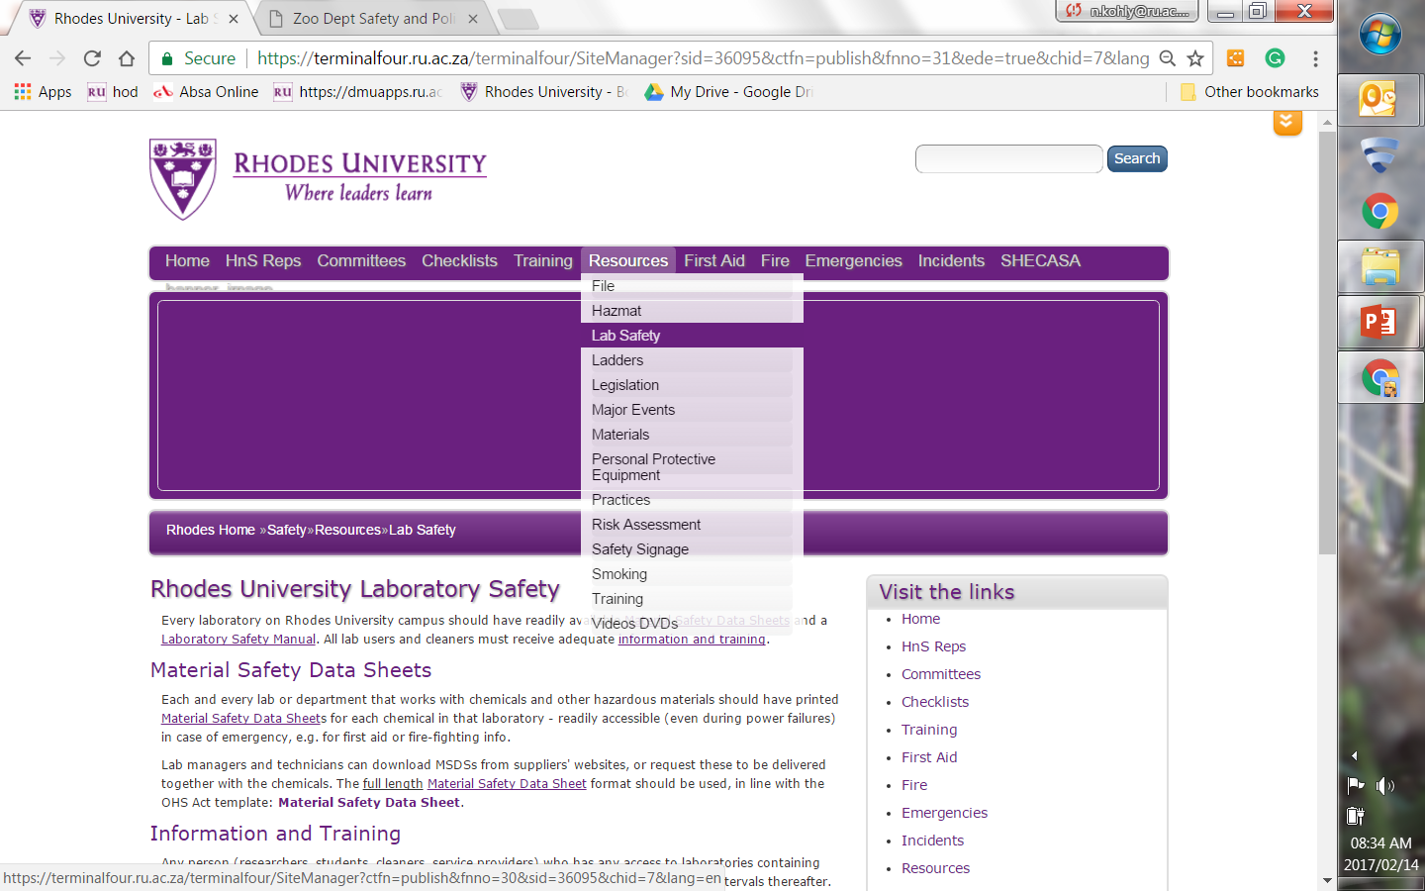
Lab Safety – Link
www.ru.ac.za/safety/resources/labsafety

Slide 16
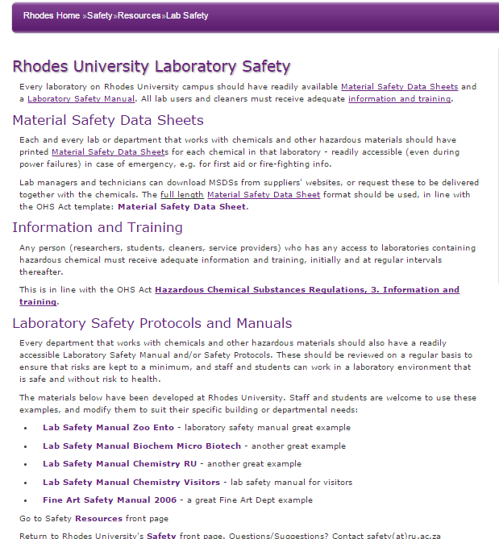
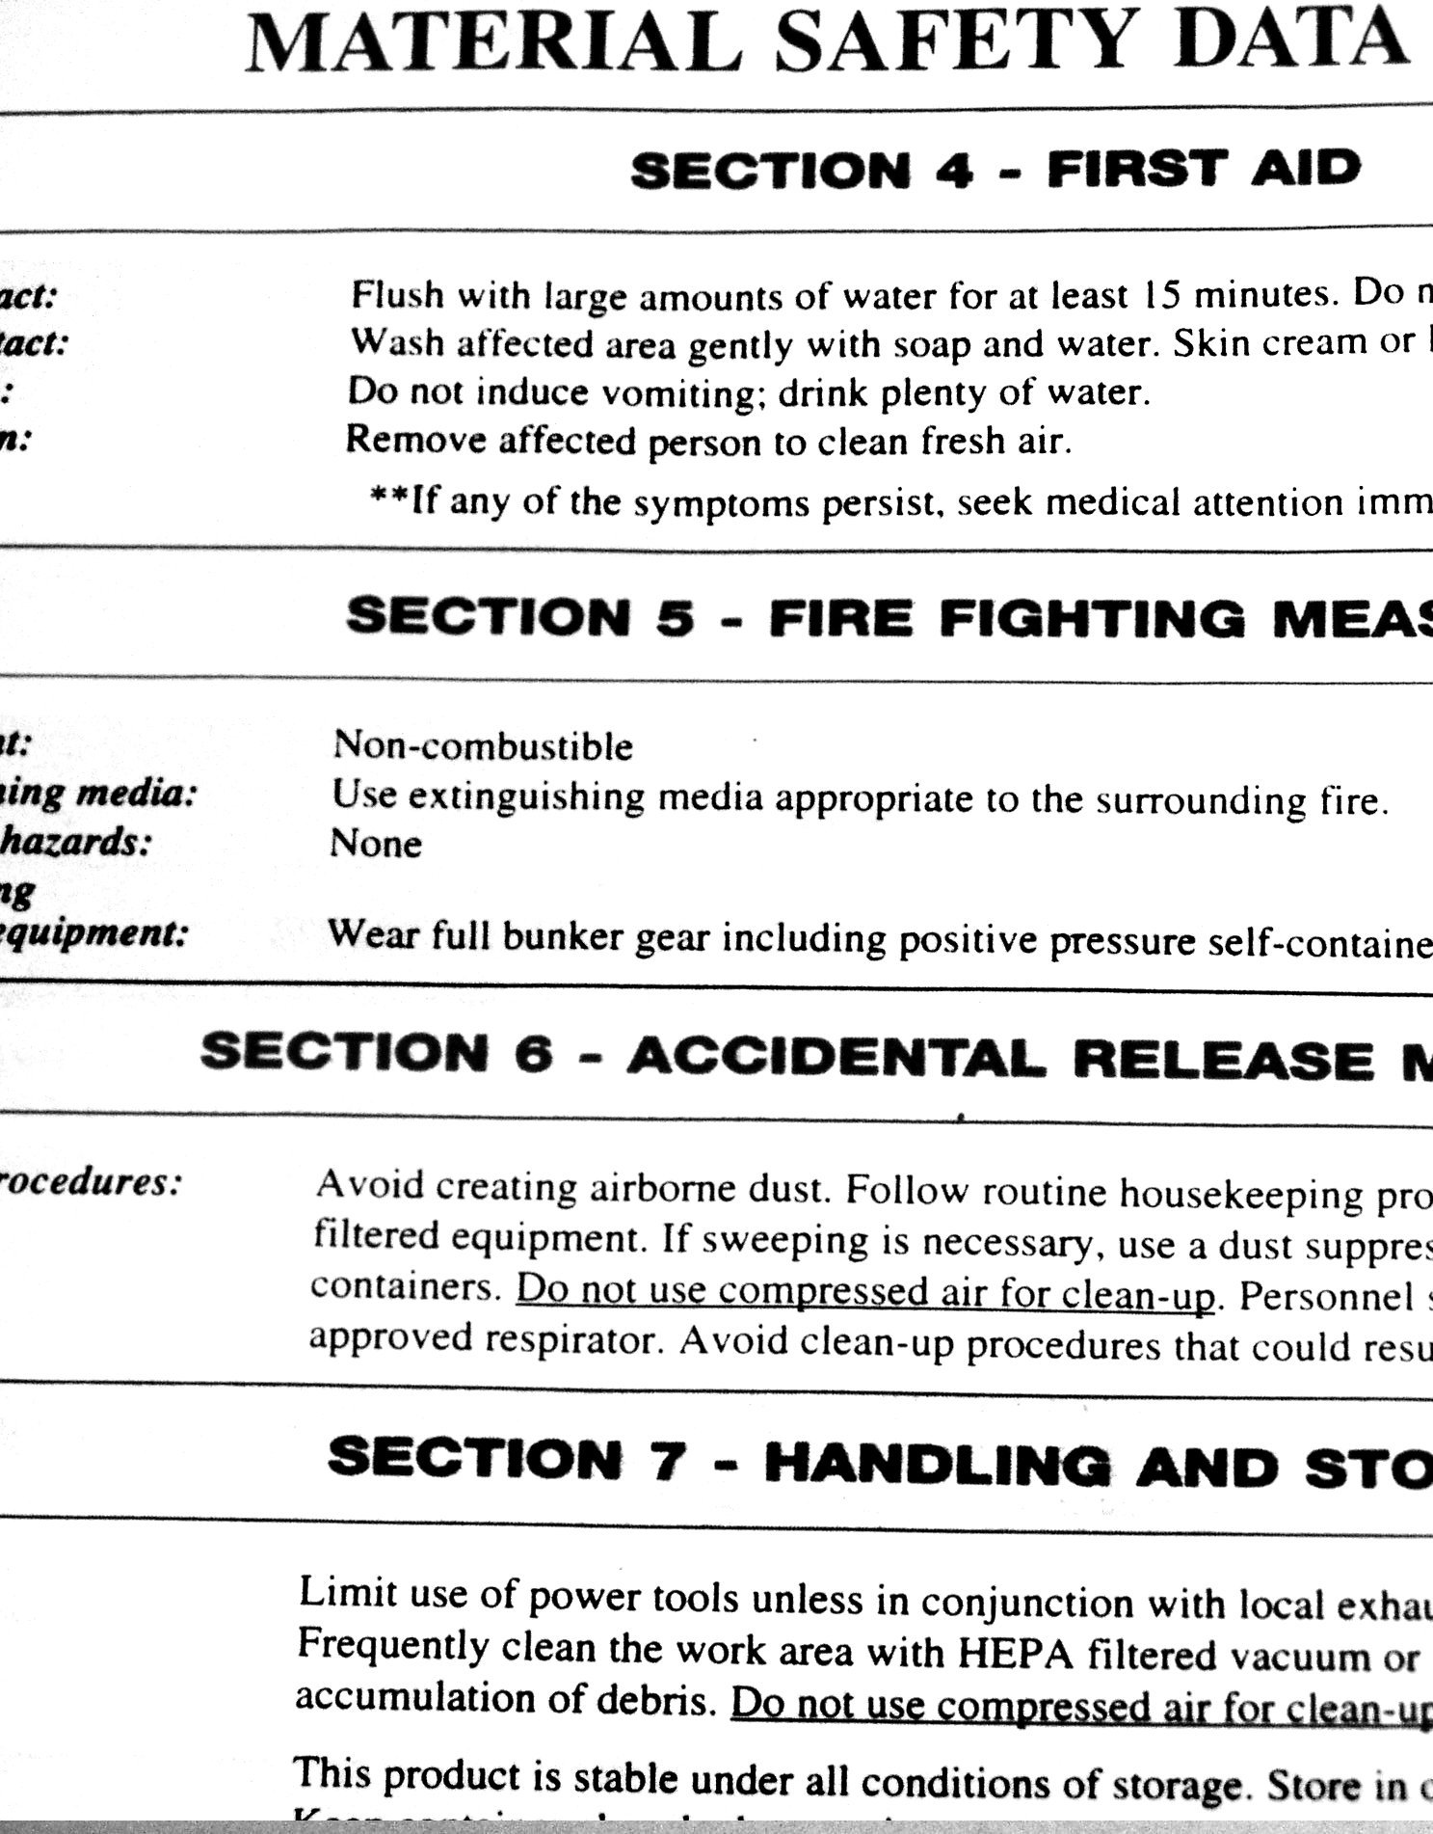
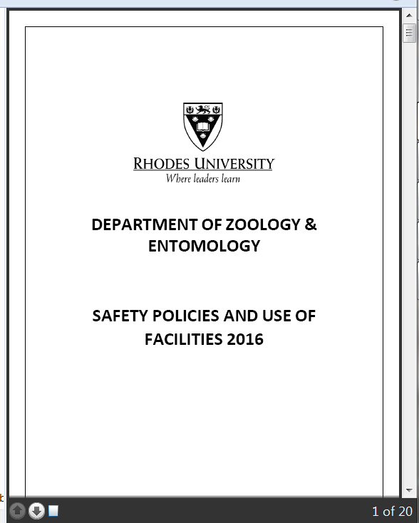
Lab Safety – Resources

Slide 17
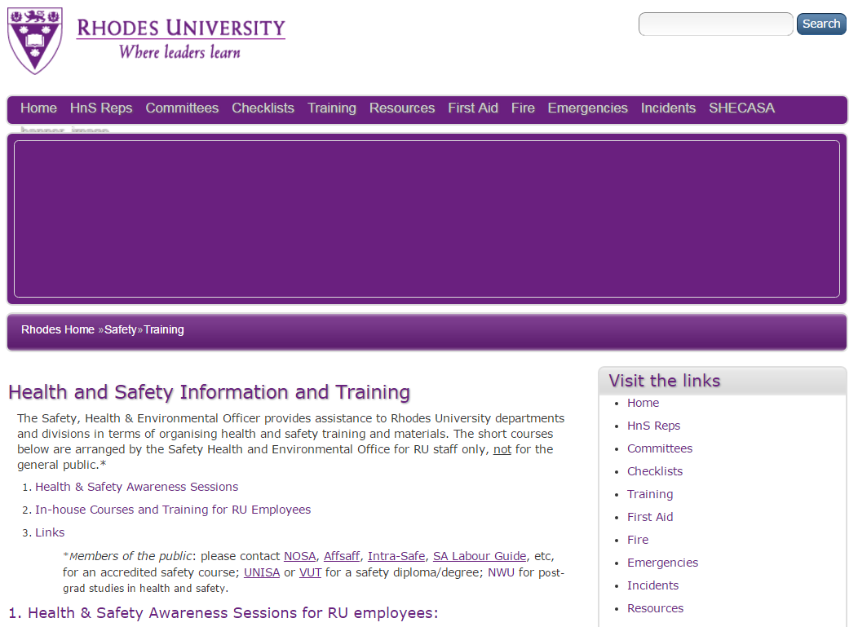
Lab Safety – Training
Specialised lab safety training
General safety training
www.ru.ac.za/safety/training

Slide 18
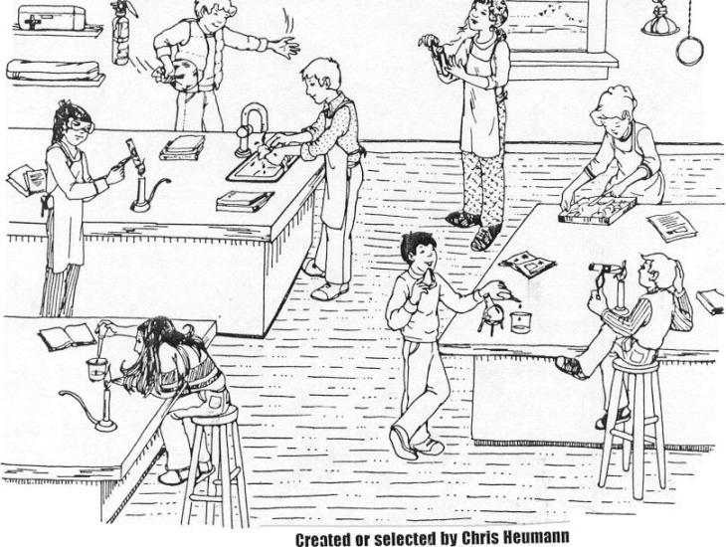
ACTIVITY
How many problems do you see in this lab?

Slide 19
HAZARDOUS MATERIAL
Intro
Lab Safety
Hazmat
Fire
Waste & Recycling

Slide 20
Hazardous Material – General
Hazardous waste: waste that poses substantial or potential threats to public health or the environment, even in low concentrations... contains or is contaminated by poison, corrosive agents, flammable or explosive substances, chemicals or any other substance which may have a detrimental or chronic impact.
Responsible hazardous waste disposal is costly – especially if unidentified
Strive to identify and minimise hazardous waste
Ensure ALL staff and students know the correct procedures for disposal‌ of hazardous waste generated in your area of responsibility
www.ru.ac.za/safety/resources/hazmat

Slide 21
Hazardous Material – General
Hazardous Biological Agents (HBA)
Medical Waste/Health Care Risk Waste (HCRW)
Sharps
Cigarettes
Batteries
E-waste (computers, cell phones, etc)
Fluorescent light bulbs
Printing cartridges
Oil (engine & cooking)
Paint
www.ru.ac.za/safety/resources/hazmat

Slide 22
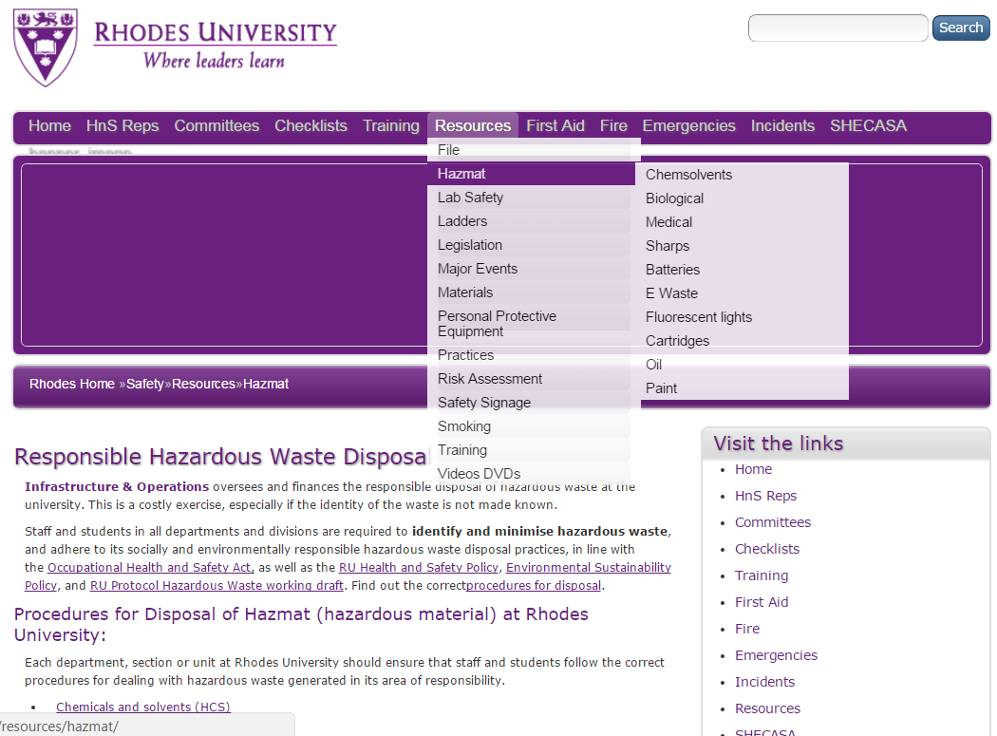
Hazardous Material - Link
www.ru.ac.za/safety/resources/hazmat

Slide 23
FIRE SAFETY
Intro
Lab Safety
Hazmat
Fire
Waste & Recycling

Slide 24
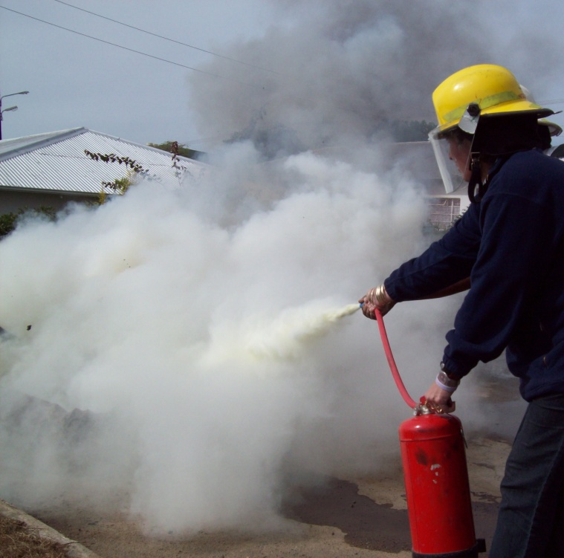

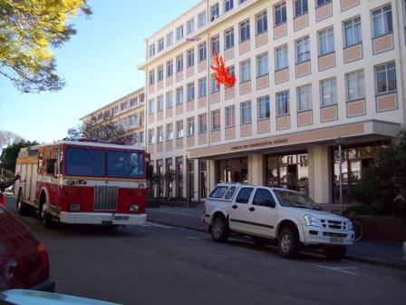
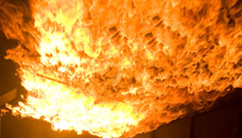
Put out
What if?
Get out
Best:
Prevent Fire

Slide 25
Fire Safety
Intro to Fire Safety PPT presentation‌
Health and Safety Training Materials‌ - go to Part 7: FIRE SAFETY
Evacuation: Guidelines on emergency evacuation procedures
Extinguishers: Info on fire extinguishers and fire hose reels
Alarms: Info on fire alarms
Fire Drills: Guidelines on fire drills
RU Fire Marshals: List of all fire marshals on campus
Fire Safety Training: How to get training to become a fire marshal
www.ru.ac.za/safety/fire

Slide 26
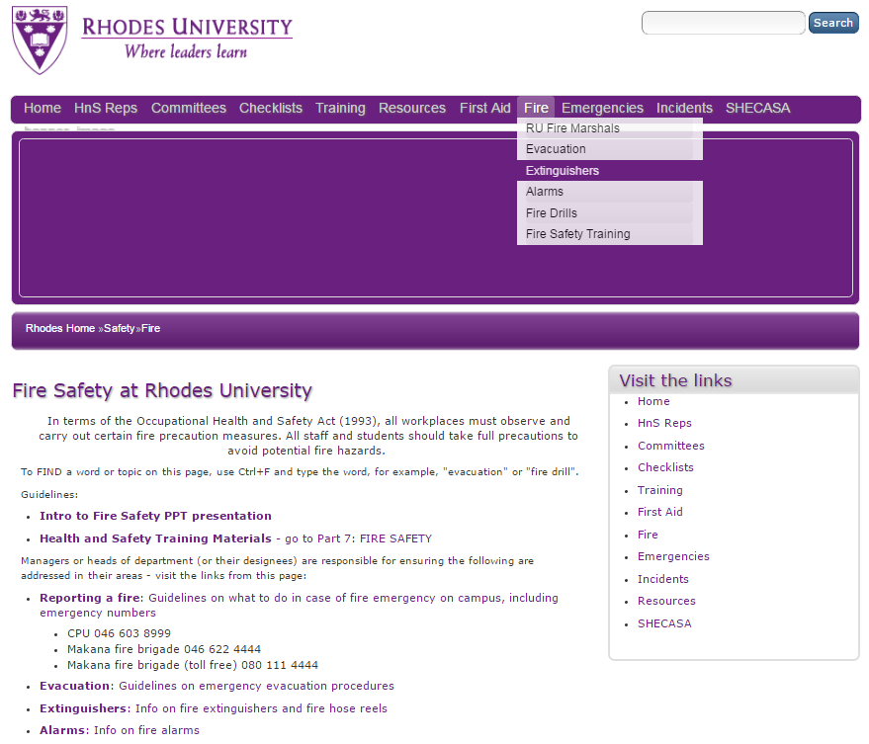
Fire Safety – Link
www.ru.ac.za/safety/fire

Slide 27
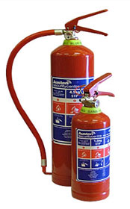
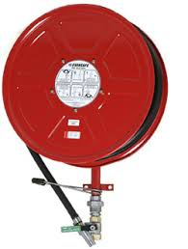
Fire - Extinguishers
Most extinguishers at RU
DRY POWDER: for all types of fire - A/B/C/D
FIRE HOSES: only good for solids – A
Managed by RU Engineering section
www.ru.ac.za/safety/fire/extinguishers

Slide 28
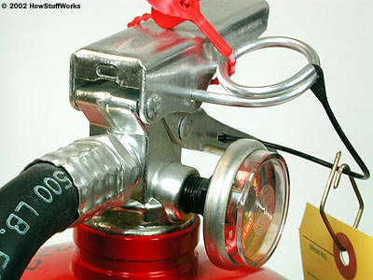

Fire - Extinguishers
Safety pin prevents us squeezing the trigger accidentally.
Think P.A.S.S.
  P – Pull the pin
  A – Aim the nozzle at base of fire
  S – Squeeze the trigger
  S – Sweep the nozzle from side to side

Slide 29
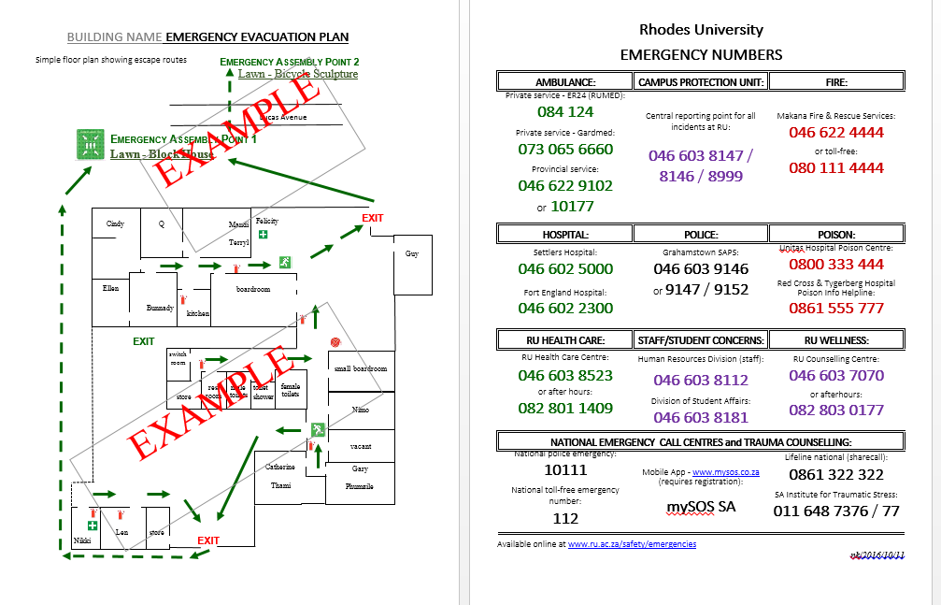
Fire – Emergency Evacuation Planning
Emergency Evacuation Plan of Action GENERIC‌
Emergency Coordinator (HOD/Manager)
Health and Safety Representative(s)
First Aider(s)
Fire Marshal(s)
www.ru.ac.za/safety/fire/evacuation

Slide 30
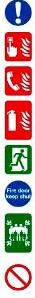
Fire – Emergency Evacuation
Raise the alarm – scream, whistle, push alarm button…
CPU EMERGENCY 046 603 8999 (save on cellphone) call no matter how small the fire
Only try to extinguish if safe
Evacuate – crawl to avoid smoke/heat suffocation
Close windows & doors, help people with disabilities
Meet at Assembly Point, for roll call
Don’t take risks – don’t use lifts, do NOT go back inside.
www.ru.ac.za/safety/fire/evacuation

Slide 31
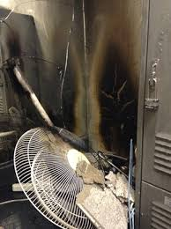
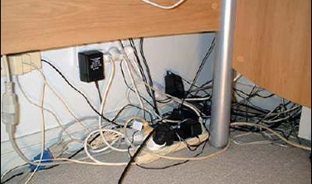
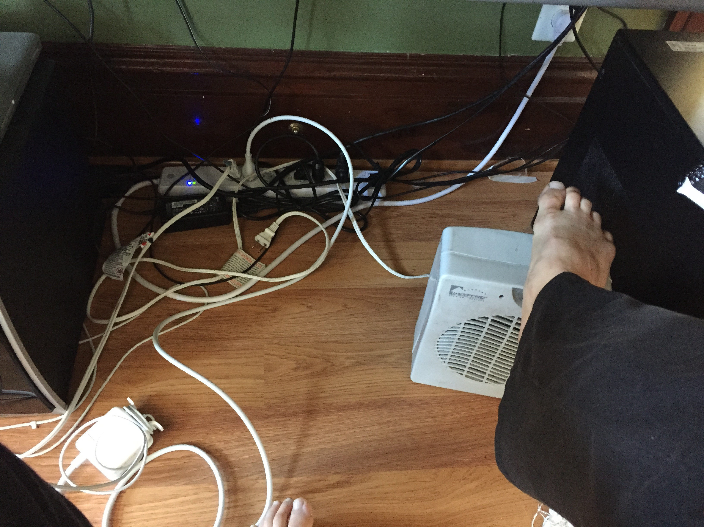
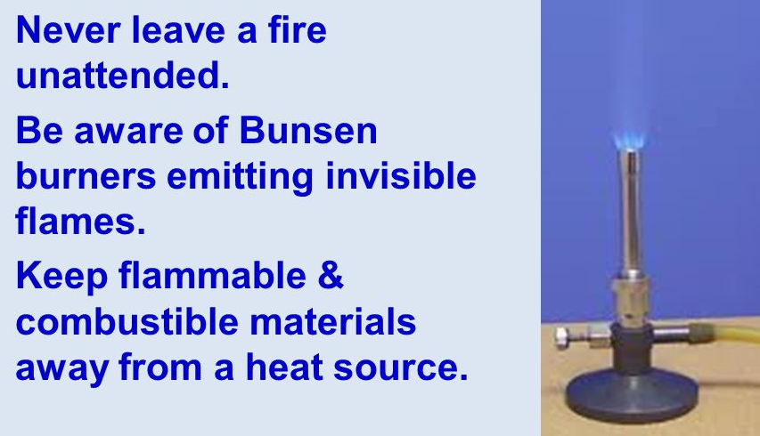
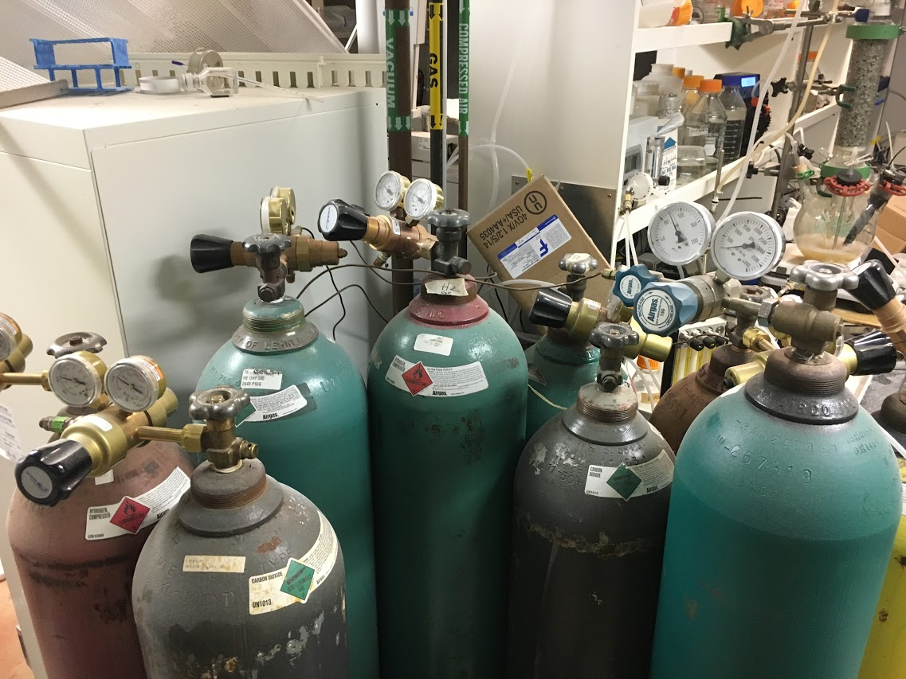

Fire - Prevention

Slide 32

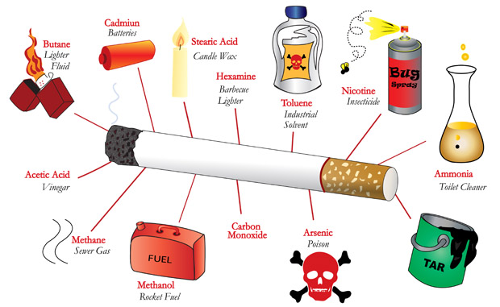
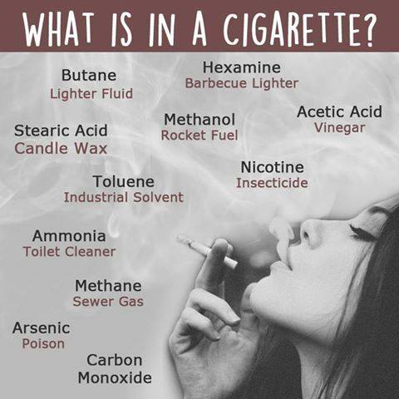
Cigarettes

Slide 33
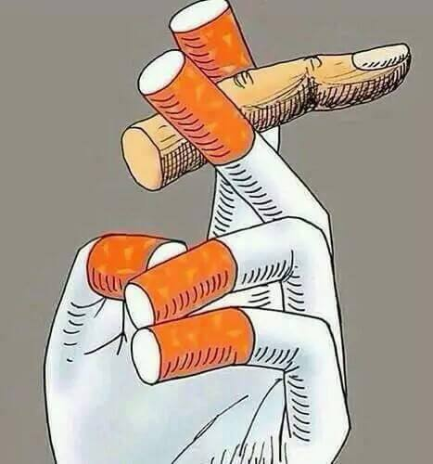
Cigarettes: RU Smoking Rules
Both the OHS Act and the Tobacco Products Control Act apply on campus.
Smoking is not permitted inside any University building or partially enclosed public space (e.g. covered patios, verandas, balconies, walkways and parking areas).
Smoking outside may not be closer than 10 metres from any window, entrance or air inlet.
www.ru.ac.za/safety/resources/smoking

Slide 34
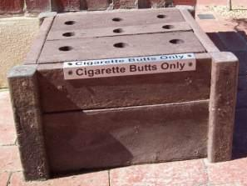

Cigarettes
Safely dispose of extinguished cigarettes into designated bins.
Better still...
Kick the habit!

Slide 35
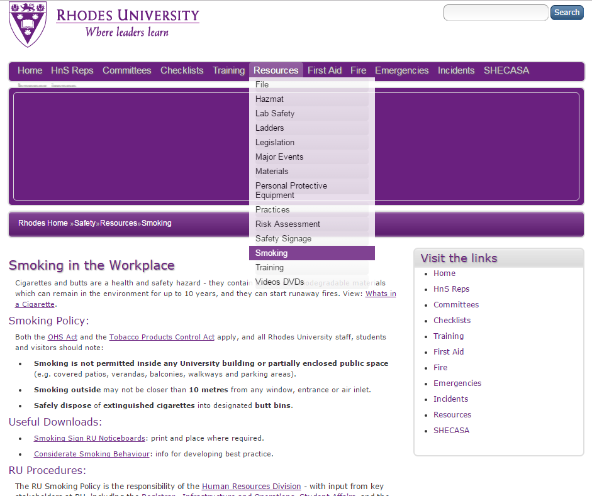
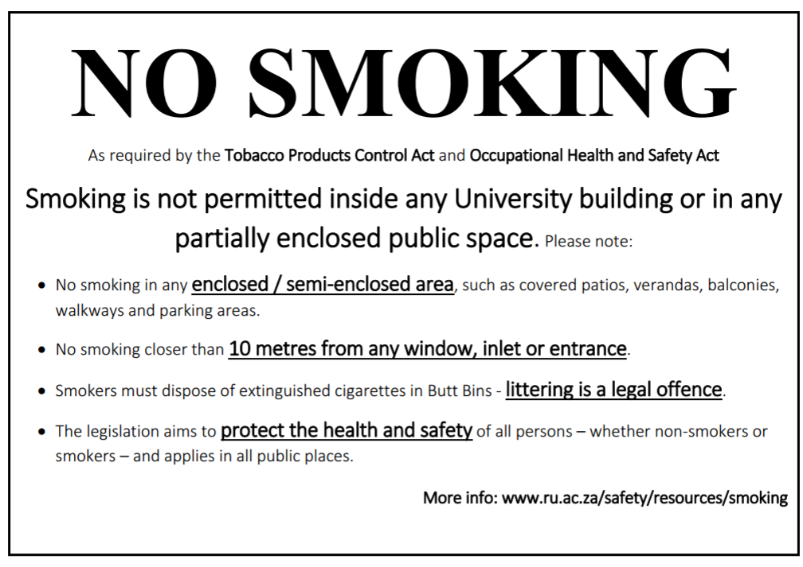
Cigarettes - Link
www.ru.ac.za/safety/resources/smoking

Slide 36
ACTIVITY
In groups: answer the questions briefly.
List 3 types of hazardous waste generated in this dept.
How could we minimize the amount of hazardous waste that we produce?
Refer to your list in (1) above, and note where RU staff & students should take each type for safe disposal.
With regard to extinguishing a fire, what does “PASS” remind us to do?
List 3 hazards which increase the risk of fire.

Slide 37
WASTE & RECYCLING
Intro
Lab Safety
Hazmat
Fire
Waste & Recycling

Slide 38
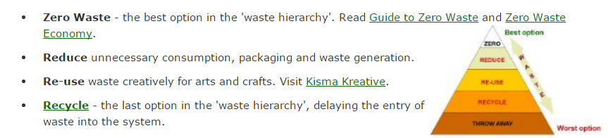
Waste & Recycling
Waste & Recycling

Slide 39
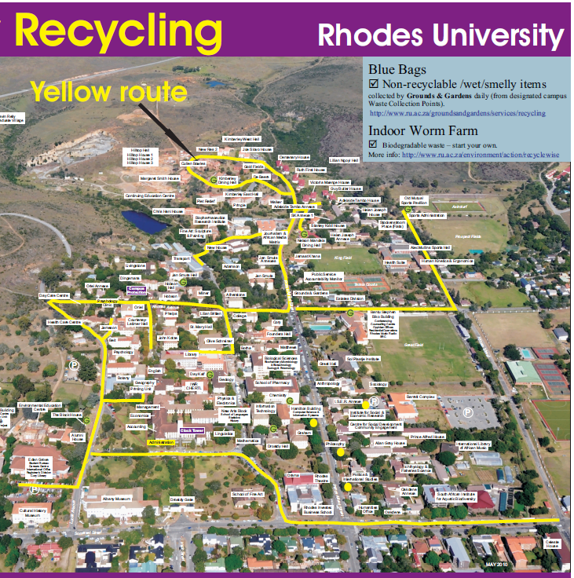
Waste & Recycling
Waste management at Rhodes University
Indoors: Housekeeping manages waste and recycling inside all buildings.
Outdoors: Grounds and Gardens - collection + outsourced recycling.
2-bag system at RU:
  BLUE BAGS - disposable waste.
  CLEAR BAGS - recyclable materials.
    Paper/card
    Plastic
    Glass
    Metals (tins etc)
www.ru.ac.za/environment/resources/waste

Slide 40
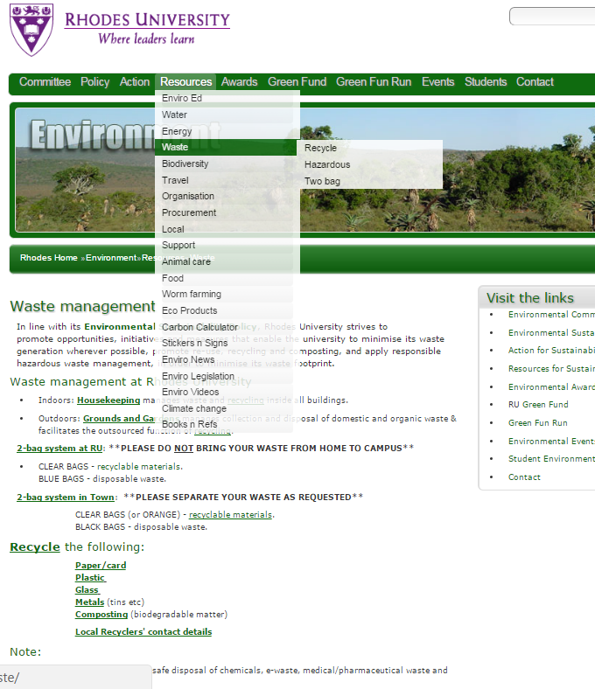
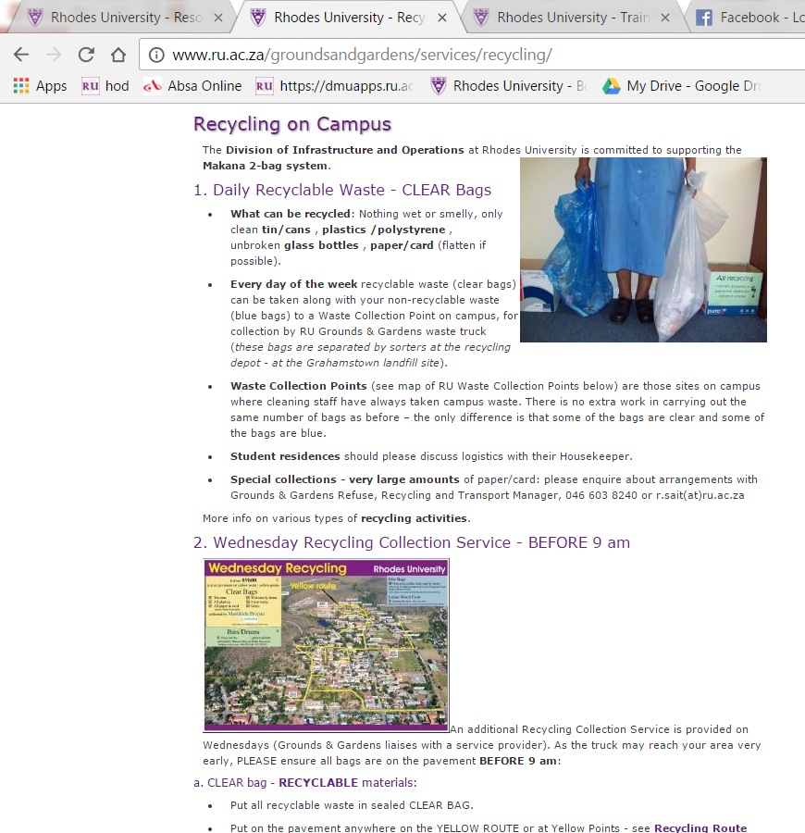
Waste & Recycling - Links
www.ru.ac.za/environment/resources/waste
www.ru.ac.za/groundsandgardens/services/recycling

Slide 41
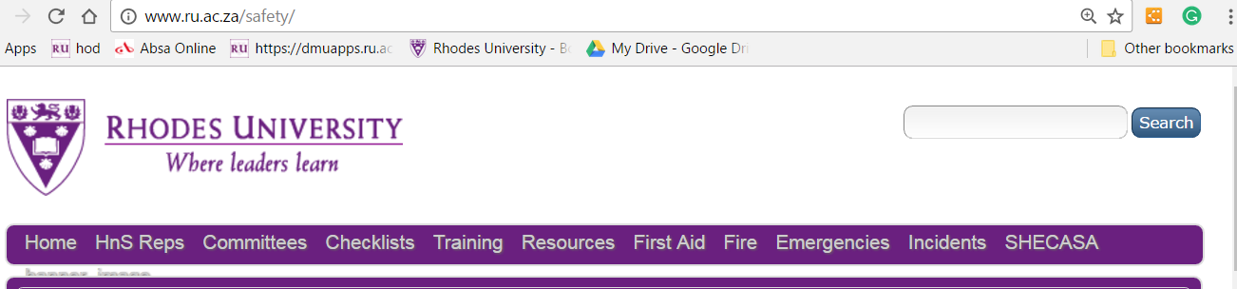
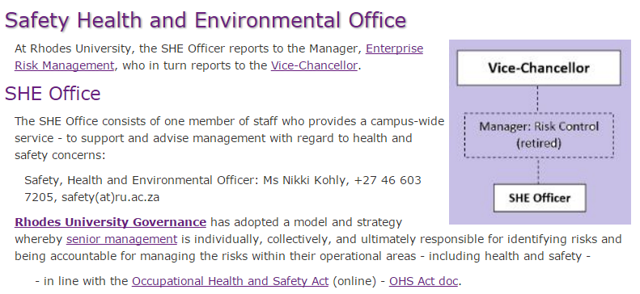
THANK YOU
Search Box (top right of RU webpage)
MORE INFO:
SHE Officer
046 603 7205
safety@ru.ac.za
www.ru.ac.za/safety
www.ru.ac.za/environment

