Slide 1
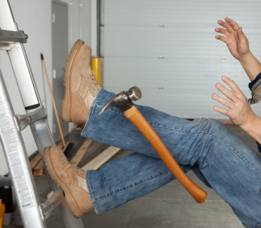

Ladder Safety COURSE
Notes:
Today’s topic is ladder safety. This training is required as part of OSHA’s Ladder Safety Standard (29 CFR 1926.1053).
You will learn about:
the different types of ladders commonly used on the job
proper construction, use, placement and care of ladders
fall safety equipment required when working at heights, and
safe operating procedures when working on and around ladders.
Suggestions for the Speaker
Open up the discussion by asking:
Who has experience working on ladders?
What potential hazards come with ladder work?

Slide 2
WHY?

Slide 3
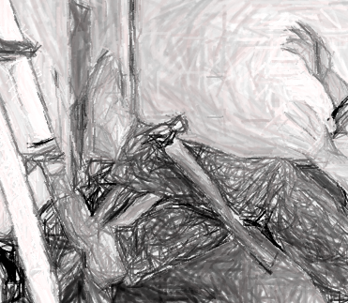
Falls in the Workplace
  1 in 6 of lost-time work injuries are a result of slips, trips and falls
  25% of all accidents are falls from elevated positions
  60% of these are from less than 3 metres
  16% of fatal falls are from LADDERS
Notes:
The reason for today’s training is the ever-present danger of falls in the workplace. In 2009, 617 deaths were attributed to falls, as were 25.2% of all workplace injuries.
While you can fall just about anywhere, adding ladders to the equation increases the risks. Common causes of ladder-related accidents include:
overreaching, instead of moving the ladder
failing to properly secure the ladder, allowing it to fall backward or slide to the ground
climbing one-handed or carrying something while climbing
standing on the top rung and losing balance, and
using a worn or damaged ladder that could break.
It’s not just falls you should be careful to avoid. Struck-by accidents can happen when tools left on a rung or on top of a stepladder fall.
Let’s take a look at the different types of ladders you’re most likely to see.
Suggestions for the Speaker
Share an example of a ladder-related accident. If you don’t have one, you can use this true story:
A worker was standing on a fixed ladder [12 metres] above the floor, spray painting the inside of a tower. His foot slipped and, because he wasn’t wearing any fall protection gear, he fell to his death.

Slide 4
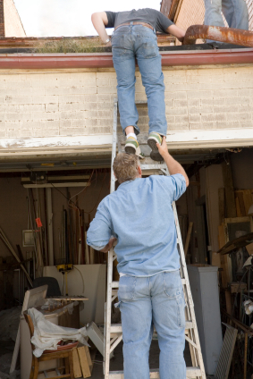
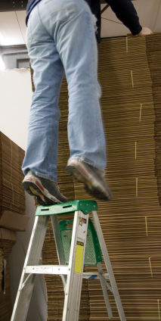
Falls in the Workplace
  Common causes of ladder accidents:
  Overreaching
  Unsecured ladder
  Climbing one-handed
  Losing balance on top rung
  Using a worn/damaged ladder that breaks
Notes:
The reason for today’s training is the ever-present danger of falls in the workplace. In 2009, 617 deaths were attributed to falls, as were 25.2% of all workplace injuries.
While you can fall just about anywhere, adding ladders to the equation increases the risks. Common causes of ladder-related accidents include:
overreaching, instead of moving the ladder
failing to properly secure the ladder, allowing it to fall backward or slide to the ground
climbing one-handed or carrying something while climbing
standing on the top rung and losing balance, and
using a worn or damaged ladder that could break.
It’s not just falls you should be careful to avoid. Struck-by accidents can happen when tools left on a rung or on top of a stepladder fall.
Let’s take a look at the different types of ladders you’re most likely to see.
Suggestions for the Speaker
Share an example of a ladder-related accident. If you don’t have one, you can use this true story:
A worker was standing on a fixed ladder 12 metres above the floor, spray painting the inside of a tower. His foot slipped and, because he wasn’t wearing any fall protection gear, he fell to his death.

Slide 5
Law: Working at Heights
OHS Act General Safety Regulations 6:
  “No employer shall require or permit any person to work in an elevated position, and no person shall work in an elevated position, unless such work is performed safely from a ladder or scaffolding, or from a position where such person has been made as safe as if he were working from scaffolding.”
OHS Act General Safety Regulations 13A: Ladders
    “…ensure that every ladder is constructed of sound material and is suitable for the purpose for which it is used...” and secure, rungs not loose/damaged, < 9m long, wood not cracked/damaged, no falling items, fixed ladder has cage.
Construction Regulations 2014 : “fall risk”
  …any potential exposure to falling from/off/into…
  Full risk assessment must be done
  Fall protection plan must be updated – annually, or if any changes in scope of work, personnel, venue, etc.
Notes:
In South Africa, legislation has changed.
Anyone who controls a workplace is responsible for the safety and health of everyone in that area.
Managing work at height involves risk assessment, and evaluation of risks that cannot always be foreseen.
Yet the responsibility remains with individuals that either do the work or those that delegate the work. In both cases the right equipment is the key to avoiding fatalities.
Any incident arising from a small negligent act can have serious consequences.
Suggestions for the Speaker
Show trainees the fall arrest systems they are required to use, and the proper way to wear the equipment.

Slide 6
WHAT?

Slide 7
Types of Ladders
  Stepladders (A-frame)
  Single (portable) ladders
  Fixed ladders
  ALL ladders must be on a ladder register
  Important to keep records!
Notes:
The reason for today’s training is the ever-present danger of falls in the workplace. In 2009, 617 deaths were attributed to falls, as were 25.2% of all workplace injuries.
While you can fall just about anywhere, adding ladders to the equation increases the risks. Common causes of ladder-related accidents include:
overreaching, instead of moving the ladder
failing to properly secure the ladder, allowing it to fall backward or slide to the ground
climbing one-handed or carrying something while climbing
standing on the top rung and losing balance, and
using a worn or damaged ladder that could break.
It’s not just falls you should be careful to avoid. Struck-by accidents can happen when tools left on a rung or on top of a stepladder fall.
Let’s take a look at the different types of ladders you’re most likely to see.
Suggestions for the Speaker
Share an example of a ladder-related accident. If you don’t have one, you can use this true story:
A worker was standing on a fixed ladder [12 metres] above the floor, spray painting the inside of a tower. His foot slipped and, because he wasn’t wearing any fall protection gear, he fell to his death.

Slide 8
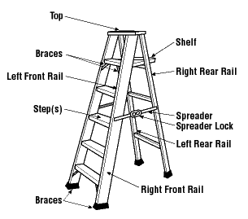
Stepladders (A-frame)
Self-supporting, fold-out, non-adjustable
Good for low heights
Use only when all 4 legs are on a
solid, level surface
Never use top two levels for steps
If locking device is damaged or missing, DO NOT USE
Notes:
Stepladders are self-supporting fold-out ladders with a non-adjustable height and flat steps.
These are good for low heights. If the height you need to reach is more than 91 cm higher than the ladder, you shouldn’t use a stepladder.
Stepladders should only be used when all four legs are on a solid, level, non-slippery surface.
When using a stepladder, one of the biggest hazards can come from using the top level and the top rung as a step. Never stand on these two levels, as it creates an imbalance that can cause the ladder to tip over and/or you to fall off.
Foldout stepladders must have a metal spreader or locking device to hold the front and back sections in place. If these devices are damaged or missing, do not use the ladder.
Suggestions for the Speaker
Provide an example of a stepladder used at your facility as a visual aid.

Slide 9
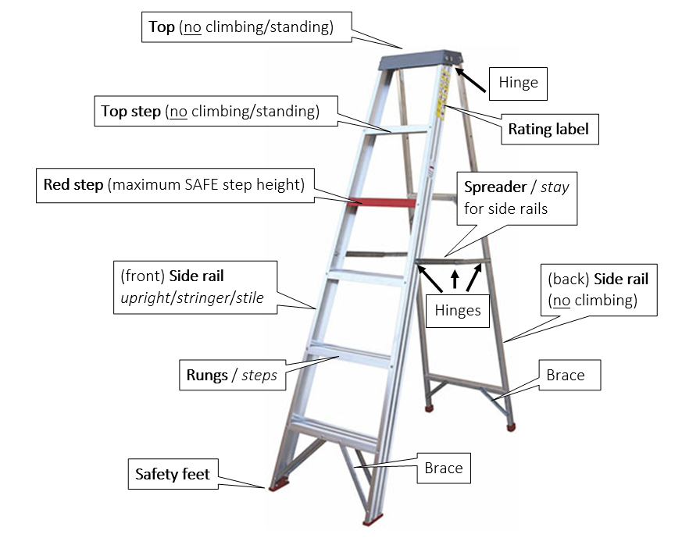

Slide 10

Single (Portable) Ladders
Non-self-supporting – lean against
wall or other support
Use leg extensions or non-slip feet
to ensure stability
Use ladder with correct duty rating
Designed to support at least 4 x maximum intended load
Must extend above roof at least 90 cm
Notes:
Portable ladders are non-self-supporting. They lean against a wall or other support, and can be used for reaching greater heights than a stepladder would allow.
When using a portable ladder, it should be placed on a flat, dry, solid surface, and it should have leg extensions or non-slip feet to ensure stability.
Portable ladders are required to support at least four times the maximum intended load. You can find the ladder’s weight capacity on its duty rating:
Type III – withstands loads up to 95 kg
Type II – withstands loads up to 100kg,
Type I – withstands loads up to 115 kg, and
Type IA – withstands loads up to 136 kg.
Based on these ratings, only Type I or IA ladders should be used in the workplace.
Suggestions for the Speaker
Provide an example of a portable ladder used in your facility as a visual aid.

Slide 11
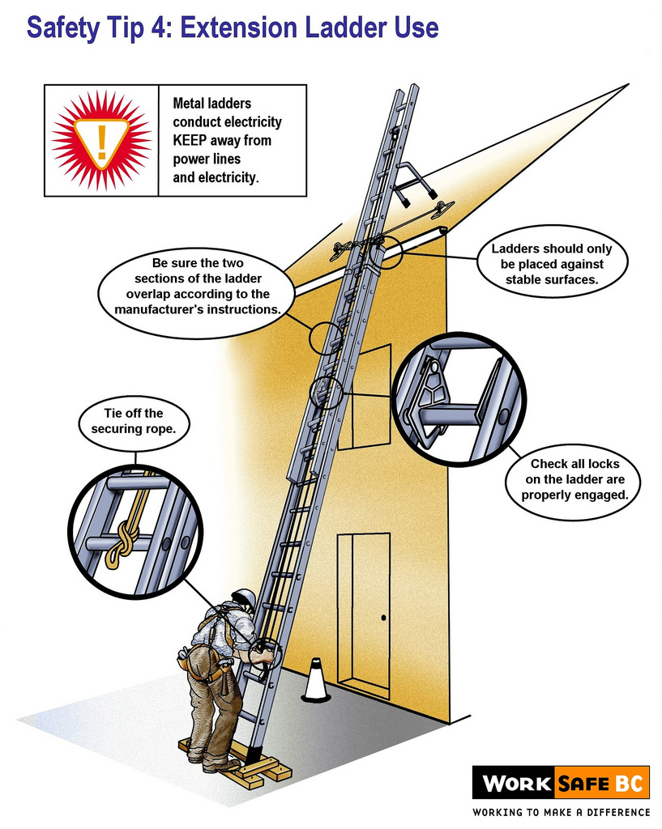

Slide 12
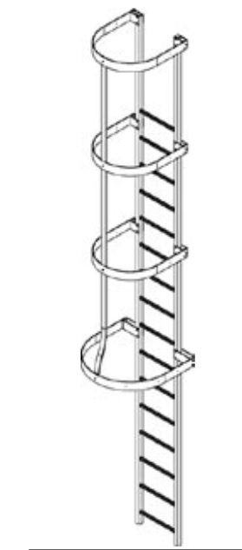
Fixed Ladders
Built into building – can’t be moved
Often encased in cages or wells – for fall arrest
Supports at least two loads of 115kg.
Notes:
Fixed ladders are built into a building or structure and can’t be moved. They’re often found on the outside of a building.
As an added safety precaution, many fixed ladders are encased in cages or wells that encircle the ladder and protect the climber from weather conditions and falling or flying objects
They must be able to support at least two loads of 250 lbs (115 kg). each.
Suggestions for the Speaker
Provide a photo of a fixed ladder as a visual aid. If available, refer to a fixed ladder at your facility.

Slide 13
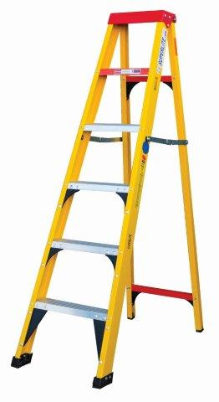
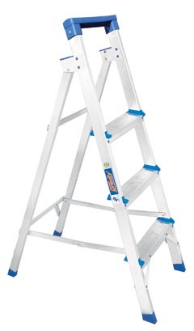
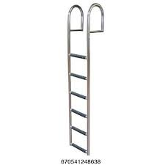
Aluminium, steel or fiberglass?
Aluminium: strong, lightweight, corrosion resistant
Steel: strong, economical, corrosion resistant
Fibreglass: electrically non-conductive, strong, leading choice of professionals
Notes:
Fixed ladders are built into a building or structure and can’t be moved. They’re often found on the outside of a building.
As an added safety precaution, many fixed ladders are encased in cages or wells that encircle the ladder and protect the climber from weather conditions and falling or flying objects
They must be able to support at least two loads of 250 lbs (115 kg). each.
Suggestions for the Speaker
Provide a photo of a fixed ladder as a visual aid. If available, refer to a fixed ladder at your facility.

Slide 14
HOW?

Slide 15
Inspecting Ladders Before Each Use
Missing or damaged components:
  Do NOT use or make temporary repairs!
Loose fasteners:
  Do NOT use or make temporary repairs!
Oil, wet paint, mud, grease, etc:
  CLEAN off all slip hazards!
Damaged, worn or exposed to fire or chemicals:
  MARK with ‘Do Not Use’ tag, DESTROY asap!
Use correct ladder for safe working height
Notes:
The best way to ensure ladder safety is by properly inspecting and maintaining the ladder before using it. This includes:
keeping ladders free of oil, grease and other slipping hazards
checking for broken, cracked or missing rungs, cleats or steps; broken or split rails or corroded components (if parts can be removed by hand, they are considered loose)
inspecting the rungs and steps to ensure they’re sufficiently corrugated, knurled, dimpled, coated with skid-resistant material or otherwise treated to minimize slips
testing movable parts to make sure they don’t stick and aren’t too loose
examining ropes in extension ladders for frays and wear
confirming the duty rating is listed on the side, and
in the case of wooden ladders, checking that they’re not covered with paint or other opaque coatings; if they are, be extra-thorough, since paint can hide small cracks that could cause a break.
Also inspect the area around the top and bottom of the ladder. This area should be kept clear and dry. Avoid slippery surfaces such as liquid, ice and snow.
If a ladder is damaged or defective in any way, it must be marked with a “Do Not Use” tag and removed from service. Don’t try to fix it yourself – leave it for maintenance to fix. Repairs must restore the ladder to its original condition before it can be returned to use.

Slide 17
Inspecting Ladders Before Each Use
Inspect area around ladder for slip hazards
Rating label must be intact – to indicate duty rating:
  Light duty (90kg): “domestic” painting, yard work
  Medium duty (100kg): “light commercial” painting, cleaning, light repair
  Heavy duty (115kg): “industrial” general contracting, building, maintenance, dry walling
  Extra heavy duty (135kg): “professional” industrial construction, building, roofing
Notes:
The best way to ensure ladder safety is by properly inspecting and maintaining the ladder before using it. This includes:
keeping ladders free of oil, grease and other slipping hazards
checking for broken, cracked or missing rungs, cleats or steps; broken or split rails or corroded components (if parts can be removed by hand, they are considered loose)
inspecting the rungs and steps to ensure they’re sufficiently corrugated, knurled, dimpled, coated with skid-resistant material or otherwise treated to minimize slips
testing movable parts to make sure they don’t stick and aren’t too loose
examining ropes in extension ladders for frays and wear
confirming the duty rating is listed on the side, and
in the case of wooden ladders, checking that they’re not covered with paint or other opaque coatings; if they are, be extra-thorough, since paint can hide small cracks that could cause a break.
Also inspect the area around the top and bottom of the ladder. This area should be kept clear and dry. Avoid slippery surfaces such as liquid, ice and snow.
If a ladder is damaged or defective in any way, it must be marked with a “Do Not Use” tag and removed from service. Don’t try to fix it yourself – leave it for maintenance to fix. Repairs must restore the ladder to its original condition before it can be returned to use.

Slide 19
Placement
If surface isn’t level, adjust legs
If needed, use a board or platform for a base
NEVER use an unstable base (e.g. boxes, bricks)
NEVER use a ladder as a horizontal platform, or on a scaffold platform, or lean a stepladder against a wall.
Notes:
After inspecting the ladder, you must choose the best placement. Both stepladders and portable ladders require an even, level surface to prevent accidental movement. If the surface isn’t level, the ladder’s leg levels can be adjusted for slight variations.
If the ladder legs aren’t long enough, a wide, stable platform such as a large board may be used as the base. But never try to level the base or increase the ladder height by setting it on boxes, bricks or any other unstable base.
When positioning a portable ladder to access a roof or platform, the ladder must extend four rungs (at least 91 cm) above the surface, so you can get on and off the ladder safely.
Placing a ladder improperly is the cause of many injuries. Never:
use a ladder as a horizontal platform or scaffold
lean stepladders against a wall for use [no non-stick feet!], or
use a ladder on a scaffold platform.

Slide 20
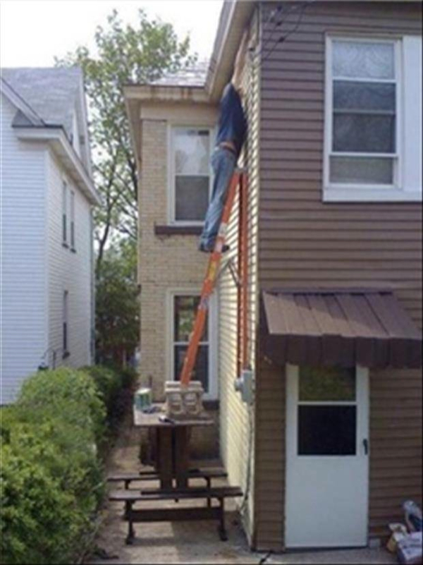
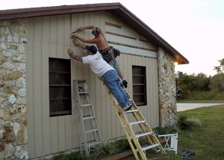

Slide 21
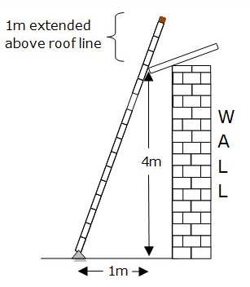
Setting Up
Step 1: Lay ladder on ground with base resting against bottom of the wall
Step 2: Lift top of the ladder; walk under toward the wall, moving hands from rung to rung
Step 3: Pull out base when ladder top touches the wall
4 to 1 rule: for every 1m high, move ladder base out ¼m (if 4m high, base out 1m) →
Notes:
With the placement secure, it’s time to set up a ladder. Proper setup is crucial. If the ladder’s too close to the wall, it could tip back. If it’s too far, it could slide out from the bottom. Here are the proper steps to setting up a ladder:
Step One: Lay the ladder on the ground with the base resting against the bottom of the wall and the top pointing away from the wall.
Step Two: Starting at the top of the ladder, lift the end over your head and walk under the ladder to the wall, moving your hands from rung to rung as you go.
Step Three: When the ladder is vertical, with the top touching the wall, pull out the base. To determine the angle, use the four-feet-to-one-foot rule. That means placing the base one foot away from the wall for every four feet in height. (Example: if a ladder is supported at a point 20 feet above ground, its base should be five feet from the wall.)
When setting up, remember to keep one foot on the base rung of the ladder to provide a firm footing.

Slide 22
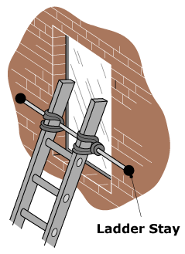
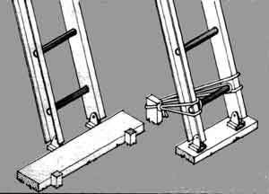
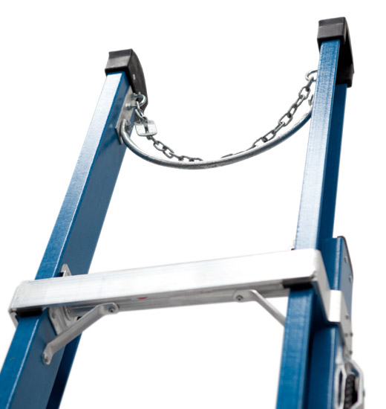
Securing the Ladder
Tie the rope to both side rails of the base – to stakes/blocks/sandbags on ground
Use ladder stays when leaning against window
Station a co-worker at the foot of the ladder
(facing ladder with a hand on each side rail, & a foot on bottom rung)
Be careful, s/he is at risk of being hit if you/items fall!
Use a pole chain when leaning against a pole
Notes:
When working with power equipment, or if the base or top seem unstable, you must secure the ladder.
To secure it:
Tie the base to stakes in the ground, fixed blocks or sandbags to guard against slipping. The rope or strap should be tied to both side rails – not the rungs, since the ropes or straps will slide. Anchor the top as well.
Use ladder stays when the ladder must lean against a window or other surface that can’t support the full weight, by extending the stays across the window for firm support, and
If it’s not possible to secure the ladder with ropes, straps or anchors, station a co-worker at the foot of the ladder, facing the ladder with a hand on each side rail and one foot resting on the bottom rung.
Suggestions for the Speaker
Show workers samples of ties, stakes and other securing equipment.

Slide 23
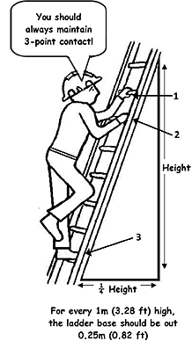
Safe Climbing
Face the ladder
One step at a time
Grab rungs, not side rails … use both hands!
3-point contact rule (hands, feet)
Harness must be used if you need to work with both hands
Notes:
With the ladder secured, the next step is making sure you climb safely.
When going up or down a ladder, remember to:
face the ladder
take only one step at a time, with feet in the center of the steps
grab the rungs of the ladder, not the side rails, and
avoid moving, shifting or extending the ladder by rocking it or pushing it away from the wall.
One of the most common causes of falls is overreaching. A good rule of thumb: Always keep your belt buckle inside the rails of the ladder. When you can no longer reach comfortably from this position, climb down and move the ladder.
Carrying heavy or bulky loads can also result in a fall. It’s safer to climb up first by yourself, then pull up the material with a rope or carry-tools. Remember: NEVER climb a ladder one-handed.
In the event you feel sick, dizzy or anxious on a ladder, don’t try to rush down. Wait, drape your arms around the rungs and rest your head against the ladder until you feel better. If the feeling doesn’t pass, call for help.

Slide 24
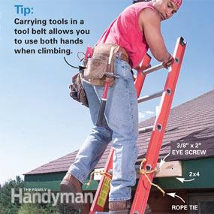
Safe Climbing
Do not move the ladder while you are on it
Follow ‘belt buckle rule’ to avoid overreaching
Never go higher than red step (SA metal ladders)
Avoid carrying bulky loads (rather use tool belt / backpack / pulley rope)
If dizzy: drape arms around rungs, rest head
NEVER climb a ladder under influence of alcohol or flu!
Notes:
With the ladder secured, the next step is making sure you climb safely.
When going up or down a ladder, remember to:
face the ladder
take only one step at a time, with feet in the center of the steps
grab the rungs of the ladder, not the side rails, and
avoid moving, shifting or extending the ladder by rocking it or pushing it away from the wall.
One of the most common causes of falls is overreaching. A good rule of thumb: Always keep your belt buckle inside the rails of the ladder. When you can no longer reach comfortably from this position, climb down and move the ladder.
Carrying heavy or bulky loads can also result in a fall. It’s safer to climb up first by yourself, then pull up the material with a rope or carry-tools. Remember: NEVER climb a ladder one-handed.
In the event you feel sick, dizzy or anxious on a ladder, don’t try to rush down. Wait, drape your arms around the rungs and rest your head against the ladder until you feel better. If the feeling doesn’t pass, call for help.

Slide 25

High Traffic Areas
Hallways, doorways, driveways
Redirect traffic
Lock and block doors
Station a co-worker on
other side of the door
Remember: objects falling off a ladder can cause injury to by passers
Notes:
When working in a high-traffic area like a hallway, doorway or driveway, there’s an increased risk someone will accidentally bump into the ladder and knock it over – and you along with it.
It’s important to alert pedestrians that you are working in the area. Make sure to hang signs and set up cones to redirect floor traffic away from your ladder.
If you must use a ladder in front of a door, make sure:
The doors have been locked to prevent use
The doors have been blocked with barrier tape or a sign warning that there is a person working on a ladder, and/or
A person is standing on the other side of the door to prevent anyone from entering while work is underway.
Suggestions for the Speaker
Point to high-traffic areas in your facility where ladders may be used.

Slide 26
Working Around Electricity
Never lean a ladder against electrical lines
Place the ladder so that if it falls, it will not touch the power lines
Check for overhead clearance and keep a safe distance from overhead/electric wires (at least 3 metres)
Use non-conductive (fiberglass/wooden) ladder
Avoid using a metal or wet wooden ladder
Notes:
Metal and wet wooden ladders conduct electricity, so working around electrical equipment or power sources can be especially dangerous.
Leaning a ladder against electrical lines is a sure-fire way to receive a dangerous shock. Before putting a ladder up, check for overhead clearance and make sure electrical lines are not in the vicinity.
If you must work near electricity, distance is important. Because electricity can “jump” even if you’re not touching the source, keep the ladder, yourself and your tools at least 10 feet away from overhead wires, and use a fiberglass ladder, which is non-conductive.

Slide 27
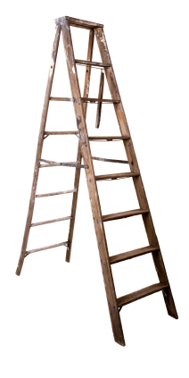
Inspecting Ladders - Quarterly
RU ladder inspection checklist
Ladder has easily readable asset tag or unique identity number
Ladder rating label is intact and easy to read
Ladder is stable, not wobbly (from side strain etc)
Rungs all present, evenly spaced, not worn, smooth or loose
Side rails, rungs, spreaders and braces not broken/cracked/split
Spreaders and hinges not bent, loose, or with broken stops
Ladder has no sharp edges, loose screws, bolts or nails
Ladder is clean, not greasy (slippery) or painted (hiding defects)
Non-slip base/safety feet intact, not damaged or worn smooth
Ladder is stored safely and correctly
All staff who routinely make use of this ladder have been instructed on ladder safety/attended a ladder safety course
Extension ladder: rope is strong, not frayed/deteriorated
Extension ladder: extension locks not loose/broken/missing
Wooden ladder: free of splinters, cracks or decay
Ladder is fit for use OR Comments on actions taken
www.ru.ac.za/safety/resources/ladders
Notes:
The best way to ensure ladder safety is by properly inspecting and maintaining the ladder before using it. This includes:
keeping ladders free of oil, grease and other slipping hazards
checking for broken, cracked or missing rungs, cleats or steps; broken or split rails or corroded components (if parts can be removed by hand, they are considered loose)
inspecting the rungs and steps to ensure they’re sufficiently corrugated, knurled, dimpled, coated with skid-resistant material or otherwise treated to minimize slips
testing movable parts to make sure they don’t stick and aren’t too loose
examining ropes in extension ladders for frays and wear
confirming the duty rating is listed on the side, and
in the case of wooden ladders, checking that they’re not covered with paint or other opaque coatings; if they are, be extra-thorough, since paint can hide small cracks that could cause a break.
Also inspect the area around the top and bottom of the ladder. This area should be kept clear and dry. Avoid slippery surfaces such as liquid, ice and snow.
If a ladder is damaged or defective in any way, it must be marked with a “Do Not Use” tag and removed from service. Don’t try to fix it yourself – leave it for maintenance to fix. Repairs must restore the ladder to its original condition before it can be returned to use.

Slide 28
WELL?

Slide 29
Remember
25% of all accidents are falls from elevated positions
Inspect equipment regularly & keep records!
Follow proper placement, setup and climbing procedures
Redirect pedestrians in high-traffic areas
Keep a safe distance from overhead/electric wires
Notes:
Ladder-related injuries, whether caused by falls or getting struck by falling objects, can be avoided.
This means carefully inspecting ladders to make sure they’re safe to use, following proper setup steps, including checking that the surface is level and free of debris and slickness, and using fall arrest systems when working at heights above six feet.
When working in high-traffic areas, remember to block off doorways and redirect pedestrian traffic away from the work area.
Avoid electrical sources whenever possible. If you must work around electricity, make sure you’re at least 10 feet away and using a non-conductive fiberglass ladder.
Suggestions for the Speaker
Open the floor to further discussion. If there are no other questions, test trainees using the quiz provided.

Slide 30
More Info
Rhodes University:
  Safety, Health & Environment
  SHE Officer - RU ext 7205
  safety@ru.ac.za
Ladder Safety:
  www.saladder.co.za
  www.heightsafety.co.za
  www.ru.ac.za/safety/resources/ladders

