Slide 1



LEARNING FROM PRACTICE: WHAT MATHEMATICAL KNOWLEDGE IS NEEDED FOR DEVELOPING NUMBER SENSE
Samukeliso Chikiwa, Lise Westaway & Mellony Graven
Rhodes University

Slide 2
Maths education in South Africa
Maths generally performed poorly in South Africa at all levels of education.
International and national studies TIMSS and SACMEQ confirm our learners are behind their international counterparts
The ANAs and the NCS results confirm the crisis
(Fleisch, 2008; Spaull 2013; Taylor & Taylor, 2013; Robertson & Graven, 2015; Graven, 2016)

Slide 3
Reasons behind maths poor performance
Research suggests that the majority of mathematics teachers lack adequate subject matter knowledge (SMK) and pedagogical content knowledge (PCK) to teach mathematics more effectively.
According to Ball et al. (2008) SMK+PCK=Mathematical Knowledge for Teaching (MKfT). Research therefore claims that the majority of teachers in SA have inadequate MKfT
Learners exit foundation phase without developing adequate number sense to solve mathematics problems. i.e. they exit with inefficient arithmetic strategies and as a result fail to cope with the arithmetic demands of the higher grades
(Fleisch, 2008; Spaull 2013; Taylor & Taylor, 2013)

Slide 4
What is Mathematics Knowledge for teaching (MKfT)?
Shulman (1987) proposed there is knowledge specific to the work of teaching which he name pedagogical content knowledge (PCK).
This is the knowledge of the content of the subject and how to teach it
Ball, Thames and Phelps (2008) refined Shulman’ s PCK to make it subject (mathematics) specific and provide a clearer understanding of what knowledge mathematics teaching requires and came up with MKfT.
MKfT =subject matter knowledge + pedagogical content knowledge.

Slide 5
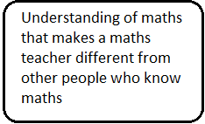

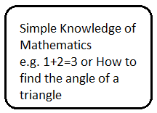
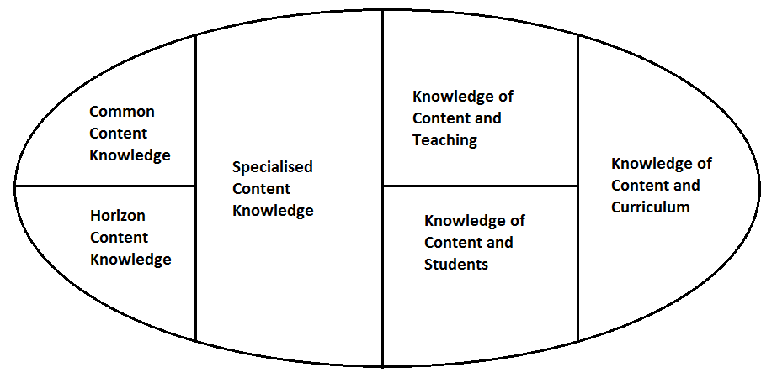
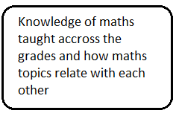
Model of Mathematical Knowledge for Teaching (Ball et al., 2008, p. 403)

Slide 6
Research generalises that mathematics teachers lack both content and pedagogy. However careful consideration makes us realise:
it is not all teachers in SA who do not have adequate mathematics knowledge for teaching
There are some teachers among us who possess the MKfT from whom we can learn.
There is therefore a need to identify such teachers and learn from them

Slide 7
Why conduct this research ?
We identified and selected one such teacher in one of our schools.
This research sought to investigate what MKfT is enacted in this selected expert teacher and how she employs this knowledge in developing number sense through counting.
Research question: What MKfT in relation to development of number sense through counting does an expert Grade 2 teacher have and use in her teaching?

Slide 8
Why counting?
Counting introduces learners to the number world.
According to the DBE (2011), “counting enables learners to develop number concept, mental mathematics, estimation, calculation skills and recognition of patterns” (p. 9).
Counting is regarded as the first step to developing number sense (Naudé & Meier, 2014).
Counting is basic to development of number sense

Slide 9
Some literature review about counting
During the early stages of learning to count, learners struggle to count in an accepted number word sequence from one to sixteen.
Learning to count requires identification and mastery of the counting pattern.
Learners often confuse the teen numbers and the decuple (teen and ty numbers) e.g. sixteen & sixty; seventeen & seventy.
(Gifford, 2005;Reys, Lindquist & Smith, 2007; Haylock & Cockburn, 2008)

Slide 10
Methodology
Qualitative research.
Case study with one teacher as a sample, conveniently selected.
Study conducted at a government school in Grahamstown
I observed fifteen mathematics lessons over four weeks focusing on the counting sessions she conducted with the whole class, her first group and third group.
Conducted two structured interviews, based on video recordings of selected observed lessons.
Both the lessons and interviews were transcribed and analysed using MKfT framework.

Slide 11
Data analysis
Sharing an excerpt from one of the lessons conducted by the selected teacher

Slide 12
T | Okay boys! It is time for Maths. Let us go to the back carpet. Come on come on let us be quick. [Learners move to the carpet and sit down facing the teacher’s carpet chair. The teacher stands next to the beadstring in front of the learners] Quiet boys! We are going to count forward in ones.
TLL | [Tr pulling the beads on the beadstring one at a time as the learners count] One, two, three, four, five, six, seven, eight, nine, ten, eleven, twelve …
TLL | [Tr reducing the tempo and emphasising the ‘teen’ sound as she counts with the learners] thirteen, fourteen, fifteen, sixteen, seventeen, eighteen, nineteen [Tr then emphasises the—‘ty’ sound and the units as she counts with the learners] twenty, twenty-one, twenty-two, twenty-three …
LL | [Tr keeps quiet] twenty-four, twenty-five, twenty-six, twenty-seven, twenty-eight, twenty-nine, thirty, thirty-one thirty-two, thirty-three, thirty-four, thirty-four, thirty-five, thirty-six
T | Stop! I was on thirty-six, I want you to listen very carefully. What two numbers do I need to make thirty-six? Thirty-six [Tr putting emphasis on thirty]
LL | Thirty and six
T | I need a thirty and a six! Good, Let’s go on.
TLL | Thirty-seven, thirty-eight, thirty-nine, forty
T | Stop! How many tens do we have in forty? Julius?
Notes:
Whole class counting on the mat
Using a bead string- tags the beads as learners count.
Counts with learners at the problematic areas of counting
Reduces the tempo of counting to emphasize the teen and the ty sound

Slide 13
Some interview extracts that influenced her counting sessions
Her counting sessions were influenced by her understanding that “there are five principles of counting that govern meaningful counting. (FI2, V2, T73).
“Counting is not just a component of just rote count, spit out of your mouth and it means absolutely nothing, … it must be one to one, it must be an uttering the correct word on the correct number” (FI2, V2, T23).
“if a child can see patterns they can do maths” (FI2,
V2, T103) because “Maths is a pattern. It’s the same thing over and over” (FI2, V2, T105).

Slide 14

Model of Mathematical Knowledge for Teaching (Ball et al., 2008, )

Slide 15
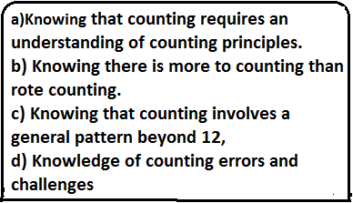
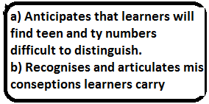
Findings: MKfT displayed during counting lessons

Slide 16
Conclusion
MKfT required to teach a seemingly easy concept like counting is complex.
All the knowledge domains are significant for teaching but not all were useful in relation to the teaching of counting.
We found that there is a strong interdependence between these MKfT domains and thus a very ‘thin line’ between them.
KCT is central to teaching of counting. All the other domains inform and influence how the teacher teaches.
Through this research, we realised that the teacher was not always conscious of her MKfT. Her counting sessions were seamless and in many respects her MKfT was automated. Like an experienced driver, she did not stop to think about what MKfT she was drawing on at any particular moment in time.

Slide 17
The end
Thank you
Questions and COMMENTS

