Slide 1
Early Number Fun Grade R programme Session 1 19th April 2016
Prof Mellony Graven; Dr Debbie Stott, Ms Carolyn Stevenson-Milln;
Ms Pam Vale; Ms Roxanne Long; Ms Samu Chikiwa

Slide 2
Community of co-learners
Who are we in the SANCP?
What is our brief?
Who are we accountable to?
Like NICLE this is a partnership of teachers, teacher educators, researchers, district/ provincial specialists to form a learning/inquiry community
Our joint enterprise: to all learn about how to support South African Grade Rs better and how to support teachers better (both pre and inset)
Resources are research informed and curriculum informed – experience of them and adaptations are teacher informed - concrete testing and trialling, discussion and sharing
Meet once per month – greatest resource will be our interactions

Slide 3
Suggested dates
Tues 17th May (1-4pm)
Tue 14th June (1-4pm)
Tue 19th July (1-4pm)
Tue 23rd August (1-4pm)
Tue 20 September (1-4pm)
Venue – Post Grad Village
Similar dates for 2017

Slide 4
Getting to know you
School visits – meet & feel for physical spaces in classrooms
Know most schools from NICLE but not G R
Need more background and views - tailor ENF & support your trajectory
Questionnaire (30 minutes)
Teacher introductions

Slide 5
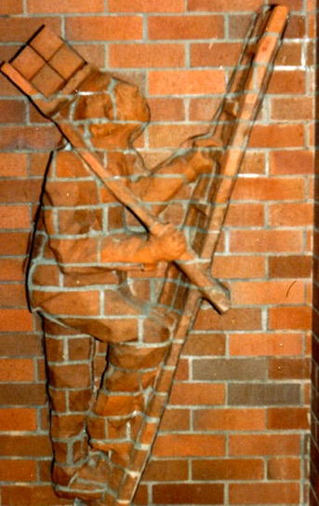
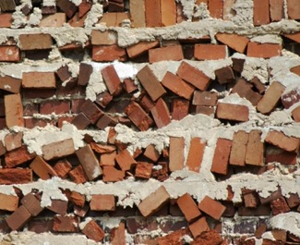
Pre-school is critical in closing the performance gap

Slide 6
Orientation document
CoPs and PLCs buzzword for supportive communities focused on learning
We all learn – common goal
our role to bring quality resources for engaging
Resources chosen - consulted widely (including teachers)
Practitioner and research informed
Program/resources transform with your input
tailor program according to feedback

Slide 7
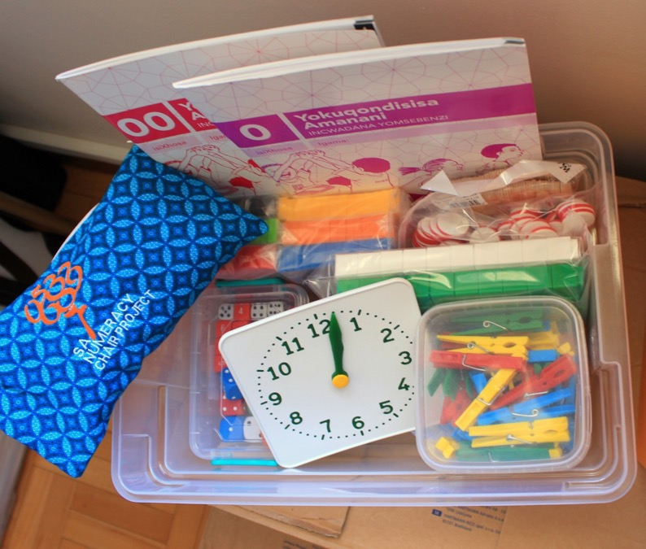

Slide 8
Guiding assumptions/ Big ideas
Active construction
Build on existing knowledge
Activities should be at ‘cutting edge’
Activities should encourage
language development
play / imaginary play
story telling
movement activities

Slide 9
Lila video
building on learner knowledge and working at the cutting edge

Slide 10
Assumption: parents critical resource
Pilot parent program in 2016 with one school
Depending on feedback offer to all schools
Based on similar resource kit

Slide 11
Progressive numeracy learning
 |  | Grade R | Gr R → 1 | Gr 1 & 2 | Gr 3 & 4 | Gr 4 →
Cranfield et al. |  | Emergent numeracy | Learning to count and calculate | Calculate by structuring | Formal calculating | Counting and calculating up to 100
Wright et al. (LFIN) | EAS | 0, 1, 2 | 3, 4 | 5
 | Structuring nos. 1 - 20 | 1, 2, 3
 | CPV |  |  |  | 3 | 3
Buys & Treffers |  | Stages 1 to 4 Context bound – up to 4 objects Object bound – up to 10 objects Via symbolisation – unseen items/fingers | Stages 5 & 6 Count all Count on Count up to Count down | Stages 7 & 8 Stringing & splitting Doubles/halves Combining with 5 & 10 Partitions of 5 & 10 |  | Stages 9 & 10 2-digit + and -
Buuys, Treffers Visual progression
Representations |  | Tallies, finger patterns, dot patterns | Models of… Line, group, combination, part-part-whole
10
9
Calculate to 100
8
Count to 100
6 - 7
Formal calculating
5
Counting by structuring
4
Calculation by counting
3
Pure calculating
2
Object bound
1
Context bound
Learning
to count

Slide 12
Grade R progression
Context-bound
Object-bound
Pure counting
Putting across “How Many” and comparison questions in such a way that they are embedded in the child’s world of experience.
Thus takes place in meaningful problem-related situations
Big push here is to present situations that encourage the child to:
Count synchronously as a meaningful function
order, compare, estimate,
more, less, many, few, ‘add’, ‘take away’
Examples through circle time and in activity areas:
How old - a birthday party cake where candles are lit one-by-one
What time is it – counting by clock strikes
How high is the tower – counting a stack of building blocks
How many children in the group – counting to know how many for sweets etc
Putting across “How Many” and comparison questions that are related directly to concrete objects.
To progress from context-bound, gradually push the context into the background but the situation still remains available for those children who still need it
E.g. Shift birthday party question from “how old” to “how many candles”
Big push here is to present situations that encourage the child to:
Count concrete objects synchronously as a meaningful function
Some visible and some hidden via concealment games
Lay out objects in an orderly way or pattern for recognition
Order, compare, estimate,
more, less, many
Simple strategies for adding and taking away items
Transferring counting from objects to representations of the objects such as
Fingers
Dot patterns
Concrete objects
Tallies
Number symbols
All above except the number symbol contain something in a countable form.
Big push here is to:
provide situations where the children can link countable items with the numeral form using flash cards and other resources.
The objective is not to do arithmetical operations but rather to focus on the understanding of the what the numeral symbol means.
Continuing to work with visible and non visible items so that children start to imagine representations.

Slide 13
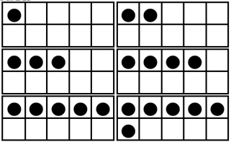
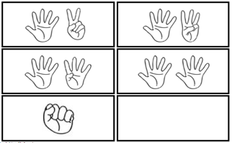
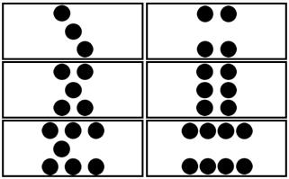
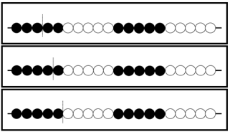
Key representations help to progress up the steps
5 and 10-frames
Fingers
Dot patterns
Bead strings

Slide 14
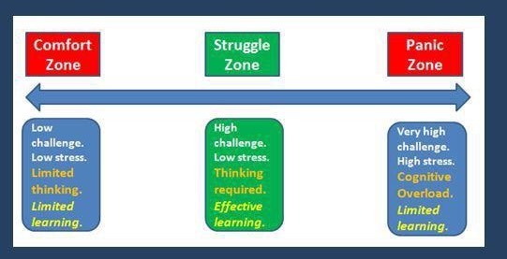
Emotions matter – but children must learn to enjoy a challenge
A teachers job is not to make all learning easy – its to help children rise to the challenges of learning and to enjoy the learning process with all the mistakes along the way

Slide 15
Growth mindset Research on mindsets overwhelmingly strong

Slide 16
Mindset posters for your classrooms

Slide 17
Cognitive control (Executive functioning)
Neurological research on executive functiong informs many activities we have chosen
3 key aspects – influence school readiness and performance more than IQ
Working memory
Inhibition
Shifting attention

Slide 18
Example game for working memory
Here is a picture of 10 objects on a plate
You have 30 seconds to try to remember them without writing them down
How many can you remember?
Learners will use real objects that they bring from home
The game can be made harder by:
More items
Asking to remember colours, size, quantity…

Slide 20
Example game for Inhibition
Simon says – change to isiXhosa or Afrikaans
Play it

Slide 21
Examples for Shifting attention

Slide 23
How many ways can you sort a pack of cards?

Slide 24
Each month
Resources relating to each of the above aspects
Teacher handbook to build up into a library
This session resources have focused on those needed for assessment
Focusing on learner progression is essential but can’t be done without individual assessment

Slide 25
Assessment
Demo of Lebone learners teachers stand around us doint it in groups with their clipboards

Slide 26
Ongoing research about what we are learning
Our accountability involves us sharing what we are learning about how to strengthen Grade R learning with others at conferences and through research and publications
All schools and teachers names are anonymous
We are researching whether the support we are giving and bringing helps
For this we will draw on questionnaires, interviews (occasional), classroom visits and learner assessment forms
NOT assessing you as teachers – researching how key resources and activities may or may not be helping

Slide 27
Fun game activity – Lion, lion what’s the time
Make a lion, leopard or other scary creature mask
Materials:
Paper plate, marker pens, elastic scissors,stapler
Children can make own and can be zebras or other in pretend play
Play game (can also use chalk on floor)

Slide 28
Next month: 17th May
Plastic box with range of other resources BUT need to bring assessment sheets of learners for our records
Travel well and we are really excited to be partnering with you all!

