Slide 1
Early Number Fun Grade R programme Session 2 17th May 2016
Prof Mellony Graven; Dr Debbie Stott, Ms Carolyn Stevenson-Milln;
Ms Pam Vale; Ms Roxanne Long; Ms Samu Chikiwa

Slide 2
Group feedback on: Session 1 assessments
In groups of 3-4 and with teachers from other schools discuss the questions on the handout
Select a scribe to jot down main ideas and points of discussion

Slide 3
Reflection on: implementation of session 1 Activities
In groups of 3-4 and with teachers from other schools discuss the questions on the handout
Select a scribe to jot down main ideas and points of discussion

Slide 4
Dialogical reading using number story books
CONTEXT-BOUND– BUT extending to OBJECT-BOUND counting

Slide 5
Number story activities: Key numeracy skills
Context bound counting and calculating (1-5 in the first 2 stories 1-10 in the 3rd)
Object bound counting and calculating (1-5 in the first 2 stories 1-10 in the 3rd )
Numeral recognition (numerals 1-5 in the first 2 stories 1-10 in the 3rd)
Compare quantities and develop language of more/ less/ many/ none
Develop comparative language for size – big and small; more and less
Recognition of words like ‘more’ ‘less’ ‘big’ ‘small’
Develop a patterned sense of bonds to 5 (i.e. 5-0; 4-1; 3-2; 2-3; 1-4; 0-5 and bonds to 10 - 3rd story)
Use written tallies and/or numbers to represent the patterned story of how the ‘number of …’ changes in each place in each stage of the story (extension for learners ready for this aspect)

Slide 6
Number stories – key literacy skills
Love of stories and Love of reading
Listening and prediction skills
Comprehension skills
Develop comparative language for size: big and small; more and less
Common word recognition: ‘more’ ‘less’ ‘big’ ‘small’
Imagination and own story telling
Logic, structuring and organisation of ideas

Slide 7
Method
Focus on pictures, numerals and words and speak the key words and number names as the story unfolds
Act out with facial expressions emotions and feelings communicated in the story
Have a conversation with the reader
Predict what might happen next
Tell their own stories using story-boards and puppets
Tell their own stories using their fingers to represent the number of monkeys/frogs/children in different trees/lily pads/places etc.
Do imitative reading where they ‘read’ the story to others in the class

Slide 8
Piloting and demonstration
Method was piloted with 3 learners in an after care centre
Piloting with a small group of learners first can help to adapt you method and needs to the Gr R learners in your class
Today we have 2 learner volunteers to share with you a demonstration of using the books
Of course each situation will be different according to your learners input but we hope the demonstration illuminates some aspects of the method

Slide 9
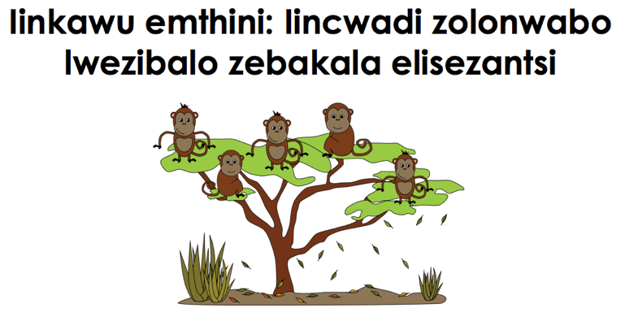
isiXhosa
Afrikaans
English

Slide 10
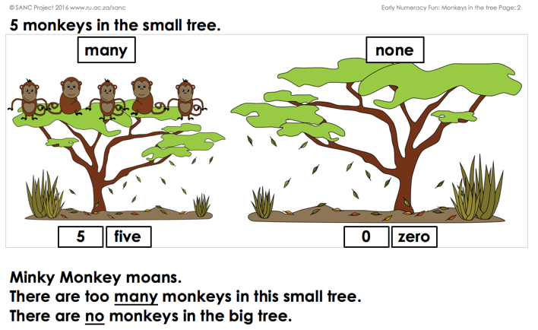
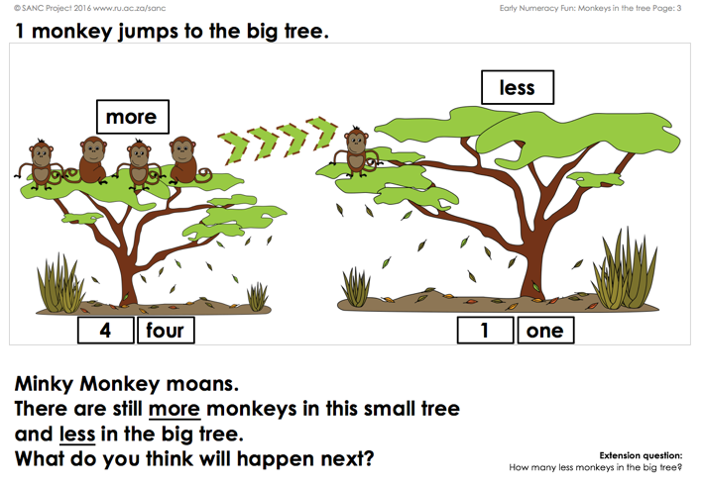
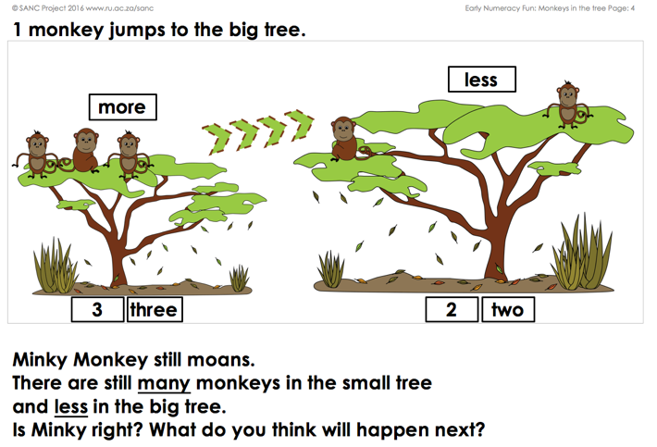
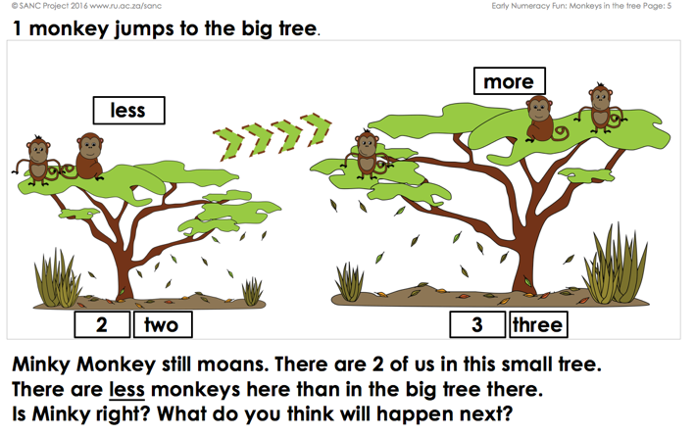

Slide 11
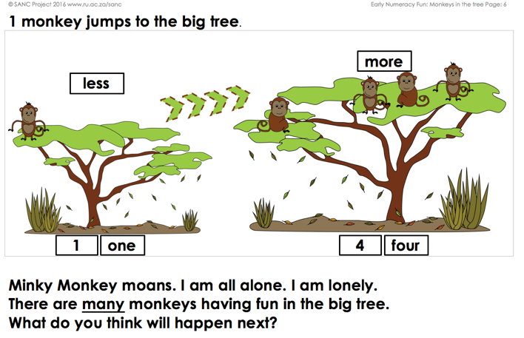
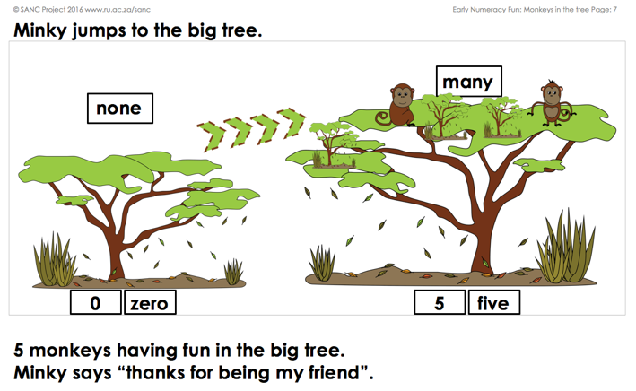
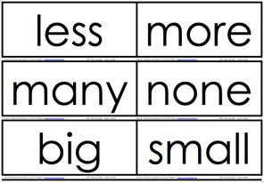
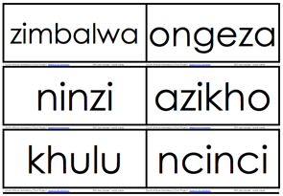
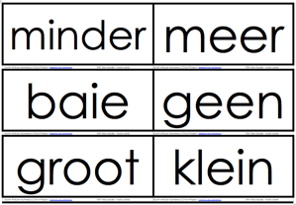
Available from:
http://www.ru.ac.za/sanc/teacherdevelopment/earlynumberfungrader2016-2017

Slide 12
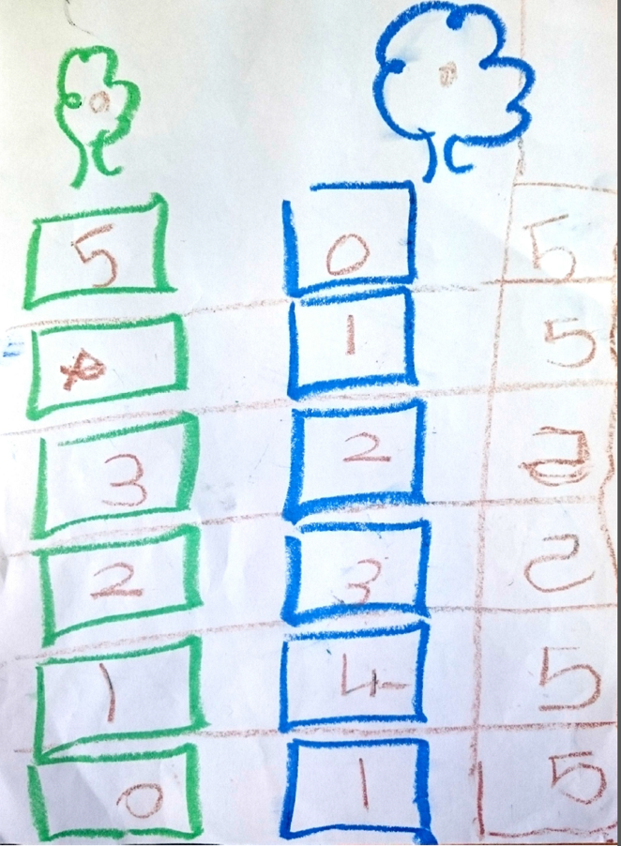
Example extension activity

Slide 13
Reflection and possible adaptations
Based on what you saw in the reading demonstration discuss the following:
What numeracy skills were being developed?
What other skills were being developed?
What would you do differently with your learners? Explain.

Slide 14
Creative activity – Making finger puppets

Slide 15
Next mindset poster for your classrooms

Slide 16
Love of learning – love of numbers
Developing confidence in working with numbers will help learners develop a love of numbers BUT
Grappling with numbers, making mistakes and thinking about those mistakes is important for developing love for learning about numbers and sustaining this love even when the number ranges get much bigger and more challenging.
Discuss these ideas with your learners when you put up the poster – we love working with numbers not because its always easy but because its interesting and helps our brain to grow (previous poster).

Slide 17
Cognitive control Focus on SHIFTING ATTENTION

Slide 18
Free Play / Inquiry Phase
to develop and support geometric reasoning, learners should be given many different opportunities to play freely with materials, e.g. the shape cards in your resource kit.
By playing with shape-related materials, children develop their physical knowledge. Guided not by the teacher, but by their own imagination - through touching, looking at, and building with shapes and objects - learners develop understanding of the properties of the materials provided.
Visualisation skills also develop through free-play and exploration of materials, as learners:
recognise the shapes and objects
sort them into group with similar properties or attributes, and can see the differences and similarities between the shapes or objects

Slide 19
Focused Play
During ‘focused play’, sometimes referred to as ‘teacher-directed activities’; learners use the same materials as ‘free-play’.
BUT rather than leaving the learners to create their own shapes and objects, the teacher guides the activity -by setting challenges
This develops - Logico mathematical (conceptual) knowledge
These games are examples of ‘challenges’ to pose to learners

Slide 20
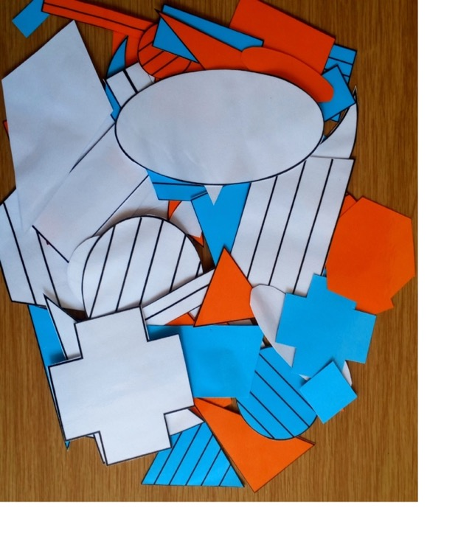
Shape sorting

Slide 21
Games

Slide 25
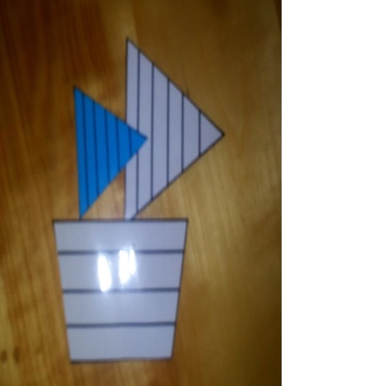
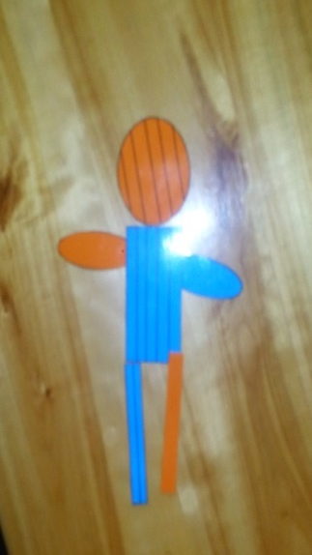
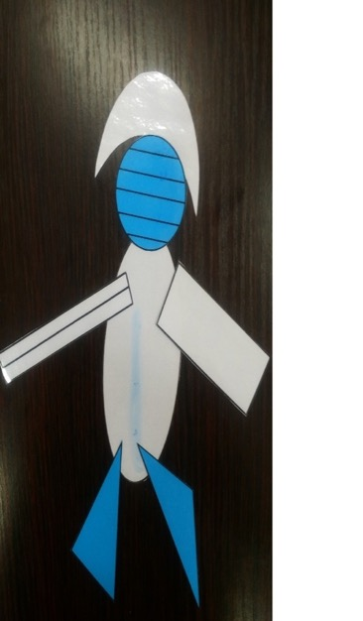
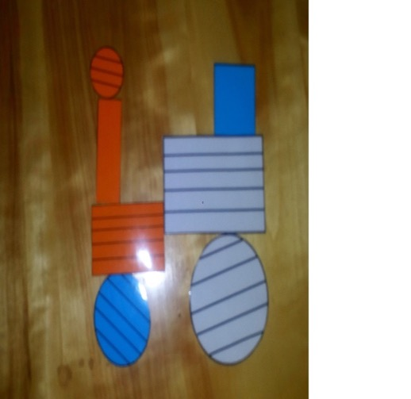
Examples

Slide 26
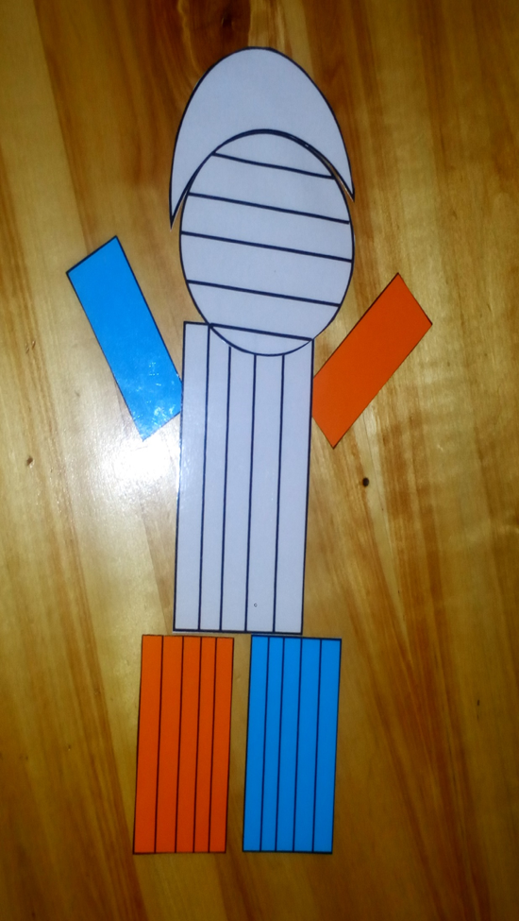
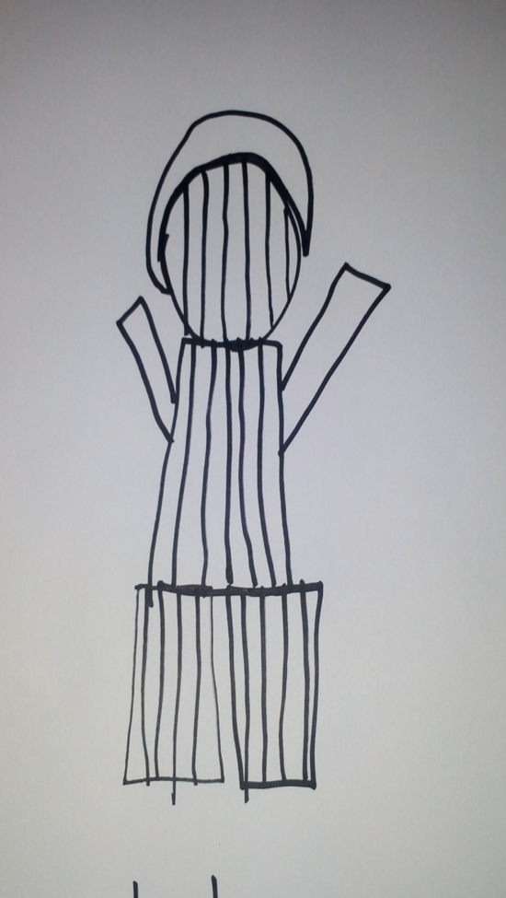

Slide 27
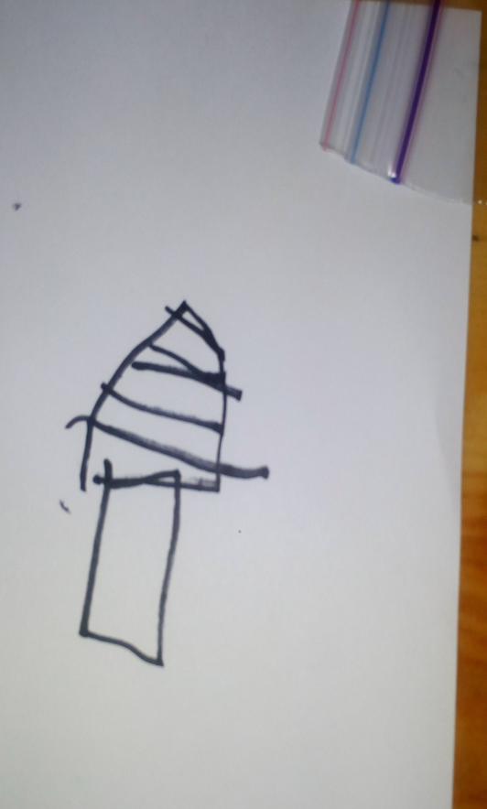
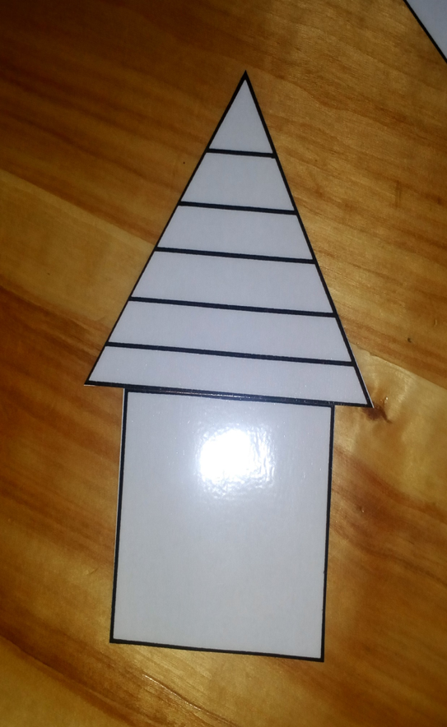

Slide 28
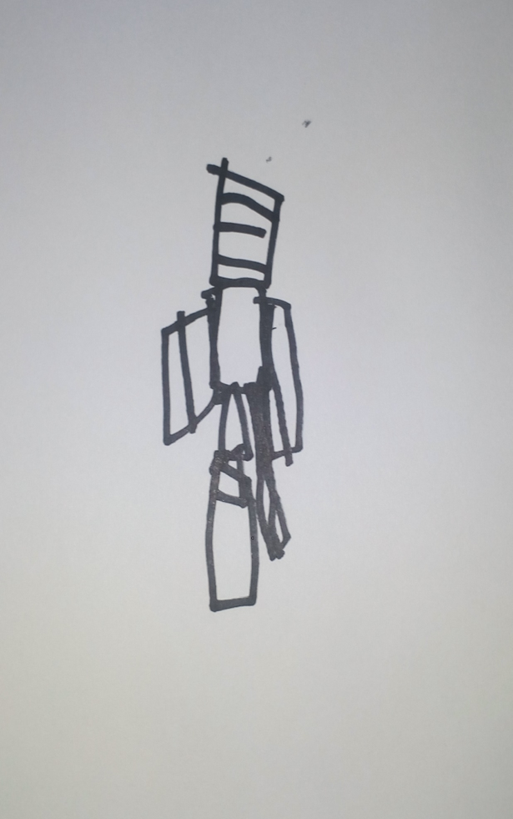
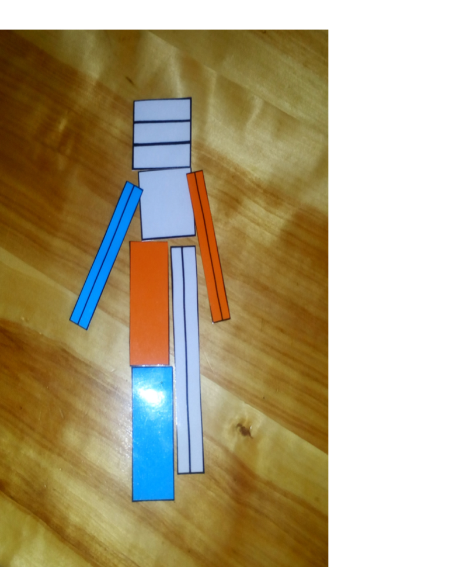

Slide 31
Do these activities with 3-D objects
All of the above activities can be done with differently shaped 3-D objects that learners can bring from their environment.
e.g. toilet rolls, match/milk/tissue boxes, cans, dice, balls and so on

Slide 32
“Both free- and focused play contribute to children developing intuitive understandings of how shapes and objects are the same and/or different. They begin to realise that properties such as the lengths of the sides/edges, the angle-size of vertices and nature of surfaces all define the shape or object with which they are working.”
(Numeracy Handbook for Foundation Phase Teachers, (2013), p. 114)

Slide 33
Implementing ideas
In the next session as always we will reflect on your implementation of these activities in your class
Take photos of your learners using resources in class
Jot down your reflections and bring them to the next session

Slide 34
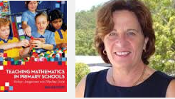
Next month: 20th June
Next month’s session – Monday 20th June
Internationally acclaimed mathematics educator Robyn Jorgensen (NICLE teachers to join from 3pm)
Travel well and we are really excited to be partnering with you all!

