Slide 1
Early Number Fun Grade R programme Session 4 19th July 2016
Prof Mellony Graven; Dr Debbie Stott, Ms Carolyn Stevenson-Milln;
Ms Pam Vale; Ms Roxanne Long; Ms Samu Chikiwa

Slide 2
Agenda
Housekeeping
Dates: 5th September and 25th October
Umbrella and Children story
Classroom video and discussion
Patterning and puzzle activities
Playing card activities
Cognitive control
Mathematical focus
Finish

Slide 3
Dialogical reading using number story books
CONTEXT-BOUND– BUT extending to OBJECT-BOUND counting

Slide 4
Number story activities: Key numeracy skills
Context bound counting and calculating (1-5 in the first 2 stories 1-10 in the 3rd)
Object bound counting and calculating (1-5 in the first 2 stories 1-10 in the 3rd )
Numeral recognition (numerals 1-5 in the first 2 stories 1-10 in the 3rd)
Compare quantities and develop language of more/ less/ many/ none
Develop comparative language for size – big and small; more and less
Recognition of words like ‘more’ ‘less’ ‘big’ ‘small’
Develop a patterned sense of bonds to 5 (i.e. 5-0; 4-1; 3-2; 2-3; 1-4; 0-5 and bonds to 10 - 3rd story)
Use written tallies and/or numbers to represent the patterned story of how the ‘number of …’ changes in each place in each stage of the story (extension for learners ready for this aspect)

Slide 5
Number stories – key literacy skills
Love of stories and Love of reading
Listening and prediction skills
Comprehension skills
Develop comparative language for size: big and small; more and less
Common word recognition: ‘more’ ‘less’ ‘big’ ‘small’
Imagination and own story telling
Logic, structuring and organisation of ideas

Slide 6
Method
Focus on pictures, numerals and words and speak the key words and number names as the story unfolds
Act out with facial expressions emotions and feelings communicated in the story
Have a conversation with the reader
Predict what might happen next
Tell their own stories using story-boards and puppets
Tell their own stories using their fingers to represent the number of monkeys/frogs/children in different trees/lily pads/places etc.
Do imitative reading where they ‘read’ the story to others in the class

Slide 7
isiXhosa
Afrikaans
English

Slide 8
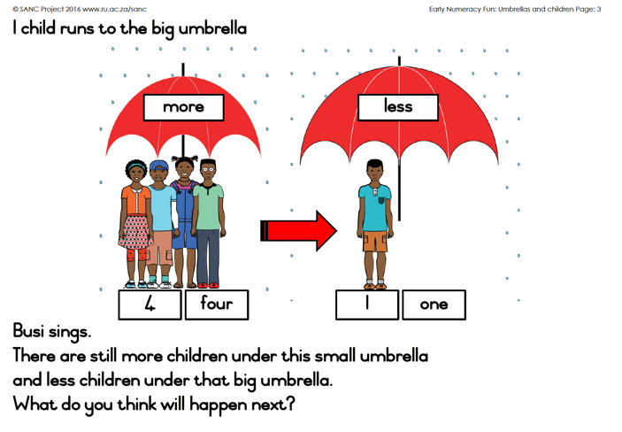
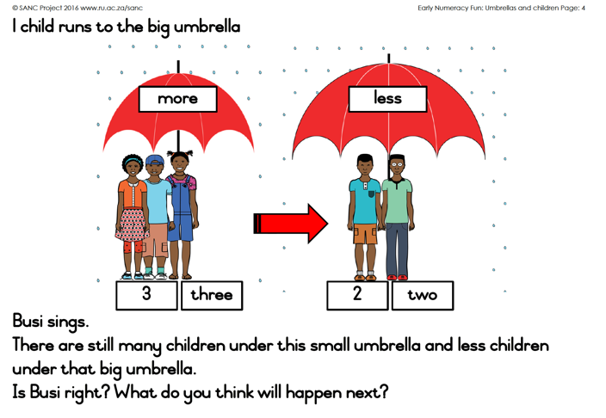

Slide 9
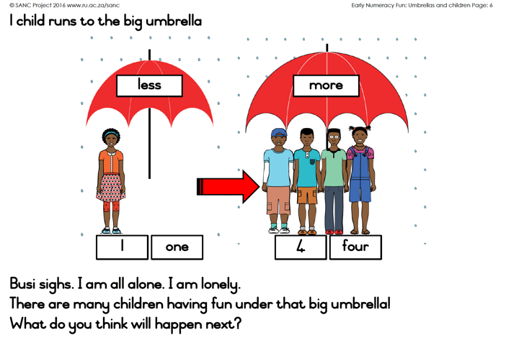
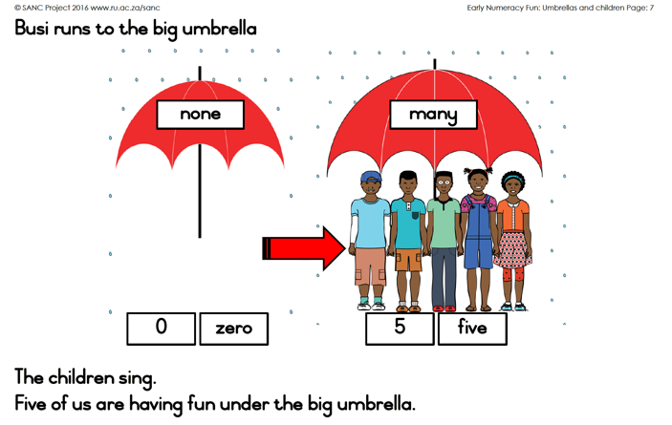
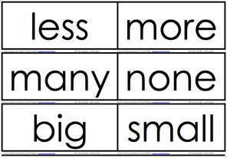
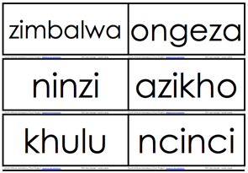
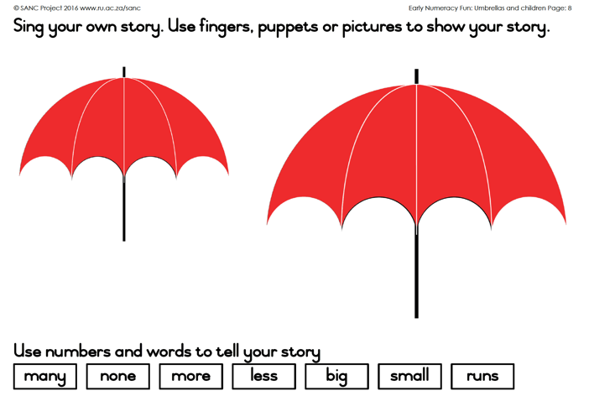
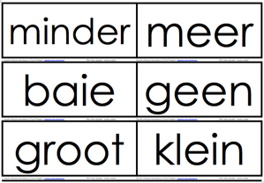
Available from:
http://www.ru.ac.za/sanc/teacherdevelopment/earlynumberfungrader2016-2017

Slide 10
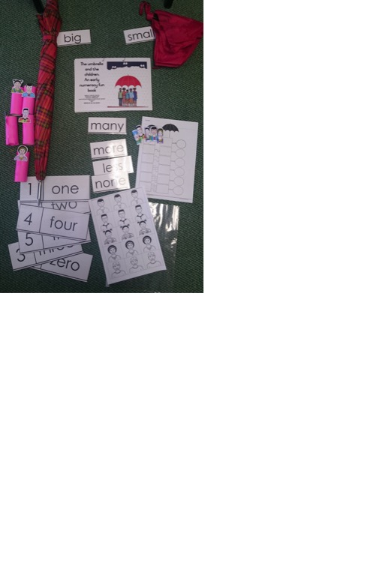
Umbrella and children story
15 minute classroom video
Using the story in the classroom:
Use the story over the course of a week
Day 1 – read the story
Day 2 – Introduce many, more, less, none words & number symbols on cards
Day 3 – Introduce numerals and words on cards
Day 4 – act it out
Day 5 – Make finger puppets with children for learners to use to enact story
Following days – worksheet and other adaptations

Slide 11
Patterning and puzzle activities
1 to 31 number grid
1 to 10 number grid
Puzzle pieces

Slide 12
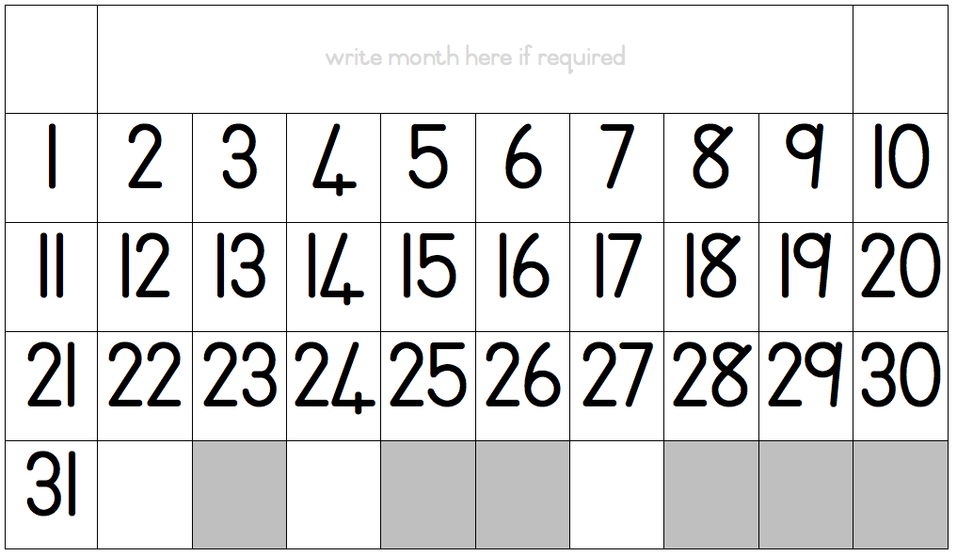
1 – 31 number grid page 6
Ask learners to read the numbers from 1 to 10 with you. Then continue reading the numbers all the way up to 31 for the learners
Ask learners if they know what today’s day is, month is and day is. Show them this day on your calendar. Write the month at the top of the grid.
Now ask the learners if they can find that same day (number) on the 1-31 grid. Circle this number with a dry wipe marker.
Ask learners if they can guess why the numbers here stop at 31.
Cover the numbers 11-31 with paper – focusing on the row of numbers from 1-10. Tell learners that you are going to cover one number with a block and they must figure out what number is covered. Ask learners to close their eyes and you cover any one number on the grid. E.g. if you cover 6 then ask learners what number did I cover? And how do you know that number is 6?
Cover a number as above, and ask a learner to write the number that is underneath.
Cover a number as above. Ask learners what number comes before and after

Slide 13
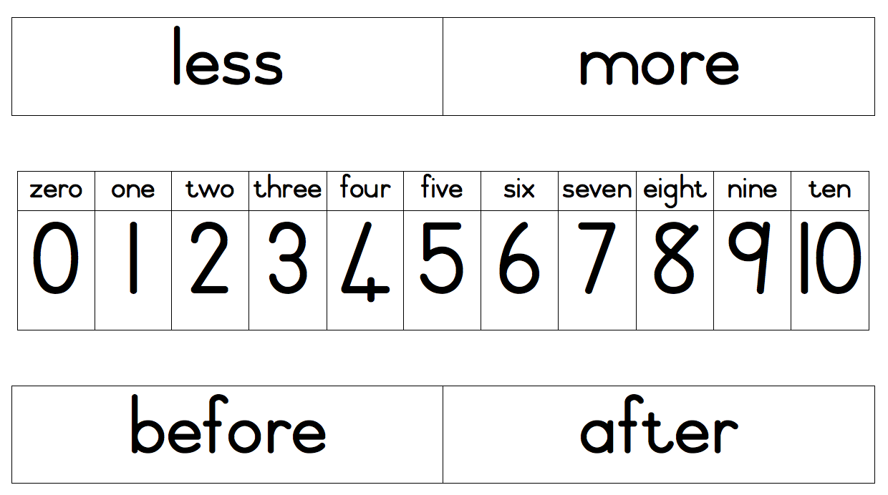
1 – 10 number grid
This can be used for individual work to extend activities introduced with the 1 to 31 grid

Slide 14
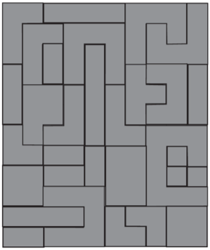
Puzzle pieces page 7
Object of learning:
Shape recognition and description of shapes
Spatial reasoning and measurement
Developing language of comparison
Build rectangles
Ask learners to show you a rectangle in the classroom (they could point to the door, or windows or carpet, tiles etc.).
Ask them why they say those are rectangles and discuss the properties of the opposite sides being equal and usually we have 2 long sides and two short sides and the upright (not slanty or pointy) corners.
Now ask the learners to use some shapes to build you a rectangle.
Then ask them to see if they can build another different rectangle (e.g. a longer, fatter or thinner one).
Ask learners to compare their rectangle to a friend’s and describe how they are the same and different using words such as longer, shorter, fatter, wider, thinner, thicker, smaller, etc..
Ask them how they know this i.e. putting the shapes next to / on top of each other to make comparisons.
Build squares
Ask learners to explain what a square is and to show you a square in the classroom.
Discuss why it is a square (i.e. all the sides are equal – and so it is a special case of a rectangle).
Now ask the learners to use some shapes to build you a square.
Depending on the size of the square learners have built, ask them to see if they can build another smaller or bigger square

Slide 15
Playing card activities
Cognitive control
Sorting
Memory (concentration)
Dingaan’s kraal
Snap!
Mathematical focus
Ordering
Make 5
More and less

Slide 16
Cognitive control card activities page 8

Slide 17
Cognitive control card activities pages 9 & 10

Slide 18
Mathematical card activities page 11

Slide 19
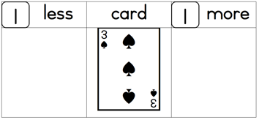
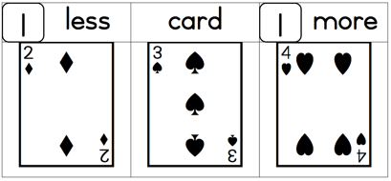
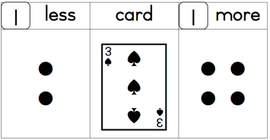
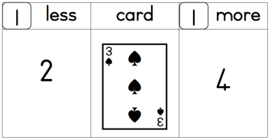
Mathematical card activities page 12
or
or

Slide 20
Implementing ideas
In the next session as always we will reflect on your implementation of these activities in your class
Take photos of your learners using resources in class
Jot down your reflections and bring them to the next session

Slide 21
Next month: 5th September
Next month’s session – 5th September
Fellow Numeracy Chair: Hamsa Venkat
Travel well and we are really excited to be partnering with you all!

