Slide 1

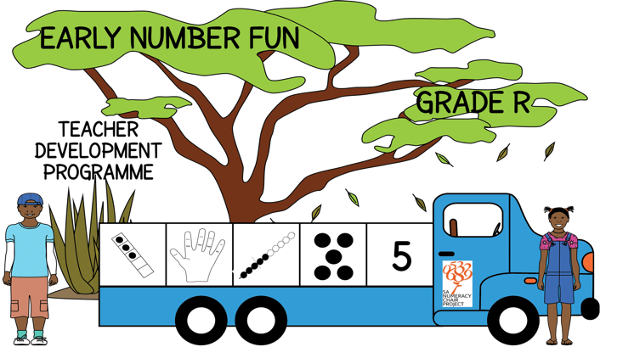


Early Number Fun
Grade R programme
Session 7
14th February 2017
Prof Mellony Graven; Dr Debbie Stott, Ms Carolyn Stevenson-Milln; Ms Roxanne Long; Ms Samu Chikiwa

Slide 2
Admin
Dates for this year:
  14th March
  16th May
  13th June
New QR code on handbooks
  Download QR reader on your phone
  Scan the code
  Go straight to the resources page on our website!

Slide 3
Group feedback on:
2016 learner assessments
In groups of 3-4 and with teachers from other schools discuss the questions on the handout
Select a scribe to jot down main ideas and points of discussion

Slide 4
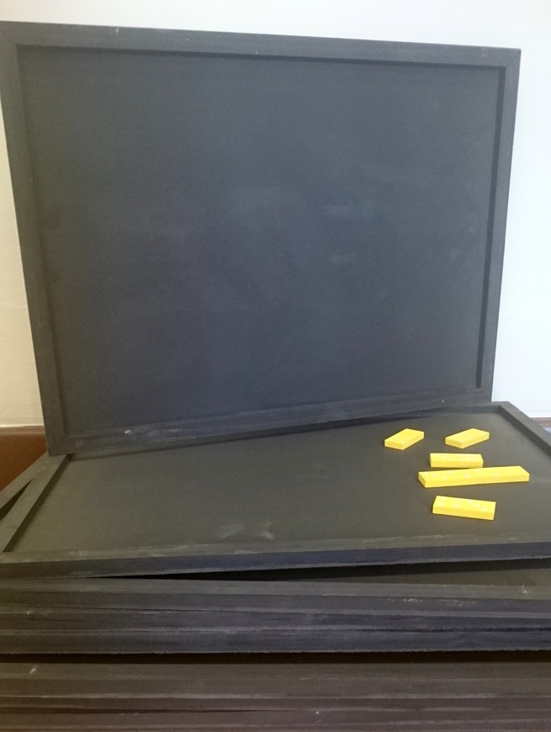

Suggestions for using the black trays…
Throwing dice
Working with dominos
Puzzles (e.g. shapes, jigsaws
Patterning activities
With chalk

Slide 5
Cognitive control
Focus on FINGER DIFFERNTIATION page 8
Build finger differentiation
  important for developing numerical and visual mathematical understanding
Skills:
  Inhibition and shifting attention
  Colour differentiation
  Descriptive vocabulary such as up, down, left, right, curved, straight, around

Slide 6
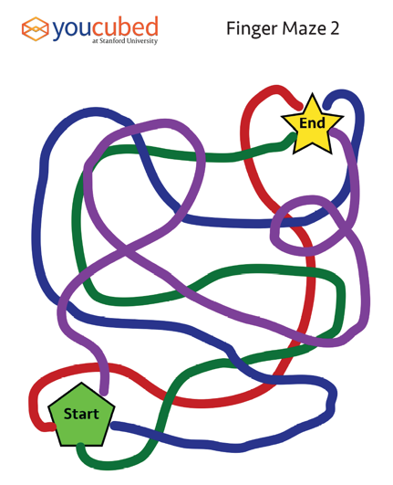
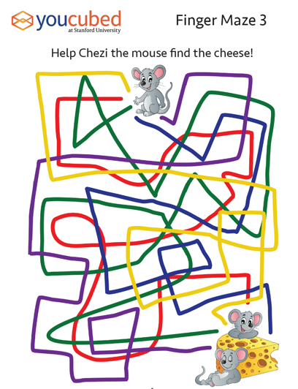
Finger Differentiation
Put a coloured dot on each child’s fingernail as shown in the diagram.
Have the child match their red index finger to the red path in the maze and slowly trace the path to the end. Help the child focus on the path and not speed along.
Each path should be traced slowly and take several seconds.
Next trace the green path with the matching finger.
After a child uses their dominant hand to trace all of the paths in the maze ask them to use their other hand.

Slide 7
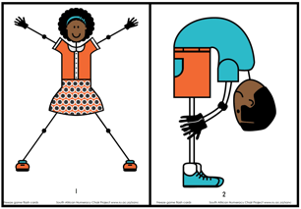
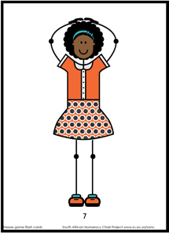
Calming and concentration:
FREEZE! Game page 9
Before playing the game, familiarise learners with the positions on the cards
As soon as the music starts playing, the learners move around the chosen outdoor space any way they want. But emphasise that they must listen for when the music stops.
After some time, stop the music.
When the music stops, show a card to the learners. Each learner copies the position and FREEZE in position.
Any learner who moves or has the wrong position is out.
Repeat steps 1 to 4, showing different cards each time.
Show this card, and all learners must stand with their feet together and both hands on top of their heads.

Slide 8
Calming and concentration:
Hopscotch (page 10)
Outside if possible
Draw layout with chalk
Throw stone (start in box 1)
Avoid box with stone
Hop / jump through the layout
Turn at 5 or 10
Hop / jump back to 1
Pick up stone as you go back

Slide 9
Learner progression
CONTEXT-BOUND– BUT extending to OBJECT-BOUND counting

Slide 10
Subitising
“the ability to recognise dot arrangements in different patterns”
most common dot patterns seen on dice, dominoes and playing cards

Slide 11
Subitising
Two types of subitising:
  Perceptual subitising - recognition of the number pattern
  Conceptual subitising - recognition of number pattern as a combination of the whole and its parts
    Spatial arrangements of dot sets can influence how difficult they are to subitise
Rectangular arrangement (commonly seen on cards, dominoes and dice) are easiest to subitise | Linear arrangements are averagely difficulty to subitise | Scattered (random) arrangements are the most difficult to subitise

Slide 12
Regular and Alternate Dot Patterns
Regular dot patterns are the easiest to recognise
Alternate dot patterns
  work with other dot arrangements
  intended to help the learners to ‘see’ patterns in different configurations
  Different arrangements of dots lead to different decompositions of that number
Here 6 dots can be seen in different ways

Slide 13
Dot Pattern Flash Cards
regular dot pattern cards
  ‘R’ in the top left corner
alternate dot pattern cards
  ‘A’ in the top left corner
Example regular pattern cards | Example alternate pattern cards

Slide 14
Subitising and Early Number Strategies
Subitising fundamental skill in the development of:
  number sense
  supporting the development of compensation, unitizing, counting on, composing and decomposing of numbers
Young children can begin by learning the patterns of dots up to 6
  Learners connect the dot patterns to numbers, numerals, finger patterns, bead strings, etc.
Children begin to learn these patterns by counting each dot one at a time
  Useful to work with learners to see the patterns without counting in ones.
Encourage language use

Slide 15
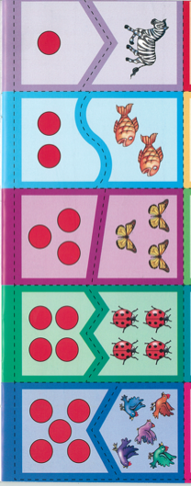
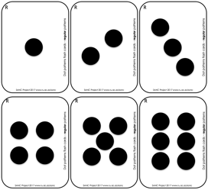
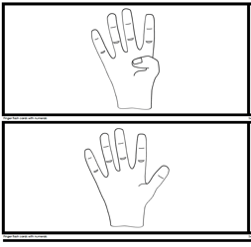
Subitising activities with dot cards
Dot Card Trains using DBE dot cards
page 9
Finger Dot Match
page 10

Slide 16
Having fun with dominos (Tania)
Domino Parking Lot
Match Dots to Number Cards
Domino Cups

Slide 17
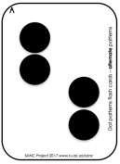
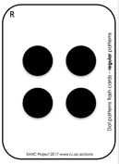
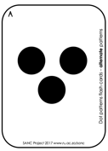
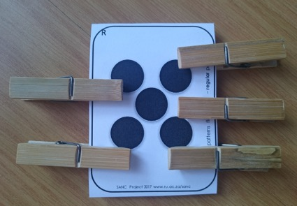
Subitising activities with dot cards continued
Clothespin Match
page 10
The same and different
page 11

Slide 18
Playing dominos page 14
Turn taking
Subitising
Language development

Slide 19

Subitising activities with dominoes
Dice/Domino Match page 12
Domino Flash Game page 12
  Ask:
    How many dots did you see?
    How did you see them?
    How did you remember what to build?
  Discuss the configuration of the pattern
  how children saw the number of dots there were

Slide 20






Sequencing activities with dominoes page 13
Simple sequences
  small to large
  large to small
What comes next
  complete up to 6 dominos
What is missing
  complete the sequence

Slide 21
Next session
Next month’s session – Tuesday 14th March
Travel well and we are really excited to be partnering with you all!

