Slide 1
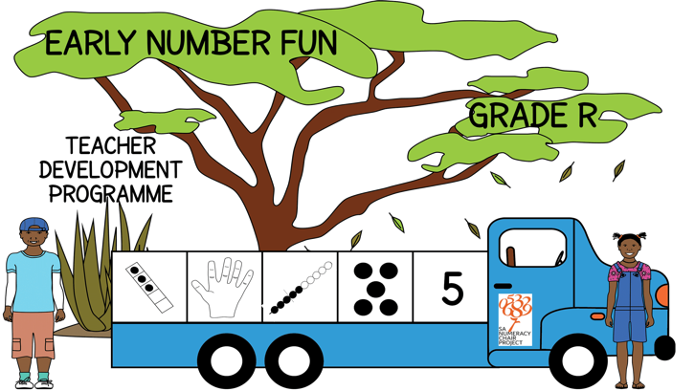
Early Number Fun Grade R programme Session 8 14th March 2017
Prof Mellony Graven; Dr Debbie Stott, Ms Carolyn Stevenson-Milln; Ms Roxanne Long; Ms Samu Chikiwa

Slide 2
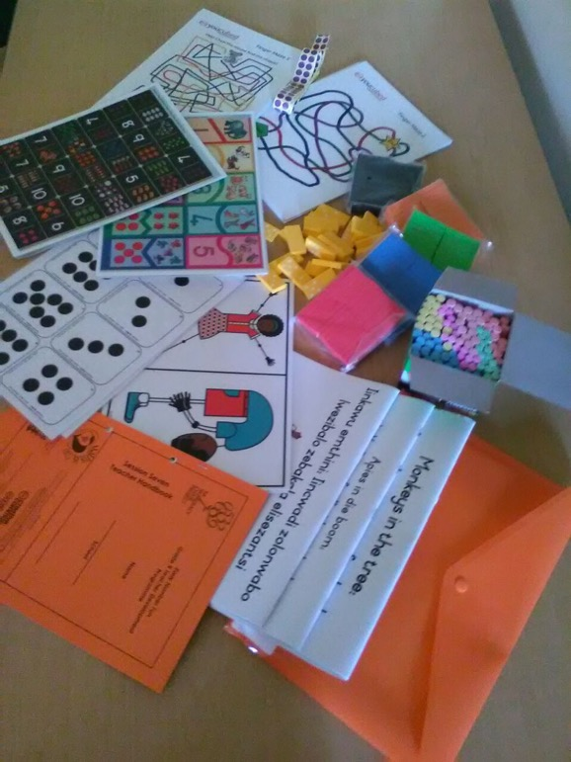
Group feedback on: resources from session 7
In groups of 3-4 and with teachers from other schools discuss the questions on the handout
Select a scribe to jot down main ideas and points of discussion

Slide 3
Based on your feedback from the last session
Align with CAPS terminology and assessment levels where possible. For example:
only numbers 1 to 5 in 1st two terms and then 1 to 10 in last 2 terms
Patterns
Our thoughts to keep it simpler and easier to manage:
Keep it to two pages (1 back to back)
Reduce the number of resources required

Slide 4
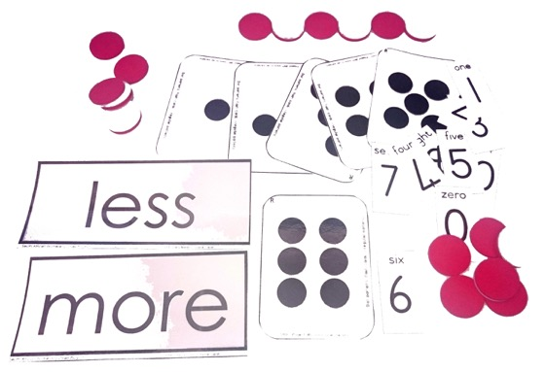

Slide 5
Assessment
Assess individually
With:
3 strongest learners
3 average learners
3 weakest
This should give you a general indication of the abilities of the class as a whole
Assess the same 9 children in March and in October

Slide 6
Assessment: Example commenting system

Slide 7
Cognitive control Spot the Difference activities page 6
Skills:
to develop executive functions of working memory and shifting attention
to develop descriptive language of comparison
Instructions:
learners to compare two dot patterns on one card
look for what is the SAME and what is DIFFERENT between them

Slide 8
Spot the Difference
Using dot patterns to practice subitising (1st set of 10)
Some cards have three patterns: a, b & c
Some cards have two patterns: a & b

Slide 9
Spot the Difference
Encourage learners to explain the differences they notice to develop their language of comparison using words about:
colour, shape, quantity, cardinal positions and so on.

Slide 10
Learner progression
CONTEXT-BOUND– BUT extending to OBJECT-BOUND counting

Slide 11
Number story activities: Key numeracy skills (pages 7 to 9)
Context bound counting and calculating:
In the range 1-5
Object bound counting and calculating:
In the range 1-5
Numeral recognition:
In the range 1-5
Compare quantities and develop language of:
more, less, many, few, none
Develop comparative language for size:
big and small; more and less
Recognition of words like:
more, less, big, small
Develop a patterned sense of bonds to 5:
5-0; 4-1; 3-2; 2-3; 1-4; 0-5

Slide 12
Number stories – key literacy skills
Love of stories and love of reading
Skills:
Listening and prediction
Comprehension
Common word recognition:
more, less, big, small
Logic, structuring and organisation of ideas
Develop comparative language for size:
big and small; more and less
Imagination and own story telling

Slide 13
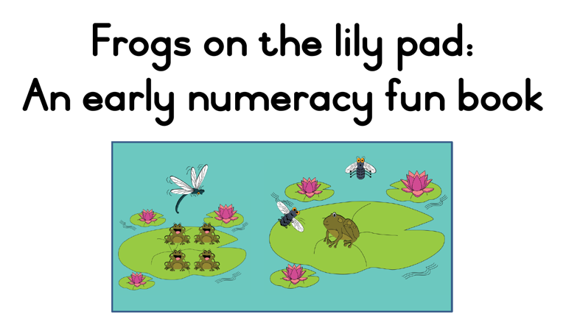
isiXhosa
Afrikaans
English

Slide 14
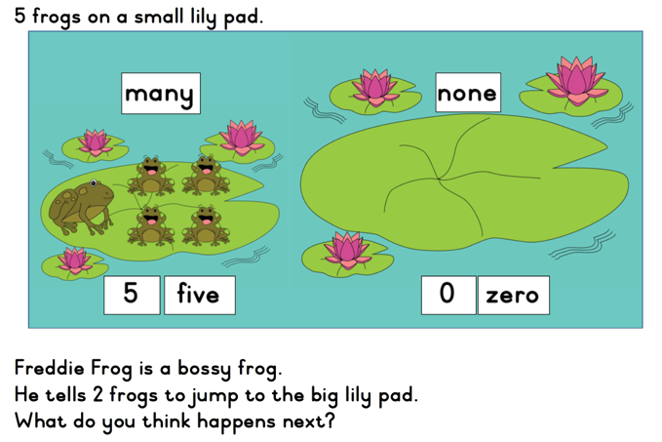
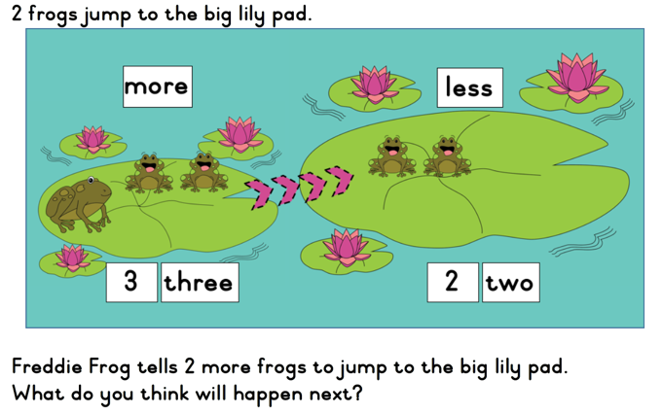
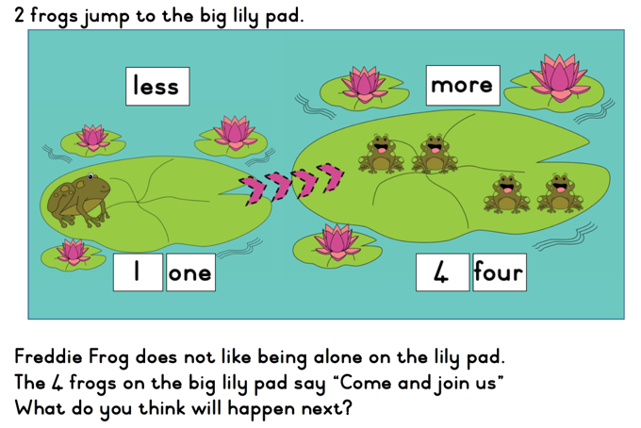
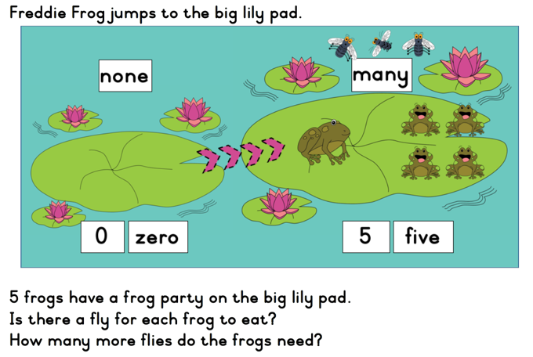
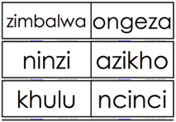
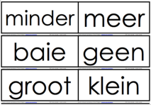
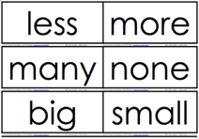

Slide 15
5 and 10-frames for developing a sense of 5 and 10
Understanding that numbers are composed of tens and ones is an important foundational concept, setting the stage for work with larger numbers.
A strong sense of "ten" is a prerequisite for place-value understanding and mental calculations.
allows learners to “see” numbers
useful for developing number sense within the context of ten
help to form mental images of the numbers represented

Slide 16
Working with the 5 and 10-frame
Grade R and 1 explore numbers with a 5-frame 1st
Then move onto 10-frame
Introduce the 10-frame with the following rule, a standard way to fill the frame:
Always fill the top row first, starting on the left, the same way you read.
When the top row is full, counters can be placed on the bottom row, also from the left.

Slide 17
Additional 5-frame activities
Five Frame Tell About page 13
Building Sets page 13
Roll and Build page 14

Slide 18
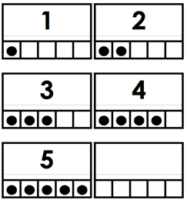
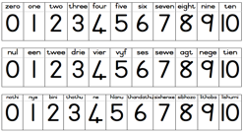
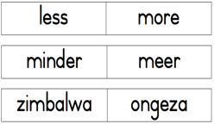
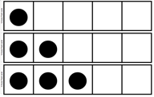
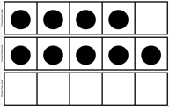
Additional 5-frame activities
Ordering frames page 14
Assigning a numeral to the frame page 14
Five Frame Flash page 15
Five Frame Memory Game (with numeral recognition) page 15

Slide 19
Next session
Next session – Tuesday 16th May
Travel well

